Slide 1
Node / Navigator
Protocol

Slide 2
Architecture
Host
Navigator
Node
server thread
Node
client thread
Rendering
thread
Ogre Rendering Engine
Contents cache
Local contents cache
(= Host contents cache if Navigator embedded)

Slide 3
Protocol
XML/HTTP
  Step 1 : XML/RPC without contents download/upload
  Step 2 : XML/HTTP with contents download/upload

Slide 4
Requests
Login
(retCode, nodeId, objects uid list) Login(username, pwd, ctxt)
Logout
(retCode) Logout()
HandleEvt
(retCode, evt) HandleEvt(nodeId)
SendEvt
(retCode) SendEvt(nodeId, evt)

Slide 5
XML messages
Event
<evt type="Integer">
<object>
</object>
<status>
</status>
</evt>
Event type
0 New object
1 Lost object
2 Updated object
3 Action on object
100 Status report

Slide 6
XML messages
Object
<object uid="objUid" type="Integer" name="String">
<position x="Real" y="Real" z="Real" />
<orientation x="Real" y="Real" z="Real" w="Real" />
<shape>
</shape>
<content>
</content>
</object>
Object type
0 Avatar object
1 Scene object
2 Movable object

Slide 7
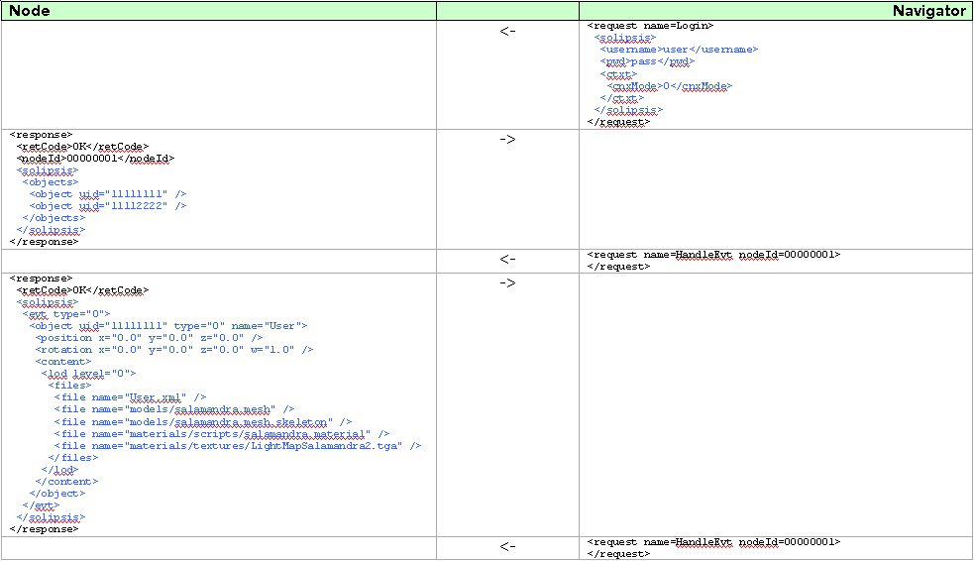
Call flow 1/2

Slide 8
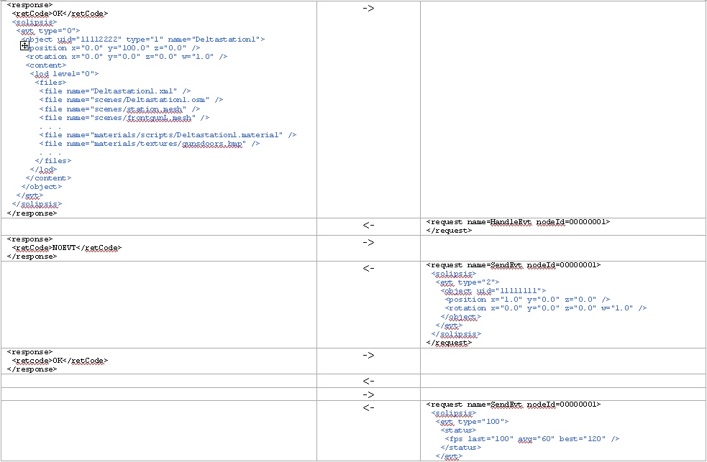
Call flow 2/2

