Slide 1
CIS 480
Pre-Capstone
Week 12
Sprint 1 Website
16 November 2023

Slide 2
Introduction
Create initial software distribution with Github.

Slide 3
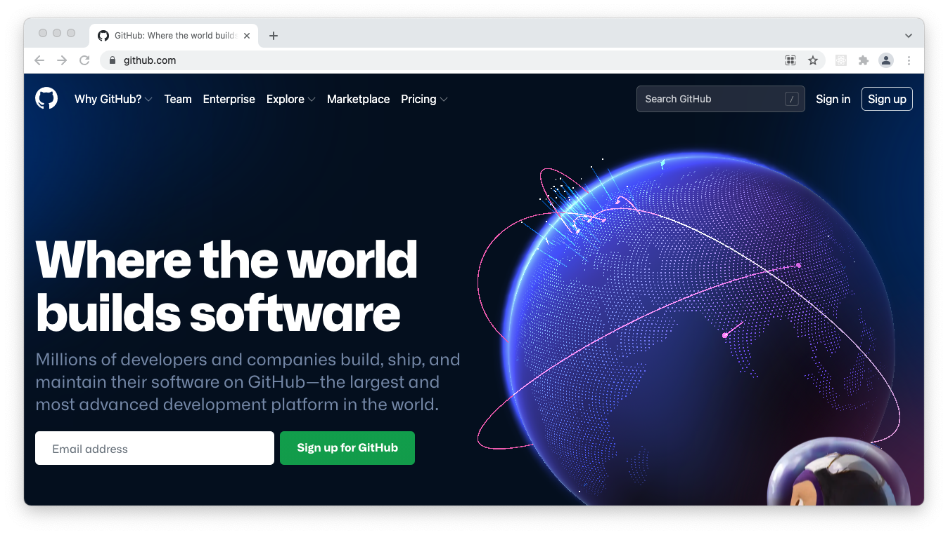
Check Account
Open https://github.com/ and use your account (team leader).
Make sure all team members and your advisor are added.
Add me to your team (use gracanind@vmi.edu).
You may need to install the GitHub desktop app:
https://docs.github.com/en/desktop/overview/getting-started-with-github-desktop

Slide 4
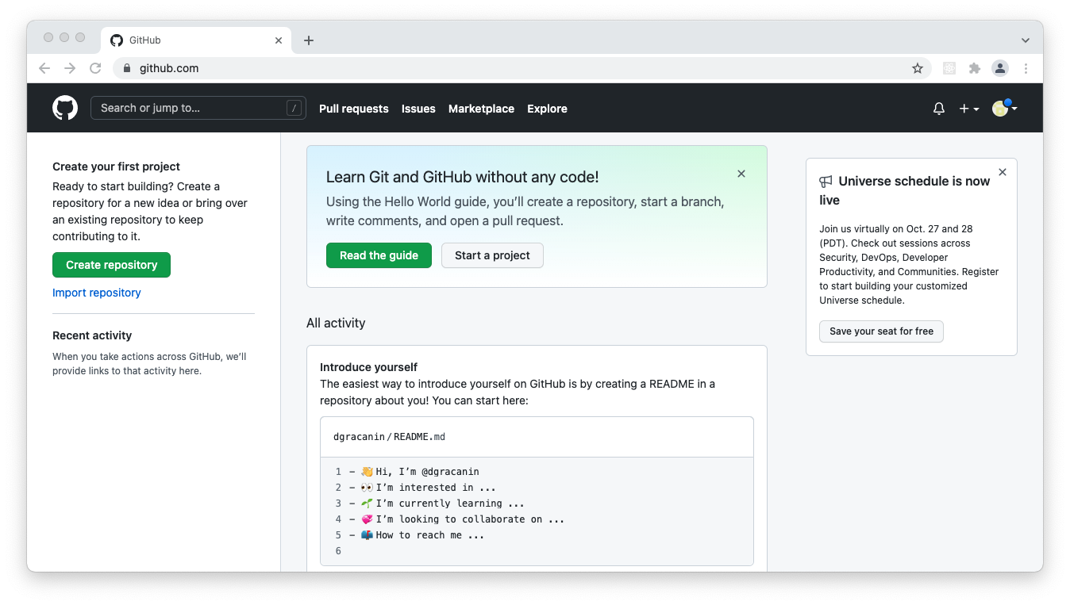
Learn how to Use
Check documentation.

Slide 5
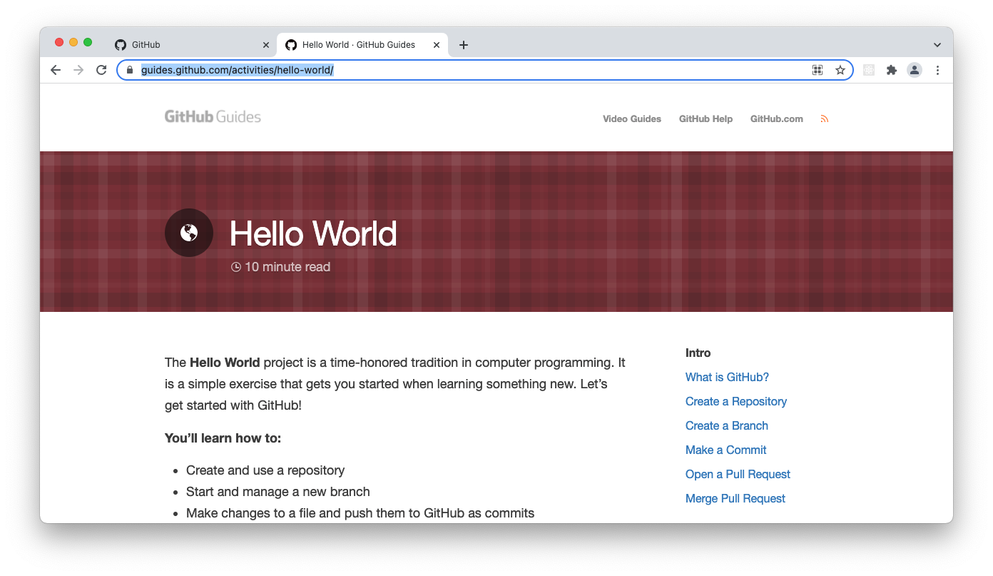
Tutorial
Check https://guides.github.com/activities/hello-world/.

Slide 6
Create Initial Code
Create a branch.
Deploy initial software skeleton.
Download the code and make sure it compiles/runs.

Slide 7
Create Initial Web Page
Check settings/pages page.
Crete or use an existing branch.
Provide index.html.
Deploy from branch.
Copy Pages created on Canvas.

Slide 8
Summary
Continue working on implementation in Sprint 1.

