Slide 1
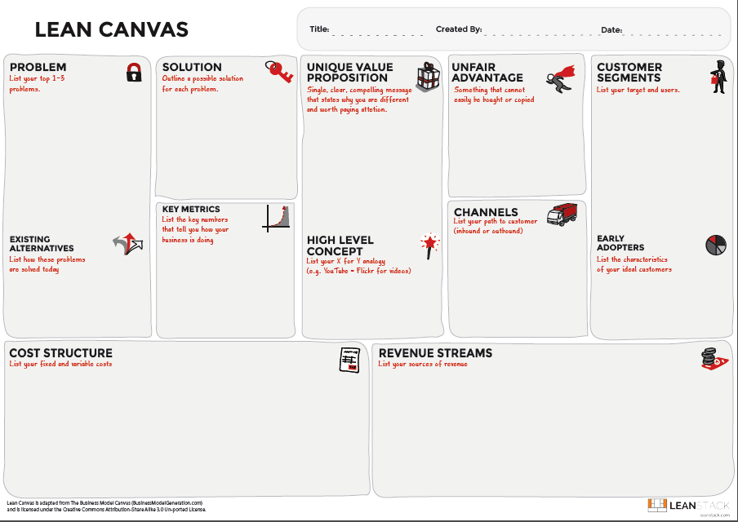
Macau Tourism Project
Point 1:
Day and Night Activities & Fun
City of Gastronomy
Fabulous foreign retail stores and goods
Historic Centre of Macao (世界文化遺產)
Not enough disclosure of Macau essence
Tourism products not update to date as immediate desire of people
Create hot topics and post to promote Macau in social media platforms
Develop products and packages with local enterprises
Build Virtual KOL to promote Macau
Own unique patented KOL icon
Tier 1 cities in Asia
Point 2:
Use those mainland data to package local products
Create products which people like up to date.
Tailor-made products
KOL owner
Cooperated with plenty of local enterprise to make synergy effects to strength Macau competitive advantages
Virtual KOL’s monthly fans base growth in various platforms
No. of on-line sales/booking through Virtual KOL
The click rate of related posts
Social media platforms
Local integrated resort spent on destination marketing individually
Business model through data driven marketing and artificial intelligence
Capable to collaborate and associate with tourism key members.
Government
Hotels
F&B outlets
Sightseeing points and association related to tourism
KOL creation and maintenance cost
R&D expense
Product manufacturing & storage cost
Cost in marketing, labor, operating, fixed assets, etc.
Advertising Fee
On-line direct sales
F&B outlet commission
Business Consultation Fee

