Slide 1
Reilly Birthday Trivia
1. Carol
2. Frank
3. Grace
4. Dave
5. Alice
6. Bob
7. Eve
Reilly Birthday Mode · Carol 2–3 · Frank 4 · Grace 5–6 · Dave 7–8 · Alice 9–10 · Bob 11–12 · Eve 13–14
order random seed 42

Slide 2
In which year did the Berlin Wall fall?
Carol's question

Slide 3
Answer: 1989
9 November

Slide 4
What is the capital of Australia?
Answer: Canberra (a one-slide deck: the app sees a question with no answer slide)

Slide 5
Which country has the most time zones?

Slide 6
Answer: France
12 time zones, thanks to its overseas territories

Slide 7
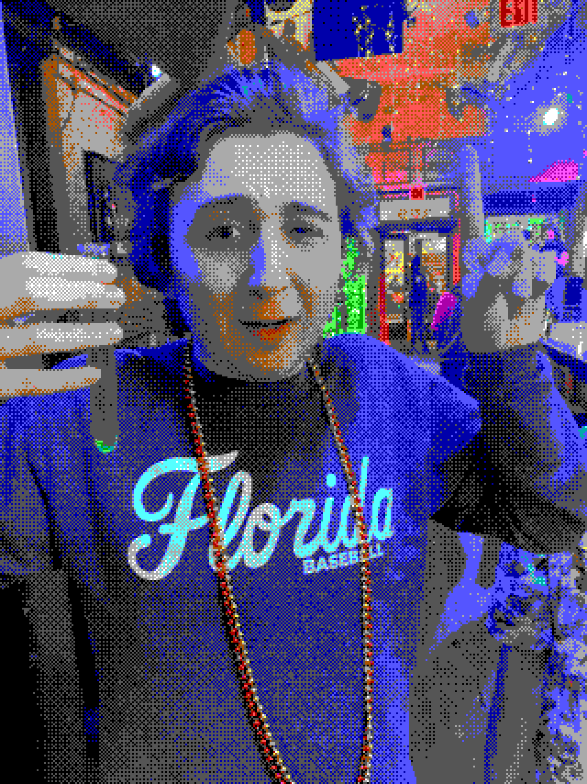
Who is this, in EGA?

Slide 8
Answer: John, at a bar, holding a shot

Slide 9
Which planet has the most moons?

Slide 10
Answer: Saturn
146 confirmed as of 2023, overtaking Jupiter

Slide 11
What is the only letter that does not appear in any US state name?

Slide 12
Answer: Q

Slide 13
How many hearts does an octopus have?

Slide 14
Answer: three
Two pump blood through the gills, one through the body

