Slide 1




Entity Resolution: Past, present and yet-to-come From structured to heterogeneous, to crowd-sourced, to deep learned
EDBT 2020, Copenhagen
30th March - 2nd April
George Papadakis
University of Athens
gpapadis@di.uoa.gr
Ekaterini Ioannou
University of Tilburg
Ekaterini.Ioannou@uvt.nl
Themis Palpanas
University of Paris
French University Institute
themis@mi.parisdescartes.fr
https://research.tilburguniversity.edu/en/projects/4ger
Notes:
reference as:
George Papadakis, Ekaterini Ioannou, Themis Palpanas. Entity Resolution: Past, Present and Yet-to-Come -- From Structured to Heterogeneous, to Crowd-sourced, to Deep Learned. The International Conference on Extending Database Technology (EDBT), Copenhagen, Denmark, March 2020.

Slide 2
Structure Outline
Introduction
Four Generations
Entity Resolution Revisited: Leveraging External Knowledge
Challenges and Final Remarks

Slide 3
Part A – Introduction
Motivation
Preliminaries
Four Generations
Entity Resolution Revisited: Leveraging External Knowledge
Challenges and Final Remarks

Slide 4
Motivation
Entities → invaluable asset for numerous current
applications and systems
Encode a large part of our knowledge
Locations
Organizations
Projects
Persons
Products
Events
Notes:
The first question we have to answer is why entity resolution is important.
Web data are dominated by entity profiles.
In an ideal world, every entity is described by a universally unique identifier, thus facilitating all applications that are based on entities, e.g., entity-centric search.

Slide 5
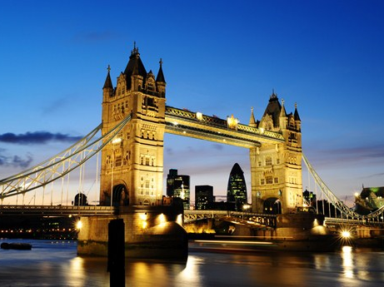
Matching, Linkage, Reconciliation, etc.
Many names, descriptions, or IDs (URIs) are used for the same real-world “entity”
Example:
Notes:
In reality, there is ambiguity/noise of two forms:
different entities with the same description/name, and
same entity with different descriptions/names.

Slide 6
Matching, Linkage, Reconciliation, etc.
Many names, descriptions, or IDs (URIs) are used for the same real-world “entity”
Example:
London 런던 ܠܘܢܕܘܢ लंडन लंदन લંડન ለንደን ロンドン লন্ডন ลอนดอน இலண்டன் ლონდონი Llundain Londain Londe Londen Londen Londen Londinium London Londona Londonas Londoni Londono Londra Londres Londrez Londyn Lontoo Loundres Luân Đôn Lunden Lundúnir Lunnainn Lunnon لندن لندن لندن لوندون לאנדאן לונדון Λονδίνο Лёндан Лондан Лондон Лондон Лондон Լոնդոն 伦敦 …

Slide 7
Matching, Linkage, Reconciliation, etc.
Many names, descriptions, or IDs (URIs) are used for the same real-world “entity”
Example:
London 런던 ܠܘܢܕܘܢ लंडन लंदन લંડન ለንደን ロンドン লন্ডন ลอนดอน இலண்டன் ლონდონი Llundain Londain Londe Londen Londen Londen Londinium London Londona Londonas Londoni Londono Londra Londres Londrez Londyn Lontoo Loundres Luân Đôn Lunden Lundúnir Lunnainn Lunnon لندن لندن لندن لوندون לאנדאן לונדון Λονδίνο Лёндан Лондан Лондон Лондон Лондон Լոնդոն 伦敦 …
capital of UK, host city of the IV Olympic Games, host city of the XIV Olympic Games, future host of the XXX Olympic Games, city of the Westminster Abbey, city of the London Eye, the city described by Charles Dickens in his novels, …

Slide 8
Matching, Linkage, Reconciliation, etc.
Many names, descriptions, or IDs (URIs) are used for the same real-world “entity”
Example:
London 런던 ܠܘܢܕܘܢ लंडन लंदन લંડન ለንደን ロンドン লন্ডন ลอนดอน இலண்டன் ლონდონი Llundain Londain Londe Londen Londen Londen Londinium London Londona Londonas Londoni Londono Londra Londres Londrez Londyn Lontoo Loundres Luân Đôn Lunden Lundúnir Lunnainn Lunnon لندن لندن لندن لوندون לאנדאן לונדון Λονδίνο Лёндан Лондан Лондон Лондон Лондон Լոնդոն 伦敦 …
capital of UK, host city of the IV Olympic Games, host city of the XIV Olympic Games, future host of the XXX Olympic Games, city of the Westminster Abbey, city of the London Eye, the city described by Charles Dickens in his novels, …
http://sws.geonames.org/2643743/
http://en.wikipedia.org/wiki/London
http://dbpedia.org/resource/Category:London
…

Slide 9
Disambiguation, Deduplication, etc.
Plethora of different “entities” have the same name
Example:
London, KY
London, Laurel, KY
London, OH
London, Madison, OH
London, AR
London, Pope, AR
London, TX
London, Kimble, TX
London, MO
London, London, MI
London, London, Monroe, MI
London, Uninc Conecuh County, AL
London, Uninc Conecuh County, Conecuh, AL
London, Uninc Shelby County, IN
London, Uninc Shelby County, Shelby, IN
London, Deerfield, WI
London, Deerfield, Dane, WI
London, Uninc Freeborn County, MN
...

Slide 10
Disambiguation, Deduplication, etc.
Plethora of different “entities” have the same name
Example:
London, Jack 2612 Almes Dr Montgomery, AL (334) 272-7005
London, Jack R 2511 Winchester Rd Montgomery, AL 36106-3327 (334) 272-7005
London, Jack 1222 Whitetail Trl Van Buren, AR 72956-7368 (479) 474-4136
London, Jack 7400 Vista Del Mar Ave La Jolla, CA 92037-4954 (858) 456-1850
...
London, KY
London, Laurel, KY
London, OH
London, Madison, OH
London, AR
London, Pope, AR
London, TX
London, Kimble, TX
London, MO
London, London, MI
London, London, Monroe, MI
London, Uninc Conecuh County, AL
London, Uninc Conecuh County, Conecuh, AL
London, Uninc Shelby County, IN
London, Uninc Shelby County, Shelby, IN
London, Deerfield, WI
London, Deerfield, Dane, WI
London, Uninc Freeborn County, MN
...

Slide 11

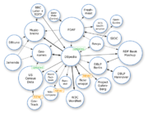

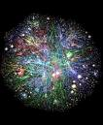




Entities in today’s settings
Content providers provide valuable information describing (part of) real-world “entities”
ER are required for data integration, link discovery, query answering, Web / object-oriented searching, etc.
News about London
reviews on hotels in London
Wiki pages about the London
Pictures and tags about London
Social networks in London
Videos and tags for London
Notes:
The situation is aggrevated due to the Web 2.0 tools, which allow every Web user to upload non-curated and, thus, noisy content.

Slide 12
Entity Resolution
Identifies and aggregates the different entity profiles that describe the same objects [1,2,3,4]
Primary usefulness:
Improves data quality and integrity
Fosters re-use of existing data sources
Example application domains:
Linked Data
Building Knowledge Graphs
Census data
Price comparison portals
Notes:
To leverage Big Data, we need to perform ER.
ER is a core task for many applications, like Linked Data.

Slide 13
Types of Entity Resolution
The given entity collections can be of two types:
clean + dirty [3,5]
Clean:
Duplicate-free data
E.g., DBLP, ACM Digital Library, Wikipedia, Freebase
Dirty:
Contain duplicate entity profiles
E.g., Google Scholar, CiteseerX

Slide 14
Types of Entity Resolution
The given entity collections can be of two types:
clean + dirty [3,5]
Clean:
Duplicate-free data
E.g., DBLP, ACM Digital Library, Wikipedia, Freebase
Dirty:
Contain duplicate entity profiles
E.g., Google Scholar, CiteseerX
Clean
Dirty
Notes:
To leverage Big Data, we need to perform ER.
ER is a core task for many applications, like Linked Data.

Slide 15
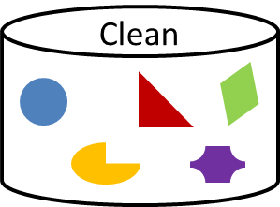
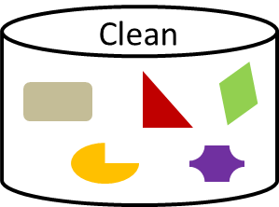
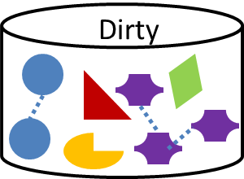
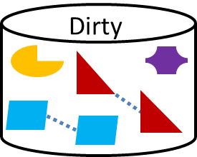
Types of Entity Resolution
Clean
Based on the quality of input, we distinguish entity resolution into 3 sub-tasks:
Clean-Clean ER (a.k.a. Record Linkage in databases)
Dirty-Clean ER
Dirty-Dirty ER
Dirty
Equivalent to Dirty ER
(a.k.a. Deduplication in databases)

Slide 16
References
X. L. Dong, D. Srivastava. Big Data Integration. Synthesis Lectures on Data Management, Morgan & Claypool Publishers 2015, pp. 1-198.
A. K. Elmagarmid, P. G. Ipeirotis, V. S. Verykios. Duplicate Record Detection: A Survey. IEEE Trans. Knowl. Data Eng. 19(1): 1-16 (2007).
V. Christophides, V. Efthymiou, K. Stefanidis. Entity Resolution in the Web of Data. Synthesis Lectures on the Semantic Web: Theory and Technology, Morgan & Claypool Publishers 2015.
P. Christen. Data Matching - Concepts and Techniques for Record Linkage, Entity Resolution, and Duplicate Detection. Data-Centric Systems and Applications, Springer 2012, ISBN 978-3-642-31163-5, pp. I-XIX, 1-270.
P. Christen. A Survey of Indexing Techniques for Scalable Record Linkage and Deduplication. IEEE Trans. Knowl. Data Eng. 24(9): 1537-1555 (2012).
Generation 1: Tackling Veracity

Slide 17
Introduction
Part B – Four Generations
Generation 1: tackling Veracity
Generation 2: tackling Volume and Veracity
Generation 3: tackling Variety, Volume and Veracity
Generation 4: tackling Velocity, Variety, Volume and Veracity
Entity Resolution Revisited:
Leveraging External Knowledge
Challenges and Final Remarks

Slide 18
Generation 1: Tackling Veracity
Schema Alignment
Blocking
Matching
Clustering
Earliest approach
Scope:
Structured data
Goal:
Achieve high accuracy despite inconsistencies, noise, or errors in entity profiles
Assumptions:
Known schema → custom, schema-based solutions
Notes:
which are introduced during manual data entry, or by the limitations of the automatic extraction techniques

Slide 19
Step 1: Schema Alignment / Matching
Scope:
Record Linkage
Goal:
Create mappings between equivalent attributes of the two schemata, e.g., profession ≡ job
Types of Solutions:
Structure-based
Instance-based
Usage-based
Hybrid
Generation 1: Tackling Veracity

Slide 20
Step 1: Schema Alignment / Matching
Taxonomy of Main Schema Matching Methods (in chronological order)
Method | Category | Type of Evidence
Cupid [1] | Structure-based | Name similarity, Constraints, Contextual similarity
Similarity Flooding [2] | Structure-based | Name similarity, Contextual similarity
COMA [3] | Hybrid | Name similarity, Constraints, Contextual similarity
Distribution-based [4] | Instance-based | Value distribution
Generation 1: Tackling Veracity

Slide 21

Step 2: Blocking
Scope:
Both Deduplication and Record Linkage
Goal:
ER is an inherently quadratic problem, O(n²): every entity has to be compared with all others
Blocking groups similar entities into blocks
Comparisons are executed only inside each block
Complexity is now quadratic to the size of the block (much smaller than dataset size!)
Generation 1: Tackling Veracity

Slide 22
Computational cost
Brute-force approach
Input:
Entity Collection E
Blocking
Duplicate Pairs
|E| entities
E.g.: For a dataset with 100,000 entities:
~10¹⁰ comparisons,
If 0.05 msec each → >100 hours in total
|E| entities
Generation 1: Tackling Veracity
Notes:
We can illustrate the relative cost of the main approaches through a diagram.
In the ideal case, the green circle coincides with the red one.
Blocking covers the largest part of duplicate pairs, but not all of them.
It also incorporates comparisons between non-matching entities.
The closer the green circle is to the red one, the better the blocking method is.

Slide 23
General Principles of Blocking
Represent each entity by one or more signatures called blocking keys
Focus on string values
Place into blocks all entities having the same or similar blocking key
Two matching profiles can be detected as long as they co-occur in at least one block
Trade-off between recall and precision!
Generation 1: Tackling Veracity
Notes:
To leverage Big Data, we need to perform ER.
ER is a core task for many applications, like Linked Data.

Slide 24
Taxonomy of Blocking Methods [1]
Method | Key Type | Redundancy awareness | Matching awareness | Key selection
Standard Blocking [2] | Hash-based | Red.-free | Static | Non-learning
Suffix Arrays [3] + [4,5] | Hash-based | Red.-positive | Static | Non-learning
Q-grams Blocking [6] + [4] | Hash-based | Red.-positive | Static | Non-learning
MFIBlocks [7] | Hash-based | Red.-positive | Static | Non-learning
Sorted Neighborhood [9] + [4,10] | Sort-based | Red.-neutral | Static | Non-learning
Duplicate Count Strategy [11] | Sort-based | Red.-neutral | Dynamic | Non-learning
Sorted Blocks [12] | Hybrid | Red.-neutral | Static | Non-learning
ApproxDNF [13] | Hash-based | Red.-positive | Static | Learning-based
Blocking Scheme Learner [14] | Hash-based | Red.-positive | Static | Learning-based
CBlock [15] | Hash-based | Red.-positive | Static | Learning-based
FisherDisjunctive [16] | Hash-based | Red.-positive | Static | Learning-based
Generation 1: Tackling Veracity

Slide 25
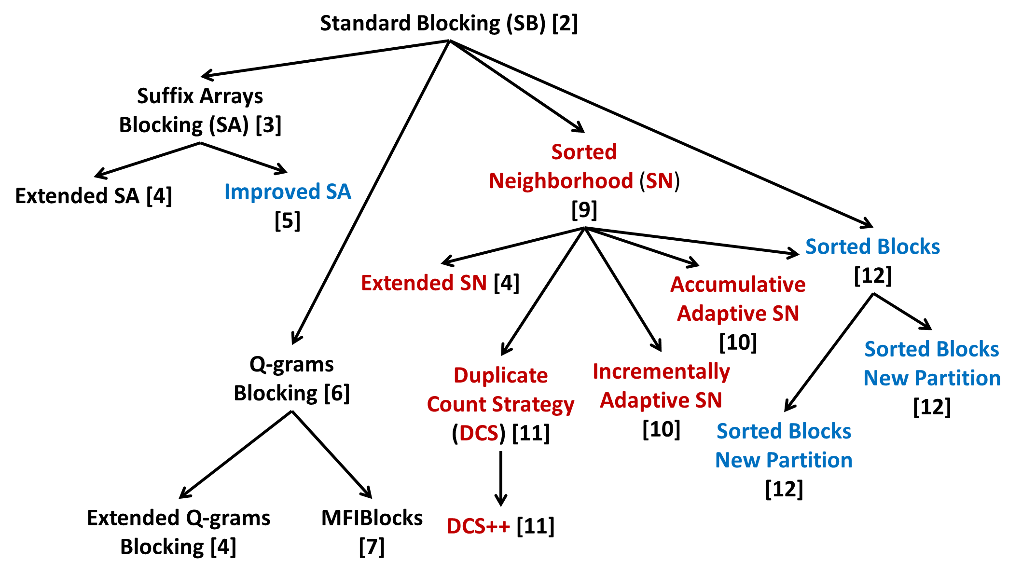
Genealogy Tree of Non-learning Blocking Methods [1]
Generation 1: Tackling Veracity

Slide 26
Step 3: Matching
Estimates the similarity of candidate matches.
Input
A set of blocks
Every distinct comparison in any block is a candidate match
Output
Similarity Graph
Nodes → entities
Edges → candidate matches
Edge weights → matching likelihood (based on similarity score)
Papadakis, Ioannou, Palpanas
Generation 1: Tackling Veracity

Slide 27
Evolution of Matching
Active Learning Methods [1,2]
Supervised Methods [3,4]
Probabilistic Methods [5,6]
Unsupervised Methods [7,8]
Learning-based Methods
Collective Methods [9,10,11]
Rule-based Methods [6]
All are heavily based on string similarity measures [6].
Generation 1: Tackling Veracity

Slide 28



Step 4: Clustering
Partitions the matched pairs into equivalence clusters
i.e., groups of entity profiles describing the same
real-world object
Input
Similarity Graph:
Nodes → entities
Edges → candidate matches
Edge weights → matching likelihood (based on similarity score)
Output
Equivalence Clusters
Papadakis, Ioannou, Palpanas
Generation 1: Tackling Veracity

Slide 29
Clustering Algorithms for Record Linkage
Relies on 1-1 constraint
1 entity from source dataset matches to 1 entity from target dataset
Unique Mapping Clustering [1][2]
Sorts all edges in decreasing weight
Starting from the top, each edge corresponds to a pair of duplicates if:
None of the adjacent entities has already been matched
predefined threshold < edge weight
Row-Column Clustering [3]
efficient approximation of the Hungarian Algorithm
Best Assignment Clustering [4]
efficient, heuristic solution to the assignment problem in unbalanced bipartite graphs
Generation 1: Tackling Veracity
Notes:
only this algo for clean-clean ER
there is only match for each entity

Slide 30
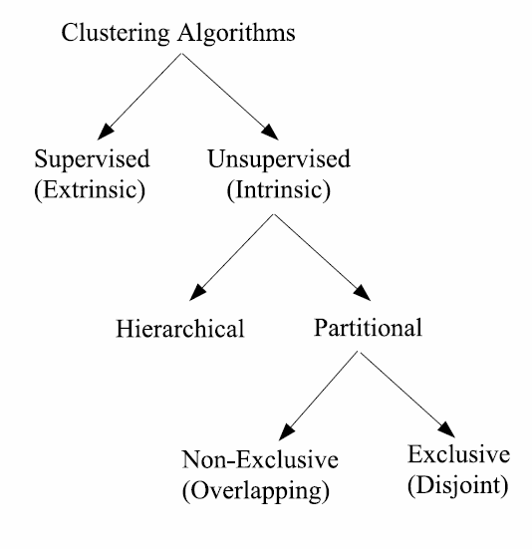
Clustering Algorithms for Deduplication
A wealth of literature on clustering algorithms
Requirements:
Partitional and disjoint Algorithms
Sometimes overlapping may be desirable
Goal: Sets of clusters that
maximize the intra-cluster weights
minimize the inter-cluster edge weights
Classification of clustering algorithms
[6]
Generation 1: Tackling Veracity
(courtesy of Oktie Hassanzadeh)

Slide 31
Dirty ER Clustering Algorithms Characteristics [3]
Most important feature “Unconstrained algorithms”
Algorithms need to be able to predict the correct number of clusters
Need to scale well
Time complexity < O(n²)
Need to be robust with respect to characteristics of the data
E.g., distribution of the duplicates
Need to be capable of finding ‘singleton’ clusters
Different from many clustering algorithms
E.g., algorithms proposed for image segmentation
Generation 1: Tackling Veracity
(courtesy of Oktie Hassanzadeh)

Slide 32
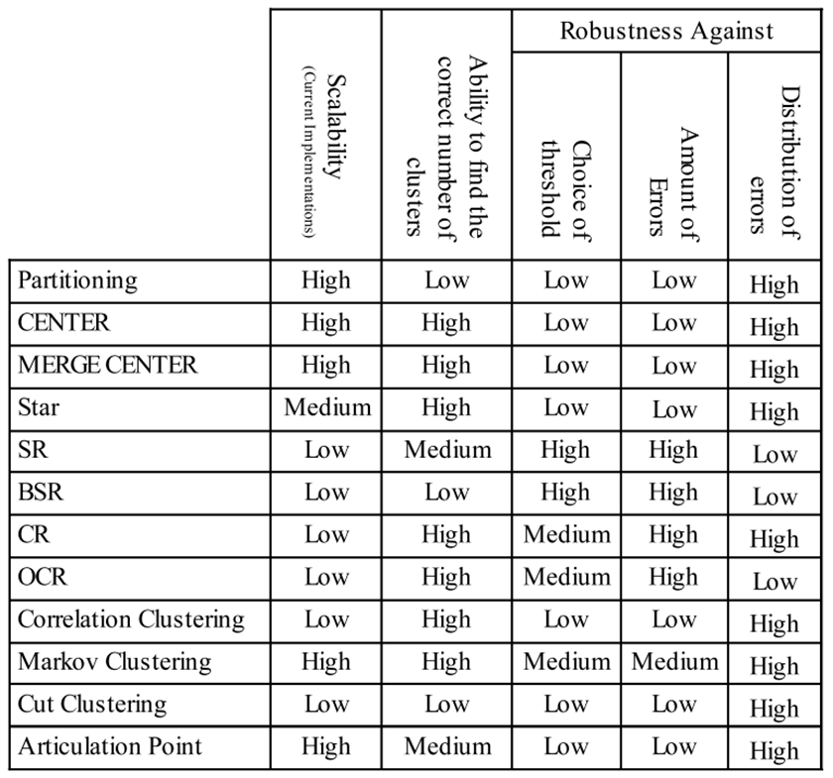
Summary of Experimental Results [3]
Generation 1: Tackling Veracity
Notes:
None of the clustering algorithms produces perfect clustering
Transitive closure:
highly scalable, but results in poor quality of duplicate groups
Poor quality even wrt other single-pass algorithms
Most algorithms are robust to distribution of duplicates, except Ricochet algorithms:
high performance over uniformly distributed duplicates
poor performance otherwise
Cut clustering and Correlation clustering:
sophisticated & popular algorithms
achieve lower accuracy than some single-pass algorithms
Markov clustering:
very efficient
one the most accurate algorithms

Slide 33
Schema Matching References
J. Madhavan, P. A. Bernstein, and E. Rahm. Generic schema matching with cupid. In VLDB, pages 49–58, 2001.
S. Melnik, H. Garcia-Molina, and E. Rahm. Similarity flooding: A versatile graph matching algorithm and its application to schema matching. In ICDE, pages 117–128, 2002.
H.-H. Do and E. Rahm. COMA: a system for flexible combination of schema matching approaches. In VLDB, pages 610–621, 2002.
M. Zhang, M. Hadjieleftheriou, B. C. Ooi, C. M. Procopiuc, D. Srivastava. Automatic discovery of attributes in relational databases. In SIGMOD, pages 109–120, 2011.
H. W. Kuhn. The hungarian method for the assignment problem. Naval research logistics quarterly, 2(1-2):83–97, 1955.
L. Ramshaw and R. E. Tarjan. On minimum-cost assignments in unbalanced bipartite graphs. HP Labs, Palo Alto, CA, USA, Tech. Rep. HPL-2012-40R1, 2012.
Generation 1: Tackling Veracity

Slide 34
Blocking References – Part I
George Papadakis, Dimitrios Skoutas, Emmanouil Thanos, Themis Palpanas: A Survey of Blocking and Filtering Techniques for Entity Resolution. CoRR abs/1905.06167 (2019)
I. P. Fellegi and A. B. Sunter. A theory for record linkage. Journal of the American Statistical Association, 64(328):1183–1210, 1969.
A. N. Aizawa and K. Oyama. A fast linkage detection scheme for multi-source information integration. In WIRI, pages 30–39, 2005.
P. Christen. A survey of indexing techniques for scalable record linkage and deduplication. IEEE TKDE, 24(9):1537–1555, 2012.
T. de Vries, H. Ke, S. Chawla, and P. Christen. Robust record linkage blocking using suffix arrays. In CIKM, pages 305–314, 2009
R. Baxter, P. Christen, and T. Churches. A comparison of fast blocking methods for record linkage. In KDD Workshops, 2003.
B. Kenig and A. Gal. Mfiblocks: An effective blocking algorithm for entity resolution. Inf. Syst., 38(6):908–926, 2013.
M. A. Hernández and S. J. Stolfo. The merge/purge problem for large databases. In SIGMOD, pages 127–138, 1995.
S. Yan, D. Lee, M. Kan, and C. L. Giles. Adaptive sorted neighborhood methods for efficient record linkage. In JCDL, pages 185–194, 2007.
Generation 1: Tackling Veracity

Slide 35
Blocking References – Part II
U. Draisbach, F. Naumann, S. Szott, and O. Wonneberg. Adaptive windows for duplicate detection. In ICDE, pages 1073–1083, 2012.
U. Draisbach and F. Naumann. A generalization of blocking and windowing algorithms for duplicate detection. In ICDKE, pages 18–24, 2011
M. Bilenko, B. Kamath, and R. J. Mooney. Adaptive blocking: Learning to scale up record linkage. In ICDM, pages 87–96, 2006
M. Michelson and C. A. Knoblock. Learning blocking schemes for record linkage. In AAAI, pages 440–445, 2006
A. D. Sarma, A. Jain, A. Machanavajjhala, and P. Bohannon. An automatic blocking mechanism for large-scale de-duplication tasks. In CIKM, pages 1055–1064, 2012.
M. Kejriwal and D. P. Miranker. An unsupervised algorithm for learning blocking schemes. In ICDM, pages 340–349, 2013.
Generation 1: Tackling Veracity

Slide 36
Matching References
K. Qian, L. Popa, P. Sen. Active Learning for Large-Scale Entity Resolution. CIKM 2017: 1379-1388
.J. Fisher, P. Christen, Q. Wangl. Active Learning Based Entity Resolution Using Markov Logic. PAKDD (2) 2016: 338-349
Reyes-Galaviz, O.F., Pedrycz, W., He, Z., Pizzi, N.J. A supervised gradient-based learning algorithm for optimized entity resolution. Data Knowl. Eng. 112, 106–129 (2017)
P. Christen. Automatic record linkage using seeded nearest neighbour and support vector machine classification. KDD 2008: 151-159.
A. Rasch, R. Schulze, W. Gorus, J. Hiller, S. Bartholomäus, S. Gorlatch. High-performance probabilistic record linkage via multi-dimensional homomorphisms. SAC 2019: 526-533.
A. K. Elmagarmid, P. G. Ipeirotis, V. S. Verykios. Duplicate Record Detection: A Survey. IEEE Trans. Knowl. Data Eng. 19(1): 1-16 (2007)
A. Jurek, J. Hong, Y. Chi, W. Liu. A novel ensemble learning approach to unsupervised record linkage. Inf. Syst. 71: 40-54 (2017)
A. Jurek, Deepak P. It Pays to Be Certain: Unsupervised Record Linkage via Ambiguity Minimization. PAKDD (3) 2018: 177-190.X
. Dong, A. Y. Halevy, J. Madhavan. Reference Reconciliation in Complex Information Spaces. SIGMOD Conference 2005: 85-96.O
. Benjelloun, H. Garcia-Molina, D. Menestrina, Q. Su, S. E. Whang, J. Widom. Swoosh: a generic approach to entity resolution. VLDB J. 18(1): 255-276 (2009).
I. Bhattacharya, L. Getoor. Collective entity resolution in relational data. TKDD 1(1): 5 (2007).
Generation 1: Tackling Veracity

Slide 37
Clustering References
S. Lacoste-Julien, K. Palla, A. Davies, G. Kasneci, T. Graepel, Z. Ghahramani. SIGMa: simple greedy matching for aligning large knowledge bases. KDD 2013: 572-580
F. M. Suchanek, S. Abiteboul, P. Senellart. PARIS: Probabilistic Alignment of Relations, Instances, and Schema. PVLDB 5(3): 157-168 (2011)
O. Hassanzadeh, F. Chiang, R. J. Miller, H. C. Lee. Framework for Evaluating Clustering Algorithms in Duplicate Detection. PVLDB 2(1): 1282-1293 (2009)
H. W. Kuhn. The hungarian method for the assignment problem. Naval research logistics quarterly, 2(1-2):83–97, 1955.
L. Ramshaw and R. E. Tarjan. On minimum-cost assignments in unbalanced bipartite graphs. HP Labs, Palo Alto, CA, USA, Tech. Rep. HPL-2012-40R1, 2012.
A. Jain, R. Dubes, “Algorithms for Clustering Data”, Prentice Hall, 1988.
Generation 1: Tackling Veracity

Slide 38
Generation 2: Tackling Volume and Veracity
Schema Alignment
Blocking
Matching
Clustering
Same workflow as Generation 1
Scope:
(tens of) millions of structured entity profiles
Goals:
High accuracy despite noise
High time efficiency despite the size of data
Assumptions:
Known schema → custom, schema-based solutions
Notes:
which are introduced during manual data entry, or by the limitations of the automatic extraction techniques

Slide 39
Solution: Parallelization
Two types:
Multi-core parallelization
Single system → shared memory
Distribute processing among available CPUs
Massive parallelization
Cluster of independent systems
Map-Reduce paradigm [1]
Data partitioned across the nodes of a cluster
Fault-tolerant, optimized execution
Map Phase: transforms a data partition into (key, value) pairs
Reduce Phase: processes pairs with the same key
Generation 2: Tackling Volume & Veracity

Slide 40
Parallelization Methods per Step
Blocking
Dedoop [2]
MapReduce-based Sorted Neighborhood [3]
Matching
Multi-core approaches [7][8]
MapReduce-based: Emphasis on load balancing
BlockSplit & PairRange [4][5]
Dis-Dedup [6]
Message-passing framework [9]
Clustering
Fast Multi-source Entity Resolution (FAMER) framework [10][11]
Generation 2: Tackling Volume & Veracity
Notes:
Matching: initially, multi-core approaches
Then, map-reduce based approaches

Slide 41
Generation 2 References
J. Dean and S. Ghemawat. Mapreduce: simplified data processing on large clusters. Commun. ACM, 51(1):107–113, 2008.
L. Kolb, A. Thor, and E. Rahm. Dedoop: Efficient deduplication with hadoop. PVLDB, 5(12):1878–1881, 2012.
L. Kolb, A. Thor, and E. Rahm. Multi-pass sorted neighborhood blocking with mapreduce. Computer Science - R&D, 27(1):45–63, 2012.
L. Kolb, A. Thor, and E. Rahm. Load balancing for mapreduce-based entity resolution. In ICDE, pages 618–629, 2012.
W. Yan, Y. Xue, and B. Malin. Scalable load balancing for mapreduce-based record linkage. In IPCCC, pages 1–10, 2013.
X. Chu, I. F. Ilyas, and P. Koutris. Distributed data deduplication. PVLDB, 9(11):864–875, 2016.
O. Benjelloun, H. Garcia-Molina, H. Gong, H. Kawai, T. E. Larson, D. Menestrina, and S. Thavisomboon. D-swoosh: A family of algorithms for generic, distributed entity resolution. In ICDCS, page 37, 2007.
Hung-sik Kim and Dongwon Lee. Parallel linkage. In CIKM, pages 283–292, 2007.
V. Rastogi, N. N. Dalvi, and M. N. Garofalakis. Large-scale collective entity matching. PVLDB, 4(4):208–218, 2011.
A. Saeedi, E. Peukert, and E. Rahm. Comparative evaluation of distributed clustering schemes for multi-source entity resolution. In ADBIS, pages 278–293, 2017.
A. Saeedi, M. Nentwig, E. Peukert, and E. Rahm. Scalable matching and clustering of entities with FAMER. CSIMQ, 16:61–83, 2018.
Generation 2: Tackling Volume & Veracity

Slide 42
G3: Tackling Variety, Volume and Veracity
Schema Clustering
Block
Building
Block
Processing
Matching
Clustering
Scope:
User-generated Web Data
Voluminous, (semi-)structured datasets.
BTC09: 1.15 billion triples, 182 million entities.
Users are free to add attribute values and/or attribute names
→ unprecedented levels of schema heterogeneity.
Google Base: 100,000 schemata for 10,000 entity types
BTC09: 136,000 attribute names
Several datasets produced by automatic information extraction techniques → noise, tag-style values.

Slide 43
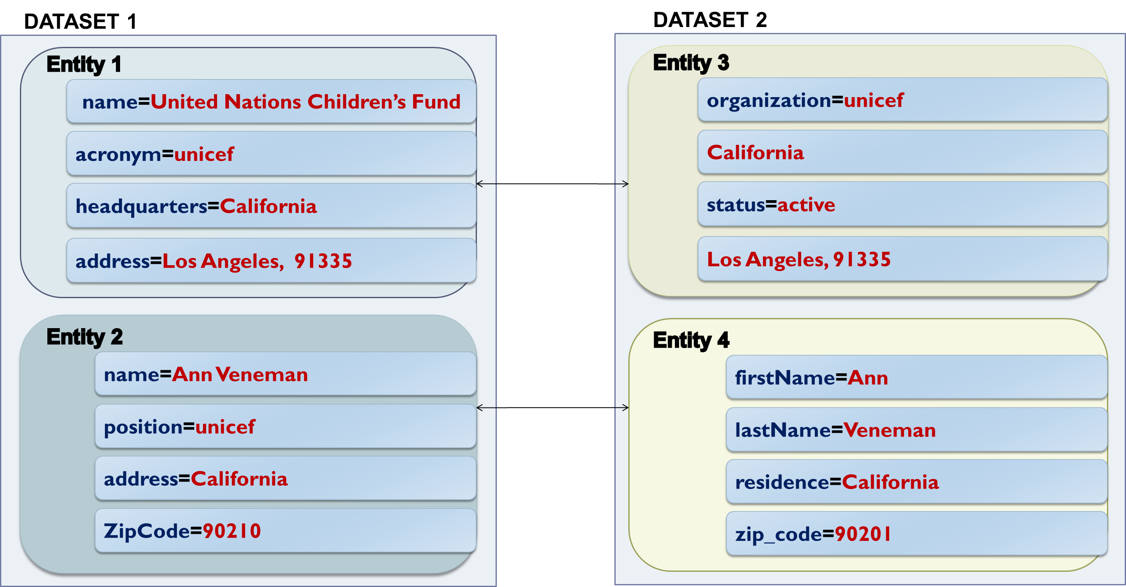
Example of Web Data
Loose Schema Binding
Split
values
Attribute
Heterogeneity
Noise
Generation 3: Tackling Variety, Volume & Veracity
Notes:
Different granularity in attribute names and values.
Loose schema binding: tag-style values, different schema for each entity.
These settings call for blocking methods that are:
Inherently robust to noise in both attribute names and attribute values
decoupled from schema information.

Slide 44

Schema Clustering
Schema Matching → not applicable
Instead, partition attributes according to their syntactic similarity, regardless of their semantic relation
Goal:
Facilitate next steps
Scope:
Both Clean-Clean and Dirty ER
Attribute Clustering [1][2][3]
Create a graph, where every node represents an attribute
For each attribute name/node n_{i}
Find the most similar node n_{j}
If sim(n_{i},n_{j}) > 0, add an edge <n_{i},n_{j}>
Extract connected components
Put all singleton nodes in a “glue” cluster
Generation 3: Tackling Variety, Volume & Veracity

Slide 45
Block Building
Unlike Blocking in G1/G2, it considers all attribute values and completely ignores all attribute names
→ schema-agnostic functionality
Core approach: Token Blocking [1]
Given an entity profile, extract all tokens that are contained in its attribute values.
Create one block for every distinct token with frequency > 2 → each block contains all entities with the corresponding token. Pros:
Parameter-free
Efficient
Unsupervised
Generation 3: Tackling Variety, Volume & Veracity

Slide 46
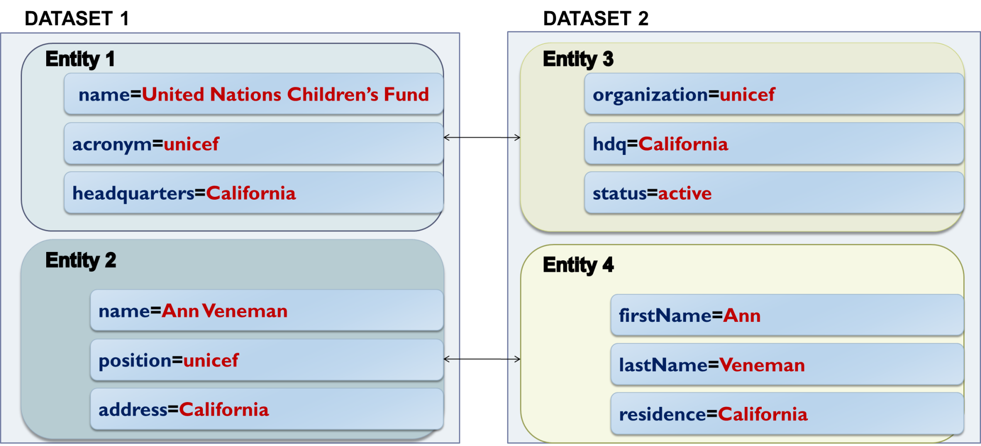
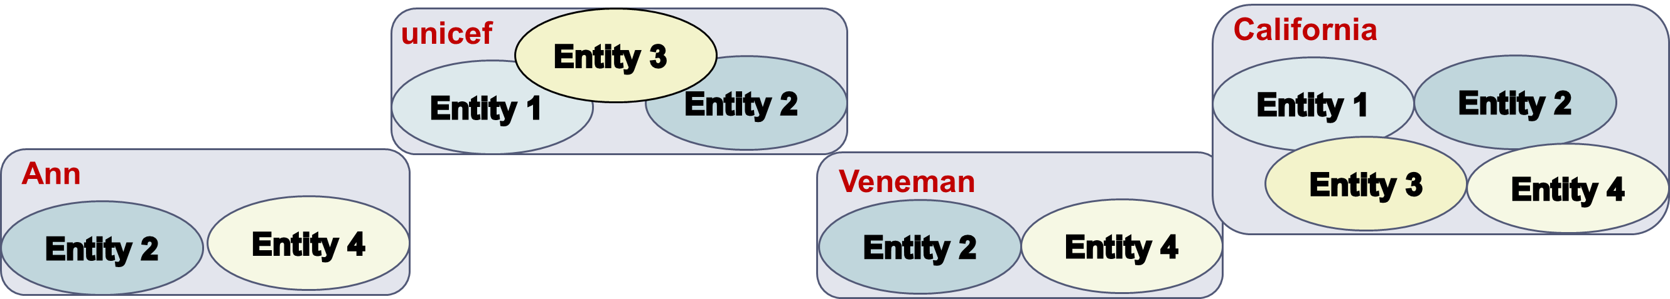
Example of Token Blocking
Generation 3: Tackling Variety, Volume & Veracity
Notes:
“united”, “nations”, children’s”, and “fund” all lead to blocks with a single entity (E1), and therefore are discarded
Highly robust to noise.
Drawback: many comparisons, large blocks.
Two solutions to overcome this issue:
We use more advanced blocking methods that build more refined blocks.
We employ block processing techniques to discard the unnecessary comparisons, without affecting the matching ones.
The two solutions are complementary.

Slide 47
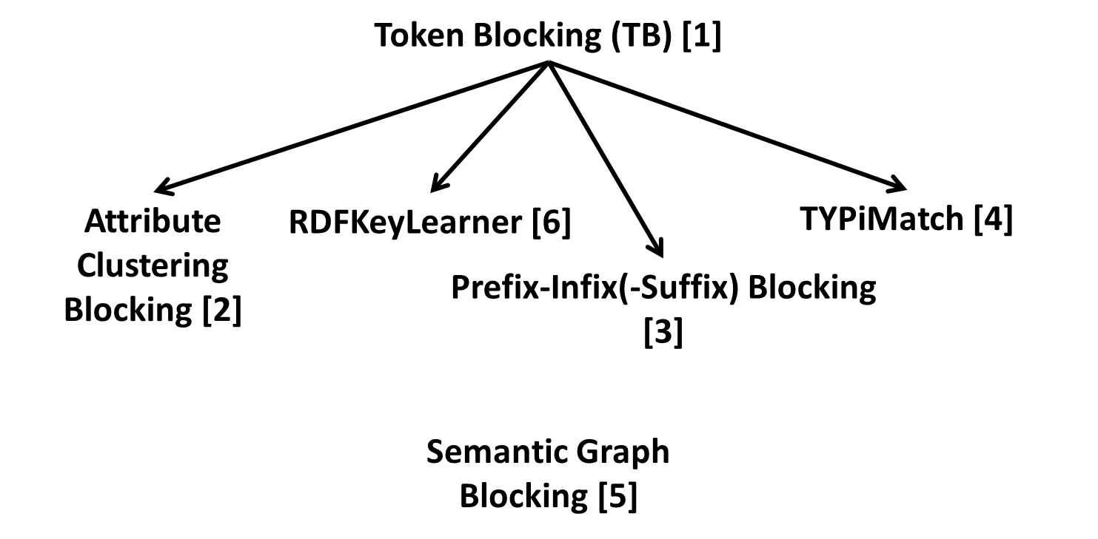
Genealogy of Block Building Techniques [8]
MapReduce-based parallelizations in [7]
Generation 3: Tackling Variety, Volume & Veracity

Slide 48
Block Processing
High Recall due to redundancy
Low Precision due to:
the blocks are overlapping → redundant comparisons
high number of comparisons between irrelevant entities → superfluous comparisons
Solution:
restructure the original blocks so as to increase
precision at no significant cost in recall
Generation 3: Tackling Variety, Volume & Veracity

Slide 49
Block Processing Techniques
Generic approach
Assign a matching likelihood score to each item
Discard items with low costs
Block-centric methods
Block Purging [1,2,3]
Block Filtering [4]
Block Clustering [5]
Generation 3: Tackling Variety, Volume & Veracity

Slide 50
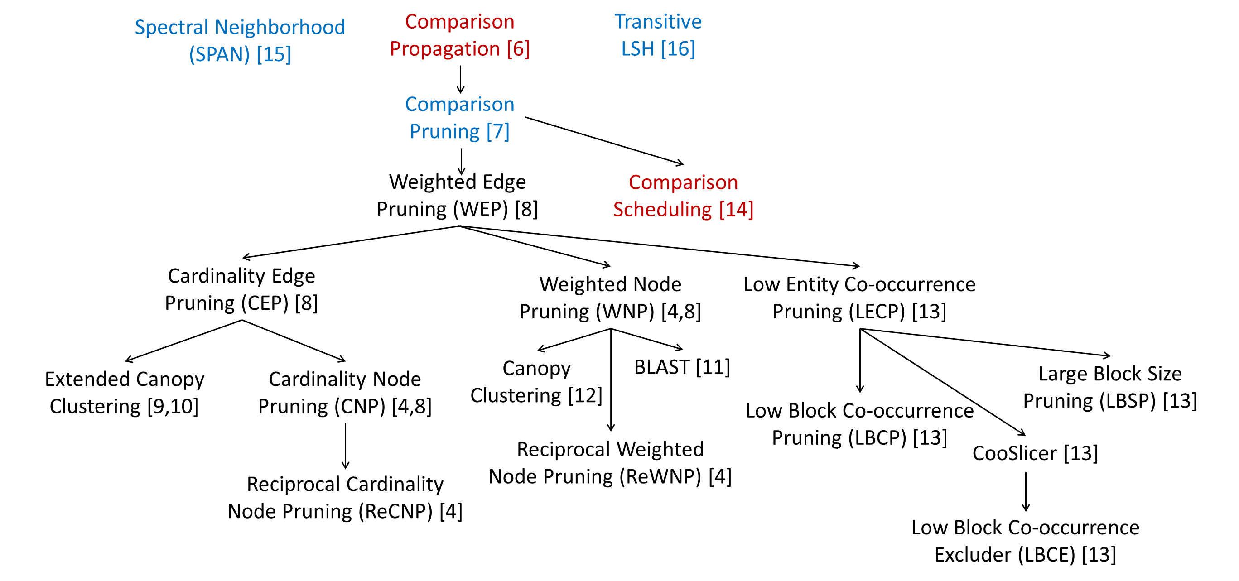
Comparison Cleaning Methods [17]
Generation 3: Tackling Variety, Volume & Veracity

Slide 51
Entity Matching
Collective approaches to tackle Variety
Most methods crafted for Clean-Clean ER
General outline of SiGMa [1], PARIS [2], LINDA [3], RiMOM-IM [4,5]
Bootstrap with a few reliable seed matches.
Using value and neighbor similarity, propagate initial matches to neighbors.
Order candidate matches in descending overall similarity
Iteratively mark the top pair as a match if it satisfies a constraint
Recompute the similarity of the neighbors
Update candidate matches order
MinoanER [6] performs a specific number of steps, rather than iterating until convergence
Generation 3: Tackling Variety, Volume & Veracity

Slide 52
Entity Clustering
Methods of G1 & G2 are still applicable
Only difference: similarity scores extracted in a schema-agnostic fashion, not from specific attributes
SplitMerge [1]
inherently capable of handling heterogeneous semantic types
[1] M. Nentwig, A. Groß, and E. Rahm. Holistic entity clustering for linked data. In ICDM Workshops, pages 194–201, 2016.
Generation 3: Tackling Variety, Volume & Veracity

Slide 53
Schema Clustering References
G. Papadakis, E. Ioannou, T. Palpanas, C. Niederée, W. Nejdl. A Blocking Framework for Entity Resolution in Highly Heterogeneous Information Spaces. IEEE Trans. Knowl. Data Eng. 25(12): 2665-2682 (2013)
G. Simonini, S. Bergamaschi, H. V. Jagadish. BLAST: a Loosely Schema-aware Meta-blocking Approach for Entity Resolution. PVLDB 9(12): 1173-1184 (2016)
G. Papadakis, L. Tsekouras, E. Thanos, G. Giannakopoulos, T. Palpanas, M. Koubarakis. The return of JedAI: End-to-End Entity Resolution for Structured and Semi-Structured Data. PVLDB 11(12): 1950-1953 (2018)
Generation 3: Tackling Variety, Volume & Veracity

Slide 54
Block Building References
G. Papadakis, E. Ioannou, C. Niederée, P. Fankhauser. Efficient entity resolution for large heterogeneous information spaces. WSDM 2011: 535-544
G. Papadakis, E. Ioannou, T. Palpanas, C. Niederée, W. Nejdl. A Blocking Framework for Entity Resolution in Highly Heterogeneous Information Spaces. IEEE Trans. Knowl. Data Eng. 25(12): 2665-2682 (2013)
G. Papadakis, E. Ioannou, C. Niederée, T. Palpanas, W. Nejdl. Beyond 100 million entities: large-scale blocking-based resolution for heterogeneous data. WSDM 2012: 53-62
Y. Ma, T. Tran. TYPiMatch: type-specific unsupervised learning of keys and key values for heterogeneous web data integration. WSDM 2013: 325-334
J. Nin, V. Muntés-Mulero, N. Martínez-Bazan, and J. Larriba-Pey. On the use of semantic blocking techniques for data cleansing and integration. In IDEAS, pages 190–198, 2007.
D. Song and J. Heflin. Automatically generating data linkages using a domain-independent candidate selection approach. In ISWC, pages 649–664, 2011.
V. Christophides, V. Efthymiou, K. Stefanidis. Entity Resolution in the Web of Data. Synthesis Lectures on the Semantic Web: Theory and Technology, Morgan & Claypool Publishers 2015.
George Papadakis, Dimitrios Skoutas, Emmanouil Thanos, Themis Palpanas: A Survey of Blocking and Filtering Techniques for Entity Resolution. CoRR abs/1905.06167 (2019)
Generation 3: Tackling Variety, Volume & Veracity

Slide 55
Block Processing References – Part I
G. Papadakis, E. Ioannou, C. Niederée, P. Fankhauser. Efficient entity resolution for large heterogeneous information spaces. WSDM 2011: 535-544
G. Papadakis, E. Ioannou, T. Palpanas, C. Niederée, W. Nejdl. A Blocking Framework for Entity Resolution in Highly Heterogeneous Information Spaces. IEEE Trans. Knowl. Data Eng. 25(12): 2665-2682 (2013)
G. Papadakis, E. Ioannou, C. Niederée, T. Palpanas, W. Nejdl. Beyond 100 million entities: large-scale blocking-based resolution for heterogeneous data. WSDM 2012: 53-62
G. Papadakis, G. Papastefanatos, T. Palpanas, M. Koubarakis. Scaling Entity Resolution to Large, Heterogeneous Data with Enhanced Meta-blocking. EDBT 2016: 221-232
J. Fisher, P. Christen, Q. Wang, E. Rahm. A Clustering-Based Framework to Control Block Sizes for Entity Resolution. KDD 2015: 279-288
G. Papadakis, E. Ioannou, C. Niederée, T. Palpanas, W. Nejdl. Eliminating the redundancy in blocking-based entity resolution methods. JCDL 2011: 85-94.
G. Papadakis, E. Ioannou, C. Niederée, T. Palpanas, W. Nejdl. To compare or not to compare: making entity resolution more efficient. SWIM 2011: 3.
G. Papadakis, G. Koutrika, T. Palpanas, W. Nejdl. Meta-Blocking: Taking Entity Resolutionto the Next Level. IEEE Trans. Knowl. Data Eng. 26(8): 1946-1960 (2014).
P. Christen. A Survey of Indexing Techniques for Scalable Record Linkage and Deduplication. IEEE Trans. Knowl. Data Eng. 24(9): 1537-1555 (2012).
G. Papadakis, G. Alexiou, G. Papastefanatos, G. Koutrika. Schema-agnostic vs Schema-based Configurations for Blocking Methods on Homogeneous Data. PVLDB 9(4): 312-323 (2015).
Generation 3: Tackling Variety, Volume & Veracity

Slide 56
Block Processing References – Part II
G. Simonini, S. Bergamaschi, H. V. Jagadish. BLAST: a Loosely Schema-aware Meta-blocking Approach for Entity Resolution. PVLDB 9(12): 1173-1184 (2016)
A. McCallum, K. Nigam, L. H. Ungar. Efficient clustering of high-dimensional data sets with application to reference matching. KDD 2000: 169-178.
D. C. Nascimento, C. E. S. Pires, and D. G. Mestre. Exploiting block co-occurrence to control block sizes for entity resolution. Knowledge and Information Systems, pages 1–42, 2019.
G. Papadakis, E. Ioannou, T. Palpanas, C. Niederée, and W. Nejdl. A blocking framework for entity resolution in highly heterogeneous information spaces. IEEE TKDE, 25(12):2665–2682, 2013.
L. Shu, A. Chen, M. Xiong, and W. Meng. Efficient spectral neighborhood blocking for entity resolution. In ICDE, pages 1067–1078, 2011.
R. C. Steorts, S. L. Ventura, M. Sadinle, and S. E. Fienberg. A comparison of blocking methods for record linkage. In Privacy in Statistical Databases, pages 253–268, 2014.
George Papadakis, Dimitrios Skoutas, Emmanouil Thanos, Themis Palpanas: A Survey of Blocking and Filtering Techniques for Entity Resolution. CoRR abs/1905.06167 (2019)
Generation 3: Tackling Variety, Volume & Veracity

Slide 57
Entity Matching References
S. Lacoste-Julien, K. Palla, A. Davies, G. Kasneci, T. Graepel, Z. Ghahramani. SIGMa: simple greedy matching for aligning large knowledge bases. KDD 2013: 572-580
F. M. Suchanek, S. Abiteboul, P. Senellart. PARIS: Probabilistic Alignment of Relations, Instances, and Schema. PVLDB 5(3): 157-168 (2011)
C. Böhm, G. de Melo, F. Naumann, and G. Weikum. LINDA: distributed web-of-data-scale entity matching. In CIKM, pages 2104–2108, 2012.
J. Li, J. Tang, Y. Li, and Q. Luo. Rimom: A dynamic multistrategy ontology alignment framework. TKDE, 21(8):1218–1232, 2009.
C. Shao, L. Hu, J. Li, Z. Wang, T. L. Chung, and J.-B. Xia. Rimom-im: A novel iterative framework for instance matching. J. Comput. Sci. Technol., 31(1):185–197, 2016.
V. Efthymiou, G. Papadakis, K. Stefanidis, and V. Christophides. MinoanER: Schema-agnostic, non-iterative, massively parallel resolution of web entities. In EDBT, pages 373–384, 2019.
Generation 3: Tackling Variety, Volume & Veracity

Slide 58
G4: Tackling Velocity, Variety, Volume and Veracity
Scope:
Applications with increasing data volume and time constraints
Loose ones (e.g., minutes, hours) → Progressive ER
Strict ones (i.e., seconds) → Real-time (On-line) ER
End-to-end workflows for Progressive ER
Schema Matching
Blocking
Prioritization
Matching
Clustering
(a)
Schema Clustering
Block
Building
Block
Processing
Prioritization
Matching
Clustering
(b)
Notes:
All other workflows execute batch processing.

Slide 59
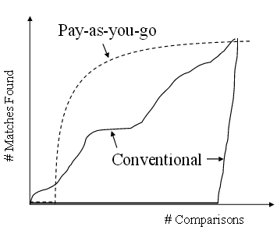
Progressive Entity Resolution
Unprecedented, increasing volume of data → applications requiring partial solutions to produce useful results
get most of the benefit
much earlier
may require some
pre-processing
Generation 4: Tackling Velocity, Variety, Volume and Veracity

Slide 60
Outline Progressive ER
Requires:
Improved Early Quality
Same Eventual Quality
Prioritization
Defines optimal processing order for a set of entities
Static Methods [1,2]:
Guide which records to compare first, independently of Entity Matching results
Dynamic Methods [3]:
If c_{i,j} is a duplicate, then check c_{i+1,j} and c_{i,j+1} as well.
Assumption:
Oracle for Entity Matching
Generation 4: Tackling Velocity, Variety, Volume and Veracity

Slide 61
Taxonomy of Static Prioritization Methods
Standard Blocking
Sorted
Neighborhood
(SN)
Suffix Arrays Blocking
(SAB)
Token Blocking
Batch
Meta-blocking
(Blocking Graph)
Progressive SN
(PSN) [1]
Hierarchy
of Record
Partitions (HRP) [1,4]
Ordered
List of Records
(OLR) [1]
Schema-based
Schema-Agnostic PSN (SA-PSN) [2]
Progressive Suffix
Arrays Blocking
(SA-PSAB) [2]
Naïve
Progressive
Local SA-PSN
(LS-PSN) [2]
Progressive Block
Scheduling (PBS) [2]
Schema-agnostic
Advanced
Progressive
Profile Scheduling
(PPS) [2]
Global SA-PSN
(GS-PSN) [2]
Comparison-based
Block-based
Profile-based
Hybrid
Generation 4: Tackling Velocity, Variety, Volume and Veracity

Slide 62
Real-time Entity Resolution
Same workflow as Generations 1 and 2:
Same scope (so far):
Structured data
Different input:
stream of query entity profiles
Different goal:
resolve each query over a large dataset in the shorted possible time (& with the minimum memory footprint)
Schema Alignment
Blocking
Matching
Clustering
Generation 4: Tackling Velocity, Variety, Volume and Veracity

Slide 63
Techniques per workflow step
Incremental Blocking
DySimII [1] - extends Standard Blocking
F-DySNI [2,3] - extends Sorted Neighborhood
(S)BlockSketch [4] - bounded matching time, constant memory footprint
Incremental Matching
QDA [5] - SQL-like selection queries over a single dataset
QuERy [6] - complex join queries over multiple, overlapping, dirty DSs
EAQP [7] - queries under data
Evolving matching rules [8]
Incremental Clustering
Incremental Correlation Clustering [9]
Generation 4: Tackling Velocity, Variety, Volume and Veracity

Slide 64
Progressive ER References
S. E. Whang, D. Marmaros, and H. Garcia-Molina. Pay-as-you-go entity resolution. TKDE, 25(5):1111–1124, 2013.
T. Papenbrock, A. Heise, and F. Naumann. Progressive duplicate detection. TKDE, 27(5):1316–1329, 2015.
G. Simonini, G. Papadakis, T. Palpanas, S. Bergamaschi. Schema-Agnostic Progressive Entity Resolution. IEEE Trans. Knowl. Data Eng. 31(6): 1208-1221 (2019)
Y. Altowim and S. Mehrotra. Parallel progressive approach to entity resolution using mapreduce. In ICDE, pages 909–920, 2017.
Generation 4: Tackling Velocity, Variety, Volume and Veracity

Slide 65
Incremental ER References
B. Ramadan and P. Christen, H. Liang, and R. W. Gayler, and D. Hawking. Dynamic similarity-aware inverted indexing for real-time entity resolution. In PAKDD Workshops, pages 47–58, 2013.
B. Ramadan and P. Christen. Forest-based dynamic sorted neighborhood indexing for real-time entity resolution. In CIKM, pages 1787–1790, 2014.
B. Ramadan and P. Christen, H. Liang, and R. W. Gayler. Dynamic sorted neighborhood indexing for real-time entity resolution. J. Data and Information Quality, 6(4):15:1–15:29, 2015.
D. Karapiperis, A. Gkoulalas-Divanis, V. S. Verykios. Summarization Algorithms for Record Linkage. EDBT 2018: 73-84.
H. Altwaijry, D. V. Kalashnikov, and S. Mehrotra. QDA: A query-driven approach to entity resolution. TKDE, 29(2):402–417, 2017.
H. Altwaijry, S. Mehrotra, and D. V. Kalashnikov. Query: A framework for integrating entity resolution with query processing. PVLDB, 9(3):120–131, 2015.
E. Ioannou, W. Nejdl, C. Niederée, and Y. Velegrakis. On-the-fly entity-aware query processing in the presence of linkage. PVLDB, 3(1): 429–438, 2010.
S. E. Whang and H. Garcia-Molina. Entity resolution with evolving rules. PVLDB, 3(1):1326–1337, 2010.
A. Gruenheid, X. L. Dong, and D. Srivastava. Incremental record linkage. Proc. VLDB Endow., 7(9):697–708, May 2014. ISSN 2150-8097.
Generation 4: Tackling Velocity, Variety, Volume and Veracity

Slide 66
Introduction
Four Generations
Part C – Entity Resolution Revisited:
Leveraging External Knowledge
Deep Learning for Entity Resolution
Crowd-sourced Entity Resolution
Challenges and Final Remarks

Slide 67
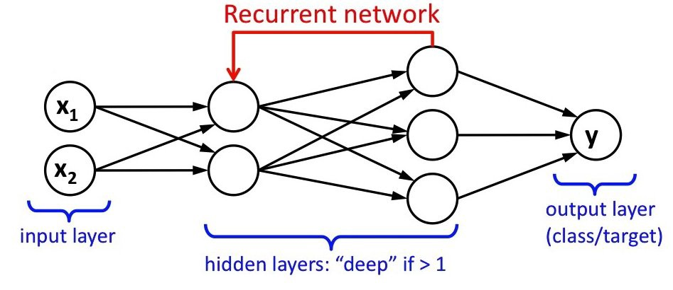
Deep Learning
Specific class of Machine Learning / Data Mining
Teaches computers to do what comes naturally to humans: learn by example
Goal: learn a complicated function from the data
Ideal for complex tasks involving multi-dimensional data
Has transformed many fields, e.g., computer vision, speech recognition, natural language processing, etc.
Similar performance, or even better, to human expert performance
Details in [1]

Slide 68
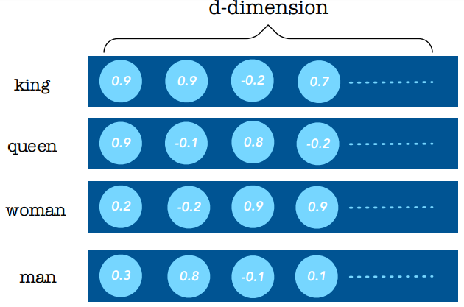
Embeddings
Based on the distributional hypothesis
i.e., words appearing in the same context share meaning
Each word is represented as a distribution of weights (positive or negative) across specific dimensions
Goal: capture semantic string similarities
Popular embeddings pre-trained over huge corpora:
Word2Vec [5]
Glove [6]
fastText [7]
Generation 4: Tackling Velocity, Variety, Volume and Veracity

Slide 69
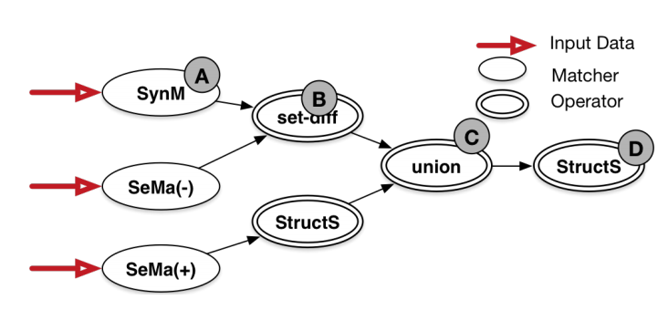
Deep Learning for Schema Matching
SEMPROP [2]
Two types of matchers:
Semantic Matcher (SeMa) based on Coherent Groups
if the average cosine similarities between all vectors in X > δ → SeMa(+), otherwise SeMa(-)
Syntactic Matcher (SYNM)
Instance matcher (Jaccard similarity between two sets of values)
Name matcher
Notes:
a coherent group contains words that fall in the same semantic space

Slide 70
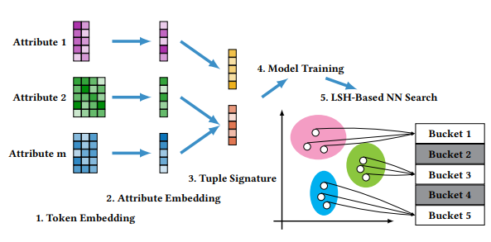
Deep Learning for Blocking
AutoBlock [3]
Ηands-off approach
Combines similarity-preserving representation learning with nearest neighbor search
Notes:
Representation learning: automatically identify a good similarity metric for blocking?
utilizes a set of pairwise labels that indicates which record pairs are matched, and learns a neural network architecture that produces, for similar tuple pairs, similar real-valued representations (named signatures), measured under some standard metric. Thus, a similarity metric for tuples is implicitly learned as the composition of the signature function (the neural network architecture) and the standard similarity metric for signatures
cross-polytope locality-sensitive hashing (LSH) [2]—a theoretically optimal LSH family for cosine similarity—to retrieve the NNs for each tuple in sublinear time.

Slide 71
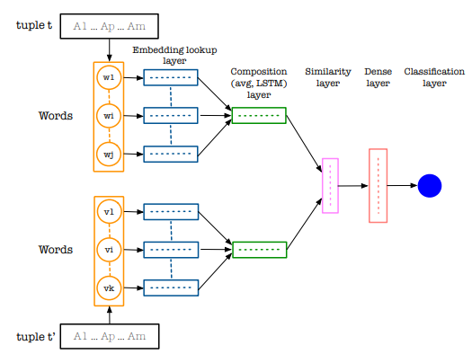
Deep Learning for Matching – Part I
DeepER [4]
Extracts tuple embeddings from word embeddings

Slide 72
DeepER [4]
Straightforward approach:
Average word embeddings in each attribute
Concatenate attribute embeddings
Entity Similarity: k-dimensional cosine similarity (k=#attributes)
Pros: Simple & efficient
Cons: Ignores word order
Compositional Approach – RNN with LSTM
Encode a sequence of words from all attribute values into a x-dimensional vector
Bidirectional RNNs capture dependencies from both directions
Semantically related attributes should have the same order
Entity Similarity: x-dimensional vector from vector difference or hadamard product
Considers out-of-vocabulary cases, e.g., Vocabulary Retrofitting
Blocking: Multi-Probe LSH based on embeddings

Slide 73
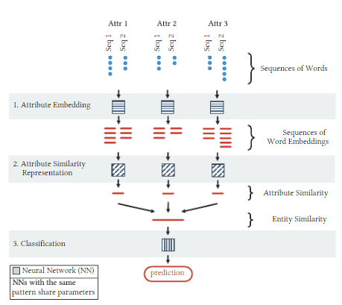
Deep Learning for Matching – Part II
DeepMatcher [8]
Assumes that Schema Matching and Blocking are already in place
Three step approach:
Attribute embedding
each attribute value is tokenized and
converted into a sequence of embedding vectors
Attribute similarity representation
one vector with the similarity per attribute
Entity Similarity: concatenate attribute similarities
Binary classification
The choices for these steps frame the
solution space for Deep Learning-based ER

Slide 74
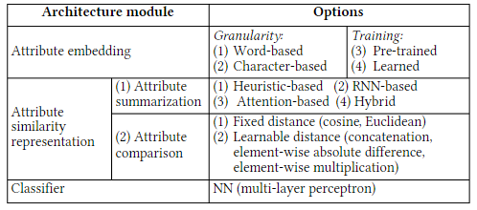
DeepMatcher
Experimental Analysis including
part of the possible solutions
over real-world datasets
Main conclusions:
For Generations 1 and 2
Deep Learning does not
outperform existing
state-of-the-art solutions,
significantly lower time efficiency (very high training time)
requires too many labelled instances
similar effectiveness,
unless the attribute values involve very high levels of noise
For Generation 3
Deep Learning yields a schema-agnostic approach that achieves the highest F-Measure

Slide 75
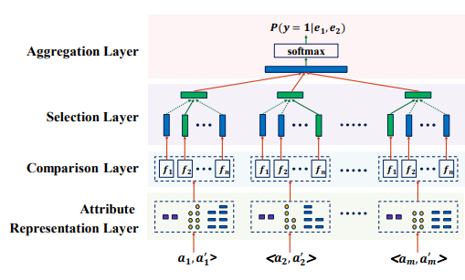
Deep Learning for Matching – Part III
Multi-Perspective Matching [9]
Adaptively selects the optimal similarity measures for heterogenous attributes
Considers 8 similarity measures:
Numeric attributes: relative difference, absolute difference
String attributes: exact similarity, edit distance, Jaro similarity, Smith and Waterman sim.
Textual attributes: RNN similarity [8], Hybrid similarity [8]

Slide 76
Deep Learning References
Ian J. Goodfellow, Yoshua Bengio, Aaron C. Courville. Deep Learning. Adaptive computation and machine learning, MIT Press 2016, ISBN 978-0-262-03561-3, pp. 1-775
R. C. Fernandez, E. Mansour, A. A. Qahtan, A. K. Elmagarmid, I. F. Ilyas, S. Madden, M. Ouzzani, M. Stonebraker, N. Tang. Seeping Semantics: Linking Datasets Using Word Embeddings for Data Discovery. ICDE 2018: 989-1000
W. Zhang, H. Wei, B. Sisman, X. L. Dong, C. Faloutsos, D. Page. AutoBlock: A Hands-off Blocking Framework for Entity Matching. WSDM 2020: 744-752
M. Ebraheem, S. Thirumuruganathan, S. R. Joty, M. Ouzzani, N. Tang. Distributed Representations of Tuples for Entity Resolution. PVLDB 11(11): 1454-1467 (2018)
J. Pennington, R. Socher, and C. D. Manning. Glove: Global vectors for word representation. In EMNLP, pages 1532–1543
T. Mikolov, I. Sutskever, K. Chen, G. S. Corrado, and J. Dean. Distributed representations of words and phrases and their compositionality. In NIPS, pages 3111–3119, 2013
P. Bojanowski, E. Grave, A. Joulin, and T. Mikolov. Enriching word vectors with subword information. TACL, 5:135–146, 2017
S. Mudgal, H. Li, T. Rekatsinas, A.H. Doan, Y. Park, G. Krishnan, R. Deep, E. Arcaute, V. Raghavendra. Deep Learning for Entity Matching: A Design Space Exploration. SIGMOD Conference 2018: 19-34
C. Fu, X. Han, L. Sun, B. Chen, W. Zhang, S. Wu, H. Kong. End-to-End Multi-Perspective Matching for Entity Resolution. IJCAI 2019: 4961-4967

Slide 77
Introduction
Four Generations
Part C – Entity Resolution Revisited:
Leveraging External Knowledge
Deep Learning for Entity Resolution
Crowd-sourced Entity Resolution
Challenges and Final Remarks

Slide 78
Crowd-sourcing
Process/work divided among a large number of people, either paid or unpaid
Idea: tasks are simple for human intelligence, but complex for computers
Approach:
Break a problem into microtasks, called Human Intelligence Tasks (HITS)
Choose an online community
Amazon Mechanical Turk
Figure Eight (former CrowdFlower)
Assign to every individual, called worker, a series of HITs
Each worker is paid per executed HIT → monetary cost
Popular for solving many tasks, e.g., CrowdDB

Slide 79
Crowd-sourcing for Entity Resolution
Delegate the entity matching decisions to the workers
i.e., transform pairwise comparisons into HITs
Challenges:
Generating HITs
Formulating HITs
Balancing accuracy and monetary cost
Restricting the labor cost

Slide 80



Challenge 1: Generating HITs
Fully Crowd-based Approach:
Create one HIT per pair of candidate match
Pros:
Straightforward implementation
Cons:
Quadratic complexity → huge monetary cost
Entity Collection A
Entity Collection B
match?

Slide 81
Hybrid HITs Generation
Two-step Approach:
Produce candidate matches using G1 workflow (i.e., Blocking → Matching)
Generate HITs for part of the candidate matches
Two approaches:
CrowdER [8]
ZenCrowd [9]

Slide 82
CrowdER [8]
It automatically discards highly dissimilar pairs of entities
Ambiguous pairs (where similarity ≥ threshold) are formulated as cluster-based HITS (see below)
Pros:
Most pairs are quickly filtered out
Significantly lower number of HITs
Cons:
Significant crowd-sourcing overhead

Slide 83
ZenCrowd [9]
Automatic step:
for every entity, rank the most similar ones using TF-IDF
threshold on the ranking function or on the number of retrieved documents
Crowdsourcing step:
Dynamically assesses the quality of worker decisions using a probabilistic model:
Each worker is assigned a prior probability based on the training set
As new decisions are made, the unreliable workers are ignored → threshold on probability estimates for accepting a pair of entities as a match

Slide 84
Challenge 2: Formulating HITs
Goal: find the best UI for presenting HITs to workers
Naive Approach: one HIT per pair of candidate matches
I.e., “is p_{i} matching with p_{j}” ?
Pros:
Simple implementation
Easy and comprehensible task
Cons:
Quadratic complexity wrt to time and monetary cost
Not scalable

Slide 85
Pair-based HITs [8]
A single HIT contains k questions of the form “is p_{i} matching with p_{j}” ?
Workers should check each question individually
Pros:
Complexity is reduced to O(n²/k)
Lower time and monetary costs than naïve approach
Cons:
Still, very high complexity

Slide 86
Cluster-based HITs [8]
A single HIT contains k entities
Each worker should mark all matches between all possible pairs
Pros:
Complexity is further lowered to O(n²/k²)
A HIT that contains many matches requires fewer comparisons than a pair-based HIT
Cons:
Still, very high complexity
Slightly lower accuracy
Two duplicates are matched only if they co-occur in a HIT

Slide 87



Pair-based vs. cluster-based HITs
Trade-off between accuracy and cost [8]:
The pair-based HITs are simpler, allowing workers to provide more accurate responses.
The cluster-based HITs enable humans to mark many pairs of records with a few clicks.
Generating Cluster-based HITs is an NP-hard problem,
CrowdER solves it in a greedy way
match?
match?
…
Notes:
Given maximum cluster size k, the similarity graph is iteratively split into connected components with up to k entities

Slide 88
Hybrid HITs [10]
Main idea: the error rate of workers is different for different profile pairs
The most “difficult” profile pairs (i.e., the high error-rate pairs) should form pair-based HITs
All other profile pairs (i.e., the low error-rate pairs) should form cluster-based HITs
In practice, generating the best hybrid hits within the given budget is an optimization task
Waldo [10] proposes algorithms with probabilistic guarantees for solving it

Slide 89
Attribute-based HITs
An entity may contain complex structures and attributes → overwhelming information for a worker
Solution: Crowdlink [14]
Each pair of entities is decomposed into attribute-level HITs
A probabilistic framework selects the k best attributes that satisfy the user requirements
Notes:
User requirements on the numbers of attributes being proved or disproved with respect to the given task.

Slide 90
Challenge 3: Balancing accuracy and monetary cost
Goal: minimize the monetary cost, while maximizing accuracy
Generic approach [1]:
Exploit the transitive relations between detected duplicates
positive transitivity: if e_{i} ≡ e_{j} and e_{j} ≡ e_{k} , then e_{i} ≡ e_{k}
negative transitivity:(a.k.a anti-transitivity): if e_{i} ≡ e_{j}, but e_{j} ≠ e_{k} , then e_{i} ≠ e_{k}
Optimize the order of HITs
Find matches before non-matches to make the most of transitivity. NP-hard problem → approximately solved with heuristics

Slide 91
Random Ordering [3]
Initialize a similarity graph G=(V,E),
while ( E ≠ {} )
pick a pair of entities e_{i}-e_{j}
crowd-source e_{i}-e_{j}
if ( e_{i} ≡ e_{j} )
contract edge <e_{i}, e_{j}>
Pros:
It performs relatively well both in theory and practice
Cons:
It ignores the edge weights
Notes:
The edge weights = matching likelihoods

Slide 92
Edge-centric ordering [1]
Initialize a cluster graph G=(V,0)
E_{sort} = candidate matches sorted in decreasing likelihood
while ( E_{sort} ≠ {} )
get the next pair of candidate matches e_{i}-e_{j}
if ( cluster_{i} = cluster_{j} )
deduced match
else
if an edge between cluster_{i} =& cluster_{j} deduced non-match
else
crowd-source e_{i}-e_{j}
update cluster graph
Notes:
For higher efficiency: parallel labelling
micro-batches of pairs that cannot be deduced are crowdsourced simultaneously

Slide 93
Node-centric ordering [3]
V_{sort} = sort entities in decreasing overall likelihood
for each v_{i} in V_{sort}
V^{i}_{sort} = candidate matches in decreasing likelihood
for each v_{j} in V^{i}_{sort}
crowd-source e_{i}-e_{j}
if (e_{i} ≡ e_{j} )
break;
Notes:
decreasing sum of edge probabilities = expected number of matches
Break, due to transitivity

Slide 94
Maximizing Progressive Recall [4]
Iteratively crowd-source the pair that maximizes the expected marginal gain in recall
Core notions:
Edge benefit:
Expected #matches detected by crowdsourcing a pair
Node benefit:
Expected #matches that could be positively inferred if any of the incident edges is a match

Slide 95
Extending Ordering Algorithms [4]
Extended Edge-centric Ordering
in every iteration, the top-w weighted edges are selected
the one with maximal edge benefit is crowd-sourced
Extended Node-centric Ordering
in every iteration, the top-w weighed nodes are selected
the one with maximal node benefit is processed for crowd-sourcing
For w=1, we get the original algorithms

Slide 96
Probabilistic framework for Question Selection [2]
Core idea:
Transform the output of a good similarity function into a probability function
Estimate the expected accuracy by asking a particular question (in combination with transitive closure)
Iteratively crowd-source the pair with the highest expected accuracy
Implementation:
Analytically computing the optimal order is #P-hard
Approximate solution based on heuristics e.g., discard pairs with very high or low probabilities.
Alternate solution: iteratively crowd-source the pair closer to 0.5
Notes:
Alternate solution: selects most “uncertain” whose

Slide 97
Perfect vs. Noisy Workers
Problem:
Previous works assume that workers are infallible
Unrealistic assumption:
High accuracy workers have an error rate up to 25% [11,12], due to
lack of domain expertise,
individual biases,
task complexity and ambiguity
tiredness
malicious behaviors
These works amplify worker errors, compromising overall ER accuracy
Solution:
Generic approach to tackling noisy workers:
Assign the same HIT to multiple workers
Reconcile their responses through majority voting
Still, errors are possible [11,12]
Need for specialized approaches that inherently tackle noisy workers
Notes:
-> they operate as an oracle with 100% accuracy
These works reduce the costs of crowdsourcing but compromise deduplication accuracy,

Slide 98
Adaptive Crowd-based Deduplication [12]
Three phases:
Pruning
Automatically eliminates record pairs with low similarities
Cluster generation
Applies correlation clustering on the results of initial crowd-sourced pairs
Cluster refinement
More new HITs to adjust the original disjoint clusters using split and merge operations
Pros:
Higher accuracy. Reconciles inconsistent crowd results, instead of computing their transitive closure.
Cons:
Higher monetary cost

Slide 99
Attribute Labeling and Clustering (ALC) [15]
Crowdsource several attribute labels per entity
E.g., label the attribute “Type of celebrity” with “Actor/Actress”, “Singer” or “Athlete”
Use attribute labels as blocking
Only pairs with common labels are crowdsourced
Strategies for error mitigation
Majority voting
Approximate matching
Probabilistic model optimizes the labelling process for a given recall
Notes:
can use the crowd to learn new metadata about our records
Unlike a traditional database however, with crowdsourcing we have the option to query for more attributes aboutrecords, and to reduce errors by soliciting the opinions of more workers. Also, while traditional blocking schemes seek only toreduce the number of pairwise comparisons needed, in our crowdsourced setting, querying for attribute labels is not free — whendeciding whether it is worth it to ask for more attributes or moreworker opinions, we must also consider both the labeling cost andpairwise comparisons cost
For approximate matching, we place an edge between pairs of records in G if their labels differ in no more than M attributes.
As we increase k, the cost of the first stage increases while the cost of the second stage decreases. Thus, there is an optimal k which minimizes our cost.

Slide 100
Partial-order based Framework [17]
Crowdsourced ER is modelled as a DAG based on a partial-order of comparisons:
c_{ij} dominates c_{kl} if it has no smaller similarities than on every attribute
c_{ij} strongly dominates c_{kl} if it has larger similarity on at least one attribute
For each crowdsourced comparison with sufficient confidence:
If it is labelled as “match” → all comparisons that dominate it are also labelled as “match”
If it is labelled as “non-match” → all comparisons that it dominates are also labelled as “non-match”
Intelligent question selection:
serially (one-by-one) or in parallel
Notes:
Root of dag: the pair with the largest sim values.
Confidence = ratio of majority workers
The monetary cost is reduced, while maintaining high accuracy as follows:

Slide 101
bDENSE [18]
Crowdsourced ER is modeled as the Maximum Likelihood Clustering (MLC) of the similarity graph
NP-hard task
Spectral-Connected-Components for approximation
merges two clusters only when the overall evidence indicates that it is likely that their entities are matching
Question selection:
In each iteration, crowdsource the comparison that maximizes the accuracy of MLC
Based an ρ-ratio, which considers the strength of positive and negative links between two disjoint sets of entities

Slide 102
Probabilistic ER With Crowd Errors [11, 16]
Crowdsourced ER is modelled as clustering problem over an uncertain similarity graph:
Edge weights: (matching probability) = the ratio of workers who voted “match”
Goal: find the maximum likelihood (and transitively-closed) clustering
Solution: in each iteration, crowdsource the pair that maximizes the reliability of a clustering
Considers global information unlike [12,18]
Notes:
Reliability: probability that every cluster Ri is connected and every pair of clusters Rj , Rk(j < k) is disconnected,

Slide 103
Pair-wise Error Correction Layer [13]
Flexible approach that can be combined with any method assuming infallible workers in three ways:
Lazy
Eager
Adaptive
Goal: maximize Progressive F-measure
Outline:
Asks random queries before adding a node to an equivalence cluster
Adds the node to the cluster only if the crowd gives #log|C| positives answers
Merge phase to boost recall
Split phase to boost precision
Notes:
area under “f-measure vs #queries"goal maximize progressive recall
input noisy graph
the larger a cluster, the more positive answers are needed
Inside a growing cluster, some nodes might become low confidence nodes
adaptive pipeline for using this layer: use it only if the crowd responses do not agree with the matching probabilities

Slide 104
Challenge 4: Restricting the labor cost
Limitations of most approaches:
They crowd-source part of the end-to-end ER workflow
They involve a high developer cost
Task-specific implementations
Restricted to ER problems with large budgets
Notes:
Only Matching is typically crowd-sourced
Each implementation is usually specific to a particular ER problem → difficult to generalize it to other ER problems.

Slide 105
Corleone [5]
Combines crowdsourcing with active learning to offer:
an end-to-end solution
generic enough to support any application
involves no implementation cost
suitable for lay users
Input comprises:
the data to be resolved
short HITs description for workers
few labeled pairs
Notes:
Covers the entire end-to-end ER workflow, without involving developersRequires no domain knowledge

Slide 106
Falcon [6] & CloudMatcher [7]
Corleone limitations:
not scalable to large datasets
runs in-memory on a single machine
Solutions:
Falcon
scales to 1-2.5M entities for only ~$60 in 2-14 hours
runs Corleone on a cluster using MapReduce
exploits crowd-time to run machine tasks
CloudMatcher
implements Falcon as a cloud service

Slide 107
References – Part I
J. Wang, G. Li, T. Kraska, M. J. Franklin, and J. Feng. Leveraging transitive relations for crowdsourced joins. In SIGMOD, pages 229–240, 2013.
S. E. Whang, P. Lofgren, and H. Garcia-Molina. Question selection for crowd entity resolution. PVLDB, 6(6):349–360, 2013.
N. Vesdapunt, K. Bellare, and N. N. Dalvi. Crowdsourcing algorithms for entity resolution. PVLDB, 7(12):1071–1082, 2014.
D. Firmani, B. Saha, and D. Srivastava. Online entity resolution using an oracle. PVLDB, 9(5):384–395, 2016.
C. Gokhale, S. Das, AnHai Doan, J. F. Naughton, Narasimhan Rampalli, Jude W. Shavlik, Xiaojin Zhu. Corleone: hands-off crowdsourcing for entity matching. SIGMOD Conference 2014: 601-6122.
S. Das, P. Suganthan G. C., AnHai Doan, J. F. Naughton, G. Krishnan, R. Deep, E. Arcaute, V. Raghavendra, Y.Park. Falcon: Scaling Up Hands-Off Crowdsourced Entity Matching to Build Cloud Services. SIGMOD Conference 2017: 1431-14463.
Y. Govind, E. Paulson, P. Nagarajan, P. Suganthan G. C., AnHai Doan, Y. Park, G. Fung, D. Conathan, M. Carter, M. Sun. CloudMatcher: A Hands-Off Cloud/Crowd Service for Entity Matching. PVLDB 11(12): 2042-2045 (2018).
Jiannan Wang, Tim Kraska, Michael J. Franklin, Jianhua Feng. CrowdER: Crowdsourcing Entity Resolution. PVLDB 5(11): 1483-1494 (2012).

Slide 108
References – Part II
Gianluca Demartini, Djellel Eddine Difallah, Philippe Cudré-Mauroux.ZenCrowd: leveraging probabilistic reasoning and crowdsourcing techniques for large-scale entity linking. WWW 2012: 469-478.
Vasilis Verroios, Hector Garcia-Molina, and Yannis Papakonstantinou. Waldo: An adaptive human interface for crowd entity resolution. In SIGMOD, pages 1133–1148, 2017.
V. K. Yalavarthi, X. Ke, and A. Khan. Select Your Questions Wisely: For Entity Resolution with Crowd Errors. In CIKM, pages 317-326, 2017.
S. Wang, X. Xiao, and C.-H. Lee. Crowd-Based Deduplication: An Adaptive Approach. In SIGMOD, pages 1263-1277, 2015.
S. Galhotra, D. Firmani, B. Saha, and D. Srivastava. Robust entity resolution using random graphs. In SIGMOD, pages 3–18, 2018.
C. J. Zhang, R. Meng, L. Chen, and F. Zhu. Crowdlink: An error-tolerantmodel for linking complex records. In ExploreDB, pages 15–20, 2015.
A. R. Khan and H. Garcia-Molina. Attribute-based crowd entity resolution. In CIKM, pages 549–558, 2016.
X. Ke, M. Teo, A. Khan, V. K. Yalavarthi. A Demonstration of PERC: Probabilistic Entity Resolution With Crowd Errors. PVLDB 11(12): 1922-1925 (2018)

Slide 109
References – Part III
C. Chai, G. Li, J. Li, D. Deng, and J. Feng. Cost-effective crowdsourced entity resolution: A partial-order approach. In SIGMOD, pages 969–984, 2016.
V. Verroios and H. Garcia-Molina. Entity resolution with crowd errors. In ICDE, pages 219–230, 2015.

Slide 110
Introduction
Four Generations
Entity Resolution Revisited:
Leveraging External Knowledge
Part D – Challenges and
Final Remarks

Slide 111
Conclusions
Most promising works focus on:
Deep Learning
Pros:
High accuracy
Cons:
High training time
too many training instances
Crowd-sourcing.
Pros:
High accuracy
Cons:
High monetary cost
Not scalable to very large datasets

Slide 112
Challenges
Many challenges ahead
Address shortcomings of Deep Learning
e.g., transfer learning for reducing labelling cost
Cover gaps
e.g., incremental ER for semi-structured data
New domains
e.g., adapt aforementioned techniques to privacy-preserving Entity Resolution

Slide 113
ER Systems
Literature focuses on stand-alone methods
More emphasis on end-to-end systems
Examples: Magellan [1], JedAI [2]
Partially cover the 4 generations
More efforts meeting the following requirements [1,3]:
open-source, extensible systems
process data of any structuredness
no coding for users
guidelines for creating effective solutions
covers the entire end-to-end pipeline exploit
a wide range of techniques

Slide 114
Automatic Configuration
Facts:
Several parameters in every method
Applies to all generations and workflow steps
Performance sensitive to internal configuration
Manual fine-tuning required
Open Research Directions:
Plug-and-play methods
Data-driven configuration
Notes:
The lazy methods are more robust in block building, but need configuration for block and comparison cleaning. The opposite is true for proactive methods.

Slide 115
Thank You!

Slide 116
References
P. Konda, S. Das, P. S. G. C., A. Doan, A. Ardalan, J. R. Ballard, H. Li, F. Panahi, H. Zhang, J. F. Naughton, S. Prasad, G. Krishnan, R. Deep, and V. Raghavendra. Magellan: Toward building entity matching management systems. PVLDB, 9(12):1197–1208, 2016.
G. Papadakis, L. Tsekouras, E. Thanos, G. Giannakopoulos, T. Palpanas, and M. Koubarakis. Domain- and structureagnostic end-to-end entity resolution with jedai. SIGMOD Record, 48(4):31, 2019.
B. Golshan, A. Y. Halevy, G. A. Mihaila, and W. Tan. Data integration: After the teenage years. In PODS, pages 101–106, 2017.

