Slide 1
Introduction to Data Science Lecture 4 Data Cleaning and Integration
CS 194 Fall 2014
John Canny
Based on notes by Michael Franklin, Dan Bruckner, Evan Sparks, Shivaram Venkataraman

Slide 2
Outline for this Evening
Data Cleaning
Perspectives on “Dirty Data”
Perspectives on Data Quality
Some problems and solutions
Data Integration
Item Similarity
Schema Matching

Slide 3
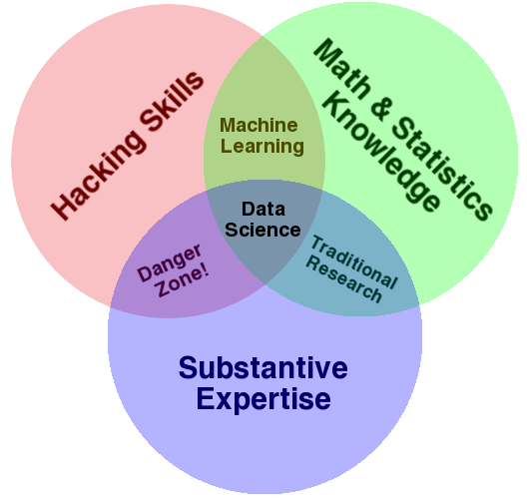
Data Science – One Definition

Slide 4

DB-hard Queries
Company_Name | Address | Market Cap
Google | Googleplex, Mtn. View, CA | $406Bn
Microsoft | Redmond, WA | $392Bn
Intl. Business Machines | Armonk, NY | $194Bn
SELECT Market_Cap
From Companies
Where Company_Name = “Apple”
Number of Rows: 0
Problem:
Missing Data

Slide 5
DB-hard Queries
Company_Name | Address | Market Cap
Google | Googleplex, Mtn. View, CA | $406Bn
Microsoft | Redmond, WA | $392Bn
Intl. Business Machines | Armonk, NY | $194Bn
SELECT Market_Cap
From Companies
Where Company_Name = “IBM”
Number of Rows: 0
Problem:
Entity Resolution

Slide 6
DB-hard Queries
Company_Name | Address | Market Cap
Google | Googleplex, Mtn. View, CA | $406
Microsoft | Redmond, WA | $392
Intl. Business Machines | Armonk, NY | $194
Sally’s Lemonade Stand | Alameda,CA | $460
SELECT MAX(Market_Cap)
From Companies
Number of Rows: 1
Problem:
Unit Mismatch

Slide 7

Who’s Calling Who’S Data Dirty?

Slide 8
Dirty Data
The Statistics View:
There is a process that produces data
We want to model ideal samples of that process, but in practice we have non-ideal samples:
Distortion – some samples are corrupted by a process
Selection Bias - likelihood of a sample depends on its value
Left and right censorship - users come and go from our scrutiny
Dependence – samples are supposed to be independent, but are not (e.g. social networks)
You can add new models for each type of imperfection, but you can’t model everything.
What’s the best trade-off between accuracy and simplicity?

Slide 9
Dirty Data
The Database View:
I got my hands on this data set
Some of the values are missing, corrupted, wrong, duplicated
Results are absolute (relational model)
You get a better answer by improving the quality of the values in your dataset

Slide 10
Dirty Data
The Domain Expert’s View:
This Data Doesn’t look right
This Answer Doesn’t look right
What happened?
Domain experts have an implicit model of the data that they can test against…

Slide 11
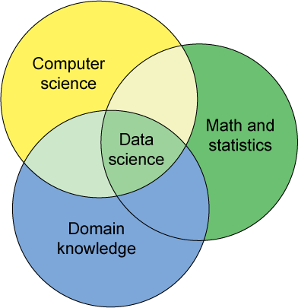
Dirty Data
The Data Scientist’s View:
Some Combination of all of the above

Slide 12
Data Quality Problems
(Source) Data is dirty on its own.
Transformations corrupt the data (complexity of software pipelines).
Data sets are clean but integration (i.e., combining them) screws them up.
“Rare” errors can become frequent after transformation or integration.
Data sets are clean but suffer “bit rot”
Old data loses its value/accuracy over time
Any combination of the above

Slide 13
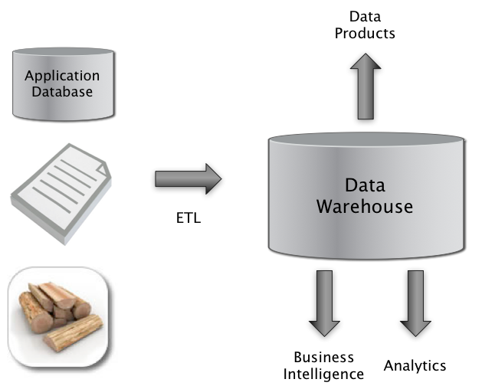

Big Picture: Where can Dirty Data Arise?
Integrate
Clean
Extract
Transform
Load

Slide 14
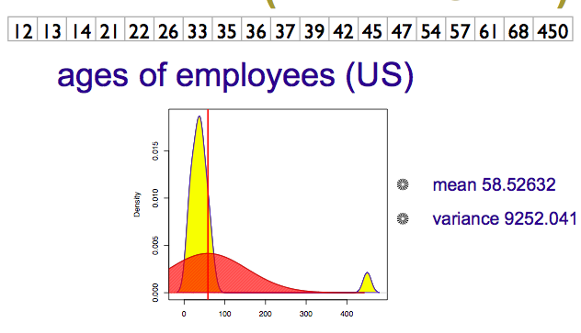

Numeric Outliers
Adapted from Joe Hellerstein’s 2012 CS 194 Guest Lecture

Slide 15
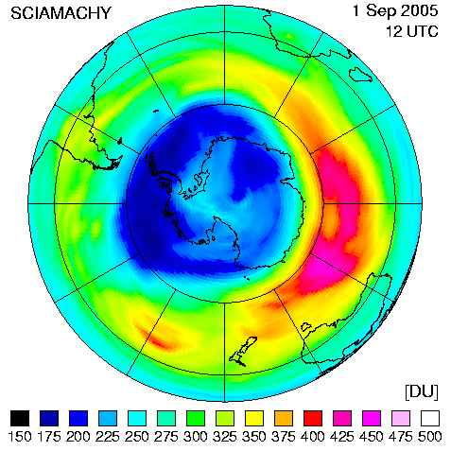
Data Cleaning Makes Everything Okay?
The appearance of a hole in the earth's ozone layer over Antarctica, first detected in 1976, was so unexpected that scientists didn't pay attention to what their instruments were telling them; they thought their instruments were malfunctioning.
National Center for Atmospheric Research
In fact, the data were rejected as unreasonable by data quality control algorithms

Slide 16
Dirty Data Problems
From Stanford Data Integration Course:
parsing text into fields (separator issues)
Naming conventions: ER: NYC vs New York
Missing required field (e.g. key field)
Different representations (2 vs Two)
Fields too long (get truncated)
Primary key violation (from un- to structured or during integration
Redundant Records (exact match or other)
Formatting issues – especially dates
Licensing issues/Privacy/ keep you from using the data as you would like?

Slide 17
Conventional Definition of Data Quality
Accuracy
The data was recorded correctly.
Completeness
All relevant data was recorded.
Uniqueness
Entities are recorded once.
Timeliness
The data is kept up to date.
Special problems in federated data: time consistency.
Consistency
The data agrees with itself.
Adapted from Ted Johnson’s SIGMOD 2003 Tutorial

Slide 18
Problems …
Unmeasurable
Accuracy and completeness are extremely difficult, perhaps impossible to measure.
Context independent
No accounting for what is important. E.g., if you are computing aggregates, you can tolerate a lot of inaccuracy.
Incomplete
What about interpretability, accessibility, metadata, analysis, etc.
Vague
The conventional definitions provide no guidance towards practical improvements of the data.
Adapted from Ted Johnson’s SIGMOD 2003 Tutorial

Slide 19
Finding a modern definition
We need a definition of data quality which
Reflects the use of the data
Leads to improvements in processes
Is measurable (we can define metrics)
First, we need a better understanding of how and where data quality problems occur
The data quality continuum
Adapted from Ted Johnson’s SIGMOD 2003 Tutorial

Slide 20
Meaning of Data Quality (2)
There are many types of data, which have different uses and typical quality problems
Federated data
High dimensional data
Descriptive data
Longitudinal data
Streaming data
Web (scraped) data
Numeric vs. categorical vs. text data
Adapted from Ted Johnson’s SIGMOD 2003 Tutorial

Slide 21
Meaning of Data Quality (2)
There are many uses of data
Operations
Aggregate analysis
Customer relations …
Data Interpretation : the data is useless if we don’t know all of the rules behind the data.
Data Suitability : Can you get the answer from the available data
Use of proxy data
Relevant data is missing
Adapted from Ted Johnson’s SIGMOD 2003 Tutorial
Notes:
Challenge in operations : many handoffs. Some processes more important than others.
Challenge in aggregate analysis: can tolerate errors, but you’re summing up over a lot of data, therefore likely to add in glitched data.
Customer relations : the fields must be accurate, but errors don’t spread.

Slide 22
The Data Quality Continuum
Data and information is not static, it flows in a data collection and usage process
Data gathering
Data delivery
Data storage
Data integration
Data retrieval
Data mining/analysis
Adapted from Ted Johnson’s SIGMOD 2003 Tutorial

Slide 23
Data Gathering
How does the data enter the system?
Sources of problems:
Manual entry
No uniform standards for content and formats
Parallel data entry (duplicates)
Approximations, surrogates – SW/HW constraints
Measurement or sensor errors.
Adapted from Ted Johnson’s SIGMOD 2003 Tutorial
Notes:
MPDS workshop, John Bates

Slide 24
Data Gathering - Solutions
Potential Solutions:
Preemptive:
Process architecture (build in integrity checks)
Process management (reward accurate data entry, data sharing, data stewards)
Retrospective:
Cleaning focus (duplicate removal, merge/purge, name & address matching, field value standardization)
Diagnostic focus (automated detection of glitches).
Adapted from Ted Johnson’s SIGMOD 2003 Tutorial

Slide 25
Data Delivery
Destroying or mutilating information by inappropriate pre-processing
Inappropriate aggregation
Nulls converted to default values
Loss of data:
Buffer overflows
Transmission problems
No checks
Adapted from Ted Johnson’s SIGMOD 2003 Tutorial

Slide 26
Data Delivery - Solutions
Build reliable transmission protocols
Use a relay server
Verification
Checksums, verification parser
Do the uploaded files fit an expected pattern?
Relationships
Are there dependencies between data streams and processing steps
Interface agreements
Data quality commitment from the data stream supplier.
Adapted from Ted Johnson’s SIGMOD 2003 Tutorial

Slide 27
Data Storage
You get a data set. What do you do with it?
Problems in physical storage
Can be an issue, but terabytes are cheap.
Problems in logical storage
Poor metadata.
Data feeds are often derived from application programs or legacy data sources. What does it mean?
Inappropriate data models.
Missing timestamps, incorrect normalization, etc.
Ad-hoc modifications.
Structure the data to fit the GUI.
Hardware / software constraints.
Data transmission via Excel spreadsheets, Y2K
Adapted from Ted Johnson’s SIGMOD 2003 Tutorial

Slide 28
Data Storage - Solutions
Metadata
Document and publish data specifications.
Planning
Assume that everything bad will happen.
Can be very difficult.
Data exploration
Use data browsing and data mining tools to examine the data.
Does it meet the specifications you assumed?
Has something changed?
Adapted from Ted Johnson’s SIGMOD 2003 Tutorial

Slide 29
Data Retrieval
Exported data sets are often a view of the actual data. Problems occur because:
Source data not properly understood.
Need for derived data not understood.
Just plain mistakes.
Inner join vs. outer join
Understanding NULL values
Computational constraints
E.g., too expensive to give a full history, we’ll supply a snapshot.
Incompatibility
Ebcdic? Unicode?
Adapted from Ted Johnson’s SIGMOD 2003 Tutorial

Slide 30
Data Mining and Analysis
What are you doing with all this data anyway?
Problems in the analysis.
Scale and performance
Confidence bounds?
Black boxes and dart boards
Attachment to models
Insufficient domain expertise
Casual empiricism
Adapted from Ted Johnson’s SIGMOD 2003 Tutorial
Notes:
Casual empiricism : use an arbitrary number to support a pre-conception.

Slide 31
Retrieval and Mining - Solutions
Data exploration
Determine which models and techniques are appropriate, find data bugs, develop domain expertise.
Continuous analysis
Are the results stable? How do they change?
Accountability
Make the analysis part of the feedback loop.
Adapted from Ted Johnson’s SIGMOD 2003 Tutorial

Slide 32
Data Quality Constraints
Many data quality problems can be captured by static constraints based on the schema.
Nulls not allowed, field domains, foreign key constraints, etc.
Many others are due to problems in workflow, and can be captured by dynamic constraints
E.g., orders above $200 are processed by Biller 2
The constraints follow an 80-20 rule
A few constraints capture most cases, thousands of constraints to capture the last few cases.
Constraints are measurable. Data Quality Metrics?
Adapted from Ted Johnson’s SIGMOD 2003 Tutorial
Notes:
Dynamic constraints often come from operational databases. But analysis data sets, CRM databases are often derived from operational data.

Slide 33
Data Quality Metrics
We want a measurable quantity
Indicates what is wrong and how to improve
Realize that DQ is a messy problem, no set of numbers will be perfect
Types of metrics
Static vs. dynamic constraints
Operational vs. diagnostic
Metrics should be directionally correct with an improvement in use of the data.
A very large number metrics are possible
Choose the most important ones.
Adapted from Ted Johnson’s SIGMOD 2003 Tutorial
Notes:
Metrics can give incentives for bad behavior : throw away data that doesn’t join.

Slide 34
Examples of Data Quality Metrics
Conformance to schema
Evaluate constraints on a snapshot.
Conformance to business rules
Evaluate constraints on changes in the database.
Accuracy
Perform inventory (expensive), or use proxy (track complaints). Audit samples?
Accessibility
Interpretability
Glitches in analysis
Successful completion of end-to-end process
Adapted from Ted Johnson’s SIGMOD 2003 Tutorial

Slide 35
Technical Approaches
We need a multi-disciplinary approach to attack data quality problems
No one approach solves all problem
Process management
Ensure proper procedures
Statistics
Focus on analysis: find and repair anomalies in data.
Database
Focus on relationships: ensure consistency.
Metadata / domain expertise
What does it mean? Interpretation
Adapted from Ted Johnson’s SIGMOD 2003 Tutorial

Slide 36
Some Notes on the Class
HW1 due Thursday
FINAL PROJECTS
Project Teams (due Friday 9/26/14)
Project Preferences (due Wednesday 10/1/14)
Project Assignments (Friday 10/3/14)
Project Proposals (due Friday 10/10/14)

Slide 37
Break – 5 min

Slide 38
Schema and Data Integration
Which problems does Integration exacerbate?
Which problems does schema on write help?
Mediated Schema
Semantic mappings
wrapper
wrapper
wrapper
wrapper
wrapper
Courtesy of Alon Halevy

Slide 39
Data Integration
Combine data sets (acquisitions, across departments).
Common source of problems
Heterogenous data : no common key, different field formats
Approximate matching
Different definitions
What is a customer: an account, an individual, a family, …
Time synchronization
Does the data relate to the same time periods? Are the time windows compatible?
Legacy data
IMS, spreadsheets, ad-hoc structures
Adapted from Ted Johnson’s SIGMOD 2003 Tutorial

Slide 40
Schema Matching
Original Problem: merge structured databases
But, even in a looser schema (e.g. NoSQL) world structural matching matters
WebTables paper shows an extreme version of this
2.6M Unique schemas (appear >1 time)
5.4M Unique attribute (field) names (>1 time)
Found by web crawling/scraping

Slide 41
WebTables Extracted Tables
Recovered Relations
ACSDb
Schema | Freq
make | model | year
Toyota | Camry | 1984
{make, model, year}
2
{make, model, year, color}
1
make | model | year
Mazda | Protégé | 2003
Chevrolet | Impala | 1979
{name, addr, city, state, zip}
1
{name, size, last-modified}
1
ACSDb is useful for computing attribute probabilities
p(“make”), p(“model”), p(“zipcode”)
p(“make” | “model”), p(“make” | “zipcode”)
make | model | year | color
Chrysler | Volare | 1974 | yellow
Nissan | Sentra | 1994 | red
name | addr | city | state | zip
Dan S | 16 Park | Seattle | WA | 98195
Alon H | 129 Elm | Belmont | CA | 94011
name | size | last-modified
Readme.txt | 182 | Apr 26, 2005
cac.xml | 813 | Jul 23, 2008

Slide 42
ACSDb* Applications
Schema Auto Complete
Attribute Synonym-Finding
Join Graph Traversal
*Attribute Correlation Statistics Database

Slide 43
Matching: Data and sTructure

Slide 44
Duplicate Record Detection needs DeDup!
Resolve multiple different mentions:
Entity Resolution
Reference Reconciliation
Object Identification/Consolidation
Remove Duplicates
Merge/Purge
Record Linking (across data sources)
Householding (interesting special case)
Approximate Match (accept fuzziness)
…

Slide 45


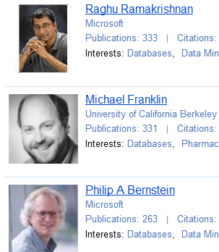
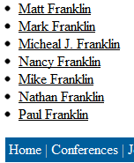
Example: Data Integration
Notes:
CrowdER Architecuture

Slide 46

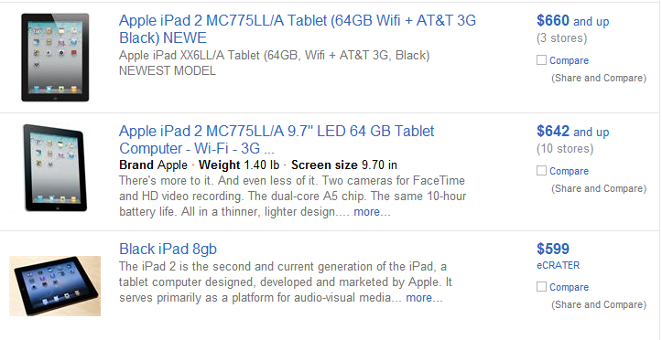
Example: DeDup/Cleaning

Slide 47
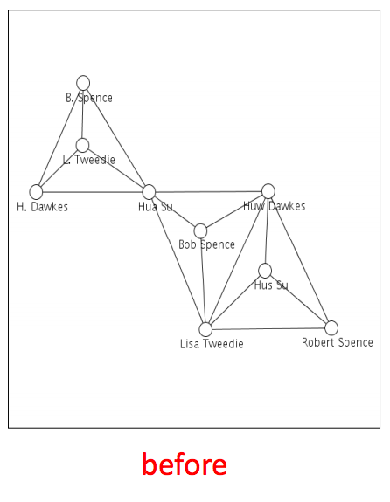
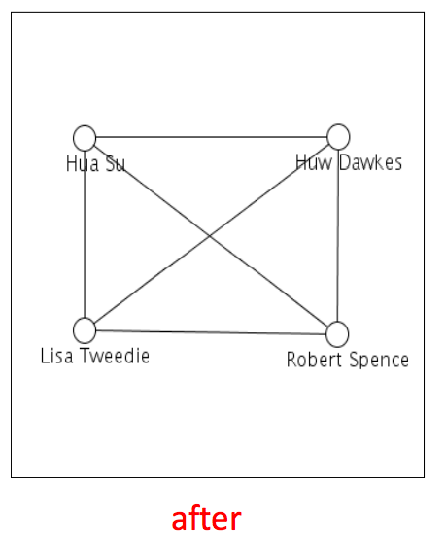
Example: Network Analysis
From: Getoor & Machanavajjhala: “Entity Resolution Tutorial”, VLDB 2012

Slide 48
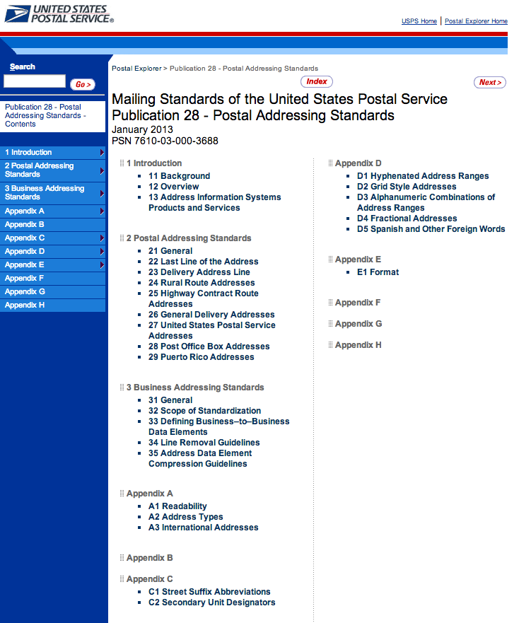
Preprocessing/Standardization
Simple idea:
Convert to canonical form
e.g. addresses

Slide 49
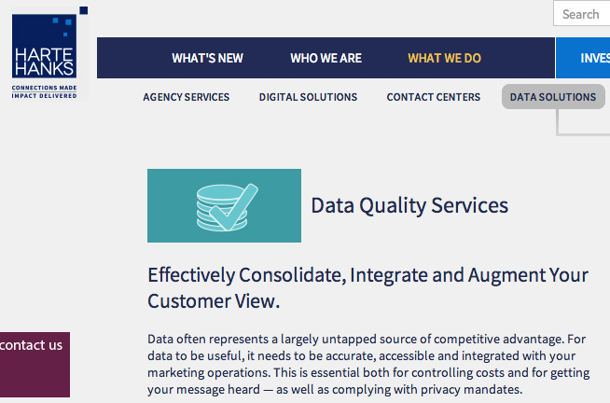
More Complicated: Householding
Different people in same house?

Slide 50
Approximate Matching
Relate tuples whose fields are “close”
Approximate string matching
Generally, based on edit distance.
Fast SQL expression using a q-gram index (a q-gram is like an n-gram on syllables)
Approximate tree matching
For Nested Data Structures (or flattened ones)
Much more expensive than string matching
Recent research in fast approximations
Feature vector matching
Similarity search
Many techniques discussed in the data mining literature.
Ad-hoc or Domain-focused matching
Use domain insights and/or clever tricks.

Slide 51
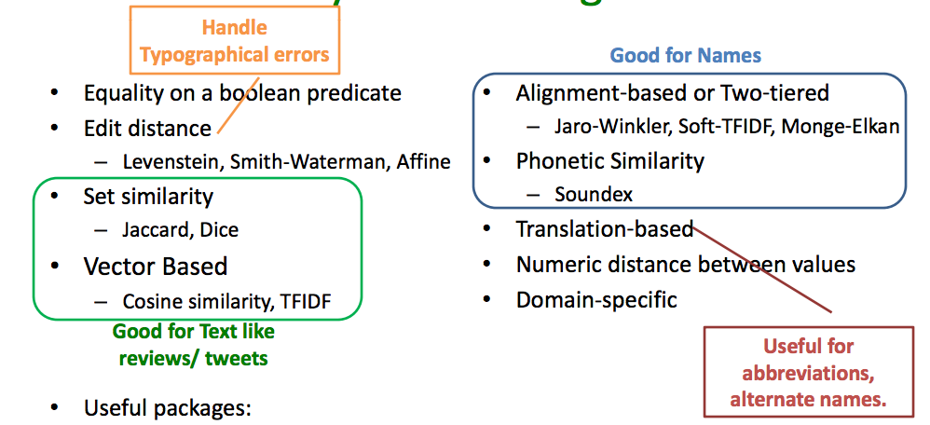
Some Similarity Measures
From: Getoor & Machanavajjhala: “Entity Resolution Tutorial”, VLDB 2012

Slide 52
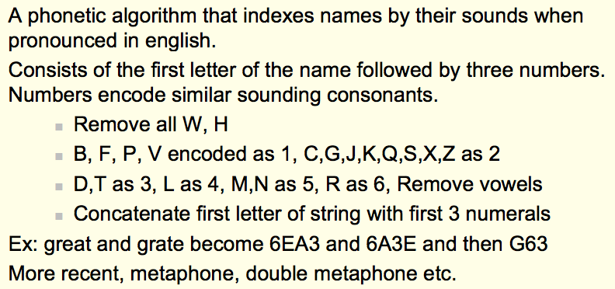
Soundex Encoding
From: Koudas, Sarawagi, Strivastava, “Record Linkage: Similarity Measures and Algorithms”, VLDB 2006

Slide 53
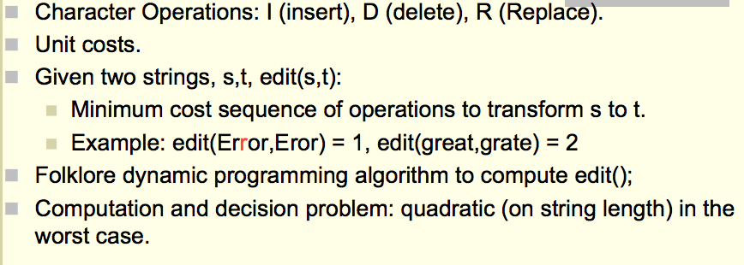
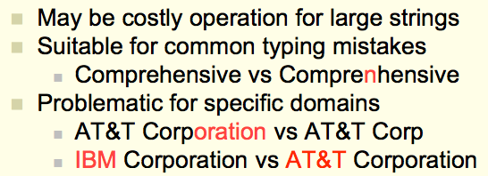
Edit Distance
From: Koudas, Sarawagi, Strivastava, “Record Linkage: Similarity Measures and Algorithms”, VLDB 2006

Slide 54
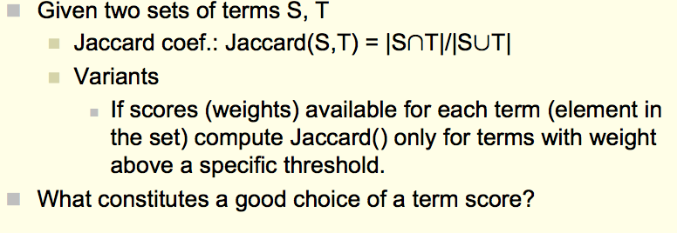
Overlap Metrics
Terms can be words or “q-grams” (sequence of q characters in a field:
e.g., {‘AT&’, ‘T&T’, ‘&T ‘, ‘T C’, …} for AT&T Corp.
From: Koudas, Sarawagi, Strivastava, “Record Linkage: Similarity Measures and Algorithms”, VLDB 2006

Slide 55
More Sophisticated Techniques
Evidence from multiple fields
Positive and Negative are possible
Evidence from linkage pattern with other records
Clustering-based approaches
…

Slide 56
Approximate Joins and Duplicate Elimination
Perform joins based on incomplete or corrupted information.
Approximate join : between two different tables
Duplicate elimination : within the same table
More general than approximate matching.
Semantics : Need to use special transforms and scoring functions.
Correlating information : verification from other sources, e.g. usage correlates with billing.
Missing data : Need to use several orthogonal search and scoring criteria.
But approximate matching is a valuable tool …

Slide 57
(Approximate Join Example)
Sales
“Gen” bucket
Provisioning
Sales
Provisioning
Genrl. Eclectic
General Magic
Gensys
Genomic Research
Genrl. Electric
Genomic Research
Gensys Inc.
Match
Genrl. Eclectic
Genomic Research
Gensys
Genrl. Electric
Genomic Research
Gensys Inc.

Slide 58
Algorithm (for scalability)
Partition data set
By hash on computed key
By sort order on computed key
By similarity search / approximate match on computed key
Perform scoring within the partition
Hash : all pairs
Sort order, similarity search : target record to retrieved records
Record pairs with high scores are matches
Use multiple computed keys / hash functions
Duplicate elimination : duplicate records form an equivalence class.

Slide 59
Schema Matching
Use similarity measures and structural cues (e.g. column names, data types, etc.) to match data definitions
Looking at data instances (or examples of them can help)
Constraints in the schema (if you have them) can also help.
Auxiliary Information: dictionaries, documentation, usage… ditto

Slide 60
Lots of Additional Problems
Address vs. Number, Street, City, …
Units
Differing Constraints
Multiple versions and schema evolution
Ontologies and other Metadata

Slide 61
Data Integration
Combine data sets (acquisitions, across departments).
Common source of problems
Heterogenous data : no common key, different field formats
Approximate matching
Different definitions
What is a customer: an account, an individual, a family, …
Time synchronization
Does the data relate to the same time periods? Are the time windows compatible?
Legacy data
IMS, spreadsheets, ad-hoc structures
Sociological factors
Reluctance to share – loss of power.
Adapted from Ted Johnson’s SIGMOD 2003 Tutorial

Slide 62
Data Integration - Solutions
Commercial Tools
Significant body of research in data integration
Many tools for address matching, schema mapping are available.
Data browsing and exploration
Many hidden problems and meanings : must extract metadata.
View before and after results : did the integration go the way you thought?
Adapted from Ted Johnson’s SIGMOD 2003 Tutorial

Slide 63
Summary
Data Cleaning
Perspectives on “Dirty Data”
Perspectives on Data Quality
Some problems and solutions
Data Integration
Item Similarity
Schema Matching

