Slide 1
New Coagulation Drugs and Their Coagulation Results
What to expect when a patient is on a Direct Thrombin Inhibitor, Rivaroxaban, and Apixaban

Slide 2
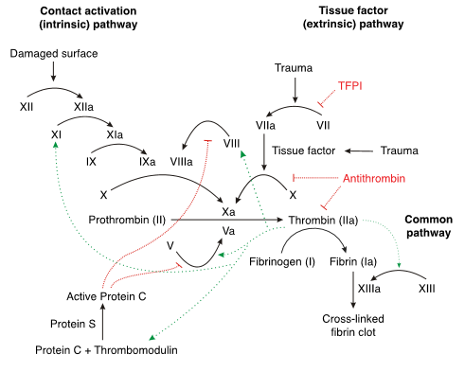
Coagulation Cascade

Slide 3
Direct Thrombin Inhibitors
Argatroban, bivalirudin, and dabigatran are all DTI’s.
They are used for venous thromboembolism (VTE), heparin-induced thrombocytopenia (HIT), acute coronary syndromes (ACS), and non-valvular Afib.
Marketed as not needing monitored.

Slide 4
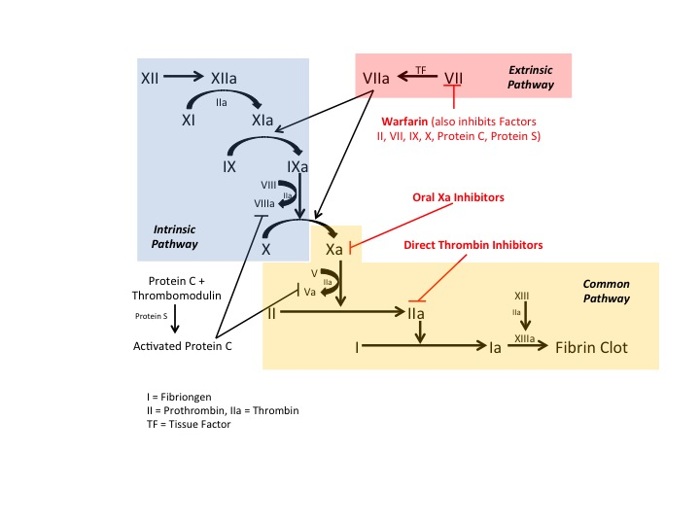
How DTI’s work
DTI’s work by binding directly to thrombin, unlike heparin which needs a cofactor (ATIII).

Slide 5
Rivaroxaban
Oral Direct Xa Inhibitor
Used for deep vein thrombosis (DVT), pulmonary embolism (PE), and non-valvular Afib.
Marketed as not needing monitored.

Slide 6
Eliquis
Oral Direct Xa Inhibitor
Used for venous thromboembolism (VTE) and non-valvular Afib.
Marketed as not needing monitored.

Slide 7
How Rivaroxaban and Eliquis Work
Both rivaroxaban and eliquis are direct Factor Xa Inhibitors

Slide 8
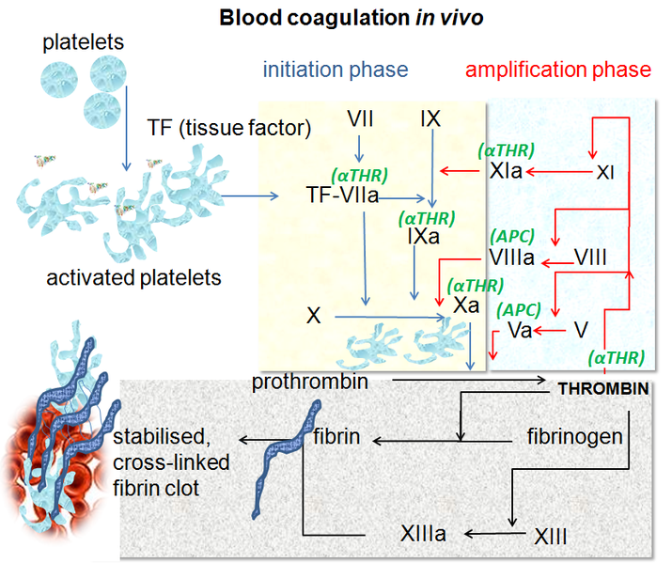
How Thrombin Time Test Works
The Thrombin Time test is the amount of time it takes fibrinogen to form fibrin when thrombin is added
The thrombin time will be elevated in the presence of DTI’s and heparin.

Slide 9
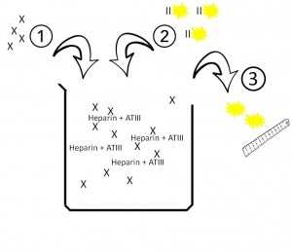
How Anti Xa Test Works
The following diagram explains the way the anti Xa assay is performed.
First, artificial factor X is added to the patient’s blood.
The heparin in the blood activates the patient’s anti thrombin III and they both act to deactivate the factor X.
The more heparin in the blood, the more factor X is deactivated and the less active Xa is left in the test tube.
Now factor II that is marked with a yellow marker is added into the test tube.
The active Xa that was left interacts with the factor II and the yellow marker is released.
This is then measured. The more yellow, the more factor Xa, the less heparin.
The amount of heparin is deduced from putting the yellow reading on a normogram.
Then Anti Xa will be elevated in the presence of rivaroxaban, apixaban, and heparin.

Slide 10
Coagulation Results
Coagulation Test | Direct Thrombin Inhibitors | Factor Xa Inhibitors
PT | Increased | Increased
PTT | Increased | Increased
Fibrinogen | Decreased | No Interference
Thrombin Time | Increased | No Interference
Lupus DVVT | Increased | Increased
Protein C | Increased | Increased
Protein S | No Interference | No Interference
APC | Increased | Increased
ATIII (Chromogenic) | Increased | No Interference
Anti - Xa | No Interference | Increased

Slide 11
Conclusion
DTI’s will have an severely increased thrombin time.
Rivaroxaban/Eliquis will have a normal thrombin time but a severely increased Anti-Xa assay.
Run Anti Xa and thrombin time on elevated lupus screen or LAPTT results.
Also run Anti Xa and thrombin time on all thrombosis panel patients.

