Slide 1
An Efficient Multicast Scheme for Mobile Networks with Reduced Feedback
2018/6/13
Advisor: 李程輝教授
Student: Grace Lee

Slide 2
Outline
Abstract
Introduction
Preliminary
Our Proposed Algorithm
Simulation
Conclusion
Bibliography

Slide 3
Abstract
Our goal is to improve the throughput of SC-PTM while transmitting minimal feedback.
We reduce feedback by sending ACK and NAK instead of CQI.
We maximize throughput by finding the most suitable MCS.
Our algorithm and methods in this slide incorporate the points above.
We compare our algorithms with SC-PTM without feedback.

Slide 4
Introduction
Recently, there has been tremendous growth of video traffic and need for live streaming.
Therefore, 3GPP defined a broadcast/multicast mode for LTE, called Evolved Multimedia Broadcast/Multicast Services (eMBMS), where he same content is delivered to multiple user equipments (UEs) simultaneously. A new transmission mode called Single-Cell Point-to-Multipoint (SC-PTM) was defined in Release 13.
Previously, research has been done on SC-PTM without feedback and SC-PTM with CQI with/without HARQ.
Our research is about SC-PTM with ACK/NAK feedback.

Slide 5
Preliminary
Usually in SC-PTM, there either no feedback, or all UEs transmit their Channel Quality Indicator (CQI) to the eNodeB.
The eNodeB, upon receiving the CQI’s from the UEs, determine which MCS the broadcast transmission will use.
The maximal MCS that each UE can correctly decode depends on the UE’s SNR.
Notes:
criteria

Slide 6
Proposed Algorithms
1_FBC (1 feedback channel for NAK)
2_FBC (2 feedback channels, 1 feedback channel for ACK and 1 feedback channel for NAK)

Slide 7
Proposed Algorithms (Problem Formulation)
Constraint: minimize feedback
High MCS => high throughput for each receiving UE, few receiving UEs.
Goal: maximize total throughput under the constraint above.

Slide 8
Proposed Algorithms (Basic Idea)
The UEs informs the eNodeB of any changes in whether the UEs can receive with or without errors
Each UE records its state with a Boolean variable called mute
The eNodeB records the feedback with an integer variable called counter, and the MCS of the previous iteration with an integer variable called MCS_Index.

Slide 9
1_FBC: UE behavior
If mute is false and UE decodes incorrectly, reply NAK, set mute to true
If mute is true and UE can decode correctly, set mute to false
Note: NAK collision is possible when multiple UEs reply NAK. Therefore, eNodeB uses energy detection to determine whether NAK(s) are sent.(等一下想跟老師討論)
Notes:
NAK collision

Slide 10
1_FBC: eNodeB behavior
If NAK(s) are received, counter++.
If counter > g, MCS-- and counter--
If counter < g, MCS++

Slide 11
1_FBC
eNB Initial:
Counter = 0
g: give up
eNodeB收到feedback
UE收到packet
UE Initial:
Mute = false
NAK
else
Counter++
Counter不變
error
correct
Mute
Counter==g?
true
false
No, counter > g
YES
No, counter < g
MCS下降
Counter--
MCS不變
MCS上升
Do nothing
回傳NAK，Mute = true
Mute = false
MCS==1?
Counter=0

Slide 12
2_FBC: UE behavior
白話文：
UE feedback給eNodeB iff 接收狀態改變
(i.e. 原本可以接收變成不能接收，或者是原本不能接收變成可以接收)
If mute is true and UE can decode correctly, reply ACK, set mute false
If mute is false and UE decodes incorrectly, reply NAK, set mute true
Note: NAK collision and ACK collision are possible when multiple UEs reply NAK. Therefore, eNodeB uses energy detection to determine whether NAK(s) or ACK(s) are sent.
NAK and ACK do not collide with each other because they are transmitted via different channels
Notes:
ACK/NAK collision

Slide 13
2_FBC: eNodeB behavior
If eNB receives both NAK and ACK, do nothing
Else if eNB receives NAK, counter++
Else if eNB receives ACK, counter--
If counter < g, MCS++
Else if counter == g, MCS = MCS
Else MCS--
白話文：
Counter的變化只與UE的 feedback相關
MCS的變化只與counter相關

Slide 14
2_FBC
eNB Initial:
Counter = 0
g: give up
eNodeB收到feedback
UE收到packet
UE Initial:
Mute = false
NAK only
ACK only
error
correct
else
Counter++
Counter不變
Counter--
Mute
Mute
true
false
true
false
Counter==g?
Do nothing
回傳NAK，Mute = true
回傳ACK，Mute = false
Do nothing
No, counter > g
YES
No, counter < g
MCS下降
MCS不變
MCS上升

Slide 15
2_FBC: a small problem
Occasionally, when this happens: (Assume that counter was originally g, MCS = MCS_{i})
Some UEs become unable to decode MCS_{i} => reply NAK => counter = g+1
MCS = MCS_{i-1}, so the UEs in 1 can decode =>reply ACK => counter = g.
Suppose there’s another group of UEs that were initially unable to decode MCS_{i} becomes able to decode MCS_{i}. If this happens at 1, then counter does not change. However, if this happens at 2, then MCS would decrease, even though the distribution of all the UEs does not change dramatically.

Slide 16
2_FBC version 2.0
The original version: if counter == g, MCS = MCS
V2.0: if counter == g || counter == g+1, MCS = MCS
The original version: if eNB receives ACK but no NAK, MCS--
V2.0: if eNB receives ACK but no NAK, MCS--, unless counter>g+1, in which case MCS-=2
Pros of V2.0: more stable than the original version
Cons of V2.0: not as simple&stupid as the original version

Slide 17
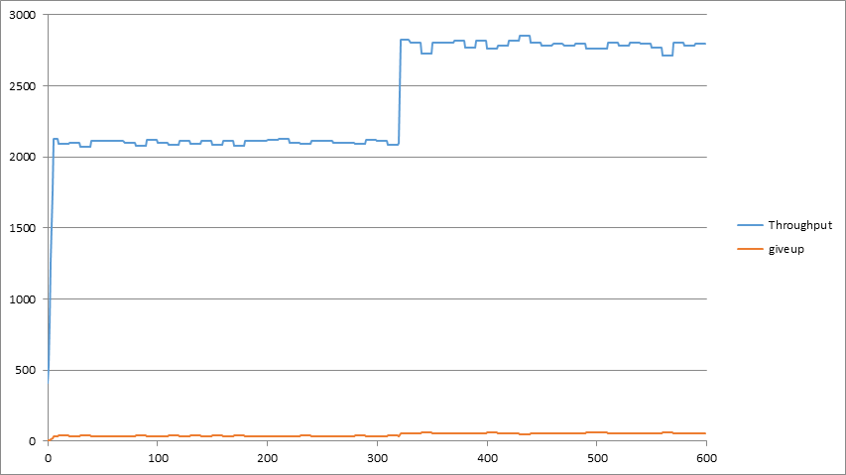
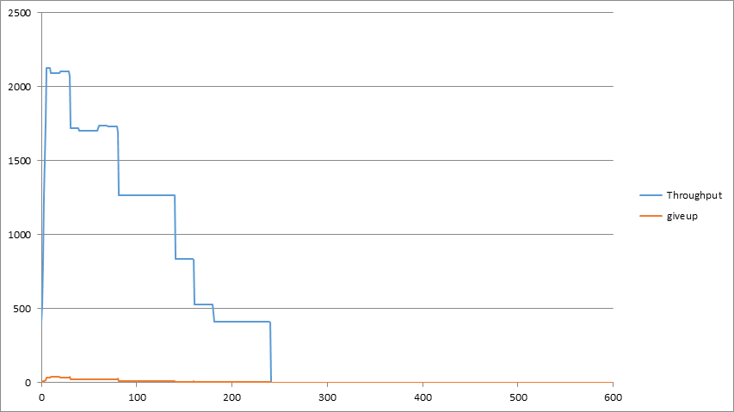
2_FBC vs 2_FBC v2.0
2_FBC v2.0
2_FBC

Slide 18
Simulation (Environment)
Traffic Model
UE distribution | Uniform between 50m and 500m
Data generation | Full buffer

Slide 19
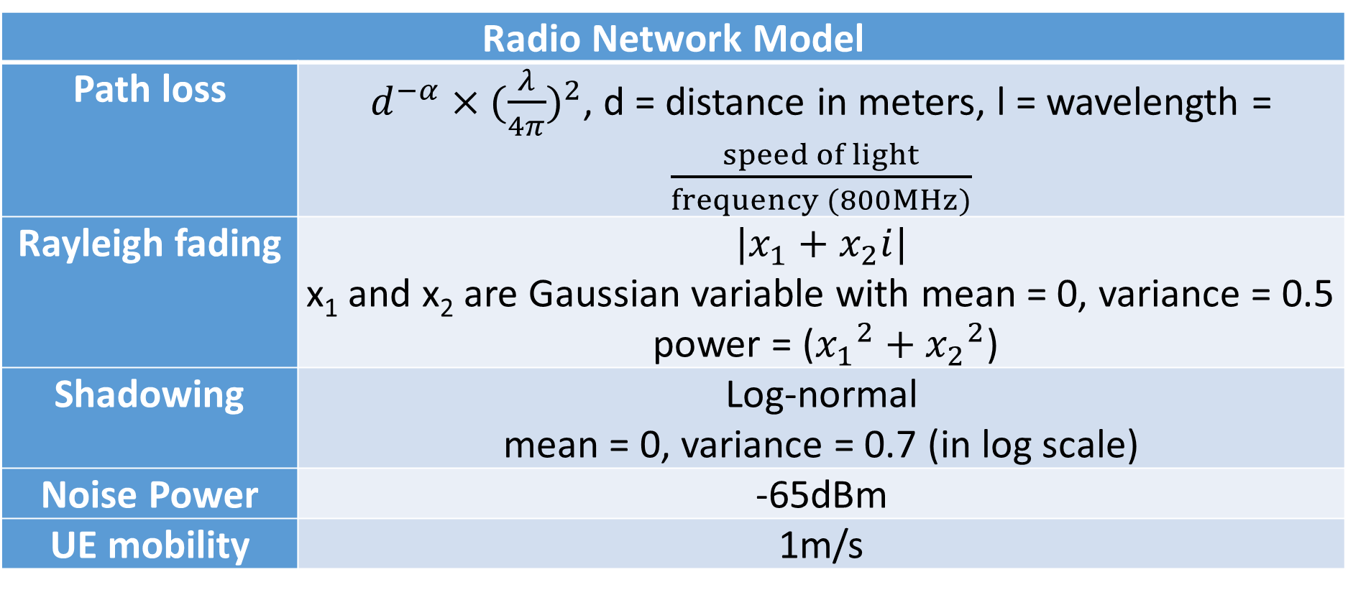
Simulation (Environment)
Radio Network Model
Path loss | $d^{−α}×{(\frac{λ}{4π})}^{2}$, d = distance in meters, l = wavelength = $\frac{speed of light}{frequency (800MHz)}$
Rayleigh fading | $$|x_{1}+x_{2}i|$$ x₁ and x₂ are Gaussian variable with mean = 0, variance = 0.5 power = (${x_{1}}^{2}+{x_{2}}^{2}$)
Shadowing | Log-normal mean = 0, variance = 0.7 (in log scale)
Noise Power | -65dBm
UE mobility | 1m/s
Notes:
UE如何移動

Slide 20

UE mobility
Each UE randomly changes direction every 10 seconds.
When a UE reaches the boundaries (50m or 500m), its changes direction by $\frac{1}{2}π$
The area

Slide 21
Simulation (Environment)
System Models
Bandwidth | 10MHz, 50 resource blocks
Base station transmit power | 46dBm
Antenna | 1 Tx, 1 Rx
MCS | QPSK, 16QAM, 64QAM, 256QAM
Simulation time | 60 seconds

Slide 22
Simulation (Parameter)
Performance Parameters
N | Number of total UEs
outage | Number of UEs that cannot decode packets

Slide 23
Simulation
We compare 1_FBC and 2_FBC with SC-PTM with no feedback.
We compare 1_FBC with 2_FBC to demonstrate the necessity of feedbacking both ACK and NAK rather than only NAK.
We use N = 36, 100, 300

Slide 24
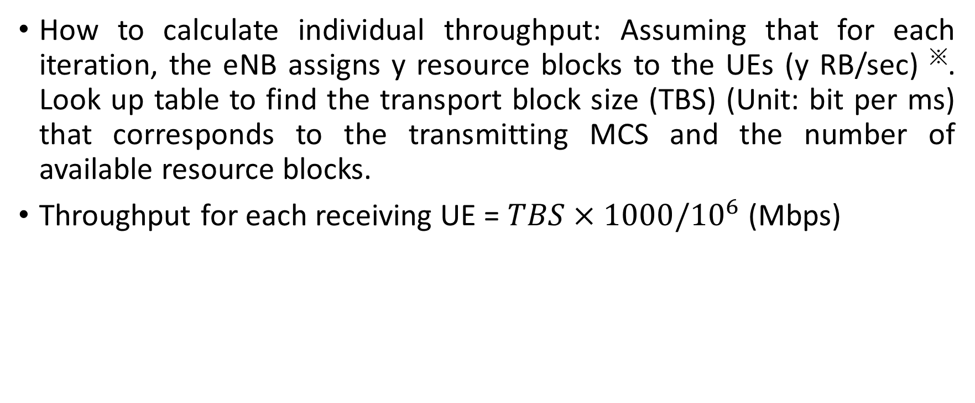
Simulation
How to calculate individual throughput: Assuming that for each iteration, the eNB assigns y resource blocks to the UEs (y RB/sec) ※. Look up table to find the transport block size (TBS) (Unit: bit per ms) that corresponds to the transmitting MCS and the number of available resource blocks.
Throughput for each receiving UE = $TBS×1000/{10}^{6}$ (Mbps)
Notes:
transmitting MCS and the number of resource blocks available

Slide 25
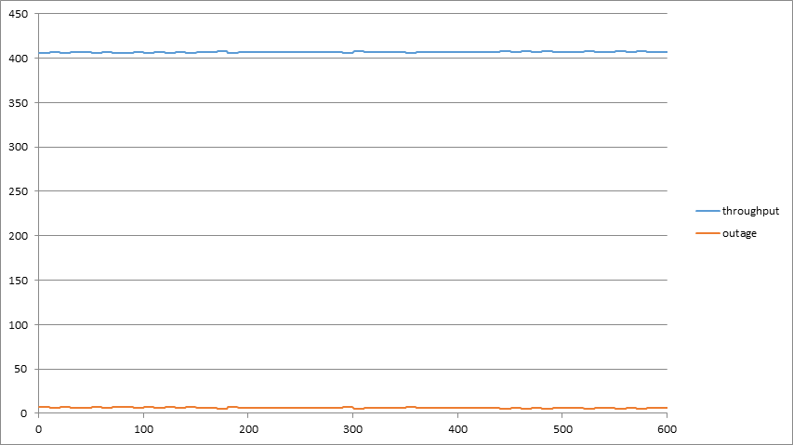
Simulation (SC-PTM with no feedback) n=300
The slight fluctuation of both the outage and the throughput reflect the movement of the UEs.
Throughput reflects the outage
Notes:
Symmetric bad

Slide 26
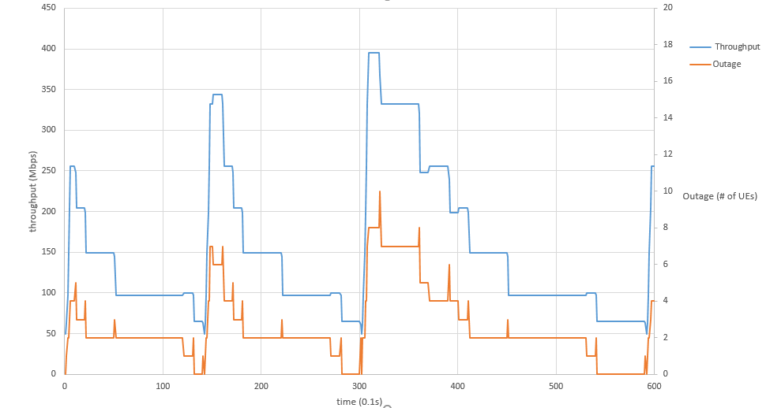
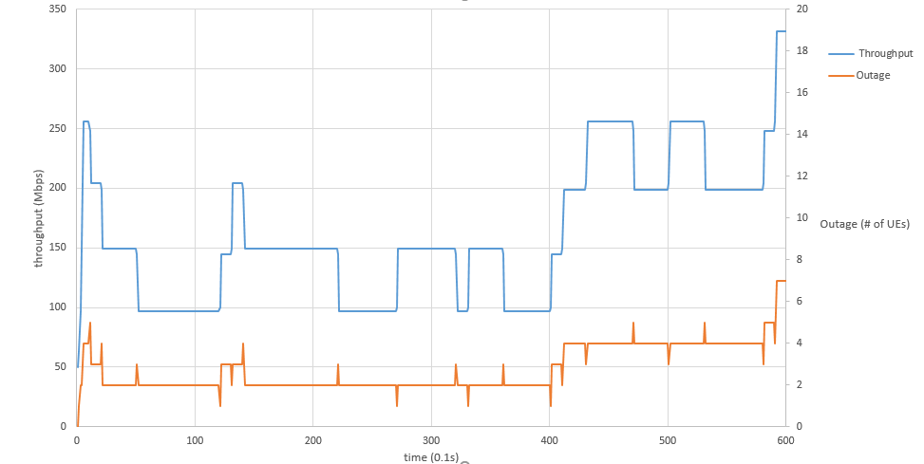
Comparison of 1_FBC and 2_FBC
N=36, g=4
Both 1_FBC and 2_FBC result in higher throughput than SC-PTM without feedback
The throughput of 2_FBC does not drop too much, and both throughput and the outage rate are more stable=> both ACK and NAK are necessary
Notes:
換圖

Slide 27
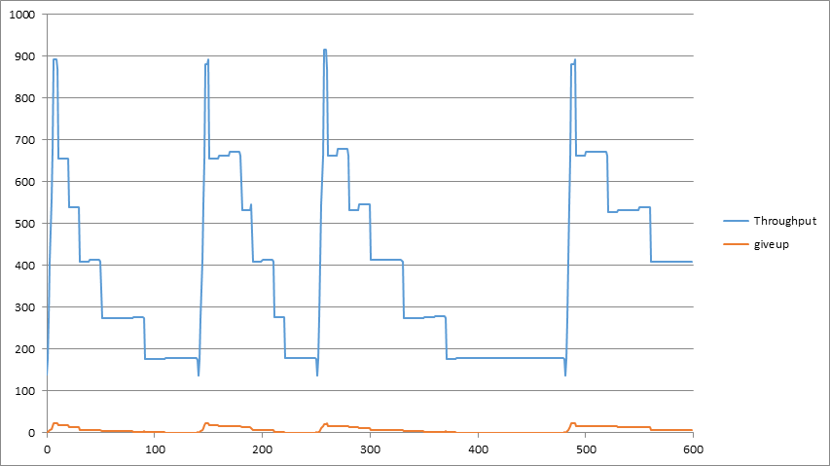
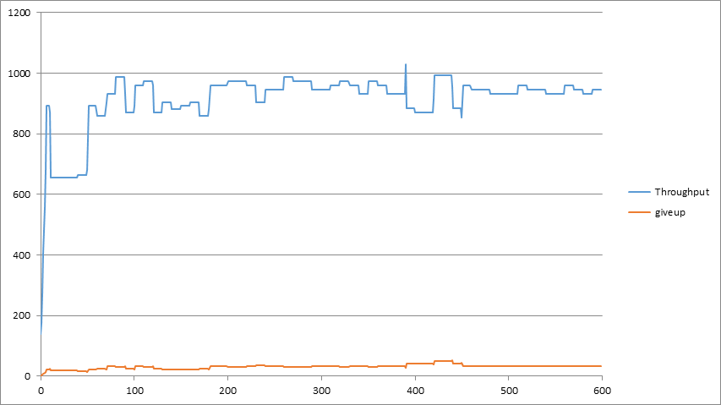
Comparison of 1_FBC and 2_FBC
N=100, g=6
Both 1 channel and 2 channels result in higher throughput than SC-PTM without feedback
2 channels is far more stable than 1 channel => both ACK and NAK are necessary
Notes:
換圖

Slide 28
Conclusion
2_FBC can reduce the amount of feedback UEs while maintaining a high total throughput.
2_FBC can be used regardless of the number of UEs.
The feedback mechanism uses very little resource because collision is allowed (Drawback: needs energy detector)

Slide 29
Future Work
Divide the UEs into different groups that receive different MCS.

Slide 30
Bibliography
[1] 3GPP TS 23.246 “Universal Mobile Telecommunications System (UMTS); LTE; Multimedia Broadcast/Multicast Service (MBMS); Architecture and functional description”.
[2] 3GPP TR 36.890 V13.0.0 (2015-06)
[3] Y. Cai et al., “Reduced Feedback Schemes for LTE MBMS,” VTC Spring 2009 - IEEE 69th Vehicular Technology Conference, Barcelona, 2009.
[4] R1-070674, “LTE physical layer framework for performance verification”, 3GPP TSG-RAN WG1 #48, St. Louis, USA, February 2007.
[5] Jeffrey G. Andrews, Arunabha Ghosh, and Rias Muhamed, “Fundamentals of WiMAX: Understanding Broadband Wireless Networking”, published by Pearson Education, Inc.
[6] 3GPP TR 36.824 V11.0.0 (2012-06)
[7] Simon R. Saunders and Alejandro AragÃ³n-Zavala, “Antennas and Propagation for Wireless Communication Systems 2nd Edition” published by WILEY.

