Slide 1
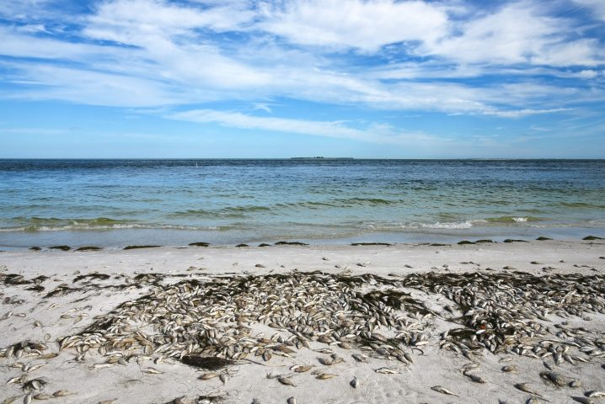
Identification and analysis of upwelling events in the Gulf of Mexico and their connection to K. brevis blooms on the West Florida shelf using remote sensing data.
Gustavo Rosas, Grace Markell

Slide 2
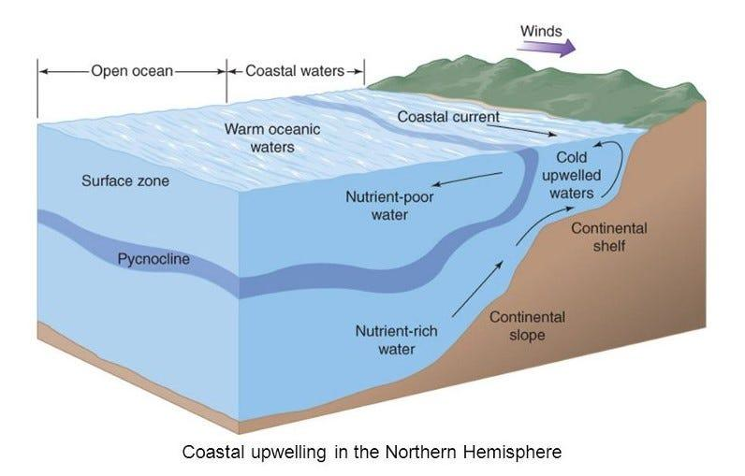
Introduction
Upwelling is the surfacing of nutrient-rich, deep ocean water that fertilizes the surface layer.
The nutrients that reach the surface via upwelling increase productivity along the continental shelf, which has been linked to K. brevis blooms (Red Tide).
Fig 1. Upwelling process (Gumustel, 2021).

Slide 3
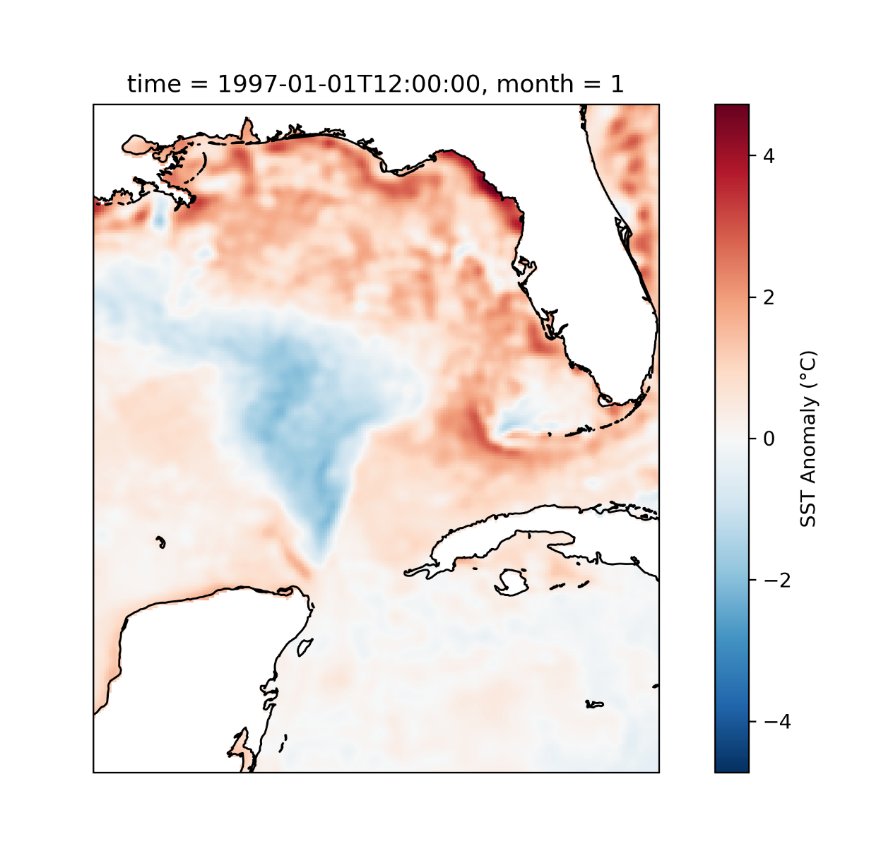
Objectives
Use sea surface temperature (SST) to identify upwelling events along the West Florida shelf from 1997 to 2011.
Compare with k. brevis concentrations to identify if there is correlation between the upwelling and red tide.
Fig 2. SST anomaly for January 1st, 1997.

Slide 4
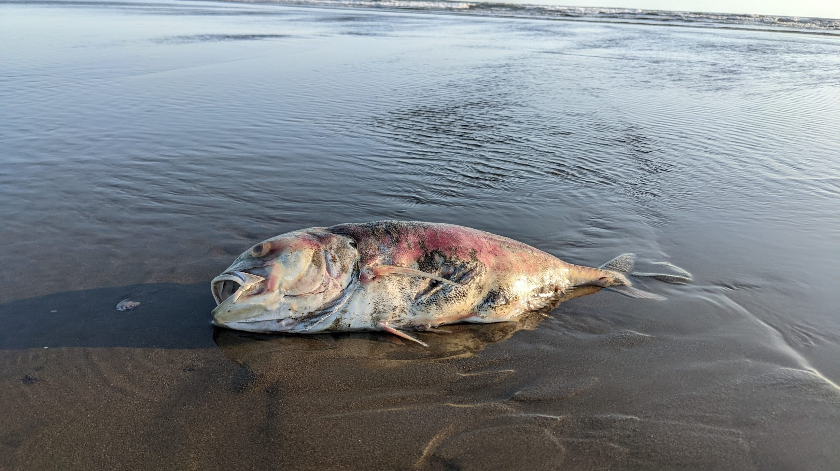
Importance
Identifying upwelling events off the West Florida shelf in relation to K. brevis blooms can be used to construct future predictive models in an effort to prepare for or prevent these harmful events from occurring.

Slide 5
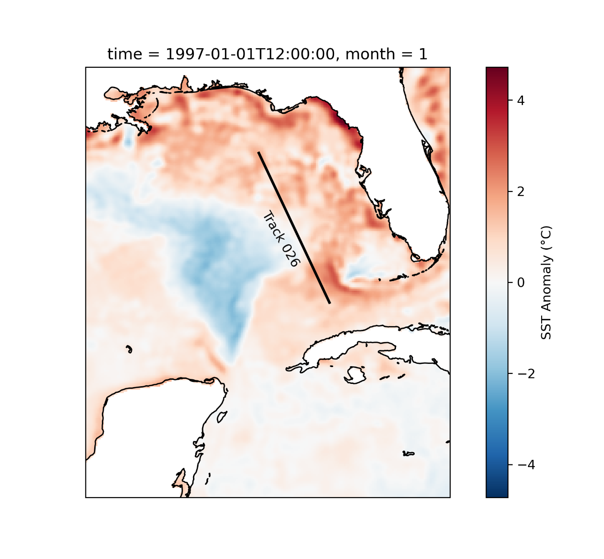
Methods
Copernicus dataset was processed via Xarray.
SST anomalies were found by calculating the monthly SST and subtracting it from the raw SST data, grouping by month.
SST anomaly data was organized by week and then extracted along a trackline (24 to 28 degrees N).
Fig 3. Trackline 026 shown from latitudes 24 to 28 deg N).

Slide 6
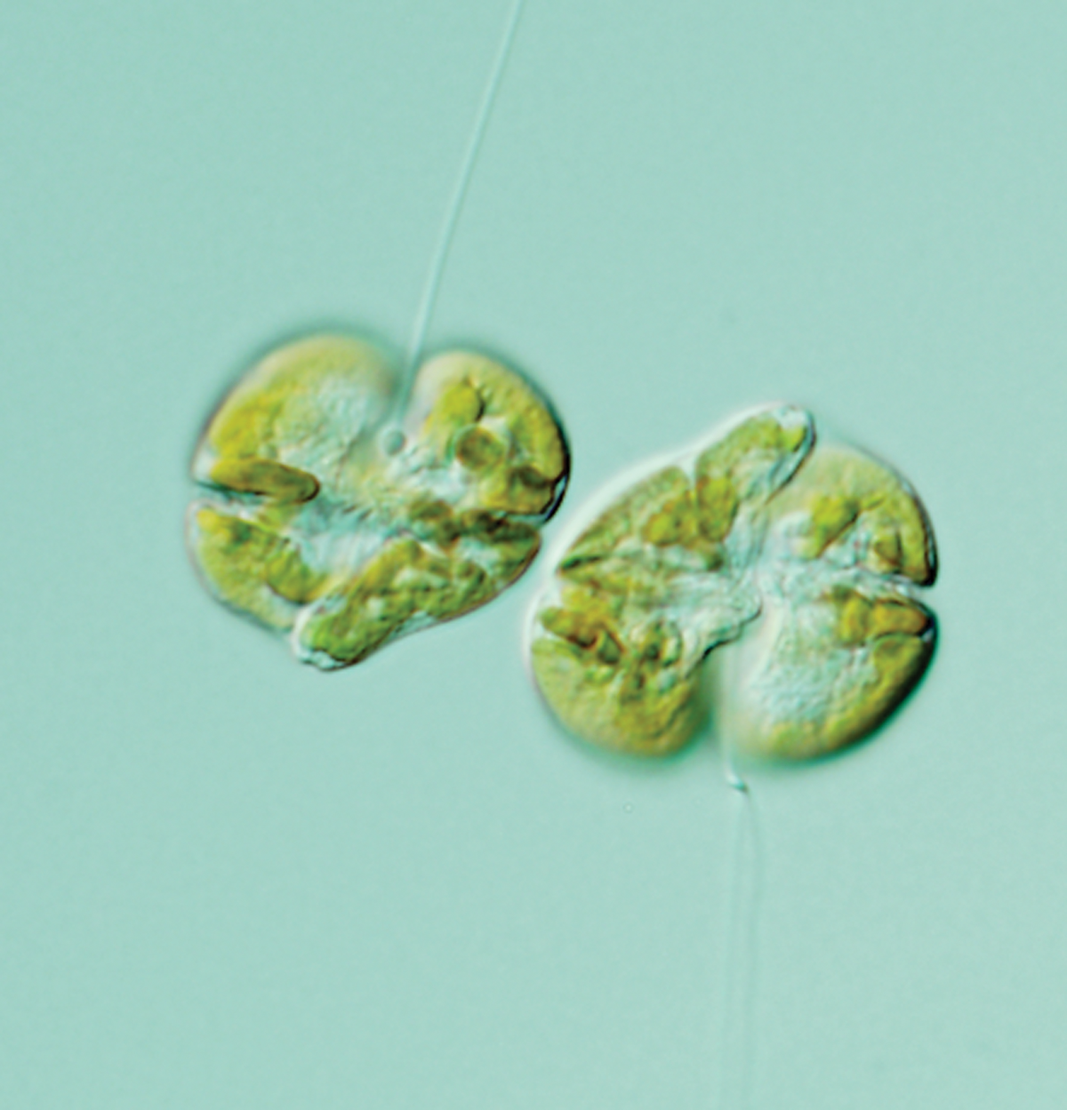
Methods
K. brevis cell count data for the Gulf of Mexico was downloaded from the National Centers for Environmental Information.
A mask of State ID was utilized to extract FL sites, and then another mask for extracting data from latitudes 26 to 28 degrees N.
Dataset was resampled to Weekly to compare to SST anomaly data.
Fig 4. K. brevis underneath a microscope (Grant, 2019).

Slide 7
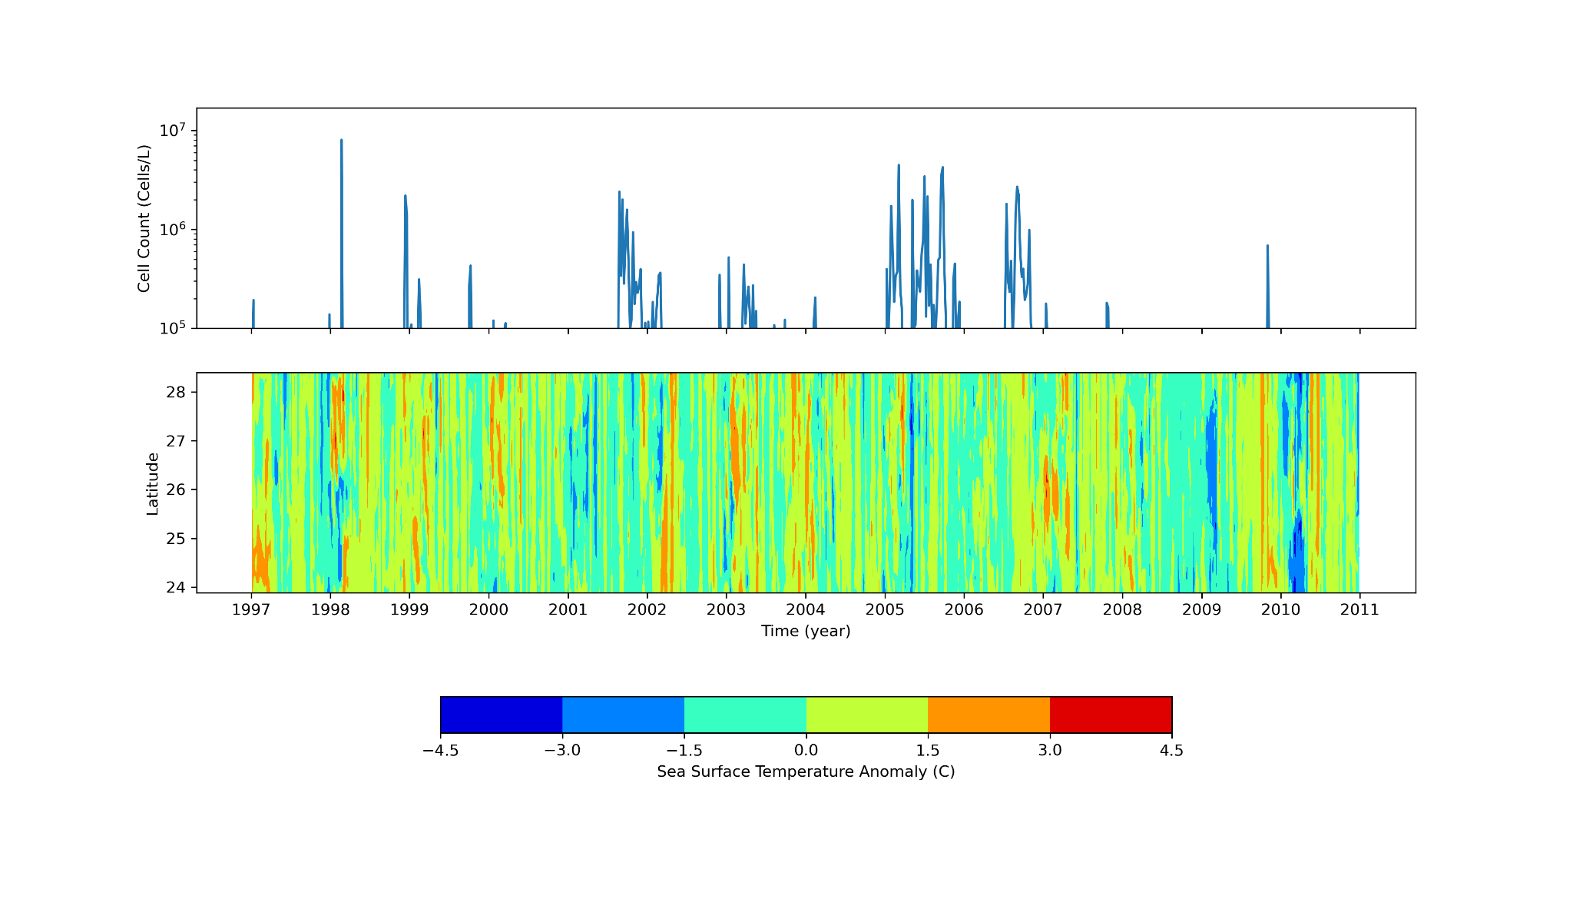
Fig 5. Mean K. brevis concentrations (cell count per L) per year are shown on top, and SST anomalies (Celsius) per year for each latitude are shown on bottom.

Slide 8
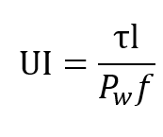
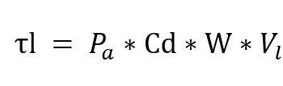
Upwelling Index (UI) Calculation
Derived from Jayaram & Jose, 2022

Slide 9
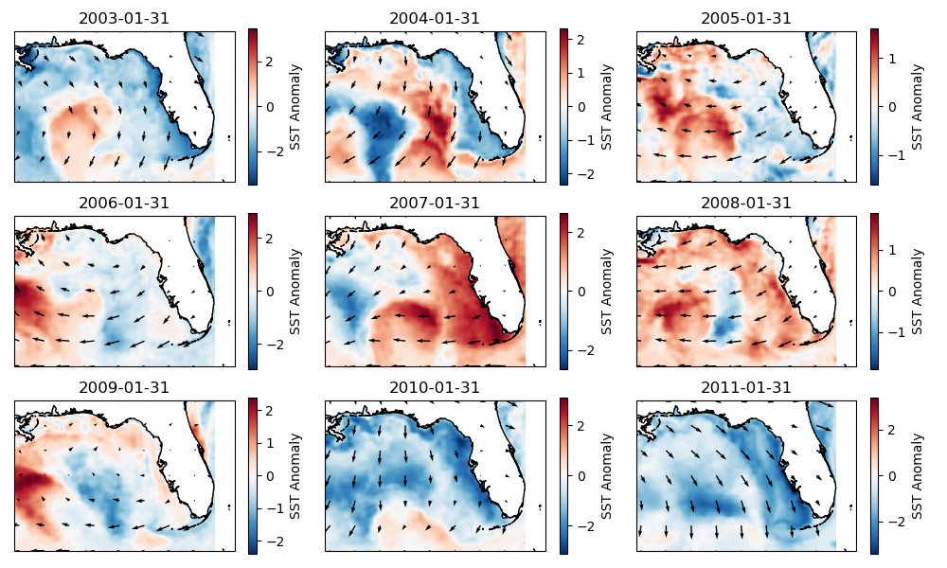

Slide 10
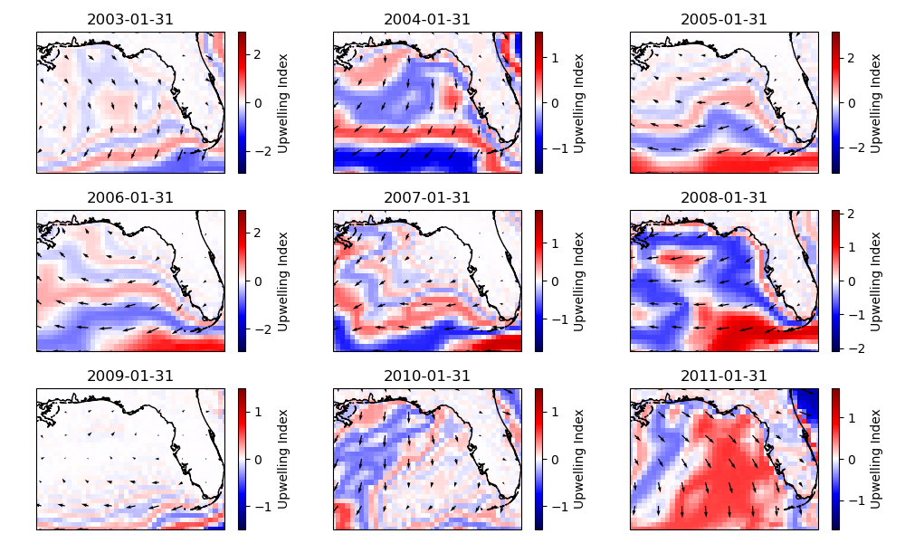

Slide 11
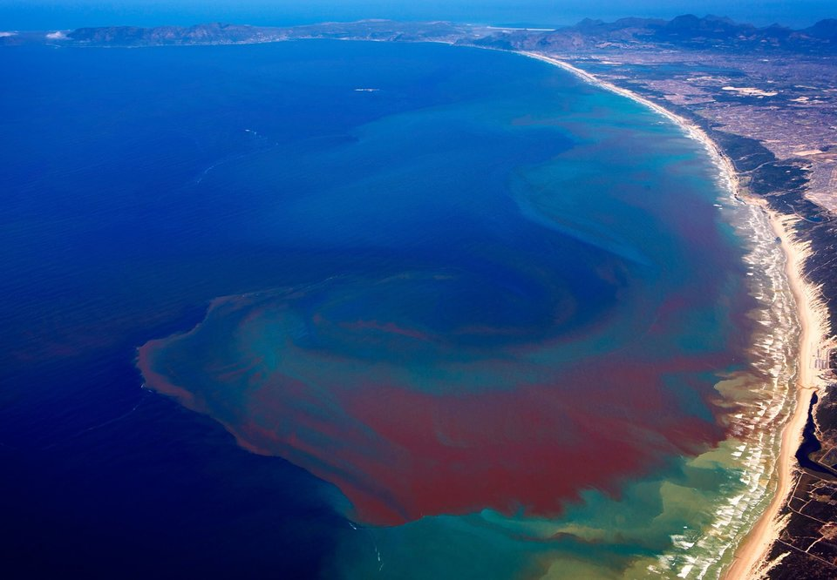
Conclusion
K. brevis cell counts were found to be their highest when upwelling was moderate, resulting in a low association between high upwelling and K. brevis. This does not support our initial hypothesis that higher upwelling would correlate to a higher K. brevis cell count, however our findings are supported by similar studies related to upwelling trends on K. brevis (Weisberg et al. 2014).

Slide 12
Works Cited
Grant, B. (2019, November). Red tides under the microscope. The Scientist Magazine®. https://www.the-scientist.com/red-tides-under-the-microscope-66606
Gumustel, D. (2021, June 1). Classifying coastal upwelling using environmental variables. Geek Culture. https://medium.com/geekculture/classifying-coastal-upwelling-using-environmental-variables-8e648d909170
Jayaram, Chiranjivi, and Felix Jose. “Relative Dominance of Wind Stress Curl and Ekman Transport on Coastal Upwelling During Summer Monsoon in the Southeastern Arabian Sea.” Continental Shelf Research, vol. 244, Elsevier BV, July 2022, p. 104782. Crossref, https://doi.org/10.1016/j.csr.2022.104782.
Weisberg, R. H., Zheng, L., Liu, Y., Lembke, C., Lenes, J. M., & Walsh, J. J. (2014). Why no red tide was observed on the West Florida Continental Shelf in 2010. Harmful Algae, 38, 119–126. https://doi.org/10.1016/j.hal.2014.04.010

