Slide 1

Age, Gender, Education, Industry & Industry Experience
A Quick Report on how Education and Experience Impact Salary

Slide 2
How do these areas impact overall salary?
Age: As individuals age, their salary will likely increase.
Industry Experience: The more experience someone has in a certain field, their salary will be higher.
Education: The more education received, the higher the salary.
Gender: Men are showing to be making more than women by a little over $6K
Industry: Based on the 4 industries (business, finance, healthcare, and technology) tech has the higher salary, then finance, business, and lastly healthcare.

Slide 3
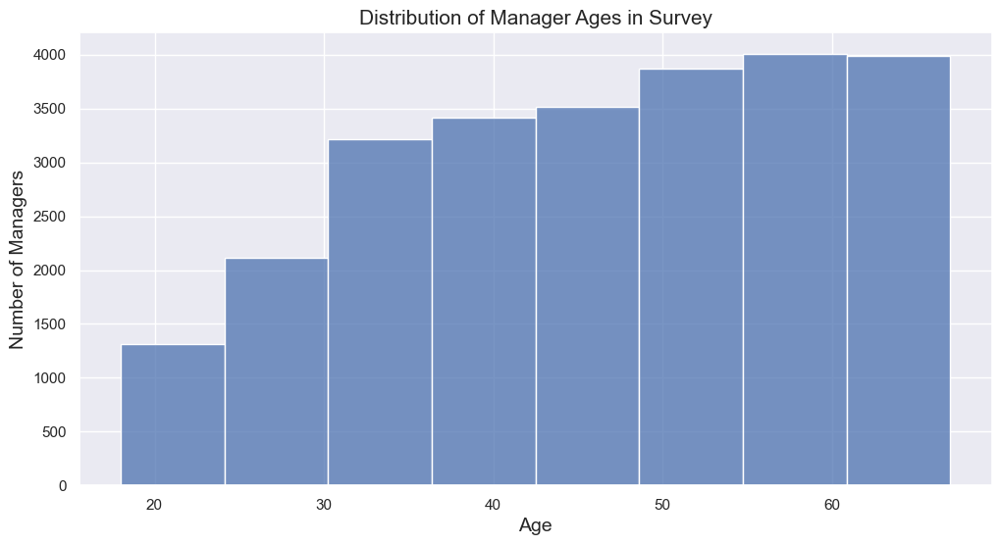
AGE: Showing number of Managers based on age-range

Slide 4
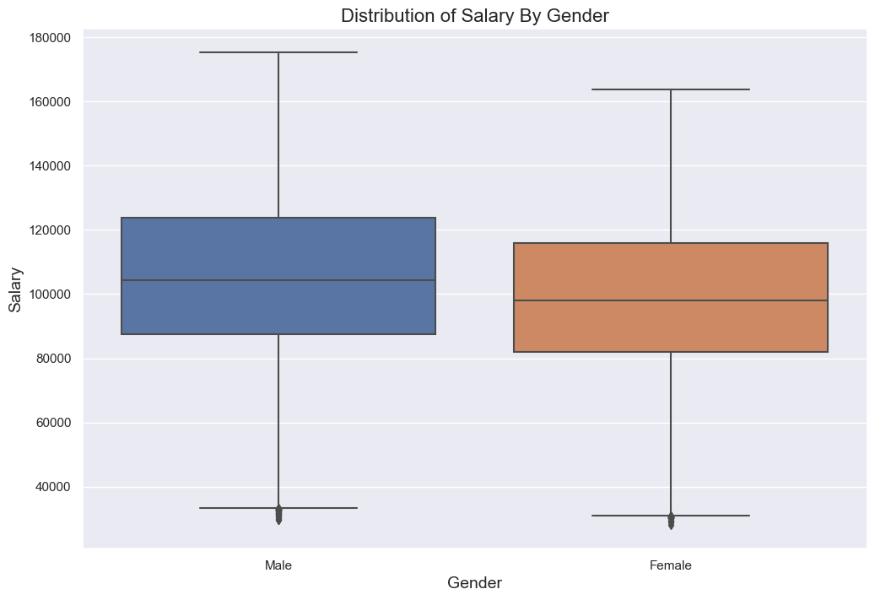
GENDER: Men vs. Women salary

Slide 5
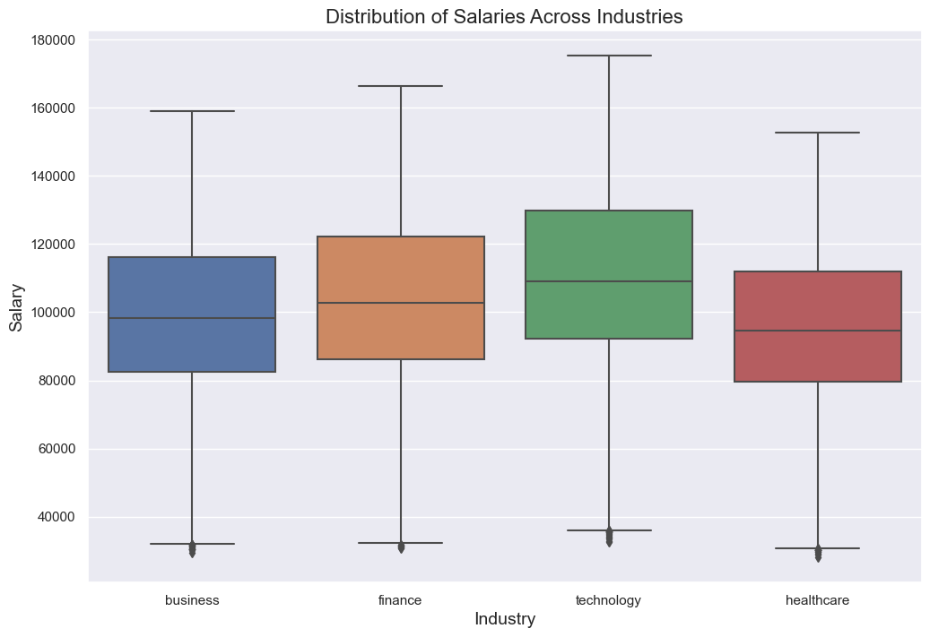
INDUSTRY: Showing salary based on the industry

