Slide 1
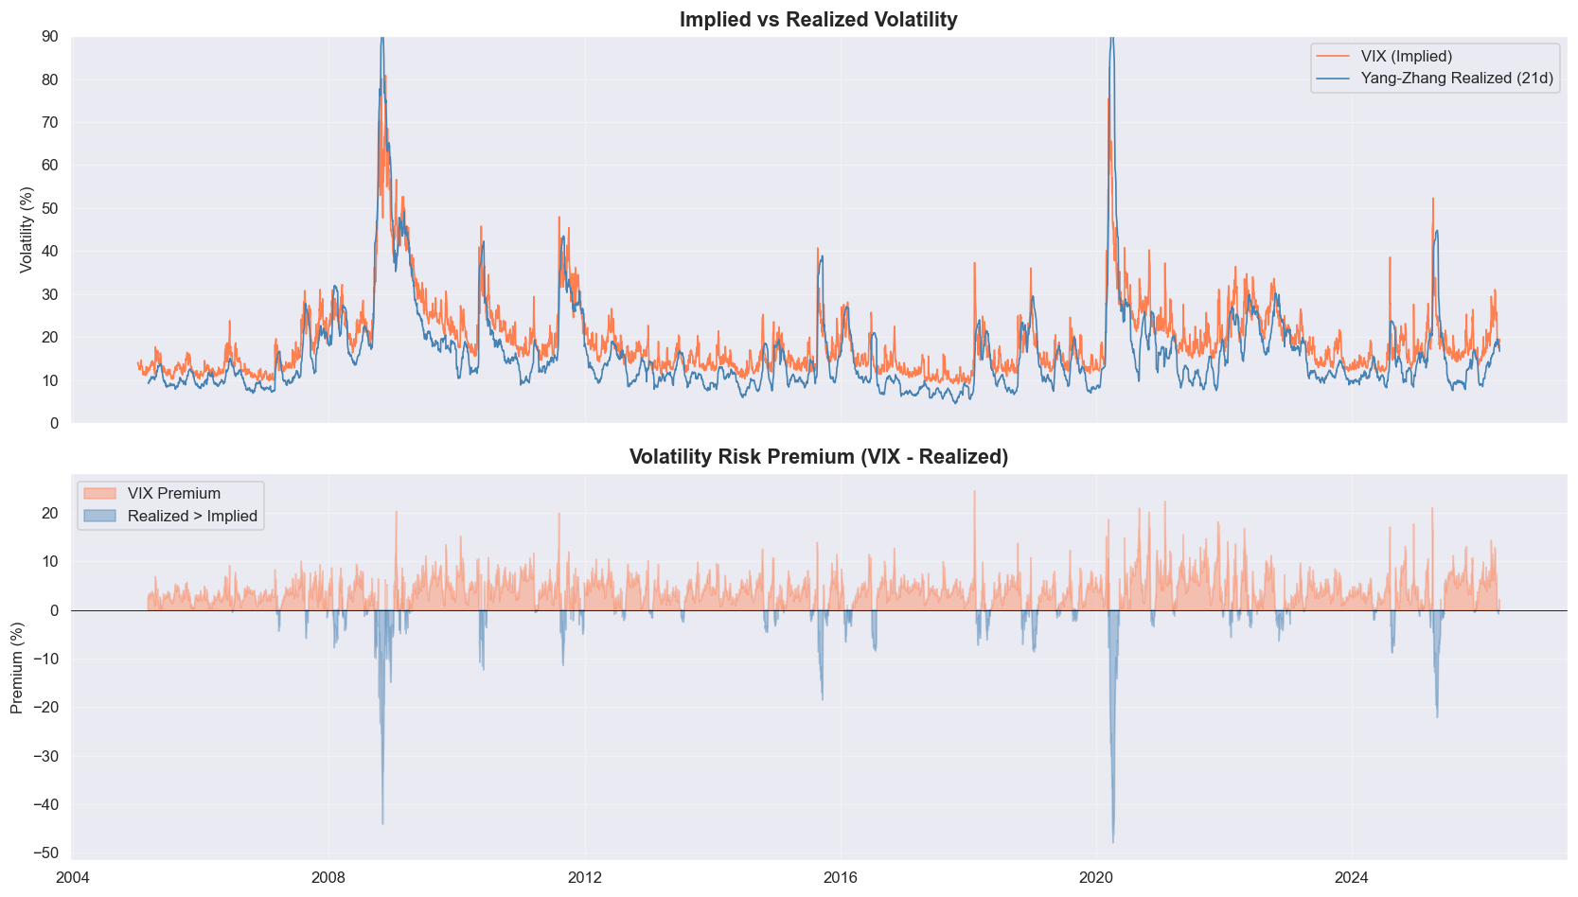
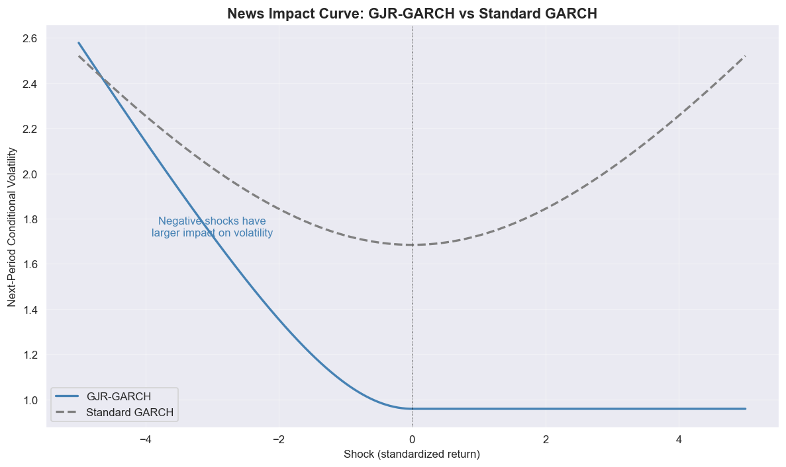
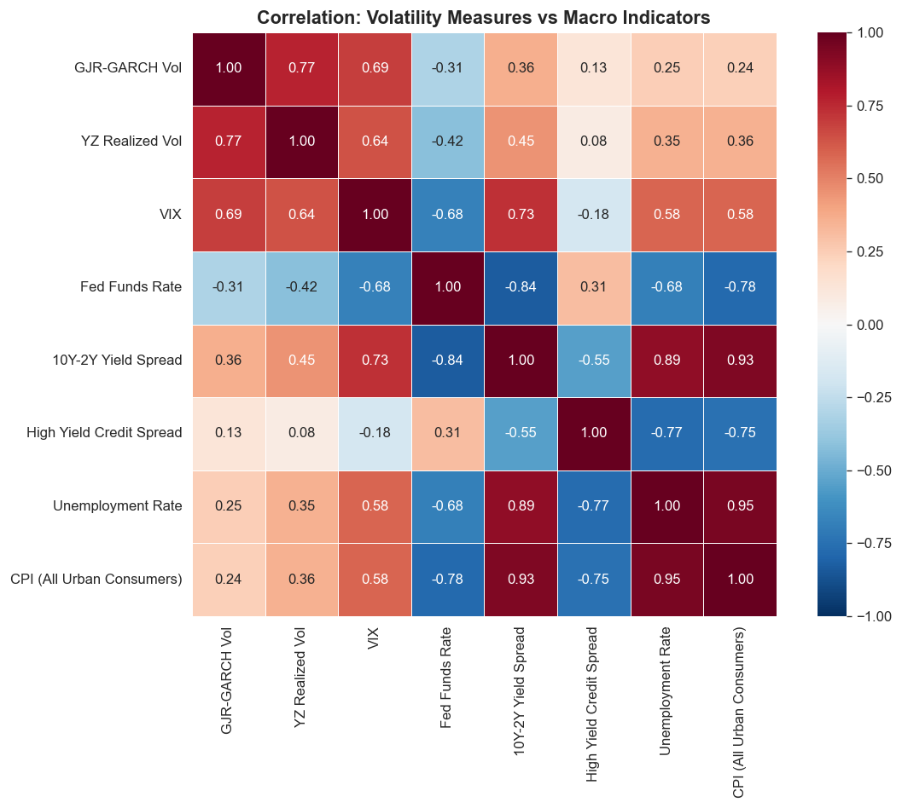
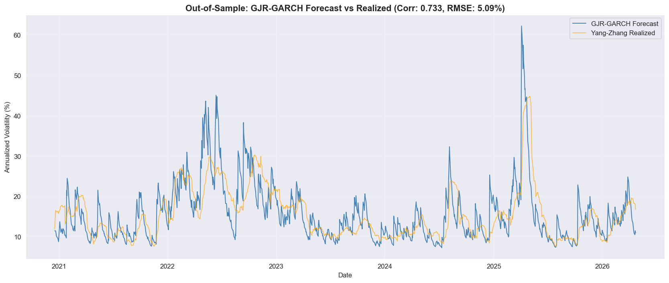
Volatility Modeling with GJR-GARCH, Yang–Zhang Estimation, and Macro Signals
Grace Yu | GTSF Investments Committee: Quant Sector Mentorship | April 2026
Implied vs Realized Vol
News Impact Curve
Macro Correlations
Out-of-Sample Forecast
Key Findings
One-Sided Leverage Effect
α ≈ 0 (positive shocks have zero impact), γ = 0.229 (negative shocks drive all volatility). Persistence = 0.979.
Volatility Risk Premium
VIX overestimates realized vol 84.6% of the time. Mean premium: 3.12%. Premium inverts during crises (2008, 2020).
Macro–Volatility Linkages
Fed funds rate negatively correlated with vol (ρ = −0.68). Credit spreads and unemployment rise with volatility regimes.
Out-of-Sample Performance
Forecast–realized correlation: 0.733. RMSE: 5.09%. Ljung–Box confirms model adequacy (all p > 0.05).
SPY OHLCV (2005–2026) · VIX · FRED Macro Data · Yang–Zhang Estimator · GJR-GARCH(1,1,1) with Student-t · AIC/BIC Model Selection

