Slide 1
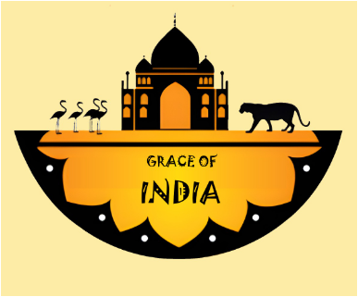
GRACE
OF
INDIA
Team Members:
Sneha Kaushik
Harsh Kumar
Ishita Jindal
Aditya Pandey
Surbhi
Isha
Team Name:
HACK O’ HOLIC

Slide 2
Objective:
To educate others about Rich Cultural Heritage & Traditions of India.
Technology Used:
HTML,CSS & Javascript
Organization:
AICTE, MIC-Student Innovation
FROM TEAM:-
HACK O’ HOLIC
Problem statement:
Ideas that shows the Rich Cultural Heritage & Traditions of India.
Category:
Software
Psno:
SM945
Domain bucket:
Heritage and Culture

Slide 3
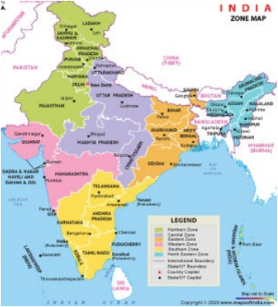

DIVISIONS OF INDIA INTO 6 PARTS ^=^
North India
South India
West India
East India
Central India
North-eastern India

Slide 4
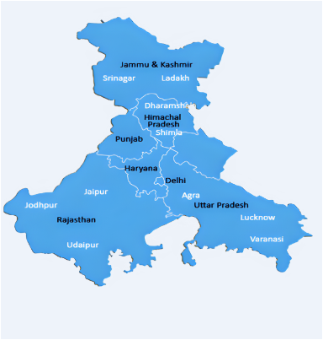
NORTH INDIA:
The northern part of India is referred to as North India, which is a loosely defined region. The Indus-Gangetic Plain and the Himalayas, which separate North India from the Tibetan Plateau and Central Asia, are the region's most prominent geographical characteristics.
It consists of states such as Himachal Pradesh, Punjab, Haryana, Rajasthan, Uttar Pradesh, Uttarakhand and union territories such as Jammu & Kashmir, Delhi, Chandigarh.

Slide 5
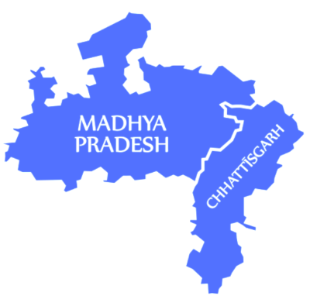
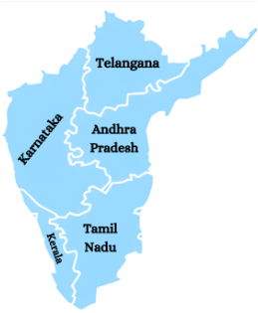
South India is a region consisting of the southern part of India, which encompasses the Indian states of Andhra Pradesh, Karnataka,
Kerala, Tamil Nadu, and
Telangana, as well as the
union territories of
Lakshadweep and
Puducherry.
SOUTH INDIA:
CENTRAL INDIA:
There is such no explanation for
central india it just consists of two states such as Madhya Pradesh & Chattisgarh.

Slide 6
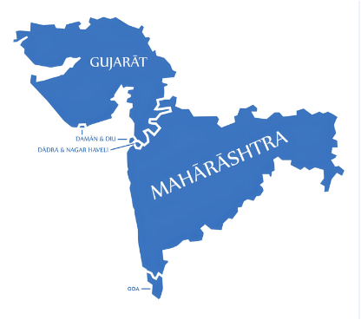
WEST INDIA:
Western India is a loosely defined region of India that encompasses the country's western regions. The states of Goa, Gujarat, and Maharashtra, as well as the Union territories of Dadra and Nagar Haveli and Daman and Diu.
They are included in the Ministry of Home Affairs' Western Zonal Council Administrative division, whereas the Ministry of Culture and certain historians include the state of Rajasthan. Maharashtra is included in the Geological Survey of India, but Rajasthan is not, and the Ministry of Minority Affairs includes Karnataka but not Rajasthan.

Slide 7
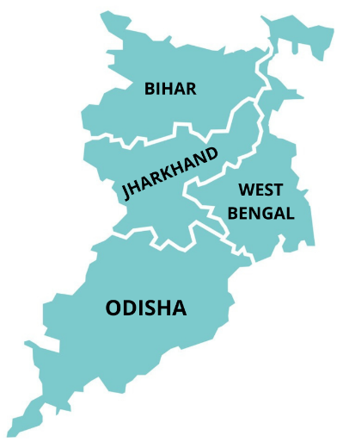
EAST INDIA:
The Indian states of Bihar, Jharkhand, Odisha, and West Bengal, as well as the union territory of the Andaman and Nicobar Islands, make up East India. The region approximately corresponds to the historical Magadha region, from which it derives its Eastern Indo-Aryan languages.
adavu, in

Slide 8
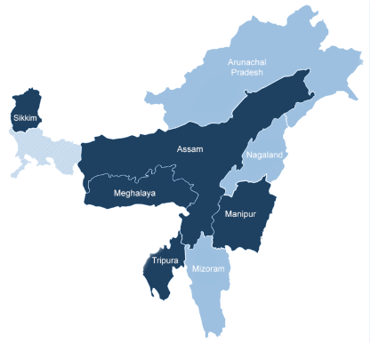
NORTH-EASTERN INDIA:
Northeast India is the country's easternmost region, and it serves as both a geographical and political administrative division. Arunachal Pradesh, Assam, Manipur, Meghalaya, Mizoram, Nagaland, Tripura, and Sikkim are the eight states that make up the region.
The region shares a 5,182 km (3,220 mi) international border (roughly 99 percent of its total geographical boundary) with several neighbouring countries: 1,395 km (867 mi) with Tibet Autonomous Region of China in the north, 1,640 km (1,020 mi) with Myanmar in the east, 1,596 km (992 mi) with Bangladesh in the south-west, 97 km (60 mi) with Nepal in the west, and 455 km (283 mi) with Bhutan in the north-west. It covers 262,230 square kilometres (101,250 square miles), or over 8% of India's total land area.
RDC.

Slide 9
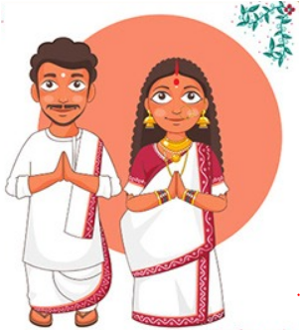
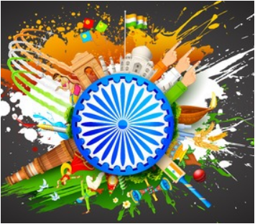
SUB CATEGORIES OF STATE-WISE DIVISIONS:
Languages
Clothes
Foods
Monuments
Artifacts
Paintings
Scientific Reasons
Economically benefits
History
Dance Forms
Music
Folklore

Slide 10
Purchase of Clothes/Artifacts/Paintings :D
Booking tickets for visiting Monuments/Landscapes :-}
MATERIALS WHICH WILL BE PROVIDED BY US ARE AS FOLLOWS:
Suggestions of places for celebrating festivals :)
Providing tutorials/ language agents for learning different languages of India :-]
Knowledge about Indian Heritage & Culture with fun ;)

Slide 11
Tourism will be increased in the local areas.
Local Venders/Small Businesses will have a platform to sell their product globally.
BENEFITS OF THE WEBSITE:
GRACE OF INDIA
Educate others about Indians cultures and traditions which are less famous worldwide.
Employment opportunities will be created.

Slide 12
BUSINESS MODEL:
THANK YOU :)
Buying Model
Selling Model

