Slide 1
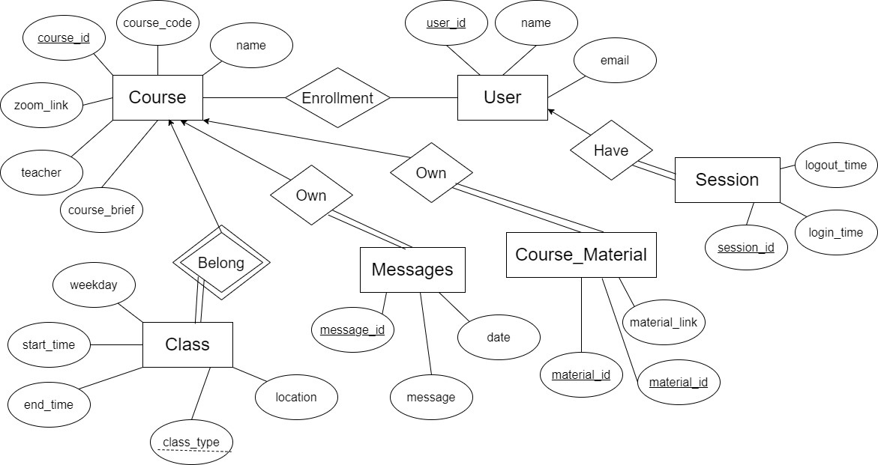
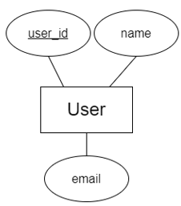
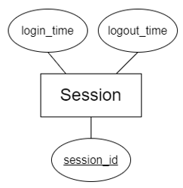
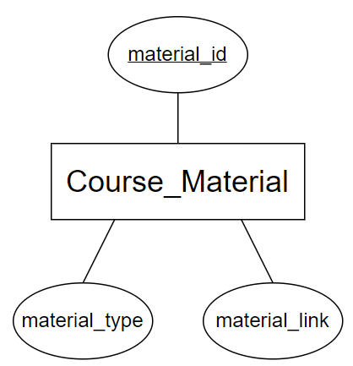
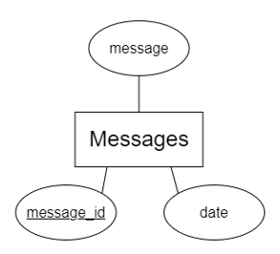
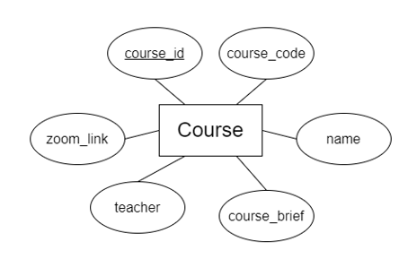
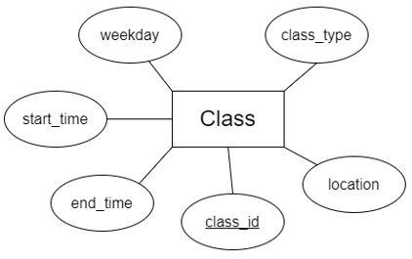
Data Implementation and Design
COMP3278 Group 2
Course_material(material_id, course_id, material_type, material_link)
Foreign keys: course_id refers Course
Class(course_id, class_type, location, start_time, end_time, weekday)
Foreign keys: course_id refers Course
Session(session_id, user_id, login_time, logout_time)
Foreign key: user_id refers Users
Messages(message_id, course_id, message, date)
Foreign keys: course_id refers Course
Course(course_id, course_code, name, zoom_link, teacher, course_brief)
User (user_id, name, email)
Chiu Yu Cheung 3035928964
Nip Hok Leung 3035957240
Nafis Ul Islam 3035835571
Sin Chung Hang 3035928067
So Ki Wai Grace 3035927116
Course_Material
Course
User
Class
Session
Messages

Slide 2
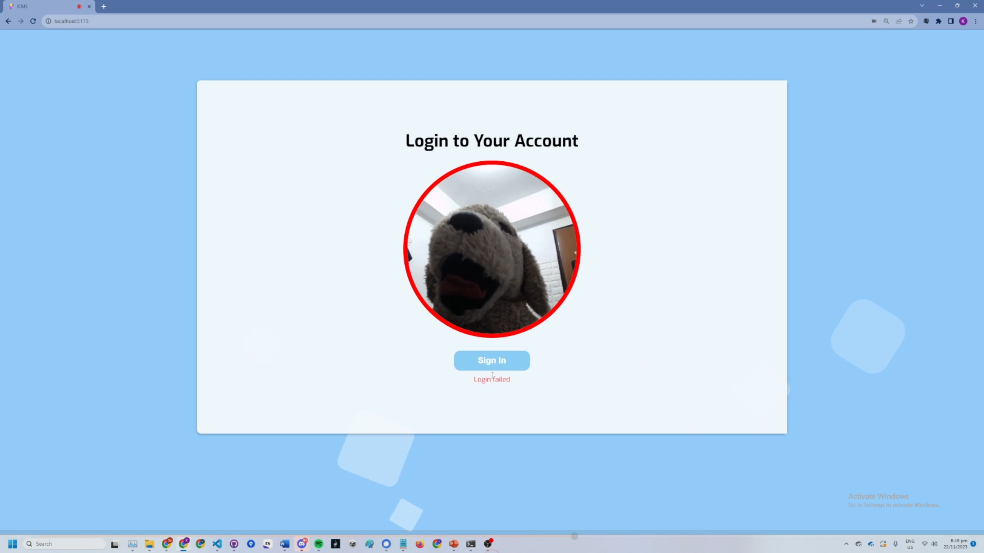
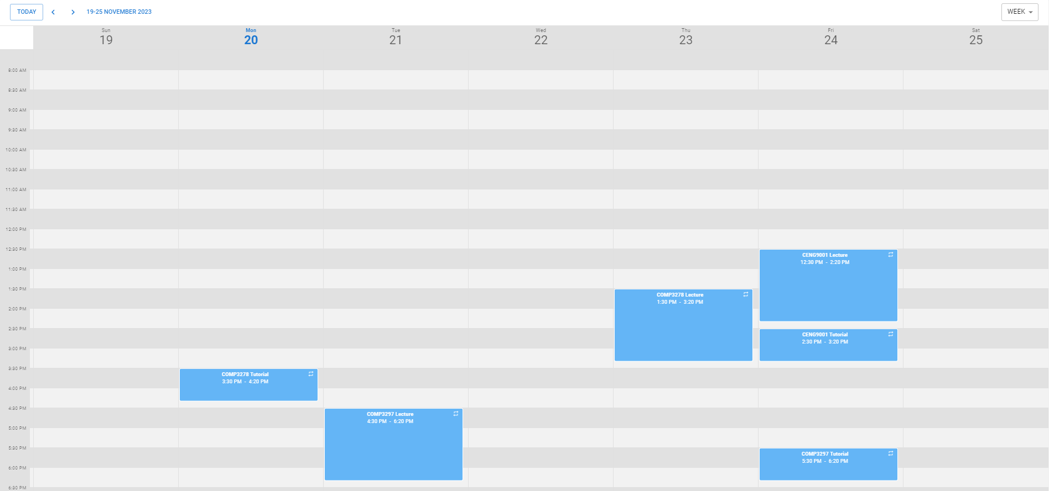
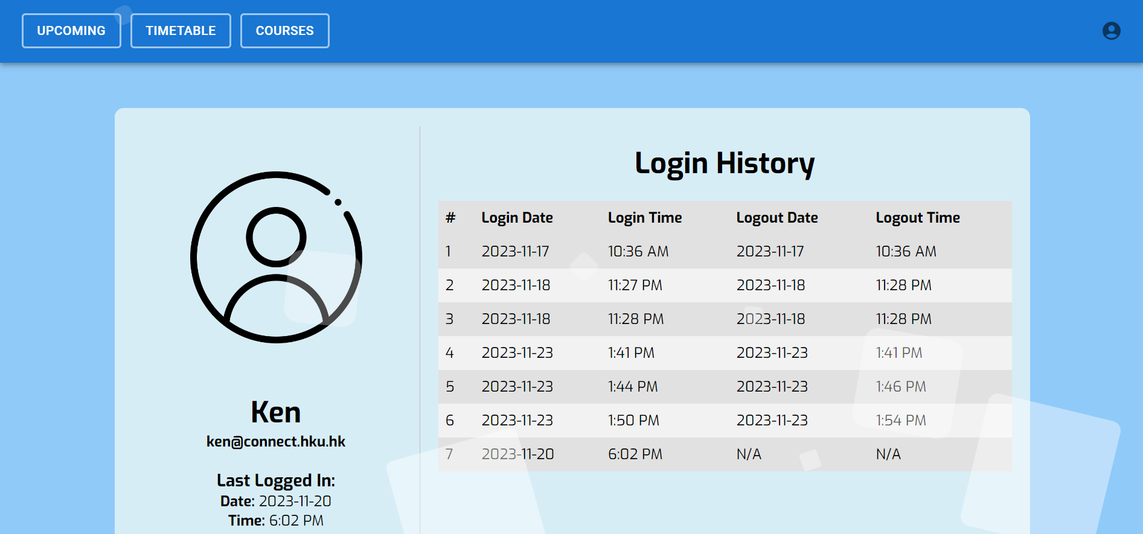
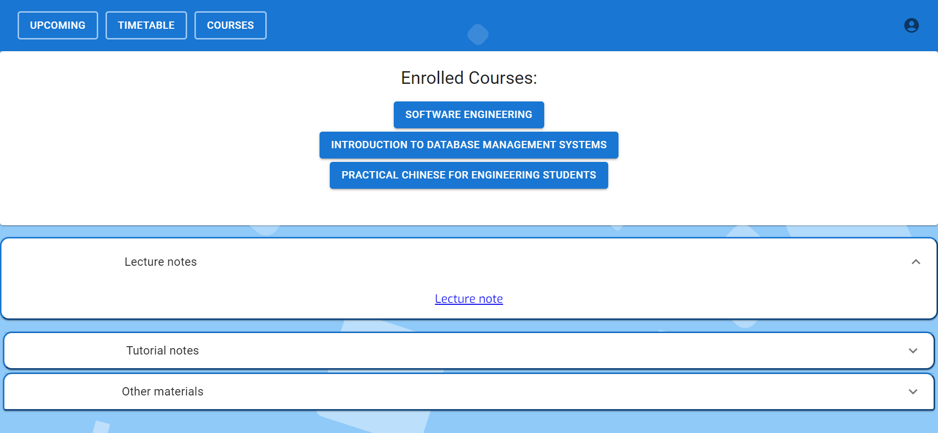
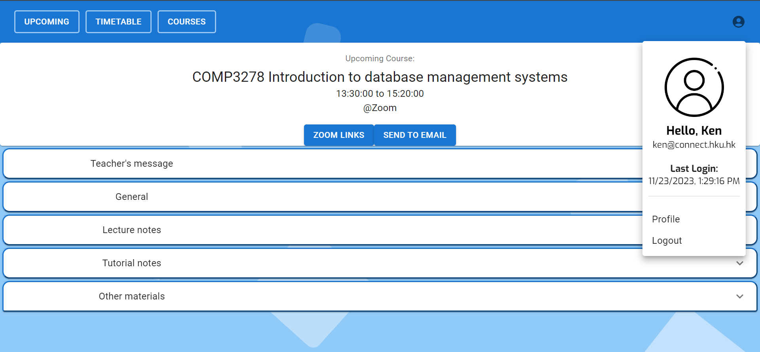
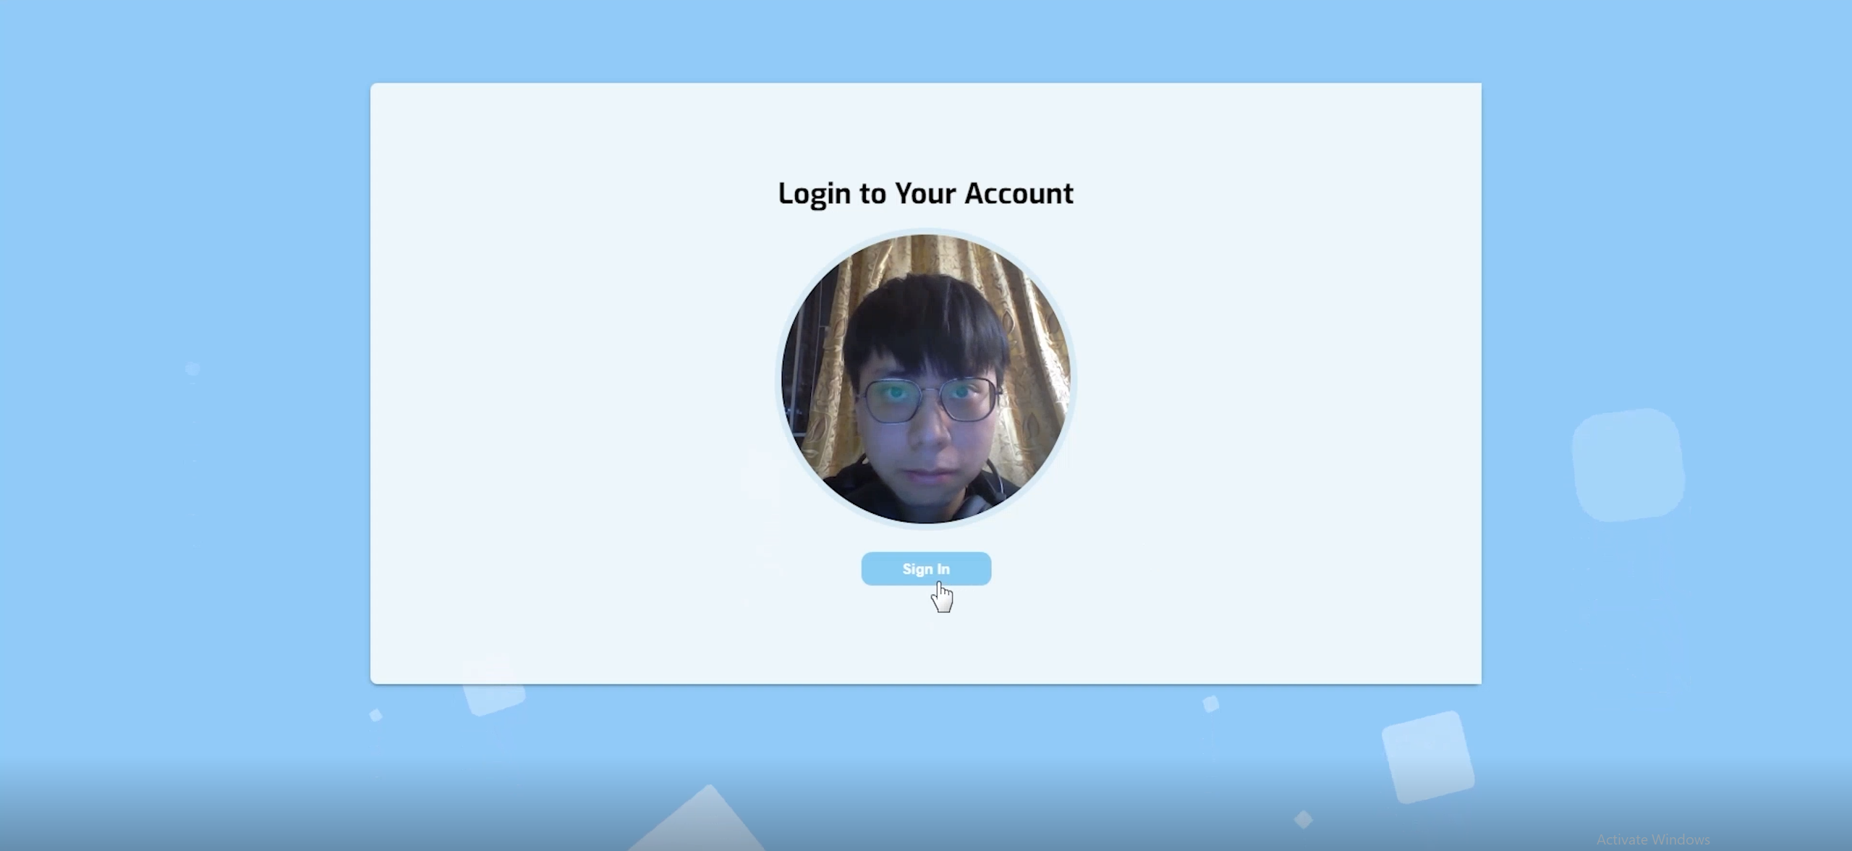
Application
Personal Timetable
Options: Day / Week
Navigation Methods
Today Button
Login
Facial login feature
Login
If there is no valid data of user in the database, access denied
Upon login
Display welcome message with name
Show email
Login time
Upcoming Course
Course Info
Location & Venue
Email Functionality
Courses Page
All Enrolled Course
Info on Selected Course
Profile Page
Previous Logins

Slide 3
Contribution
DEVELOPMENT PROCESS
Database
+
Video
Login feature
(face recognition)
+ Profile page
Frontend
+
Backend
Basic UI design
ER diagram 1st sketch
Decision of tech stack
Completed backend
Built database
Connected to frontend
05 Nov
18 Nov
Chiu Yu Cheung
Thank you!
Nip Hok Leung
Nafis Ul Islam
Backend
+
Database
Frontend
+
Presentation slides
25 Oct
14 Nov
Built frontend
Completed facial login
Completed profile
Added extra “enrolled courses” page
Sin Chung Hang
So Ki Wai Grace

