Slide 1
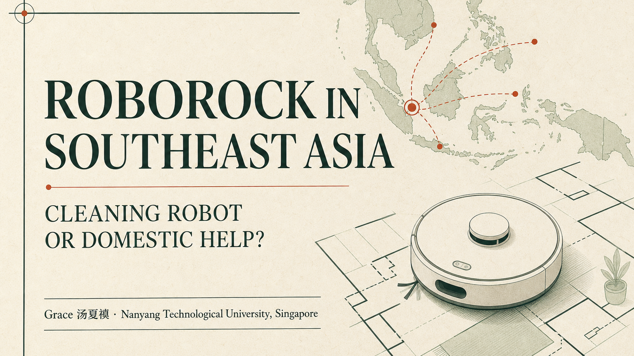
INDEPENDENT GTM RESEARCH · 2026
Roborock 如何打开 东南亚市场？
清洁机器人还是女佣雇佣
核心判断
不是替代女佣，而是每天维持干净。
Grace Tang
Nanyang Technological University, Singapore
AI-generated editorial illustration · not an official product image
Notes:
Cover image is AI-generated for this independent research project. It is not an official Roborock image or a real customer deployment.
[Sources]
AI-generated asset: portfolio-site/public/og.png
[/Sources]

Slide 2
01 HOUSEHOLD TRUTH
新加坡家庭仍需要人：机器人只覆盖“地面”这一层
~300K
人机任务分层
每日
机器人：灰尘、毛发、例行扫拖
外籍家庭佣工，2025
标准化 · 高频 · 可定时
双职工家庭与老人照护继续驱动需求。清洁只是女佣工作的一部分；照护、做饭、整理与判断无法被地面机器人替代。
每周
人工：厨房、浴室、边角、湿污
复杂 · 需要判断 · 不规则
长期
人：照护、烹饪、整理与家庭管理
1.49M
240
关系 · 责任 · 情境判断
居民家庭
HSS 公司
含义：不要卖“替代女佣”；要卖“每天都有干净地面”。
Sources: Singapore MOM (2026); SingStat households; research cut-off 25 Jul 2026
02
Notes:
MOM reported about 300,000 migrant domestic workers in 2025 and linked demand to elderly care and dual-income households.
SingStat reported 1.4871 million resident households in 2025. MOM reported the Household Services Scheme grew to around 240 companies.
[Sources]
https://www.mom.gov.sg/newsroom/speeches/2026/0113-response-to-adj-motion-on-mdws
https://www.mom.gov.sg/faq/work-permit-for-foreign-worker/what-is-household-services-scheme
https://www.singstat.gov.sg/publications/reference/ebook/households/households
[/Sources]

Slide 3
02 POSITIONING
最强答案不是二选一，而是两种“机器人＋人”组合
A
有住家女佣的家庭
B
没有住家女佣的家庭
机器人
承包每日重复扫拖
机器人
每天维持地面基线
女佣
转向照护、做饭、整理与深清
钟点工
每周 / 双周 / 每月深度清洁
销售语言
少做重复事，把时间留给更重要的人和任务。
销售语言
不增加同住人员，也能减少两次人工清洁之间的灰尘与毛发。
ROBOT × DAILY + HELPER × HIGH-VALUE
ROBOT × DAILY + HUMAN × PERIODIC
Roborock 的品类定义：不是“自动家政”，而是“每日地面维护系统”。
Sources: MOM HSS; Reddit r/askSingapore (qualitative only); author synthesis
03
Notes:
The two operating models are author synthesis. Reddit examples indicate some Singapore households combine daily robot cleaning with periodic human deep cleaning; they are qualitative, not representative.
[Sources]
https://www.mom.gov.sg/faq/work-permit-for-foreign-worker/what-is-household-services-scheme
https://www.reddit.com/r/askSingapore/comments/1foz7te/
https://www.reddit.com/r/askSingapore/comments/1gt649h/
[/Sources]

Slide 4
03 PRODUCT–VALUE LADDER
不要堆参数：用 Q7、Qrevo、Saros 回答三种购买任务
价格 / 配置
产品角色
可见功能
消费者价值
Q7
基础导航、扫拖与日程
让入门简单 适合小户型 / 次要空间
S$220–430*
→
第一次买机器人
Qrevo
多功能基站 更完整的自动维护
少操心的每日清洁 价格与自动化更平衡
S$600–1,150*
→
主流家庭的量级英雄
Saros
7.98 cm · 36,000 Pa 越障与障碍处理
减少救援时刻 适合低家具 / 混合地面
S$1,550–1,900*
→
高端能力与品牌锚点
*促销快照，随活动与配置变化。不要把旗舰卖给所有人：Qrevo 应是主销，Saros 建立高端势能，Q7 扩大入口。
Source: Roborock Singapore official store, price snapshot 25 Jul 2026
04
Notes:
Indicative promotional prices observed on the Roborock Singapore official store on 25 July 2026; prices and configurations change by campaign.
Saros 20 official claims include 36,000 Pa suction, 7.98 cm body height and threshold-handling features. Product-to-value translations and portfolio roles are author recommendations.
[Sources]
https://www.roborock.sg/collections/roborock-robotic
https://www.roborock.sg/collections/qrevo
https://www.roborock.sg/collections/saros
https://www.roborock.sg/products/roborock-saros-20
[/Sources]

Slide 5
04 COMPETITION
参数正在趋同；Roborock 应把“可靠的每日清洁”变成心智
旗舰价与卖点均为当前官网/官方店快照；不同品牌口径不可直接横比。
品牌 / 旗舰 | SG 价格快照 | 消费者心智 | 最强卖点 | Roborock 的应对
Roborock Saros 20 | S$1.55K–1.90K | 系统体验 + 宽价格梯度 | 导航、低机身、产品梯度、本地服务 | 占领“可靠的每日清洁”
Dreame X60 Ultra | ~S$1.70K | 旗舰创新 + 促销 | 36,000 Pa、低机身、越障与 100°C 基站 | 用真实房型证明，化解参数战
Ecovacs X11 OmniCyclone | ~S$1.40K | 功能丰富 + 性价比 | 滚筒拖布、无尘袋、AI 污渍与折扣 | 强调全周期便利，不打裸价战
Narwal Flow 2 | ~S$2.00K | 高端拖地 + AI | 拖地、卫生叙事、AI 视觉与设计 | 放大导航稳定性与售后可见度
赢法
房型问诊 + 真实家庭演示 + 诚实维护说明 + 本地维修
规格只是入场券
Sources: official Singapore brand/store pages, accessed 25 Jul 2026
05
Notes:
Prices are promotional snapshots, not permanent list prices. Roborock competitive positioning is author synthesis.
[Sources]
https://www.roborock.sg/collections/saros
https://dreame.sg/collections/robot-vacuum
https://dreame.sg/products/dreame-x60-ultra-master
https://www.ecovacs.com/sg/deebot-robotic-vacuum-cleaner/deebot-x11-omnicyclone
https://ecovacstineco.com.sg/products/ecovacs-deebot-x11-omnicyclone
https://sg.narwal.com/products/narwal-flow-2-robot-vacuum-mop
[/Sources]

Slide 6
05 CHANNELS, SERVICE & FAQ
新加坡高端定价的前提：在购买前后都让服务可见
01
02
03
04
发现
证明
成交
留存
DTC 内容 房型问诊
展厅 / 家庭演示 低家具与越障
官方店 / 平台 配置与套装
保修 / 维修 耗材 / 以旧换新
本地信任锚点：35 Tampines Street 92 服务中心 · 两年本地保修 · 安装、维修、延保与耗材入口
购买异议
“有女佣了，为什么还要买？”
“这么贵，不如多请几次钟点工。”
“最后还是要自己维护。”
少做每日重复扫拖；人继续负责照护与深清。
比较每日频次与随时启动；用三档产品匹配预算。
承认非零维护；明确污水、毛发、拖布和耗材节奏。
销售原则：承认边界，降低退货；用服务支撑溢价，而不是用“零维护”制造预期差。
Sources: Roborock SG official store/contact; author GTM recommendation
06
Notes:
Roborock Singapore lists a local service centre at 35 Tampines Street 92 and official store support including warranty, repair, installation, accessories, trade-in/refurbished and extended warranty options. Exact programme availability can change.
Channel journey and objection responses are author recommendations.
[Sources]
https://sg.roborock.com/pages/contact-us
https://www.roborock.sg/collections/show-lisitngs
https://www.roborock.sg/collections/accessories
[/Sources]

Slide 7
06 USE-CASE BLUEPRINT & 90-DAY TEST
一个可信的家庭案例：机器人管频次，人管复杂度
目标家庭
双职工夫妻 · 公寓 · 宠物 · 无住家女佣
10:00 DAILY
WEEKLY
MONTHLY
机器人扫拖
人工清洁
深清 / HSS
灰尘、毛发、日常地面
厨房、浴室、边角、湿污
全屋深度任务与整理
价值不是“少请一个人”，而是两次人工清洁之间，地面每天回到干净基线。
0–30 天
31–60 天
61–90 天
问诊脚本 + 展厅演示
真实家庭试用 + 异议内容
平台套装 + 服务证明
KPI：无救援完成率 · 退货原因 · 安装完成率 · 耗材附加率 · 服务响应
Source: Reddit SG household routines (qualitative only); proposed blueprint, not measured results
07
Notes:
This is a proposed use-case blueprint and test plan, not a measured customer outcome.
Reddit examples suggest some Singapore households use robots daily and retain weekly, fortnightly or monthly manual deep-cleaning. These comments are qualitative and not representative.
[Sources]
https://www.reddit.com/r/askSingapore/comments/1foz7te/
https://www.reddit.com/r/askSingapore/comments/1uihujj/
https://www.mom.gov.sg/faq/work-permit-for-foreign-worker/what-is-household-services-scheme
[/Sources]

Slide 8
07 SOUTHEAST ASIA GTM
先用新加坡证明高端信任，再按价格与渠道向区域扩张
01
02
03
新加坡
马来西亚 · 泰国
印尼 · 越南
PREMIUM PROOF
PARTNER-LED SCALE
PRICE-ACCESSIBLE GROWTH
Saros 建立高端锚点 Qrevo 主销 展厅 + 本地售后 + 案例
Qrevo 作为量级英雄 本地语言内容 平台大促 + 展厅伙伴
Q7 / Qrevo 入门 分期与平台转化 先建服务密度再冲销量
标准化信任：诚实说明边界 · 本地保修维修 · 耗材供应 · 家庭演示 · 真实口碑
给 Roborock 的四项建议
1 占领“每日干净基线”
2 Qrevo 主销，Saros 锚定
3 用服务证明高端溢价
4 渠道与价格按国家本地化
Source: Roborock APAC country presence; author market-entry recommendation
08
Notes:
Roborock lists official local country sites across Singapore, Malaysia, Indonesia, Thailand and Vietnam. The order, hero-product choices and market-entry actions are author recommendations, not official Roborock plans.
[Sources]
https://sg.roborock.com/pages/switch-country
https://sg.roborock.com/pages/about-us
[/Sources]

