Slide 1
Detecting Heavy Drinking with Smartphone Accelerometers
Grace Tang
Springboard DSC - Capstone 2

Slide 2
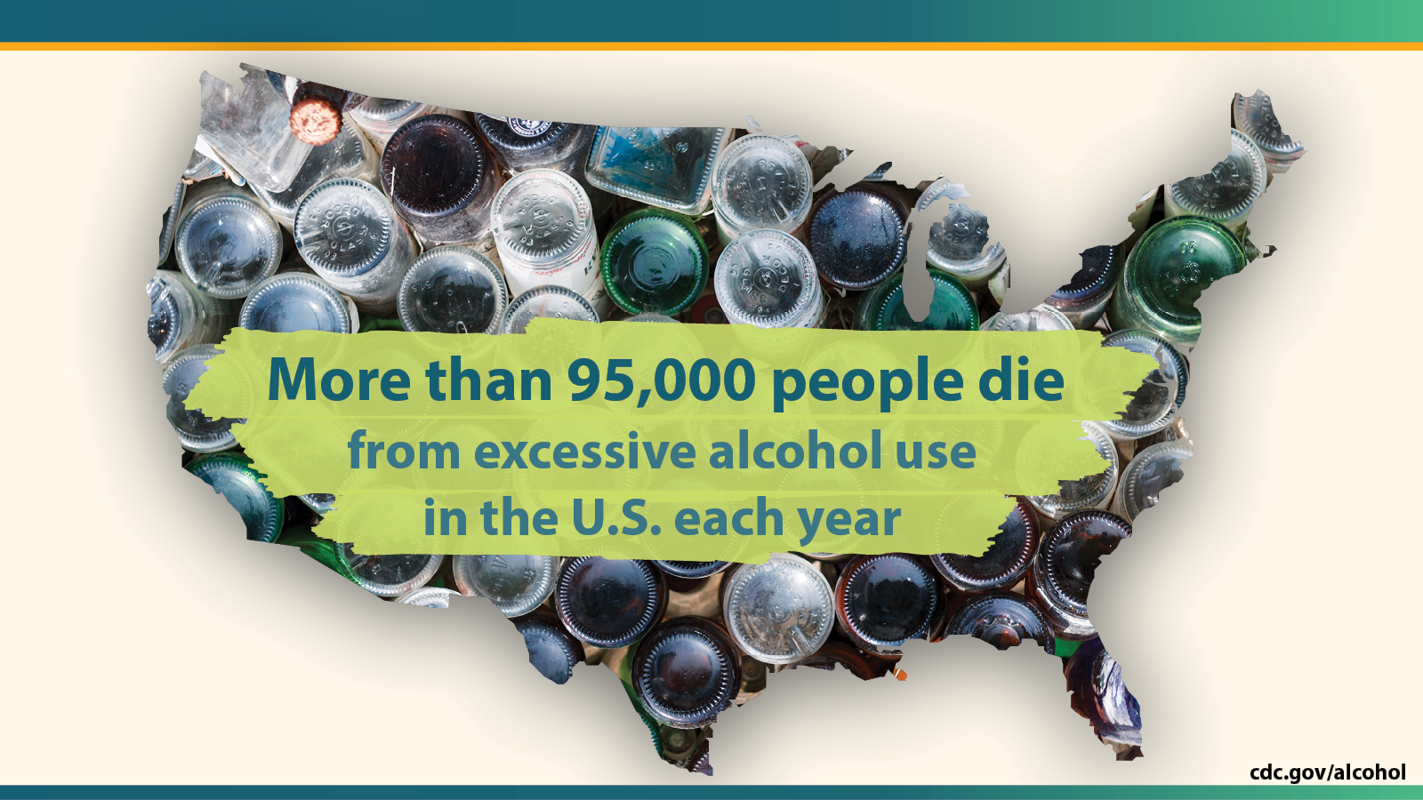
The Problem with Alcohol
Notes:
According to the CDC, Excessive alcohol use is responsible for more than 95,000 deaths in the United States each year, or 261 deaths per day.
Alcohol is 3rd leading preventable cause of death. Preceded by tobacco (first leading preventable cause) and poor diet and physical inactivity (second leading preventable cause).

Slide 3
The Solution: Smartphones and Algorithms
Can we predict incidences of heavy drinking using smartphone accelerometer data?
Many applications:
Just-In-Time Adaptive Interventions (JITAIs)
Law Enforcement
Medical Intervention
Notes:
As smartphones become increasingly commonplace in the US, and heavy drinking remains an ongoing problem, → can we predict incidences of heavy drinking using something accessible like mobile phone accelerometer data?
One particular method used to curb heavy drinking behavior is just-in-time adaptive interventions (JITAIs). This method sends prompts or cues in a strategically timed manner to the user (sent “just-in-time”) to alter user behavior and change habits.
Can we use people’s smartphone devices to detect heavy drinking, and thus increase the effectiveness of JITAIs?
We’re not limited to just JITAIs: The results of this project would have a variety of applications, from better implementation of JITAIs, to law enforcement applications, to medical interventions.

Slide 4
The Data: Accelerometers and TAC
 | time | pid | x | y | z
0 | 0 | JB3156 | 0.0000 | 0.0000 | 0.0000
1 | 0 | CC6740 | 0.0000 | 0.0000 | 0.0000
2 | 1493733882409 | SA0297 | 0.0758 | 0.0273 | -0.0102
3 | 1493733882455 | SA0297 | -0.0359 | 0.0794 | 0.0037
4 | 1493733882500 | SA0297 | -0.2427 | -0.0861 | -0.0163
13 anonymous persons
11 iPhones
2 Android phones
Accelerometer data
Sampling rate: 40 Hz
14 million rows
Transdermal Alcohol Content (TAC)
Sampling rate: per 30 min
600 rows
 | TAC Level | Time
0 | 0.0 | 2017-05-02 10:36:54
1 | 0.0 | 2017-05-02 11:09:57
2 | 0.0 | 2017-05-02 11:15:27
3 | 0.0 | 2017-05-02 11:20:57
4 | 0.0 | 2017-05-02 11:26:26
Notes:
Dataset by Jackson Killian (Harvard University); Danielle Madden (University of Southern California); John Clapp (University of Southern California)
contains smartphone accelerometer data from 13 anonymized Ohio State University college students and corresponding Transdermal Alcohol Concentration (TAC) data using SCRAM ankle bracelets, during a bar crawl.
The SCRAM bracelets are like a breathalyzer for the ankle. Measures alcohol through the skin.
SCRAM bracelets show better TAC accuracy at higher alcohol concentrations, making the dataset unsuitable for regression, but suitable for classification
Accelerometer data
The file contains 5 columns: a timestamp, a participant ID, and a sample from each axis of the accelerometer.
Time is measured in unix timestamp, with millisecond granularity
40 Hz sampling rate.
TAC data
Sampled every 30 minutes, for a full 24 hours
The file contains 14 million (14057567) rows , and there are no missing values.
Problem: There is much higher granularity in the accelerometer data (sampled at 40 Hz) than in the TAC data (sampled every 30 minutes). We will need to impute the missing TAC data.

Slide 5
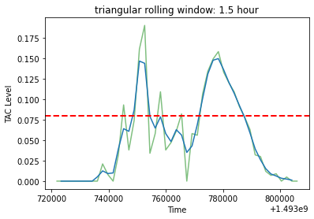
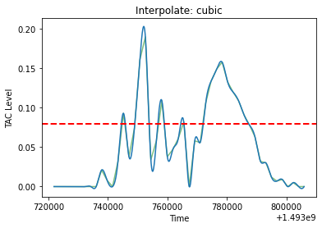
Bifurcating the Dataset: 2 Ways to Impute TAC
Smooth with TMA
Then scipy interpolate
Preserve the raw datapoints
Then scipy interpolate
Notes:
SCRAM bracelets not very accurate; may have outliers; → smoothing will help control for outliers
We used 2 methods to impute our data, resulting in a bifurcation of our dataset.
Use an interpolation function on the raw data to impute TAC values for every accelerometer row; and
Use a triangular-moving-average of window size 3 to smooth all data points (for both the accelerometer data and TAC data), followed by a 3rd order interpolation on the smoothed TAC data to impute TAC values for every accelerometer row.
A.) Triangular Moving Average with rolling window of size 3, and B.) interpolation of the 3rd order.
The red-dotted line is the threshold for drunkenness: TAC Level = 0.08

Slide 6
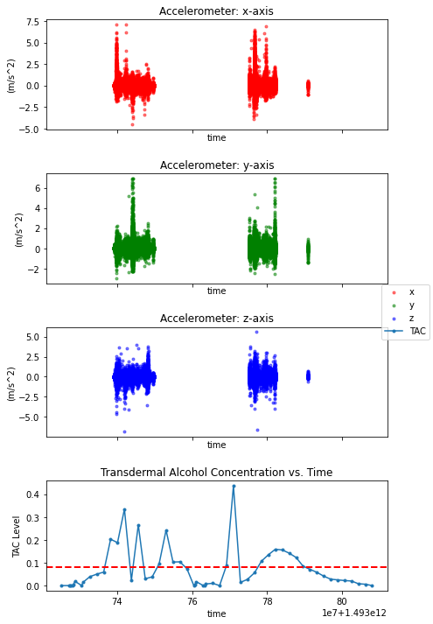
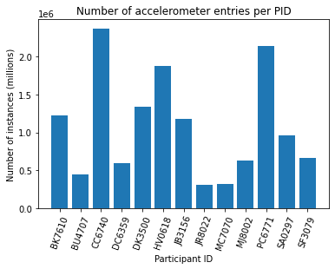
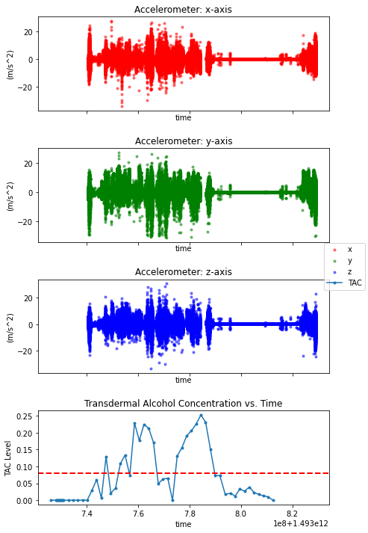
Accelerometers: Noisy Data and Missing Data
Notes:
Problem: much of the accelerometer data was missing for certain individuals
Imbalanced dataset
Left 2 figures: Missing accelerometer data for participant with iPhone (A) versus participant with Android (B).
Left: iPhone, Right: Android
Figure on the Right: Imbalanced Dataset. Some participants have over 2 million rows of accelerometer data while others have as few as 300 thousand.
Only the participants with iPhones had swaths of missing data.
I contacted a former Apple employee, performed my own online search, and parsing through the Killian et al. (2019) paper, we concluded that it was likely that the program that used to collect the accelerometer data may have been more power-hungry or buggy on the iPhone operating system than on the Android phones.
Solution: To mitigate this problem of data imbalance, in the train/test split step, I randomly sampled an equal number of instances from each participant so that the final dataset used on our models was balanced.
No overrepresentation of any single person
Like with the TAC data, we bifurcated our dataset. One copy had TMA-smoothing, and the other was left as original Raw data.

Slide 7
Featurization: Making Meaning out of Noise
Before featurization: 3 features (x, y, z) & 1 target (TAC)
Pandas rolling() method, 10-second windows
After featurization: 306 new features
Mean, Standard Deviation, Variance, Median, Max & Min (of raw & absolute signal), Skew, Kurtosis, Zero Crossing Rate, Gait stretch, Number of steps, Step Time, Root Mean Squared, Average Resultant Acceleration, partial derivatives of each axes
Jerk (the derivative of acceleration) + above
Snap (the derivative of jerk) + above
The standard deviation of all of the above features
Notes:
The dataset had only 3 independent variables (x, y, and z accelerometer data) to predict our 1 dependent variable (TAC Level).
Feeding these 3 columns of data into a machine learning model is essentially meaningless.
Features have to be derived from the accelerometer data.
These features will provide data for the algorithms to model on
features were made in 6-fold sets (x, y, and z axis, plus their smoothed counterparts x_tma, y_tma, and z_tma) using the pandas rolling() method over 10-second windows
I would like to note that jerk and snap were not features present in the original paper by Killian et al. (2019), and neither were the standard deviations of all the features.
Features:
Mean
Standard Deviation
Variance
Median
Max (of raw and of absolute signal)
Min (of raw and of absolute signal)
Skew
Kurtosis
Zero Crossing Rate - the number of times the signal changes signs.
Gait stretch - the difference between max and min of one stride (of raw signal).
Number of steps - the total number of peaks.
Step Time - the average time between steps.
RMS - Root-mean-square of accelerations, i.e. the average power.
Average Resultant Acceleration - Average of the square roots of the sum of the values of each axis squared:
Jerk (the gradient of the accelerometer data) and the above features for Jerk.
Snap (the gradient of jerk) and the above features for Snap.
The standard deviation of all of the above features.

Slide 8
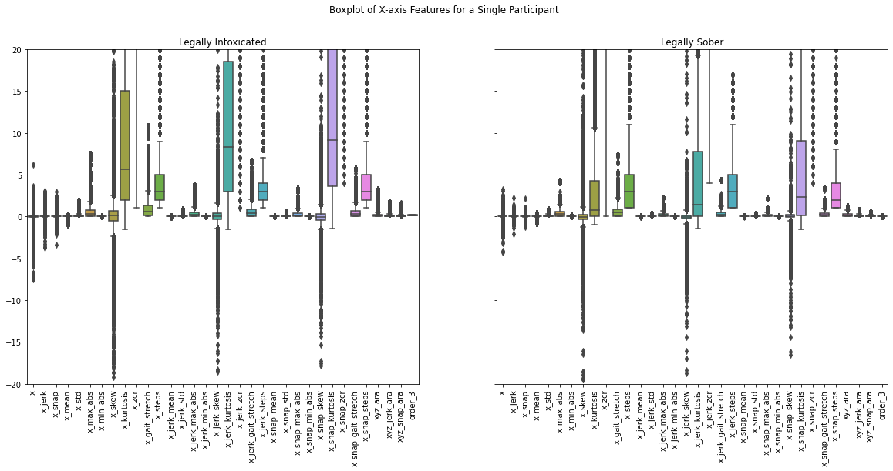
No Immediate Patterns
Notes:
The decision to calculate the standard deviations of all features was made after plotting heatmaps, scatterplots, histograms, and boxplots of the former features.
There was no obvious relationship between any of the features and the participant's TAC.
However, there visually appears in the boxplots to be less variation in the features for the participant when they are sober compared to when they are intoxicated.
Boxplots of X-axis features for a single participant. TAC > 8% (left) , TAC < 8% (right). Note that the IQR appears larger when the participant is intoxicated compared to non-intoxicated.

Slide 9
Sequential Processing is slow...
23 million rows to featurize
13 dataframes (1 per person)
2 datasets (raw vs smoothed)
Dataframe Size | Sequential Processing | Parallelized Processing | Speed Increase
10,000 rows | 126.9 seconds | 17.2 seconds | 7.4x faster
447,423 rows | 3414 seconds | -- | --
22,756,812 rows | 174k seconds (48.2 hours) | 48732 seconds (13.5 hours) | 3.6x faster
Notes:
As I began featurizing, I quickly realized that adding 306 new features to my dataset → time consuming.
13 dataframes (one for each participant) with hundreds-of-thousands to millions of rows in each dataframe. In total, I had approximately 23 million rows to featurize (about 11.4 million for the raw/interpolated dataset, and 11.4 million for the TMA-smoothed dataset).
On my system (Dell Laptop with 12 processors and 16 GB RAM), it took me approximately 127 seconds to featurize 10k rows, and 3413.8 seconds for 447423 rows. Extrapolating from these two data points, I deduced that it would have taken me roughly 87k seconds to featurize all 13 df's of a given dataset (11.4 millions rows), or on the order of 24.1 hours.
Since I had both the raw x, y, z axes as well as their TMA-smoothed counterparts (x_tma, y_tma, z_tma) the total time would have been closer to 48 hours. Therefore, being able to parallelize my processes would be a huge gamechanger!

Slide 10
Using Multiprocessing to Parallelize
Python’s multiprocessing package
Challenges with Windows OS
Result: 48732 seconds (13.5 hours)
3.6x faster
Reduce from 2-day to overnight!
import defs
if __name__ == '__main__':
num_processors = 10
p=Pool(processes = num_processors)
output = p.map(defs.featurize_df,[i for i in df_list])
for i in range(len(df_list)):
output[i].to_csv('pid'+str(i+1)+'_featurized.csv')
print('pid'+str(i+1)+'_featurized.csv’)
Notes:
Python comes with the multiprocessing package, so no additional installation was needed.
Implementation challenge:
Because I was using a windows computer (as opposed to a Mac or Linux), multiprocessing would not run unless it called a function from a separate py file.
Unique to Windows OS, as Mac and Linux could run a function in multiprocessing directly from the file itself.
Solution: I wrote a file called defs.py that contained all of my functions, imported it back into my jupyter notebook, and called it with multiprocessing.
Put all df’s into a list, map that list to our featurization function, and export each featurized df into a CSV file.
Total time was 48732 seconds, or 13.5 hours.
Compared to our previous estimate of 48 hours, this was a 3.5x increase in speed! While this number might not seem like much, it importantly allowed me to reduce my processing time from 2 straight days to a simple overnight run.

Slide 11
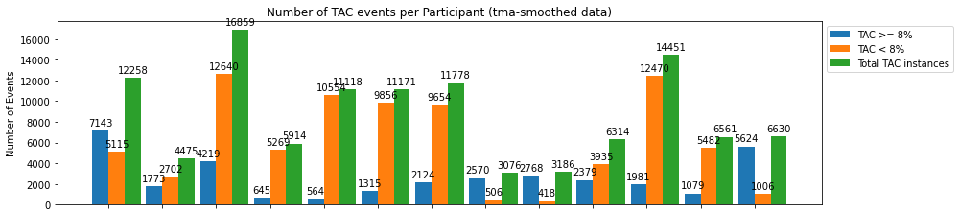
Preprocessing Data
Result
Raw/interpolate dataframe
9107 rows, 293 columns
TMA-smoothed dataframe
9486 rows, 287 columns
70/30 train/test split
Reduce from 53.0 GB to 42.4 MB
Keep only every 100th row
Random select n = 400/combo
Drop columns with > 100 NaNs
Drop rows with NaNs
Notes:
After featurization, my two datasets totaled to 53.0 GB. Since I did not need such high granularity in the data, I kept only a fraction of each df to use in my train/test split.
Used multiprocessing to: select every 100th row, dropped the rest, and wrote the selected data into a smaller CSV file.
Earlier I mentioned the issue of imbalance data. This was a two-fold problem:
Class imbalance: more TAC < 8%
Participant imbalance:
for example, the participant with the most data had 6 times more rows than the participant with the least data.
There was unequal representation from each person and from each binary class.
Look at distribution of participant and class:
The smallest number we see is 418 rows of TAC < 8% for participant 9.
I used n=400 as the number of rows I randomly selected from each participant/class combination.
This resulted in 2 dataframes with 10400 rows and 310 columns, where all rows were evenly distributed between the 13 participants and 2 classes.
Dropped any columns containing 100 or more NaN values, and then dropped any rows containing NaN or np.inf values. This left me with 2 dataframes completely clean from any NaN or infinite values. My raw/interpolated dataset contained 9107 rows and 293 columns, and my TMA-smoothed dataset contained 9486 rows and 287 columns.
I conducted a 70/30 train/test split, and used sklearn's StandardScaler to scale the independent variables.

Slide 12
Lots and Lots of Decision Trees!
Binary Classification Models:
Random Forest
AdaBoost
Gradient Boost
XGBoost
Hyperparameter Tuning: Random Search Cross Validation
XGBoost Best Params: {'n_estimators': 1000, 'max_depth': 15, 'learning_rate': 0.1}

Slide 13
Table of Results
Model | Data | Accuracy | F1 -Score | Precision | Recall | P-R AUC | ROC AUC | Runtime
RF (paper) | - | 0.775 | - | 0.666 | 0.698 | - | - | -
RF | raw | 0.753 | 0.748 | 0.718 | 0.873 | 0.82 | 0.69 | 2.526
RF | tma | 0.793 | 0.791 | 0.742 | 0.903 | 0.88 | 0.72 | 2.692
AdaBoost | raw | 0.680 | 0.679 | 0.680 | 0.741 | 0.75 | 0.64 | 34.953
AdaBoost | tma | 0.711 | 0.710 | 0.694 | 0.759 | 0.79 | 0.65 | 35.277
GradientBoost | raw | 0.739 | 0.737 | 0.719 | 0.830 | 0.81 | 0.69 | 85.575
GradientBoost | tma | 0.762 | 0.760 | 0.723 | 0.853 | 0.84 | 0.69 | 83.256
XGBoost | raw | 0.864 | 0.863 | 0.836 | 0.922 | 0.94 | 0.81 | 4.655
XGBoost | tma | 0.894 | 0.893 | 0.875 | 0.920 | 0.96 | 0.84 | 3.641
RF - tuned | tma | 0.768 | 0.765 | 0.722 | 0.874 | 0.85 | 0.69 | 0.528
XGBoost - tuned | tma | 0.909 | 0.909 | 0.891 | 0.931 | 0.97 | 0.86 | 32.856
Notes:
I evaluated each classifier by measuring their accuracy, precision, recall, F1-score, ROC Area Under Curve, Precision-Recall Area Under Curve, and runtime (the time it takes to train the model and make a prediction).
Results:
I found that RF and XGB using TMA-smoothed data performed best in all evaluation metrics compared to AdaBoost and GradientBoosting.
These models also outperformed the RF classifier in the Killian et al. (2019) paper.
The authors achieved an accuracy of 77.5%, and both our out-of-the-box RF and XGB models surpassed that when run on the TMA-smoothed data. This means that the smoothing and featurization provided useful new features that improved the predictive power of even the simple RF model.
out-of-the-box RF and XGBoost perform better than the RF model from the paper.
while XGBoost-optimized performed the best, it also took significantly longer to process than RF.

Slide 14
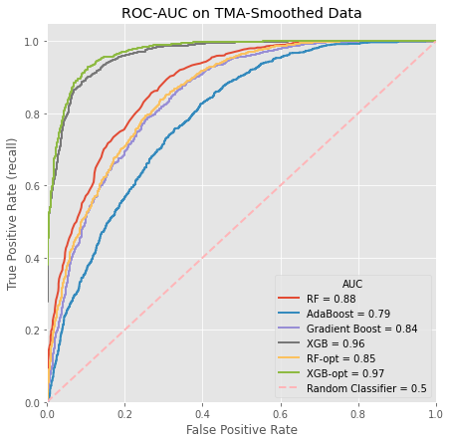
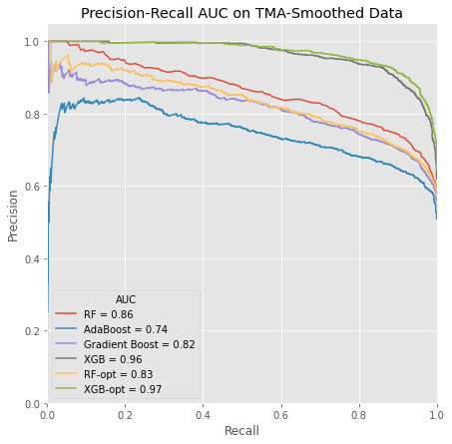
Model Comparison: ROC and Precision-Recall
Notes:
Left. Receiver operating characteristic, Area Under Curve model comparison.
Note that XGB-optimized is only slightly better than the out-of-the-box XGB.
Right. Precision-Recall, Area Under Curve model comparison.
Note that XGB and XGB-optimized outperform all of the other models.

Slide 15
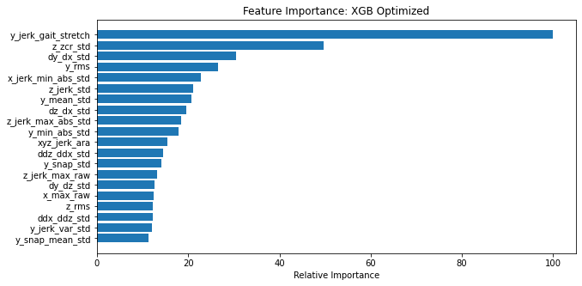
Feature Importance:
Standard Deviations of Other Features
Notes:
One more thing I wanted to look at was feature importance. Decision Trees are generally interpretable, but Random Forests and Boosted trees can become more like a black box, where it is difficult to understand what is driving the model predictions.
We CAN take a look at what features play a large role in prediction, and which do not.
The ones which contribute little to predictive power can be removed from the featurization process in the future, which could further save on resources.
I plotted the top 20 most important features for our highest performing model (XGBoost-optimized), second-best performing model (XGBoost), and our fastest performing model (RF-optimized). All models were trained on the TMA-smoothed data.
Relative feature importance of the top 20 most important features for XGB-optimized. Note that 14 of the 20 features are standard deviations of another features.
I similarly looked into the bottom 10 LEAST important features of these 3 models, and none of them included the standard deviation of another feature.
As suspected, there appeared to be more spread/variation in the features when the participant was intoxicated compared to when they were not intoxicated. Computing the standard deviation of every feature has indeed provided more predictive power to the model.

Slide 16
Takeaways: XGB is Best & Features are Good
XGBoost: best model, but heavy.
Out-of-the-box XGB: 9x faster than tuned XGB
RF: much faster, but needs additional tuning
Features:
Adding Jerk, Snap, and Standard Deviation of other features improves model prediction
Notes:
The most accurate model was XGB-optimized with the following parameters: {'n_estimators': 1000, 'max_depth': 15, 'learning_rate': 0.1}.
If resources were unlimited, this model could be used to develop an app that would predict drunkenness and prompt them with a JITAI to curb heavy drinking behavior.
If, however, we want to develop something lighter, I recommend instead the out-of-the-box XGB (where 'n_estimators':100), which also performs well.
And again, if we want something even lighter than that, then I would recommend Random Forest Classifiers as an option.

Slide 17
Future Directions: Make it Lighter
Rewrite featurization step - feature reduction
RF Classifier - additional tuning
XGB Classifier - additional tuning, cap n_estimators < 100
Alternative models:
ARIMA
Facebook Prophet
Notes:
Successful implementation for JITAIs: needs to be able to predict in real time, to be useful.
Had there been more time:
Would have liked to do more hyperparameter tuning on the RF classifiers to improve its predictive power while keeping it light.
Would have liked to do the same with XGB Classifier, tuning it while keeping the n_estimators capped at 100 to avoid making the model heavier.
Alternative models that were not discussed here could also be looked into.
Preserve the datetime index and use it in combination with the features to predict blood alcohol content ahead of time,
using forecasting methods like ARIMA or Facebook Prophet.

Slide 18
Thank you
Chris Esposo for his guidance and being an awesome Springboard mentor!
Ryan Langman for giving me feedback on generating features.
Patrick Au for answering my questions about iPhones.
Jackson A Killian (Harvard University), Danielle R Madden (University of Southern California), and John Clapp (University of Southern California) for uploading this valuable dataset to the UCI Machine Learning Repository.

Slide 19
Citations
Killian, J.A., Passino, K.M., Nandi, A., Madden, D.R. and Clapp, J., Learning to Detect Heavy Drinking Episodes Using Smartphone Accelerometer Data. In Proceedings of the 4th International Workshop on Knowledge Discovery in Healthcare Data co-located with the 28th International Joint Conference on Artificial Intelligence (IJCAI 2019) (pp. 35-42). [http://ceur-ws.org/Vol-2429/paper6.pdf]
Dataset: http://archive.ics.uci.edu/ml/datasets/Bar+Crawl%3A+Detecting+Heavy+Drinking

Slide 20
Questions?

