Slide 1
Predicting Company Bankruptcy
Grace Tang
Springboard DSC - Capstone 3

Slide 2

How do I know who to lend money to?
A successful business loan can grow companies, create jobs, bolster the economy.
A failed loan can result in millions of dollars in losses.
Picture Credit: debt.org
Notes:
According to the CDC, Excessive alcohol use is responsible for more than 95,000 deaths in the United States each year, or 261 deaths per day.
Alcohol is 3rd leading preventable cause of death. Preceded by tobacco (first leading preventable cause) and poor diet and physical inactivity (second leading preventable cause).

Slide 3
The Solution: Predict Ahead of Time
Can we predict company bankruptcy, and use the results to inform financial decisions?
Many applications:
Approving/Denying business loans
Investing more safely
Understanding what contributes to company health
Notes:
As smartphones become increasingly commonplace in the US, and heavy drinking remains an ongoing problem, → can we predict incidences of heavy drinking using something accessible like mobile phone accelerometer data?
One particular method used to curb heavy drinking behavior is just-in-time adaptive interventions (JITAIs). This method sends prompts or cues in a strategically timed manner to the user (sent “just-in-time”) to alter user behavior and change habits.
Can we use people’s smartphone devices to detect heavy drinking, and thus increase the effectiveness of JITAIs?
We’re not limited to just JITAIs: The results of this project would have a variety of applications, from better implementation of JITAIs, to law enforcement applications, to medical interventions.

Slide 4
The Data: 6819 Taiwanese Companies
Index | Bankrupt? | ROA(C) before interest and depreciation before interest | ROA(A) before interest and % after tax | ROA(B) before interest and depreciation after tax | Operating Gross Margin | Realized Sales Gross Margin | Operating Profit Rate | ...
0 | 1 | 0.370594 | 0.424389 | 0.405750 | 0.601457 | 0.601457 | 0.998969 | ...
1 | 1 | 0.464291 | 0.538214 | 0.516730 | 0.610235 | 0.610235 | 0.998946 | ...
2 | 1 | 0.426071 | 0.499019 | 0.472295 | 0.601450 | 0.601364 | 0.998857 | ...
3 | 1 | 0.399844 | 0.451265 | 0.457733 | 0.583541 | 0.583541 | 0.998700 | ...
4 | 1 | 0.465022 | 0.538432 | 0.522298 | 0.598783 | 0.598783 | 0.998973 | ...
95 features
1 class label (1 for bankrupt, 0 for non-bankrupt)
6819 total companies
220 (3.23%) bankrupt companies
6599 (96.77%) non-bankrupt companies
Notes:
Dataset by Jackson Killian (Harvard University); Danielle Madden (University of Southern California); John Clapp (University of Southern California)
contains smartphone accelerometer data from 13 anonymized Ohio State University college students and corresponding Transdermal Alcohol Concentration (TAC) data using SCRAM ankle bracelets, during a bar crawl.
The SCRAM bracelets are like a breathalyzer for the ankle. Measures alcohol through the skin.
SCRAM bracelets show better TAC accuracy at higher alcohol concentrations, making the dataset unsuitable for regression, but suitable for classification
Accelerometer data
The file contains 5 columns: a timestamp, a participant ID, and a sample from each axis of the accelerometer.
Time is measured in unix timestamp, with millisecond granularity
40 Hz sampling rate.
TAC data
Sampled every 30 minutes, for a full 24 hours
The file contains 14 million (14057567) rows , and there are no missing values.
Problem: There is much higher granularity in the accelerometer data (sampled at 40 Hz) than in the TAC data (sampled every 30 minutes). We will need to impute the missing TAC data.

Slide 5
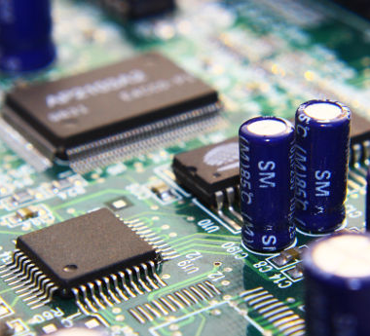
Why Taiwan? Not so different from the U.S.A.
The most technologically advanced computer microchip industry in the world
Developed capitalist economy
Most government firms privatized
7th-largest economy in Asia and 20th-largest in the world
Photo Credit: https://www.chinaimportal.com/blog/electronics-manufacturers-taiwan/
Notes:
Dataset by Jackson Killian (Harvard University); Danielle Madden (University of Southern California); John Clapp (University of Southern California)
contains smartphone accelerometer data from 13 anonymized Ohio State University college students and corresponding Transdermal Alcohol Concentration (TAC) data using SCRAM ankle bracelets, during a bar crawl.
The SCRAM bracelets are like a breathalyzer for the ankle. Measures alcohol through the skin.
SCRAM bracelets show better TAC accuracy at higher alcohol concentrations, making the dataset unsuitable for regression, but suitable for classification
Accelerometer data
The file contains 5 columns: a timestamp, a participant ID, and a sample from each axis of the accelerometer.
Time is measured in unix timestamp, with millisecond granularity
40 Hz sampling rate.
TAC data
Sampled every 30 minutes, for a full 24 hours
The file contains 14 million (14057567) rows , and there are no missing values.
Problem: There is much higher granularity in the accelerometer data (sampled at 40 Hz) than in the TAC data (sampled every 30 minutes). We will need to impute the missing TAC data.

Slide 6
Which Features are Statistically Significant Between Class Labels? - Student’s T-Test
Null Hypothesis: “There are no differences in feature values between ‘bankrupt’ & ‘non-bankrupt’ companies.” (p-value < 0.01)
56 (60%) features significant
Return on Assets
Operating Gross Margin
Cash flow rate
Cash Reinvestment %
Debt ratio %
Net worth/Assets
…
38 (40%) features not significant
Operating Profit Rate
Pre-tax net Interest Rate
Non-industry income and expenditure/revenue
Operating Expense Rate
R&D expense rate
…
Notes:
SCRAM bracelets not very accurate; may have outliers; → smoothing will help control for outliers
We used 2 methods to impute our data, resulting in a bifurcation of our dataset.
Use an interpolation function on the raw data to impute TAC values for every accelerometer row; and
Use a triangular-moving-average of window size 3 to smooth all data points (for both the accelerometer data and TAC data), followed by a 3rd order interpolation on the smoothed TAC data to impute TAC values for every accelerometer row.
A.) Triangular Moving Average with rolling window of size 3, and B.) interpolation of the 3rd order.
The red-dotted line is the threshold for drunkenness: TAC Level = 0.08

Slide 7
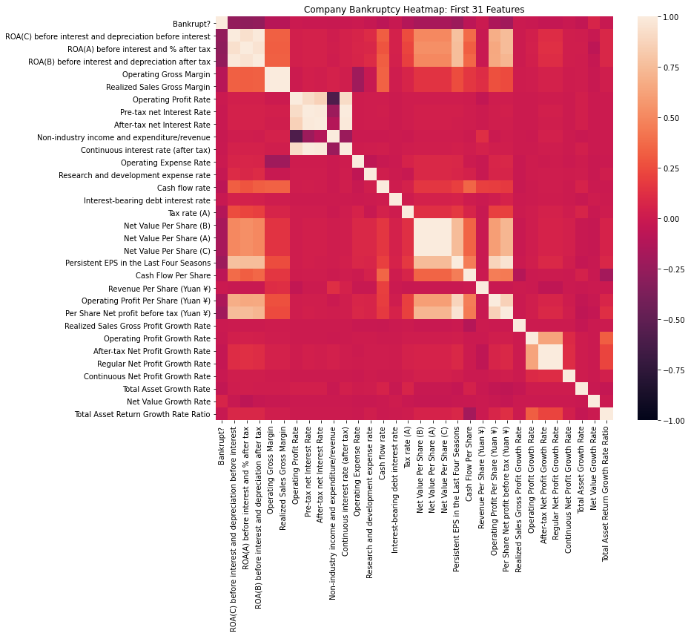
Features Non-Independent: Correlation Heatmap
No strong correlations with bankruptcy.
But some features have strong correlations with each other.
Data would benefit from dimension reduction.
Notes:
SCRAM bracelets not very accurate; may have outliers; → smoothing will help control for outliers
We used 2 methods to impute our data, resulting in a bifurcation of our dataset.
Use an interpolation function on the raw data to impute TAC values for every accelerometer row; and
Use a triangular-moving-average of window size 3 to smooth all data points (for both the accelerometer data and TAC data), followed by a 3rd order interpolation on the smoothed TAC data to impute TAC values for every accelerometer row.
A.) Triangular Moving Average with rolling window of size 3, and B.) interpolation of the 3rd order.
The red-dotted line is the threshold for drunkenness: TAC Level = 0.08

Slide 8
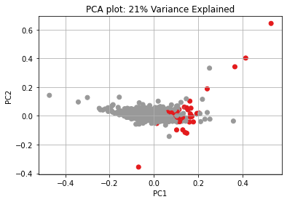
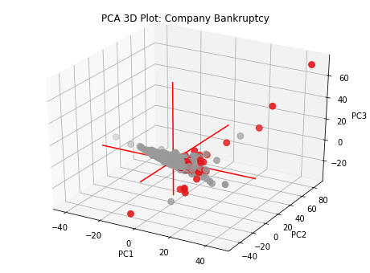
Dimension Reduction with PCA
Notes:
Problem: much of the accelerometer data was missing for certain individuals
Imbalanced dataset
Left 2 figures: Missing accelerometer data for participant with iPhone (A) versus participant with Android (B).
Left: iPhone, Right: Android
Figure on the Right: Imbalanced Dataset. Some participants have over 2 million rows of accelerometer data while others have as few as 300 thousand.
Only the participants with iPhones had swaths of missing data.
I contacted a former Apple employee, performed my own online search, and parsing through the Killian et al. (2019) paper, we concluded that it was likely that the program that used to collect the accelerometer data may have been more power-hungry or buggy on the iPhone operating system than on the Android phones.
Solution: To mitigate this problem of data imbalance, in the train/test split step, I randomly sampled an equal number of instances from each participant so that the final dataset used on our models was balanced.
No overrepresentation of any single person
Like with the TAC data, we bifurcated our dataset. One copy had TMA-smoothing, and the other was left as original Raw data.

Slide 9
PCA: Features That “Reduce” Bankruptcy
Principal Component 1
Return on Assets
Persistent EPS in the Last Four Seasons
Operating Profit Per Share
Per Share Net profit before tax
Operating profit
Net profit before tax
Net Income Total Assets
Notes:
Problem: much of the accelerometer data was missing for certain individuals
Imbalanced dataset
Left 2 figures: Missing accelerometer data for participant with iPhone (A) versus participant with Android (B).
Left: iPhone, Right: Android
Figure on the Right: Imbalanced Dataset. Some participants have over 2 million rows of accelerometer data while others have as few as 300 thousand.
Only the participants with iPhones had swaths of missing data.
I contacted a former Apple employee, performed my own online search, and parsing through the Killian et al. (2019) paper, we concluded that it was likely that the program that used to collect the accelerometer data may have been more power-hungry or buggy on the iPhone operating system than on the Android phones.
Solution: To mitigate this problem of data imbalance, in the train/test split step, I randomly sampled an equal number of instances from each participant so that the final dataset used on our models was balanced.
No overrepresentation of any single person
Like with the TAC data, we bifurcated our dataset. One copy had TMA-smoothing, and the other was left as original Raw data.

Slide 10
PCA: Features That “Contribute” to Bankruptcy
Principal Component 2
Debt ratio %
Borrowing dependency
Inventory and accounts receivable
Net Worth Turnover Rate (times)
Current Liability to Assets Ratio
Current Liability to Equity Ratio
Notes:
Problem: much of the accelerometer data was missing for certain individuals
Imbalanced dataset
Left 2 figures: Missing accelerometer data for participant with iPhone (A) versus participant with Android (B).
Left: iPhone, Right: Android
Figure on the Right: Imbalanced Dataset. Some participants have over 2 million rows of accelerometer data while others have as few as 300 thousand.
Only the participants with iPhones had swaths of missing data.
I contacted a former Apple employee, performed my own online search, and parsing through the Killian et al. (2019) paper, we concluded that it was likely that the program that used to collect the accelerometer data may have been more power-hungry or buggy on the iPhone operating system than on the Android phones.
Solution: To mitigate this problem of data imbalance, in the train/test split step, I randomly sampled an equal number of instances from each participant so that the final dataset used on our models was balanced.
No overrepresentation of any single person
Like with the TAC data, we bifurcated our dataset. One copy had TMA-smoothing, and the other was left as original Raw data.

Slide 11
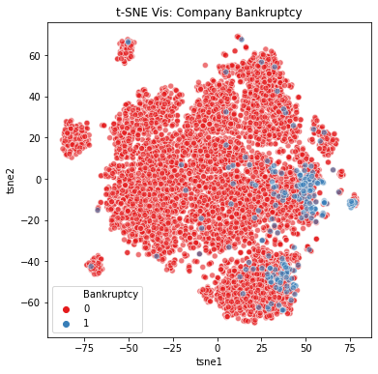
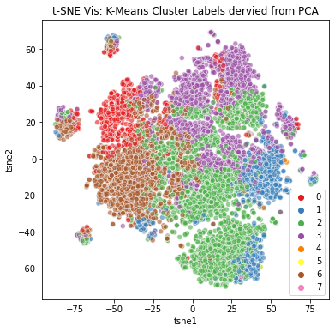
Visualizing with t-SNE and Cluster Labels
Notes:
Problem: much of the accelerometer data was missing for certain individuals
Imbalanced dataset
Left 2 figures: Missing accelerometer data for participant with iPhone (A) versus participant with Android (B).
Left: iPhone, Right: Android
Figure on the Right: Imbalanced Dataset. Some participants have over 2 million rows of accelerometer data while others have as few as 300 thousand.
Only the participants with iPhones had swaths of missing data.
I contacted a former Apple employee, performed my own online search, and parsing through the Killian et al. (2019) paper, we concluded that it was likely that the program that used to collect the accelerometer data may have been more power-hungry or buggy on the iPhone operating system than on the Android phones.
Solution: To mitigate this problem of data imbalance, in the train/test split step, I randomly sampled an equal number of instances from each participant so that the final dataset used on our models was balanced.
No overrepresentation of any single person
Like with the TAC data, we bifurcated our dataset. One copy had TMA-smoothing, and the other was left as original Raw data.

Slide 12
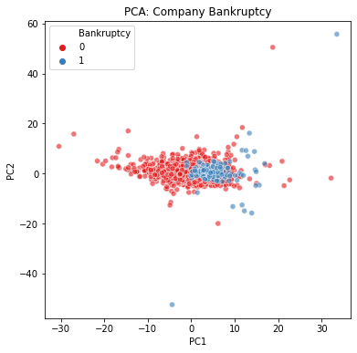
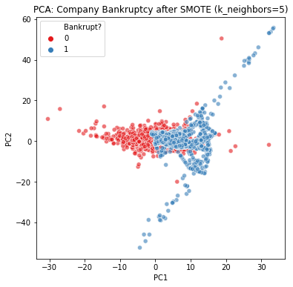
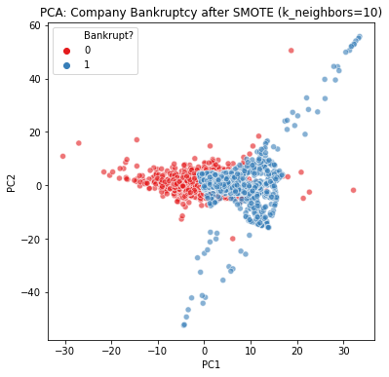
Upsampling the Minority (Bankrupt) Class
Remember, only 3.23% is in the “Bankrupt” class.
Upsample with SMOTE (Synthetic Minority Oversampling TEchnique)
Notes:
The dataset had only 3 independent variables (x, y, and z accelerometer data) to predict our 1 dependent variable (TAC Level).
Feeding these 3 columns of data into a machine learning model is essentially meaningless.
Features have to be derived from the accelerometer data.
These features will provide data for the algorithms to model on
features were made in 6-fold sets (x, y, and z axis, plus their smoothed counterparts x_tma, y_tma, and z_tma) using the pandas rolling() method over 10-second windows
I would like to note that jerk and snap were not features present in the original paper by Killian et al. (2019), and neither were the standard deviations of all the features.
Features:
Mean
Standard Deviation
Variance
Median
Max (of raw and of absolute signal)
Min (of raw and of absolute signal)
Skew
Kurtosis
Zero Crossing Rate - the number of times the signal changes signs.
Gait stretch - the difference between max and min of one stride (of raw signal).
Number of steps - the total number of peaks.
Step Time - the average time between steps.
RMS - Root-mean-square of accelerations, i.e. the average power.
Average Resultant Acceleration - Average of the square roots of the sum of the values of each axis squared:
Jerk (the gradient of the accelerometer data) and the above features for Jerk.
Snap (the gradient of jerk) and the above features for Snap.
The standard deviation of all of the above features.

Slide 13
SMOTE Upsampling Improves Model Performance
Baseline Model: Logistic Regression
Evaluation Metric | Before SMOTE | After SMOTE
Accuracy | 0.9619 | 0.8773
F1-Score | 0.0000 | 0.2807
Precision | 0.0000 | 0.1731
Recall | 0.0000 | 0.7424
Notes:
The decision to calculate the standard deviations of all features was made after plotting heatmaps, scatterplots, histograms, and boxplots of the former features.
There was no obvious relationship between any of the features and the participant's TAC.
However, there visually appears in the boxplots to be less variation in the features for the participant when they are sober compared to when they are intoxicated.
Boxplots of X-axis features for a single participant. TAC > 8% (left) , TAC < 8% (right). Note that the IQR appears larger when the participant is intoxicated compared to non-intoxicated.

Slide 14
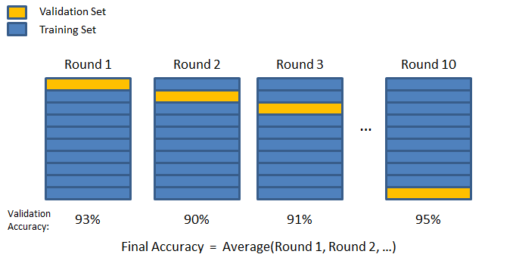
Model Evaluation
Binary Classification Models:
Logistic Regression
Random Forest
XGBoost
Hyperparameter Tuning: Random Search 10-Fold Cross Validation
Picture Credit: Chris McCormick, chrisjmccormick.wordpress.com/

Slide 15
Table of Results
Model | Data Preprocessing | Accuracy | F1-Score | Precision | Recall | ROC AUC | P-R AUC | Runtime (s)
Logistic Regression | No | 0.9619 | 0.0000 | 0.0000 | 0.0000 | 0.5887 | 0.0377 | 1.0776
Logistic Regression | Yes | 0.8739 | 0.2989 | 0.1821 | 0.8333 | 0.9252 | 0.3020 | 2.0035
Random Forest | No | 0.9707 | 0.2308 | 0.7500 | 0.1364 | 0.9497 | 0.4728 | 1.0542
Random Forest | Yes | 0.9355 | 0.2979 | 0.2295 | 0.4242 | 0.9203 | 0.2473 | 6.6547
XGBoost | No | 0.9697 | 0.3404 | 0.5714 | 0.2424 | 0.9472 | 0.4602 | 0.3819
XGBoost | Yes | 0.9355 | 0.3465 | 0.2574 | 0.5303 | 0.9086 | 0.2524 | 6.2850
Notes:
The most accurate model was XGB-optimized with the following parameters: {'n_estimators': 1000, 'max_depth': 15, 'learning_rate': 0.1}.
If resources were unlimited, this model could be used to develop an app that would predict drunkenness and prompt them with a JITAI to curb heavy drinking behavior.
If, however, we want to develop something lighter, I recommend instead the out-of-the-box XGB (where 'n_estimators':100), which also performs well.
And again, if we want something even lighter than that, then I would recommend Random Forest Classifiers as an option.

Slide 16
Takeaways:
F1-Score is higher for the models fitted to the processed data.
scaled, dimension reduction, upsampling with SMOTE
Logistic Regression Model with data preprocessing has highest recall (minimizes false negatives).
XGBoost with data preprocessing has highest F1-Score.
XGBoost also more robust to outliers than LR.
Notes:
The most accurate model was XGB-optimized with the following parameters: {'n_estimators': 1000, 'max_depth': 15, 'learning_rate': 0.1}.
If resources were unlimited, this model could be used to develop an app that would predict drunkenness and prompt them with a JITAI to curb heavy drinking behavior.
If, however, we want to develop something lighter, I recommend instead the out-of-the-box XGB (where 'n_estimators':100), which also performs well.
And again, if we want something even lighter than that, then I would recommend Random Forest Classifiers as an option.

Slide 17
Future Directions
Understand the Model:
Investigate the underlying features that contribute to bankruptcy. (Build on results from PCA and t-test.)
Improve the Model:
Further investigation into data preprocessing methods to improve separation between classes.
Apply the Model:
Implement model pipeline on USA business data and evaluate.
Notes:
Successful implementation for JITAIs: needs to be able to predict in real time, to be useful.
Had there been more time:
Would have liked to do more hyperparameter tuning on the RF classifiers to improve its predictive power while keeping it light.
Would have liked to do the same with XGB Classifier, tuning it while keeping the n_estimators capped at 100 to avoid making the model heavier.
Alternative models that were not discussed here could also be looked into.
Preserve the datetime index and use it in combination with the features to predict blood alcohol content ahead of time,
using forecasting methods like ARIMA or Facebook Prophet.

Slide 18
Thank you
Chris Esposo for being an awesome Springboard mentor: for teaching me about SMOTE, helping me narrow down ideas, and giving me guidance throughout this project.
Deron Liang and Chih-Fong Tsai (National Central University, Taiwan) for donating this valuable dataset to the UCI Machine Learning Repository.
Federico Soriano Palacios for uploading the dataset to kaggle, where I was able to access it.

Slide 19
Citations
Dataset donated by: Deron Liang and Chih-Fong Tsai, deronliang '@' gmail.com; cftsai '@' mgt.ncu.edu.tw, National Central University, Taiwan
Relevant Paper: Liang, D., Lu, C.-C., Tsai, C.-F., and Shih, G.-A. (2016) Financial Ratios and Corporate Governance Indicators in Bankruptcy Prediction: A Comprehensive Study. European Journal of Operational Research, vol. 252, no. 2, pp. 561-572.
Dataset: https://www.kaggle.com/fedesoriano/company-bankruptcy-prediction

Slide 20
Questions?

