Slide 1
Asynchronous crowd feedback gathering vs.
Synchronous crowd critique
(Virtual Design Studio)

Slide 2
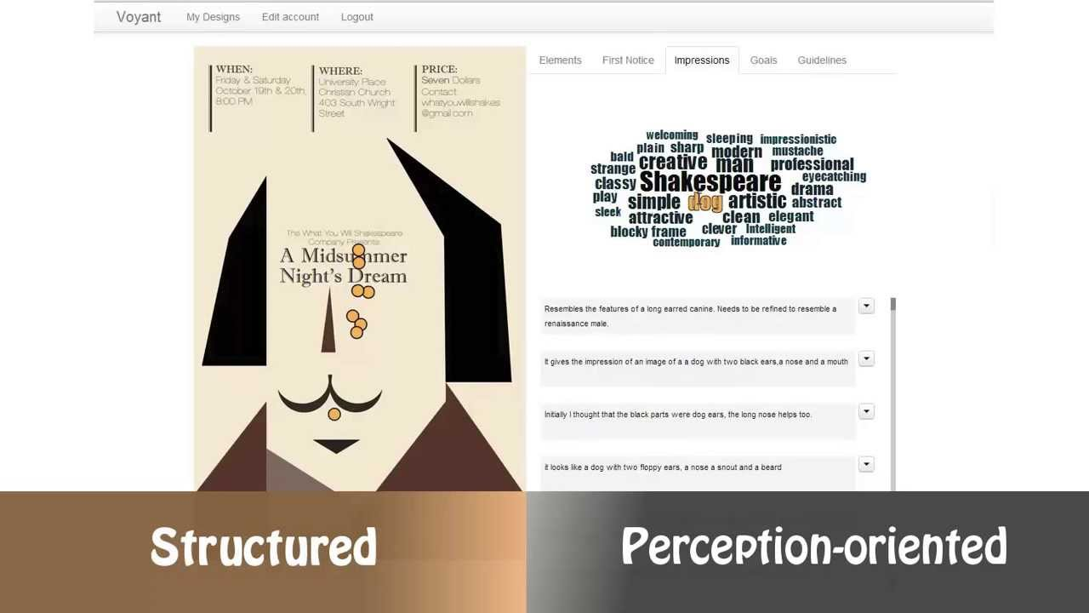
Take one step back:
Crowd feedback was mostly perceived as moderately useful and prompted limited revisions.
Highly depend on how a designer interpret the feedback. Low-quality feedback inhibit the trustfulness of feedback sources.
Difficult to interpret contradictory and ambiguous feedback.

Slide 3
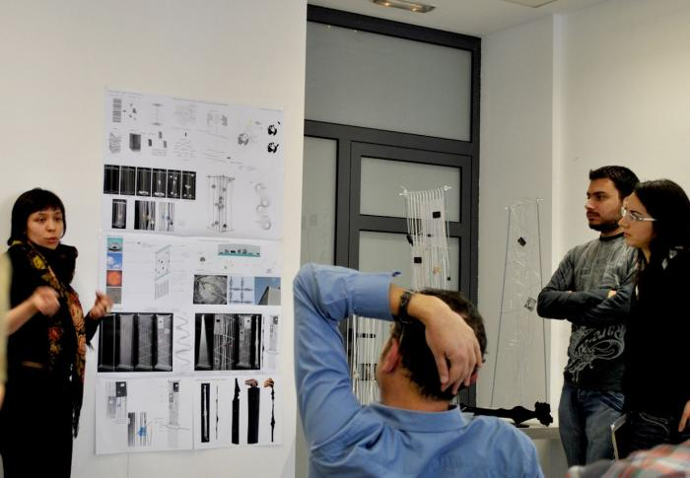
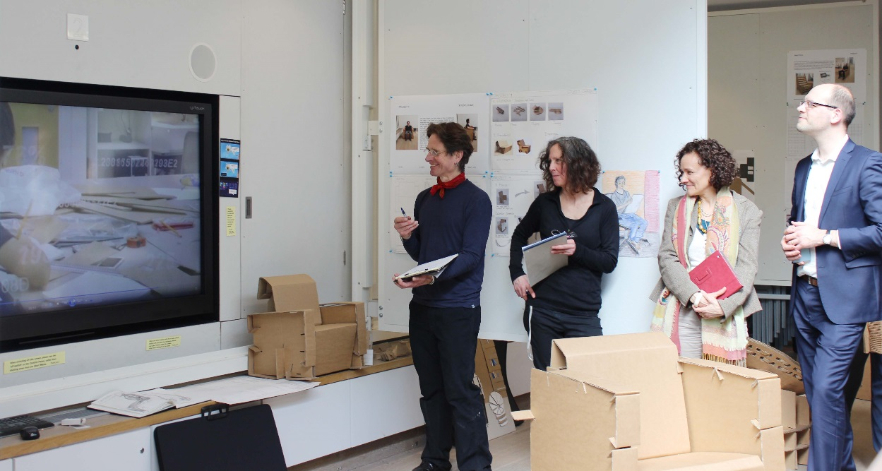
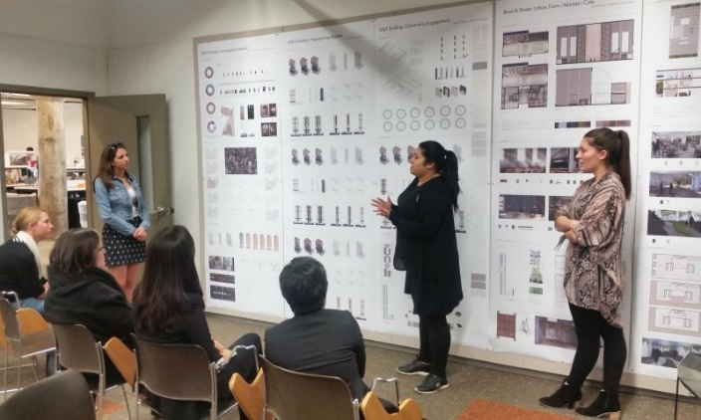
Designers are involved in the discussion.
Afford follow-up clarification.
Feedback providers shared AWARENESS with each other.
Resolve conflicting viewpoints through discussion rather than designers taking side.

Slide 4
A design critique involves a small group of 3-7 to discuss a set of sketches or prototypes. You could focus purely on branding elements, ease of use concepts, or even engineering feasibility, it’s up to whoever leads. The important thing is someone does lead the discussion, define what questions should be discussed and facilitate the conversation.
http://scottberkun.com/essays/23-how-to-run-a-design-critique/

Slide 5
Bridge the gap between design studio and crowd feedback platform
Synchronized Crowd Feedback
https://www.crowdchat.net/chat/c3BvdF9vYmpfOTUx

Slide 6
Step 1: Gain insights about how design studio works
1. Attend design studios, observing the structure of the discussion and roles of the critique members.
2. Understand the functionality of feedback
--something other than revealing the gap and assess the design

Slide 7
Step 2: Gain insights about how designers interpret feedback
1. Conduct field study, observing how designers form action plans based on asynchronous crowd feedback. (annotate, structuralize, filter)
2. Interview the designer, asking their perceptions of the differences between getting feedback from in-person critique session and crowd feedback.

Slide 8
-Test the learning effect of individual vs. group critique on providing constructive feedback.
- Discover patterns of the group critique=> Could prototype a Chatbot that facilitate discussion.

Slide 9
Test different formation of critique group
From social media
From paid crowds
Expert
Designer
Non-expert
Mixed

Slide 10
Test different flow of critique session
Group
Group
Another Group
Individual

Slide 12
https://www.crowdchat.net/chat/c3BvdF9vYmpfOTUx

Slide 14
Crowd feedback system

Slide 16
http://www.uxbooth.com/articles/design-studios-the-good-the-bad-and-the-science/

Slide 17
Increase the awareness of feedback providers

