Slide 1
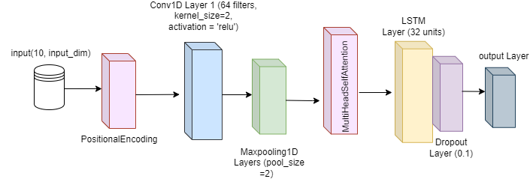
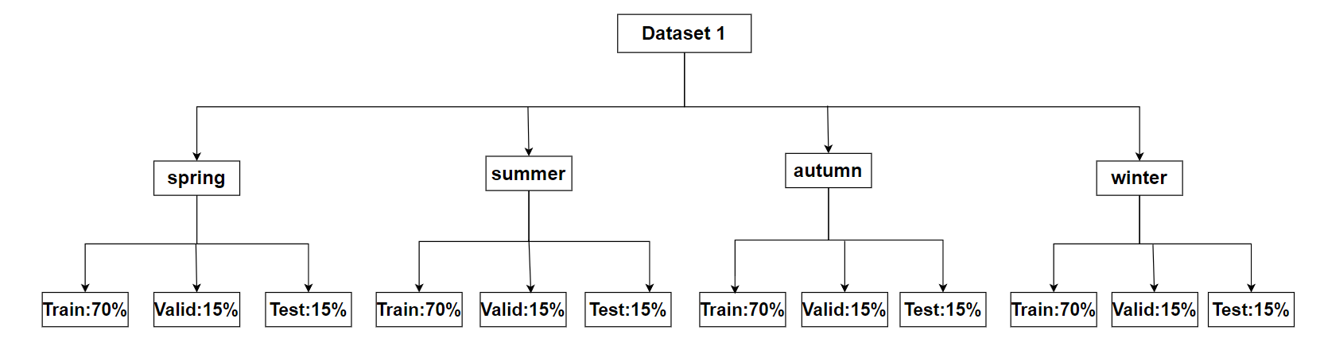
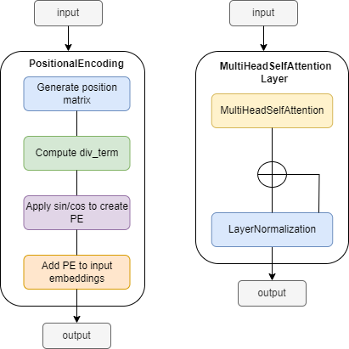

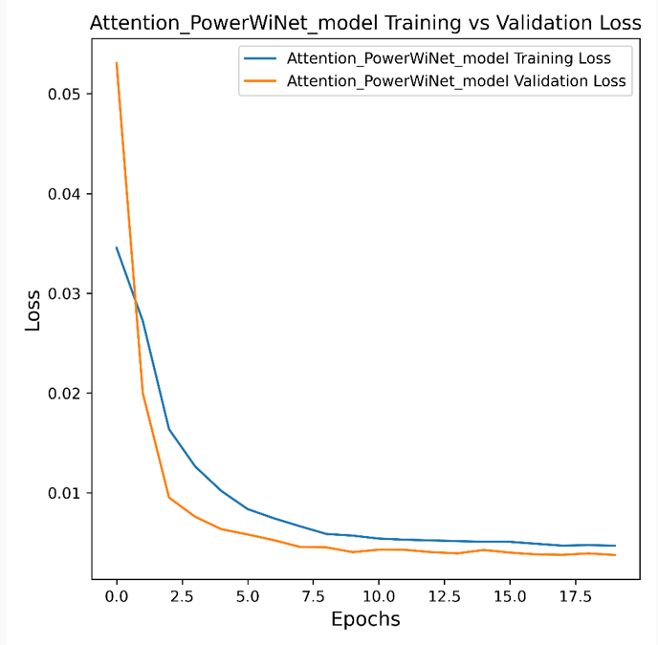
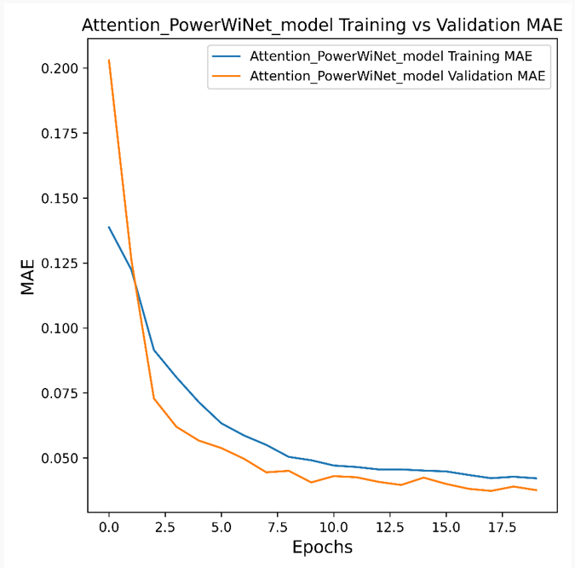
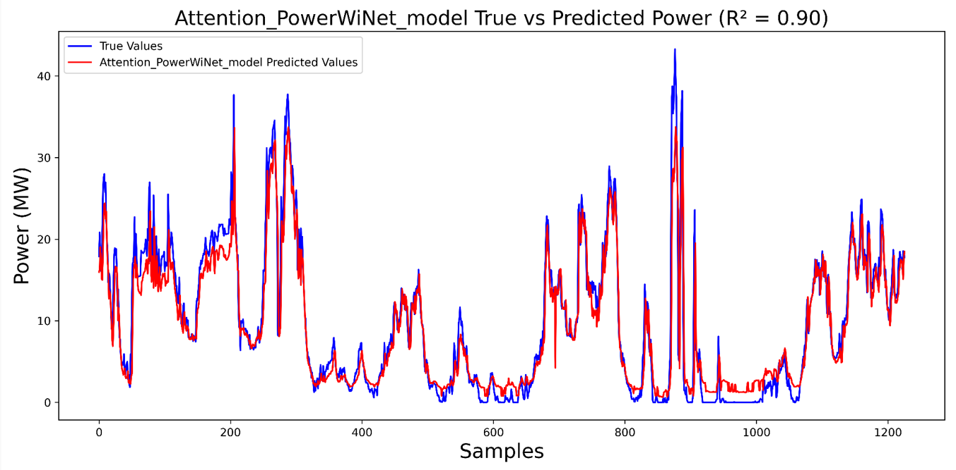
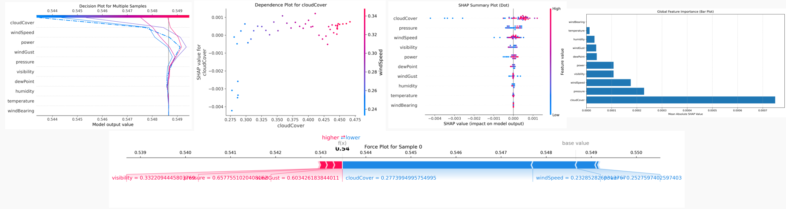
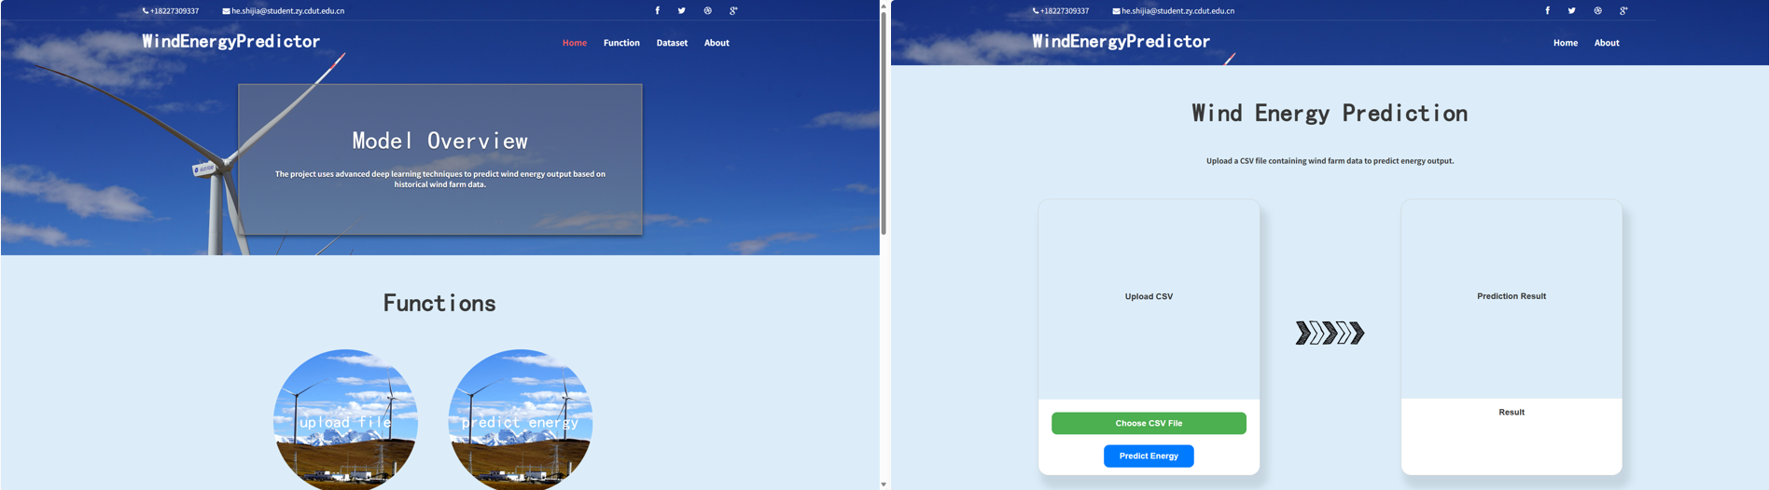
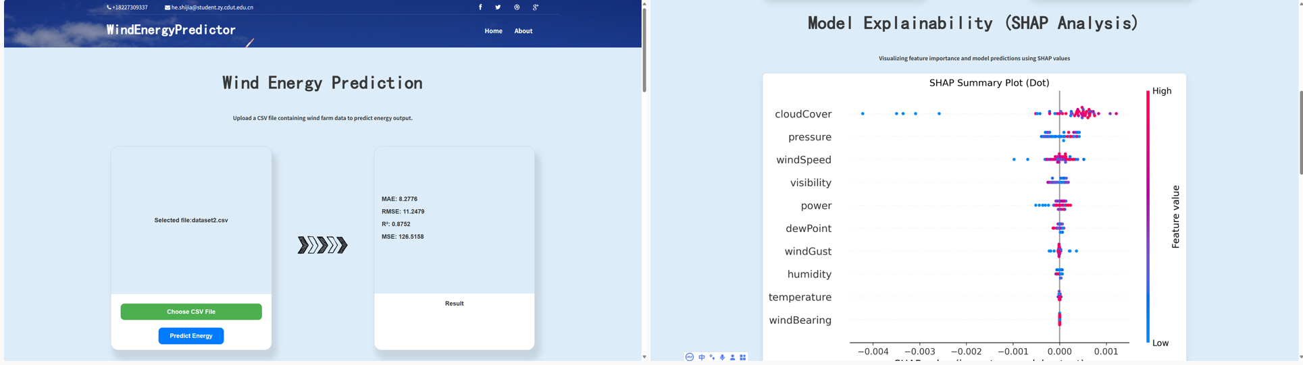
Wind Power Prediction Using Attention-PowerWiNet
Oxford Brookes University in collaboration with Chengdu University of Technology
Author: He Shi Jia
Supervisor: Dr Grace Ugochi Nneji
Abstract
Wind power forecasting is challenged by environmental variability. This project proposes Attention-PowerWiNet, a hybrid model combining PowerNet, WiNet, and attention mechanisms to capture spatial-temporal features. Experiments on two real-world datasets show it achieves the best performance (MAE 0.035, RMSE 2.314, R² 0.906). SHAP analysis highlights wind speed and cloud cover as key factors. A user-friendly GUI was also developed to support data uploading, prediction, and interpretation, enhancing both accuracy and transparency.
Datasets
Proposed model
Dataset 1 contains 35,040 rows of wind farm operational data from 2017, while Dataset 2 records 14,554 rows of environmental factors from 2018 to 2020.
Attention-PowerWiNet
Figure 3. Attention-PowerWiNet architecture
Figure 1. Dataset1 split
Figure 3 shows the architecture of Attention-PowerWiNet, which combines a convolution layer, attention, and an LSTM layer. The Attention-PowerWiNet is used to better capture features and time dependencies for wind power forecasting, the architecture of attention in this model shown in Figure 4.
Figure 2. Dataset2 split
Data preprocessing contains: 1. Data Normalization. 2. Time Series Windowing
Figure 4. Attention architecture
Model Explainability (SHAP)
Result Analysis
To enhance model transparency and build trust, uses methods like SHAP
Figure 6. Loss curve
Figure 7. MAE curve
Figure 8. Predicted value - actual value
Figure 5. SHAP Plots
Figures 6 and 7 show the loss and MAE curves of the summer dataset, and Figure 8 shows the comparison curve between the actual values and the true values.
Conclusion
Model Deployment
Proposed Attention-PowerWiNet to enhance wind power prediction.
Achieved the best on summer and winter datasets.
Applied SHAP for interpretability, confirming the rationality of key input features.
Developed a visual web interface for real-time prediction and result explanation.
This project develops a web-based wind power forecasting platform, supporting CSV data upload, generation prediction via Attention-PowerWiNet, and SHAP-based interpretability alongside prediction results.
Figure 9. SHAP Plots
References
[1] X. Zheng and X. Li, ‘Wind Electricity Power Prediction Based on CNN - LSTM Network Model’, in 2023 IEEE International Conference on Sensors, Electronics and Computer Engineering (ICSECE), Aug. 2023, pp. 231–236. doi: 10.1109/ICSECE58870.2023.10263409.
[2] H. Zhang, L. Zhao, and Z. Du, ‘Wind power prediction based on CNN-LSTM’, in 2021 IEEE 5th Conference on Energy Internet and Energy System Integration (EI2), Oct. 2021, pp. 3097–3102. doi: 10.1109/EI252483.2021.9713238.

