Slide 1

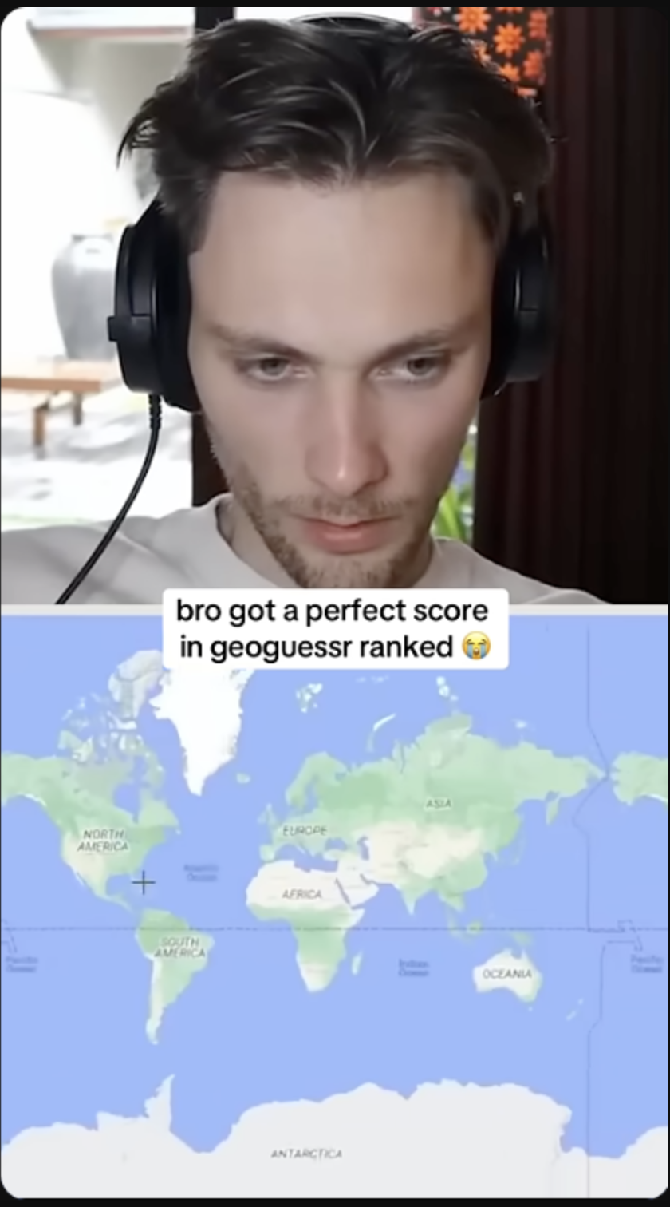

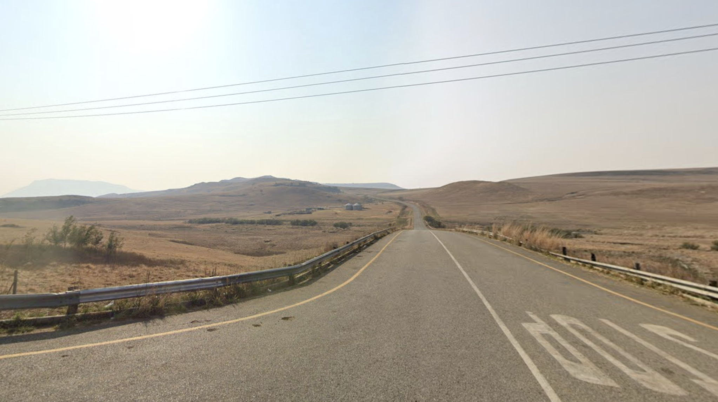
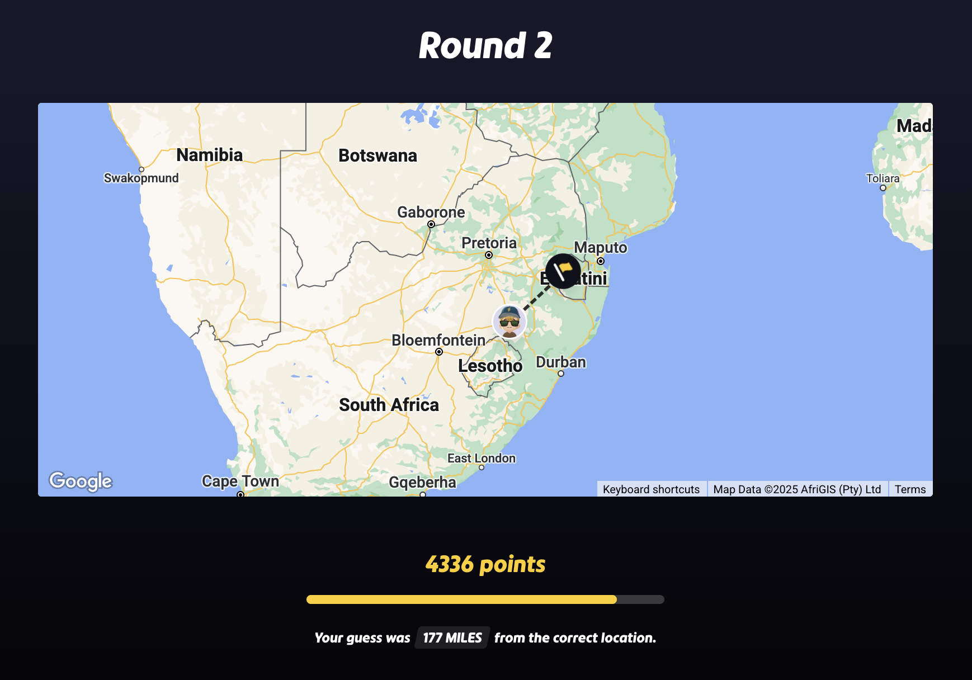

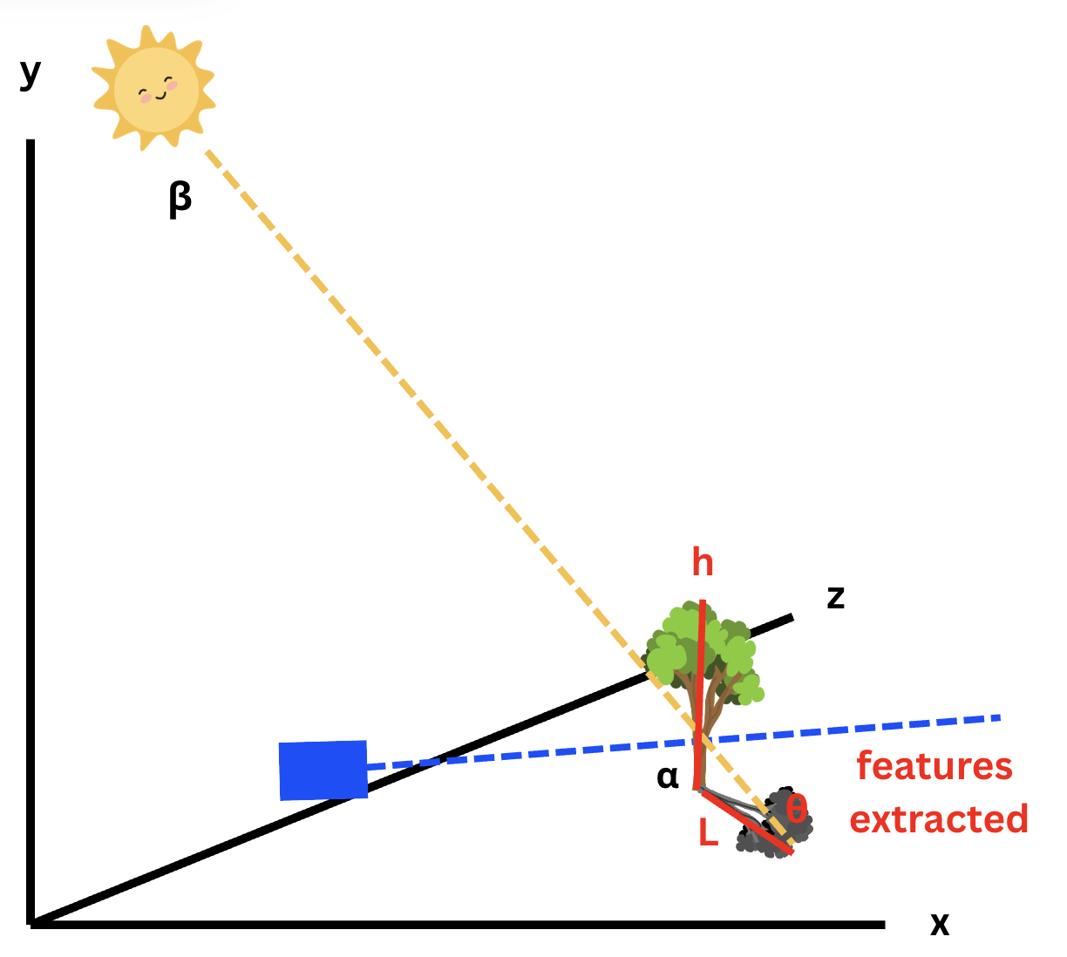
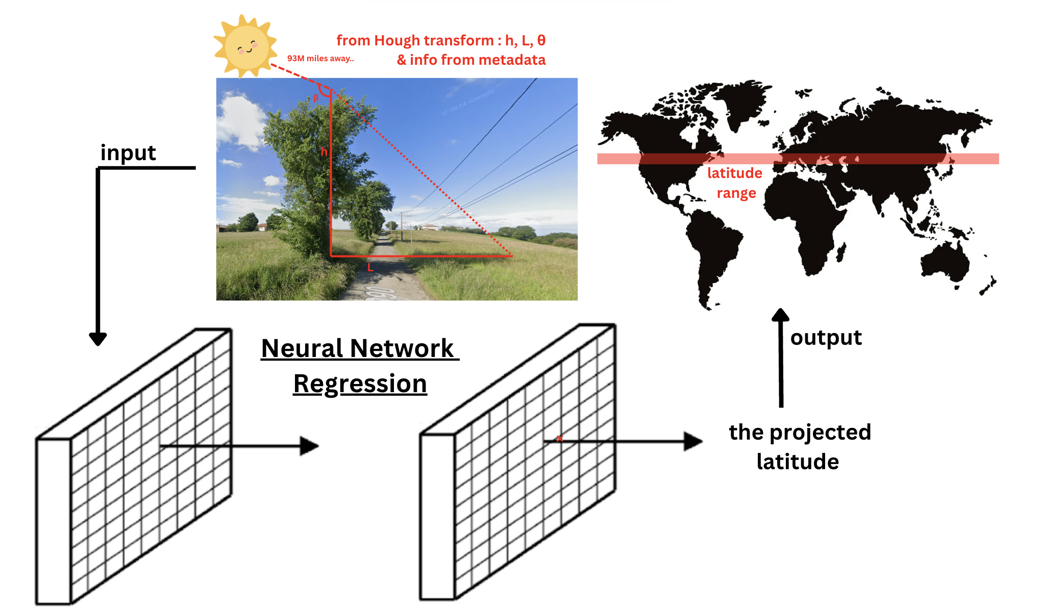
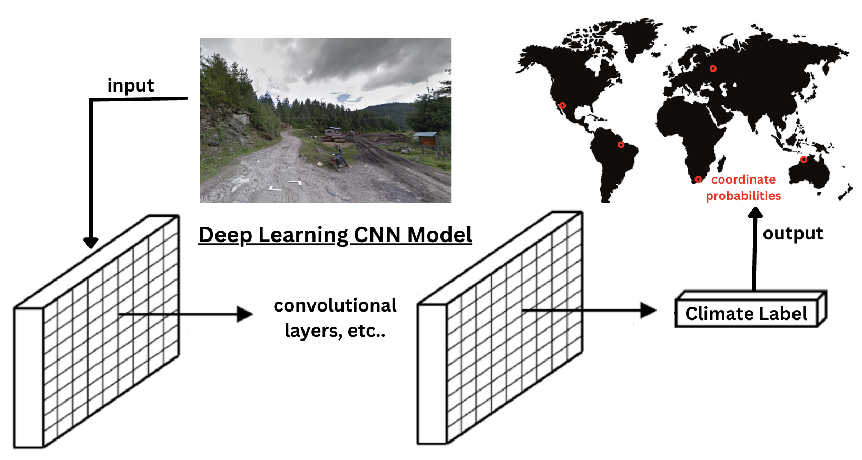
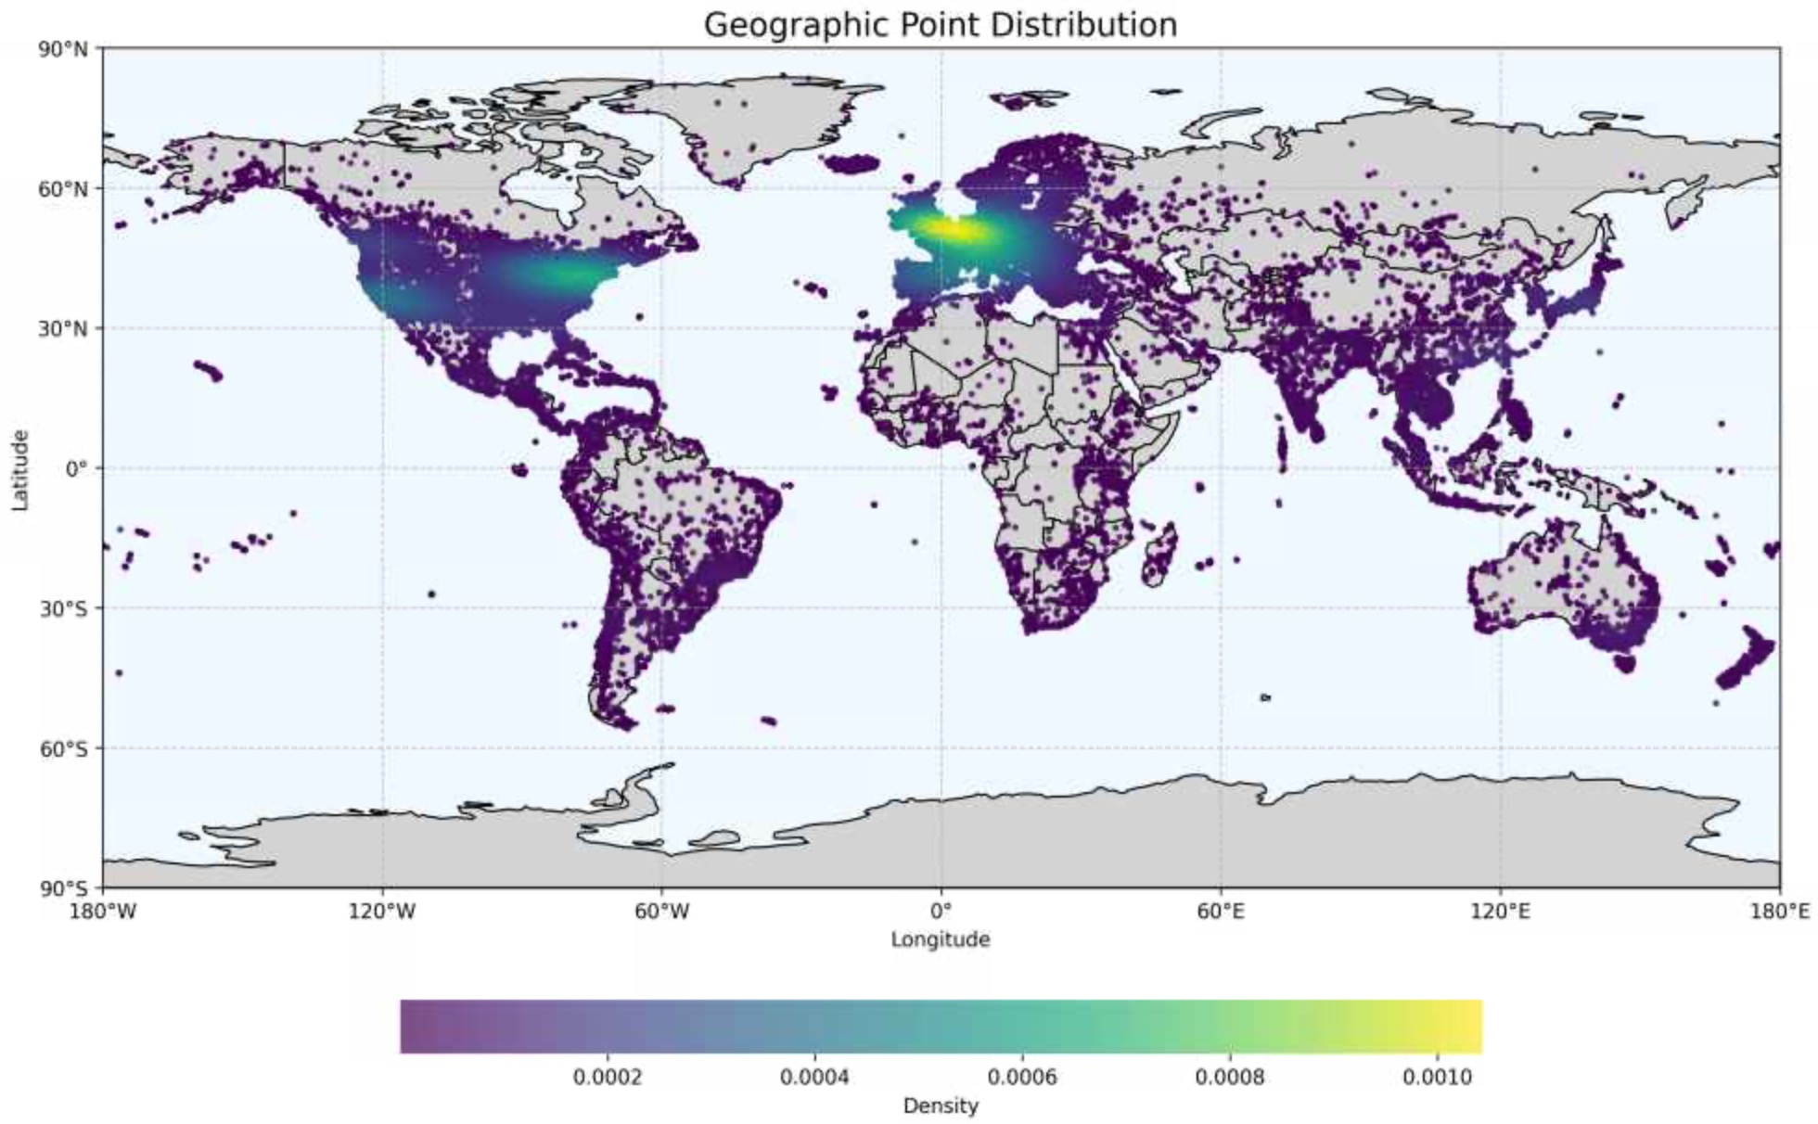
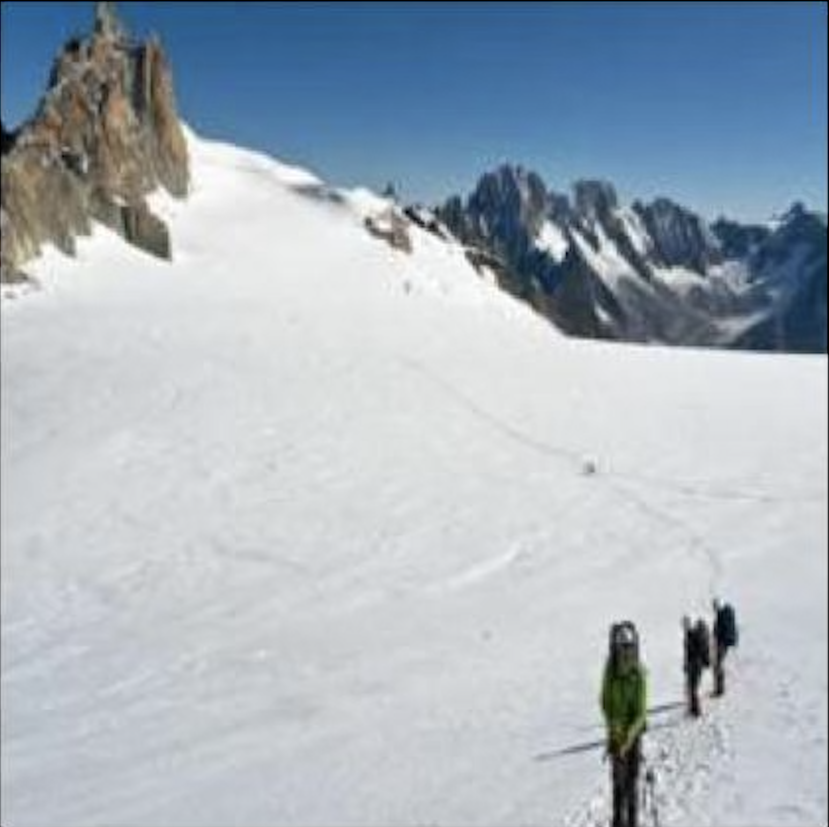
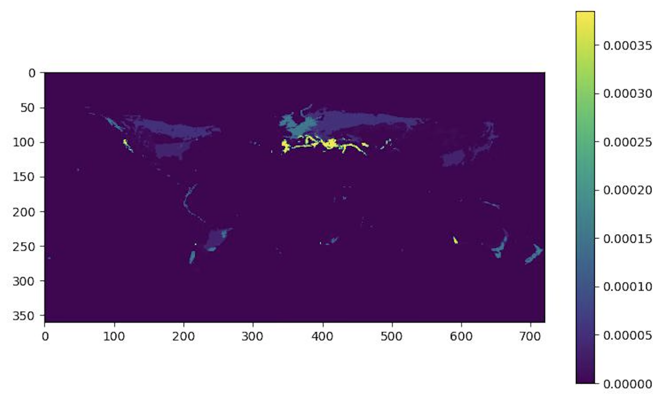
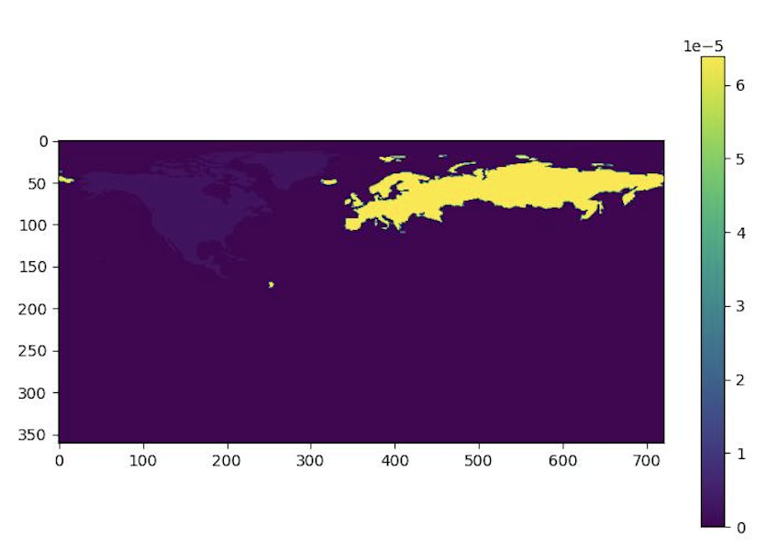
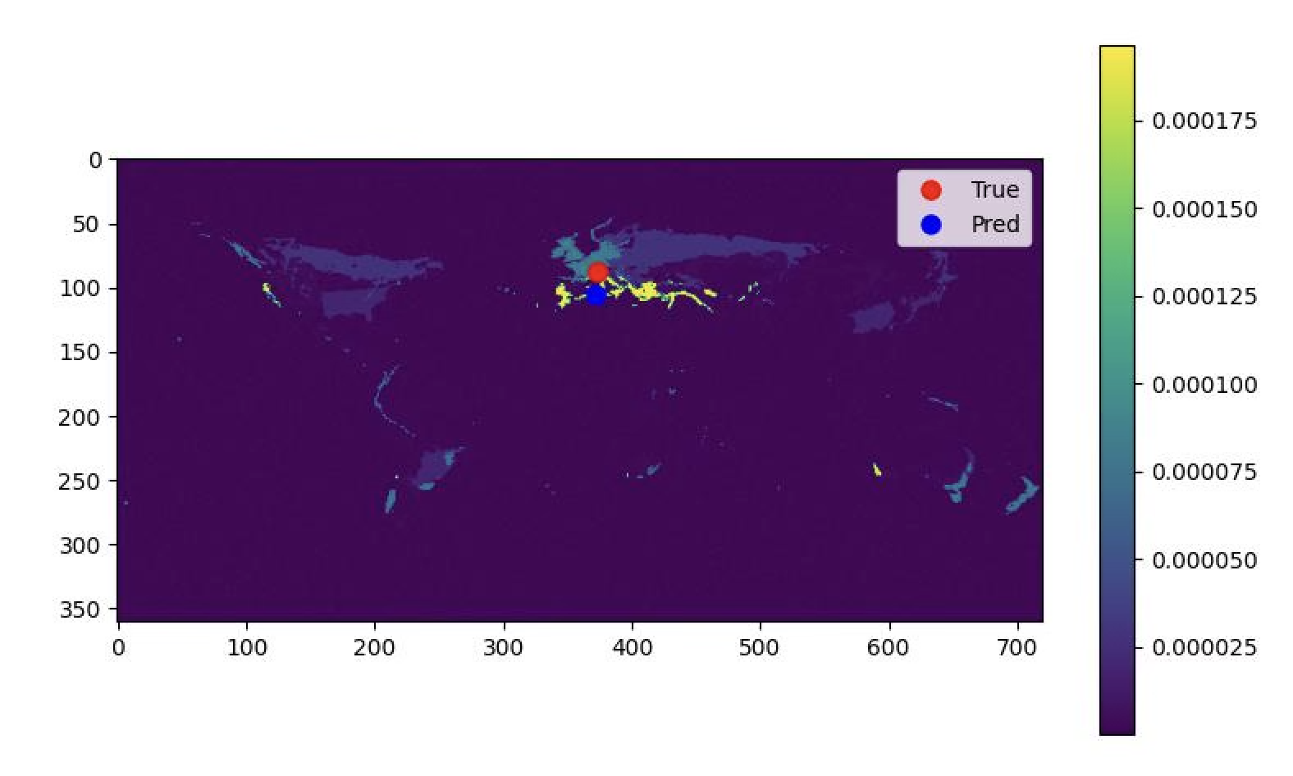
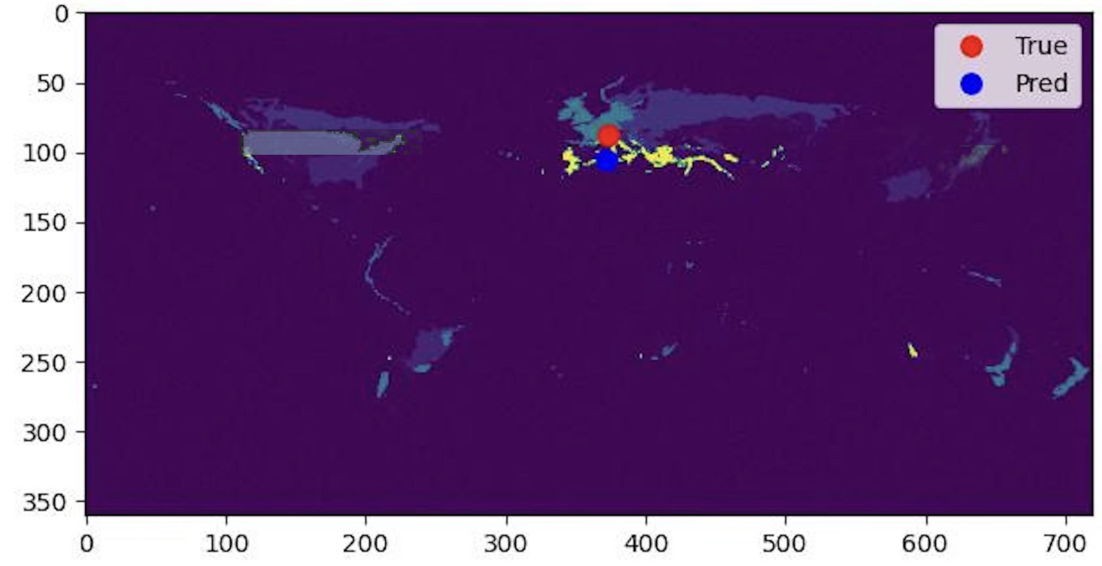
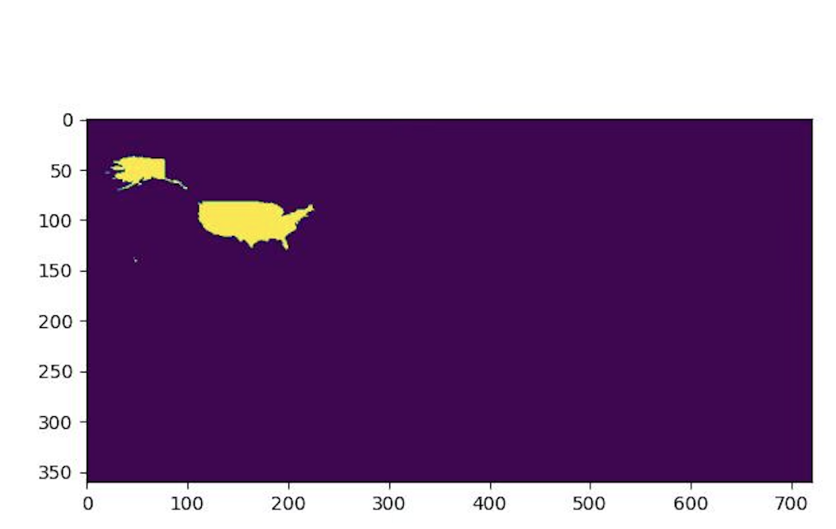
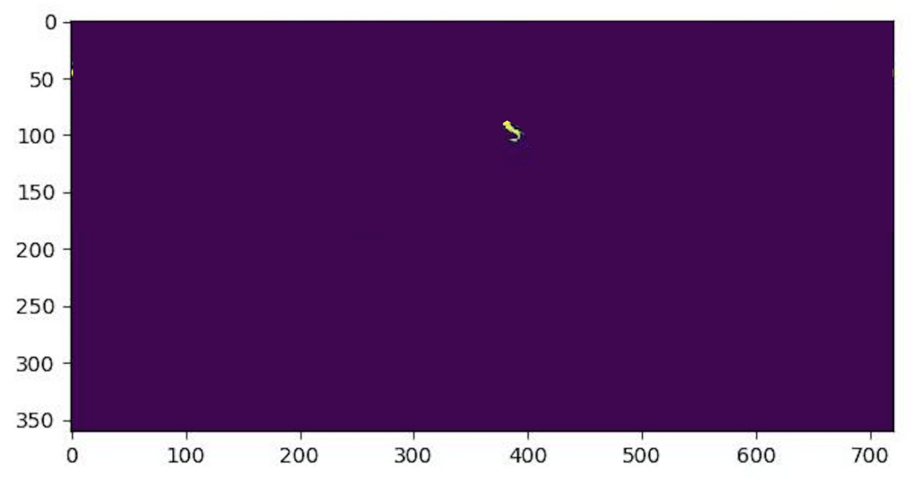
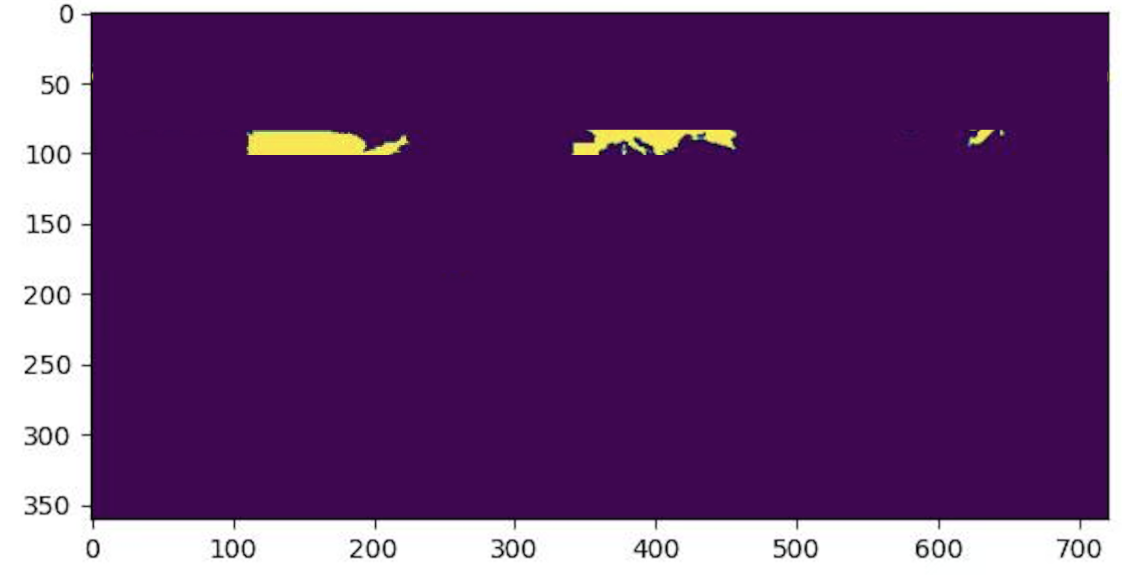
CSCI
1430
GeoGoat: Computer Vision-Driven Global Geographic Inference
Harys Dalvi Kelvin Jiang Akarsh Ojha Grace Yang
Motivation
The Core Problem
Goal
We wanted to create a CV model that performed better in the popular game GeoGuessr than most human players.
Supervised Global Positioning
Supervision via coordinate-based geotags from Flickr, Street View.
No explicit region labels or
semantic annotations included.
Our model should be able to:
Accurately predict the location (country or coordinates) of any given geographic image
Specifically analyze biome/geography features, and shadow angles as visual cues
Category-Free Location Regression
No fixed object classes; inference based on global scene semantics.
Location emerges from patterns in natural and man-made environments.
Geo-Localization from Visual Content
Requires learning spatial cues from visual features alone.
A Joint Computer Vision and Deep Learning Approach
Shadow Angle Calculation
We extract shadow orientation features from our global Flickr dataset using the Hough transform, then map them to absolute latitude from the equator using a neural network regressor.
Climate Feature Detection
Our convolutional neural network starts with a pretrained resnet model and is fine-tuned on our Flickr dataset, then we map the climate classification (1 of 30 types) to potential coordinates & locations.
Data Distribution
Results
Climate Model - Coordinates
Climate Model - Continent
Input Image
Climate Model - Country
Shadow Model - Latitudes
Final Prediction, with our Pipeline (Combined) Model
References
Acknowledgements
[1] S. Alberti, C. Finn, L. Haas, M. Skreta, “PIGEON: Predicting Image Geolocations” arXiv:2307.05845, 2024.
[2] Beck, H.E., T.R. McVicar, N. Vergopolan, A. Berg, N.J. Lutsko, A. Dufour, Z. Zeng, X. Jiang, A.I.J.M. van Dijk, D.G. Miralles, “High-resolution (1 km) Köppen-Geiger maps for 1901–2099 based on constrained CMIP6 projections” Scientific Data 10, 724, doi:10.1038/s41597-023–02549‑6, 2023.
We would like to thank the wonderful teaching staff of CS1430, the writers of our inspiration paper (Reference 1), the collectors and subjects of our data, and the creators of GeoGuessr!
Notes:
https://www.kaggle.com/datasets/paulchambaz/google-street-view
If need to change the graphics, edit & screenshot from here: https://www.canva.com/design/DAGnMUGMPkA/LVfdiytq1BvDeDnm8emlyQ/edit?utm_content=DAGnMUGMPkA&utm_campaign=designshare&utm_medium=link2&utm_source=sharebutton

