Slide 1
Abstractive Text Summarization With Sentence Ranking
Alan Tan, Cynthia (Yue) Hu, Grace Lin
12/13/2018
Notes:
Speaker FirstName
Speaker Script or Notes

Slide 2
Executive Summary
This project aims to generate abstract from news article using New York Times corpus
Combine extractive and abstractive methods in text summarization
Graph-based sentence ranking to select salient sentences
Sequence-to-sequence model to rewrite sentences
Sentence ranking model achieved slightly lower ROUGE scores than baseline but close to those in recent papers
Sequence-to-sequence model did not improve the ROUGE scores.
Notes:
Speaker Name: Cynthia, 1 min
Speaker Notes:
Document summarization is an important and challenging task in natural language processing. It helps people to extract important information from long document quickly and multiple-document summarization is useful in queries.
There are two approaches in summarization. Extractive approach focuses on extracting words or sentences from original document directly by using sentence selection or other compression methods. On the other hand, abstractive approach can rewrite the sentences using new sentences, phrases, or words not seen in the training data. The latter method is similar to how human does summarization.
Neural network based abstractive method for text summarization is popular and effective on the CNN/Daily Mail dataset. For this project we combined extractive and abstractive methods to derive summary for the news articles. We apply the neural sequence-to-sequence model with attention on New York Times corpus after selecting salient sentences.
The graph-based sentence ranking algorithm itself achieves high ROUGE score, close to the start-of-the-art result on CNN daily dataset though slightly lower ROUGE scores than the baseline which is the lead paragraph. However, applying the sequence-to-sequence model on top of sentence selecting does not improve the score. We have seen the common issues of sequence-to-sequence model, such as generating nonsense words or repetition

Slide 3
Data and Preprocessing
Data: New York Times Corpus, 650k articles with abstract
Preprocessing: use bash script to extract required fields into csv file
Tokenization: word_tokenize function from NLTK
Sentence Segmentation: Customized sentence segmentation function.
Embedding: Not pre-trained but training from the corpus above
Notes:
Speaker Name: Cynthia, 1 min
Speaker Notes:
Understanding the full breath of data processing including original text is important for properly studying NLP based summarization. We prefer to preprocess the text ourselves instead of using the pre-processed CNN/daily mail data. Further, the CNN data is commonly used in recent works of neural models and we worry about that the whole industry is overfitting the models using the same dataset. That’s why we chose New York Times corpus. There are about 650k articles with abstract.
We downloaded the 3 GB zipped dataset and wrote a bash script to extract required fields into a consolidated csv file.
We compared multiple tokenization and sentence segmentation functions. Though the word_tokenize function from NLTK is good, the sentence segmentation didn’t work well for our data. For example, if there is no space between two sentences, the NLTK function cannot separate them, it also could not separate sentences by “;”. After evaluating our options, we created a customized sentence segmentation and tokenization function by adding several rules, such as checking whether next letter is capitalized and the previous letter is lowercase (so the U.S. is not an end of sentence).
We decided not to perform stemming because the tense in new articles should be preserved as much as we can.
Next, we studied importing pre-trained embedding and sentence embedding. While word2vec could be successfully used to embed our input, it was not able to generate
cohesive output by itself. One more challenge with pre-trained embedding is that they are quite slow to embed full sentences with any kind of meaningful weight (either
3 TF-IDF, or attention). So we chose to train our own model with embedding that is integrated with our seq2seq model.

Slide 4
Experimental Setup
16 core i7 MacBook Pro with 32GB RAM running latest MacOS and Python 3, Tensorflow 1.10
NVidia Jetson XT2 development kit with 256 CUDA GPU cores, 6 CPU cores and 8GB RAM, Python 3, Tensorflow 1.09
3.6GB zipped dataset, 22G expanded, 1.8 Mil articles, 655K abstracts.
Extract each news article to one line with Title, Abstract, Lead_Paragraph and full_text
Remove outliers - news with very long abstract (100 words) or lead paragraph(200 words)
Tokenization with our own code (parallel multiprocessing) due to format and volume.
Run pre-process build vocab, convert text tokens to integer_ids, and save for later.
Notes:
Speaker Name: Grace, 0.5 min
Speaker Notes:
Below end-to-end process was implemented on a 16 core i7 MacBook Pro with 32GB RAM running latest MacOS and Python 3, Tensorflow 1.18. We also used an NVidia Jetson XT2 development kit with 256 CUDA cores, 6 CPU cores and 8GB RAM.
We downloaded the 3 GB zipped dataset and wrote a bash script to extract required fields into a consolidated csv file which took about 7 hours with shell parallelism.
We then loaded csv file into a Pandas dataframe, and used the ABSTRACT as target and LEAD_PARAGRAPH as source for seq2seq model. We tokenized source and target changing numbers to “N”, and removed all punctuations. We did not separate sentences because the LEAD_PARAGRAPH and ABSTRACT does not have one to one sentence to sentence relationship; the mapping is only at paragraph level.
We then built joint vocabulary, and mapped words to integer indexes.
We split data into smaller batches and fed it into the graph for training. Every 100 batches, we peak into training and validation performance with a sample sentence rewritten to output.

Slide 5
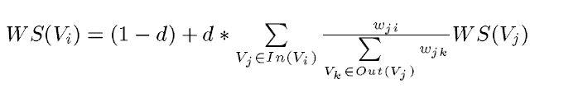
Extractive Model - Sentence Ranking
Graph-based model
Unsupervised model
Identify vertices
Relation between vertices
Score of a vertex
Build and Train the model
Statistical parsing and tagging
Key phrases collecting and counting
Calculate weight for each sentence
Select most significant sentences for the summarization
Notes:
Speaker Name: Grace , 1 min
Speaker Notes:
This graph-based algorithm is very similar to Google’s core algorithm: PageRank. The essence is to decide the importance of a vertex within a graph, based on global information recursively drawn from the entire graph. To achieve such goals, we would need to identify vertices, the relations that connect such vertices, and calculate scores when the algorithms converge. The score of a vertex is based on the number of votes that are cast for it. The score can be calculated by the following equation:
where d is a damping factor that can be set between 0 and 1, 1-d referring to the probability of randomly jumping from a vertex to another vertex. The factor d is usually set to 0.85 (Brin and Page,1998), and this is the value we are also using in our implementation.
The steps to use this model include performing statistical parsing and tagging, collecting and normalizing the key phrases from a parsed document, calculating a significance weight for each sentence, using MinHash to approximate a Jaccard distance from key phrases determined by TextRank, and finally summarizing a document based on most significant sentences and key phrases.

Slide 6
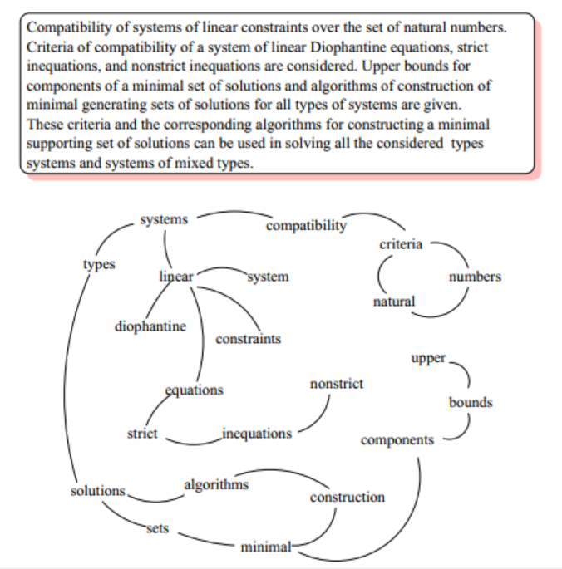
Extractive Model - Sentence Ranking
Notes:
Speaker Name: Grace , 1 min
Speaker Notes:
A simple graph is like this. First, we have compatibility, next to it, we have systems, next to systems we have types. That’s how to get the entire link graphs.

Slide 7
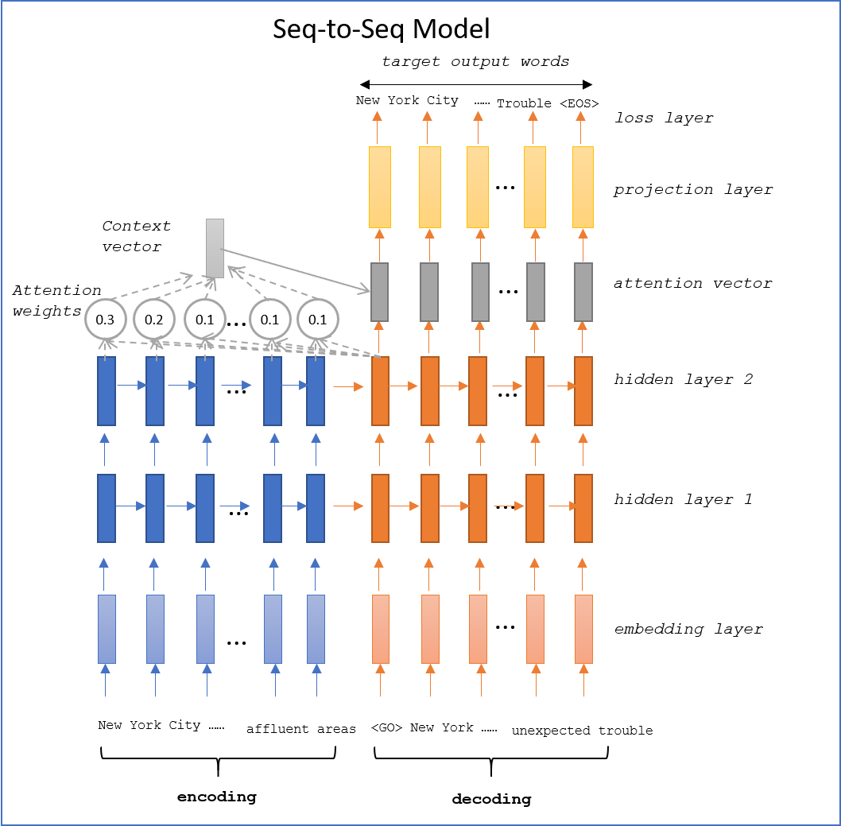
Abstractive Model - Seq2Seq
Notes:
Speaker Name: Alan, 0.5 min
Speaker Notes:
Our abstractive model is based on re-write of extractive summary. The idea is an abstractive summary usually have its own written style, word choice and idea organization, that could make abstract more informative or easier to consume. We will use a seq2seq model that is popular among translation models.
The model includes encoder and decoder parts (see Figure 1). Similar to machine translation, the encoder reads in all sentences from one example and converts the information into one vector for the decoder to absorb. The decoder also take into consideration of previous target output words (abstract words that already chosen), shifting to the left by one time step with an end-of sentence tag appended on the right. We use the reverse source sequence as many recent study popularized. We also added <GO> tag at the beginning of target output to indicate the mark between encoding source and decoding target.
During training, we use the actual target output (manual written abstract) as decoder target; during inference step, we use the RNN output from previous time step as the input for the current input.

Slide 8
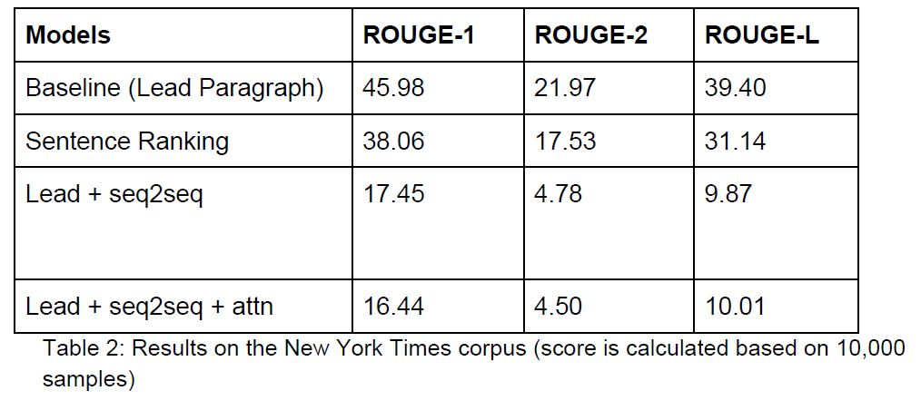
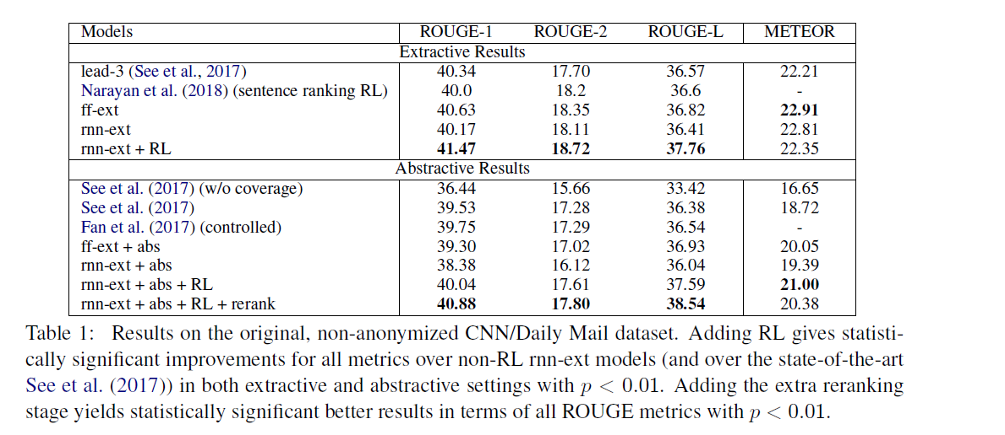
Results
Table 1 is from Chen and Bansal (2018), representing the state-of-the-art document summarization using CNN/Daily Mail data
Notes:
Speaker Name: Alan, 0.5 min
Speaker Notes:
Evaluation is based on recall oriented ROUGE metric: ROUGE-1 (unigrams), ROUGE-2 (bigrams), and ROUGE-L (sentences). ROUGE-N refers to the overlap of n-gram between the predicted summary and the actual abstract. ROUGE metric is calculated for each article on the test data set and then it is averaged to get the final score.
The results of four models using New York Times corpus are in table 2. The baseline has the highest score which is not a surprise for news articles. Our sentence ranking model achieved scores close to those in the recent papers. However, the seq2seq models got relatively low scores and didn’t improve much after adding attention.

Slide 9
Appendix:
Example
Original Text (truncated): the holidays are over the gifts given and received the family snapshots taken. Now comes the tricky part getting the film processed properly and storing the pictures so that they will last as long as possible. Most people learn the importance of these tasks the hard way by watching a treasured color snapshot fade to purple.
Seq2Seq Attention: article on new york times neediest cases fund for children’s christmas gifts
Original Text (truncated): while standing smooth down as much fabric as possible with both hands, then cross the knees bend and sit. optional precaution place purse over lap this peculiar choreography is the daily routine for women wearing miniskirts, extremely short miniskirts as they try to grab a subway seat with all the grace and modesty they can muster
Seq2Seq w/ Attention: article on new york city s wear in new york metropolitan area photos m Introduce punctuation back into prediction: Article on New York City’s wear in New York metropolitan area. Photo(m).
Notes:
Speaker Name: Alan
Speaker Notes:

Slide 10
Observation
Computing power
is
The new OIL
Issues with Seq2Seq model for summarization
Repeating most frequently seen words without much meaning.
Appears could not handle sequence this long
Diagnose the model
English-English (abstract to abstract) “translation” will converge to rewrite sentences 100% word-for-word
Add attention model
Start to pick up some very abstract “concepts” of the article.
Training is really slow
Tuning Parameter
learning rate (0.0025), the number of epochs (10), the number of layers(3), embedding dimension (300), dropout rate(0.9)
Vocabulary
332197 words in vocab,
580454K articles with abstract.
Average length of abstract 95 words
Notes:
Speaker Name: Alan, 1 min
Speaker Notes:
When first ran the basic sequence-to-sequence model on a small data set, we noticed the issues mentioned in Chen and Bansal (2018). The model generated random and repeated words or didn’t generate enough words at all.
To diagnose the model with limited machine power, we chose to use target as source, the idea is this should train a model rewrite literally. We were able to achieve this goal with 113K short sentences without attention in less than 5 Epochs. During training, we were able to observe the generated sentences get closer and closer to the source, and by Epochs 5, it mostly generating exactly the same as source, which is what we expected because our training source and training target were set to identical.
This test indicated our graph will generate expected outcome based on the data we feed to it.
We then move on to feed all actual data (580K) with attention which is quite memory and CPU consuming.
In addition, we tried tuning the values of key parameters, including learning rate (0.0025), the number of epochs (5), the number of layers(3), embedding dimension (300), dropout rate(0.9).
When we found the loss kept decreasing, we know that we haven’t reached the minimum loss yet and increased the number of epochs till the loss didn’t change much between epochs. When we see the loss oscillating, we know the learning rate is too high. Next, increasing the number of layers generally helps generating more meaningful words, but slows down training. Attention also slows down training dramatically (to the order of dozens)
Defining the vocabulary is a little tricky here. We built the vocabulary based on the input (selected sentences) and output of the seq2seq model, not the whole articles. It’s a surprise, when the vocabulary was expanded to cover the full contents, the output was worse. When we saw the very common words generated, we were thinking about removing stop words. However, we don’t think we should remove stop words from the source or target as they are useful in generating natural language.
In contrary to the machine translation which performs better if read in the source sentence in the reverse order, the model generates better words if read in the source in the original order.

Slide 11
Appendix:
References
Alexander M. Rush, Sumit Chopra, Jason Weston. 2015. A Neural Attention Model for Abstractive Sentence Summarization.
Dipanjan Das, Andre F.T. Martins. 2007. A Survey on Automatic Text Summarization.
Yen-Chun Chen, Mohit Bansal. 2018. Fast Abstractive Summarization with
Reinforce-Selected Sentence Rewriting.
Gunes Erkan, Dragomir R. Radev. 2004. LexRank: Graph-based Lexical Centrality as Salience in Text Summarization.
Shashi Narayan, Shay B. Cohen, Mirella Lapata. 2018. Ranking Sentences for Extractive Summarization with Reinforcement Learning.
Abigail See, Peter J. Liu, Christopher D. Manning. 2017. Get To The Point: Summarization with Pointer-Generator Networks.
Rada Mihalcea, Paul Tarau. 2004. TextRank: Bringing Order into Texts.
Dzmitry Bahdanau, KyungHyun Cho, Yoshua Bengio. 2016. Neural Machine Translation by Jointly Learning to Align and Translate.
Ilya Sutskever, Oriol Vinyals, Quoc V. Le. 2014. Sequence to Sequence Learning with Neural Networks.
Tensorflow Neural Machine Translation (seq2seq) Tutorial https://github.com/tensorflow/nmt, https://towardsdatascience.com/seq2seq-model-in-tensorflow-ec0c557e560f
3 silver bullets of word embeddings in NLP https://towardsdatascience.com/3-silver-bullets-of-word-embedding-in-nlp-10fa8f50cc5a
TextRank for Text Summarization https://nlpforhackers.io/textrank-text-summarization/
Python implementation for testrank: https://github.com/ceteri/pytextrank
Rouge evaluation: https://github.com/miso-belica/sumy/blob/dev/sumy/evaluation/rouge.py
Notes:
Speaker Name:
Speaker Notes:

