Slide 1

KickStarter
Understanding Success
Leo Wang
Kirby Bloom
Grace Lin

Slide 2
Introduction
Kickstarter is a funding platform for creative projects.
Everything on Kickstarter must be a project with a clear goal.
Backers are folks who pledge money to join creators in bringing projects to life.
Funding on Kickstarter is all-or-nothing.
Notes:
Everything from films, games, and music to art, design, and technology. Kickstarter is full of ambitious, innovative, and imaginative ideas that are brought to life through the direct support of others.

Slide 3
Research Questions
We set out to investigate the data elements of Kickstarter projects in hopes of identifying attributes for creators to shoot for and those to stay away from.

Slide 4
Research Questions
Categorical
Timing
Numbers
Notes:
Categorical
Which categories are strongly correlated to success or failure?
Within the top categories, what is distribution of success across their sub-categories
Which categories attract the most backers?
Which categories require the largest funding amounts?
Do countries have any impact on category or project fate?
What’s the relationship between goal and pledged? Any correlation? Which category raise most above goal?
Timing
What is the ideal project timeline?
Does a longer timeline increase the fundraising amount?
What is the average timeline per category?
Is there an optimal month to launch or end a project?
Year to year comparisons
What categories are trending upwards / downwards over the years?
General comparisons on success rates, amounts requested / pledged
Numbers & Cents
What impact does the goal amount have on success / failure?
Do more backers equate to success?
What is the average amount pledged per backer?
Does the impact success?
Does it change per category
What percentage do failed projects typically run short?

Slide 5
The Data
URL: Kickstarter 2018 Data
For this project, we are using the ks-projects-201801.csv file for our primary research. This dataset contains the features above for all projects launched from May of 2009 through February of 2017.
Published Features: ID , name , category , main_category , currency , deadline , goal , launched , pledged , state , backers , country , usd pledged, usd_pledged_real, usd_goal_real

Slide 6
Additional Data
2016 KickStarter dataset
Sanity check
Top 10 KickStarter projects
Article highlighting top 10 most funded projects
Country Codes
Country data validation / Full names

Slide 7
Preparation
General formatting
Converted strings to date columns
Converted strings to floats for currency
Few erroneous values
Convenience Columns
Duration (Launch - Deadline)
Average USD Pledged / Backer
Notes:
5 dates from 1970,
3800 observations with bad country value
When we converted the string to float, there were 623 observations ( 0.1% of total 323,750 observations) with characters in the USD amount column. We used 0 to replace those values.

Slide 8
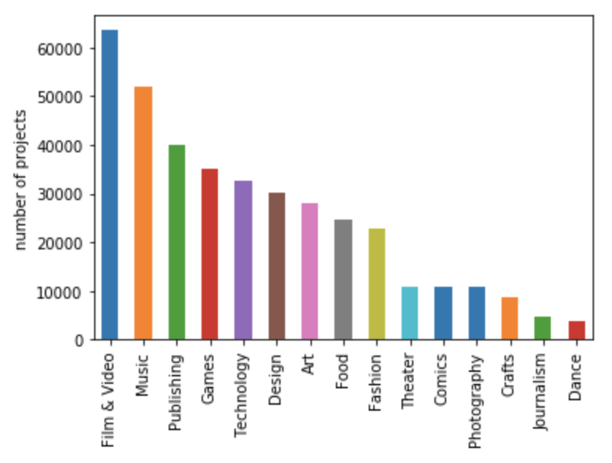
Categorical Overview
Film & Video has the most projects at 63,585
Notes:
In terms of the number of projects by main category, Film & Video has the highest number of projects at 63,585, followed by Music and Publishing. Dance, Journalism and Crafts have the fewest projects.

Slide 9
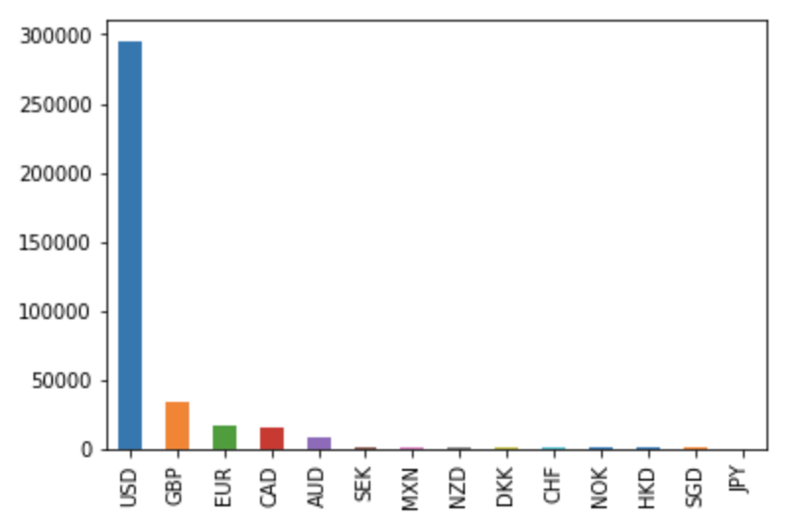
Categorical Overview
By currency, a dominant number of projects used USD as the currency.
Notes:
By currency, a dominant number of projects used USD as the currency.

Slide 10
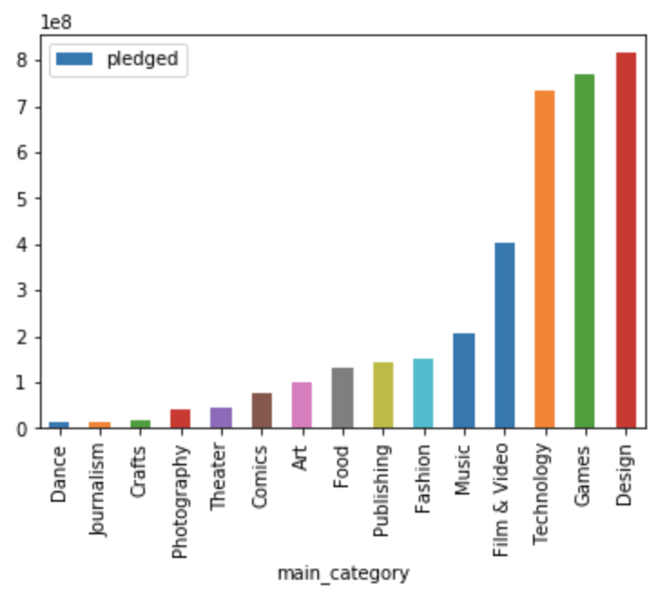
Categorical Overview
Design category raised the highest amount, followed by Games and Technology.
Notes:
In terms of pledged dollar amount by main category, Design category raised the highest amount, followed by Games and Technology.

Slide 11
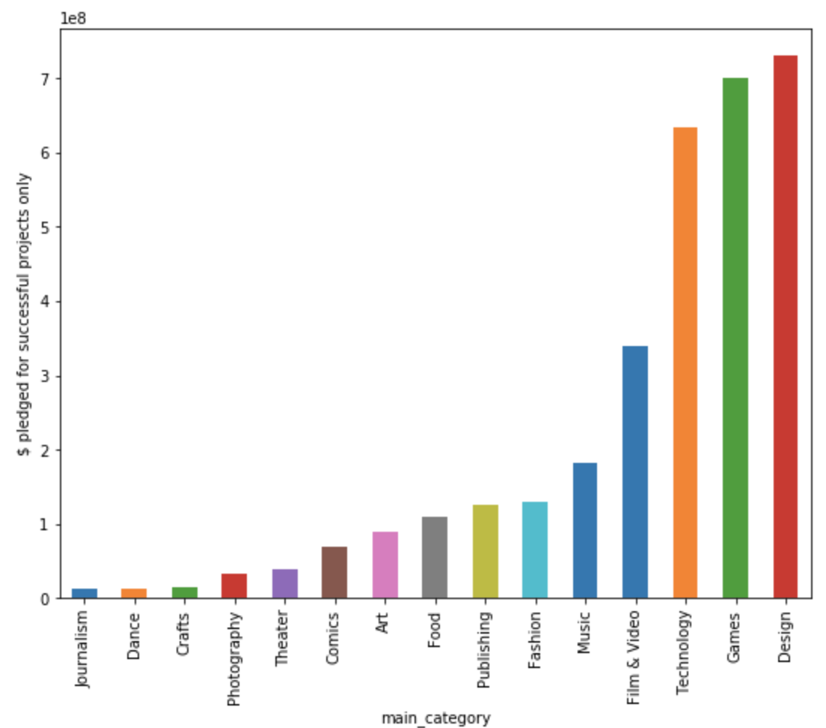
Categorical Overview
Successful project of Design, Games, and Technology category raised the most money
Notes:
If we’re looking at just the successful projects, the pledged amount for these successful projects by category is pretty much in the same order with Design, Games, and Technology as the top 3 categories.

Slide 12
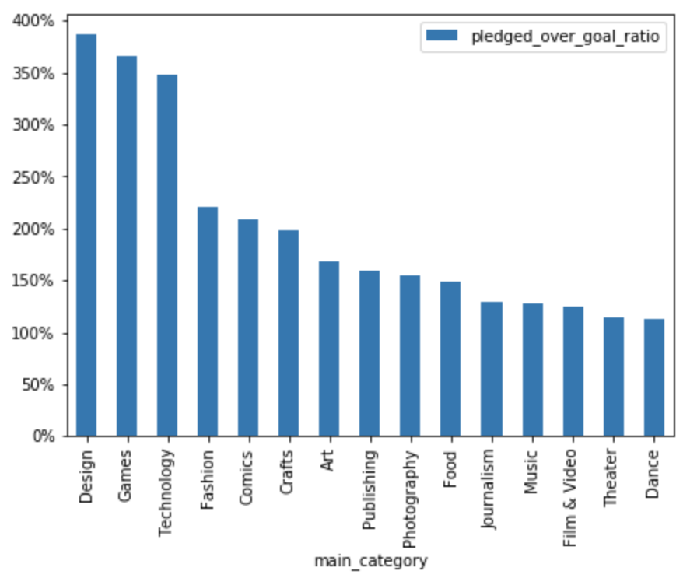
Categorical Overview
Successful projects in Design, Games and Technology category on average raised over 350% the goal.
Notes:
The ratio of pledged dollar amount to goal amount, measures how much a successful project raised over the goal. As shown below, successful projects in Design, Games and Technology category on average raised over 350% the goal. Projects in Dance and Theatre category perform relatively poorly, just raising over 100% the goal.

Slide 13
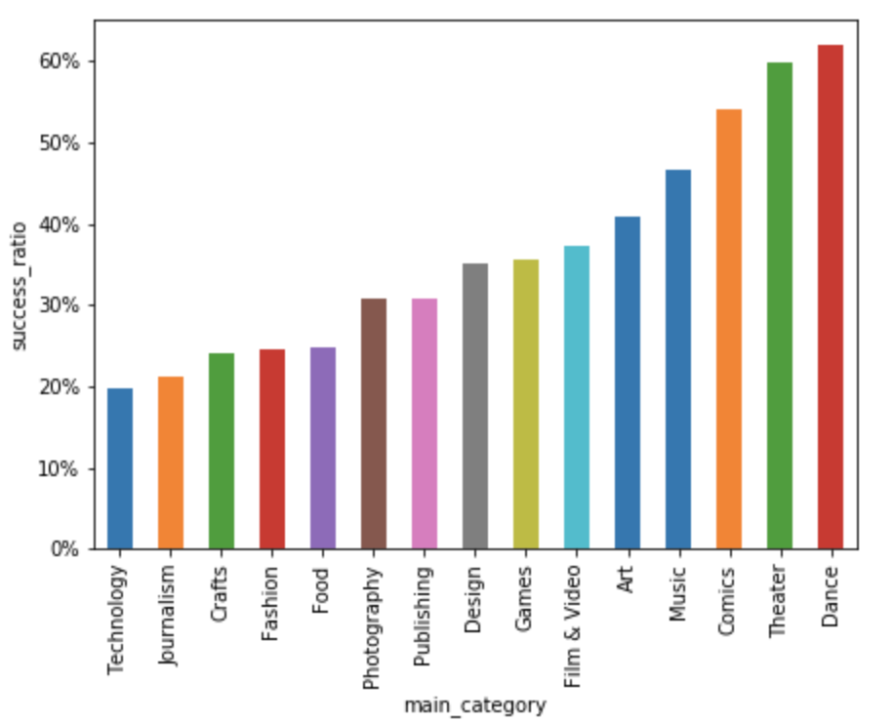
Categorical Overview
Dance, Theatre and Comics projects have the highest success rate.
Notes:
However, when it comes to Success Ratio, which is defined as the number of successful projects divided by the total number of projects per main category, we can see that Dance, Theatre and Comics have the highest success rate. It means that projects in these categories are more likely to meet their goals and become successful although they may raise just above the goal without exceeding too much.

Slide 14
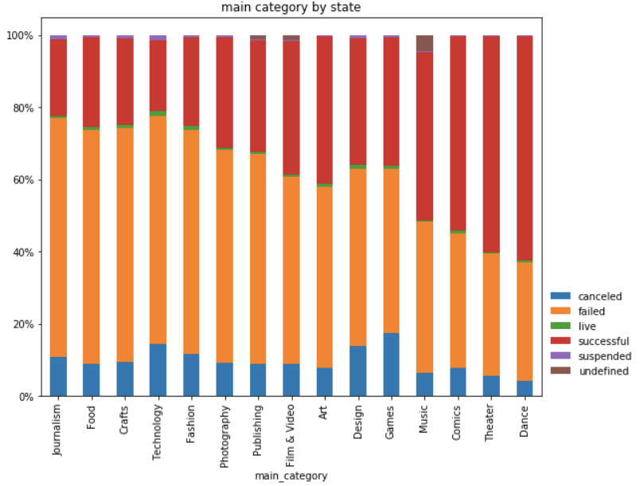
Categorical Overview
Food and Crafts have the highest failure rate. Technology projects have the 4th highest failure rate and actually are most likely to be canceled. Games and Design projects are also very likely to be canceled.
Notes:
Plotting projects by category by state (sorted by failed), we found that Journalism, Food and Crafts have the highest failure rate. Technology projects have the 4th highest failure rate and actually are most likely to be canceled. Games and Design projects are also very likely to be canceled.

Slide 15
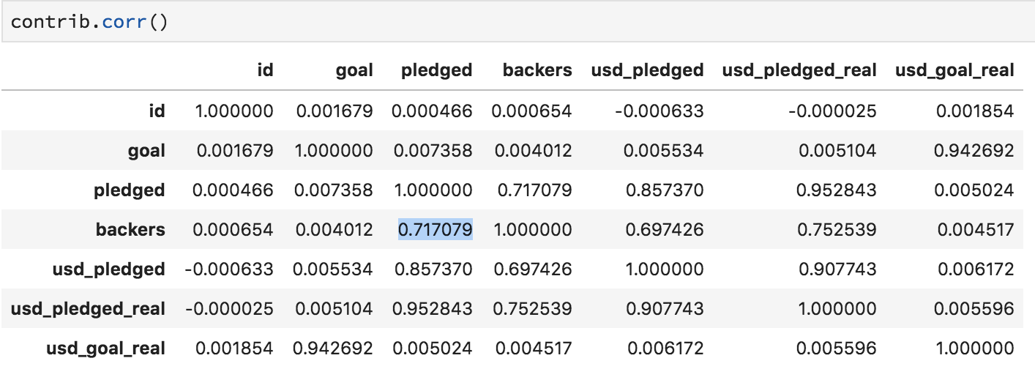
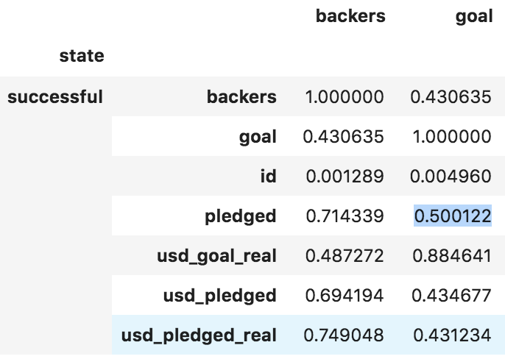
Categorical Overview
There is almost zero correlation between pledged and goal at aggregate level. The successful projects have the highest correlation between goal and pledged at 0.5.
Notes:
To understand what makes a project successful. We examined the correlations among various variables and found that the number of backers is highly correlated with pledged, usd_pledged and usd_pledged_real. Triggered by the almost zero correlation between pledged and goal, so we plotted the correlation by state and found the successful projects have the highest correlation at 0.5.

Slide 16
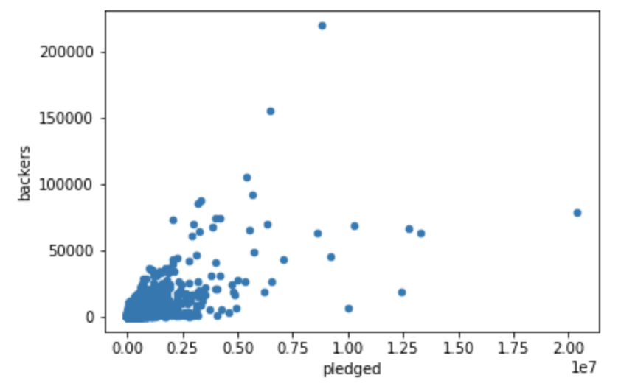
Categorical Overview
There is a positive relationship between the number of backers and the amount a project is able to raise, with correlation at about 70-75%.
Notes:
There is a positive relationship between the number of backers and the amount a project is able to raise, with the correlation coefficient around 70-75%. Below is a more intuitive illustration of that correlation. There is a positive relationship between the number of backers and the amount a project is able to raise, with the correlation coefficient around 70-75%. Below is a more intuitive illustration of that correlation.

Slide 17
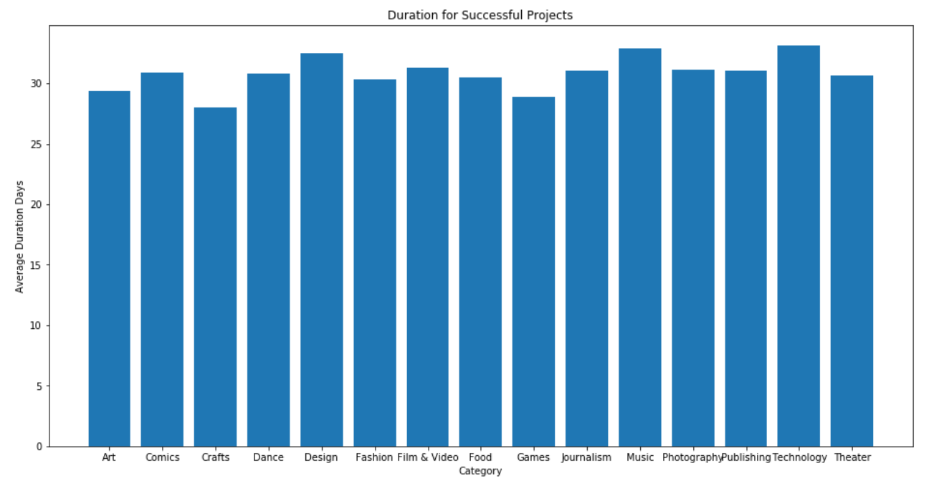
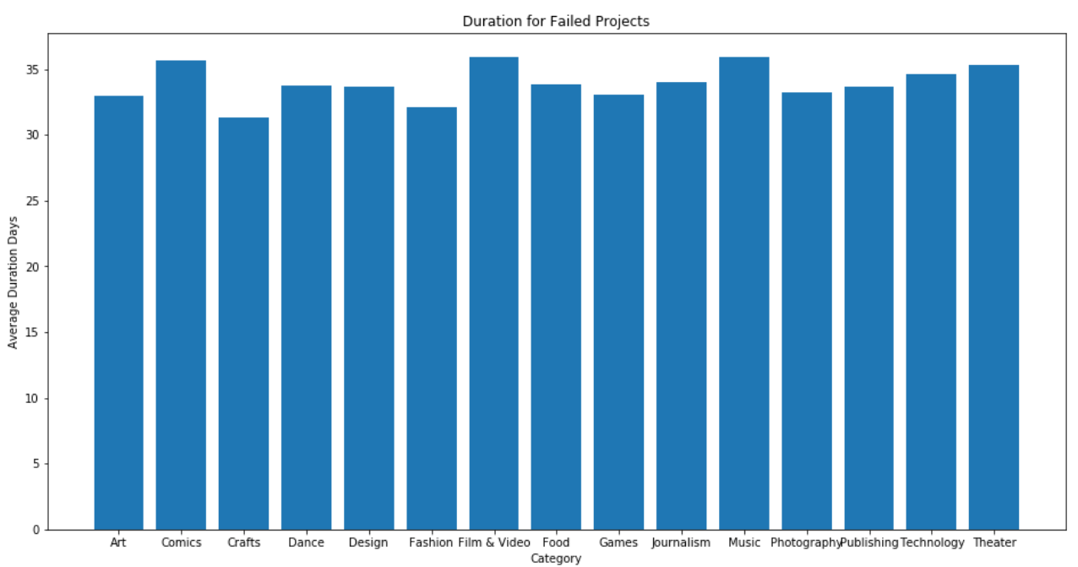
Timing Overview
Do different categories have different average fundraising time?
Notes:
Through the previous analysis, we acknowledged that different categories had their own distinctive features. We started to wonder whether timing could impact the fundraising process.

Slide 18
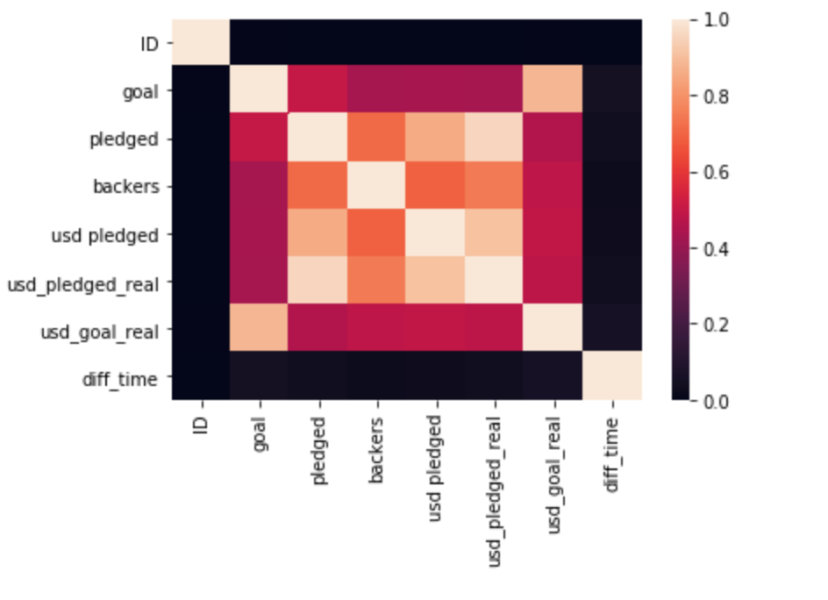
Timing Overview
If we increase project duration, can we raise more funding?

Slide 19
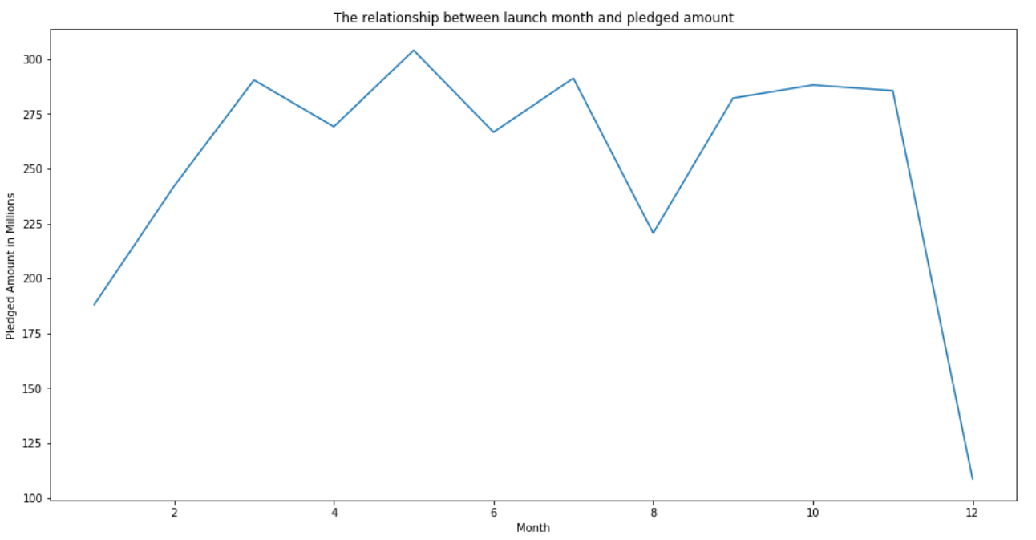
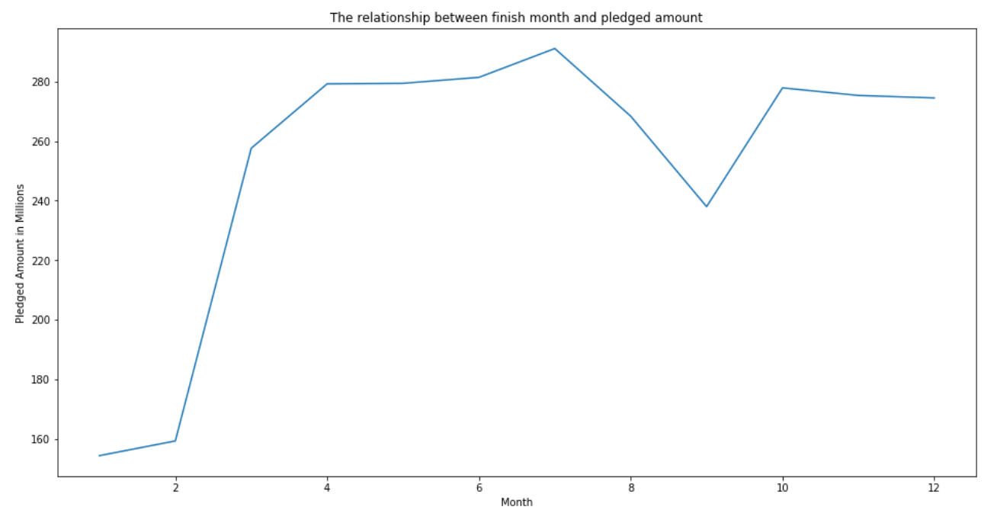
Timing Overview
What about which month to launch?

Slide 20
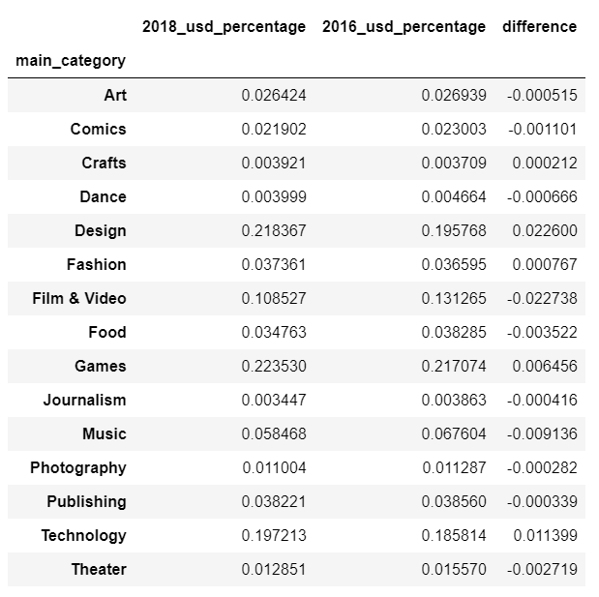
Timing Overview
Are the popular categories in 2016 still popular in 2018?
Notes:
What categories are trending upwards / downwards over the years?

Slide 21
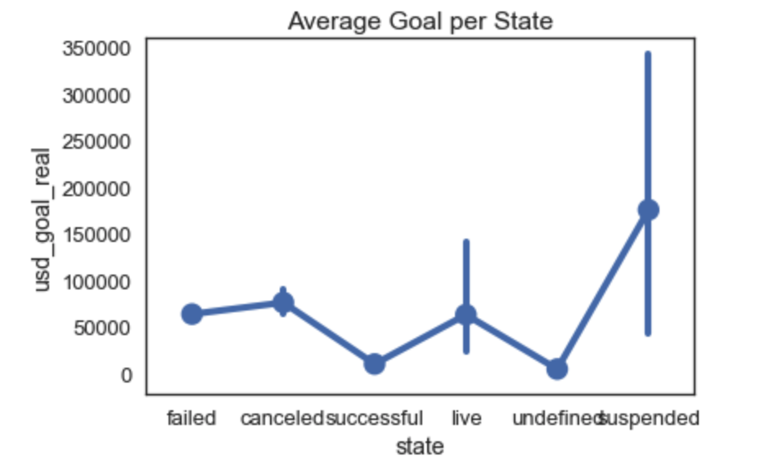
Numbers and Cents
Lower goals to make the project successful?

Slide 22
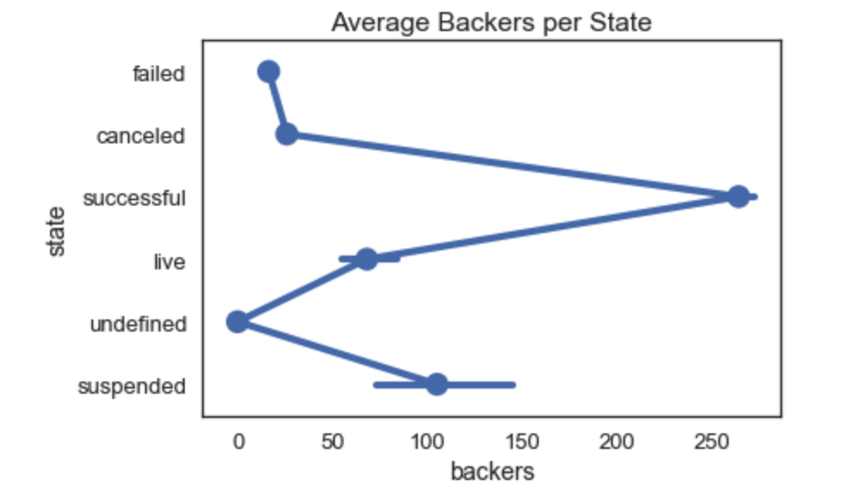
Numbers and Cents
More backers can make the project successful?

Slide 23
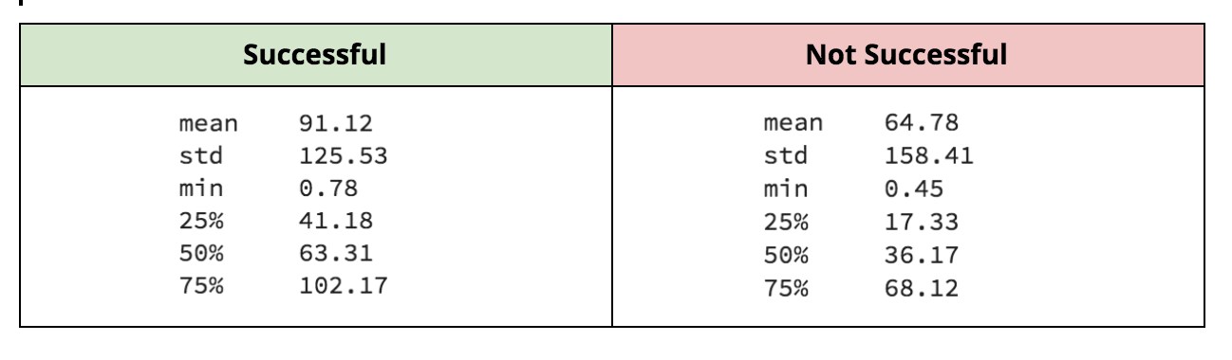
Numbers and Cents
Amounts pledged per backer

Slide 24
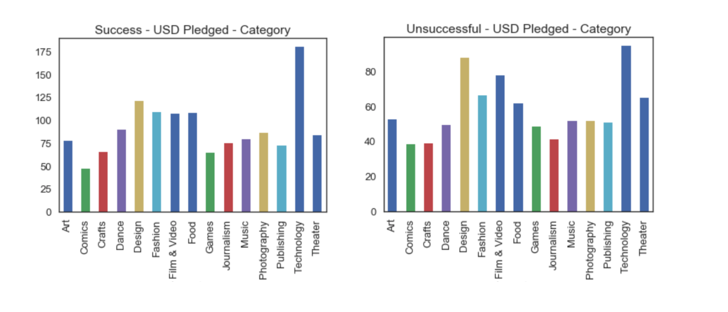
Numbers and Cents
Amounts pledged per backer across categories
(note max dollar amounts)

Slide 25
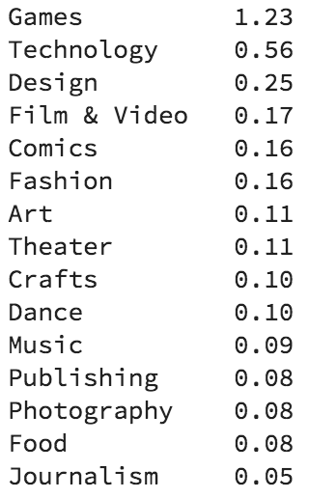
Number and Cents
The bigger they come, the harder they fall...

Slide 26
Summary
For a kickstarter project to be successful:
Dance, Theatre and Comics industries
Lower pledged goals
Increase the number of beckers
For a kickstarter project to raise more funding:
Design, Games, and Technology industries
Avoid summer and winter vacations to launch the projects

Slide 27
Question & Answers
Thank you!

