Slide 1
Houston vs Chicago Housing Price
Grace Yu
8/18/2020

Slide 2
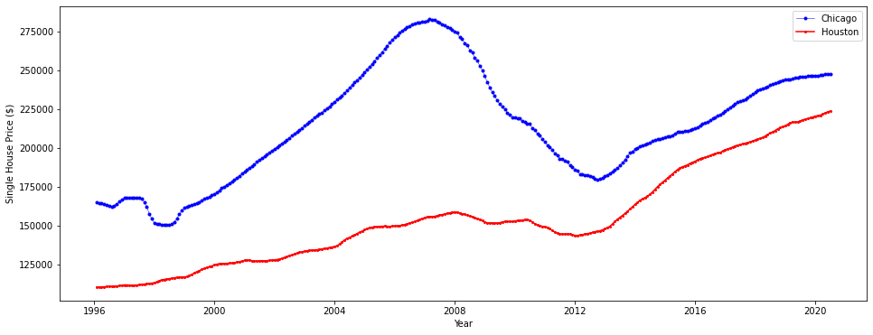
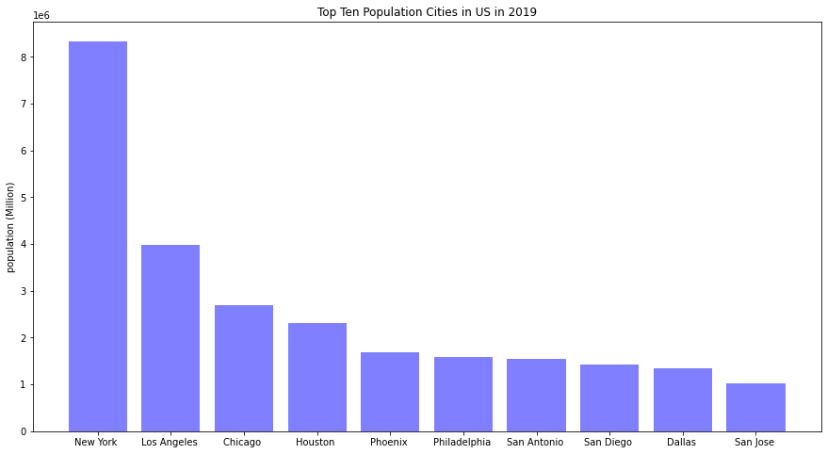
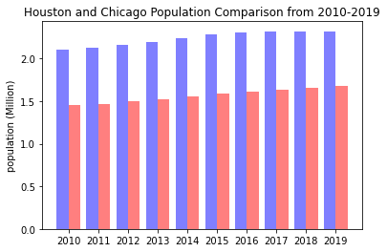
Motivation
Chicago
Houston
Chicago
Houston
Chicago
Houston

Slide 3
Highlights
Compared Chicago and Houston, the third and fourth largest city in population, housing price variation over the last two decades;
Bridge and weld different data sources. Build a complete dataset which includes house price, GDP, employment opportunities, and population for quantitative analysis;
Built multivariable and single variable linear regression model to predict house price;
Performed time series analysis to predict house price for the next 20 years.

Slide 4
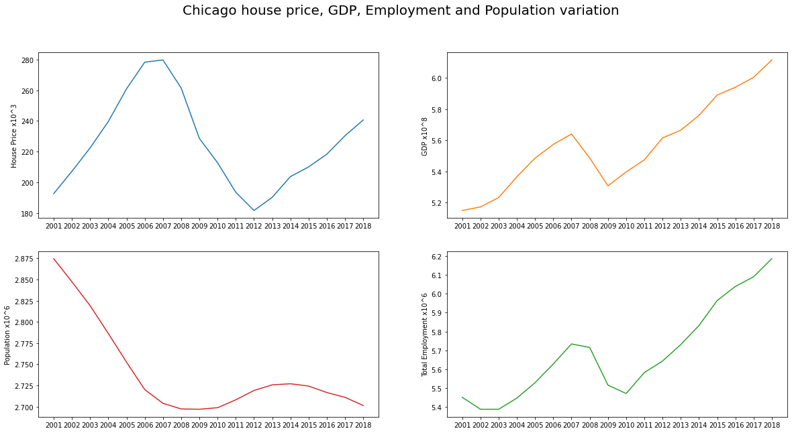
Chicago - All features Overview
House Price
GDP
Two Trends, cyclic
The average price is higher
Big drop for GDP
Mean = 225k
Mean = 557M
Population
Employment
Big drop for jobs in Chicago
Population is decreasing
Mean = 2.74M
Mean = 5.68M

Slide 5
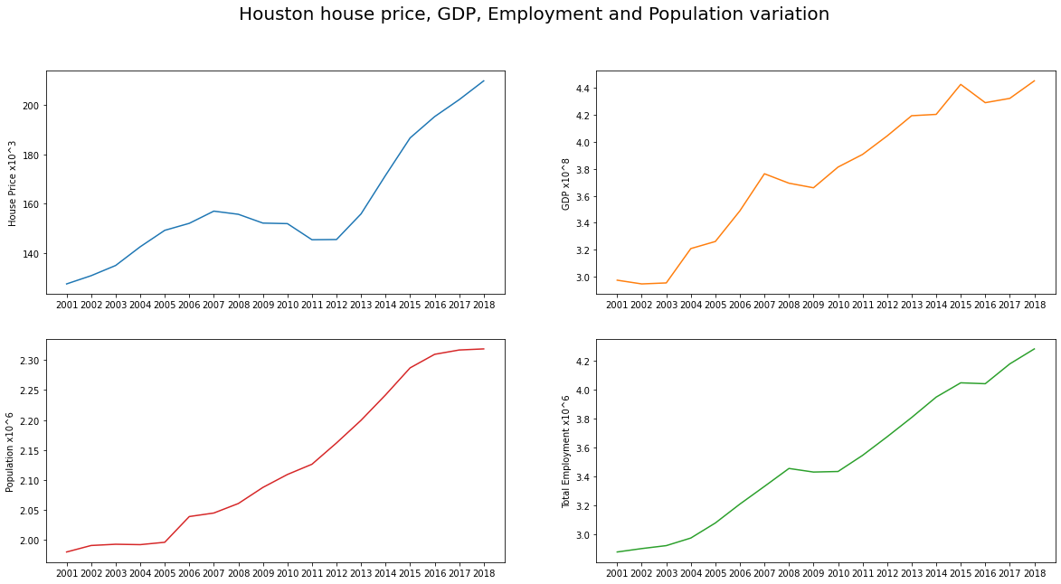
Houston - All features Overview
House Price
GDP
No big drop at 2008
One Trend, overall increase with time
Mean = 159k
Mean = 375M
Population
Employment
Oil Price Crash
Plateau II: 2015-2016
Trend is opposite, increase with time
After 2016 the slope turns flat
Plateau I: 2008-2010
Mean = 2.13M
Mean = 3.51M

Slide 6
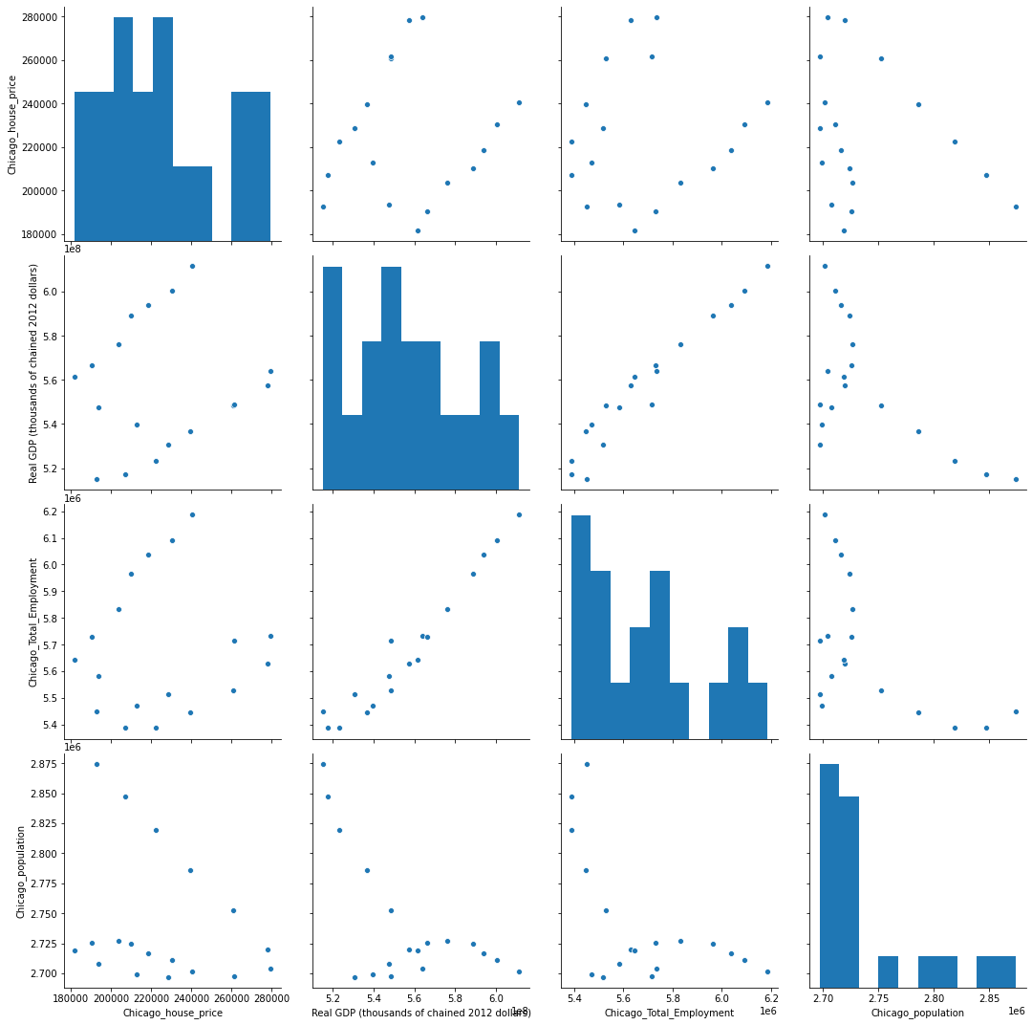
Chicago - All features Cross Plot
House Price
GDP
Employment
Population
House Price
GDP
Employment
Population

Slide 7
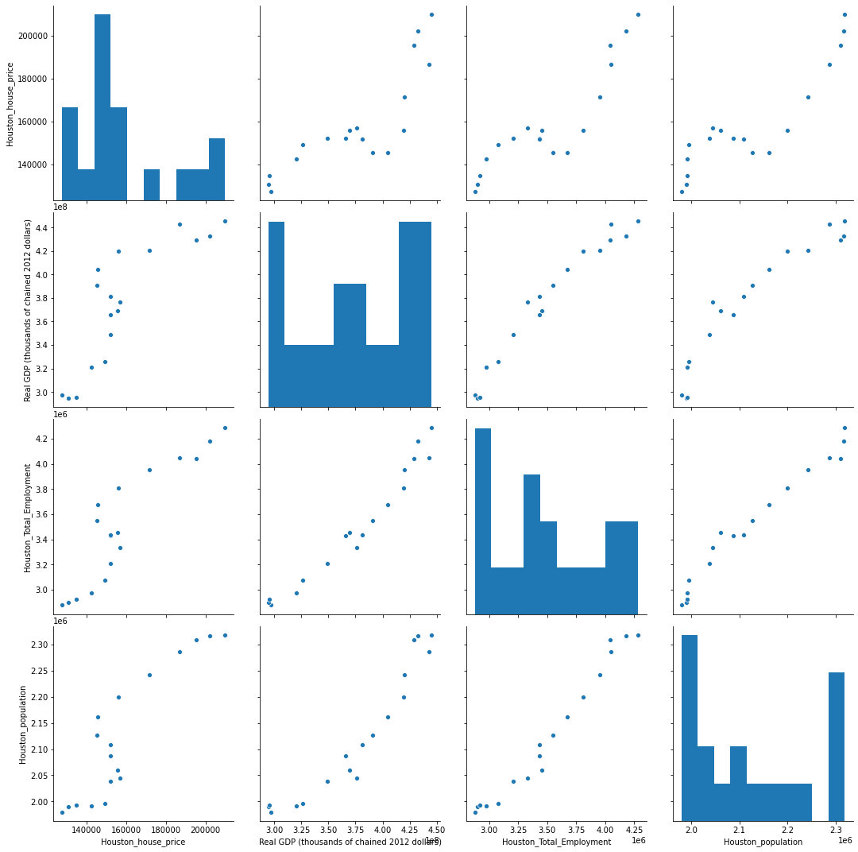
Houston - All features Cross Plot
House Price
GDP
Employment
Population
House Price
GDP
Employment
Population

Slide 8
Chicago - All features Correlation Coefficient
 | House Price | Real GDP (thousands of chained 2012 dollars) | Total Employment | Population
House Price | 1.000000 | 0.100000 | 0.090000 | -0.260000
Real GDP (thousands of chained 2012 dollars) | 0.100000 | 1.000000 | 0.970000 | -0.630000
Total Employment | 0.090000 | 0.970000 | 1.000000 | -0.560000
Population | -0.260000 | -0.630000 | -0.560000 | 1.000000
House price has very low correlation with GDP, total employment and population.
GDP has very high correlation with total employment
GDP has negative relationship with population

Slide 9
Houston - All features Correlation Coefficient
 | House Price | Real GDP (thousands of chained 2012 dollars) | Total Employment | Population
House Price | 1.000000 | 0.840000 | 0.900000 | 0.900000
Real GDP (thousands of chained 2012 dollars) | 0.840000 | 1.000000 | 0.980000 | 0.940000
Total Employment | 0.900000 | 0.980000 | 1.000000 | 0.980000
Population | 0.900000 | 0.940000 | 0.980000 | 1.000000
Instead, House price has very high correlation with GDP, total employment and population.
GDP, total employment and population has very high correlation with each other, so we can drop features like total employment and population, decrease the prediction model order to one.
For Linear Regression model both multi-variable and single variable models are tested.

Slide 10
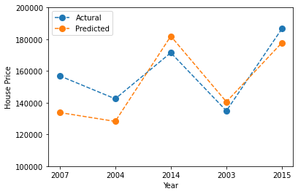
House Price = -38699.16*GDP+61567.69*Total_Employment-1527.66*Population
HOUSTON
Model1 – Multi-variable Linear Regression
Data sources: 17 data points , Training: 75%, instances (12), Testing: 25%, instances (5)

Slide 11
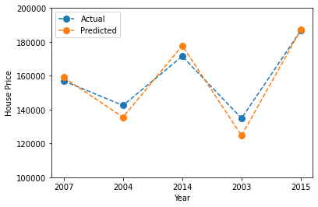
House Price = 0.00042*GDP-695.3363
HOUSTON
Model2 – Single-variable Linear Regression
Better Fit
The simpler the better

Slide 12
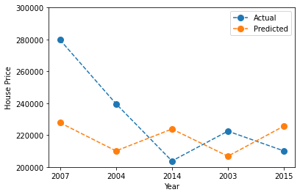
House Price = -11176.31*GDP+12039.75*Total_Employment-9225.55*Population
CHICAGO
Model1 – Multi-variable Linear Regression

Slide 13
Time series analysis
Chicago
Houston
No seasonality
There is a low frequency trend

Slide 14
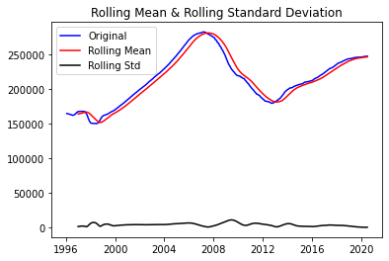
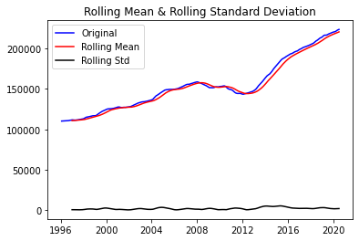
Data Stationary or Non-Stationary
Rolling Statistics
Augmented Dickey-Fuller Test
ADF Statistic: -2.743111756487362
p-value: 0.0668705107489899
Critical Values: 1%: -3.4541800885158525
5%: -2.872031361137725
10%: -2.5723603999791473
ADF Statistic: -0.2864468062292527
p-value: 0.927402056623277
Critical Values: 1%: -3.4541800885158525
5%: -2.872031361137725
10%: -2.5723603999791473
Stationary?
Non-Stationary?

Slide 15
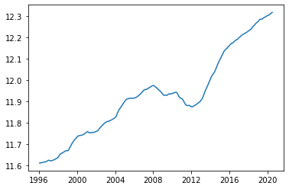
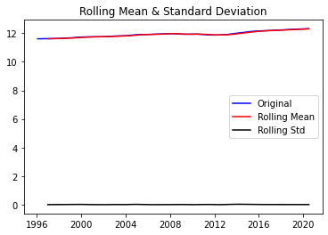
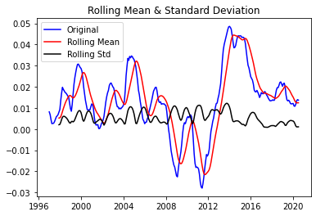
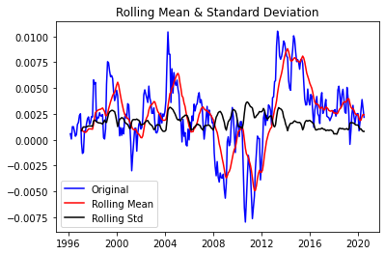
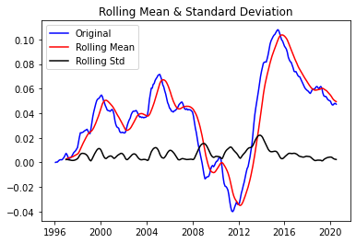
log
HOUSTON
log
Subtract mean
Apply time shift
Apply exponential decay
The best

Slide 16
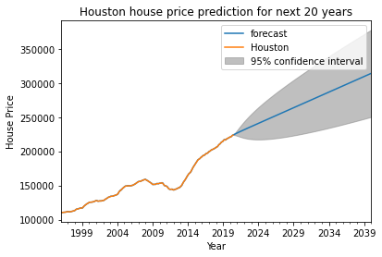
Autoregressive Integrated Moving Average Model
HOUSTON
ARIMA Model (1,1,1)

Slide 17
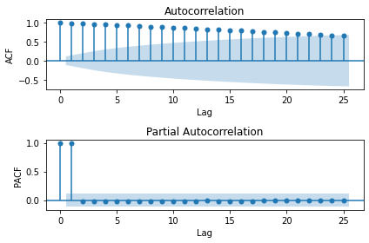
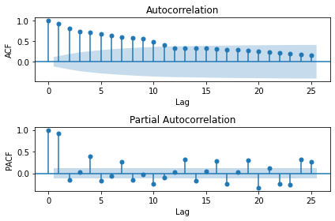
ARIMA Model parameter selection
HOUSTON
Original Data
1st difference

Slide 18
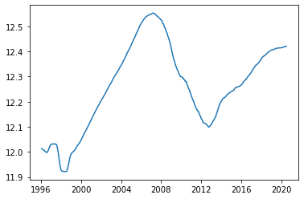
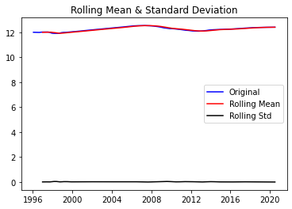
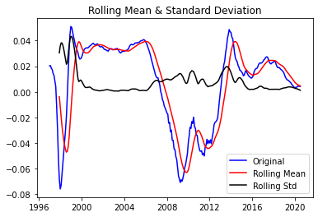
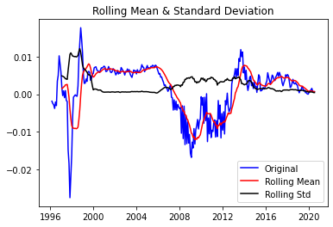
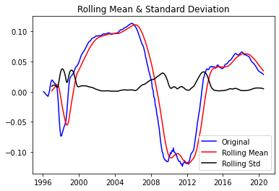
log
None of this better than the original data
CHICAGO
log
Subtract mean
Apply time shift
Apply exponential decay

Slide 19
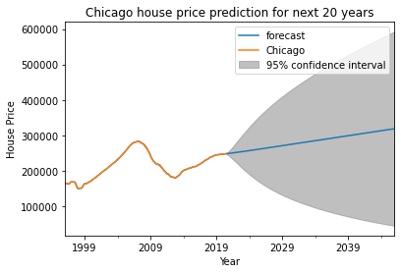
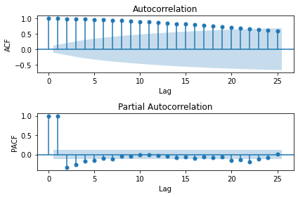
Autoregressive Integrated Moving Average Model - Chicago
ARIMA Model (1,1,1)

Slide 20
Conclusion
Linear regression model was built for Chicago and Houston house price;
Houston house price is highly related to GDP;
Chicago house price is not linear to GDP, total employment, and population;
Time series analysis show very dynamic range for Chicago house price. It could go up or go down with big error range;
Time series analysis for Houston show an overall increase model.

Slide 21
Future Work
Add more features and longer years of observations;
Try more complicated machine learning algorithm.

Slide 22
Data Sources
House Price (single-family house)
https://www.kaggle.com/moezabid/zillow-all-homes-data
Population
https://www.census.gov/data/datasets/time-series/demo/popest/2010s-total-cities-and-towns.html
GDP and Employment
https://www.bea.gov/data/economic-accounts/regional

