Slide 1
London Housing Case Study
Grace Yu
7/17/2020

Slide 2
Objectives: Within Greater London there are 32 London boroughs, and each borough has its own governing council. Their house prices change with time. The objective of this project is to find out which borough has the greatest average housing price increase over approximately two decades, i.e. from year 1998-2018. Data source: https://data.london.gov.uk/download/uk-house-price-index/70ac0766-8902-4eb5-aab5-01951aaed773/UK%20House%20price%20index.xls Steps: 1. Data loading 2. Data cleaning, transforming and visualizing 3. Modeling
Project Overview

Slide 3
Results - Top 15 Borough with housing price increase
Borough Name | Housing Price Increase (2018_average_price/1998_average_price)
Hackney | 6.198286
Waltham Forest | 5.834756
Southwark | 5.516485
Lewisham | 5.449221
Westminster | 5.353565
Newham | 5.305390
City of London | 5.301620
Haringey | 5.134625
Kensington & Chelsea | 5.082465
Lambeth | 4.957751
Camden | 4.935353
Barking & Dagenham | 4.896619
Brent | 4.894554
Islington | 4.844048
Greenwich | 4.763036

Slide 4
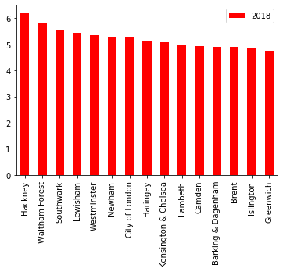
Top 15 Borough with housing price increase Bar Chart

Slide 5
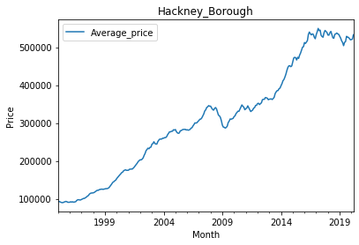
Hackney Borough House Price Trend

Slide 6
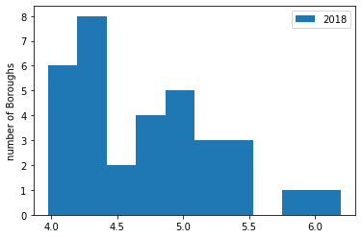
Histogram of all Boroughs housing price increase over the two decades

Slide 7
Conclusion
Hackney Borough has the greatest housing price increase over the last two decades in Greater London area. The increase ratio is especially high, needing more in-depth investigation of reasons.

