Slide 1

Bio727P Group software project
Team Celine
Celine, Amanah, Gracia & Pavan
03.02.2021

Slide 2
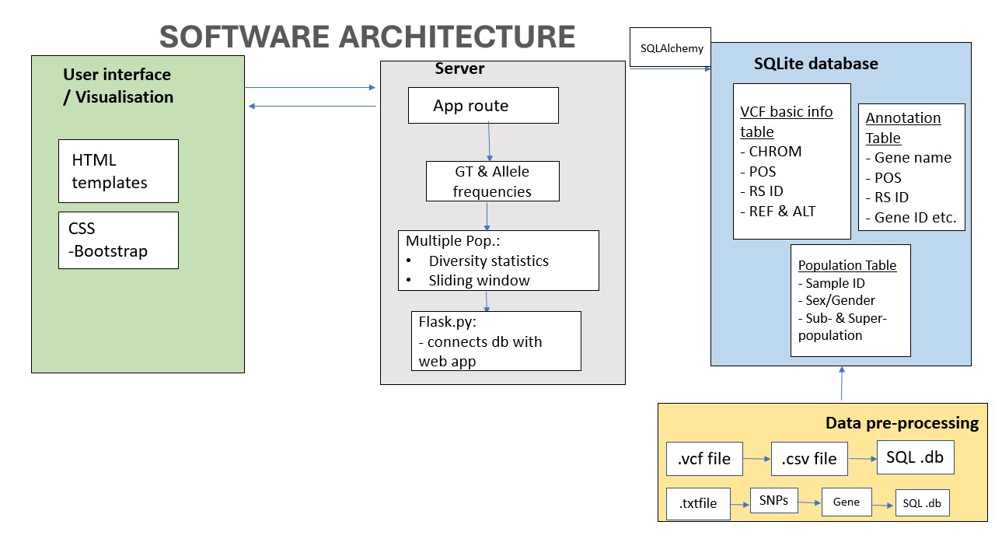

Slide 3
Completed tasks
Extraction of VCF files
Building SQL database
Filter for one population using bcftools ➔ focused on GBR for now
Researched on summary statistics

Slide 4
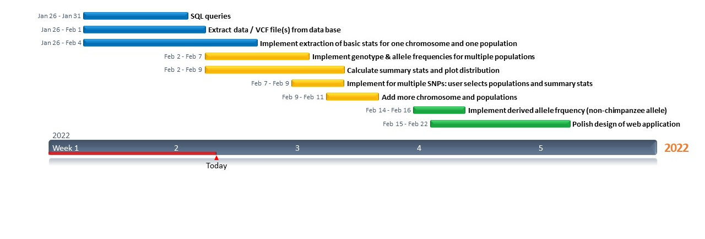
Gantt chart update

Slide 5
Next week‘s milestones
Implement genotype frequencies
Calculate allele frequencies
Connect flask and SQL database
Build very basic web app template
Derive summary statistics from successful GT & allele frequencies

