Slide 1

Bio727P Group software project
Team Celine
Celine, Amanah, Gracia & Pavan
10.02.2021

Slide 2
SOFTWARE ARCHITECTURE
SQLAlchemy
User interface / Visualisation
SQLite database
Server
App route
AF/GT table
- CHROM
- POS
- Unique ID
- GT
- AF
Annotation Table
- CHROM
- POS
- RS ID
- REF & ALT​
- IMPACT
- Gene ID & Name
HTML templates
GT & Allele frequencies
CSS
-Bootstrap
Multiple Pop.:
Diversity statistics
Sliding window
Data pre-processing
Flask.py:
- connects db with web app
Sample Table
- Sample ID
- Sex/Gender
- Sub- & Super-population
Selecting population: filtering for samples
.vcf file
.csv file
SQL .db
.txtfile
SNPs
Gene
SQL .db
Notes:
genotype frequencies, and allele frequency

Slide 3
Celine's Workspace – pls ignore
- need to refine indels and connect GBR table after frequencies are calculated
Gene names table
CHROM
POS​
RS ID​
Unique ID {{PK}}
22:10519265:CA:C
REF & ALT
GENE name
GENEID
IMPACT
Genotype table – phased.vcf
CHROM
POS
Unique ID {{FK}}
22:10519265:CA:C
Allele frequencies for REF & ALT
GT frequencies
Population-sample table
- SAMPLE ID {{PK}}
- Sex
- Biosample ID
- Population code & name
- Superpopulation code % name
- DATA

Slide 4
Completed tasks (07/02 – 11/02/2022)
Refined data base (removed indels) and connect GBR table after frequencies are calculated ➔ Celine
Connect flask and SQL database ➔ Celine
Setting up query function to search the DB ➔ Celine
Build very basic web app template ➔ Celine
Properly research summary stats and how to visualise them ➔ Amanah & Pavan
Calculate genotype frequencies ➔ Gracia & Amanah
Calculate allele frequencies ➔ Gracia
Prepare project update PPT ➔ Gracia

Slide 5
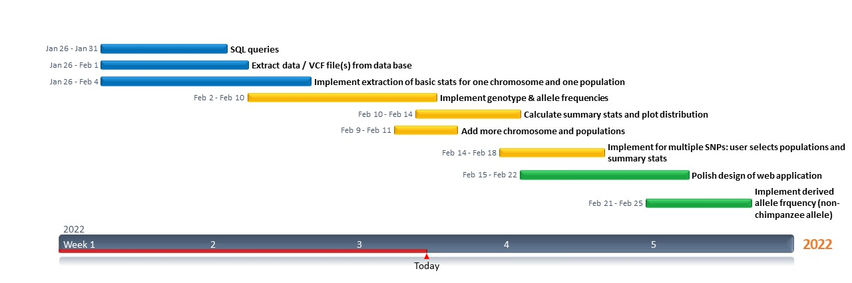
Gantt chart update

Slide 6





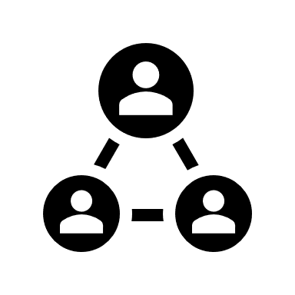

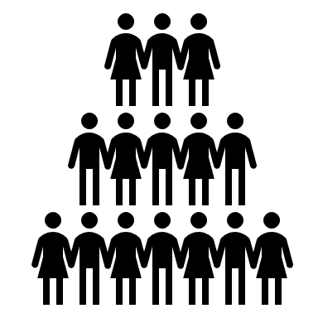
Next week‘s milestones (14/02 – 18/02/2022)
Derive summary statistics from GT & allele frequencies
Connect R Script to flask /web app / data base
Sliding window & plots
Web application: HTML templates & result pages
Add more populations
Optional: add more chromosomes

Slide 7


Questions
Do indels count as SNPs?
Who picks the 5 populations? User or us as developers?
Genotypes: 0/0, 0/1, 1/0?
Visualisation of GT frequencies ➔ on summary stats! (if any additional visualisation that might be useful, that’s fine too)
Share data base via some online cloud (link) probably
Do you have any questions for us?

