Slide 1

Bio727P Group software project
Team Celine
Celine, Amanah & Gracia
17.02.2021

Slide 2
SOFTWARE ARCHITECTURE
User interface / Visualisation
SQLite database
Server
App route
Main table
- Unique ID
- CHROM
- POS
- RS ID
- REF & ALT
- AF per pop
- AC per pop
- Gene Name
- Gene ID
- Impact
- Gene Aliases
HTML templates
Flask.py:
- connects db with web app
GT & Allele frequencies
CSS
-Bootstrap
Multiple Pop.:
Diversity statistics
Sliding window
Data pre-processing
Sample Table
- Sample ID
- Sex/Gender
- Sub- & Super-population
Selecting population: filtering for samples
.vcf file
.csv file
SQL .db
.txtfile
SNPs
Gene
SQL .db
Notes:
genotype frequencies, and allele frequency

Slide 3




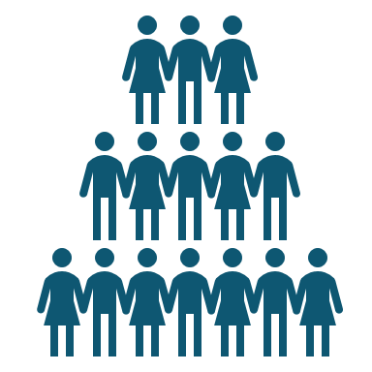
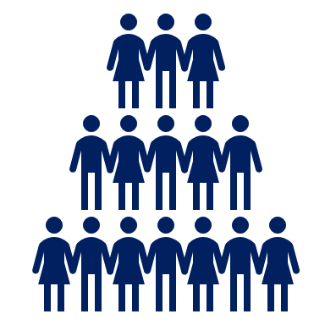
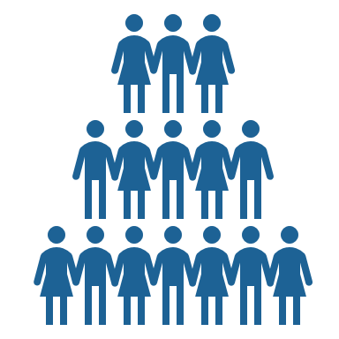
Completed tasks (14/02 - 18/02/2022)
Calculate summary statistics
Shannon Diversity, Tajima's D – Celine
Heterozygosity Index – Gracia
FST – Amanah
Sliding window & plots – Amanah & Gracia
Gene Aliases added and combine data to one table – Gracia
Documentation – Amanah
Flask: added routes - Celine
html pages (search results and statistics/population selection)
Statistics added: shannon
Add more populations – group decision
Extract population data and calculate gt & allele freqs – Celine & Gracia

Slide 4
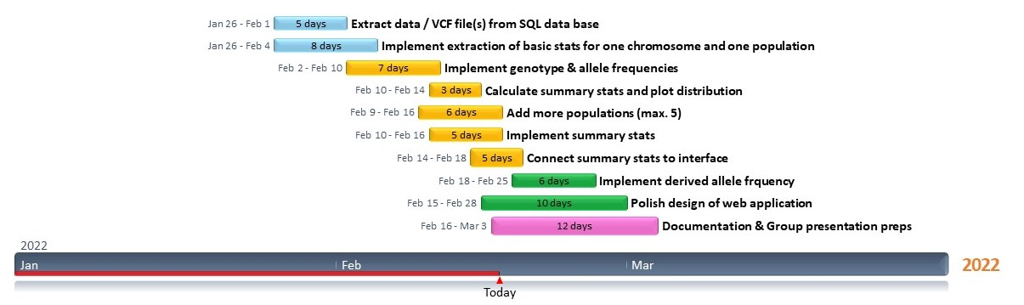
Gantt chart update

Slide 5






Next week‘s milestones (21/02 – 25/02/2022)
Connect summary stats calculation and sliding window for a query to web app – Celine
Download text file – Celine
Documentation – Amanah & Gracia
Polishing of web app (incl. Design → HTML templates) – Celine
Derived chimpanzee allele frequency – Amanah
==> making sure what we are producing makes sense!

Slide 6


Questions
Which types of genes should we keep? NcRNA (example: ENSG00000232073 ***), pseudogenes, or only DNA genes?
Derived allele frequency → theta threshold?
Is it a problem that no rsIDs for all SNPs?
Documentation structure?
Any questions for us?

