Slide 1
Understanding contraceptive discontinuation as part of sustainable mCPR growth
Evidence from the Ethiopia DHS 2024–25 contraceptive calendar
1

Slide 2
Sustaining mCPR growth depends on entry and retention - which is a stock-and-flow problem
New / returning
modern users
Modern method
user stock
Exits from
modern use
Current users can continue,
switch, or exit
New entrants also face future
discontinuation risk
Modern-use exit affects the mCPR
numerator
1
2
3
Discontinuation is not simply a method outcome. It affects whether a woman remains in the modern-user stock.
The method mix of new starts shapes where future retention needs will concentrate.
If a woman stops a modern method and does not immediately move to another modern method, she leaves the mCPR numerator.
2
2
2
2
2

Slide 3
Questions guiding the discontinuation analysis
1
What methods are women using and how is method mix changing over time?
2
When are methods discontinued, and how does timing differ by method?
3
Why are methods discontinued, and how do reasons vary by method and timing?
4
How do discontinuation, switching, and modern-use exit vary across subgroups and geographies?
5
How do discontinuation pathways affect whether women remain in modern use?
6
What longer trajectories follow discontinuation, including stable use, churn, re-entry, or prolonged nonuse?
7
What is the population-level burden of modern-use exit, and what could increased retention mean for mCPR?
3

Slide 4
Modern contraceptive use in Ethiopia
Method mix among current modern users
Current modern use
22.7%
of all women aged 15–49 currently use a modern method
Share of current modern users (%)

Slide 5
Entry methods set the denominator for future retention risk
Overall initiation mix
Initiation mix by calendar year
Injectables
Implants
Pill
IUD
EC
Other modern
Non-modern methods

Slide 6
About 40% of modern-method episodes are discontinued within 12 months. Pills and injectables have the highest 12-month discontinuation rates.
70%
Pill 67.4%
60%
50%
Injectables 44.5%
40%
25.6%
All modern 39.1%
Cumulative discontinuation probability
30%
Other modern 36.2%
16.2%
IUD 24.7%
20%
Implants 16.0%
10%
0%
0
3
6
9
12
Months since method initiation
Other modern: male condom, female and male sterilization, LAM, SDM, and other modern methods; excludes IUD. All modern and Other modern exclude EC.

Slide 7
Injectables account for most method starts and have the second-highest 12-month discontinuation rate
Percent
Share of all method starts
12-month discontinuation

Slide 8
Understanding discontinuation reasons, risk factors, and regional differences
1
Reasons
2
Risk factors
3
Regions
Which reasons account for discontinuation and when do they emerge?
What factors are associated with a higher discontinuation rate?
Which regions have higher discontinuation rates and why?

Slide 9
Different reasons for discontinuation call for different responses
Actionable and can be addressed by programs
Not a program failure / retained in modern use
Side effects / health concerns
Counseling quality, side-effect management, method-fit support
Wanted to become pregnant
Access / cost / convenience barriers
Stopping reflects reproductive intention, not a service gap.
Resupply, availability, affordability, service delivery
Husband/partner disapproval
Changed preferences / circumstances
Partner, community, and provider engagement
Stopping can be appropriate; interpretation depends on intention, destination, and later outcomes.
Method failure / unintended pregnancy
Correct use, method fit, follow-up, quality of counseling
Successful modern switch
Wanted a more effective method
She stops a method but remains protected because she is able to switch to another modern method right away.
Switching support and access to the preferred method
Program interpretation depends on destination: method discontinuation is diagnostic; modern-use exit is the mCPR-relevant outcome
9

Slide 10
Nearly half of discontinuations reflect a desire to become pregnant
Wanted to become pregnant
47.6
Wanted a more effective method
13.9
Other
13.3
Side effects / health
12.8
Access / cost / convenience
9.5
Method failure / pregnancy while using
2.2
Husband/partner disapproved
0.8
Other includes infrequent sex/husband away, marital dissolution/separation, up to God/fatalistic, difficult to get pregnant/menopausal, other, and don’t know.

Slide 11
Discontinuation reflects pregnancy intentions and potential service gaps
47.6%
39.1%
13.3%
Not a program failure
Potentially actionable
Circumstantial
Wanted to become pregnant.
Side effects or health, access barriers, wanting a more effective method, method failure, or partner disapproval.
Infrequent sex or partner away, separation, fatalistic reasons, reduced fertility or menopause, other, or don’t know.

Slide 12
Reasons for discontinuation differ by method
Share of recorded discontinued episodes (%)
Wanted to become pregnant
Method experience or access
Husband/partner disapproved
Other reasons
Method experience or access includes failure, wanting a more effective method, side effects/health, and access, cost or inconvenience; Other reasons includes infrequent sex/partner away, separation, reduced fertility/menopause, fatalistic reasons, other and don’t know. Other modern includes condoms, sterilization, LAM, SDM and residual modern methods; IUD is separate and EC is excluded.
Percentages sum to 100 within each method before rounding.

Slide 13
Method experience and access contribute most to 12-month discontinuation across methods
2.2
Pill
18.7
28.2
18.4
67.4
0.6
Injectables
18.4
18.8
6.8
44.5
3.8
Other modern methods
19.0
13.4
36.2
1.4
IUD
9.7
13.5
24.7
1.7
Implants
6.1
8.3
16.0
0.6
All modern methods
14.9
17.0
6.7
39.1
0
20
40
60
80
12-month cumulative discontinuation (%)
Wanted to become pregnant
Method experience or access
Husband/partner disapproved
Other reasons
Method experience or access includes failure, wanting a more effective method, side effects/health, and access, cost or inconvenience. Other reasons includes infrequent sex/partner away, separation, reduced fertility/menopause, fatalistic reasons, other and don’t know. Other modern includes condoms, sterilization, LAM, SDM and residual modern methods. IUD is separate and EC is excluded.

Slide 14
Who is more likely to discontinue a modern method?
Characteristic
Adjusted 12-month probability (%)
Estimate (95% CI)
Age at start
15–19
38.6 (32.0–45.2)
20–24
38.2 (34.0–42.5)
25–34
39.9 (36.5–43.4)
35–49
38.5 (33.4–43.5)
Parity at start
0
55.7 (48.3–63.2)
1–2
38.3 (35.2–41.4)
3+
35.0 (31.1–38.9)
Education
None
41.5 (37.2–45.7)
Primary
37.8 (34.1–41.6)
Secondary+
38.8 (35.4–42.1)
Household wealth
Poorest 40%
41.7 (37.0–46.5)
Middle 20%
38.4 (33.8–42.9)
Richest 40%
38.2 (35.0–41.3)
Residence
Rural
38.6 (35.7–41.5)
Urban
39.8 (35.3–44.2)
0
20
40
60
12-month cumulative probability of ending the original method

Slide 15
Subnational analysis shows that Tigray has the highest 12-month modern-method discontinuation. Method experience and accessibility represent main reasons for discontinuation.
Ending the original method (%)
Reasons among first-year discontinuations (%)
National 38.9
Wanted to become pregnant
Method experience / access
Partner disapproved
Other
Tigray
51.0
Tigray
37.2
46.3
0.4
16.1
Benishangul-Gumuz
50.4
Benishangul-Gumuz
30.5
36.5
1.3
31.6
Gambella
47.8
Gambella
27.4
45.0
0.9
26.8
Afar
47.7
Afar
30.3
41.9
0.0
27.9
Central Ethiopia
46.5
Central Ethiopia
41.7
48.2
1.2
8.9
Somali (30 episodes)
45.8
Somali (11 events)
19.8
41.1
0.0
39.1
Harari
41.4
Harari
30.2
47.7
0.0
22.1
South Ethiopia
40.7
South Ethiopia
31.5
43.5
0.9
24.1
Oromia
39.3
Oromia
38.7
43.5
2.6
15.2
Amhara
38.4
Amhara
41.1
39.3
1.1
18.4
Addis Ababa
33.5
Addis Ababa
34.1
45.9
0.0
20.0
South West Ethiopia
32.3
South West Ethiopia
35.2
52.0
1.8
11.0
Sidama
31.2
Sidama
32.3
56.8
0.6
10.3
Dire Dawa
29.9
Dire Dawa
35.7
49.4
1.3
13.6
0
20
40
60
Other includes infrequent sex or husband away and marital dissolution or separation. It also includes reduced fertility or menopause, fatalistic reasons, other, and don’t know.

Slide 16
Why do regions differ in contraceptive discontinuation?
01
02
03
Measure regional
variation
Explain regional
gaps
Link service
context
Where is risk high and
the burden large?
Do different users and
methods explain the gap?
Which conditions track
the remaining gaps?
Compare discontinuation,
modern-use exits, and mCPR.
Use adjusted survival models
and Oaxaca–Blinder
decomposition to assess how
method mix and differences
in characteristics such as age,
parity, and wealth, among
others, explain regional gaps.
Use multilevel survival
models linked to service data
to examine associations with
supply, access, counseling,
and support for switching.

Slide 17
mCPR and discontinuation guide targeting
Higher
Improve access
and retention
Support continuation
and switching
Low uptake, high discontinuation
High uptake, high discontinuation
Expand method access and
reduce exits.
Strengthen method choice,
switching, and follow-up.
Discontinuation
Build demand, access,
and continuity
Sustain uptake
and continuation
Low uptake, low discontinuation
High uptake, low discontinuation
Address barriers to uptake
and support continued use.
Maintain continuity and study
practices worth adapting.
Lower
Lower modern uptake
Higher modern uptake
Modern contraceptive prevalence (mCPR)

Slide 18
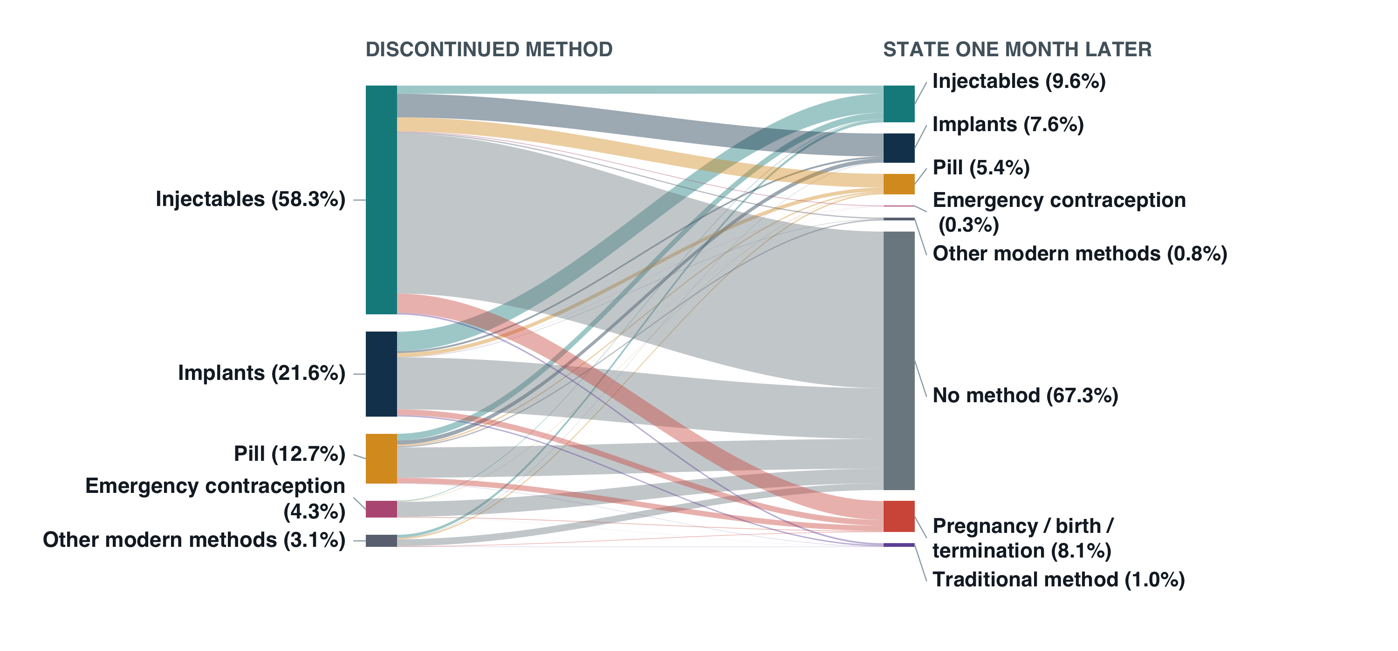
One month after stopping a modern method for reasons other than wanting pregnancy, 67% were using no method

Slide 19
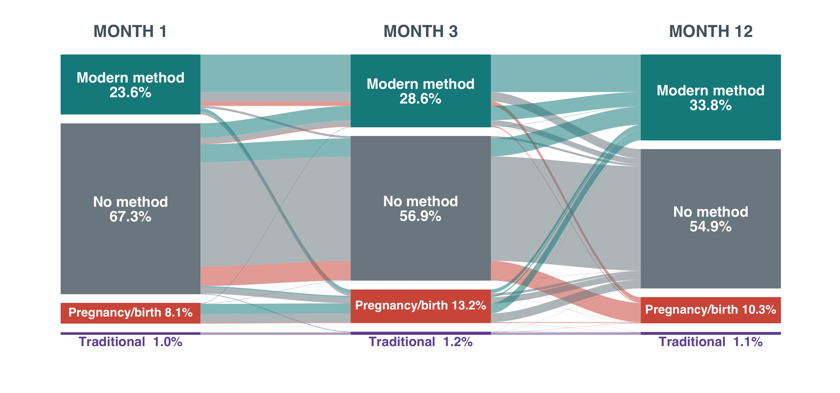
Modern use rises by month 12, but nonuse persists

Slide 20
A single discontinuation tells us what happened once. Trajectories show whether it becomes a pattern.
Contraceptive use changes as women’s needs and circumstances change. Women may start, stop, switch methods, and return to use over time.
Following each woman across five years reveals patterns that individual episodes cannot show.
Separate switching from interruptions
Distinguish brief gaps from prolonged nonuse
Identify repeated stopping and restarting
A change in modern method can maintain continuous use without a gap.
Short gaps followed by return differ from a long period without a method.
Repeated stops and restarts can reveal instability that individual episodes miss.
Brief gap and return
Continuous modern use
Prolonged nonuse
Stops, switches, and returns
Modern method A
Modern method B
Traditional method
No method
Pregnancy or birth

Slide 21
Trajectories distinguish switching from interruptions in use. Gaps may be temporary, repeated, or sustained.
Illustrative profiles
YEAR 1
YEAR 2
YEAR 3
YEAR 4
YEAR 5
Stable modern use
Continuous modern use
Switch with continuity
No gap in modern use
Modern to traditional
Switch outside modern use
Brief gap and return
Short gap, then return
Repeated churn
Multiple stops and restarts
Early exit
Prolonged nonuse
Predominant nonuse
Little modern method use
Modern method A
Modern method B
Traditional method
No method
Pregnancy or birth
Compare profile prevalence, user characteristics, and regional concentration to identify priorities for switching support, continuity of supply, and return to use.

Slide 22
From discontinuation diagnostics back to mCPR
The analysis shows when methods end and what follows. We can use these risks and transitions to estimate users retained or lost and the implications for mCPR.

Slide 23
Sustained mCPR growth depends on entries and continued modern use
New and returning users
At the start of the year
At year end
Enter modern use during the year
Current modern users
Modern users at year end
Continued use and switching
Women already using a modern method
Continued users, new adopters, and women who return
Exits from modern use
No method or traditional use at year end
A method switch can maintain modern use.

Slide 24
Discontinuation risks can inform user counts and mCPR impact
Estimate users at risk
Apply relevant risks
Estimate users affected
Use the number of women aged 15–49, mCPR, and current method mix to estimate current users.
Use 12-month life-table discontinuation probabilities by method and reason.
Estimate discontinuations and women affected by method, reason, and in total.
Add new and returning users when they enter.
Account for time already using a method and when new users start.
Track switching and return to estimate exits from modern use.
Focus on potentially addressable gaps
Estimate what support could change
For example, stopping because of side effects while pregnancy prevention is still desired.
Compare support scenarios. Report additional modern users at year end and the corresponding change in mCPR.

Slide 25
Estimated 12-month discontinuations by method
Women aged 15–49: 34.06 million
mCPR: 22.7%
Current modern users: 7.74 million
Method | Current mix (%) | Current users | 12-month risk (%) | Estimated discontinuations
Injectables | 57.5 | 4,455,000 | 44.5 | 1,981,000
Implants | 29.6 | 2,288,000 | 16.0 | 367,000
Pill | 7.1 | 547,000 | 67.4 | 369,000
IUD | 2.5 | 190,000 | 24.7 | 47,000
Other modern methods | 2.5 | 194,000 | 36.2 | 70,000
EC | 0.9 | 66,000 | Not applied | Not estimated
Total, excluding EC | 99.1 | 7,675,000 | 36.9 | 2,835,000

Slide 26
Estimated 12-month discontinuations by reason
Current users covered: 7.67 million (excluding EC)
Total: 2.83 million
Reason | Estimated discontinuations | Share of estimated discontinuations (%)
Wanted to become pregnant | 1,086,000 | 38.3
Other | 469,000 | 16.5
Side effects / health | 449,000 | 15.8
Wanted a more effective method | 416,000 | 14.7
Access / cost / convenience | 317,000 | 11.2
Method failure / pregnancy while using | 60,000 | 2.1
Husband/partner disapproved | 38,000 | 1.3
Total | 2,835,000 | 100.0

Slide 27
Appendix: interpreting the preliminary user counts
Main takeaways
Limitations
About 7.74 million women currently use a modern method. Applying first-year risks implies 2.83 million original-method endings in this planning scenario.
Injectables account for about 70% of estimated endings. Their large user population and substantial discontinuation risk make continuation and switching support especially relevant.
Side effects or health concerns account for about 449,000 endings and access barriers for 317,000. Wanting pregnancy accounts for 38.3% of estimated endings.
Current users have different durations of use. Their next-12-month risks require probabilities conditional on how long they have already used the method.
Method endings do not directly measure losses from modern use. Switching and returning to use can preserve mCPR. This calculation also excludes future entrants.
Counts depend on population and pooled risk assumptions, exclude EC, and have no uncertainty intervals yet. Reported reasons do not establish how much discontinuation an intervention could prevent.

Slide 28
Focus on potentially actionable discontinuation
The next regional analyses and user-count illustrations focus on method experience and access reasons. Later mCPR scenarios describe overall growth.

Slide 29
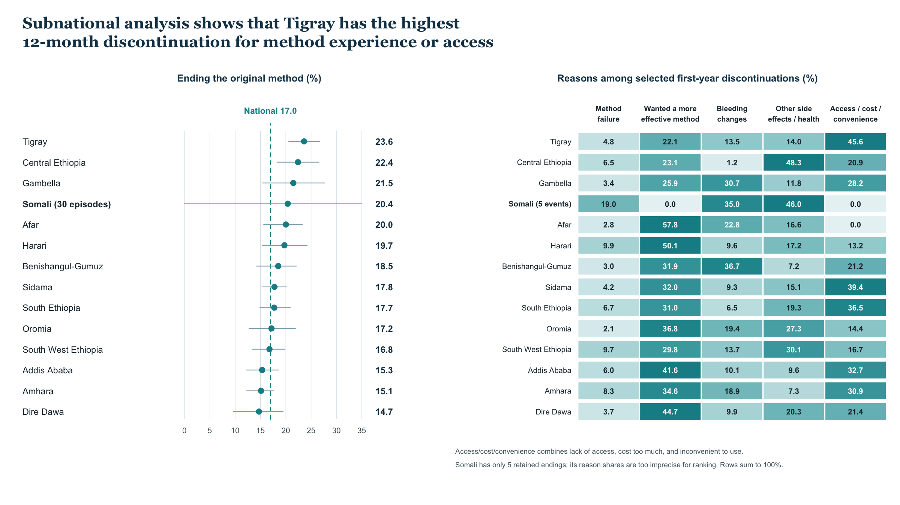

Slide 30
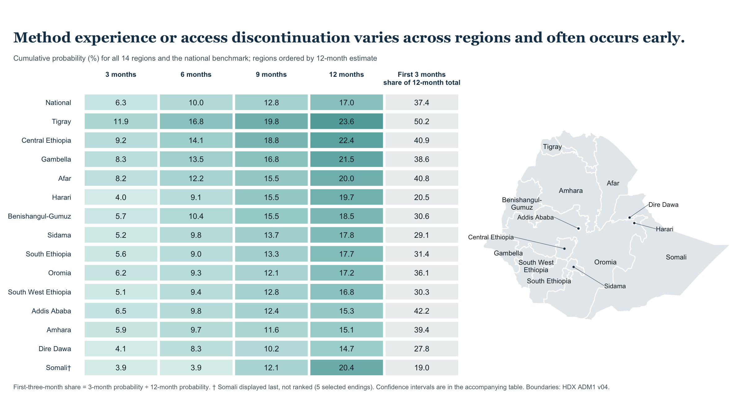

Slide 31
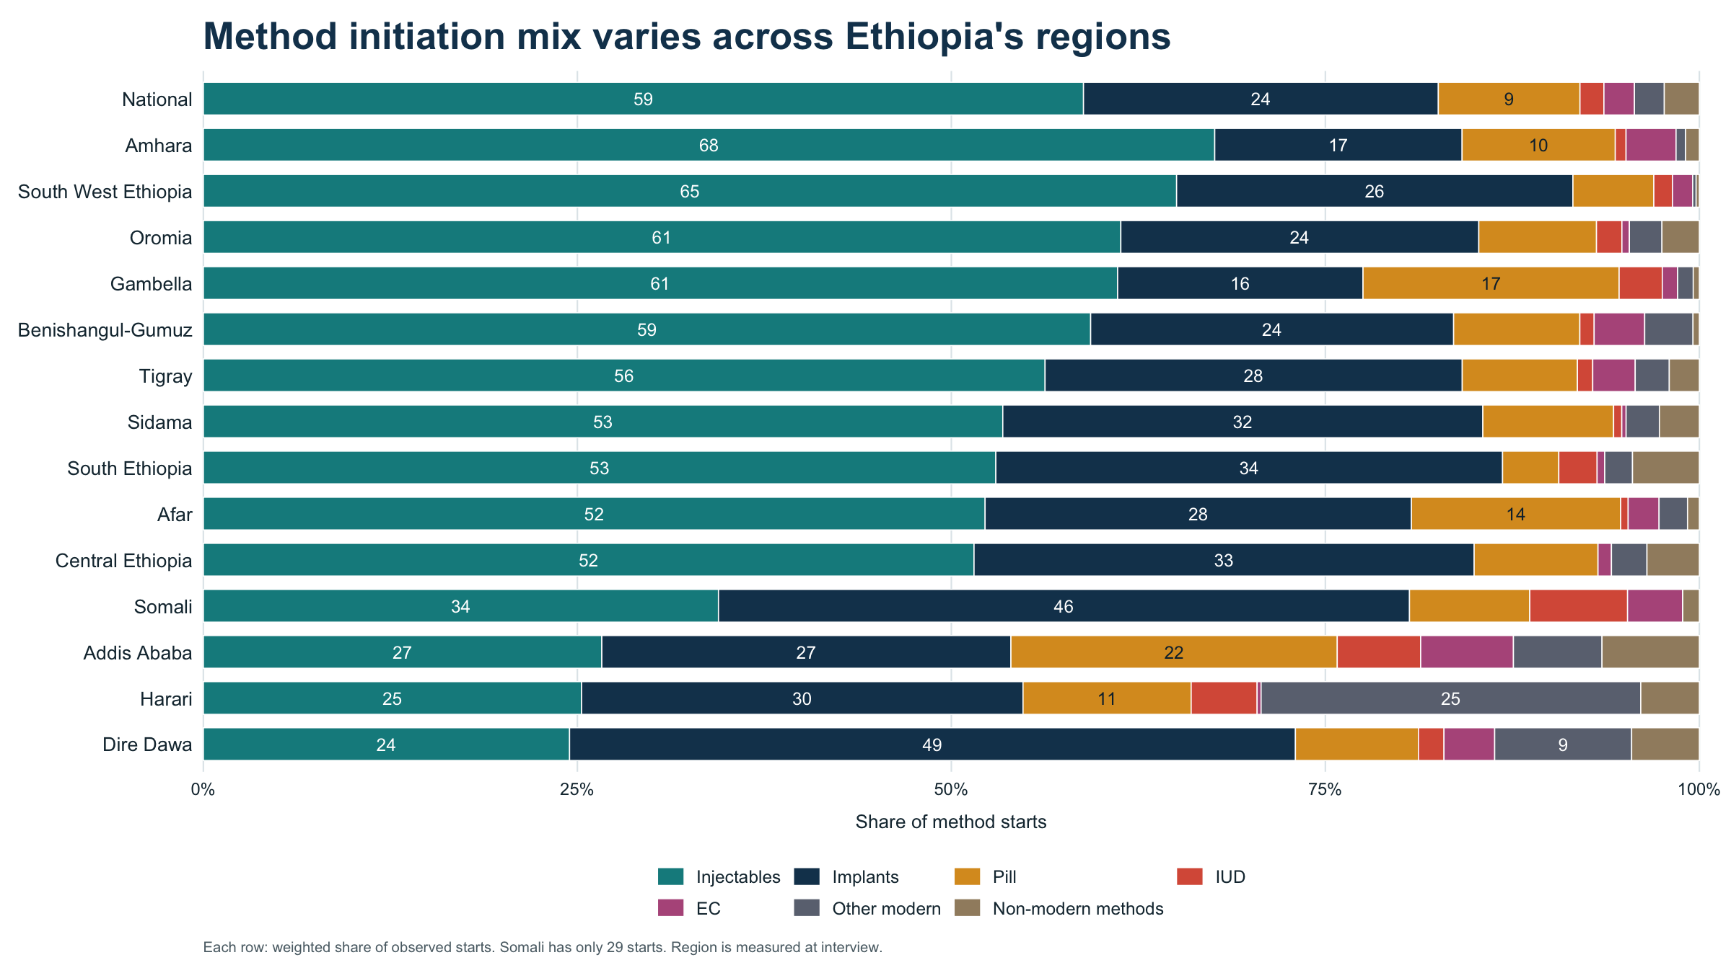

Slide 32
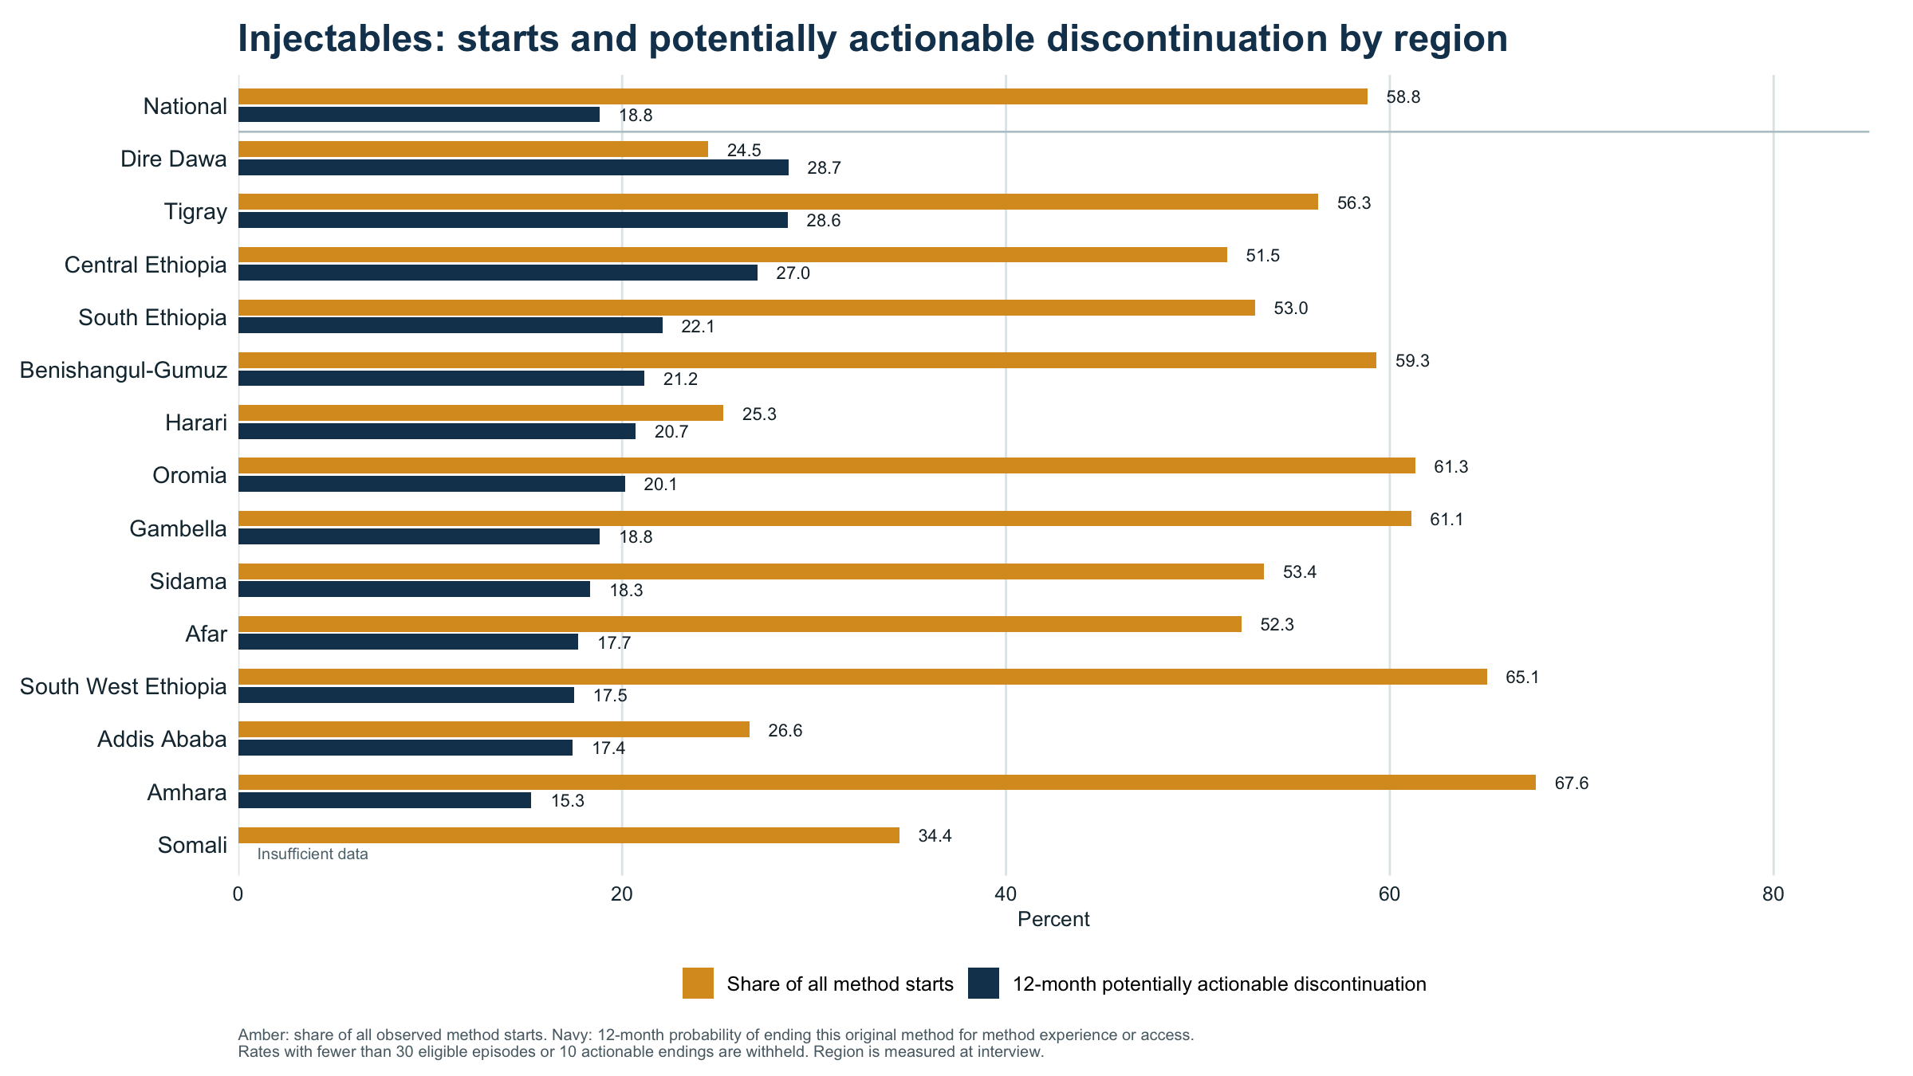

Slide 33
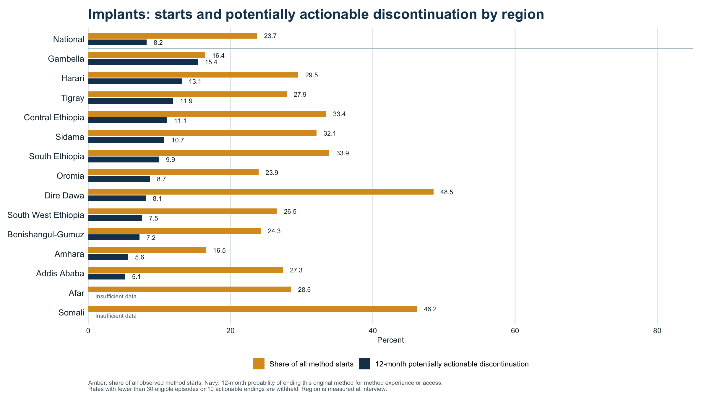

Slide 34
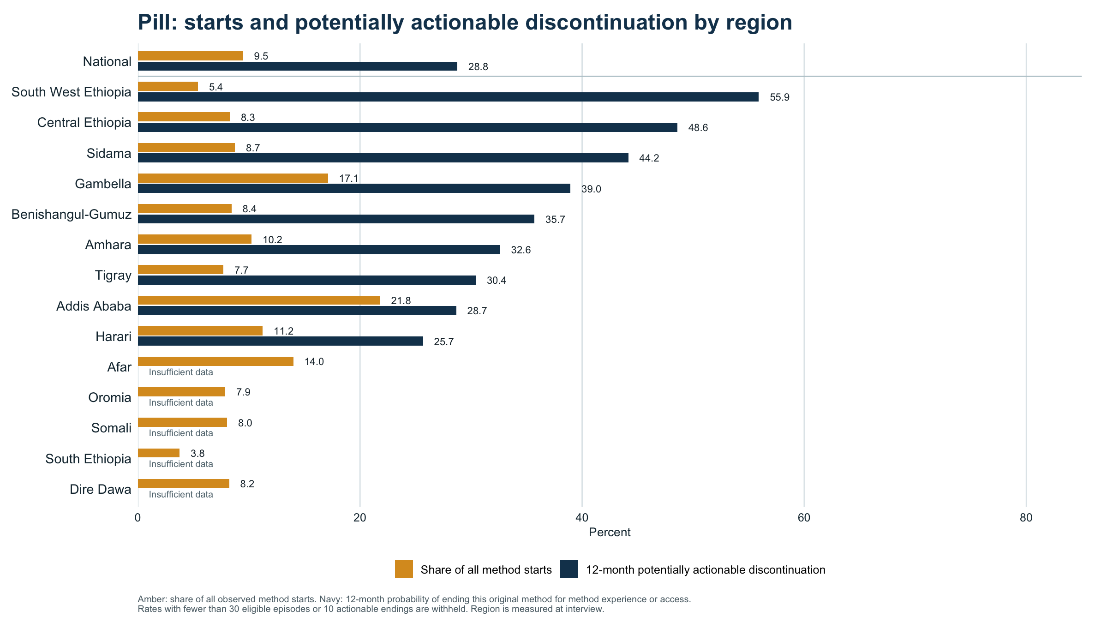

Slide 35
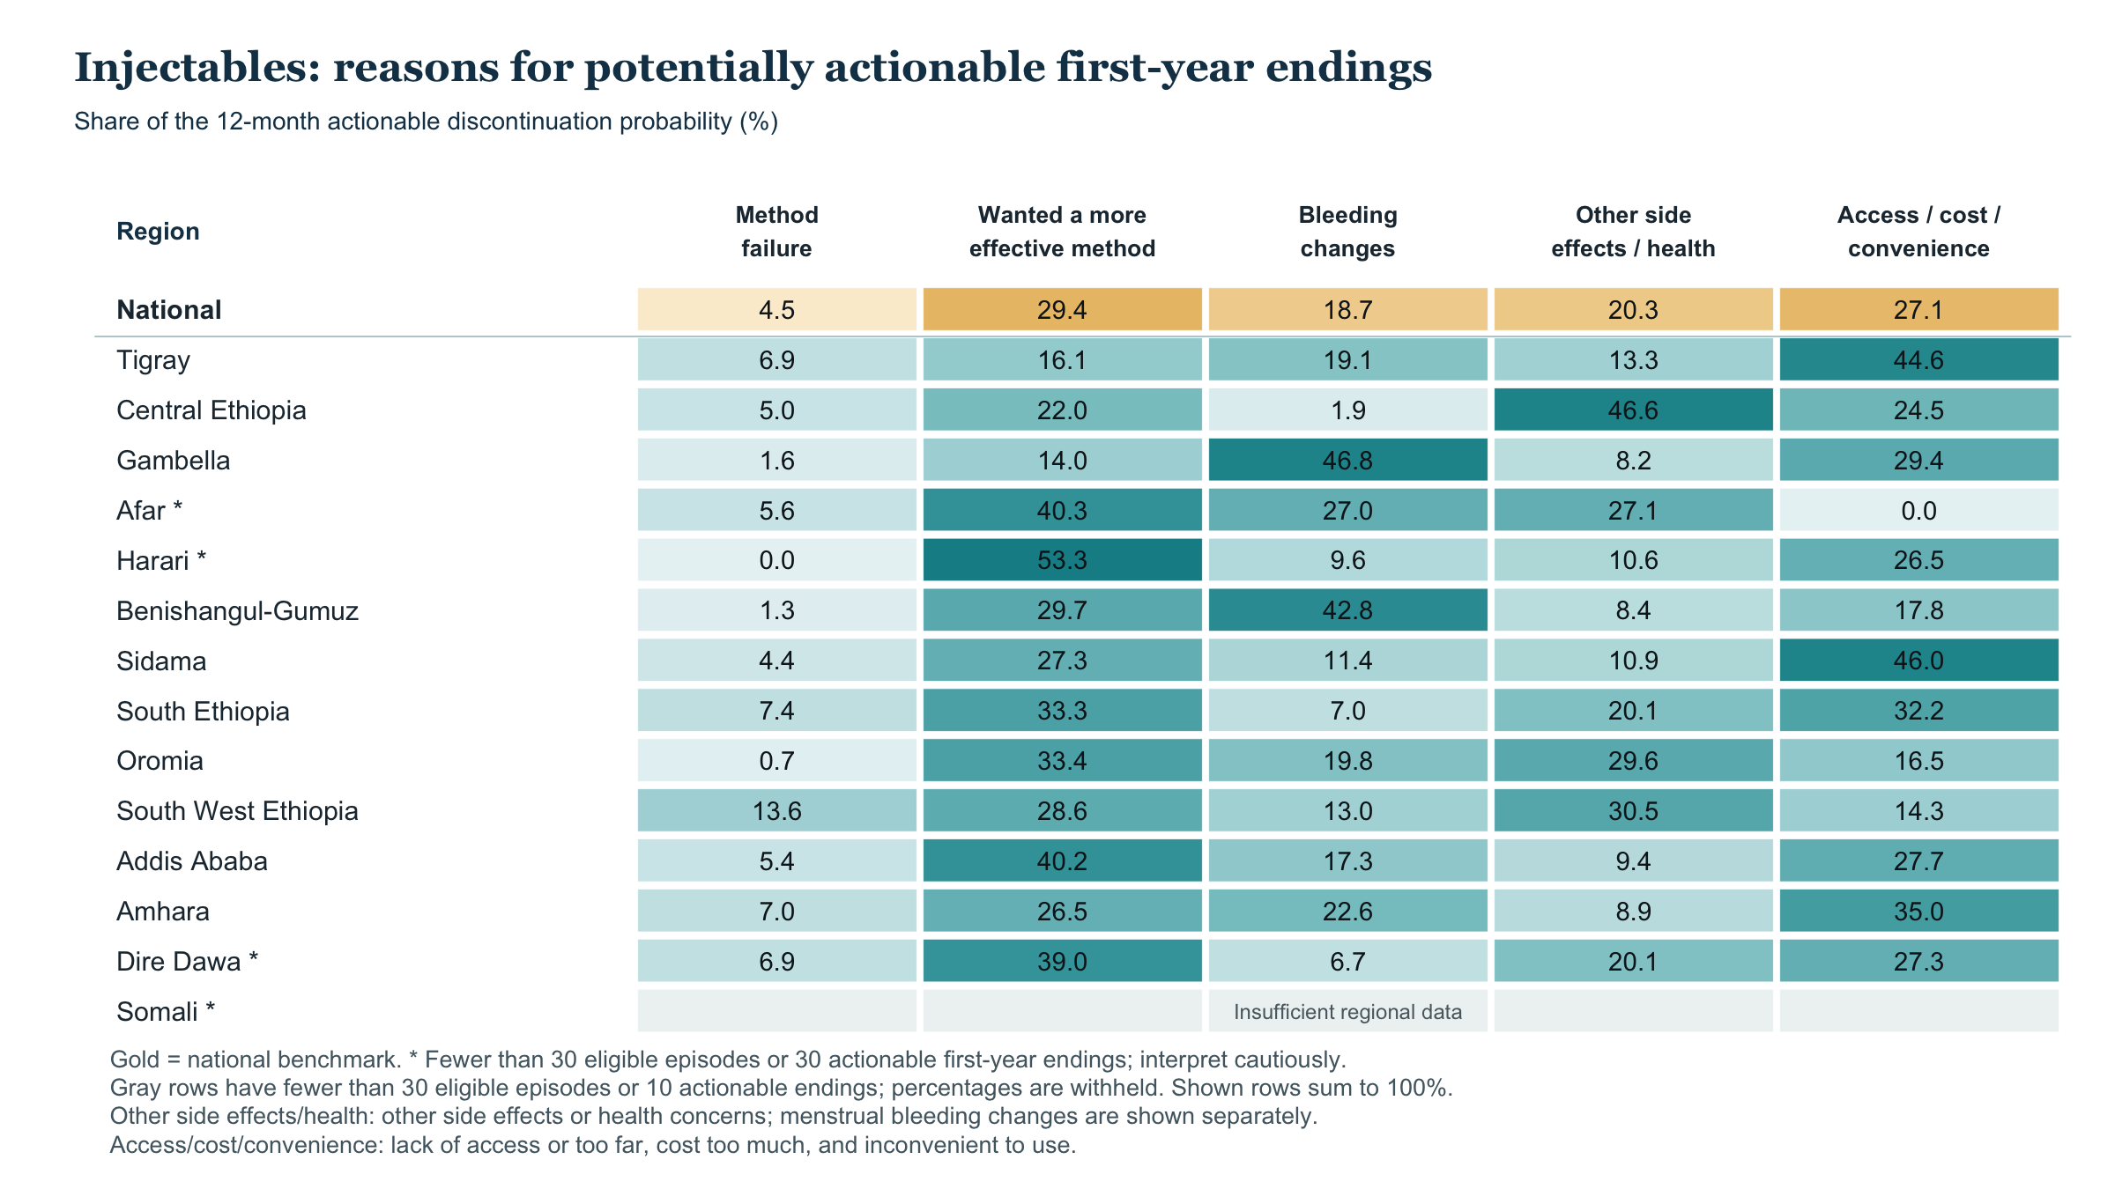

Slide 36
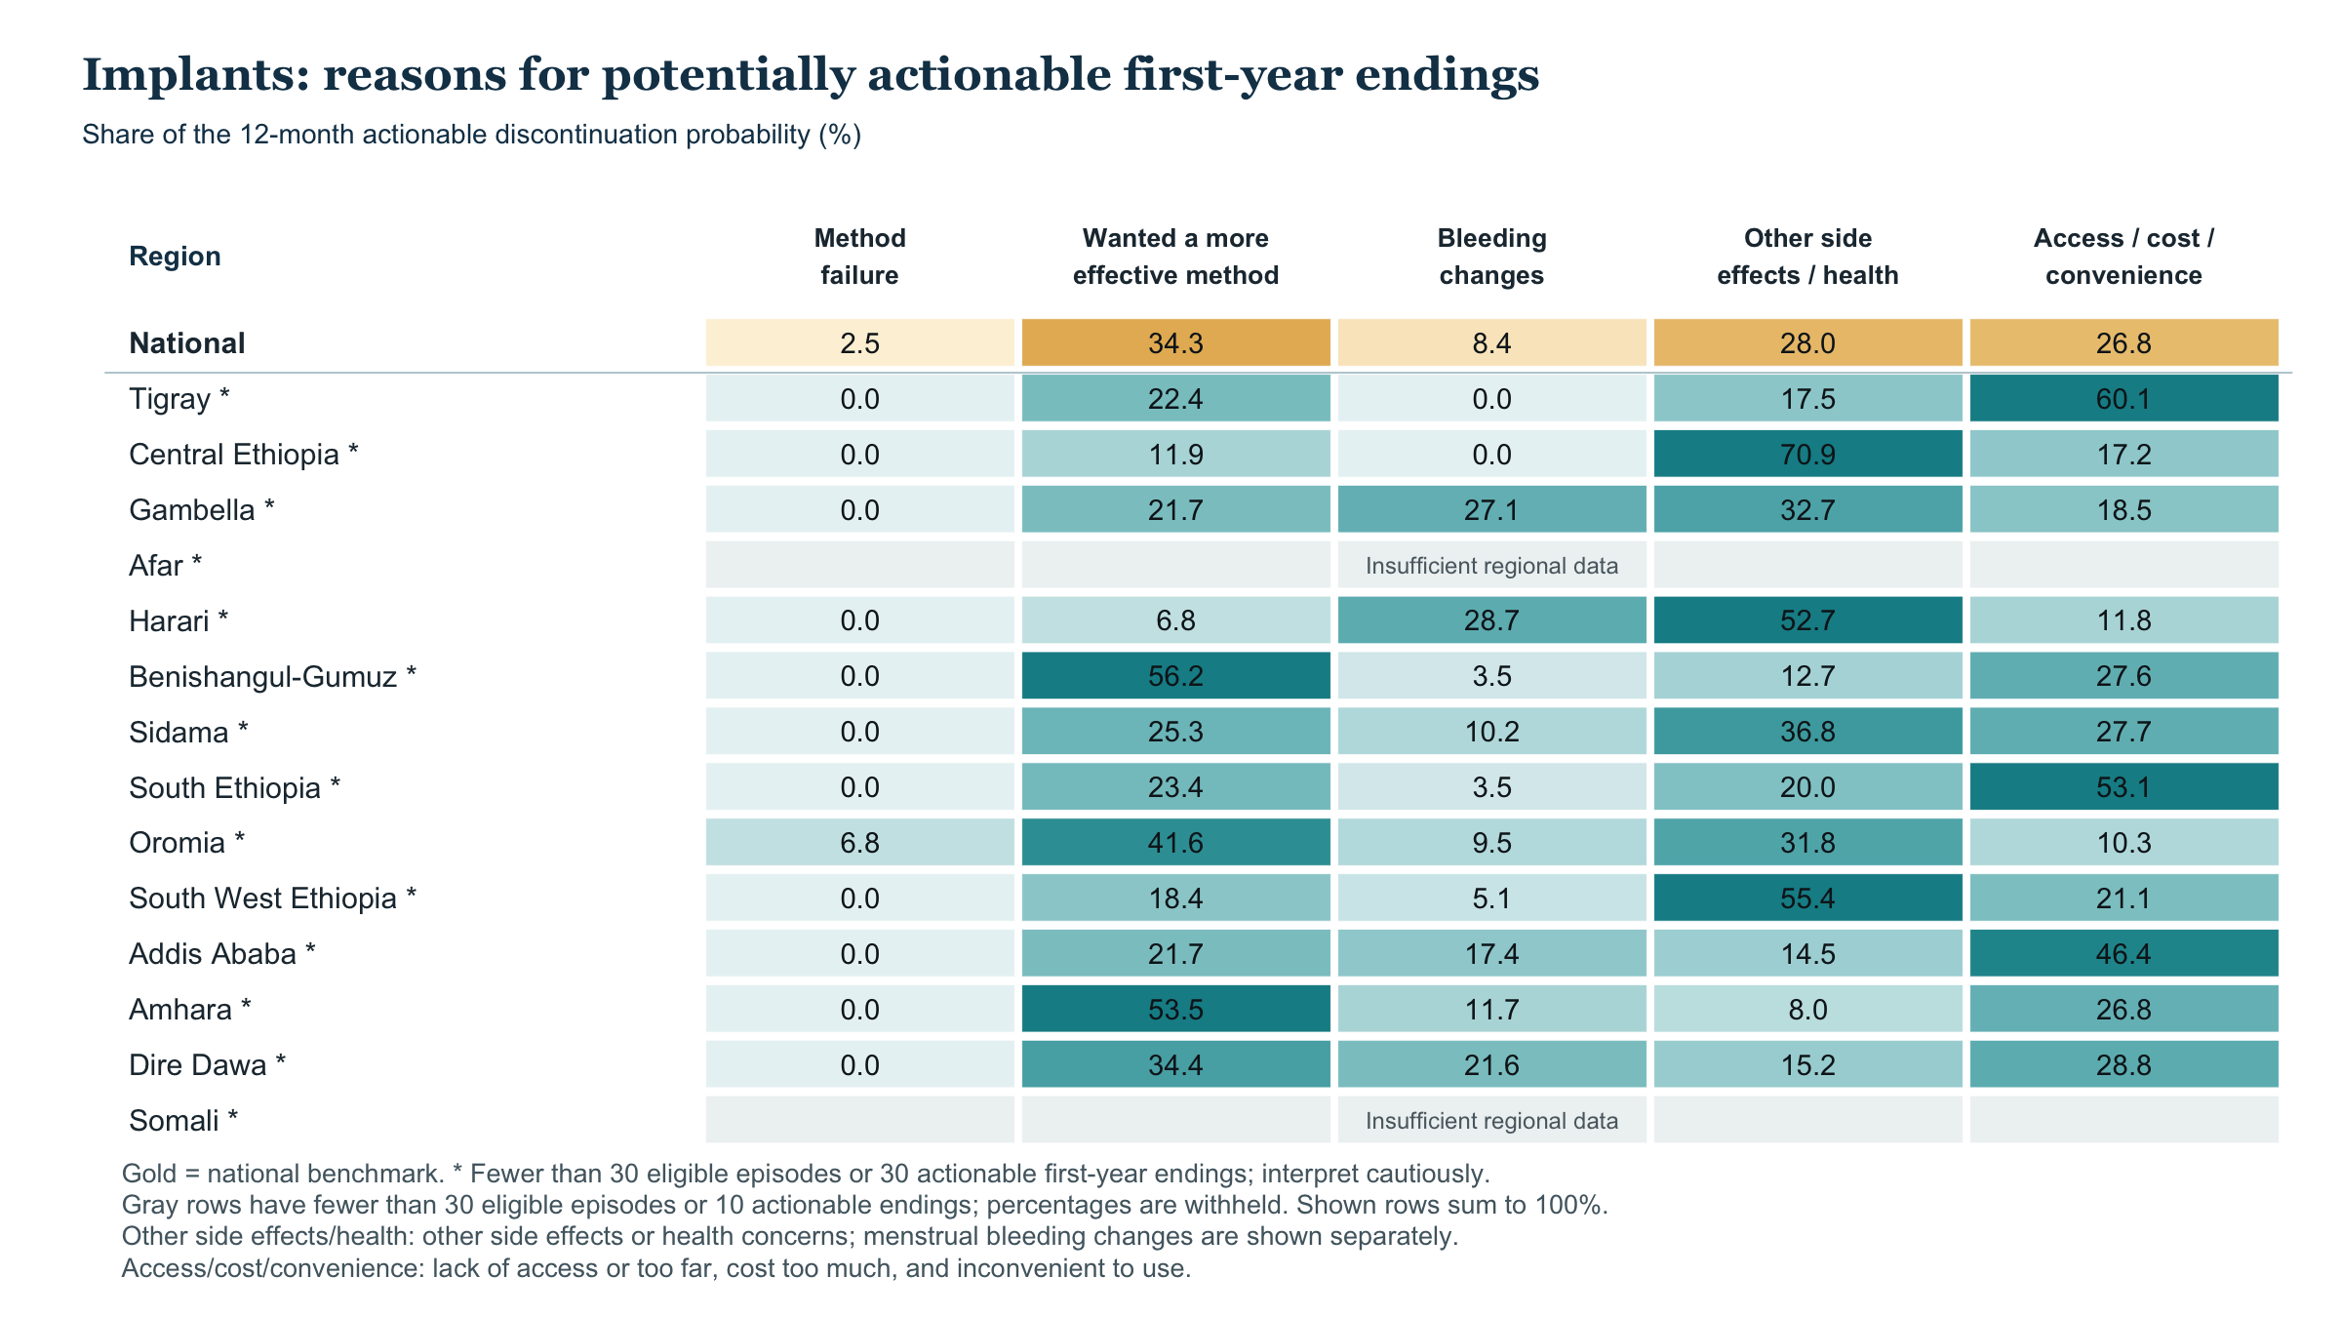

Slide 37
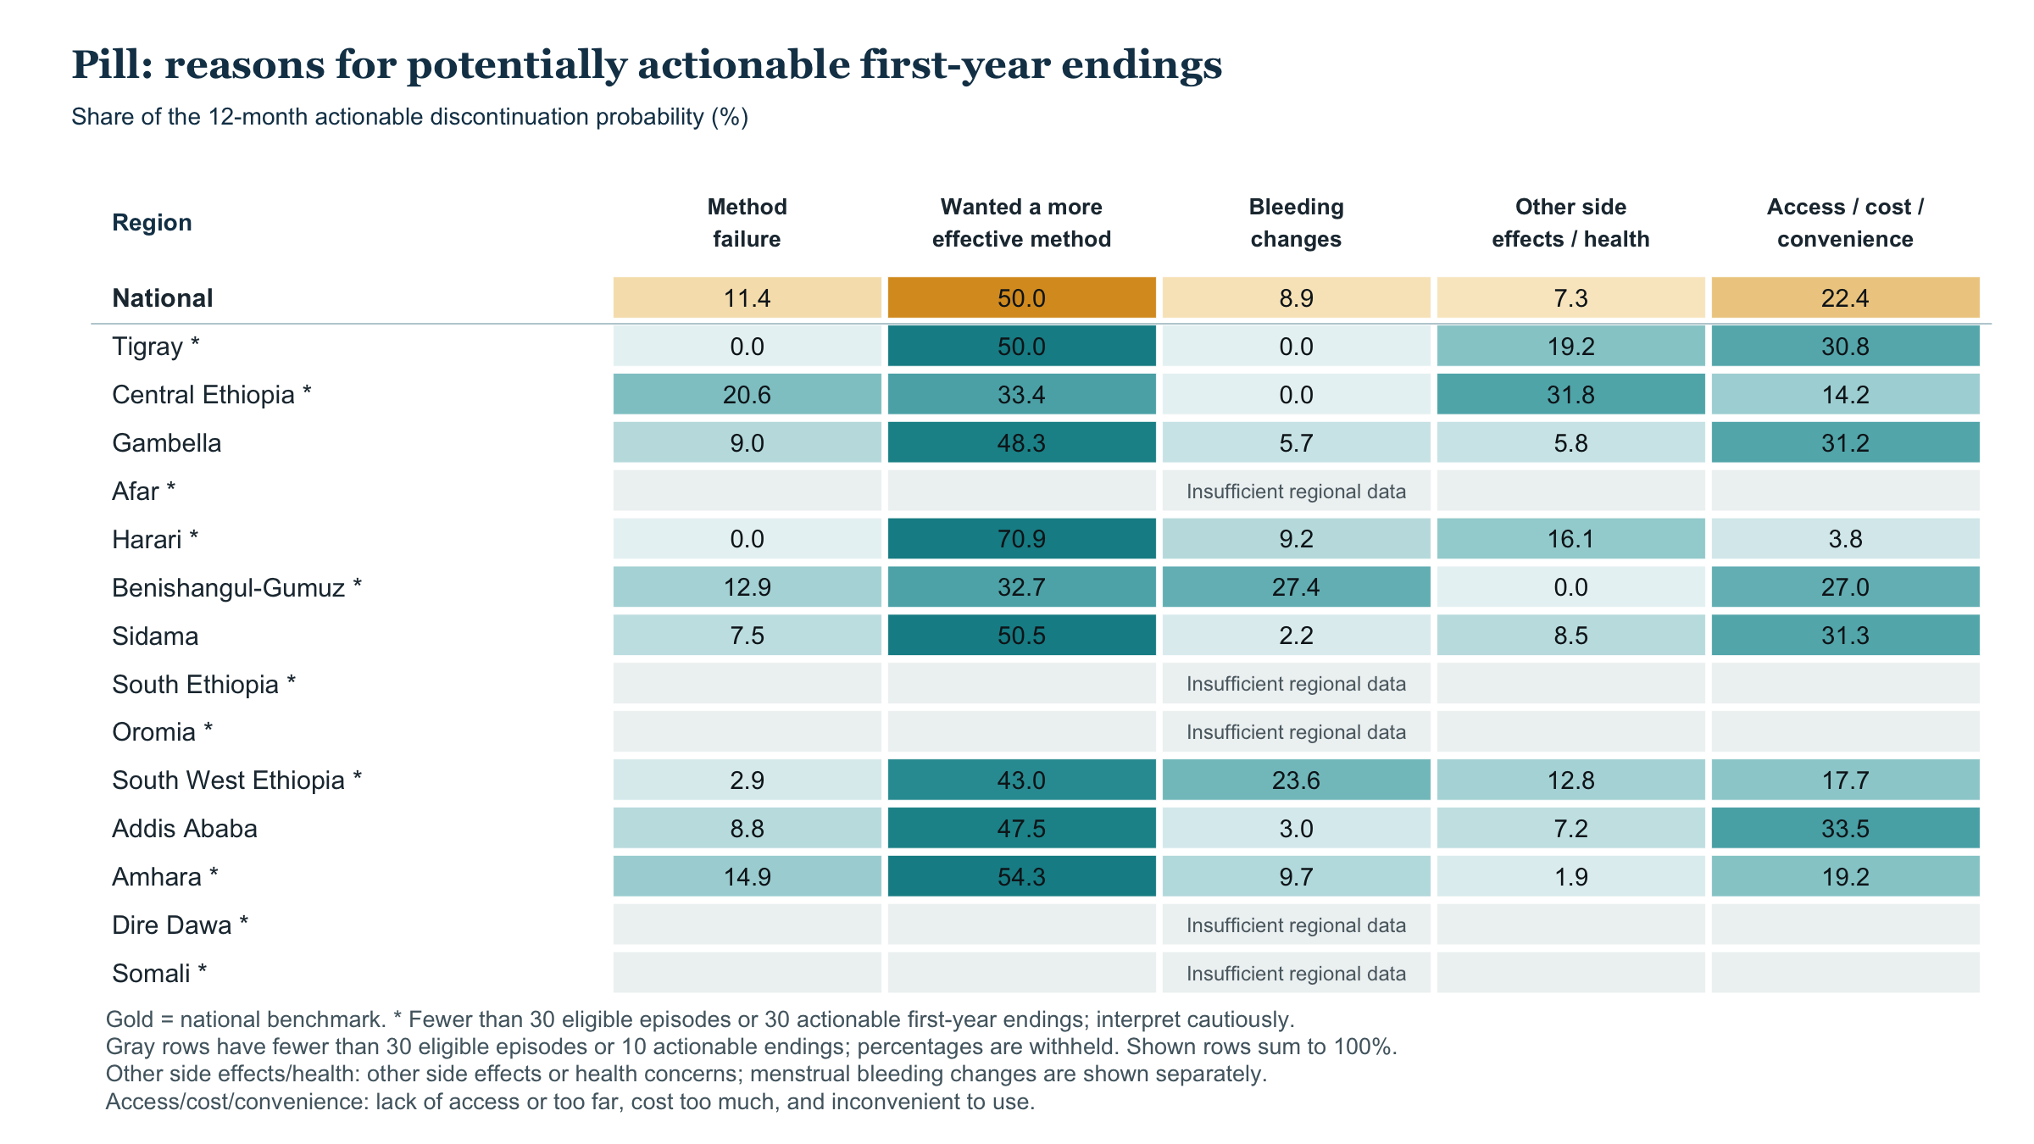

Slide 38
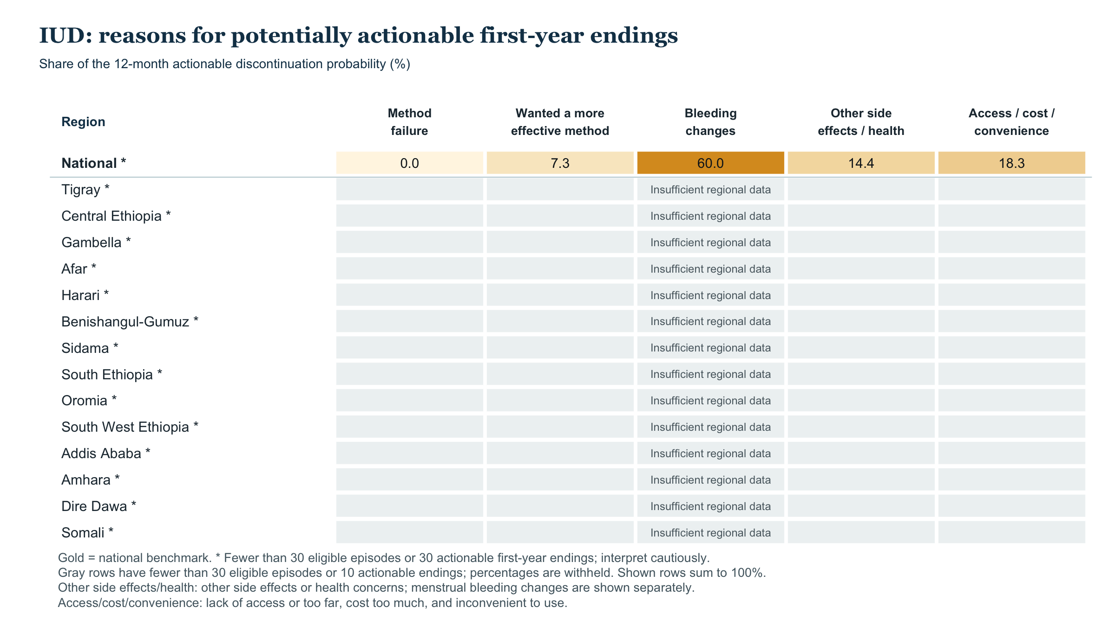

Slide 39
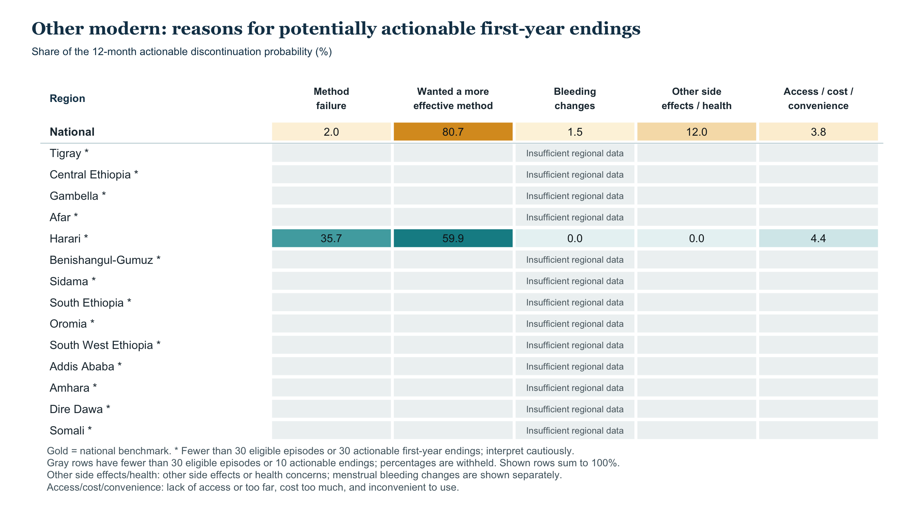

Slide 40
12-month discontinuation by region: potentially actionable reasons
Observed and fully adjusted probabilities (%) • 95% confidence intervals
Observed
Fully adjusted
OBSERVED
ADJUSTED
National
17.0%
17.2%
Tigray
23.6%
25.6%
Central Ethiopia
22.4%
24.5%
Gambella
21.5%
18.5%
Afar
20.0%
20.6%
Harari
19.7%
18.9%
Benishangul-Gumuz
18.5%
18.8%
Sidama
17.8%
18.7%
South Ethiopia
17.7%
18.3%
Oromia
17.2%
17.1%
South West Ethiopia
16.8%
17.7%
Addis Ababa
15.3%
14.2%
Amhara
15.1%
15.2%
Dire Dawa
14.7%
18.0%
Somali†
20.4%
21.1%
0
10
20
30
40
50
Actionable: failure, wanting greater effectiveness, bleeding/other health effects, or access/cost/convenience; other endings compete.
Model 2 adjusts for method, use month, region, age/parity at start, marital status, education, wealth, residence, and start year.
Observed n=8,611; adjusted reference n=7,648 starts. 95% CIs; adjusted: 500 PSU-bootstrap refits. † Somali: 30 episodes, 5 endings. CI overlap is not a regional test.

Slide 41
Regional discontinuation probabilities
12-month potentially actionable discontinuation (%)
Region | Episodes (n) | Observed (95% CI) | Model 1 (95% CI) | Model 2 (95% CI)
National | 8,611 | 17.0% (15.2–18.8) | 17.1% (15.4–18.9) | 17.2% (15.0–19.0)
Tigray | 682 | 23.6% (20.6–26.7) | 24.9% (21.9–28.2) | 25.6% (21.6–29.6)
Central Ethiopia | 457 | 22.4% (18.2–26.5) | 24.5% (20.1–29.4) | 24.5% (19.6–29.9)
Afar | 194 | 20.0% (15.6–23.2) | 19.6% (14.5–24.0) | 20.6% (15.0–25.9)
Harari | 425 | 19.7% (15.3–24.2) | 19.1% (13.7–25.3) | 18.9% (13.5–25.0)
Benishangul-Gumuz | 652 | 18.5% (14.2–22.1) | 18.6% (14.6–21.6) | 18.8% (14.6–23.0)
Sidama | 1,155 | 17.8% (15.4–20.1) | 18.7% (15.9–21.4) | 18.7% (15.4–21.9)
Gambella | 548 | 21.5% (15.4–27.7) | 19.7% (14.0–25.2) | 18.5% (13.0–24.1)
Model 1: region, method and months of use. Model 2 adds age and parity at method start, marital status, education, wealth, residence and start year. All estimates use survey weights. Intervals retain all 797 IR PSUs in 27 strata; adjusted intervals use 500 PSU-bootstrap refits. Observed cohort: 8,611 episodes; common adjusted reference: 7,648 observed starts. Somali has only five actionable endings.

Slide 42
Regional discontinuation probabilities (continued)
12-month potentially actionable discontinuation (%)
Region | Episodes (n) | Observed (95% CI) | Model 1 (95% CI) | Model 2 (95% CI)
South Ethiopia | 644 | 17.7% (14.9–20.9) | 19.5% (16.6–23.2) | 18.3% (15.3–22.5)
Dire Dawa | 289 | 14.7% (9.6–19.4) | 17.8% (12.1–23.1) | 18.0% (11.9–24.4)
South West Ethiopia | 927 | 16.8% (13.3–19.8) | 17.8% (14.0–21.1) | 17.7% (13.6–21.6)
Oromia | 861 | 17.2% (12.7–21.9) | 17.3% (12.9–21.5) | 17.1% (12.7–21.3)
Amhara | 999 | 15.1% (12.3–17.6) | 14.8% (11.8–17.3) | 15.2% (12.1–18.1)
Addis Ababa | 748 | 15.3% (12.2–18.6) | 14.6% (11.4–17.9) | 14.2% (10.5–19.0)
Somali | 30 | 20.4% (0.0–49.6) | 20.6% (0.0–47.6) | 21.1% (0.0–51.8)
Model 1: region, method and months of use. Model 2 adds age and parity at method start, marital status, education, wealth, residence and start year. All estimates use survey weights. Intervals retain all 797 IR PSUs in 27 strata; adjusted intervals use 500 PSU-bootstrap refits. Observed cohort: 8,611 episodes; common adjusted reference: 7,648 observed starts. Somali has only five actionable endings.

Slide 43
Two regional gaps remain with the same method and population mix
Potentially actionable 12-month discontinuation • 91 pairwise comparisons, Holm-corrected
2 of 91 regional pairs remain statistically different after full adjustment.
Overall regional test p<0.001. The chart shows only these pairs; all results remain in the working HTML.
Tigray vs Amhara
+10.3 pp
25.6% vs 15.2%
Holm p<0.001
Tigray vs Addis Ababa
+11.3 pp
25.6% vs 14.2%
Holm p=0.002
0
5
10
15
20
25
Adjusted difference in 12-month probability (percentage points)
Gold whiskers: conservative 95% familywise Bonferroni intervals for 91 contrasts; p-values use Holm correction.
Differences use the same survey-stratified PSU bootstrap refit for both regions; 500 full-model refits.
Somali (30 episodes, 5 selected endings) is too sparse to interpret as a ranked contrast. Regional associations are not causal effects.

Slide 44
Regional gaps change when regions have the same method mix
Potentially actionable 12-month discontinuation, three pairs passing Holm correction across 91 comparisons
Each region’s own method mix
Same mix within this pair, with 95% CI
OWN MIX
SAME MIX
Tigray vs Amhara
Holm p=<0.001
8.4 pp
10.2 pp
Tigray vs Addis Ababa
Holm p=0.004
8.4 pp
10.0 pp
Central Ethiopia vs Amhara
Holm p=0.047
7.3 pp
9.7 pp
0
4
8
12
16
Gap in 12-month probability (percentage points)
Same mix: average of each pair’s weighted method-start shares; each region keeps its fitted risk within each method.
Model 1 includes region, method, and month of use. It excludes EC and uses 8,611 eligible episodes; mix uses 7,648 observed starts.
Gold whiskers are pointwise 95% bootstrap intervals. Holm p-values adjust 91 tests; the fitted gaps do not decompose raw life-table gaps.

Slide 45
Regional gaps: observed, same method mix, same method and population mix
12-month discontinuation due to potentially actionable reasons · gap in percentage points
Observed
Same method mix
Fully adjusted
Tigray vs Amhara
8.5
10.2
10.3
Tigray vs Addis Ababa
8.3
10.0
11.3
Central Ethiopia vs Amhara
7.3
9.7
9.3
0
5
10
15
0
5
10
15
0
5
10
15
Difference in 12-month probability (percentage points)
Filled dots: Holm p < 0.05 across 91 pairs. Lines: pointwise 95% survey-bootstrap intervals.
Same method mix: each pair’s average method-start mix. Fully adjusted: one common observed-start profile.
8,611 EC-excluded episodes. These panels do not form an exact decomposition of the observed gap.

Slide 46
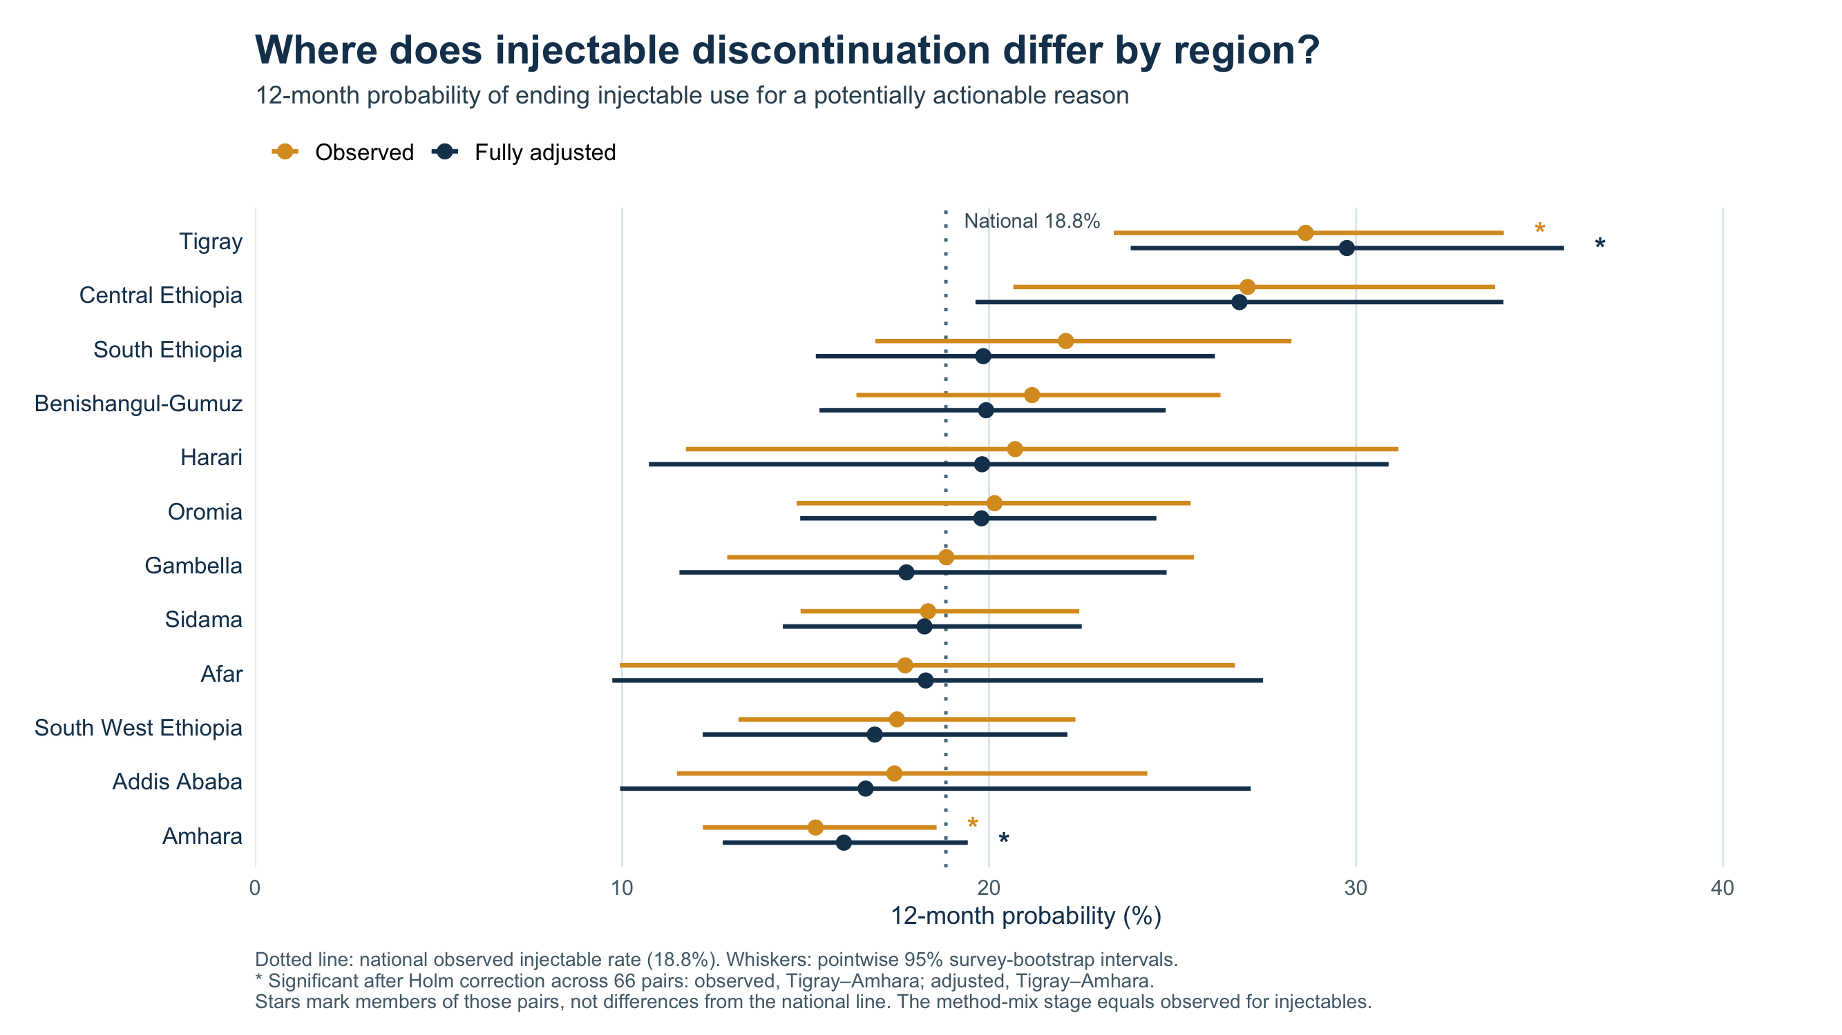

Slide 47
First-year: actionable discontinuation and mCPR
Users in thousands; estimates (95% CI)
Method | 2025 current users | Actionable ending probability | Users ending original method | mCPR equivalent
Injectables | 4,454.5 (4,137.9–4,865.2) | 18.8% (16.8–21.4) | 838.4 (733.2–998.0) | 2.39 pp (2.09–2.85)
Implants | 2,288.4 (2,073.3–2,535.9) | 8.2% (6.2–10.5) | 187.8 (143.9–240.8) | 0.54 pp (0.41–0.69)
Pill | 547.4 (445.8–657.7) | 28.8% (22.9–34.3) | 157.5 (114.2–201.1) | 0.45 pp (0.33–0.57)
IUD | 190.2 (132.2–291.8) | 14.0% (5.4–26.7) | 26.6 (11.7–53.6) | 0.08 pp (0.03–0.15)
Other modern | 194.2 (133.4–271.5) | 16.2% (8.2–25.9) | 31.4 (15.4–51.0) | 0.09 pp (0.04–0.15)
EC | 66.2 (38.9–111.7) | Not applied | Not estimated | Not estimated
Current-user mix excluding EC | 7,674.7 (7,265.1–8,187.8) | 16.2% (14.4–18.2) | 1,241.7 (1,098.7–1,443.0) | 3.55 pp (3.14–4.12)
First-year: survey-weighted cumulative incidence of an actionable ending during months 1–12 after initiation, applied to current users; elapsed use is not incorporated. Every actionable ending is assumed to be a user lost; switching/restarting is not deducted. 95% CIs: 500 positive-multiplier PSU bootstrap replicates within all 27 survey strata, including current-user mix and estimated risks. Population and growth assumptions are fixed. CI bounds are not additive. Totals use unrounded estimates. † CI unavailable when no events were observed. Total probability is weighted by current-user method mix. The pooled episode life-table probability is 17.0%, with a different method mix.

Slide 48
First-year: users by method and cause
Users in thousands; estimates (95% CI)
Method / measure | Method failure | Want more effective | Bleeding changes | Other side effects/health | Access/cost/ convenience | All actionable causes
Injectables | 38.0 (21.5–64.1) | 246.0 (196.0–307.6) | 156.7 (115.8–203.0) | 170.3 (118.9–268.2) | 227.4 (190.9–271.9) | 838.4 (733.2–998.0)
Implants | 4.6 (0.1–17.4) | 64.5 (34.2–108.9) | 15.8 (5.8–37.8) | 52.6 (32.8–80.0) | 50.3 (36.0–71.8) | 187.8 (143.9–240.8)
Pill | 17.9 (8.1–33.7) | 78.8 (53.5–112.0) | 14.0 (6.7–26.0) | 11.4 (6.1–18.2) | 35.3 (20.8–53.3) | 157.5 (114.2–201.1)
IUD | 0.0 (CI unavailable†) | 1.9 (0.3–5.7) | 15.9 (3.0–41.2) | 3.8 (0.6–9.2) | 4.9 (1.7–10.8) | 26.6 (11.7–53.6)
Other modern | 0.6 (0.1–1.5) | 25.4 (11.4–45.3) | 0.5 (<0.1–1.9) | 3.8 (0.2–11.7) | 1.2 (0.3–2.8) | 31.4 (15.4–51.0)
Users ending method | 61.1 (39.6–90.3) | 416.6 (338.7–507.5) | 202.9 (147.8–288.3) | 242.0 (175.9–355.5) | 319.1 (271.9–374.9) | 1,241.7 (1,098.7–1,443.0)
First-year: survey-weighted cumulative incidence of an actionable ending during months 1–12 after initiation, applied to current users; elapsed use is not incorporated. Every actionable ending is assumed to be a user lost; switching/restarting is not deducted. 95% CIs: 500 positive-multiplier PSU bootstrap replicates within all 27 survey strata, including current-user mix and estimated risks. Population and growth assumptions are fixed. CI bounds are not additive. Totals use unrounded estimates. † CI unavailable when no events were observed.

Slide 49
First-year: common mCPR growth assumptions
Same baseline assumptions for all discontinuation approaches
Different mCPR growth scenarios | 2025 survey mCPR | Illustrative 2026 mCPR
Status quo | 22.73% (21.50–24.27) | 22.73% (21.50–24.27)
Illustrative +0.8 pp | 22.73% (21.50–24.27) | 23.53% (22.30–25.07)
Illustrative +0.7 pp | 22.73% (21.50–24.27) | 23.43% (22.20–24.97)
All three 2026 scenarios start from the 2024–25 DHS all-women mCPR used for 2025: unchanged, +0.8 pp or +0.7 pp. These retain the earlier growth assumptions and are illustrative baselines. 95% CIs: 500 positive-multiplier PSU bootstrap replicates within all 27 survey strata, including current-user mix and estimated risks. Population and growth assumptions are fixed. CI bounds are not additive. Totals use unrounded estimates. † CI unavailable when no events were observed.

Slide 50
First-year: mCPR if actionable losses are avoided
Users in thousands; estimates (95% CI)
Different mCPR growth scenarios | 2026 users usual scenario | 2026 mCPR | 2026 users if retained | mCPR if retained | Increase (pp)
Status quo | 7,958.7 (7,530.2–8,499.2) | 22.73% (21.50–24.27) | 9,200.4 (8,668.6–9,856.5) | 26.27% (24.76–28.15) | 3.55 pp (3.14–4.12)
Illustrative +0.8 pp | 8,238.8 (7,810.3–8,779.4) | 23.53% (22.30–25.07) | 9,480.5 (8,948.7–10,136.7) | 27.07% (25.56–28.95) | 3.55 pp (3.14–4.12)
Illustrative +0.7 pp | 8,203.8 (7,775.3–8,744.3) | 23.43% (22.20–24.97) | 9,445.5 (8,913.7–10,101.6) | 26.97% (25.46–28.85) | 3.55 pp (3.14–4.12)
First-year: survey-weighted cumulative incidence of an actionable ending during months 1–12 after initiation, applied to current users; elapsed use is not incorporated. Every actionable ending is assumed to be a user lost; switching/restarting is not deducted. 95% CIs: 500 positive-multiplier PSU bootstrap replicates within all 27 survey strata, including current-user mix and estimated risks. Population and growth assumptions are fixed. CI bounds are not additive. Totals use unrounded estimates. † CI unavailable when no events were observed.

Slide 51
First-year: status quo by method
Users in thousands; estimates (95% CI)
Method | 2025 current users | 2026 users usual scenario | Losses avoided | 2026 users if retained | 2026 mCPR | mCPR if retained
Injectables | 4,454.5 (4,137.9–4,865.2) | 4,579.9 (4,254.3–5,002.1) | 838.4 (733.2–998.0) | 5,418.3 (5,033.6–5,921.3) | 13.08% (12.15–14.29) | 15.47% (14.38–16.91)
Implants | 2,288.4 (2,073.3–2,535.9) | 2,352.8 (2,131.6–2,607.3) | 187.8 (143.9–240.8) | 2,540.5 (2,306.5–2,806.6) | 6.72% (6.09–7.45) | 7.26% (6.59–8.02)
Pill | 547.4 (445.8–657.7) | 562.8 (458.4–676.2) | 157.5 (114.2–201.1) | 720.3 (592.8–869.7) | 1.61% (1.31–1.93) | 2.06% (1.69–2.48)
IUD | 190.2 (132.2–291.8) | 195.5 (135.9–300.0) | 26.6 (11.7–53.6) | 222.1 (155.6–321.7) | 0.56% (0.39–0.86) | 0.63% (0.44–0.92)
Other modern | 194.2 (133.4–271.5) | 199.7 (137.2–279.2) | 31.4 (15.4–51.0) | 231.1 (161.0–318.4) | 0.57% (0.39–0.80) | 0.66% (0.46–0.91)
EC | 66.2 (38.9–111.7) | 68.0 (40.0–114.9) | — | 68.0 (40.0–114.9) | 0.19% (0.11–0.33) | 0.19% (0.11–0.33)
All modern | 7,740.8 (7,324.0–8,266.6) | 7,958.7 (7,530.2–8,499.2) | 1,241.7 (1,098.7–1,443.0) | 9,200.4 (8,668.6–9,856.5) | 22.73% (21.50–24.27) | 26.27% (24.76–28.15)
First-year: survey-weighted cumulative incidence of an actionable ending during months 1–12 after initiation, applied to current users; elapsed use is not incorporated. Every actionable ending is assumed to be a user lost; switching/restarting is not deducted. 95% CIs: 500 positive-multiplier PSU bootstrap replicates within all 27 survey strata, including current-user mix and estimated risks. Population and growth assumptions are fixed. CI bounds are not additive. Totals use unrounded estimates. † CI unavailable when no events were observed. Method mix in the usual 2026 scenario is held at the current distribution.

Slide 52
First-year: illustrative +0.8 pp by method
Users in thousands; estimates (95% CI)
Method | 2025 current users | 2026 users usual scenario | Losses avoided | 2026 users if retained | 2026 mCPR | mCPR if retained
Injectables | 4,454.5 (4,137.9–4,865.2) | 4,741.1 (4,410.8–5,170.2) | 838.4 (733.2–998.0) | 5,579.5 (5,189.1–6,086.6) | 13.54% (12.60–14.77) | 15.93% (14.82–17.38)
Implants | 2,288.4 (2,073.3–2,535.9) | 2,435.6 (2,208.7–2,696.5) | 187.8 (143.9–240.8) | 2,623.4 (2,385.0–2,892.8) | 6.96% (6.31–7.70) | 7.49% (6.81–8.26)
Pill | 547.4 (445.8–657.7) | 582.6 (474.1–700.2) | 157.5 (114.2–201.1) | 740.1 (609.2–892.6) | 1.66% (1.35–2.00) | 2.11% (1.74–2.55)
IUD | 190.2 (132.2–291.8) | 202.4 (140.6–310.7) | 26.6 (11.7–53.6) | 229.0 (160.3–331.5) | 0.58% (0.40–0.89) | 0.65% (0.46–0.95)
Other modern | 194.2 (133.4–271.5) | 206.7 (142.0–289.0) | 31.4 (15.4–51.0) | 238.1 (165.9–328.1) | 0.59% (0.41–0.83) | 0.68% (0.47–0.94)
EC | 66.2 (38.9–111.7) | 70.4 (41.5–119.0) | — | 70.4 (41.5–119.0) | 0.20% (0.12–0.34) | 0.20% (0.12–0.34)
All modern | 7,740.8 (7,324.0–8,266.6) | 8,238.8 (7,810.3–8,779.4) | 1,241.7 (1,098.7–1,443.0) | 9,480.5 (8,948.7–10,136.7) | 23.53% (22.30–25.07) | 27.07% (25.56–28.95)
First-year: survey-weighted cumulative incidence of an actionable ending during months 1–12 after initiation, applied to current users; elapsed use is not incorporated. Every actionable ending is assumed to be a user lost; switching/restarting is not deducted. 95% CIs: 500 positive-multiplier PSU bootstrap replicates within all 27 survey strata, including current-user mix and estimated risks. Population and growth assumptions are fixed. CI bounds are not additive. Totals use unrounded estimates. † CI unavailable when no events were observed. Method mix in the usual 2026 scenario is held at the current distribution.

Slide 53
First-year: illustrative +0.7 pp by method
Users in thousands; estimates (95% CI)
Method | 2025 current users | 2026 users usual scenario | Losses avoided | 2026 users if retained | 2026 mCPR | mCPR if retained
Injectables | 4,454.5 (4,137.9–4,865.2) | 4,721.0 (4,391.3–5,149.2) | 838.4 (733.2–998.0) | 5,559.4 (5,169.7–6,066.0) | 13.48% (12.54–14.71) | 15.88% (14.76–17.32)
Implants | 2,288.4 (2,073.3–2,535.9) | 2,425.2 (2,199.1–2,685.4) | 187.8 (143.9–240.8) | 2,613.0 (2,375.1–2,882.0) | 6.93% (6.28–7.67) | 7.46% (6.78–8.23)
Pill | 547.4 (445.8–657.7) | 580.1 (472.1–697.2) | 157.5 (114.2–201.1) | 737.6 (607.1–889.7) | 1.66% (1.35–1.99) | 2.11% (1.73–2.54)
IUD | 190.2 (132.2–291.8) | 201.6 (140.1–309.3) | 26.6 (11.7–53.6) | 228.1 (159.7–330.2) | 0.58% (0.40–0.88) | 0.65% (0.46–0.94)
Other modern | 194.2 (133.4–271.5) | 205.8 (141.4–287.8) | 31.4 (15.4–51.0) | 237.3 (165.3–326.8) | 0.59% (0.40–0.82) | 0.68% (0.47–0.93)
EC | 66.2 (38.9–111.7) | 70.1 (41.3–118.5) | — | 70.1 (41.3–118.5) | 0.20% (0.12–0.34) | 0.20% (0.12–0.34)
All modern | 7,740.8 (7,324.0–8,266.6) | 8,203.8 (7,775.3–8,744.3) | 1,241.7 (1,098.7–1,443.0) | 9,445.5 (8,913.7–10,101.6) | 23.43% (22.20–24.97) | 26.97% (25.46–28.85)
First-year: survey-weighted cumulative incidence of an actionable ending during months 1–12 after initiation, applied to current users; elapsed use is not incorporated. Every actionable ending is assumed to be a user lost; switching/restarting is not deducted. 95% CIs: 500 positive-multiplier PSU bootstrap replicates within all 27 survey strata, including current-user mix and estimated risks. Population and growth assumptions are fixed. CI bounds are not additive. Totals use unrounded estimates. † CI unavailable when no events were observed. Method mix in the usual 2026 scenario is held at the current distribution.

Slide 54
First-year: mCPR equivalent by cause
Users in thousands; estimates (95% CI)
Method / measure | Method failure | Want more effective | Bleeding changes | Other side effects/health | Access/cost/ convenience | All actionable causes
Injectables | 38.0 (21.5–64.1) | 246.0 (196.0–307.6) | 156.7 (115.8–203.0) | 170.3 (118.9–268.2) | 227.4 (190.9–271.9) | 838.4 (733.2–998.0)
Implants | 4.6 (0.1–17.4) | 64.5 (34.2–108.9) | 15.8 (5.8–37.8) | 52.6 (32.8–80.0) | 50.3 (36.0–71.8) | 187.8 (143.9–240.8)
Pill | 17.9 (8.1–33.7) | 78.8 (53.5–112.0) | 14.0 (6.7–26.0) | 11.4 (6.1–18.2) | 35.3 (20.8–53.3) | 157.5 (114.2–201.1)
IUD | 0.0 (CI unavailable†) | 1.9 (0.3–5.7) | 15.9 (3.0–41.2) | 3.8 (0.6–9.2) | 4.9 (1.7–10.8) | 26.6 (11.7–53.6)
Other modern | 0.6 (0.1–1.5) | 25.4 (11.4–45.3) | 0.5 (<0.1–1.9) | 3.8 (0.2–11.7) | 1.2 (0.3–2.8) | 31.4 (15.4–51.0)
Users ending method | 61.1 (39.6–90.3) | 416.6 (338.7–507.5) | 202.9 (147.8–288.3) | 242.0 (175.9–355.5) | 319.1 (271.9–374.9) | 1,241.7 (1,098.7–1,443.0)
2026 women aged 15–49 (fixed) | 35,016.2 | 35,016.2 | 35,016.2 | 35,016.2 | 35,016.2 | 35,016.2
mCPR increase (pp) | 0.17 pp (0.11–0.26) | 1.19 pp (0.97–1.45) | 0.58 pp (0.42–0.82) | 0.69 pp (0.50–1.02) | 0.91 pp (0.78–1.07) | 3.55 pp (3.14–4.12)
First-year: survey-weighted cumulative incidence of an actionable ending during months 1–12 after initiation, applied to current users; elapsed use is not incorporated. Every actionable ending is assumed to be a user lost; switching/restarting is not deducted. 95% CIs: 500 positive-multiplier PSU bootstrap replicates within all 27 survey strata, including current-user mix and estimated risks. Population and growth assumptions are fixed. CI bounds are not additive. Totals use unrounded estimates. † CI unavailable when no events were observed.

Slide 55
Historical duration-aware: actionable discontinuation and mCPR
Users in thousands; estimates (95% CI)
Method | 2025 current users | Actionable ending probability | Users ending original method | mCPR equivalent
Injectables | 4,454.5 (4,137.9–4,865.2) | 11.9% (10.5–13.6) | 532.2 (460.6–623.9) | 1.52 pp (1.32–1.78)
Implants | 2,288.4 (2,073.3–2,535.9) | 11.2% (9.2–13.3) | 256.3 (211.2–313.3) | 0.73 pp (0.60–0.89)
Pill | 547.4 (445.8–657.7) | 21.3% (16.2–25.4) | 116.8 (87.4–146.7) | 0.33 pp (0.25–0.42)
IUD | 190.2 (132.2–291.8) | 8.4% (4.7–13.5) | 16.0 (7.4–33.9) | 0.05 pp (0.02–0.10)
Other modern | 194.2 (133.4–271.5) | 11.1% (5.2–20.7) | 21.5 (10.6–40.1) | 0.06 pp (0.03–0.11)
EC | 66.2 (38.9–111.7) | Not applied | Not estimated | Not estimated
Current-user mix excluding EC | 7,674.7 (7,265.1–8,187.8) | 12.3% (11.1–13.5) | 942.9 (839.9–1,065.4) | 2.69 pp (2.40–3.04)
Historical: weighted next-12-month actionable-ending probability at the current method and elapsed duration, from past calendar landmarks; the survey duration mix is held fixed. 61+ months uses the observed 37–60-month proxy. Every actionable ending is assumed to be a user lost; switching/restarting is not deducted. 95% CIs: 500 positive-multiplier PSU bootstrap replicates within all 27 survey strata, including current-user mix and estimated risks. Population and growth assumptions are fixed. CI bounds are not additive. Totals use unrounded estimates. † CI unavailable when no events were observed. Total probability is weighted by current-user method mix.

Slide 56
Historical duration-aware: users by method and cause
Users in thousands; estimates (95% CI)
Method / measure | Method failure | Want more effective | Bleeding changes | Other side effects/health | Access/cost/ convenience | All actionable causes
Injectables | 34.3 (21.1–52.1) | 177.4 (141.3–220.7) | 88.4 (62.1–121.4) | 97.7 (70.7–139.9) | 134.3 (106.0–171.5) | 532.2 (460.6–623.9)
Implants | 4.8 (0.7–12.9) | 95.5 (69.7–127.6) | 25.7 (14.5–45.2) | 63.4 (43.4–95.9) | 66.9 (47.7–88.6) | 256.3 (211.2–313.3)
Pill | 32.6 (14.7–53.1) | 44.2 (29.9–62.2) | 8.0 (4.1–14.3) | 9.4 (4.7–16.5) | 22.7 (13.6–34.9) | 116.8 (87.4–146.7)
IUD | <0.1 (<0.1–0.1) | 7.7 (2.2–22.9) | 5.3 (1.1–13.9) | 0.9 (0.2–2.4) | 2.1 (0.8–5.0) | 16.0 (7.4–33.9)
Other modern | 1.3 (0.5–2.6) | 16.3 (6.7–34.5) | 1.2 (0.1–4.3) | 2.0 (0.6–5.2) | 0.7 (0.1–2.0) | 21.5 (10.6–40.1)
Users ending method | 73.1 (48.8–99.6) | 341.1 (285.9–408.2) | 128.6 (95.4–168.8) | 173.4 (136.1–228.4) | 226.7 (191.6–273.0) | 942.9 (839.9–1,065.4)
Historical: weighted next-12-month actionable-ending probability at the current method and elapsed duration, from past calendar landmarks; the survey duration mix is held fixed. 61+ months uses the observed 37–60-month proxy. Every actionable ending is assumed to be a user lost; switching/restarting is not deducted. 95% CIs: 500 positive-multiplier PSU bootstrap replicates within all 27 survey strata, including current-user mix and estimated risks. Population and growth assumptions are fixed. CI bounds are not additive. Totals use unrounded estimates. † CI unavailable when no events were observed.

Slide 57
Historical duration-aware: common mCPR growth assumptions
Same baseline assumptions for all discontinuation approaches
Different mCPR growth scenarios | 2025 survey mCPR | Illustrative 2026 mCPR
Status quo | 22.73% (21.50–24.27) | 22.73% (21.50–24.27)
Illustrative +0.8 pp | 22.73% (21.50–24.27) | 23.53% (22.30–25.07)
Illustrative +0.7 pp | 22.73% (21.50–24.27) | 23.43% (22.20–24.97)
All three 2026 scenarios start from the 2024–25 DHS all-women mCPR used for 2025: unchanged, +0.8 pp or +0.7 pp. These retain the earlier growth assumptions and are illustrative baselines. 95% CIs: 500 positive-multiplier PSU bootstrap replicates within all 27 survey strata, including current-user mix and estimated risks. Population and growth assumptions are fixed. CI bounds are not additive. Totals use unrounded estimates. † CI unavailable when no events were observed.

Slide 58
Historical duration-aware: mCPR if actionable losses are avoided
Users in thousands; estimates (95% CI)
Different mCPR growth scenarios | 2026 users usual scenario | 2026 mCPR | 2026 users if retained | mCPR if retained | Increase (pp)
Status quo | 7,958.7 (7,530.2–8,499.2) | 22.73% (21.50–24.27) | 8,901.6 (8,399.0–9,515.6) | 25.42% (23.99–27.17) | 2.69 pp (2.40–3.04)
Illustrative +0.8 pp | 8,238.8 (7,810.3–8,779.4) | 23.53% (22.30–25.07) | 9,181.7 (8,679.1–9,795.8) | 26.22% (24.79–27.97) | 2.69 pp (2.40–3.04)
Illustrative +0.7 pp | 8,203.8 (7,775.3–8,744.3) | 23.43% (22.20–24.97) | 9,146.7 (8,644.1–9,760.7) | 26.12% (24.69–27.87) | 2.69 pp (2.40–3.04)
Historical: weighted next-12-month actionable-ending probability at the current method and elapsed duration, from past calendar landmarks; the survey duration mix is held fixed. 61+ months uses the observed 37–60-month proxy. Every actionable ending is assumed to be a user lost; switching/restarting is not deducted. 95% CIs: 500 positive-multiplier PSU bootstrap replicates within all 27 survey strata, including current-user mix and estimated risks. Population and growth assumptions are fixed. CI bounds are not additive. Totals use unrounded estimates. † CI unavailable when no events were observed.

Slide 59
Historical duration-aware: status quo by method
Users in thousands; estimates (95% CI)
Method | 2025 current users | 2026 users usual scenario | Losses avoided | 2026 users if retained | 2026 mCPR | mCPR if retained
Injectables | 4,454.5 (4,137.9–4,865.2) | 4,579.9 (4,254.3–5,002.1) | 532.2 (460.6–623.9) | 5,112.1 (4,740.4–5,563.8) | 13.08% (12.15–14.29) | 14.60% (13.54–15.89)
Implants | 2,288.4 (2,073.3–2,535.9) | 2,352.8 (2,131.6–2,607.3) | 256.3 (211.2–313.3) | 2,609.1 (2,383.1–2,904.4) | 6.72% (6.09–7.45) | 7.45% (6.81–8.29)
Pill | 547.4 (445.8–657.7) | 562.8 (458.4–676.2) | 116.8 (87.4–146.7) | 679.6 (560.0–811.8) | 1.61% (1.31–1.93) | 1.94% (1.60–2.32)
IUD | 190.2 (132.2–291.8) | 195.5 (135.9–300.0) | 16.0 (7.4–33.9) | 211.6 (147.0–332.6) | 0.56% (0.39–0.86) | 0.60% (0.42–0.95)
Other modern | 194.2 (133.4–271.5) | 199.7 (137.2–279.2) | 21.5 (10.6–40.1) | 221.2 (156.4–303.2) | 0.57% (0.39–0.80) | 0.63% (0.45–0.87)
EC | 66.2 (38.9–111.7) | 68.0 (40.0–114.9) | — | 68.0 (40.0–114.9) | 0.19% (0.11–0.33) | 0.19% (0.11–0.33)
All modern | 7,740.8 (7,324.0–8,266.6) | 7,958.7 (7,530.2–8,499.2) | 942.9 (839.9–1,065.4) | 8,901.6 (8,399.0–9,515.6) | 22.73% (21.50–24.27) | 25.42% (23.99–27.17)
Historical: weighted next-12-month actionable-ending probability at the current method and elapsed duration, from past calendar landmarks; the survey duration mix is held fixed. 61+ months uses the observed 37–60-month proxy. Every actionable ending is assumed to be a user lost; switching/restarting is not deducted. 95% CIs: 500 positive-multiplier PSU bootstrap replicates within all 27 survey strata, including current-user mix and estimated risks. Population and growth assumptions are fixed. CI bounds are not additive. Totals use unrounded estimates. † CI unavailable when no events were observed. Method mix in the usual 2026 scenario is held at the current distribution.

Slide 60
Historical duration-aware: illustrative +0.8 pp by method
Users in thousands; estimates (95% CI)
Method | 2025 current users | 2026 users usual scenario | Losses avoided | 2026 users if retained | 2026 mCPR | mCPR if retained
Injectables | 4,454.5 (4,137.9–4,865.2) | 4,741.1 (4,410.8–5,170.2) | 532.2 (460.6–623.9) | 5,273.3 (4,896.2–5,730.5) | 13.54% (12.60–14.77) | 15.06% (13.98–16.37)
Implants | 2,288.4 (2,073.3–2,535.9) | 2,435.6 (2,208.7–2,696.5) | 256.3 (211.2–313.3) | 2,691.9 (2,460.6–2,992.5) | 6.96% (6.31–7.70) | 7.69% (7.03–8.55)
Pill | 547.4 (445.8–657.7) | 582.6 (474.1–700.2) | 116.8 (87.4–146.7) | 699.4 (576.4–834.5) | 1.66% (1.35–2.00) | 2.00% (1.65–2.38)
IUD | 190.2 (132.2–291.8) | 202.4 (140.6–310.7) | 16.0 (7.4–33.9) | 218.5 (151.9–343.3) | 0.58% (0.40–0.89) | 0.62% (0.43–0.98)
Other modern | 194.2 (133.4–271.5) | 206.7 (142.0–289.0) | 21.5 (10.6–40.1) | 228.2 (161.5–312.5) | 0.59% (0.41–0.83) | 0.65% (0.46–0.89)
EC | 66.2 (38.9–111.7) | 70.4 (41.5–119.0) | — | 70.4 (41.5–119.0) | 0.20% (0.12–0.34) | 0.20% (0.12–0.34)
All modern | 7,740.8 (7,324.0–8,266.6) | 8,238.8 (7,810.3–8,779.4) | 942.9 (839.9–1,065.4) | 9,181.7 (8,679.1–9,795.8) | 23.53% (22.30–25.07) | 26.22% (24.79–27.97)
Historical: weighted next-12-month actionable-ending probability at the current method and elapsed duration, from past calendar landmarks; the survey duration mix is held fixed. 61+ months uses the observed 37–60-month proxy. Every actionable ending is assumed to be a user lost; switching/restarting is not deducted. 95% CIs: 500 positive-multiplier PSU bootstrap replicates within all 27 survey strata, including current-user mix and estimated risks. Population and growth assumptions are fixed. CI bounds are not additive. Totals use unrounded estimates. † CI unavailable when no events were observed. Method mix in the usual 2026 scenario is held at the current distribution.

Slide 61
Historical duration-aware: illustrative +0.7 pp by method
Users in thousands; estimates (95% CI)
Method | 2025 current users | 2026 users usual scenario | Losses avoided | 2026 users if retained | 2026 mCPR | mCPR if retained
Injectables | 4,454.5 (4,137.9–4,865.2) | 4,721.0 (4,391.3–5,149.2) | 532.2 (460.6–623.9) | 5,253.1 (4,876.7–5,709.5) | 13.48% (12.54–14.71) | 15.00% (13.93–16.31)
Implants | 2,288.4 (2,073.3–2,535.9) | 2,425.2 (2,199.1–2,685.4) | 256.3 (211.2–313.3) | 2,681.6 (2,451.1–2,981.5) | 6.93% (6.28–7.67) | 7.66% (7.00–8.51)
Pill | 547.4 (445.8–657.7) | 580.1 (472.1–697.2) | 116.8 (87.4–146.7) | 697.0 (574.4–831.7) | 1.66% (1.35–1.99) | 1.99% (1.64–2.38)
IUD | 190.2 (132.2–291.8) | 201.6 (140.1–309.3) | 16.0 (7.4–33.9) | 217.6 (151.3–341.9) | 0.58% (0.40–0.88) | 0.62% (0.43–0.98)
Other modern | 194.2 (133.4–271.5) | 205.8 (141.4–287.8) | 21.5 (10.6–40.1) | 227.3 (160.8–311.4) | 0.59% (0.40–0.82) | 0.65% (0.46–0.89)
EC | 66.2 (38.9–111.7) | 70.1 (41.3–118.5) | — | 70.1 (41.3–118.5) | 0.20% (0.12–0.34) | 0.20% (0.12–0.34)
All modern | 7,740.8 (7,324.0–8,266.6) | 8,203.8 (7,775.3–8,744.3) | 942.9 (839.9–1,065.4) | 9,146.7 (8,644.1–9,760.7) | 23.43% (22.20–24.97) | 26.12% (24.69–27.87)
Historical: weighted next-12-month actionable-ending probability at the current method and elapsed duration, from past calendar landmarks; the survey duration mix is held fixed. 61+ months uses the observed 37–60-month proxy. Every actionable ending is assumed to be a user lost; switching/restarting is not deducted. 95% CIs: 500 positive-multiplier PSU bootstrap replicates within all 27 survey strata, including current-user mix and estimated risks. Population and growth assumptions are fixed. CI bounds are not additive. Totals use unrounded estimates. † CI unavailable when no events were observed. Method mix in the usual 2026 scenario is held at the current distribution.

Slide 62
Historical duration-aware: mCPR equivalent by cause
Users in thousands; estimates (95% CI)
Method / measure | Method failure | Want more effective | Bleeding changes | Other side effects/health | Access/cost/ convenience | All actionable causes
Injectables | 34.3 (21.1–52.1) | 177.4 (141.3–220.7) | 88.4 (62.1–121.4) | 97.7 (70.7–139.9) | 134.3 (106.0–171.5) | 532.2 (460.6–623.9)
Implants | 4.8 (0.7–12.9) | 95.5 (69.7–127.6) | 25.7 (14.5–45.2) | 63.4 (43.4–95.9) | 66.9 (47.7–88.6) | 256.3 (211.2–313.3)
Pill | 32.6 (14.7–53.1) | 44.2 (29.9–62.2) | 8.0 (4.1–14.3) | 9.4 (4.7–16.5) | 22.7 (13.6–34.9) | 116.8 (87.4–146.7)
IUD | <0.1 (<0.1–0.1) | 7.7 (2.2–22.9) | 5.3 (1.1–13.9) | 0.9 (0.2–2.4) | 2.1 (0.8–5.0) | 16.0 (7.4–33.9)
Other modern | 1.3 (0.5–2.6) | 16.3 (6.7–34.5) | 1.2 (0.1–4.3) | 2.0 (0.6–5.2) | 0.7 (0.1–2.0) | 21.5 (10.6–40.1)
Users ending method | 73.1 (48.8–99.6) | 341.1 (285.9–408.2) | 128.6 (95.4–168.8) | 173.4 (136.1–228.4) | 226.7 (191.6–273.0) | 942.9 (839.9–1,065.4)
2026 women aged 15–49 (fixed) | 35,016.2 | 35,016.2 | 35,016.2 | 35,016.2 | 35,016.2 | 35,016.2
mCPR increase (pp) | 0.21 pp (0.14–0.28) | 0.97 pp (0.82–1.17) | 0.37 pp (0.27–0.48) | 0.50 pp (0.39–0.65) | 0.65 pp (0.55–0.78) | 2.69 pp (2.40–3.04)
Historical: weighted next-12-month actionable-ending probability at the current method and elapsed duration, from past calendar landmarks; the survey duration mix is held fixed. 61+ months uses the observed 37–60-month proxy. Every actionable ending is assumed to be a user lost; switching/restarting is not deducted. 95% CIs: 500 positive-multiplier PSU bootstrap replicates within all 27 survey strata, including current-user mix and estimated risks. Population and growth assumptions are fixed. CI bounds are not additive. Totals use unrounded estimates. † CI unavailable when no events were observed.

Slide 63
AFT survival: actionable discontinuation and mCPR
Users in thousands; estimates (95% CI)
Method | 2025 current users | Actionable ending probability | Users ending original method | mCPR equivalent
Injectables | 4,454.5 (4,137.9–4,865.2) | 14.0% (12.6–15.5) | 621.5 (555.8–709.3) | 1.77 pp (1.59–2.03)
Implants | 2,288.4 (2,073.3–2,535.9) | 8.3% (7.2–9.5) | 189.6 (165.9–217.7) | 0.54 pp (0.47–0.62)
Pill | 547.4 (445.8–657.7) | 23.7% (19.8–27.5) | 129.8 (99.7–159.7) | 0.37 pp (0.28–0.46)
IUD | 190.2 (132.2–291.8) | 10.4% (7.4–13.7) | 19.8 (12.3–30.1) | 0.06 pp (0.04–0.09)
Other modern | 194.2 (133.4–271.5) | 13.3% (8.1–18.0) | 25.8 (15.3–38.9) | 0.07 pp (0.04–0.11)
EC | 66.2 (38.9–111.7) | Not applied | Not estimated | Not estimated
Current-user mix excluding EC | 7,674.7 (7,265.1–8,187.8) | 12.9% (11.7–14.1) | 986.5 (889.1–1,102.4) | 2.82 pp (2.54–3.15)
AFT: method-only survival models estimate next-12-month actionable-ending probability conditional on elapsed use; other endings compete, and cause-specific models allocate actionable endings. Every actionable ending is assumed to be a user lost; switching/restarting is not deducted. 95% CIs: 500 positive-multiplier PSU bootstrap replicates within all 27 survey strata, including current-user mix and estimated risks. Population and growth assumptions are fixed. CI bounds are not additive. Totals use unrounded estimates. † CI unavailable when no events were observed. Total probability is weighted by current-user method mix. Sparse causes include IUD failure (1 event), other-modern bleeding (2) and implant failure (5).

Slide 64
AFT survival: users by method and cause
Users in thousands; estimates (95% CI)
Method / measure | Method failure | Want more effective | Bleeding changes | Other side effects/health | Access/cost/ convenience | All actionable causes
Injectables | 36.6 (23.9–51.1) | 204.5 (168.1–244.9) | 115.8 (89.0–145.6) | 103.5 (81.1–133.6) | 161.2 (137.0–191.6) | 621.5 (555.8–709.3)
Implants | 3.1 (0.6–9.3) | 64.5 (46.3–83.2) | 21.6 (13.3–33.6) | 51.0 (39.2–67.0) | 49.2 (39.0–62.2) | 189.6 (165.9–217.7)
Pill | 18.9 (9.7–31.8) | 62.3 (44.1–85.2) | 11.7 (6.0–19.3) | 8.6 (5.3–12.5) | 28.3 (18.1–40.4) | 129.8 (99.7–159.7)
IUD | <0.1 (<0.1–0.2) | 6.2 (2.0–15.4) | 7.6 (2.8–14.2) | 2.4 (0.7–4.6) | 3.6 (1.8–6.4) | 19.8 (12.3–30.1)
Other modern | 0.9 (0.4–1.7) | 18.9 (10.6–29.0) | 0.4 (<0.1–1.3) | 3.9 (0.8–9.3) | 1.7 (0.6–3.3) | 25.8 (15.3–38.9)
Users ending method | 59.7 (41.1–81.0) | 356.4 (299.1–418.3) | 157.1 (123.1–199.7) | 169.4 (140.5–207.7) | 243.9 (213.2–289.0) | 986.5 (889.1–1,102.4)
AFT: method-only survival models estimate next-12-month actionable-ending probability conditional on elapsed use; other endings compete, and cause-specific models allocate actionable endings. Every actionable ending is assumed to be a user lost; switching/restarting is not deducted. 95% CIs: 500 positive-multiplier PSU bootstrap replicates within all 27 survey strata, including current-user mix and estimated risks. Population and growth assumptions are fixed. CI bounds are not additive. Totals use unrounded estimates. † CI unavailable when no events were observed. Sparse causes include IUD failure (1 event), other-modern bleeding (2) and implant failure (5).

Slide 65
AFT survival: common mCPR growth assumptions
Same baseline assumptions for all discontinuation approaches
Different mCPR growth scenarios | 2025 survey mCPR | Illustrative 2026 mCPR
Status quo | 22.73% (21.50–24.27) | 22.73% (21.50–24.27)
Illustrative +0.8 pp | 22.73% (21.50–24.27) | 23.53% (22.30–25.07)
Illustrative +0.7 pp | 22.73% (21.50–24.27) | 23.43% (22.20–24.97)
All three 2026 scenarios start from the 2024–25 DHS all-women mCPR used for 2025: unchanged, +0.8 pp or +0.7 pp. These retain the earlier growth assumptions and are illustrative baselines. 95% CIs: 500 positive-multiplier PSU bootstrap replicates within all 27 survey strata, including current-user mix and estimated risks. Population and growth assumptions are fixed. CI bounds are not additive. Totals use unrounded estimates. † CI unavailable when no events were observed. Sparse causes include IUD failure (1 event), other-modern bleeding (2) and implant failure (5).

Slide 66
AFT survival: mCPR if actionable losses are avoided
Users in thousands; estimates (95% CI)
Different mCPR growth scenarios | 2026 users usual scenario | 2026 mCPR | 2026 users if retained | mCPR if retained | Increase (pp)
Status quo | 7,958.7 (7,530.2–8,499.2) | 22.73% (21.50–24.27) | 8,945.2 (8,431.6–9,542.7) | 25.55% (24.08–27.25) | 2.82 pp (2.54–3.15)
Illustrative +0.8 pp | 8,238.8 (7,810.3–8,779.4) | 23.53% (22.30–25.07) | 9,225.4 (8,711.7–9,822.8) | 26.35% (24.88–28.05) | 2.82 pp (2.54–3.15)
Illustrative +0.7 pp | 8,203.8 (7,775.3–8,744.3) | 23.43% (22.20–24.97) | 9,190.3 (8,676.7–9,787.8) | 26.25% (24.78–27.95) | 2.82 pp (2.54–3.15)
AFT: method-only survival models estimate next-12-month actionable-ending probability conditional on elapsed use; other endings compete, and cause-specific models allocate actionable endings. Every actionable ending is assumed to be a user lost; switching/restarting is not deducted. 95% CIs: 500 positive-multiplier PSU bootstrap replicates within all 27 survey strata, including current-user mix and estimated risks. Population and growth assumptions are fixed. CI bounds are not additive. Totals use unrounded estimates. † CI unavailable when no events were observed. Sparse causes include IUD failure (1 event), other-modern bleeding (2) and implant failure (5).

Slide 67
AFT survival: status quo by method
Users in thousands; estimates (95% CI)
Method | 2025 current users | 2026 users usual scenario | Losses avoided | 2026 users if retained | 2026 mCPR | mCPR if retained
Injectables | 4,454.5 (4,137.9–4,865.2) | 4,579.9 (4,254.3–5,002.1) | 621.5 (555.8–709.3) | 5,201.4 (4,827.4–5,669.2) | 13.08% (12.15–14.29) | 14.85% (13.79–16.19)
Implants | 2,288.4 (2,073.3–2,535.9) | 2,352.8 (2,131.6–2,607.3) | 189.6 (165.9–217.7) | 2,542.3 (2,306.4–2,813.6) | 6.72% (6.09–7.45) | 7.26% (6.59–8.04)
Pill | 547.4 (445.8–657.7) | 562.8 (458.4–676.2) | 129.8 (99.7–159.7) | 692.6 (567.4–828.3) | 1.61% (1.31–1.93) | 1.98% (1.62–2.37)
IUD | 190.2 (132.2–291.8) | 195.5 (135.9–300.0) | 19.8 (12.3–30.1) | 215.3 (150.9–328.0) | 0.56% (0.39–0.86) | 0.61% (0.43–0.94)
Other modern | 194.2 (133.4–271.5) | 199.7 (137.2–279.2) | 25.8 (15.3–38.9) | 225.5 (156.4–309.8) | 0.57% (0.39–0.80) | 0.64% (0.45–0.88)
EC | 66.2 (38.9–111.7) | 68.0 (40.0–114.9) | — | 68.0 (40.0–114.9) | 0.19% (0.11–0.33) | 0.19% (0.11–0.33)
All modern | 7,740.8 (7,324.0–8,266.6) | 7,958.7 (7,530.2–8,499.2) | 986.5 (889.1–1,102.4) | 8,945.2 (8,431.6–9,542.7) | 22.73% (21.50–24.27) | 25.55% (24.08–27.25)
AFT: method-only survival models estimate next-12-month actionable-ending probability conditional on elapsed use; other endings compete, and cause-specific models allocate actionable endings. Every actionable ending is assumed to be a user lost; switching/restarting is not deducted. 95% CIs: 500 positive-multiplier PSU bootstrap replicates within all 27 survey strata, including current-user mix and estimated risks. Population and growth assumptions are fixed. CI bounds are not additive. Totals use unrounded estimates. † CI unavailable when no events were observed. Method mix in the usual 2026 scenario is held at the current distribution. Sparse causes include IUD failure (1 event), other-modern bleeding (2) and implant failure (5).

Slide 68
AFT survival: illustrative +0.8 pp by method
Users in thousands; estimates (95% CI)
Method | 2025 current users | 2026 users usual scenario | Losses avoided | 2026 users if retained | 2026 mCPR | mCPR if retained
Injectables | 4,454.5 (4,137.9–4,865.2) | 4,741.1 (4,410.8–5,170.2) | 621.5 (555.8–709.3) | 5,362.6 (4,983.0–5,835.1) | 13.54% (12.60–14.77) | 15.31% (14.23–16.66)
Implants | 2,288.4 (2,073.3–2,535.9) | 2,435.6 (2,208.7–2,696.5) | 189.6 (165.9–217.7) | 2,625.2 (2,385.2–2,901.6) | 6.96% (6.31–7.70) | 7.50% (6.81–8.29)
Pill | 547.4 (445.8–657.7) | 582.6 (474.1–700.2) | 129.8 (99.7–159.7) | 712.4 (583.7–852.0) | 1.66% (1.35–2.00) | 2.03% (1.67–2.43)
IUD | 190.2 (132.2–291.8) | 202.4 (140.6–310.7) | 19.8 (12.3–30.1) | 222.2 (155.8–338.3) | 0.58% (0.40–0.89) | 0.63% (0.44–0.97)
Other modern | 194.2 (133.4–271.5) | 206.7 (142.0–289.0) | 25.8 (15.3–38.9) | 232.5 (161.3–319.1) | 0.59% (0.41–0.83) | 0.66% (0.46–0.91)
EC | 66.2 (38.9–111.7) | 70.4 (41.5–119.0) | — | 70.4 (41.5–119.0) | 0.20% (0.12–0.34) | 0.20% (0.12–0.34)
All modern | 7,740.8 (7,324.0–8,266.6) | 8,238.8 (7,810.3–8,779.4) | 986.5 (889.1–1,102.4) | 9,225.4 (8,711.7–9,822.8) | 23.53% (22.30–25.07) | 26.35% (24.88–28.05)
AFT: method-only survival models estimate next-12-month actionable-ending probability conditional on elapsed use; other endings compete, and cause-specific models allocate actionable endings. Every actionable ending is assumed to be a user lost; switching/restarting is not deducted. 95% CIs: 500 positive-multiplier PSU bootstrap replicates within all 27 survey strata, including current-user mix and estimated risks. Population and growth assumptions are fixed. CI bounds are not additive. Totals use unrounded estimates. † CI unavailable when no events were observed. Method mix in the usual 2026 scenario is held at the current distribution. Sparse causes include IUD failure (1 event), other-modern bleeding (2) and implant failure (5).

Slide 69
AFT survival: illustrative +0.7 pp by method
Users in thousands; estimates (95% CI)
Method | 2025 current users | 2026 users usual scenario | Losses avoided | 2026 users if retained | 2026 mCPR | mCPR if retained
Injectables | 4,454.5 (4,137.9–4,865.2) | 4,721.0 (4,391.3–5,149.2) | 621.5 (555.8–709.3) | 5,342.4 (4,963.6–5,814.2) | 13.48% (12.54–14.71) | 15.26% (14.18–16.60)
Implants | 2,288.4 (2,073.3–2,535.9) | 2,425.2 (2,199.1–2,685.4) | 189.6 (165.9–217.7) | 2,614.8 (2,375.3–2,890.6) | 6.93% (6.28–7.67) | 7.47% (6.78–8.26)
Pill | 547.4 (445.8–657.7) | 580.1 (472.1–697.2) | 129.8 (99.7–159.7) | 709.9 (581.7–849.0) | 1.66% (1.35–1.99) | 2.03% (1.66–2.42)
IUD | 190.2 (132.2–291.8) | 201.6 (140.1–309.3) | 19.8 (12.3–30.1) | 221.4 (155.2–337.0) | 0.58% (0.40–0.88) | 0.63% (0.44–0.96)
Other modern | 194.2 (133.4–271.5) | 205.8 (141.4–287.8) | 25.8 (15.3–38.9) | 231.7 (160.7–317.9) | 0.59% (0.40–0.82) | 0.66% (0.46–0.91)
EC | 66.2 (38.9–111.7) | 70.1 (41.3–118.5) | — | 70.1 (41.3–118.5) | 0.20% (0.12–0.34) | 0.20% (0.12–0.34)
All modern | 7,740.8 (7,324.0–8,266.6) | 8,203.8 (7,775.3–8,744.3) | 986.5 (889.1–1,102.4) | 9,190.3 (8,676.7–9,787.8) | 23.43% (22.20–24.97) | 26.25% (24.78–27.95)
AFT: method-only survival models estimate next-12-month actionable-ending probability conditional on elapsed use; other endings compete, and cause-specific models allocate actionable endings. Every actionable ending is assumed to be a user lost; switching/restarting is not deducted. 95% CIs: 500 positive-multiplier PSU bootstrap replicates within all 27 survey strata, including current-user mix and estimated risks. Population and growth assumptions are fixed. CI bounds are not additive. Totals use unrounded estimates. † CI unavailable when no events were observed. Method mix in the usual 2026 scenario is held at the current distribution. Sparse causes include IUD failure (1 event), other-modern bleeding (2) and implant failure (5).

Slide 70
AFT survival: mCPR equivalent by cause
Users in thousands; estimates (95% CI)
Method / measure | Method failure | Want more effective | Bleeding changes | Other side effects/health | Access/cost/ convenience | All actionable causes
Injectables | 36.6 (23.9–51.1) | 204.5 (168.1–244.9) | 115.8 (89.0–145.6) | 103.5 (81.1–133.6) | 161.2 (137.0–191.6) | 621.5 (555.8–709.3)
Implants | 3.1 (0.6–9.3) | 64.5 (46.3–83.2) | 21.6 (13.3–33.6) | 51.0 (39.2–67.0) | 49.2 (39.0–62.2) | 189.6 (165.9–217.7)
Pill | 18.9 (9.7–31.8) | 62.3 (44.1–85.2) | 11.7 (6.0–19.3) | 8.6 (5.3–12.5) | 28.3 (18.1–40.4) | 129.8 (99.7–159.7)
IUD | <0.1 (<0.1–0.2) | 6.2 (2.0–15.4) | 7.6 (2.8–14.2) | 2.4 (0.7–4.6) | 3.6 (1.8–6.4) | 19.8 (12.3–30.1)
Other modern | 0.9 (0.4–1.7) | 18.9 (10.6–29.0) | 0.4 (<0.1–1.3) | 3.9 (0.8–9.3) | 1.7 (0.6–3.3) | 25.8 (15.3–38.9)
Users ending method | 59.7 (41.1–81.0) | 356.4 (299.1–418.3) | 157.1 (123.1–199.7) | 169.4 (140.5–207.7) | 243.9 (213.2–289.0) | 986.5 (889.1–1,102.4)
2026 women aged 15–49 (fixed) | 35,016.2 | 35,016.2 | 35,016.2 | 35,016.2 | 35,016.2 | 35,016.2
mCPR increase (pp) | 0.17 pp (0.12–0.23) | 1.02 pp (0.85–1.19) | 0.45 pp (0.35–0.57) | 0.48 pp (0.40–0.59) | 0.70 pp (0.61–0.83) | 2.82 pp (2.54–3.15)
AFT: method-only survival models estimate next-12-month actionable-ending probability conditional on elapsed use; other endings compete, and cause-specific models allocate actionable endings. Every actionable ending is assumed to be a user lost; switching/restarting is not deducted. 95% CIs: 500 positive-multiplier PSU bootstrap replicates within all 27 survey strata, including current-user mix and estimated risks. Population and growth assumptions are fixed. CI bounds are not additive. Totals use unrounded estimates. † CI unavailable when no events were observed. Sparse causes include IUD failure (1 event), other-modern bleeding (2) and implant failure (5).

Slide 71
Appendix
Sensitivity analysis if some users
who discontinue switch
Historical duration-aware and AFT plus observed pathways
• The following tables deduct women using a modern method at year end after an actionable ending, including direct switchers and later restarters.
• 126 of 200 AFT pathway cells require pooling. Forty-eight pool across methods by cause because fewer than 10 distinct episodes support the narrower group.
• Historical 61+ months uses 37–60-month experience. AFT depends on selected survival curves. Rare causes include IUD failure (1 event) and other-modern bleeding (2).
• Confidence intervals reflect survey sampling uncertainty under fixed population and growth assumptions. They do not quantify intervention effectiveness.

Slide 72
Historical sensitivity: actionable discontinuation and mCPR
Users in thousands; estimates (95% CI)
Method | 2025 current users | Original-method ending probability | Year-end losses after switching | mCPR equivalent
Injectables | 4,454.5 (4,137.9–4,865.2) | 11.9% (10.5–13.6) | 344.9 (297.0–402.4) | 0.99 pp (0.85–1.15)
Implants | 2,288.4 (2,073.3–2,535.9) | 11.2% (9.2–13.3) | 175.9 (140.9–222.1) | 0.50 pp (0.40–0.63)
Pill | 547.4 (445.8–657.7) | 21.3% (16.2–25.4) | 75.5 (49.8–100.3) | 0.22 pp (0.14–0.29)
IUD | 190.2 (132.2–291.8) | 8.4% (4.7–13.5) | 12.8 (5.7–27.8) | 0.04 pp (0.02–0.08)
Other modern | 194.2 (133.4–271.5) | 11.1% (5.2–20.7) | 9.0 (4.4–17.0) | 0.03 pp (0.01–0.05)
EC | 66.2 (38.9–111.7) | Not applied | Not estimated | Not estimated
Current-user mix excluding EC | 7,674.7 (7,265.1–8,187.8) | 12.3% (11.1–13.5) | 618.0 (540.4–709.6) | 1.76 pp (1.54–2.03)
Historical: weighted next-12-month actionable-ending probability at the current method and elapsed duration, from past calendar landmarks; the survey duration mix is held fixed. 61+ months uses the observed 37–60-month proxy. Year-end losses also incorporate observed switching/restarting, including EC as modern use at year end. 95% CIs: 500 positive-multiplier PSU bootstrap replicates within all 27 survey strata, including current-user mix and estimated risks. Population and growth assumptions are fixed. CI bounds are not additive. Totals use unrounded estimates. † CI unavailable when no events were observed. Total probability is weighted by current-user method mix.

Slide 73
Historical sensitivity: users by method and cause
Users in thousands; estimates (95% CI)
Method / measure | Method failure | Want more effective | Bleeding changes | Other side effects/health | Access/cost/ convenience | All actionable causes
Injectables | 29.2 (18.4–43.7) | 75.5 (53.9–102.6) | 69.4 (44.9–100.8) | 82.2 (58.7–117.4) | 88.6 (70.2–112.6) | 344.9 (297.0–402.4)
Implants | 4.5 (0.7–12.2) | 54.2 (37.6–75.5) | 18.1 (9.5–33.1) | 48.0 (29.9–80.6) | 51.1 (35.7–68.3) | 175.9 (140.9–222.1)
Pill | 26.7 (10.4–43.3) | 22.4 (12.1–34.7) | 6.7 (3.2–13.0) | 6.9 (3.1–12.8) | 12.7 (6.9–21.8) | 75.5 (49.8–100.3)
IUD | <0.1 (<0.1–0.1) | 6.5 (1.5–21.1) | 4.5 (0.9–12.2) | 0.6 (0.1–1.8) | 1.1 (0.3–3.2) | 12.8 (5.7–27.8)
Other modern | 1.1 (0.4–2.2) | 4.8 (1.4–12.3) | 1.1 (<0.1–4.2) | 1.5 (0.4–3.6) | 0.5 (<0.1–1.8) | 9.0 (4.4–17.0)
Year-end losses | 61.6 (40.0–84.6) | 163.4 (134.2–199.1) | 99.8 (70.5–135.0) | 139.2 (105.7–189.7) | 154.0 (129.8–184.5) | 618.0 (540.4–709.6)
Historical: weighted next-12-month actionable-ending probability at the current method and elapsed duration, from past calendar landmarks; the survey duration mix is held fixed. 61+ months uses the observed 37–60-month proxy. Year-end losses also incorporate observed switching/restarting, including EC as modern use at year end. 95% CIs: 500 positive-multiplier PSU bootstrap replicates within all 27 survey strata, including current-user mix and estimated risks. Population and growth assumptions are fixed. CI bounds are not additive. Totals use unrounded estimates. † CI unavailable when no events were observed.

Slide 74
Historical sensitivity: common mCPR growth assumptions
Same baseline assumptions for all discontinuation approaches
Different mCPR growth scenarios | 2025 survey mCPR | Illustrative 2026 mCPR
Status quo | 22.73% (21.50–24.27) | 22.73% (21.50–24.27)
Illustrative +0.8 pp | 22.73% (21.50–24.27) | 23.53% (22.30–25.07)
Illustrative +0.7 pp | 22.73% (21.50–24.27) | 23.43% (22.20–24.97)
All three 2026 scenarios start from the 2024–25 DHS all-women mCPR used for 2025: unchanged, +0.8 pp or +0.7 pp. These retain the earlier growth assumptions and are illustrative baselines. 95% CIs: 500 positive-multiplier PSU bootstrap replicates within all 27 survey strata, including current-user mix and estimated risks. Population and growth assumptions are fixed. CI bounds are not additive. Totals use unrounded estimates. † CI unavailable when no events were observed.

Slide 75
Historical sensitivity: mCPR if actionable losses are avoided
Users in thousands; estimates (95% CI)
Different mCPR growth scenarios | 2026 users usual scenario | 2026 mCPR | 2026 users if retained | mCPR if retained | Increase (pp)
Status quo | 7,958.7 (7,530.2–8,499.2) | 22.73% (21.50–24.27) | 8,576.7 (8,110.4–9,164.3) | 24.49% (23.16–26.17) | 1.76 pp (1.54–2.03)
Illustrative +0.8 pp | 8,238.8 (7,810.3–8,779.4) | 23.53% (22.30–25.07) | 8,856.9 (8,390.6–9,444.4) | 25.29% (23.96–26.97) | 1.76 pp (1.54–2.03)
Illustrative +0.7 pp | 8,203.8 (7,775.3–8,744.3) | 23.43% (22.20–24.97) | 8,821.8 (8,355.5–9,409.4) | 25.19% (23.86–26.87) | 1.76 pp (1.54–2.03)
Historical: weighted next-12-month actionable-ending probability at the current method and elapsed duration, from past calendar landmarks; the survey duration mix is held fixed. 61+ months uses the observed 37–60-month proxy. Year-end losses also incorporate observed switching/restarting, including EC as modern use at year end. 95% CIs: 500 positive-multiplier PSU bootstrap replicates within all 27 survey strata, including current-user mix and estimated risks. Population and growth assumptions are fixed. CI bounds are not additive. Totals use unrounded estimates. † CI unavailable when no events were observed.

Slide 76
Historical sensitivity: status quo by method
Users in thousands; estimates (95% CI)
Method | 2025 current users | 2026 users usual scenario | Losses avoided | 2026 users if retained | 2026 mCPR | mCPR if retained
Injectables | 4,454.5 (4,137.9–4,865.2) | 4,579.9 (4,254.3–5,002.1) | 344.9 (297.0–402.4) | 4,924.8 (4,569.9–5,360.6) | 13.08% (12.15–14.29) | 14.06% (13.05–15.31)
Implants | 2,288.4 (2,073.3–2,535.9) | 2,352.8 (2,131.6–2,607.3) | 175.9 (140.9–222.1) | 2,528.6 (2,309.0–2,805.5) | 6.72% (6.09–7.45) | 7.22% (6.59–8.01)
Pill | 547.4 (445.8–657.7) | 562.8 (458.4–676.2) | 75.5 (49.8–100.3) | 638.2 (523.9–759.0) | 1.61% (1.31–1.93) | 1.82% (1.50–2.17)
IUD | 190.2 (132.2–291.8) | 195.5 (135.9–300.0) | 12.8 (5.7–27.8) | 208.3 (144.4–328.6) | 0.56% (0.39–0.86) | 0.59% (0.41–0.94)
Other modern | 194.2 (133.4–271.5) | 199.7 (137.2–279.2) | 9.0 (4.4–17.0) | 208.7 (144.2–288.4) | 0.57% (0.39–0.80) | 0.60% (0.41–0.82)
EC | 66.2 (38.9–111.7) | 68.0 (40.0–114.9) | — | 68.0 (40.0–114.9) | 0.19% (0.11–0.33) | 0.19% (0.11–0.33)
All modern | 7,740.8 (7,324.0–8,266.6) | 7,958.7 (7,530.2–8,499.2) | 618.0 (540.4–709.6) | 8,576.7 (8,110.4–9,164.3) | 22.73% (21.50–24.27) | 24.49% (23.16–26.17)
Historical: weighted next-12-month actionable-ending probability at the current method and elapsed duration, from past calendar landmarks; the survey duration mix is held fixed. 61+ months uses the observed 37–60-month proxy. Year-end losses also incorporate observed switching/restarting, including EC as modern use at year end. 95% CIs: 500 positive-multiplier PSU bootstrap replicates within all 27 survey strata, including current-user mix and estimated risks. Population and growth assumptions are fixed. CI bounds are not additive. Totals use unrounded estimates. † CI unavailable when no events were observed. Method mix in the usual 2026 scenario is held at the current distribution.

Slide 77
Historical sensitivity: illustrative +0.8 pp by method
Users in thousands; estimates (95% CI)
Method | 2025 current users | 2026 users usual scenario | Losses avoided | 2026 users if retained | 2026 mCPR | mCPR if retained
Injectables | 4,454.5 (4,137.9–4,865.2) | 4,741.1 (4,410.8–5,170.2) | 344.9 (297.0–402.4) | 5,086.0 (4,729.4–5,529.7) | 13.54% (12.60–14.77) | 14.52% (13.51–15.79)
Implants | 2,288.4 (2,073.3–2,535.9) | 2,435.6 (2,208.7–2,696.5) | 175.9 (140.9–222.1) | 2,611.4 (2,385.9–2,893.6) | 6.96% (6.31–7.70) | 7.46% (6.81–8.26)
Pill | 547.4 (445.8–657.7) | 582.6 (474.1–700.2) | 75.5 (49.8–100.3) | 658.1 (540.0–782.4) | 1.66% (1.35–2.00) | 1.88% (1.54–2.23)
IUD | 190.2 (132.2–291.8) | 202.4 (140.6–310.7) | 12.8 (5.7–27.8) | 215.2 (149.2–339.2) | 0.58% (0.40–0.89) | 0.61% (0.43–0.97)
Other modern | 194.2 (133.4–271.5) | 206.7 (142.0–289.0) | 9.0 (4.4–17.0) | 215.7 (149.0–298.3) | 0.59% (0.41–0.83) | 0.62% (0.43–0.85)
EC | 66.2 (38.9–111.7) | 70.4 (41.5–119.0) | — | 70.4 (41.5–119.0) | 0.20% (0.12–0.34) | 0.20% (0.12–0.34)
All modern | 7,740.8 (7,324.0–8,266.6) | 8,238.8 (7,810.3–8,779.4) | 618.0 (540.4–709.6) | 8,856.9 (8,390.6–9,444.4) | 23.53% (22.30–25.07) | 25.29% (23.96–26.97)
Historical: weighted next-12-month actionable-ending probability at the current method and elapsed duration, from past calendar landmarks; the survey duration mix is held fixed. 61+ months uses the observed 37–60-month proxy. Year-end losses also incorporate observed switching/restarting, including EC as modern use at year end. 95% CIs: 500 positive-multiplier PSU bootstrap replicates within all 27 survey strata, including current-user mix and estimated risks. Population and growth assumptions are fixed. CI bounds are not additive. Totals use unrounded estimates. † CI unavailable when no events were observed. Method mix in the usual 2026 scenario is held at the current distribution.

Slide 78
Historical sensitivity: illustrative +0.7 pp by method
Users in thousands; estimates (95% CI)
Method | 2025 current users | 2026 users usual scenario | Losses avoided | 2026 users if retained | 2026 mCPR | mCPR if retained
Injectables | 4,454.5 (4,137.9–4,865.2) | 4,721.0 (4,391.3–5,149.2) | 344.9 (297.0–402.4) | 5,065.9 (4,709.5–5,508.5) | 13.48% (12.54–14.71) | 14.47% (13.45–15.73)
Implants | 2,288.4 (2,073.3–2,535.9) | 2,425.2 (2,199.1–2,685.4) | 175.9 (140.9–222.1) | 2,601.1 (2,376.3–2,882.6) | 6.93% (6.28–7.67) | 7.43% (6.79–8.23)
Pill | 547.4 (445.8–657.7) | 580.1 (472.1–697.2) | 75.5 (49.8–100.3) | 655.6 (537.9–779.4) | 1.66% (1.35–1.99) | 1.87% (1.54–2.23)
IUD | 190.2 (132.2–291.8) | 201.6 (140.1–309.3) | 12.8 (5.7–27.8) | 214.3 (148.6–337.9) | 0.58% (0.40–0.88) | 0.61% (0.42–0.97)
Other modern | 194.2 (133.4–271.5) | 205.8 (141.4–287.8) | 9.0 (4.4–17.0) | 214.9 (148.4–297.1) | 0.59% (0.40–0.82) | 0.61% (0.42–0.85)
EC | 66.2 (38.9–111.7) | 70.1 (41.3–118.5) | — | 70.1 (41.3–118.5) | 0.20% (0.12–0.34) | 0.20% (0.12–0.34)
All modern | 7,740.8 (7,324.0–8,266.6) | 8,203.8 (7,775.3–8,744.3) | 618.0 (540.4–709.6) | 8,821.8 (8,355.5–9,409.4) | 23.43% (22.20–24.97) | 25.19% (23.86–26.87)
Historical: weighted next-12-month actionable-ending probability at the current method and elapsed duration, from past calendar landmarks; the survey duration mix is held fixed. 61+ months uses the observed 37–60-month proxy. Year-end losses also incorporate observed switching/restarting, including EC as modern use at year end. 95% CIs: 500 positive-multiplier PSU bootstrap replicates within all 27 survey strata, including current-user mix and estimated risks. Population and growth assumptions are fixed. CI bounds are not additive. Totals use unrounded estimates. † CI unavailable when no events were observed. Method mix in the usual 2026 scenario is held at the current distribution.

Slide 79
Historical sensitivity: mCPR equivalent by cause
Users in thousands; estimates (95% CI)
Method / measure | Method failure | Want more effective | Bleeding changes | Other side effects/health | Access/cost/ convenience | All actionable causes
Injectables | 29.2 (18.4–43.7) | 75.5 (53.9–102.6) | 69.4 (44.9–100.8) | 82.2 (58.7–117.4) | 88.6 (70.2–112.6) | 344.9 (297.0–402.4)
Implants | 4.5 (0.7–12.2) | 54.2 (37.6–75.5) | 18.1 (9.5–33.1) | 48.0 (29.9–80.6) | 51.1 (35.7–68.3) | 175.9 (140.9–222.1)
Pill | 26.7 (10.4–43.3) | 22.4 (12.1–34.7) | 6.7 (3.2–13.0) | 6.9 (3.1–12.8) | 12.7 (6.9–21.8) | 75.5 (49.8–100.3)
IUD | <0.1 (<0.1–0.1) | 6.5 (1.5–21.1) | 4.5 (0.9–12.2) | 0.6 (0.1–1.8) | 1.1 (0.3–3.2) | 12.8 (5.7–27.8)
Other modern | 1.1 (0.4–2.2) | 4.8 (1.4–12.3) | 1.1 (<0.1–4.2) | 1.5 (0.4–3.6) | 0.5 (<0.1–1.8) | 9.0 (4.4–17.0)
Year-end losses | 61.6 (40.0–84.6) | 163.4 (134.2–199.1) | 99.8 (70.5–135.0) | 139.2 (105.7–189.7) | 154.0 (129.8–184.5) | 618.0 (540.4–709.6)
2026 women aged 15–49 (fixed) | 35,016.2 | 35,016.2 | 35,016.2 | 35,016.2 | 35,016.2 | 35,016.2
mCPR increase (pp) | 0.18 pp (0.11–0.24) | 0.47 pp (0.38–0.57) | 0.29 pp (0.20–0.39) | 0.40 pp (0.30–0.54) | 0.44 pp (0.37–0.53) | 1.76 pp (1.54–2.03)
Historical: weighted next-12-month actionable-ending probability at the current method and elapsed duration, from past calendar landmarks; the survey duration mix is held fixed. 61+ months uses the observed 37–60-month proxy. Year-end losses also incorporate observed switching/restarting, including EC as modern use at year end. 95% CIs: 500 positive-multiplier PSU bootstrap replicates within all 27 survey strata, including current-user mix and estimated risks. Population and growth assumptions are fixed. CI bounds are not additive. Totals use unrounded estimates. † CI unavailable when no events were observed.

Slide 80
AFT sensitivity: actionable discontinuation and mCPR
Users in thousands; estimates (95% CI)
Method | 2025 current users | Original-method ending probability | Year-end losses after switching | mCPR equivalent
Injectables | 4,454.5 (4,137.9–4,865.2) | 14.0% (12.6–15.5) | 400.2 (353.4–457.9) | 1.14 pp (1.01–1.31)
Implants | 2,288.4 (2,073.3–2,535.9) | 8.3% (7.2–9.5) | 127.5 (109.0–151.7) | 0.36 pp (0.31–0.43)
Pill | 547.4 (445.8–657.7) | 23.7% (19.8–27.5) | 76.1 (54.7–97.1) | 0.22 pp (0.16–0.28)
IUD | 190.2 (132.2–291.8) | 10.4% (7.4–13.7) | 14.8 (8.5–24.5) | 0.04 pp (0.02–0.07)
Other modern | 194.2 (133.4–271.5) | 13.3% (8.1–18.0) | 9.3 (4.3–15.9) | 0.03 pp (0.01–0.05)
EC | 66.2 (38.9–111.7) | Not applied | Not estimated | Not estimated
Current-user mix excluding EC | 7,674.7 (7,265.1–8,187.8) | 12.9% (11.7–14.1) | 627.8 (565.1–708.5) | 1.79 pp (1.61–2.02)
AFT: method-only survival models estimate next-12-month actionable-ending probability conditional on elapsed use; other endings compete, and cause-specific models allocate actionable endings. Year-end losses also incorporate observed switching/restarting, including EC as modern use at year end. 95% CIs: 500 positive-multiplier PSU bootstrap replicates within all 27 survey strata, including current-user mix and estimated risks. Population and growth assumptions are fixed. CI bounds are not additive. Totals use unrounded estimates. † CI unavailable when no events were observed. Total probability is weighted by current-user method mix. Sparse causes include IUD failure (1 event), other-modern bleeding (2) and implant failure (5).

Slide 81
AFT sensitivity: users by method and cause
Users in thousands; estimates (95% CI)
Method / measure | Method failure | Want more effective | Bleeding changes | Other side effects/health | Access/cost/ convenience | All actionable causes
Injectables | 32.1 (20.8–45.5) | 85.2 (62.4–113.1) | 85.3 (63.4–112.0) | 86.1 (64.4–112.5) | 111.4 (91.8–135.2) | 400.2 (353.4–457.9)
Implants | 2.6 (0.5–8.2) | 34.9 (23.8–47.2) | 15.5 (9.2–24.8) | 35.9 (25.2–48.9) | 38.6 (29.2–49.2) | 127.5 (109.0–151.7)
Pill | 13.4 (6.6–22.1) | 30.5 (18.9–44.4) | 10.0 (4.7–17.8) | 6.2 (3.4–10.0) | 15.9 (8.3–24.6) | 76.1 (54.7–97.1)
IUD | <0.1 (<0.1–0.1) | 5.2 (1.4–14.8) | 5.7 (2.2–10.6) | 1.9 (0.5–3.6) | 1.9 (0.6–4.5) | 14.8 (8.5–24.5)
Other modern | 0.7 (0.3–1.3) | 4.3 (1.1–10.3) | 0.3 (<0.1–0.9) | 2.7 (0.6–7.4) | 1.2 (0.4–2.3) | 9.3 (4.3–15.9)
Year-end losses | 48.9 (33.9–64.8) | 160.2 (128.1–197.8) | 116.9 (89.0–151.6) | 132.8 (106.5–165.8) | 169.0 (145.2–201.1) | 627.8 (565.1–708.5)
AFT: method-only survival models estimate next-12-month actionable-ending probability conditional on elapsed use; other endings compete, and cause-specific models allocate actionable endings. Year-end losses also incorporate observed switching/restarting, including EC as modern use at year end. 95% CIs: 500 positive-multiplier PSU bootstrap replicates within all 27 survey strata, including current-user mix and estimated risks. Population and growth assumptions are fixed. CI bounds are not additive. Totals use unrounded estimates. † CI unavailable when no events were observed. Sparse causes include IUD failure (1 event), other-modern bleeding (2) and implant failure (5).

Slide 82
AFT sensitivity: common mCPR growth assumptions
Same baseline assumptions for all discontinuation approaches
Different mCPR growth scenarios | 2025 survey mCPR | Illustrative 2026 mCPR
Status quo | 22.73% (21.50–24.27) | 22.73% (21.50–24.27)
Illustrative +0.8 pp | 22.73% (21.50–24.27) | 23.53% (22.30–25.07)
Illustrative +0.7 pp | 22.73% (21.50–24.27) | 23.43% (22.20–24.97)
All three 2026 scenarios start from the 2024–25 DHS all-women mCPR used for 2025: unchanged, +0.8 pp or +0.7 pp. These retain the earlier growth assumptions and are illustrative baselines. 95% CIs: 500 positive-multiplier PSU bootstrap replicates within all 27 survey strata, including current-user mix and estimated risks. Population and growth assumptions are fixed. CI bounds are not additive. Totals use unrounded estimates. † CI unavailable when no events were observed. Sparse causes include IUD failure (1 event), other-modern bleeding (2) and implant failure (5).

Slide 83
AFT sensitivity: mCPR if actionable losses are avoided
Users in thousands; estimates (95% CI)
Different mCPR growth scenarios | 2026 users usual scenario | 2026 mCPR | 2026 users if retained | mCPR if retained | Increase (pp)
Status quo | 7,958.7 (7,530.2–8,499.2) | 22.73% (21.50–24.27) | 8,586.6 (8,123.4–9,146.7) | 24.52% (23.20–26.12) | 1.79 pp (1.61–2.02)
Illustrative +0.8 pp | 8,238.8 (7,810.3–8,779.4) | 23.53% (22.30–25.07) | 8,866.7 (8,403.5–9,426.8) | 25.32% (24.00–26.92) | 1.79 pp (1.61–2.02)
Illustrative +0.7 pp | 8,203.8 (7,775.3–8,744.3) | 23.43% (22.20–24.97) | 8,831.7 (8,368.5–9,391.8) | 25.22% (23.90–26.82) | 1.79 pp (1.61–2.02)
AFT: method-only survival models estimate next-12-month actionable-ending probability conditional on elapsed use; other endings compete, and cause-specific models allocate actionable endings. Year-end losses also incorporate observed switching/restarting, including EC as modern use at year end. 95% CIs: 500 positive-multiplier PSU bootstrap replicates within all 27 survey strata, including current-user mix and estimated risks. Population and growth assumptions are fixed. CI bounds are not additive. Totals use unrounded estimates. † CI unavailable when no events were observed. Sparse causes include IUD failure (1 event), other-modern bleeding (2) and implant failure (5).

Slide 84
AFT sensitivity: status quo by method
Users in thousands; estimates (95% CI)
Method | 2025 current users | 2026 users usual scenario | Losses avoided | 2026 users if retained | 2026 mCPR | mCPR if retained
Injectables | 4,454.5 (4,137.9–4,865.2) | 4,579.9 (4,254.3–5,002.1) | 400.2 (353.4–457.9) | 4,980.1 (4,641.2–5,433.1) | 13.08% (12.15–14.29) | 14.22% (13.25–15.52)
Implants | 2,288.4 (2,073.3–2,535.9) | 2,352.8 (2,131.6–2,607.3) | 127.5 (109.0–151.7) | 2,480.3 (2,252.3–2,748.6) | 6.72% (6.09–7.45) | 7.08% (6.43–7.85)
Pill | 547.4 (445.8–657.7) | 562.8 (458.4–676.2) | 76.1 (54.7–97.1) | 638.9 (525.1–760.7) | 1.61% (1.31–1.93) | 1.82% (1.50–2.17)
IUD | 190.2 (132.2–291.8) | 195.5 (135.9–300.0) | 14.8 (8.5–24.5) | 210.3 (146.1–322.9) | 0.56% (0.39–0.86) | 0.60% (0.42–0.92)
Other modern | 194.2 (133.4–271.5) | 199.7 (137.2–279.2) | 9.3 (4.3–15.9) | 208.9 (144.2–289.9) | 0.57% (0.39–0.80) | 0.60% (0.41–0.83)
EC | 66.2 (38.9–111.7) | 68.0 (40.0–114.9) | — | 68.0 (40.0–114.9) | 0.19% (0.11–0.33) | 0.19% (0.11–0.33)
All modern | 7,740.8 (7,324.0–8,266.6) | 7,958.7 (7,530.2–8,499.2) | 627.8 (565.1–708.5) | 8,586.6 (8,123.4–9,146.7) | 22.73% (21.50–24.27) | 24.52% (23.20–26.12)
AFT: method-only survival models estimate next-12-month actionable-ending probability conditional on elapsed use; other endings compete, and cause-specific models allocate actionable endings. Year-end losses also incorporate observed switching/restarting, including EC as modern use at year end. 95% CIs: 500 positive-multiplier PSU bootstrap replicates within all 27 survey strata, including current-user mix and estimated risks. Population and growth assumptions are fixed. CI bounds are not additive. Totals use unrounded estimates. † CI unavailable when no events were observed. Method mix in the usual 2026 scenario is held at the current distribution. Sparse causes include IUD failure (1 event), other-modern bleeding (2) and implant failure (5).

Slide 85
AFT sensitivity: illustrative +0.8 pp by method
Users in thousands; estimates (95% CI)
Method | 2025 current users | 2026 users usual scenario | Losses avoided | 2026 users if retained | 2026 mCPR | mCPR if retained
Injectables | 4,454.5 (4,137.9–4,865.2) | 4,741.1 (4,410.8–5,170.2) | 400.2 (353.4–457.9) | 5,141.3 (4,800.8–5,600.0) | 13.54% (12.60–14.77) | 14.68% (13.71–15.99)
Implants | 2,288.4 (2,073.3–2,535.9) | 2,435.6 (2,208.7–2,696.5) | 127.5 (109.0–151.7) | 2,563.1 (2,327.9–2,838.0) | 6.96% (6.31–7.70) | 7.32% (6.65–8.10)
Pill | 547.4 (445.8–657.7) | 582.6 (474.1–700.2) | 76.1 (54.7–97.1) | 658.7 (541.8–784.0) | 1.66% (1.35–2.00) | 1.88% (1.55–2.24)
IUD | 190.2 (132.2–291.8) | 202.4 (140.6–310.7) | 14.8 (8.5–24.5) | 217.2 (151.1–333.2) | 0.58% (0.40–0.89) | 0.62% (0.43–0.95)
Other modern | 194.2 (133.4–271.5) | 206.7 (142.0–289.0) | 9.3 (4.3–15.9) | 216.0 (149.1–299.5) | 0.59% (0.41–0.83) | 0.62% (0.43–0.86)
EC | 66.2 (38.9–111.7) | 70.4 (41.5–119.0) | — | 70.4 (41.5–119.0) | 0.20% (0.12–0.34) | 0.20% (0.12–0.34)
All modern | 7,740.8 (7,324.0–8,266.6) | 8,238.8 (7,810.3–8,779.4) | 627.8 (565.1–708.5) | 8,866.7 (8,403.5–9,426.8) | 23.53% (22.30–25.07) | 25.32% (24.00–26.92)
AFT: method-only survival models estimate next-12-month actionable-ending probability conditional on elapsed use; other endings compete, and cause-specific models allocate actionable endings. Year-end losses also incorporate observed switching/restarting, including EC as modern use at year end. 95% CIs: 500 positive-multiplier PSU bootstrap replicates within all 27 survey strata, including current-user mix and estimated risks. Population and growth assumptions are fixed. CI bounds are not additive. Totals use unrounded estimates. † CI unavailable when no events were observed. Method mix in the usual 2026 scenario is held at the current distribution. Sparse causes include IUD failure (1 event), other-modern bleeding (2) and implant failure (5).

Slide 86
AFT sensitivity: illustrative +0.7 pp by method
Users in thousands; estimates (95% CI)
Method | 2025 current users | 2026 users usual scenario | Losses avoided | 2026 users if retained | 2026 mCPR | mCPR if retained
Injectables | 4,454.5 (4,137.9–4,865.2) | 4,721.0 (4,391.3–5,149.2) | 400.2 (353.4–457.9) | 5,121.2 (4,780.8–5,579.1) | 13.48% (12.54–14.71) | 14.63% (13.65–15.93)
Implants | 2,288.4 (2,073.3–2,535.9) | 2,425.2 (2,199.1–2,685.4) | 127.5 (109.0–151.7) | 2,552.8 (2,318.2–2,826.9) | 6.93% (6.28–7.67) | 7.29% (6.62–8.07)
Pill | 547.4 (445.8–657.7) | 580.1 (472.1–697.2) | 76.1 (54.7–97.1) | 656.2 (539.7–781.1) | 1.66% (1.35–1.99) | 1.87% (1.54–2.23)
IUD | 190.2 (132.2–291.8) | 201.6 (140.1–309.3) | 14.8 (8.5–24.5) | 216.3 (150.4–331.9) | 0.58% (0.40–0.88) | 0.62% (0.43–0.95)
Other modern | 194.2 (133.4–271.5) | 205.8 (141.4–287.8) | 9.3 (4.3–15.9) | 215.1 (148.5–298.3) | 0.59% (0.40–0.82) | 0.61% (0.42–0.85)
EC | 66.2 (38.9–111.7) | 70.1 (41.3–118.5) | — | 70.1 (41.3–118.5) | 0.20% (0.12–0.34) | 0.20% (0.12–0.34)
All modern | 7,740.8 (7,324.0–8,266.6) | 8,203.8 (7,775.3–8,744.3) | 627.8 (565.1–708.5) | 8,831.7 (8,368.5–9,391.8) | 23.43% (22.20–24.97) | 25.22% (23.90–26.82)
AFT: method-only survival models estimate next-12-month actionable-ending probability conditional on elapsed use; other endings compete, and cause-specific models allocate actionable endings. Year-end losses also incorporate observed switching/restarting, including EC as modern use at year end. 95% CIs: 500 positive-multiplier PSU bootstrap replicates within all 27 survey strata, including current-user mix and estimated risks. Population and growth assumptions are fixed. CI bounds are not additive. Totals use unrounded estimates. † CI unavailable when no events were observed. Method mix in the usual 2026 scenario is held at the current distribution. Sparse causes include IUD failure (1 event), other-modern bleeding (2) and implant failure (5).

Slide 87
AFT sensitivity: mCPR equivalent by cause
Users in thousands; estimates (95% CI)
Method / measure | Method failure | Want more effective | Bleeding changes | Other side effects/health | Access/cost/ convenience | All actionable causes
Injectables | 32.1 (20.8–45.5) | 85.2 (62.4–113.1) | 85.3 (63.4–112.0) | 86.1 (64.4–112.5) | 111.4 (91.8–135.2) | 400.2 (353.4–457.9)
Implants | 2.6 (0.5–8.2) | 34.9 (23.8–47.2) | 15.5 (9.2–24.8) | 35.9 (25.2–48.9) | 38.6 (29.2–49.2) | 127.5 (109.0–151.7)
Pill | 13.4 (6.6–22.1) | 30.5 (18.9–44.4) | 10.0 (4.7–17.8) | 6.2 (3.4–10.0) | 15.9 (8.3–24.6) | 76.1 (54.7–97.1)
IUD | <0.1 (<0.1–0.1) | 5.2 (1.4–14.8) | 5.7 (2.2–10.6) | 1.9 (0.5–3.6) | 1.9 (0.6–4.5) | 14.8 (8.5–24.5)
Other modern | 0.7 (0.3–1.3) | 4.3 (1.1–10.3) | 0.3 (<0.1–0.9) | 2.7 (0.6–7.4) | 1.2 (0.4–2.3) | 9.3 (4.3–15.9)
Year-end losses | 48.9 (33.9–64.8) | 160.2 (128.1–197.8) | 116.9 (89.0–151.6) | 132.8 (106.5–165.8) | 169.0 (145.2–201.1) | 627.8 (565.1–708.5)
2026 women aged 15–49 (fixed) | 35,016.2 | 35,016.2 | 35,016.2 | 35,016.2 | 35,016.2 | 35,016.2
mCPR increase (pp) | 0.14 pp (0.10–0.19) | 0.46 pp (0.37–0.56) | 0.33 pp (0.25–0.43) | 0.38 pp (0.30–0.47) | 0.48 pp (0.41–0.57) | 1.79 pp (1.61–2.02)
AFT: method-only survival models estimate next-12-month actionable-ending probability conditional on elapsed use; other endings compete, and cause-specific models allocate actionable endings. Year-end losses also incorporate observed switching/restarting, including EC as modern use at year end. 95% CIs: 500 positive-multiplier PSU bootstrap replicates within all 27 survey strata, including current-user mix and estimated risks. Population and growth assumptions are fixed. CI bounds are not additive. Totals use unrounded estimates. † CI unavailable when no events were observed. Sparse causes include IUD failure (1 event), other-modern bleeding (2) and implant failure (5).

Slide 88
Appendix: duration and switching diagnostics
Updated counts and survey confidence intervals
These companion tables retain the earlier diagnostic comparisons.
Original-method discontinuation remains an ending even when followed by switching or restarting.
Year-end modern use includes EC, consistently with the all-women mCPR definition. EC is excluded from ongoing-method discontinuation risks.

Slide 89
Historical sensitivity: original endings and year-end use
Users in thousands; estimates (95% CI)
Method | 2025 current users | Actionable endings | Direct modern switches | Modern at year end | Outside modern use at year end | 61+ months already used
Injectables | 4,454.5 (4,137.9–4,865.2) | 532.2 (460.6–623.9) | 123.3 (96.4–156.9) | 187.3 (150.1–227.4) | 344.9 (297.0–402.4) | 8.1% (6.2–10.2)
Implants | 2,288.4 (2,073.3–2,535.9) | 256.3 (211.2–313.3) | 65.3 (47.5–90.2) | 80.5 (61.6–103.7) | 175.9 (140.9–222.1) | 4.5% (2.9–6.4)
Pill | 547.4 (445.8–657.7) | 116.8 (87.4–146.7) | 29.1 (19.7–42.2) | 41.4 (29.2–56.5) | 75.5 (49.8–100.3) | 3.9% (1.6–7.5)
IUD | 190.2 (132.2–291.8) | 16.0 (7.4–33.9) | 1.7 (0.5–4.5) | 3.3 (1.2–7.6) | 12.8 (5.7–27.8) | 23.3% (10.1–37.5)
Other modern | 194.2 (133.4–271.5) | 21.5 (10.6–40.1) | 10.8 (4.1–26.5) | 12.5 (5.1–28.2) | 9.0 (4.4–17.0) | 20.9% (10.9–33.4)
EC | 66.2 (38.9–111.7) | — | — | — | — | —
All modern | 7,740.8 (7,324.0–8,266.6) | 942.9 (839.9–1,065.4) | 230.3 (191.9–283.8) | 324.9 (278.1–380.7) | 618.0 (540.4–709.6) | 7.4% (6.1–8.9)
Historical: weighted next-12-month actionable-ending probability at the current method and elapsed duration, from past calendar landmarks; the survey duration mix is held fixed. 61+ months uses the observed 37–60-month proxy. Year-end modern use includes direct switching and later restarting, including EC. Original-method endings are unchanged by switching. 95% CIs: 500 positive-multiplier PSU bootstrap replicates within all 27 survey strata, including current-user mix and estimated risks. Population and growth assumptions are fixed. CI bounds are not additive. Totals use unrounded estimates. † CI unavailable when no events were observed.

Slide 90
Historical sensitivity: users by method and cause
Users in thousands; estimates (95% CI)
Method / measure | Method failure | Want more effective | Bleeding changes | Other side effects/health | Access/cost/ convenience | All actionable causes
Injectables | 29.2 (18.4–43.7) | 75.5 (53.9–102.6) | 69.4 (44.9–100.8) | 82.2 (58.7–117.4) | 88.6 (70.2–112.6) | 344.9 (297.0–402.4)
Implants | 4.5 (0.7–12.2) | 54.2 (37.6–75.5) | 18.1 (9.5–33.1) | 48.0 (29.9–80.6) | 51.1 (35.7–68.3) | 175.9 (140.9–222.1)
Pill | 26.7 (10.4–43.3) | 22.4 (12.1–34.7) | 6.7 (3.2–13.0) | 6.9 (3.1–12.8) | 12.7 (6.9–21.8) | 75.5 (49.8–100.3)
IUD | <0.1 (<0.1–0.1) | 6.5 (1.5–21.1) | 4.5 (0.9–12.2) | 0.6 (0.1–1.8) | 1.1 (0.3–3.2) | 12.8 (5.7–27.8)
Other modern | 1.1 (0.4–2.2) | 4.8 (1.4–12.3) | 1.1 (<0.1–4.2) | 1.5 (0.4–3.6) | 0.5 (<0.1–1.8) | 9.0 (4.4–17.0)
Year-end losses | 61.6 (40.0–84.6) | 163.4 (134.2–199.1) | 99.8 (70.5–135.0) | 139.2 (105.7–189.7) | 154.0 (129.8–184.5) | 618.0 (540.4–709.6)
Historical: weighted next-12-month actionable-ending probability at the current method and elapsed duration, from past calendar landmarks; the survey duration mix is held fixed. 61+ months uses the observed 37–60-month proxy. Year-end losses also incorporate observed switching/restarting, including EC as modern use at year end. 95% CIs: 500 positive-multiplier PSU bootstrap replicates within all 27 survey strata, including current-user mix and estimated risks. Population and growth assumptions are fixed. CI bounds are not additive. Totals use unrounded estimates. † CI unavailable when no events were observed.

Slide 91
Sensitivity: how the year-end mCPR equivalent changes
Users in thousands; estimates (95% CI)
2026 baseline | Usual mCPR | Gross first-year endings | Without direct modern switch | Outside modern use at year end | mCPR increase (pp)
Status quo | 22.73% (21.50–24.27) | 1,241.7 (1,098.7–1,443.0) | 902.2 (774.7–1,106.3) | 618.0 (540.4–709.6) | 1.76 pp (1.54–2.03)
Illustrative +0.8 pp | 23.53% (22.30–25.07) | 1,241.7 (1,098.7–1,443.0) | 902.2 (774.7–1,106.3) | 618.0 (540.4–709.6) | 1.76 pp (1.54–2.03)
Illustrative +0.7 pp | 23.43% (22.20–24.97) | 1,241.7 (1,098.7–1,443.0) | 902.2 (774.7–1,106.3) | 618.0 (540.4–709.6) | 1.76 pp (1.54–2.03)
Direct switching describes the next recorded month. Historical year-end loss also accounts for later restarting and current elapsed duration. Each scenario uses 35,016,171 women aged 15–49 in 2026. 95% CIs: 500 positive-multiplier PSU bootstrap replicates within all 27 survey strata, including current-user mix and estimated risks. Population and growth assumptions are fixed. CI bounds are not additive. Totals use unrounded estimates. † CI unavailable when no events were observed.

Slide 92
Limitations of duration-aware estimates
Historical patterns, limited samples and extrapolation
Issue | Interpretation
Elapsed duration | Historical probabilities match method and elapsed-use bins. Users at 61+ months use 37–60-month experience.
Switching support | 126 of 200 AFT pathway cells require pooling. 48 pool across methods by cause. Repeated landmarks are not independent episodes.
Rare causes | IUD failure has 1 observed training event; other-modern bleeding has 2 and implant failure 5.
Uncertainty | Intervals condition on fixed population/growth assumptions and selected AFT families. They do not quantify intervention effectiveness.
All three main approaches concern potentially actionable original-method endings of modern methods, excluding EC. Switching and restarting are sensitivity calculations.

Slide 93
Historical sensitivity: mCPR equivalent by cause
Users in thousands; estimates (95% CI)
Method / measure | Method failure | Want more effective | Bleeding changes | Other side effects/health | Access/cost/ convenience | All actionable causes
Injectables | 29.2 (18.4–43.7) | 75.5 (53.9–102.6) | 69.4 (44.9–100.8) | 82.2 (58.7–117.4) | 88.6 (70.2–112.6) | 344.9 (297.0–402.4)
Implants | 4.5 (0.7–12.2) | 54.2 (37.6–75.5) | 18.1 (9.5–33.1) | 48.0 (29.9–80.6) | 51.1 (35.7–68.3) | 175.9 (140.9–222.1)
Pill | 26.7 (10.4–43.3) | 22.4 (12.1–34.7) | 6.7 (3.2–13.0) | 6.9 (3.1–12.8) | 12.7 (6.9–21.8) | 75.5 (49.8–100.3)
IUD | <0.1 (<0.1–0.1) | 6.5 (1.5–21.1) | 4.5 (0.9–12.2) | 0.6 (0.1–1.8) | 1.1 (0.3–3.2) | 12.8 (5.7–27.8)
Other modern | 1.1 (0.4–2.2) | 4.8 (1.4–12.3) | 1.1 (<0.1–4.2) | 1.5 (0.4–3.6) | 0.5 (<0.1–1.8) | 9.0 (4.4–17.0)
Year-end losses | 61.6 (40.0–84.6) | 163.4 (134.2–199.1) | 99.8 (70.5–135.0) | 139.2 (105.7–189.7) | 154.0 (129.8–184.5) | 618.0 (540.4–709.6)
2026 women aged 15–49 (fixed) | 35,016.2 | 35,016.2 | 35,016.2 | 35,016.2 | 35,016.2 | 35,016.2
mCPR increase (pp) | 0.18 pp (0.11–0.24) | 0.47 pp (0.38–0.57) | 0.29 pp (0.20–0.39) | 0.40 pp (0.30–0.54) | 0.44 pp (0.37–0.53) | 1.76 pp (1.54–2.03)
Historical: weighted next-12-month actionable-ending probability at the current method and elapsed duration, from past calendar landmarks; the survey duration mix is held fixed. 61+ months uses the observed 37–60-month proxy. Year-end losses also incorporate observed switching/restarting, including EC as modern use at year end. 95% CIs: 500 positive-multiplier PSU bootstrap replicates within all 27 survey strata, including current-user mix and estimated risks. Population and growth assumptions are fixed. CI bounds are not additive. Totals use unrounded estimates. † CI unavailable when no events were observed.

Slide 94
Historical sensitivity: mCPR pp by method and cause
Users in thousands; estimates (95% CI)
Method / measure | Method failure | Want more effective | Bleeding changes | Other side effects/health | Access/cost/ convenience | All actionable causes
Injectables | 0.08 pp (0.05–0.12) | 0.22 pp (0.15–0.29) | 0.20 pp (0.13–0.29) | 0.23 pp (0.17–0.34) | 0.25 pp (0.20–0.32) | 0.99 pp (0.85–1.15)
Implants | 0.01 pp (<0.01–0.03) | 0.15 pp (0.11–0.22) | 0.05 pp (0.03–0.09) | 0.14 pp (0.09–0.23) | 0.15 pp (0.10–0.20) | 0.50 pp (0.40–0.63)
Pill | 0.08 pp (0.03–0.12) | 0.06 pp (0.03–0.10) | 0.02 pp (0.01–0.04) | 0.02 pp (0.01–0.04) | 0.04 pp (0.02–0.06) | 0.22 pp (0.14–0.29)
IUD | <0.01 pp (<0.01–<0.01) | 0.02 pp (<0.01–0.06) | 0.01 pp (<0.01–0.03) | <0.01 pp (<0.01–0.01) | <0.01 pp (<0.01–0.01) | 0.04 pp (0.02–0.08)
Other modern | <0.01 pp (<0.01–0.01) | 0.01 pp (<0.01–0.04) | <0.01 pp (<0.01–0.01) | <0.01 pp (<0.01–0.01) | <0.01 pp (<0.01–0.01) | 0.03 pp (0.01–0.05)
Total | 0.18 pp (0.11–0.24) | 0.47 pp (0.38–0.57) | 0.29 pp (0.20–0.39) | 0.40 pp (0.30–0.54) | 0.44 pp (0.37–0.53) | 1.76 pp (1.54–2.03)
Each cell divides users outside modern use at year end after an actionable ending by 35,016,171 women aged 15–49, and multiplies by 100. 95% CIs: 500 positive-multiplier PSU bootstrap replicates within all 27 survey strata, including current-user mix and estimated risks. Population and growth assumptions are fixed. CI bounds are not additive. Totals use unrounded estimates. † CI unavailable when no events were observed.

Slide 95
AFT survival: actionable discontinuation and mCPR
Users in thousands; estimates (95% CI)
Method | 2025 current users | Actionable ending probability | Users ending original method | mCPR equivalent
Injectables | 4,454.5 (4,137.9–4,865.2) | 14.0% (12.6–15.5) | 621.5 (555.8–709.3) | 1.77 pp (1.59–2.03)
Implants | 2,288.4 (2,073.3–2,535.9) | 8.3% (7.2–9.5) | 189.6 (165.9–217.7) | 0.54 pp (0.47–0.62)
Pill | 547.4 (445.8–657.7) | 23.7% (19.8–27.5) | 129.8 (99.7–159.7) | 0.37 pp (0.28–0.46)
IUD | 190.2 (132.2–291.8) | 10.4% (7.4–13.7) | 19.8 (12.3–30.1) | 0.06 pp (0.04–0.09)
Other modern | 194.2 (133.4–271.5) | 13.3% (8.1–18.0) | 25.8 (15.3–38.9) | 0.07 pp (0.04–0.11)
EC | 66.2 (38.9–111.7) | Not applied | Not estimated | Not estimated
Current-user mix excluding EC | 7,674.7 (7,265.1–8,187.8) | 12.9% (11.7–14.1) | 986.5 (889.1–1,102.4) | 2.82 pp (2.54–3.15)
AFT: method-only survival models estimate next-12-month actionable-ending probability conditional on elapsed use; other endings compete, and cause-specific models allocate actionable endings. Every actionable ending is assumed to be a user lost; switching/restarting is not deducted. 95% CIs: 500 positive-multiplier PSU bootstrap replicates within all 27 survey strata, including current-user mix and estimated risks. Population and growth assumptions are fixed. CI bounds are not additive. Totals use unrounded estimates. † CI unavailable when no events were observed. Total probability is weighted by current-user method mix. Sparse causes include IUD failure (1 event), other-modern bleeding (2) and implant failure (5).

Slide 96
AFT survival: mCPR equivalent by cause
Users in thousands; estimates (95% CI)
Method / measure | Method failure | Want more effective | Bleeding changes | Other side effects/health | Access/cost/ convenience | All actionable causes
Injectables | 36.6 (23.9–51.1) | 204.5 (168.1–244.9) | 115.8 (89.0–145.6) | 103.5 (81.1–133.6) | 161.2 (137.0–191.6) | 621.5 (555.8–709.3)
Implants | 3.1 (0.6–9.3) | 64.5 (46.3–83.2) | 21.6 (13.3–33.6) | 51.0 (39.2–67.0) | 49.2 (39.0–62.2) | 189.6 (165.9–217.7)
Pill | 18.9 (9.7–31.8) | 62.3 (44.1–85.2) | 11.7 (6.0–19.3) | 8.6 (5.3–12.5) | 28.3 (18.1–40.4) | 129.8 (99.7–159.7)
IUD | <0.1 (<0.1–0.2) | 6.2 (2.0–15.4) | 7.6 (2.8–14.2) | 2.4 (0.7–4.6) | 3.6 (1.8–6.4) | 19.8 (12.3–30.1)
Other modern | 0.9 (0.4–1.7) | 18.9 (10.6–29.0) | 0.4 (<0.1–1.3) | 3.9 (0.8–9.3) | 1.7 (0.6–3.3) | 25.8 (15.3–38.9)
Users ending method | 59.7 (41.1–81.0) | 356.4 (299.1–418.3) | 157.1 (123.1–199.7) | 169.4 (140.5–207.7) | 243.9 (213.2–289.0) | 986.5 (889.1–1,102.4)
2026 women aged 15–49 (fixed) | 35,016.2 | 35,016.2 | 35,016.2 | 35,016.2 | 35,016.2 | 35,016.2
mCPR increase (pp) | 0.17 pp (0.12–0.23) | 1.02 pp (0.85–1.19) | 0.45 pp (0.35–0.57) | 0.48 pp (0.40–0.59) | 0.70 pp (0.61–0.83) | 2.82 pp (2.54–3.15)
AFT: method-only survival models estimate next-12-month actionable-ending probability conditional on elapsed use; other endings compete, and cause-specific models allocate actionable endings. Every actionable ending is assumed to be a user lost; switching/restarting is not deducted. 95% CIs: 500 positive-multiplier PSU bootstrap replicates within all 27 survey strata, including current-user mix and estimated risks. Population and growth assumptions are fixed. CI bounds are not additive. Totals use unrounded estimates. † CI unavailable when no events were observed. Sparse causes include IUD failure (1 event), other-modern bleeding (2) and implant failure (5).

Slide 97
AFT sensitivity: original endings and year-end use
Users in thousands; estimates (95% CI)
Method | 2025 current users | AFT actionable endings | Direct modern switches | Modern at year end | Outside modern use at year end | mCPR increase (pp)
Injectables | 4,454.5 (4,137.9–4,865.2) | 621.5 (555.8–709.3) | 156.3 (123.0–195.4) | 221.3 (180.7–265.5) | 400.2 (353.4–457.9) | 1.14 pp (1.01–1.31)
Implants | 2,288.4 (2,073.3–2,535.9) | 189.6 (165.9–217.7) | 54.1 (41.0–72.0) | 62.1 (49.0–77.3) | 127.5 (109.0–151.7) | 0.36 pp (0.31–0.43)
Pill | 547.4 (445.8–657.7) | 129.8 (99.7–159.7) | 39.5 (26.6–57.1) | 53.7 (38.2–73.6) | 76.1 (54.7–97.1) | 0.22 pp (0.16–0.28)
IUD | 190.2 (132.2–291.8) | 19.8 (12.3–30.1) | 3.3 (1.5–5.4) | 5.0 (2.7–7.9) | 14.8 (8.5–24.5) | 0.04 pp (0.02–0.07)
Other modern | 194.2 (133.4–271.5) | 25.8 (15.3–38.9) | 16.6 (8.8–26.8) | 16.6 (8.3–27.0) | 9.3 (4.3–15.9) | 0.03 pp (0.01–0.05)
Total | 7,674.7 (7,265.1–8,187.8) | 986.5 (889.1–1,102.4) | 269.7 (225.8–325.6) | 358.7 (306.6–417.5) | 627.8 (565.1–708.5) | 1.79 pp (1.61–2.02)
AFT: method-only survival models estimate next-12-month actionable-ending probability conditional on elapsed use; other endings compete, and cause-specific models allocate actionable endings. Switching and restarting come from observed pathways, with pooling for sparse unique-episode samples. The AFT model itself does not model switching. 95% CIs: 500 positive-multiplier PSU bootstrap replicates within all 27 survey strata, including current-user mix and estimated risks. Population and growth assumptions are fixed. CI bounds are not additive. Totals use unrounded estimates. † CI unavailable when no events were observed.

Slide 98
AFT sensitivity: immediate modern switches by cause
Users in thousands; estimates (95% CI)
Method / measure | Method failure | Want more effective | Bleeding changes | Other side effects/health | Access/cost/ convenience | All actionable causes
Injectables | <0.1 (<0.1–0.2) | 99.8 (72.8–131.0) | 20.2 (9.8–34.1) | 5.4 (2.5–10.0) | 30.9 (21.5–44.5) | 156.3 (123.0–195.4)
Implants | <0.1 (<0.1–<0.1) | 33.0 (21.9–47.8) | 1.0 (0.4–2.0) | 11.7 (6.3–19.8) | 8.3 (4.9–14.2) | 54.1 (41.0–72.0)
Pill | 0.0 (CI unavailable†) | 23.5 (13.9–40.7) | 1.7 (0.5–3.9) | 3.1 (1.2–6.4) | 11.1 (5.9–19.3) | 39.5 (26.6–57.1)
IUD | <0.1 (<0.1–<0.1) | 0.8 (0.1–2.3) | 1.0 (0.4–1.9) | 0.3 (0.1–0.8) | 1.1 (0.2–2.6) | 3.3 (1.5–5.4)
Other modern | 0.0 (CI unavailable†) | 16.0 (8.3–26.4) | 0.1 (<0.1–0.2) | 0.2 (<0.1–0.4) | 0.3 (0.1–0.7) | 16.6 (8.8–26.8)
Total | <0.1 (<0.1–0.2) | 173.2 (134.1–216.8) | 24.0 (12.7–39.1) | 20.7 (13.3–30.1) | 51.8 (40.0–68.4) | 269.7 (225.8–325.6)
A direct switch means modern use in the next recorded month after an actionable original-method ending. It does not guarantee modern use at year end. 95% CIs: 500 positive-multiplier PSU bootstrap replicates within all 27 survey strata, including current-user mix and estimated risks. Population and growth assumptions are fixed. CI bounds are not additive. Totals use unrounded estimates. † CI unavailable when no events were observed.

Slide 99
AFT sensitivity: mCPR equivalent by cause
Users in thousands; estimates (95% CI)
Method / measure | Method failure | Want more effective | Bleeding changes | Other side effects/health | Access/cost/ convenience | All actionable causes
Injectables | 32.1 (20.8–45.5) | 85.2 (62.4–113.1) | 85.3 (63.4–112.0) | 86.1 (64.4–112.5) | 111.4 (91.8–135.2) | 400.2 (353.4–457.9)
Implants | 2.6 (0.5–8.2) | 34.9 (23.8–47.2) | 15.5 (9.2–24.8) | 35.9 (25.2–48.9) | 38.6 (29.2–49.2) | 127.5 (109.0–151.7)
Pill | 13.4 (6.6–22.1) | 30.5 (18.9–44.4) | 10.0 (4.7–17.8) | 6.2 (3.4–10.0) | 15.9 (8.3–24.6) | 76.1 (54.7–97.1)
IUD | <0.1 (<0.1–0.1) | 5.2 (1.4–14.8) | 5.7 (2.2–10.6) | 1.9 (0.5–3.6) | 1.9 (0.6–4.5) | 14.8 (8.5–24.5)
Other modern | 0.7 (0.3–1.3) | 4.3 (1.1–10.3) | 0.3 (<0.1–0.9) | 2.7 (0.6–7.4) | 1.2 (0.4–2.3) | 9.3 (4.3–15.9)
Year-end losses | 48.9 (33.9–64.8) | 160.2 (128.1–197.8) | 116.9 (89.0–151.6) | 132.8 (106.5–165.8) | 169.0 (145.2–201.1) | 627.8 (565.1–708.5)
2026 women aged 15–49 (fixed) | 35,016.2 | 35,016.2 | 35,016.2 | 35,016.2 | 35,016.2 | 35,016.2
mCPR increase (pp) | 0.14 pp (0.10–0.19) | 0.46 pp (0.37–0.56) | 0.33 pp (0.25–0.43) | 0.38 pp (0.30–0.47) | 0.48 pp (0.41–0.57) | 1.79 pp (1.61–2.02)
AFT: method-only survival models estimate next-12-month actionable-ending probability conditional on elapsed use; other endings compete, and cause-specific models allocate actionable endings. Year-end losses also incorporate observed switching/restarting, including EC as modern use at year end. 95% CIs: 500 positive-multiplier PSU bootstrap replicates within all 27 survey strata, including current-user mix and estimated risks. Population and growth assumptions are fixed. CI bounds are not additive. Totals use unrounded estimates. † CI unavailable when no events were observed. Sparse causes include IUD failure (1 event), other-modern bleeding (2) and implant failure (5).

