Slide 1
Understanding contraceptive discontinuation as part of sustainable mCPR growth
Evidence from the DRC DHS 2023–24 contraceptive calendar
Democratic Republic of the Congo • 26 provinces
1

Slide 2
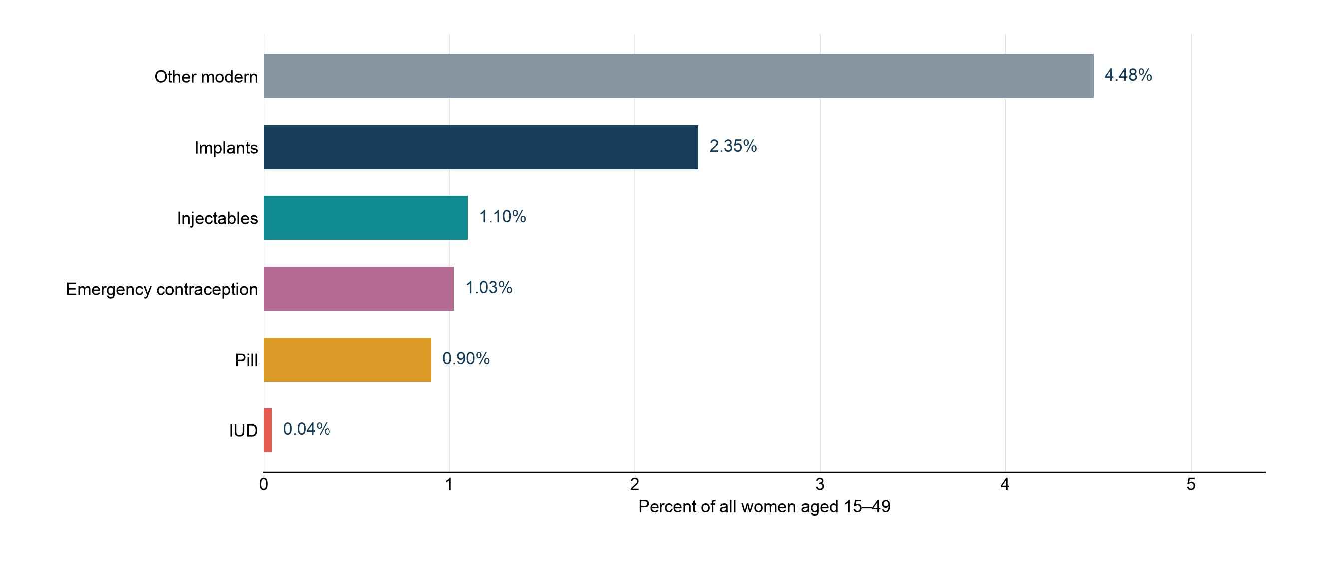
Modern contraceptive use in the DRC
9.9% of all women aged 15–49 report current modern-method use
Survey-weighted current use among all women; emergency contraception is included in the DHS modern-use classification.
2

Slide 3
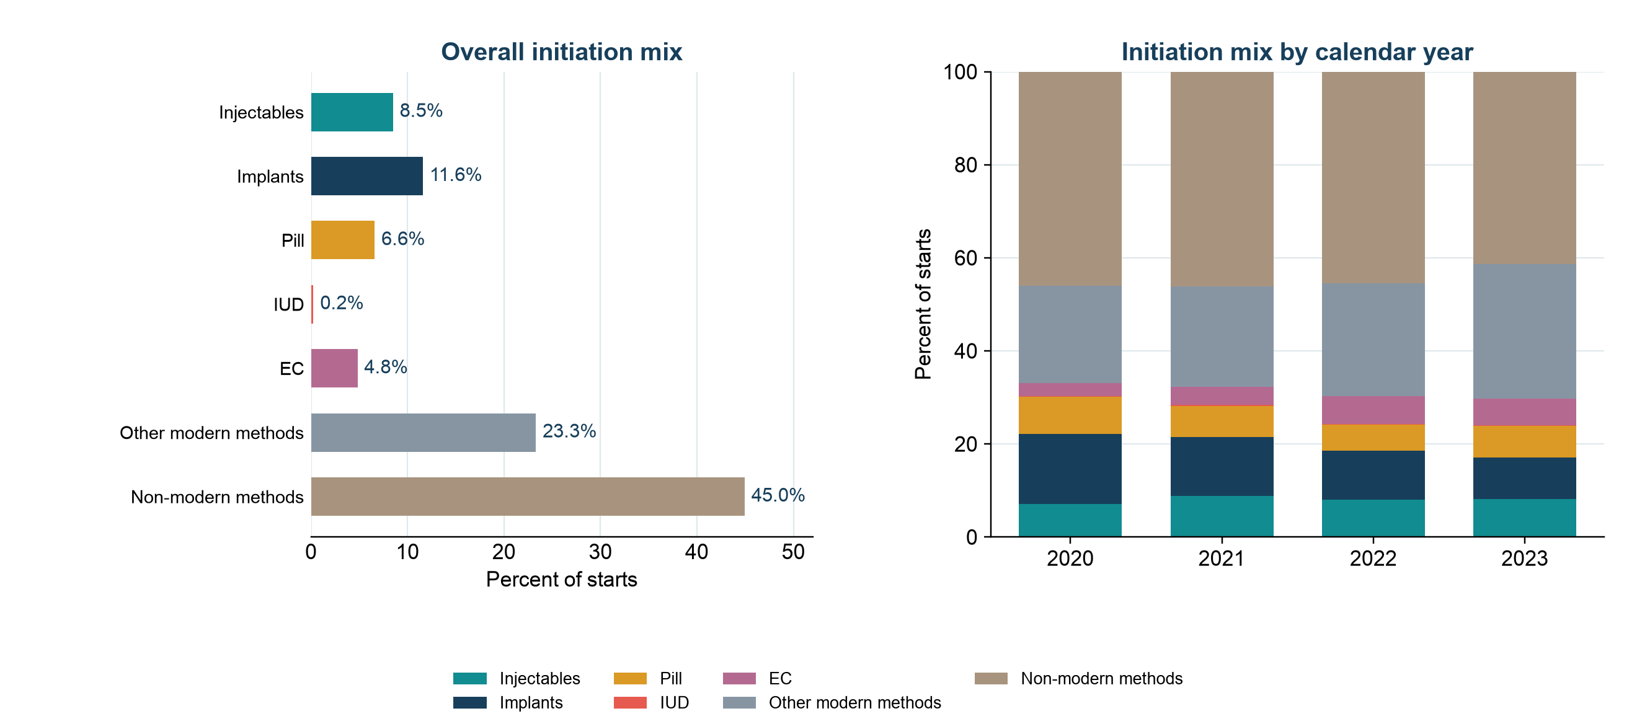
Entry methods set the denominator for future retention risk
Overall initiation mix and calendar-year changes
Shares use all observed contraceptive starts, including non-modern methods and emergency contraception.
3

Slide 4
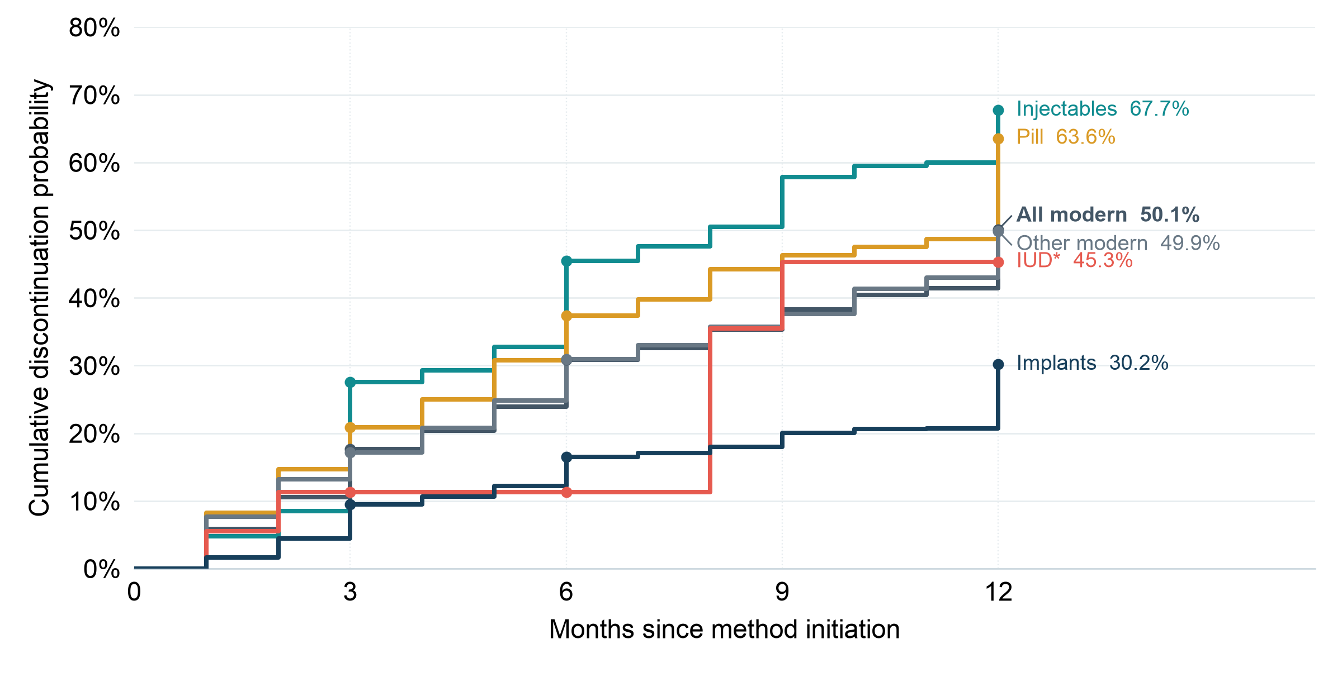
About half of modern-method episodes end within 12 months
Injectables and pills have the highest all-reason rates
All modern excludes emergency contraception. IUD is based on 23 eligible episodes and has limited precision.
4

Slide 5
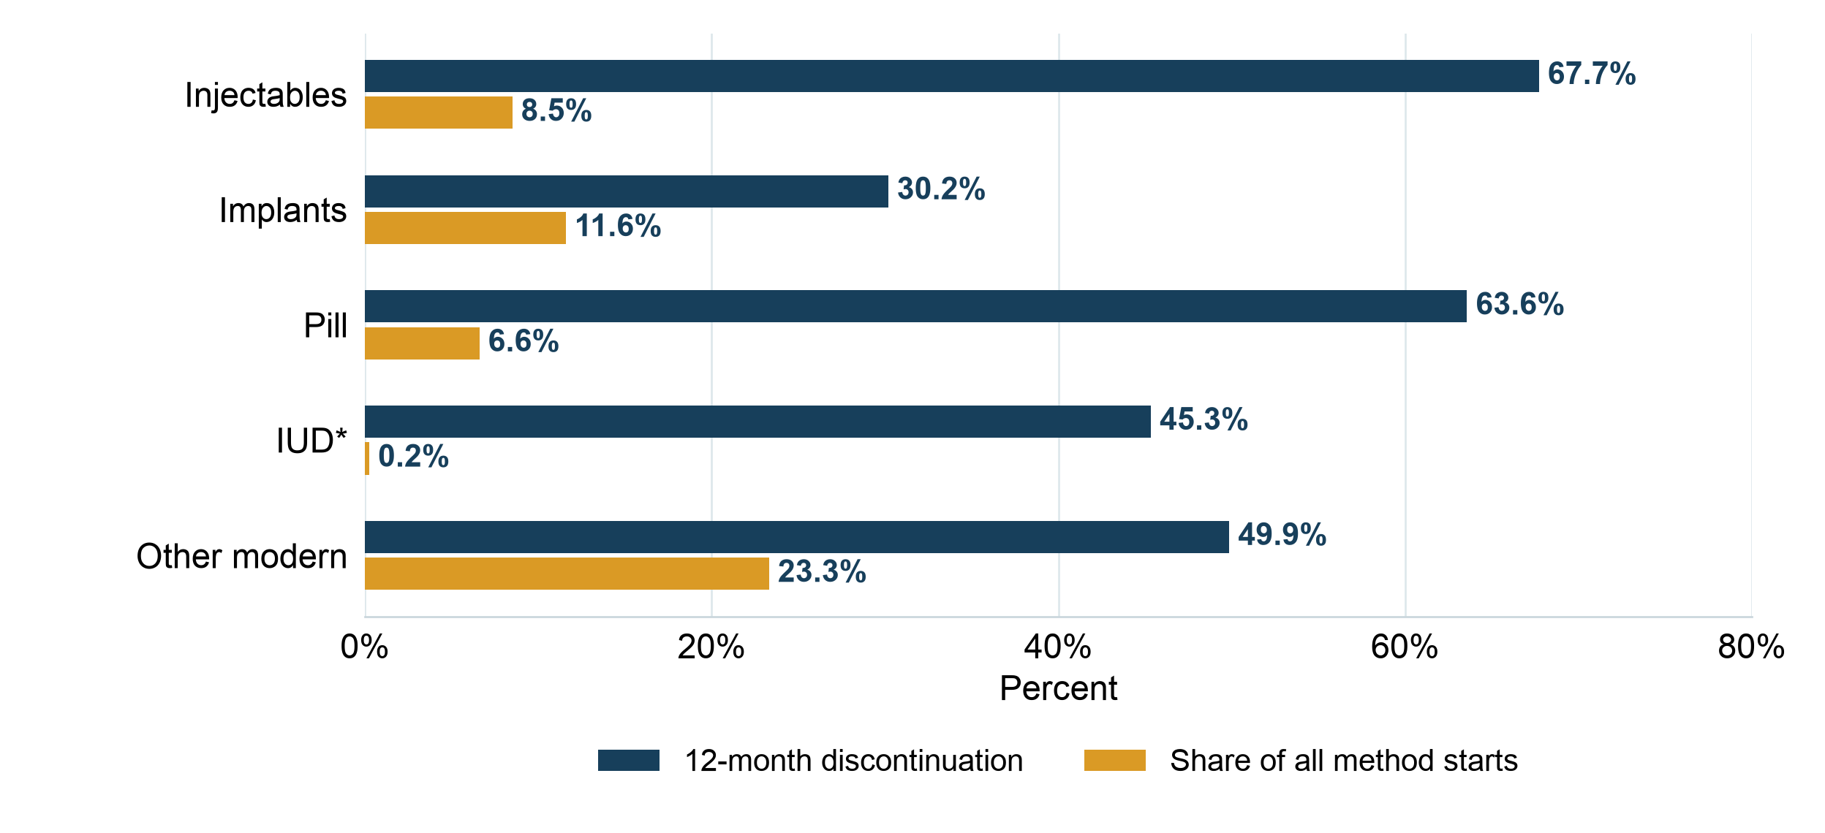
Starts and 12-month discontinuation vary by method
Share of all starts (gold) and all-reason discontinuation among episodes of each modern method (navy)
Start shares include non-modern methods in the denominator; IUD risk is sparse.
5

Slide 6
Understanding discontinuation reasons, risk factors, and regional differences
1
Reasons
2
Risk factors
3
Regions
Which reasons account for discontinuation and when do they emerge?
What factors are associated with a higher discontinuation rate?
Which regions have higher discontinuation rates and why?
6

Slide 7
Discontinuation reasons fall into four distinct groups
Partner/spousal disapproval is separate from potentially actionable method experience and access causes
Wanted pregnancy
Potentially actionable
Partner / spousal
disapproval
Circumstantial / other
Not a program failure
Method experience / access
Separate category
Other recorded reasons
Wanted to become pregnant.
Method failure
Wanted greater effectiveness
Bleeding changes
Other side effects / health
Access / cost / convenience
Husband or partner opposed contraceptive use.
Infrequent sex / partner away
Separation
Reduced fertility / menopause
Fatalistic, other or unknown
Only the five method experience/access causes enter actionable discontinuation rates and mCPR planning. Wanted pregnancy, partner disapproval and other endings remain competing events.

Slide 8
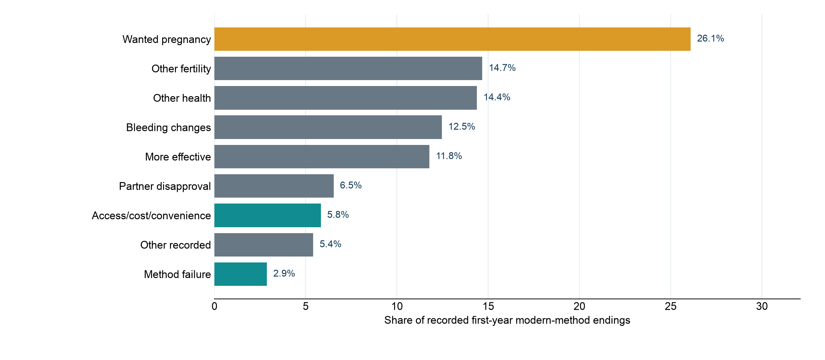
Pregnancy intention is the largest single recorded reason for ending modern use
Weighted distribution among recorded first-year modern-method endings
Other fertility includes infrequent sex or husband away, marital dissolution or separation, and difficulty becoming pregnant or menopause.
8

Slide 9
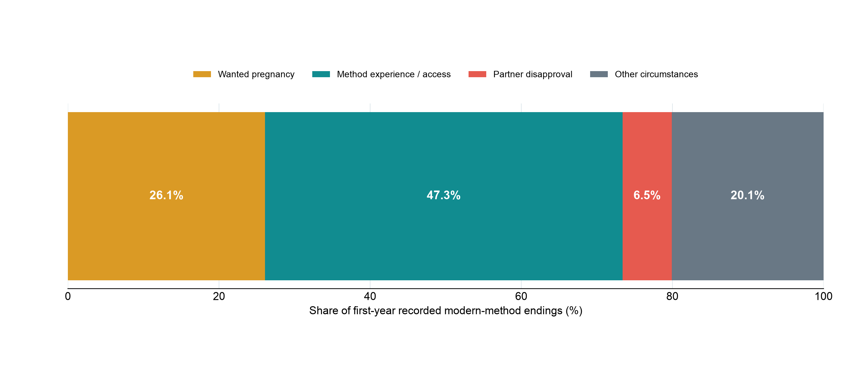
Method experience and access account for many modern-method endings
Share of recorded first-year modern-method endings
These shares describe reasons among endings; they are not 12-month risks among all episodes.
9

Slide 10
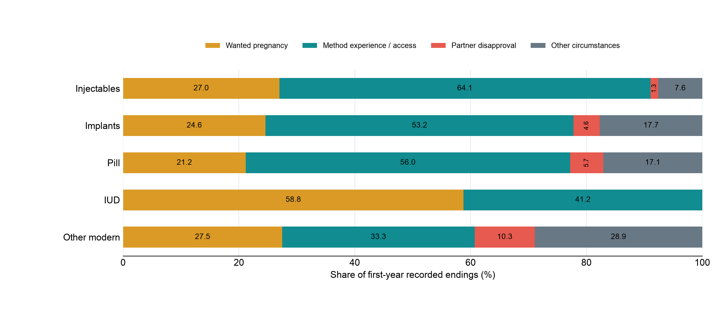
Reasons for discontinuation differ by modern method
Share of recorded first-year endings within each method
10

Slide 11
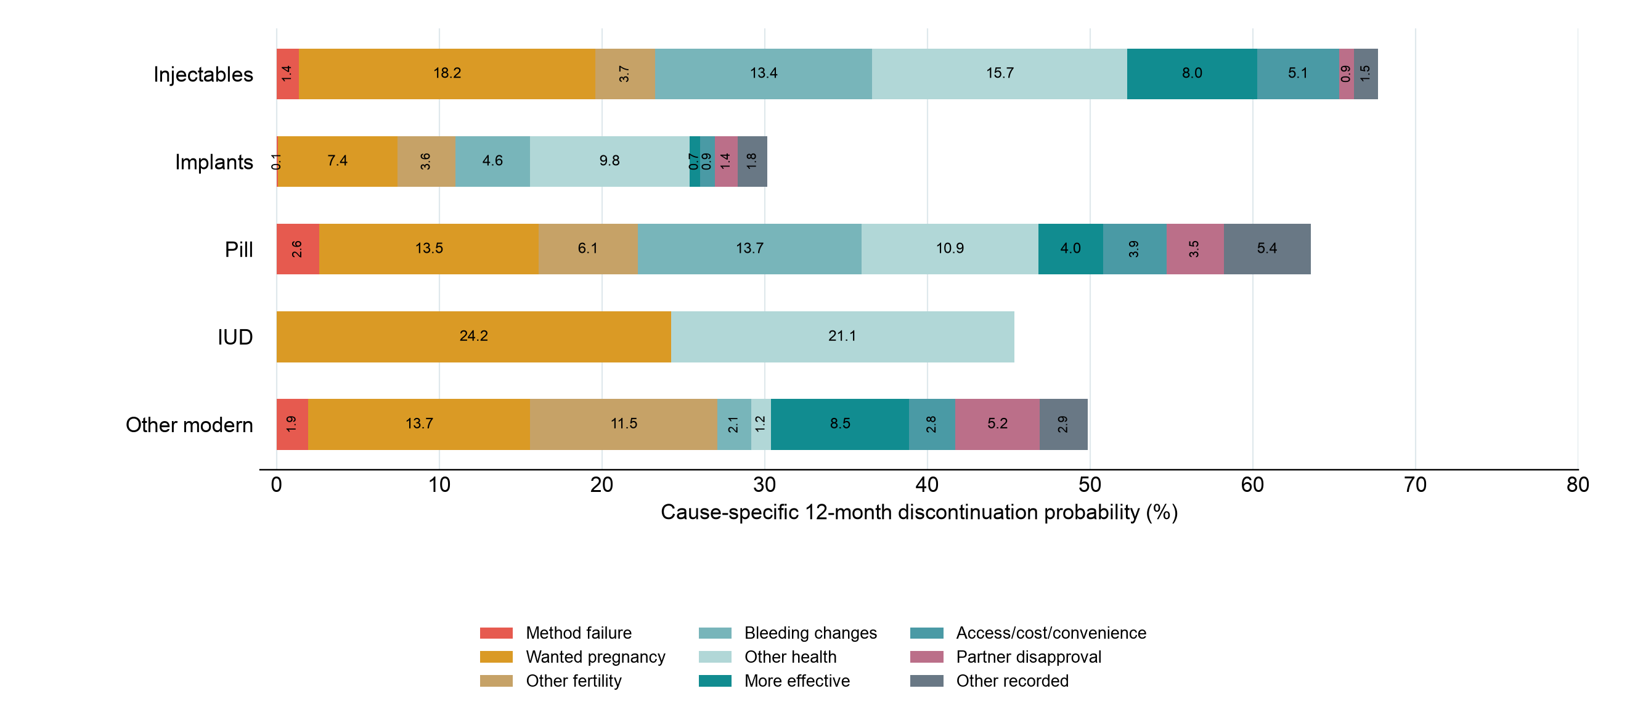
Cause-specific 12-month discontinuation differs by method
Competing-risk probabilities; colored segments sum to each method’s all-reason rate
The IUD row is imprecise because only 23 eligible episodes were observed.
11

Slide 12
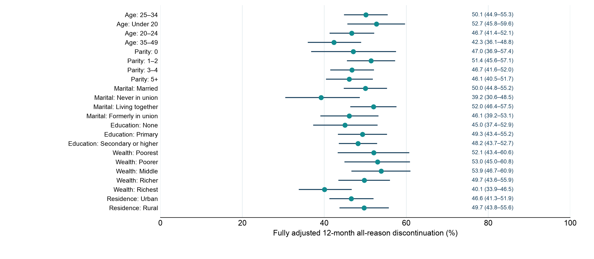
Who is more likely to discontinue a modern method?
Fully adjusted 12-month all-reason probabilities by subgroup
Survey-design discrete-time model adjusts for method, province, month of use, age, parity, marital status, education, wealth, residence, and start year.
12

Slide 13
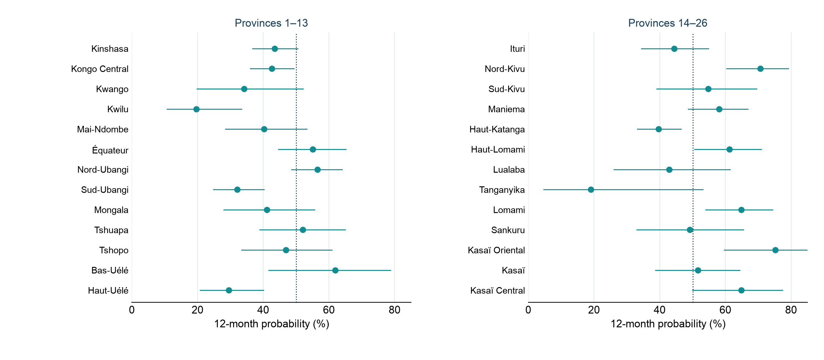
All-reason discontinuation varies across the DRC’s 26 provinces
Observed 12-month probabilities with survey-design confidence intervals
All modern methods excluding emergency contraception; several provinces have wide intervals.
13

Slide 14
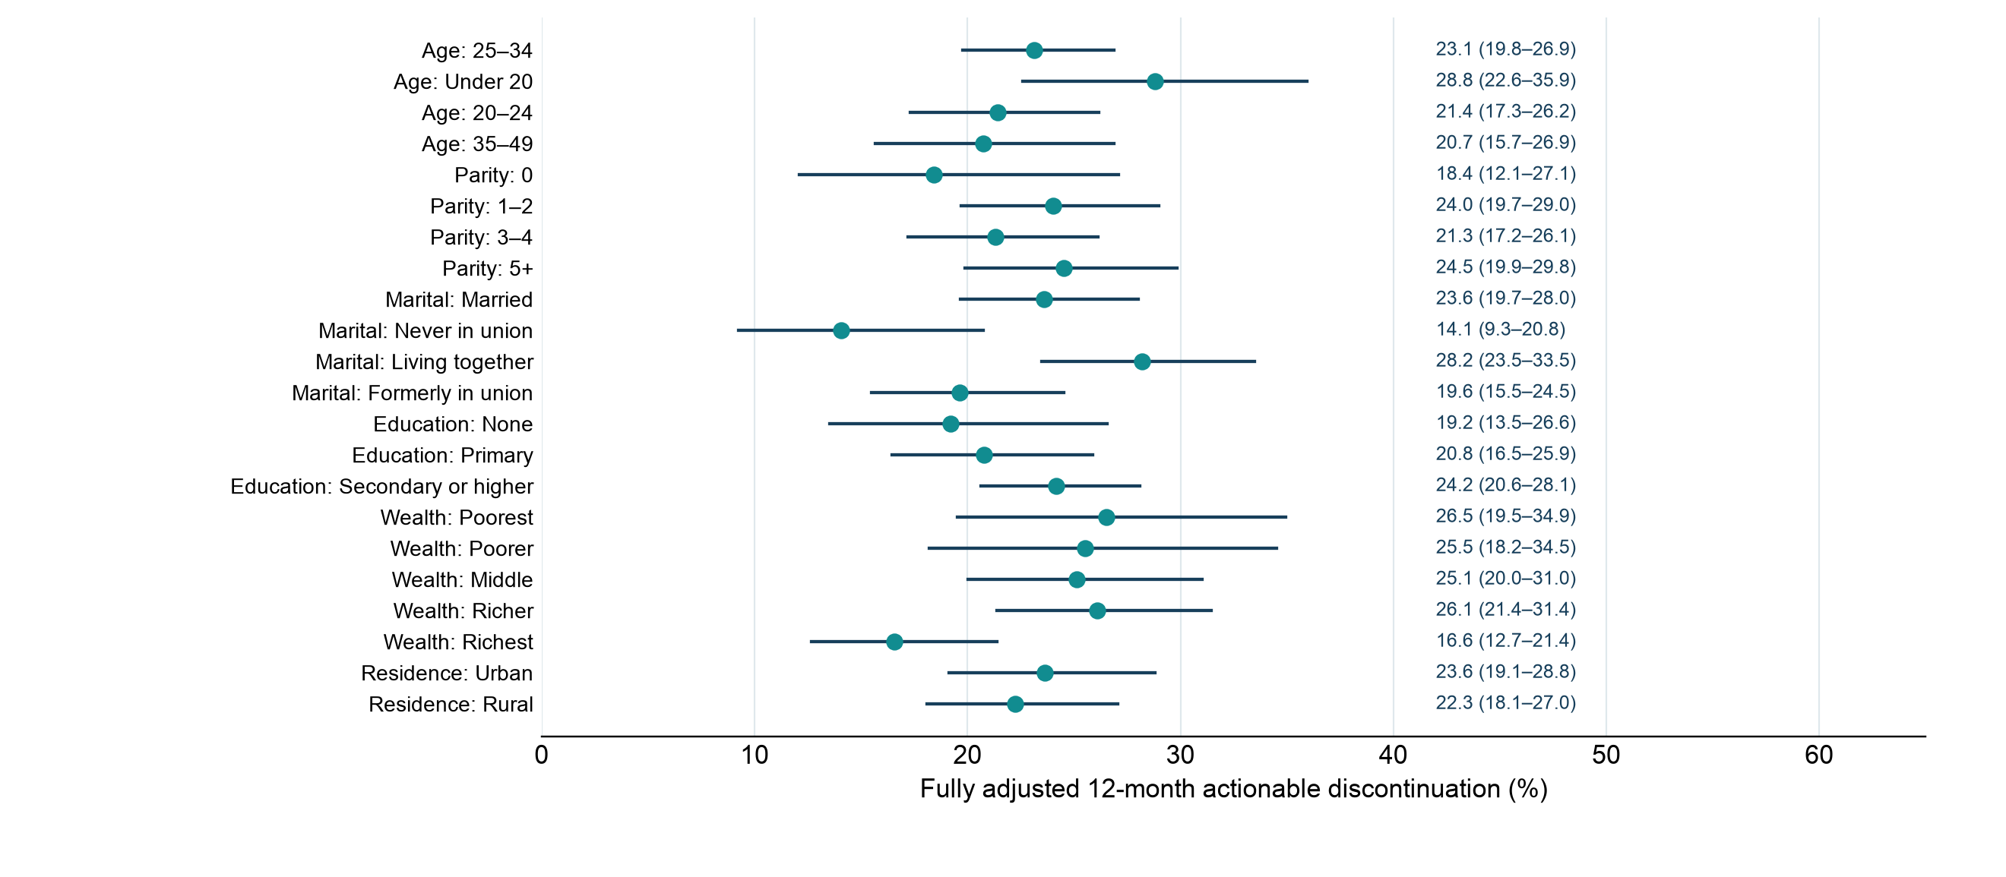
Who is more likely to stop a modern method for an actionable reason?
Fully adjusted 12-month probabilities by subgroup
Full-frame survey-design intervals. The competing-risk model adjusts for method, province, month of use, age, parity, marital status, education, wealth, residence and start year.
14

Slide 15
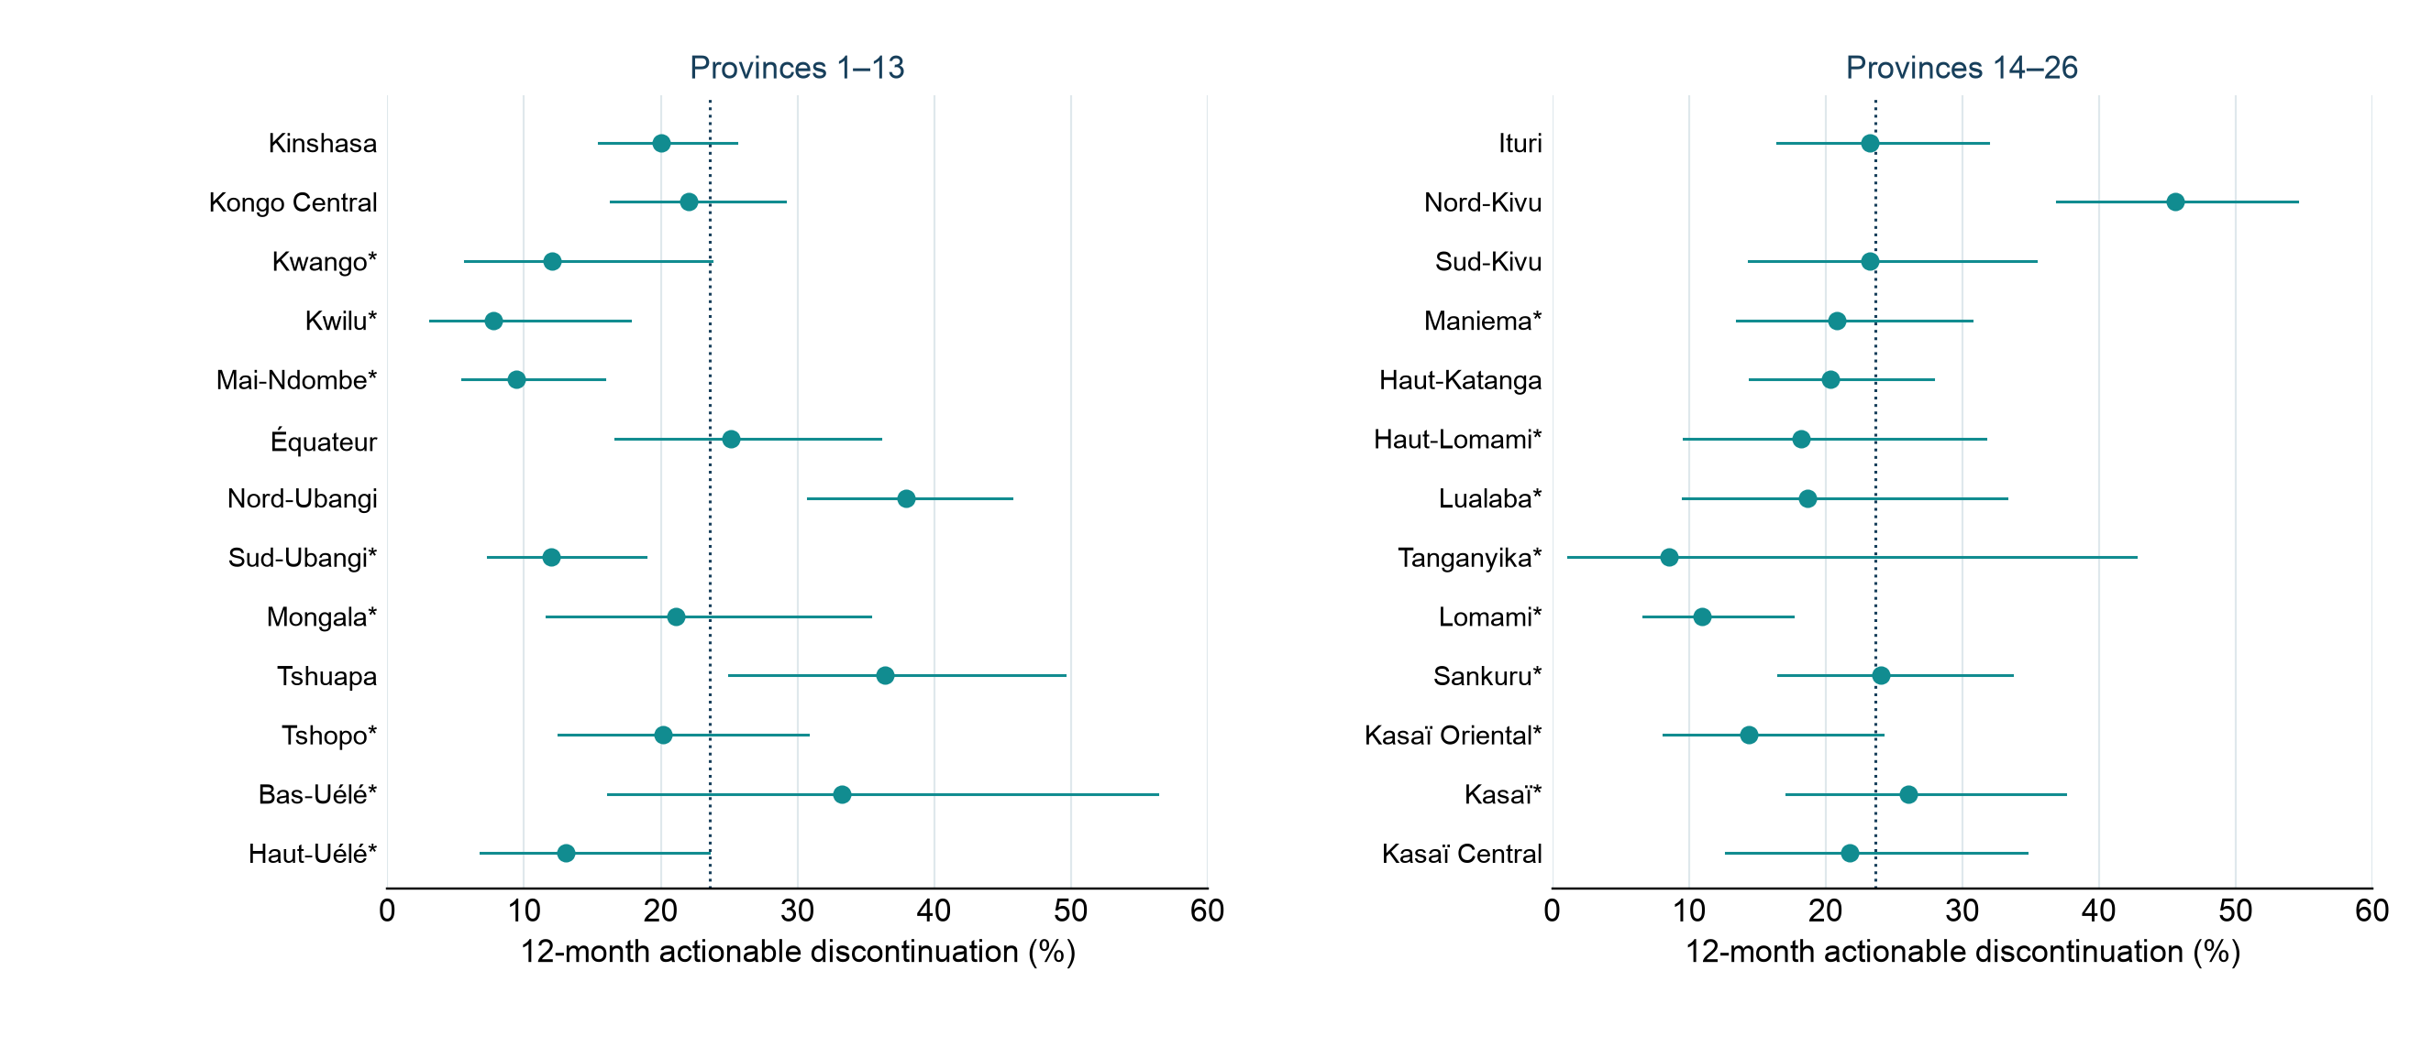
Actionable discontinuation varies across the DRC’s 26 provinces
Observed 12-month probabilities with survey-design confidence intervals
All modern methods excluding EC. * Fewer than 30 observed actionable endings; interpret these provincial estimates cautiously.
15

Slide 16
Why do regions differ in contraceptive discontinuation?
01
02
03
Measure regional
variation
Explain regional
gaps
Link service
context
Where is risk high and
the burden large?
Do different users and
methods explain the gap?
Which conditions track
the remaining gaps?
Compare discontinuation,
modern-use exits, and mCPR.
Use adjusted survival models
and Oaxaca–Blinder
decomposition to assess how
method mix and differences
in characteristics such as age,
parity, and wealth, among
others, explain regional gaps.
Use multilevel survival
models linked to service data
to examine associations with
supply, access, counseling,
and support for switching.
16

Slide 17
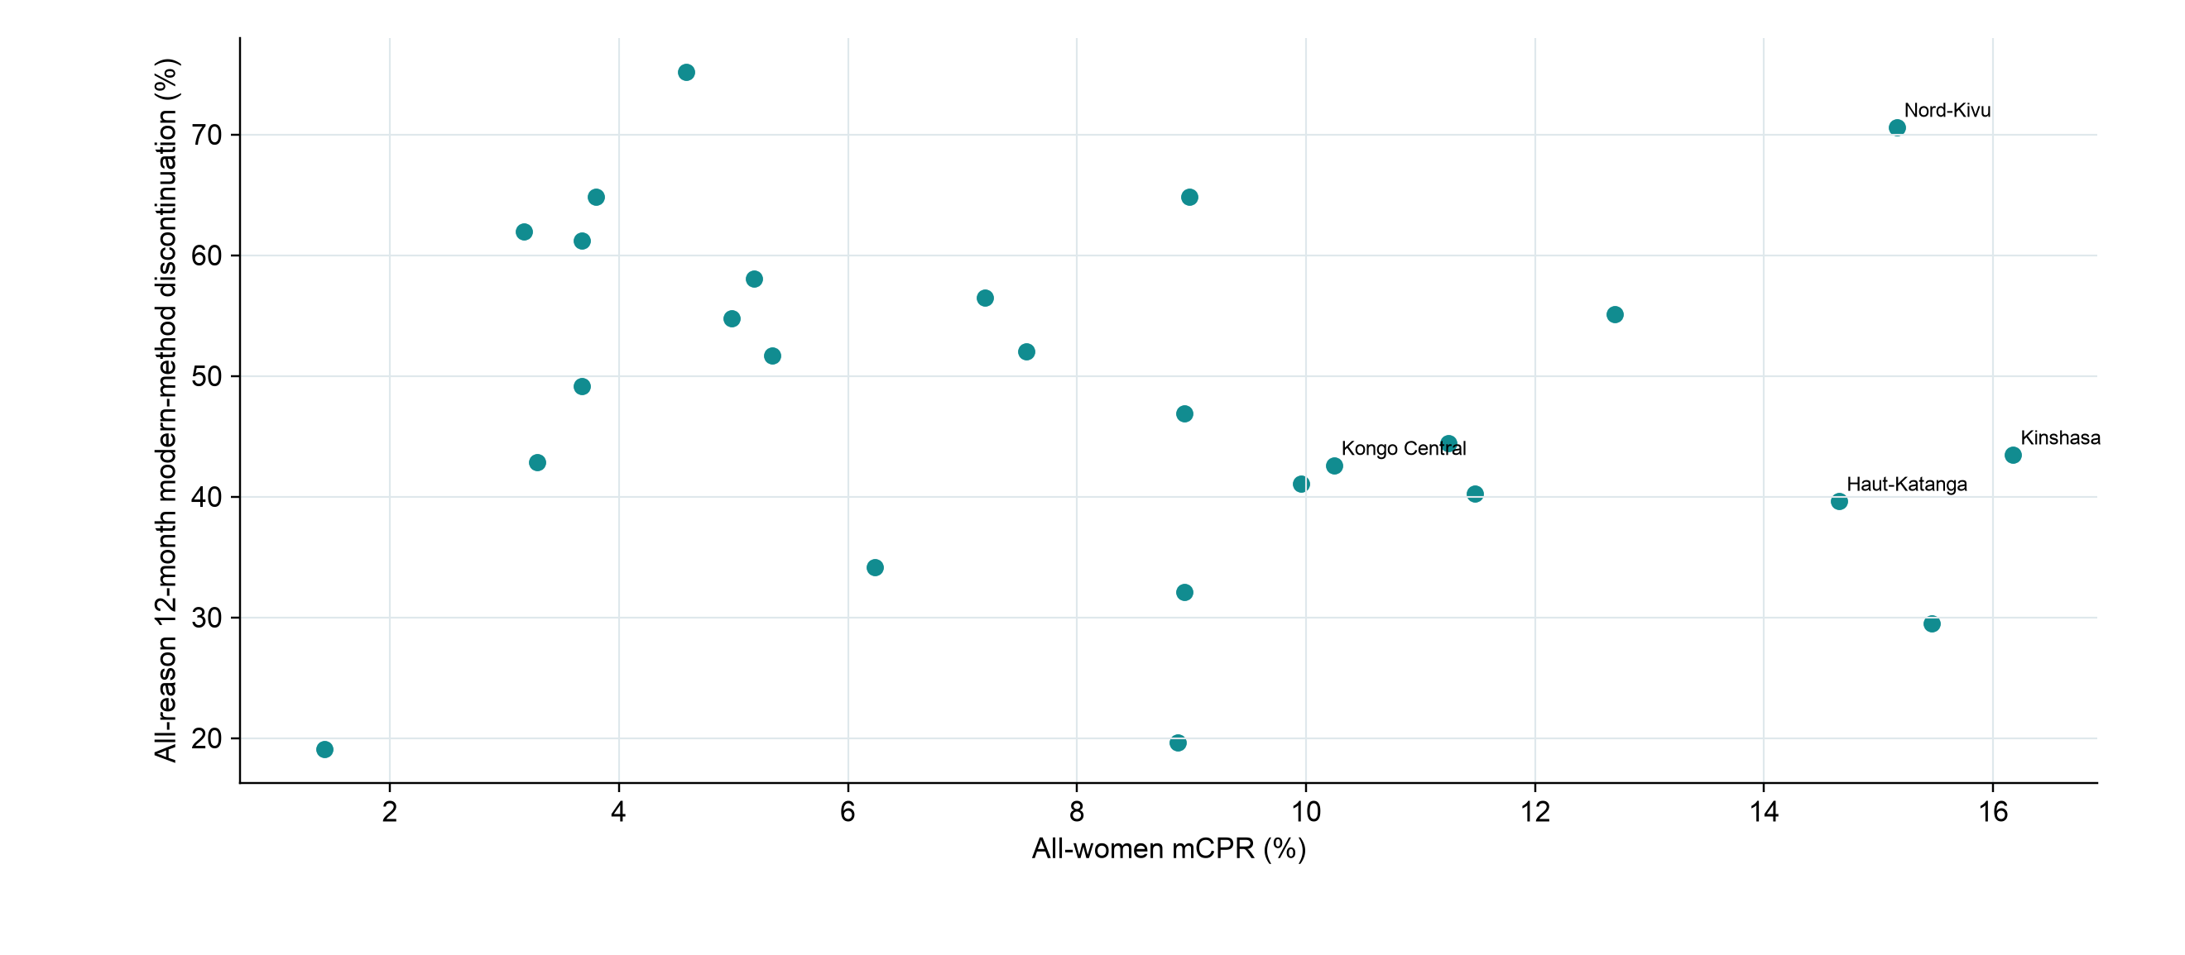
mCPR and discontinuation provide different provincial signals
All-women mCPR versus all-reason 12-month modern-method discontinuation
The two measures have different denominators and should be used together for program planning.
17

Slide 18
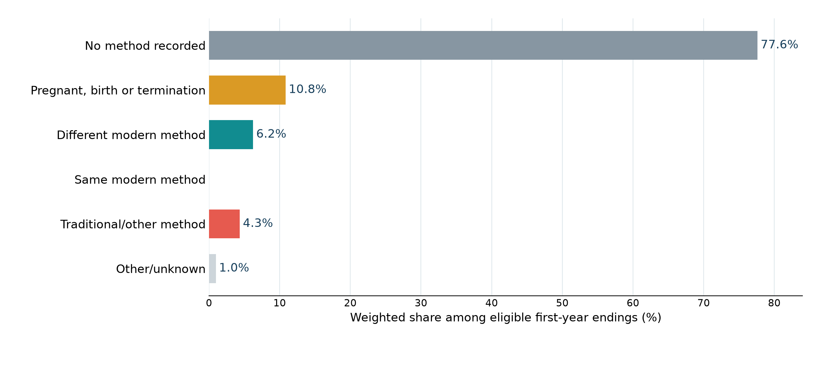
Many women are not using a modern method one month after ending one
Modern-method status one month after a selected-reason ending
Selected reasons exclude wanted pregnancy and partner disapproval; the chart is weighted among eligible endings.
18

Slide 19
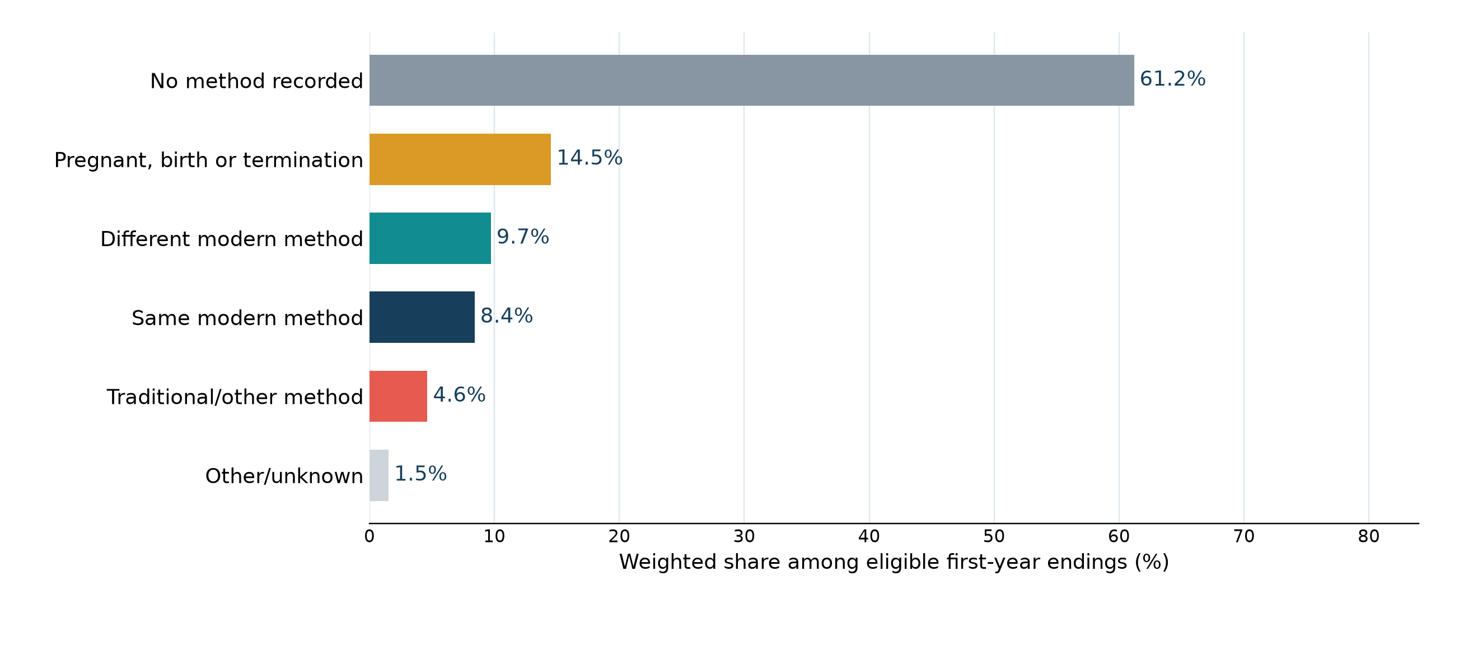
Modern use can resume after discontinuation, but nonuse persists
Modern-method status 12 months after a selected-reason ending
Selected reasons exclude wanted pregnancy and partner disapproval; this is a descriptive follow-up cohort.
19

Slide 20
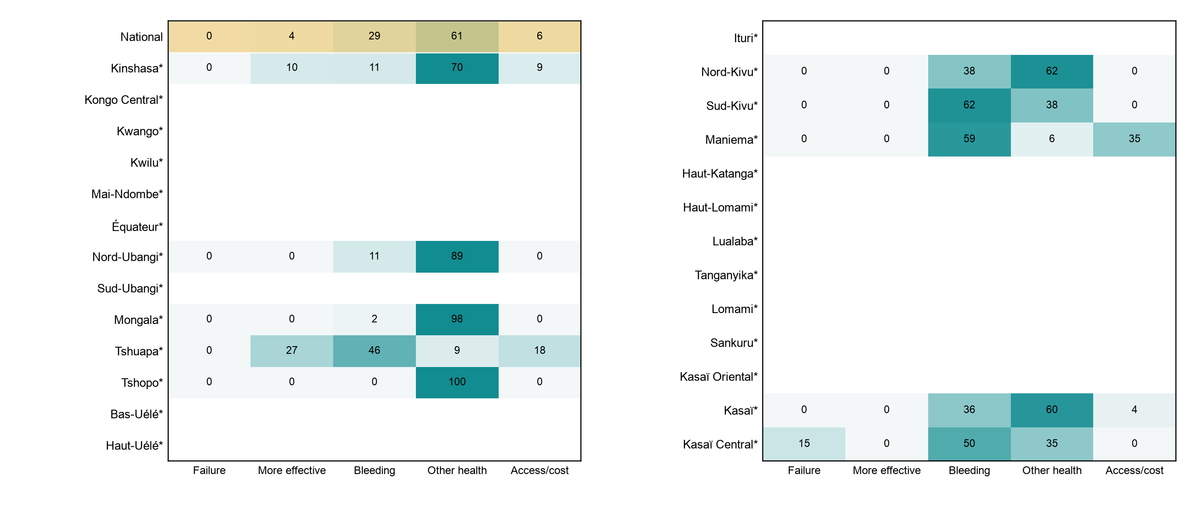
Implants: reasons for actionable first-year endings
Shares among this method’s actionable first-year endings in each province
Province rows with fewer than five endings are blank; * marks fewer than 30 actionable endings. Displayed rows sum to 100 before rounding.
20

Slide 21
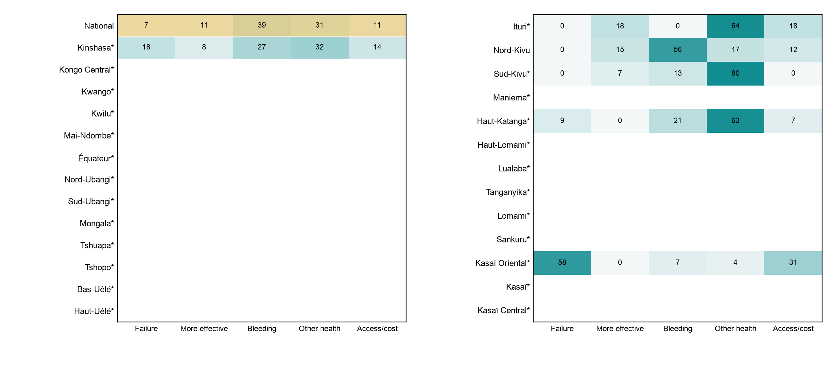
Pill: reasons for actionable first-year endings
Shares among this method’s actionable first-year endings in each province
Province rows with fewer than five endings are blank; * marks fewer than 30 actionable endings. Displayed rows sum to 100 before rounding.
21

Slide 22
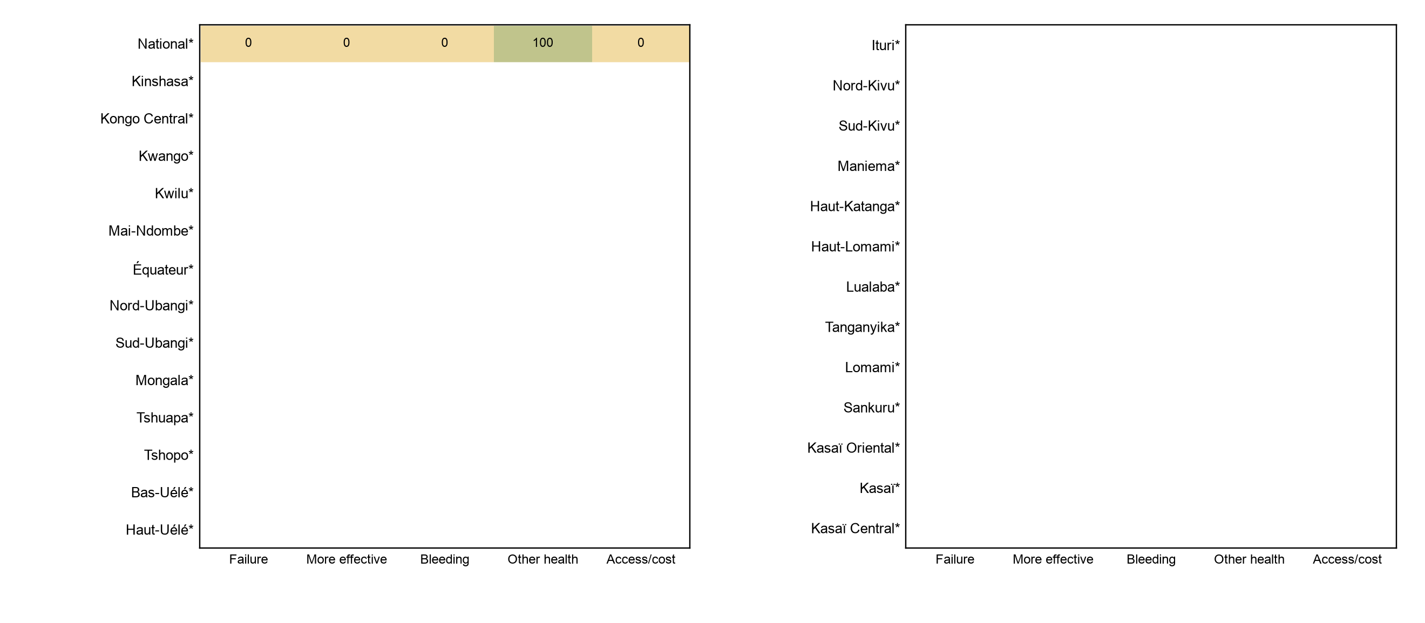
IUD: reasons for actionable first-year endings
Shares among this method’s actionable first-year endings in each province
Province rows with fewer than five endings are blank; * marks fewer than 30 actionable endings. Displayed rows sum to 100 before rounding.
22

Slide 23
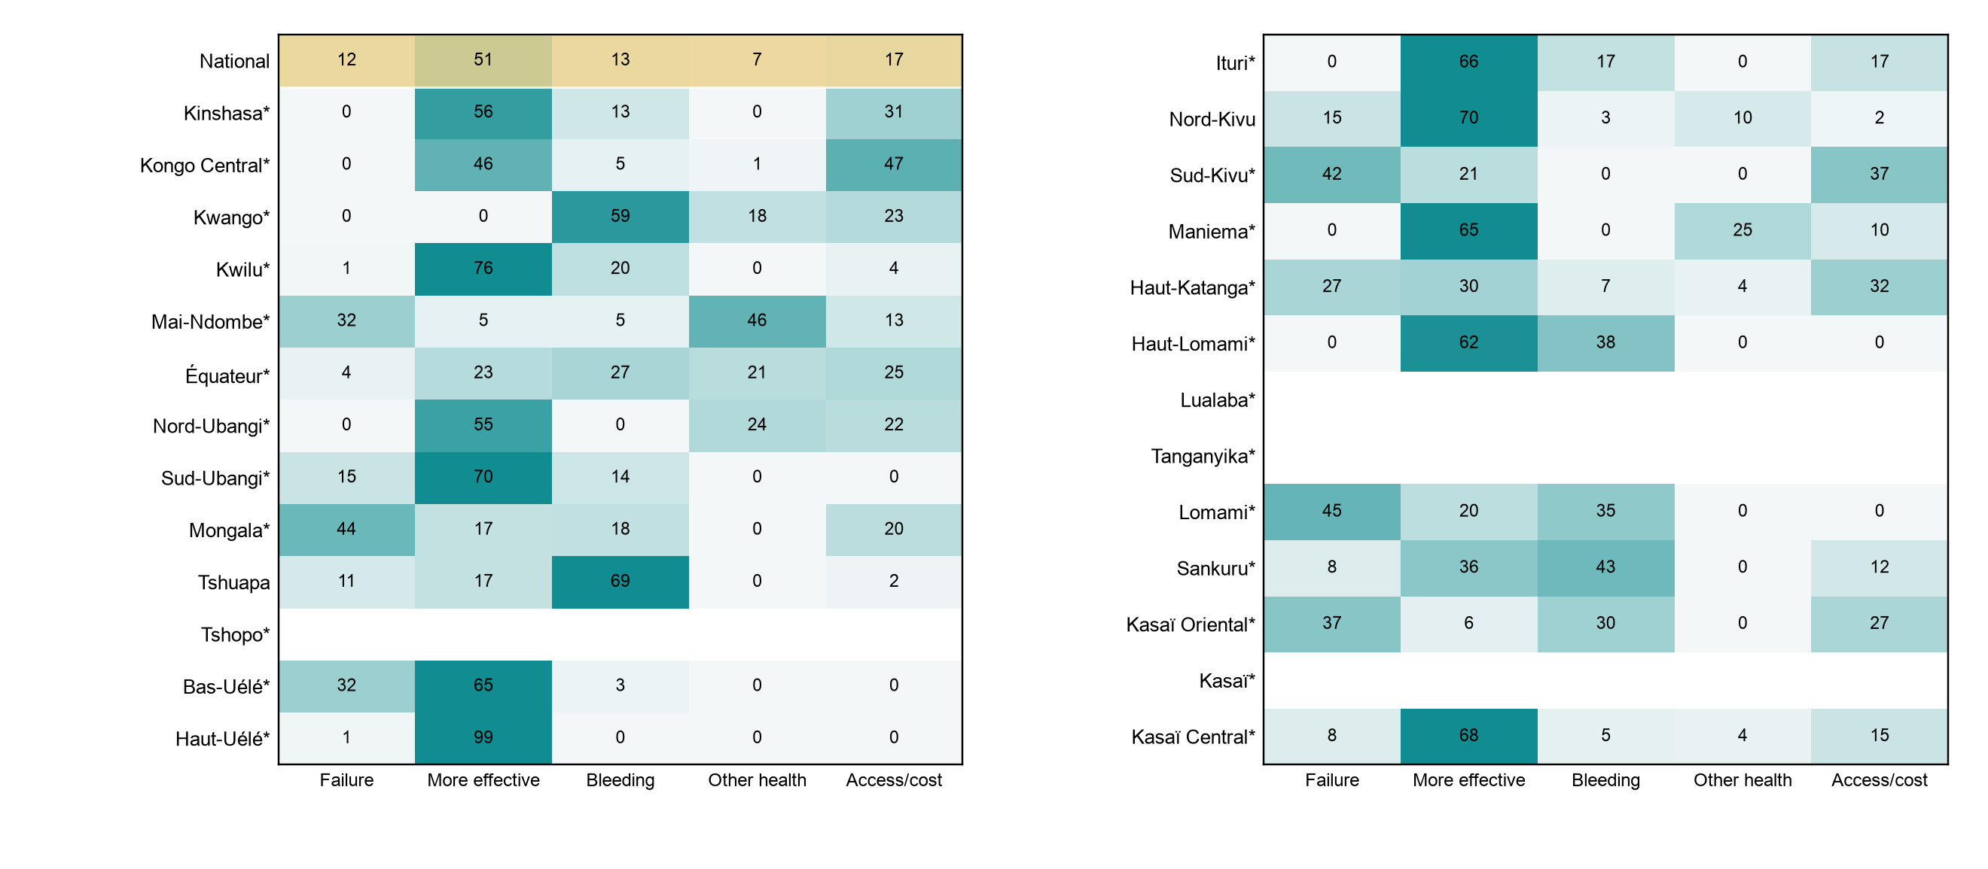
Other modern: reasons for actionable first-year endings
Shares among this method’s actionable first-year endings in each province
Province rows with fewer than five endings are blank; * marks fewer than 30 actionable endings. Displayed rows sum to 100 before rounding.
23

Slide 24
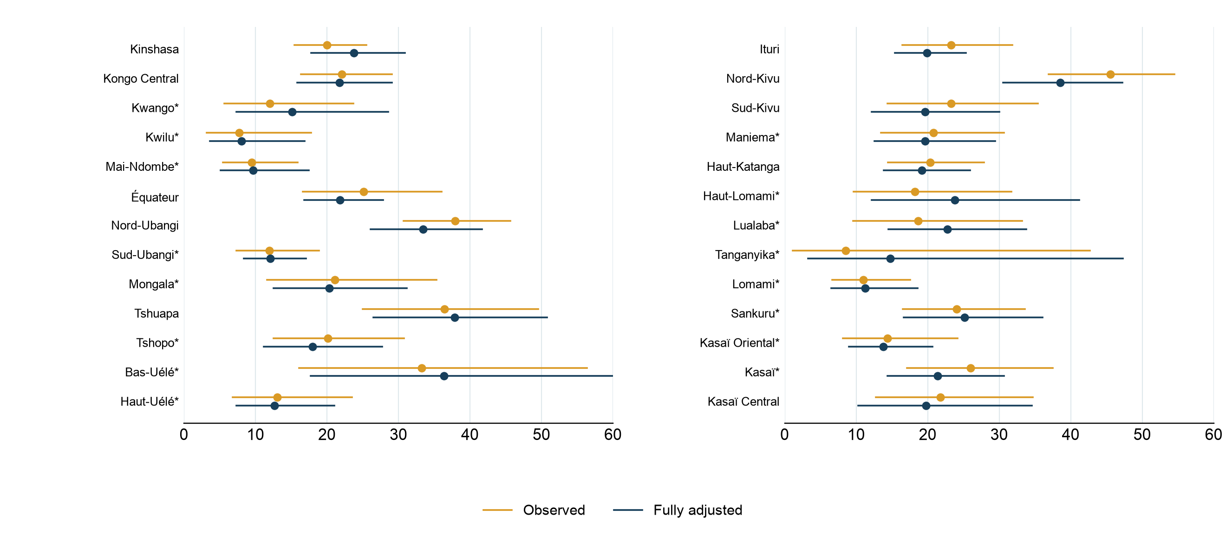
Observed and adjusted actionable discontinuation across provinces
12-month probability with 95% intervals; gold observed, navy fully adjusted
Full model adjusts for method, use month, province, age, parity, marital status, education, wealth, residence, and start year. * Sparse actionable cell.
24

Slide 25
Provincial actionable discontinuation probabilities
12-month percentage; 95% intervals in parentheses
Province | Episodes | Observed | Method + month | Fully adjusted
National | 4146 | 23.6% (20.8–26.7) | 23.3% (20.6–26.2) | 22.9% (19.9–26.2)
Kinshasa | 368 | 20.0% (15.5–25.5) | 19.5% (15.1–24.7) | 23.7% (17.8–30.9)
Kongo Central | 194 | 22.1% (16.3–29.1) | 23.3% (17.7–29.9) | 21.8% (15.9–29.1)
Kwango* | 68 | 12.0% (5.7–23.7) | 16.8% (8.8–29.9) | 15.1% (7.4–28.6)
Kwilu* | 122 | 7.7% (3.2–17.8) | 9.7% (4.2–20.9) | 8.1% (3.7–16.9)
Mai-Ndombe* | 181 | 9.5% (5.5–15.9) | 11.4% (6.4–19.5) | 9.7% (5.1–17.5)
Équateur | 256 | 25.1% (16.6–36.1) | 25.6% (20.3–31.8) | 21.8% (16.8–27.8)
Nord-Ubangi | 129 | 37.9% (30.7–45.6) | 37.6% (29.9–45.9) | 33.4% (26.1–41.7)
Sud-Ubangi* | 169 | 12.0% (7.4–18.9) | 13.5% (9.7–18.4) | 12.1% (8.4–17.1)
Mongala* | 145 | 21.1% (11.6–35.3) | 24.1% (14.8–36.7) | 20.3% (12.6–31.2)
Tshuapa | 162 | 36.4% (25.0–49.6) | 43.7% (32.4–55.7) | 37.9% (26.5–50.8)
Tshopo* | 114 | 20.1% (12.5–30.8) | 20.4% (12.1–32.2) | 18.0% (11.2–27.7)
Bas-Uélé* | 44 | 33.3% (16.1–56.3) | 41.5% (21.3–65.1) | 36.4% (17.7–60.3)
Haut-Uélé* | 94 | 13.0% (6.8–23.5) | 12.4% (7.3–20.3) | 12.7% (7.3–21.0)
Adjusted rates are predicted on a common observed-start profile. * Fewer than 30 observed actionable endings.
25

Slide 26
Provincial actionable discontinuation probabilities (continued)
12-month percentage; 95% intervals in parentheses
Province | Episodes | Observed | Method + month | Fully adjusted
Ituri | 203 | 23.3% (16.4–31.9) | 21.1% (16.7–26.3) | 19.9% (15.4–25.4)
Nord-Kivu | 378 | 45.5% (36.9–54.5) | 41.3% (33.6–49.5) | 38.5% (30.5–47.2)
Sud-Kivu | 193 | 23.3% (14.4–35.4) | 20.2% (12.2–31.6) | 19.6% (12.2–30.0)
Maniema* | 129 | 20.8% (13.5–30.7) | 23.2% (15.0–34.2) | 19.7% (12.6–29.4)
Haut-Katanga | 305 | 20.3% (14.4–27.9) | 17.5% (12.3–24.4) | 19.2% (13.9–25.9)
Haut-Lomami* | 73 | 18.2% (9.6–31.7) | 22.8% (12.3–38.2) | 23.8% (12.2–41.2)
Lualaba* | 73 | 18.7% (9.6–33.2) | 23.0% (14.6–34.5) | 22.7% (14.5–33.8)
Tanganyika* | 16 | 8.5% (1.1–42.7) | 15.2% (3.2–49.4) | 14.8% (3.2–47.3)
Lomami* | 121 | 11.0% (6.6–17.6) | 12.8% (7.7–20.3) | 11.2% (6.6–18.6)
Sankuru* | 58 | 24.0% (16.5–33.6) | 28.1% (19.6–38.4) | 25.1% (16.6–36.1)
Kasaï Oriental* | 188 | 14.4% (8.1–24.2) | 16.4% (10.6–24.6) | 13.8% (9.0–20.7)
Kasaï* | 87 | 26.0% (17.1–37.5) | 21.6% (14.6–30.9) | 21.4% (14.4–30.7)
Kasaï Central | 276 | 21.8% (12.7–34.7) | 21.8% (11.8–36.9) | 19.7% (10.3–34.6)
Adjusted rates are predicted on a common observed-start profile. * Fewer than 30 observed actionable endings.
26

Slide 27
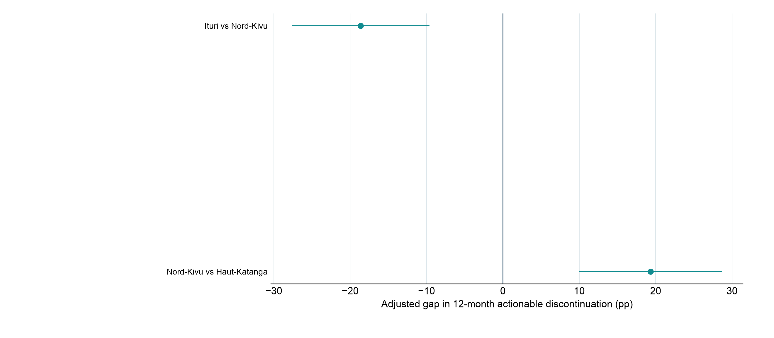
Fully adjusted province gaps that survive pairwise correction
Holm-corrected tests across 325 pairs; only nonsparse significant pairs shown
Differences use joint full-frame survey covariance and 727 design degrees of freedom. Holm correction covers 325 pairs. Omitted sparse pairs do not establish equality.
27

Slide 28
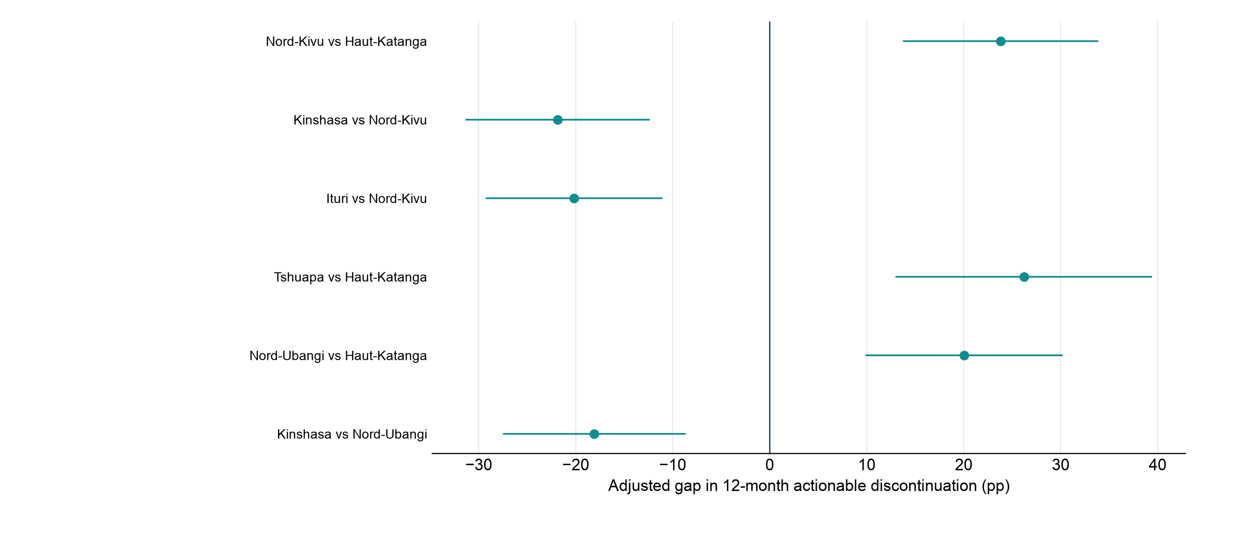
Provincial gaps after accounting for method mix
Holm-corrected tests from the method-and-month model; only nonsparse significant pairs shown
Each province is compared on a common observed-start method profile; 325 pairwise tests were evaluated.
28

Slide 29
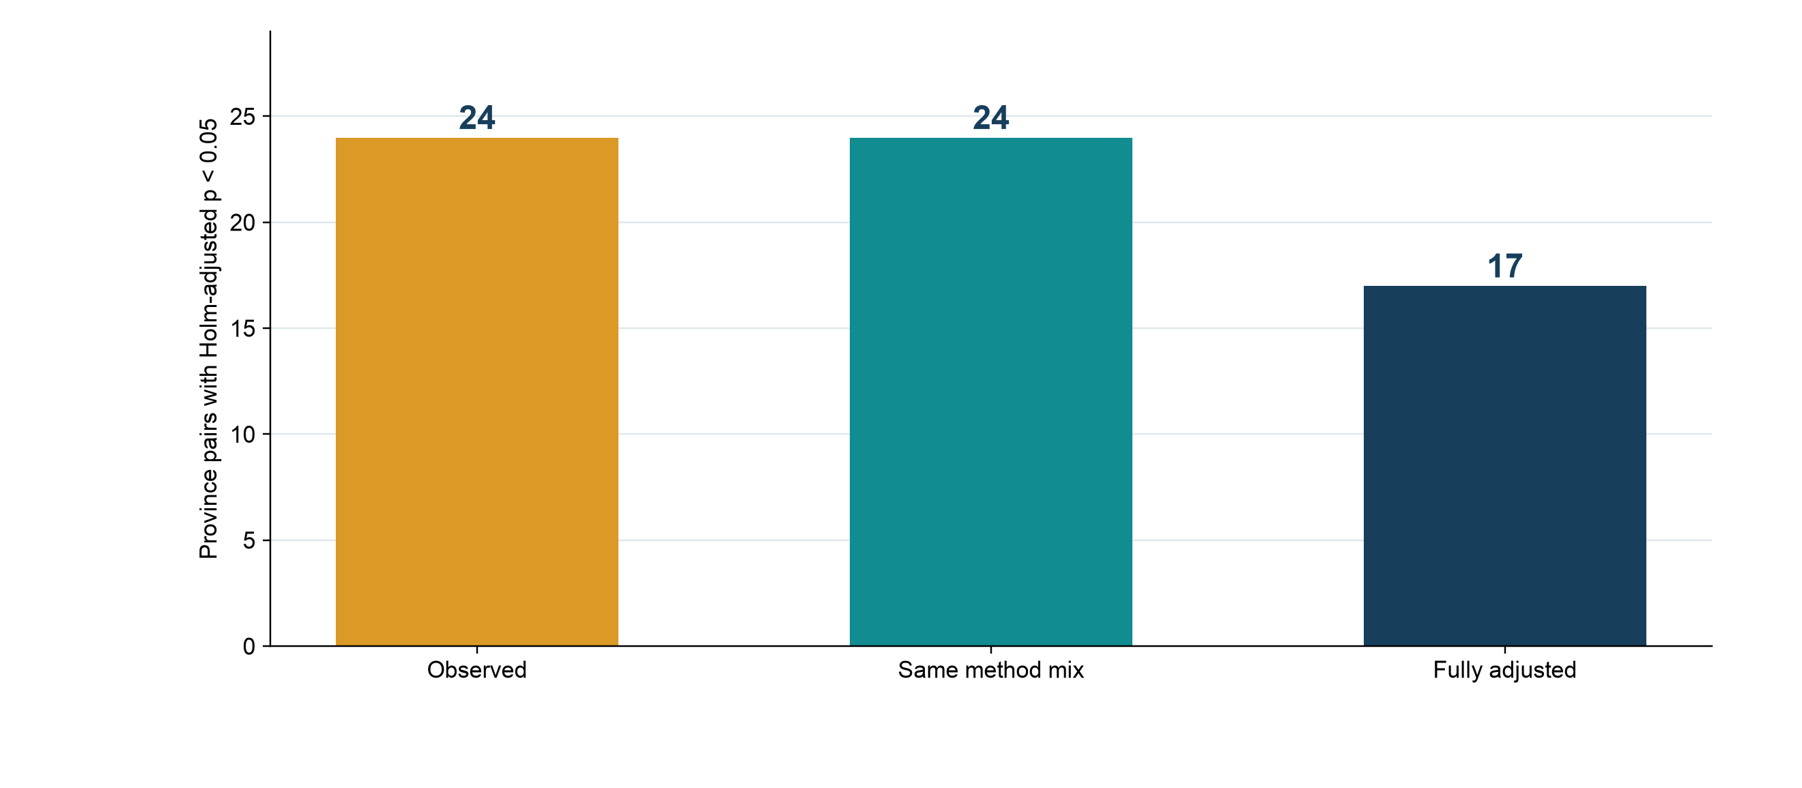
Regional comparisons depend on which differences are accounted for
Number of province pairs passing familywise Holm correction at 5%
Counts include sparse pairs and are descriptive of the testing stage; significance does not identify a cause of the gap.
29

Slide 30
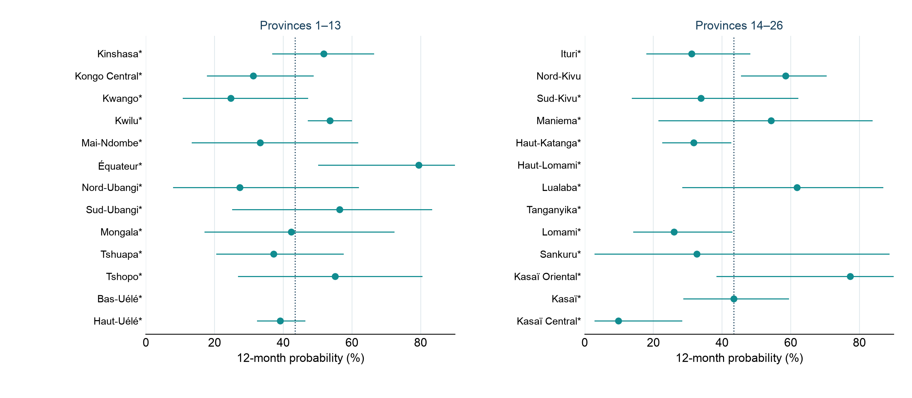
Injectable actionable discontinuation by province
Observed method-specific 12-month probabilities; dotted line is the national injectable rate
* Fewer than 30 actionable injectable endings. This sparse descriptive figure does not claim adjusted province differences.
30

Slide 31
Exploratory: users who may discontinue for actionable reasons
Exploratory estimate. Ignores time already using the method. Users in thousands (95% CI)
Method | 2024 survey current users | Actionable ending probability | Users ending original method | mCPR equivalent
Injectables | 268.2 (219.8–316.4) | 43.4% (36.9–49.7) | 116.4 (94.9–134.9) | 0.46 pp (0.38–0.53)
Implants | 571.9 (483.5–656.4) | 16.0% (12.0–20.0) | 91.6 (67.4–116.4) | 0.36 pp (0.27–0.46)
Pill | 220.5 (162.3–280.8) | 35.1% (24.9–44.1) | 77.4 (51.7–101.5) | 0.31 pp (0.20–0.40)
IUD* | 10.7 (3.3–20.0) | 21.1% (0.0–47.9) | 2.3 (<0.1–5.2) | 0.01 pp (<0.01–0.02)
Other modern | 1,091.3 (966.7–1,211.9) | 16.6% (13.7–19.6) | 180.9 (146.7–217.9) | 0.72 pp (0.58–0.86)
EC | 250.2 (177.6–330.7) | Not applied | Not estimated | Not estimated
Current-user mix excluding EC | 2,162.6 (1,973.0–2,320.0) | 21.7% (18.9–24.1) | 468.5 (400.7–537.7) | 1.86 pp (1.59–2.13)
Applies each method’s first-year actionable-ending probability to all current users, regardless of time already used. Every ending counts as a lost modern user. Switching and restarting are excluded. The total averages method-specific probabilities using current-user method mix. mCPR contribution (pp) = users retained ÷ 25,246,885 women aged 15–49 in 2025 × 100. Partner/spousal disapproval is excluded. 95% CIs use 500 survey bootstrap samples with fixed population and growth. Confidence limits do not add. † No observed events, so no reliable CI. * IUD has only 23 episodes and 14 current users.
31

Slide 32
Exploratory: actionable discontinuation by method and cause
Exploratory estimate. Ignores time already using the method. Users in thousands (95% CI)
Method / measure | Method failure | Want more effective | Bleeding changes | Other side effects/health | Access/cost/ convenience | All actionable causes
Injectables | 3.6 (0.8–7.0) | 21.4 (11.4–31.2) | 35.8 (25.1–46.7) | 42.0 (29.3–55.6) | 13.6 (5.9–24.9) | 116.4 (94.9–134.9)
Implants | 0.4 (0.0–1.4) | 3.7 (0.0–8.3) | 26.1 (13.8–37.8) | 56.0 (38.3–77.0) | 5.3 (0.9–11.7) | 91.6 (67.4–116.4)
Pill | 5.8 (1.1–10.7) | 8.8 (3.1–15.2) | 30.3 (15.5–46.7) | 24.0 (13.2–36.6) | 8.6 (2.8–15.3) | 77.4 (51.7–101.5)
IUD* | 0.0 (CI unavailable†) | 0.0 (CI unavailable†) | 0.0 (CI unavailable†) | 2.3 (<0.1–5.2) | 0.0 (CI unavailable†) | 2.3 (<0.1–5.2)
Other modern | 21.1 (10.6–33.8) | 92.5 (63.0–122.8) | 22.8 (14.2–33.5) | 13.5 (7.2–21.1) | 30.9 (20.4–42.0) | 180.9 (146.7–217.9)
Users ending method | 30.9 (19.2–42.8) | 126.5 (91.4–159.8) | 115.0 (92.1–141.5) | 137.8 (107.5–170.7) | 58.3 (39.8–80.4) | 468.5 (400.7–537.7)
Applies each method’s first-year actionable-ending probability to all current users, regardless of time already used. Every ending counts as a lost modern user. Switching and restarting are excluded. Partner/spousal disapproval is excluded. 95% CIs use 500 survey bootstrap samples with fixed population and growth. Confidence limits do not add. † No observed events, so no reliable CI. * IUD has only 23 episodes and 14 current users.
32

Slide 33
Exploratory: assumptions for 2025 mCPR
2024 survey baseline and a one-year projection to 2025
Different mCPR growth scenarios | Annual change (pp/year) | 2024 survey mCPR | Projected 2025 mCPR
10-year DHS trend (+0.18 pp/year) | +0.18 | 9.89% (9.09–10.57) | 10.07% (9.26–10.75)
17-year DHS trend (+0.19 pp/year) | +0.19 | 9.89% (9.09–10.57) | 10.08% (9.28–10.77)
FPET-informed growth (+0.40 pp/year) | +0.40 | 9.89% (9.09–10.57) | 10.29% (9.49–10.97)
Starts from the 2024 DHS all-women mCPR. Annual changes are (2024−2014)/10 for the recent DHS trend and (2024−2007)/17 for the longer trend. The FPET-informed scenario adds 0.40 pp to the DHS baseline. It is an assumed increment, not an official FPET forecast for 2025. The same observed 2024 user cohort applies across scenarios. Partner/spousal disapproval is excluded. 95% CIs use 500 survey bootstrap samples with fixed population and growth. Confidence limits do not add. † No observed events, so no reliable CI. * IUD has only 23 episodes and 14 current users.
33

Slide 34
Exploratory: 2025 mCPR if actionable discontinuation is averted
Exploratory estimate. Ignores time already using the method. Users in thousands (95% CI)
Different mCPR growth scenarios | 2025 users usual scenario | 2025 mCPR | 2025 users if retained | mCPR if retained | Increase (pp)
10-year DHS trend (+0.18 pp/year) | 2,542.7 (2,338.7–2,714.5) | 10.07% (9.26–10.75) | 3,011.2 (2,779.0–3,226.5) | 11.93% (11.01–12.78) | 1.86 pp (1.59–2.13)
17-year DHS trend (+0.19 pp/year) | 2,546.0 (2,342.1–2,717.8) | 10.08% (9.28–10.77) | 3,014.6 (2,782.3–3,229.8) | 11.94% (11.02–12.79) | 1.86 pp (1.59–2.13)
FPET-informed growth (+0.40 pp/year) | 2,598.9 (2,395.0–2,770.7) | 10.29% (9.49–10.97) | 3,067.4 (2,835.2–3,282.7) | 12.15% (11.23–13.00) | 1.86 pp (1.59–2.13)
Applies each method’s first-year actionable-ending probability to all current users, regardless of time already used. Every ending counts as a lost modern user. Switching and restarting are excluded. mCPR contribution (pp) = users retained ÷ 25,246,885 women aged 15–49 in 2025 × 100. Partner/spousal disapproval is excluded. 95% CIs use 500 survey bootstrap samples with fixed population and growth. Confidence limits do not add. † No observed events, so no reliable CI. * IUD has only 23 episodes and 14 current users.
34

Slide 35
Exploratory: users and mCPR under 10-year DHS trend
Exploratory estimate. Ignores time already using the method. Users in thousands (95% CI)
Method | 2024 survey users | 2025 users usual scenario | Losses avoided | 2025 users if retained | 2025 mCPR | mCPR if retained
Injectables | 268.2 (219.8–316.4) | 282.6 (231.9–333.3) | 116.4 (94.9–134.9) | 399.0 (330.4–461.9) | 1.12% (0.92–1.32) | 1.58% (1.31–1.83)
Implants | 571.9 (483.5–656.4) | 602.7 (509.7–691.1) | 91.6 (67.4–116.4) | 694.3 (590.5–798.9) | 2.39% (2.02–2.74) | 2.75% (2.34–3.16)
Pill | 220.5 (162.3–280.8) | 232.3 (171.2–295.8) | 77.4 (51.7–101.5) | 309.7 (230.0–392.0) | 0.92% (0.68–1.17) | 1.23% (0.91–1.55)
IUD* | 10.7 (3.3–20.0) | 11.3 (3.4–21.1) | 2.3 (<0.1–5.2) | 13.5 (4.6–24.8) | 0.04% (0.01–0.08) | 0.05% (0.02–0.10)
Other modern | 1,091.3 (966.7–1,211.9) | 1,150.1 (1,019.8–1,276.3) | 180.9 (146.7–217.9) | 1,330.9 (1,177.6–1,482.0) | 4.56% (4.04–5.06) | 5.27% (4.66–5.87)
EC | 250.2 (177.6–330.7) | 263.7 (187.4–348.1) | Not estimated | 263.7 (187.4–348.1) | 1.04% (0.74–1.38) | 1.04% (0.74–1.38)
All modern | 2,412.8 (2,215.8–2,578.7) | 2,542.7 (2,338.7–2,714.5) | 468.5 (400.7–537.7) | 3,011.2 (2,779.0–3,226.5) | 10.07% (9.26–10.75) | 11.93% (11.01–12.78)
Applies each method’s first-year actionable-ending probability to all current users, regardless of time already used. Every ending counts as a lost modern user. Switching and restarting are excluded. mCPR contribution (pp) = users retained ÷ 25,246,885 women aged 15–49 in 2025 × 100. The usual scenario keeps the current method mix. Partner/spousal disapproval is excluded. 95% CIs use 500 survey bootstrap samples with fixed population and growth. Confidence limits do not add. † No observed events, so no reliable CI. * IUD has only 23 episodes and 14 current users.
35

Slide 36
Exploratory: users and mCPR under 17-year DHS trend
Exploratory estimate. Ignores time already using the method. Users in thousands (95% CI)
Method | 2024 survey users | 2025 users usual scenario | Losses avoided | 2025 users if retained | 2025 mCPR | mCPR if retained
Injectables | 268.2 (219.8–316.4) | 283.0 (232.2–333.7) | 116.4 (94.9–134.9) | 399.4 (330.7–462.3) | 1.12% (0.92–1.32) | 1.58% (1.31–1.83)
Implants | 571.9 (483.5–656.4) | 603.5 (510.5–692.0) | 91.6 (67.4–116.4) | 695.1 (591.2–799.8) | 2.39% (2.02–2.74) | 2.75% (2.34–3.17)
Pill | 220.5 (162.3–280.8) | 232.6 (171.4–296.2) | 77.4 (51.7–101.5) | 310.1 (230.2–392.4) | 0.92% (0.68–1.17) | 1.23% (0.91–1.55)
IUD* | 10.7 (3.3–20.0) | 11.3 (3.4–21.1) | 2.3 (<0.1–5.2) | 13.6 (4.6–24.8) | 0.04% (0.01–0.08) | 0.05% (0.02–0.10)
Other modern | 1,091.3 (966.7–1,211.9) | 1,151.6 (1,021.2–1,278.0) | 180.9 (146.7–217.9) | 1,332.4 (1,179.1–1,483.6) | 4.56% (4.04–5.06) | 5.28% (4.67–5.88)
EC | 250.2 (177.6–330.7) | 264.0 (187.6–348.6) | Not estimated | 264.0 (187.6–348.6) | 1.05% (0.74–1.38) | 1.05% (0.74–1.38)
All modern | 2,412.8 (2,215.8–2,578.7) | 2,546.0 (2,342.1–2,717.8) | 468.5 (400.7–537.7) | 3,014.6 (2,782.3–3,229.8) | 10.08% (9.28–10.77) | 11.94% (11.02–12.79)
Applies each method’s first-year actionable-ending probability to all current users, regardless of time already used. Every ending counts as a lost modern user. Switching and restarting are excluded. mCPR contribution (pp) = users retained ÷ 25,246,885 women aged 15–49 in 2025 × 100. The usual scenario keeps the current method mix. Partner/spousal disapproval is excluded. 95% CIs use 500 survey bootstrap samples with fixed population and growth. Confidence limits do not add. † No observed events, so no reliable CI. * IUD has only 23 episodes and 14 current users.
36

Slide 37
Exploratory: users and mCPR under FPET-informed growth
Exploratory estimate. Ignores time already using the method. Users in thousands (95% CI)
Method | 2024 survey users | 2025 users usual scenario | Losses avoided | 2025 users if retained | 2025 mCPR | mCPR if retained
Injectables | 268.2 (219.8–316.4) | 288.9 (237.3–340.6) | 116.4 (94.9–134.9) | 405.3 (335.8–469.2) | 1.14% (0.94–1.35) | 1.61% (1.33–1.86)
Implants | 571.9 (483.5–656.4) | 616.0 (521.9–705.6) | 91.6 (67.4–116.4) | 707.6 (602.3–814.1) | 2.44% (2.07–2.79) | 2.80% (2.39–3.22)
Pill | 220.5 (162.3–280.8) | 237.5 (175.1–302.4) | 77.4 (51.7–101.5) | 314.9 (234.0–398.9) | 0.94% (0.69–1.20) | 1.25% (0.93–1.58)
IUD* | 10.7 (3.3–20.0) | 11.5 (3.5–21.6) | 2.3 (<0.1–5.2) | 13.8 (4.7–25.2) | 0.05% (0.01–0.09) | 0.05% (0.02–0.10)
Other modern | 1,091.3 (966.7–1,211.9) | 1,175.5 (1,043.5–1,303.1) | 180.9 (146.7–217.9) | 1,356.4 (1,202.7–1,509.3) | 4.66% (4.13–5.16) | 5.37% (4.76–5.98)
EC | 250.2 (177.6–330.7) | 269.5 (191.8–355.4) | Not estimated | 269.5 (191.8–355.4) | 1.07% (0.76–1.41) | 1.07% (0.76–1.41)
All modern | 2,412.8 (2,215.8–2,578.7) | 2,598.9 (2,395.0–2,770.7) | 468.5 (400.7–537.7) | 3,067.4 (2,835.2–3,282.7) | 10.29% (9.49–10.97) | 12.15% (11.23–13.00)
Applies each method’s first-year actionable-ending probability to all current users, regardless of time already used. Every ending counts as a lost modern user. Switching and restarting are excluded. mCPR contribution (pp) = users retained ÷ 25,246,885 women aged 15–49 in 2025 × 100. The usual scenario keeps the current method mix. Partner/spousal disapproval is excluded. 95% CIs use 500 survey bootstrap samples with fixed population and growth. Confidence limits do not add. † No observed events, so no reliable CI. * IUD has only 23 episodes and 14 current users.
37

Slide 38
Exploratory: mCPR contribution by actionable cause
Exploratory estimate. Ignores time already using the method. Users in thousands (95% CI)
Method / measure | Method failure | Want more effective | Bleeding changes | Other side effects/health | Access/cost/ convenience | All actionable causes
Injectables | 3.6 (0.8–7.0) | 21.4 (11.4–31.2) | 35.8 (25.1–46.7) | 42.0 (29.3–55.6) | 13.6 (5.9–24.9) | 116.4 (94.9–134.9)
Implants | 0.4 (0.0–1.4) | 3.7 (0.0–8.3) | 26.1 (13.8–37.8) | 56.0 (38.3–77.0) | 5.3 (0.9–11.7) | 91.6 (67.4–116.4)
Pill | 5.8 (1.1–10.7) | 8.8 (3.1–15.2) | 30.3 (15.5–46.7) | 24.0 (13.2–36.6) | 8.6 (2.8–15.3) | 77.4 (51.7–101.5)
IUD* | 0.0 (CI unavailable†) | 0.0 (CI unavailable†) | 0.0 (CI unavailable†) | 2.3 (<0.1–5.2) | 0.0 (CI unavailable†) | 2.3 (<0.1–5.2)
Other modern | 21.1 (10.6–33.8) | 92.5 (63.0–122.8) | 22.8 (14.2–33.5) | 13.5 (7.2–21.1) | 30.9 (20.4–42.0) | 180.9 (146.7–217.9)
Users ending method | 30.9 (19.2–42.8) | 126.5 (91.4–159.8) | 115.0 (92.1–141.5) | 137.8 (107.5–170.7) | 58.3 (39.8–80.4) | 468.5 (400.7–537.7)
2025 women aged 15–49 (fixed) | 25,246.9 | 25,246.9 | 25,246.9 | 25,246.9 | 25,246.9 | 25,246.9
mCPR increase (pp) | 0.12 pp (0.08–0.17) | 0.50 pp (0.36–0.63) | 0.46 pp (0.36–0.56) | 0.55 pp (0.43–0.68) | 0.23 pp (0.16–0.32) | 1.86 pp (1.59–2.13)
Applies each method’s first-year actionable-ending probability to all current users, regardless of time already used. Every ending counts as a lost modern user. Switching and restarting are excluded. mCPR contribution (pp) = users retained ÷ 25,246,885 women aged 15–49 in 2025 × 100. Partner/spousal disapproval is excluded. 95% CIs use 500 survey bootstrap samples with fixed population and growth. Confidence limits do not add. † No observed events, so no reliable CI. * IUD has only 23 episodes and 14 current users.
38

Slide 39
Historical: users who may discontinue for actionable reasons
Next 12 months, accounting for time already using the method. Users in thousands (95% CI)
Method | 2024 survey current users | Actionable ending probability | Users ending original method | mCPR equivalent
Injectables | 268.2 (219.8–316.4) | 26.0% (19.8–33.9) | 69.6 (51.8–88.8) | 0.28 pp (0.21–0.35)
Implants | 571.9 (483.5–656.4) | 10.7% (8.2–13.8) | 61.3 (44.9–79.8) | 0.24 pp (0.18–0.32)
Pill | 220.5 (162.3–280.8) | 22.1% (13.8–32.4) | 48.8 (33.2–67.4) | 0.19 pp (0.13–0.27)
IUD* | 10.7 (3.3–20.0) | 10.9% (0.0–39.5) | 1.2 (0.0–4.1) | <0.01 pp (0.00–0.02)
Other modern | 1,091.3 (966.7–1,211.9) | 12.1% (8.9–15.6) | 131.7 (97.8–171.5) | 0.52 pp (0.39–0.68)
EC | 250.2 (177.6–330.7) | Not applied | Not estimated | Not estimated
Current-user mix excluding EC | 2,162.6 (1,973.0–2,320.0) | 14.5% (12.0–16.8) | 312.5 (259.0–367.8) | 1.24 pp (1.03–1.46)
Uses past users of the same method and similar time already used to estimate actionable endings over the next 12 months. Every ending counts as a lost modern user. Switching and restarting are excluded. Users at 61+ months use 37–60-month experience. The total averages method-specific probabilities using current-user method mix. mCPR contribution (pp) = users retained ÷ 25,246,885 women aged 15–49 in 2025 × 100. Partner/spousal disapproval is excluded. 95% CIs use 500 survey bootstrap samples with fixed population and growth. Confidence limits do not add. † No observed events, so no reliable CI. * IUD has only 23 episodes and 14 current users.
39

Slide 40
Historical: actionable discontinuation by method and cause
Next 12 months, accounting for time already using the method. Users in thousands (95% CI)
Method / measure | Method failure | Want more effective | Bleeding changes | Other side effects/health | Access/cost/ convenience | All actionable causes
Injectables | 4.4 (1.8–7.6) | 9.6 (4.4–15.0) | 19.8 (12.8–28.7) | 30.5 (19.5–42.6) | 5.4 (2.4–8.8) | 69.6 (51.8–88.8)
Implants | 1.2 (<0.1–2.9) | 1.9 (0.2–4.4) | 25.8 (12.4–39.8) | 31.5 (22.4–42.6) | 1.0 (0.1–2.2) | 61.3 (44.9–79.8)
Pill | 9.6 (2.0–22.0) | 1.8 (0.3–4.3) | 20.1 (9.6–34.1) | 15.0 (8.4–23.3) | 2.3 (0.7–4.9) | 48.8 (33.2–67.4)
IUD* | 0.0 (CI unavailable†) | 0.1 (0.0–1.8) | 0.0 (CI unavailable†) | 0.1 (0.0–0.8) | 0.9 (0.0–3.5) | 1.2 (0.0–4.1)
Other modern | 43.4 (19.7–74.1) | 45.9 (31.6–62.8) | 14.8 (7.9–24.8) | 6.9 (2.4–13.3) | 20.7 (9.1–38.3) | 131.7 (97.8–171.5)
Users ending method | 58.6 (32.3–89.9) | 59.3 (43.8–79.2) | 80.5 (58.9–105.1) | 83.9 (65.6–103.1) | 30.2 (17.9–48.1) | 312.5 (259.0–367.8)
Uses past users of the same method and similar time already used to estimate actionable endings over the next 12 months. Every ending counts as a lost modern user. Switching and restarting are excluded. Users at 61+ months use 37–60-month experience. Partner/spousal disapproval is excluded. 95% CIs use 500 survey bootstrap samples with fixed population and growth. Confidence limits do not add. † No observed events, so no reliable CI. * IUD has only 23 episodes and 14 current users.
40

Slide 41
Historical: assumptions for 2025 mCPR
2024 survey baseline and a one-year projection to 2025
Different mCPR growth scenarios | Annual change (pp/year) | 2024 survey mCPR | Projected 2025 mCPR
10-year DHS trend (+0.18 pp/year) | +0.18 | 9.89% (9.09–10.57) | 10.07% (9.26–10.75)
17-year DHS trend (+0.19 pp/year) | +0.19 | 9.89% (9.09–10.57) | 10.08% (9.28–10.77)
FPET-informed growth (+0.40 pp/year) | +0.40 | 9.89% (9.09–10.57) | 10.29% (9.49–10.97)
Starts from the 2024 DHS all-women mCPR. Annual changes are (2024−2014)/10 for the recent DHS trend and (2024−2007)/17 for the longer trend. The FPET-informed scenario adds 0.40 pp to the DHS baseline. It is an assumed increment, not an official FPET forecast for 2025. The same observed 2024 user cohort applies across scenarios. Partner/spousal disapproval is excluded. 95% CIs use 500 survey bootstrap samples with fixed population and growth. Confidence limits do not add. † No observed events, so no reliable CI. * IUD has only 23 episodes and 14 current users.
41

Slide 42
Historical: 2025 mCPR if actionable discontinuation is averted
Next 12 months, accounting for time already using the method. Users in thousands (95% CI)
Different mCPR growth scenarios | 2025 users usual scenario | 2025 mCPR | 2025 users if retained | mCPR if retained | Increase (pp)
10-year DHS trend (+0.18 pp/year) | 2,542.7 (2,338.7–2,714.5) | 10.07% (9.26–10.75) | 2,855.2 (2,633.0–3,043.4) | 11.31% (10.43–12.05) | 1.24 pp (1.03–1.46)
17-year DHS trend (+0.19 pp/year) | 2,546.0 (2,342.1–2,717.8) | 10.08% (9.28–10.77) | 2,858.5 (2,636.4–3,046.8) | 11.32% (10.44–12.07) | 1.24 pp (1.03–1.46)
FPET-informed growth (+0.40 pp/year) | 2,598.9 (2,395.0–2,770.7) | 10.29% (9.49–10.97) | 2,911.4 (2,689.3–3,099.7) | 11.53% (10.65–12.28) | 1.24 pp (1.03–1.46)
Uses past users of the same method and similar time already used to estimate actionable endings over the next 12 months. Every ending counts as a lost modern user. Switching and restarting are excluded. Users at 61+ months use 37–60-month experience. mCPR contribution (pp) = users retained ÷ 25,246,885 women aged 15–49 in 2025 × 100. Partner/spousal disapproval is excluded. 95% CIs use 500 survey bootstrap samples with fixed population and growth. Confidence limits do not add. † No observed events, so no reliable CI. * IUD has only 23 episodes and 14 current users.
42

Slide 43
Historical: users and mCPR under 10-year DHS trend
Next 12 months, accounting for time already using the method. Users in thousands (95% CI)
Method | 2024 survey users | 2025 users usual scenario | Losses avoided | 2025 users if retained | 2025 mCPR | mCPR if retained
Injectables | 268.2 (219.8–316.4) | 282.6 (231.9–333.3) | 69.6 (51.8–88.8) | 352.2 (293.8–405.1) | 1.12% (0.92–1.32) | 1.40% (1.16–1.60)
Implants | 571.9 (483.5–656.4) | 602.7 (509.7–691.1) | 61.3 (44.9–79.8) | 664.0 (568.7–762.5) | 2.39% (2.02–2.74) | 2.63% (2.25–3.02)
Pill | 220.5 (162.3–280.8) | 232.3 (171.2–295.8) | 48.8 (33.2–67.4) | 281.1 (211.2–352.1) | 0.92% (0.68–1.17) | 1.11% (0.84–1.39)
IUD* | 10.7 (3.3–20.0) | 11.3 (3.4–21.1) | 1.2 (0.0–4.1) | 12.4 (3.9–23.3) | 0.04% (0.01–0.08) | 0.05% (0.02–0.09)
Other modern | 1,091.3 (966.7–1,211.9) | 1,150.1 (1,019.8–1,276.3) | 131.7 (97.8–171.5) | 1,281.7 (1,141.1–1,429.4) | 4.56% (4.04–5.06) | 5.08% (4.52–5.66)
EC | 250.2 (177.6–330.7) | 263.7 (187.4–348.1) | Not estimated | 263.7 (187.4–348.1) | 1.04% (0.74–1.38) | 1.04% (0.74–1.38)
All modern | 2,412.8 (2,215.8–2,578.7) | 2,542.7 (2,338.7–2,714.5) | 312.5 (259.0–367.8) | 2,855.2 (2,633.0–3,043.4) | 10.07% (9.26–10.75) | 11.31% (10.43–12.05)
Uses past users of the same method and similar time already used to estimate actionable endings over the next 12 months. Every ending counts as a lost modern user. Switching and restarting are excluded. Users at 61+ months use 37–60-month experience. mCPR contribution (pp) = users retained ÷ 25,246,885 women aged 15–49 in 2025 × 100. The usual scenario keeps the current method mix. Partner/spousal disapproval is excluded. 95% CIs use 500 survey bootstrap samples with fixed population and growth. Confidence limits do not add. † No observed events, so no reliable CI. * IUD has only 23 episodes and 14 current users.
43

Slide 44
Historical: users and mCPR under 17-year DHS trend
Next 12 months, accounting for time already using the method. Users in thousands (95% CI)
Method | 2024 survey users | 2025 users usual scenario | Losses avoided | 2025 users if retained | 2025 mCPR | mCPR if retained
Injectables | 268.2 (219.8–316.4) | 283.0 (232.2–333.7) | 69.6 (51.8–88.8) | 352.6 (294.2–405.5) | 1.12% (0.92–1.32) | 1.40% (1.17–1.61)
Implants | 571.9 (483.5–656.4) | 603.5 (510.5–692.0) | 61.3 (44.9–79.8) | 664.8 (569.4–763.4) | 2.39% (2.02–2.74) | 2.63% (2.26–3.02)
Pill | 220.5 (162.3–280.8) | 232.6 (171.4–296.2) | 48.8 (33.2–67.4) | 281.4 (211.4–352.5) | 0.92% (0.68–1.17) | 1.11% (0.84–1.40)
IUD* | 10.7 (3.3–20.0) | 11.3 (3.4–21.1) | 1.2 (0.0–4.1) | 12.5 (3.9–23.3) | 0.04% (0.01–0.08) | 0.05% (0.02–0.09)
Other modern | 1,091.3 (966.7–1,211.9) | 1,151.6 (1,021.2–1,278.0) | 131.7 (97.8–171.5) | 1,283.3 (1,142.5–1,431.1) | 4.56% (4.04–5.06) | 5.08% (4.53–5.67)
EC | 250.2 (177.6–330.7) | 264.0 (187.6–348.6) | Not estimated | 264.0 (187.6–348.6) | 1.05% (0.74–1.38) | 1.05% (0.74–1.38)
All modern | 2,412.8 (2,215.8–2,578.7) | 2,546.0 (2,342.1–2,717.8) | 312.5 (259.0–367.8) | 2,858.5 (2,636.4–3,046.8) | 10.08% (9.28–10.77) | 11.32% (10.44–12.07)
Uses past users of the same method and similar time already used to estimate actionable endings over the next 12 months. Every ending counts as a lost modern user. Switching and restarting are excluded. Users at 61+ months use 37–60-month experience. mCPR contribution (pp) = users retained ÷ 25,246,885 women aged 15–49 in 2025 × 100. The usual scenario keeps the current method mix. Partner/spousal disapproval is excluded. 95% CIs use 500 survey bootstrap samples with fixed population and growth. Confidence limits do not add. † No observed events, so no reliable CI. * IUD has only 23 episodes and 14 current users.
44

Slide 45
Historical: users and mCPR under FPET-informed growth
Next 12 months, accounting for time already using the method. Users in thousands (95% CI)
Method | 2024 survey users | 2025 users usual scenario | Losses avoided | 2025 users if retained | 2025 mCPR | mCPR if retained
Injectables | 268.2 (219.8–316.4) | 288.9 (237.3–340.6) | 69.6 (51.8–88.8) | 358.5 (299.0–412.2) | 1.14% (0.94–1.35) | 1.42% (1.18–1.63)
Implants | 571.9 (483.5–656.4) | 616.0 (521.9–705.6) | 61.3 (44.9–79.8) | 677.3 (581.4–777.8) | 2.44% (2.07–2.79) | 2.68% (2.30–3.08)
Pill | 220.5 (162.3–280.8) | 237.5 (175.1–302.4) | 48.8 (33.2–67.4) | 286.3 (215.1–358.2) | 0.94% (0.69–1.20) | 1.13% (0.85–1.42)
IUD* | 10.7 (3.3–20.0) | 11.5 (3.5–21.6) | 1.2 (0.0–4.1) | 12.7 (4.0–23.7) | 0.05% (0.01–0.09) | 0.05% (0.02–0.09)
Other modern | 1,091.3 (966.7–1,211.9) | 1,175.5 (1,043.5–1,303.1) | 131.7 (97.8–171.5) | 1,307.2 (1,165.8–1,456.4) | 4.66% (4.13–5.16) | 5.18% (4.62–5.77)
EC | 250.2 (177.6–330.7) | 269.5 (191.8–355.4) | Not estimated | 269.5 (191.8–355.4) | 1.07% (0.76–1.41) | 1.07% (0.76–1.41)
All modern | 2,412.8 (2,215.8–2,578.7) | 2,598.9 (2,395.0–2,770.7) | 312.5 (259.0–367.8) | 2,911.4 (2,689.3–3,099.7) | 10.29% (9.49–10.97) | 11.53% (10.65–12.28)
Uses past users of the same method and similar time already used to estimate actionable endings over the next 12 months. Every ending counts as a lost modern user. Switching and restarting are excluded. Users at 61+ months use 37–60-month experience. mCPR contribution (pp) = users retained ÷ 25,246,885 women aged 15–49 in 2025 × 100. The usual scenario keeps the current method mix. Partner/spousal disapproval is excluded. 95% CIs use 500 survey bootstrap samples with fixed population and growth. Confidence limits do not add. † No observed events, so no reliable CI. * IUD has only 23 episodes and 14 current users.
45

Slide 46
Historical: mCPR contribution by actionable cause
Next 12 months, accounting for time already using the method. Users in thousands (95% CI)
Method / measure | Method failure | Want more effective | Bleeding changes | Other side effects/health | Access/cost/ convenience | All actionable causes
Injectables | 4.4 (1.8–7.6) | 9.6 (4.4–15.0) | 19.8 (12.8–28.7) | 30.5 (19.5–42.6) | 5.4 (2.4–8.8) | 69.6 (51.8–88.8)
Implants | 1.2 (<0.1–2.9) | 1.9 (0.2–4.4) | 25.8 (12.4–39.8) | 31.5 (22.4–42.6) | 1.0 (0.1–2.2) | 61.3 (44.9–79.8)
Pill | 9.6 (2.0–22.0) | 1.8 (0.3–4.3) | 20.1 (9.6–34.1) | 15.0 (8.4–23.3) | 2.3 (0.7–4.9) | 48.8 (33.2–67.4)
IUD* | 0.0 (CI unavailable†) | 0.1 (0.0–1.8) | 0.0 (CI unavailable†) | 0.1 (0.0–0.8) | 0.9 (0.0–3.5) | 1.2 (0.0–4.1)
Other modern | 43.4 (19.7–74.1) | 45.9 (31.6–62.8) | 14.8 (7.9–24.8) | 6.9 (2.4–13.3) | 20.7 (9.1–38.3) | 131.7 (97.8–171.5)
Users ending method | 58.6 (32.3–89.9) | 59.3 (43.8–79.2) | 80.5 (58.9–105.1) | 83.9 (65.6–103.1) | 30.2 (17.9–48.1) | 312.5 (259.0–367.8)
2025 women aged 15–49 (fixed) | 25,246.9 | 25,246.9 | 25,246.9 | 25,246.9 | 25,246.9 | 25,246.9
mCPR increase (pp) | 0.23 pp (0.13–0.36) | 0.23 pp (0.17–0.31) | 0.32 pp (0.23–0.42) | 0.33 pp (0.26–0.41) | 0.12 pp (0.07–0.19) | 1.24 pp (1.03–1.46)
Uses past users of the same method and similar time already used to estimate actionable endings over the next 12 months. Every ending counts as a lost modern user. Switching and restarting are excluded. Users at 61+ months use 37–60-month experience. mCPR contribution (pp) = users retained ÷ 25,246,885 women aged 15–49 in 2025 × 100. Partner/spousal disapproval is excluded. 95% CIs use 500 survey bootstrap samples with fixed population and growth. Confidence limits do not add. † No observed events, so no reliable CI. * IUD has only 23 episodes and 14 current users.
46

Slide 47
AFT: users who may discontinue for actionable reasons
Next 12 months, accounting for time already using the method. Users in thousands (95% CI)
Method | 2024 survey current users | Actionable ending probability | Users ending original method | mCPR equivalent
Injectables | 268.2 (219.8–316.4) | 27.6% (22.8–33.4) | 73.9 (58.4–89.3) | 0.29 pp (0.23–0.35)
Implants | 571.9 (483.5–656.4) | 10.9% (8.8–13.2) | 62.2 (49.1–77.2) | 0.25 pp (0.19–0.31)
Pill | 220.5 (162.3–280.8) | 23.7% (17.7–30.9) | 52.3 (36.7–67.8) | 0.21 pp (0.15–0.27)
IUD* | 10.7 (3.3–20.0) | 11.3% (9.2–13.9) | 1.2 (0.4–2.3) | <0.01 pp (<0.01–0.01)
Other modern | 1,091.3 (966.7–1,211.9) | 12.1% (10.1–14.6) | 132.5 (108.3–162.5) | 0.53 pp (0.43–0.64)
EC | 250.2 (177.6–330.7) | Not applied | Not estimated | Not estimated
Current-user mix excluding EC | 2,162.6 (1,973.0–2,320.0) | 14.9% (12.8–17.2) | 322.1 (275.6–372.3) | 1.28 pp (1.09–1.47)
Six survival models estimate endings over the next 12 months, given the current method and time already used. Five actionable causes compete with other reasons. Every actionable ending counts as a lost modern user. Switching and restarting are excluded. The total averages method-specific probabilities using current-user method mix. mCPR contribution (pp) = users retained ÷ 25,246,885 women aged 15–49 in 2025 × 100. Partner/spousal disapproval is excluded. 95% CIs use 500 survey bootstrap samples with fixed population and growth. Confidence limits do not add. † No observed events, so no reliable CI. AFT intervals hold the curve families fixed. * IUD uses the Other-modern AFT curve.
47

Slide 48
AFT: actionable discontinuation by method and cause
Next 12 months, accounting for time already using the method. Users in thousands (95% CI)
Method / measure | Method failure | Want more effective | Bleeding changes | Other side effects/health | Access/cost/ convenience | All actionable causes
Injectables | 5.3 (2.4–8.6) | 12.5 (7.1–17.5) | 22.1 (15.5–30.1) | 27.0 (20.1–35.6) | 7.0 (3.4–11.5) | 73.9 (58.4–89.3)
Implants | 0.4 (0.0–1.2) | 2.9 (0.6–5.4) | 17.8 (11.1–25.4) | 37.4 (26.4–49.4) | 3.6 (1.2–6.3) | 62.2 (49.1–77.2)
Pill | 6.8 (2.9–10.9) | 6.7 (2.9–10.2) | 16.8 (9.3–26.2) | 17.3 (10.2–25.0) | 4.6 (1.7–8.5) | 52.3 (36.7–67.8)
IUD* | 0.3 (0.1–0.6) | 0.4 (0.1–0.8) | 0.2 (0.1–0.4) | 0.2 (0.1–0.4) | 0.1 (<0.1–0.3) | 1.2 (0.4–2.3)
Other modern | 29.9 (18.2–44.4) | 48.3 (34.0–64.8) | 17.6 (11.7–25.0) | 19.5 (12.1–27.7) | 17.3 (11.2–24.7) | 132.5 (108.3–162.5)
Users ending method | 42.8 (28.2–58.4) | 70.7 (52.3–91.0) | 74.5 (57.9–93.8) | 101.4 (80.0–124.9) | 32.7 (22.3–44.7) | 322.1 (275.6–372.3)
Six survival models estimate endings over the next 12 months, given the current method and time already used. Five actionable causes compete with other reasons. Every actionable ending counts as a lost modern user. Switching and restarting are excluded. Partner/spousal disapproval is excluded. 95% CIs use 500 survey bootstrap samples with fixed population and growth. Confidence limits do not add. † No observed events, so no reliable CI. AFT intervals hold the curve families fixed. * IUD uses the Other-modern AFT curve.
48

Slide 49
AFT: assumptions for 2025 mCPR
2024 survey baseline and a one-year projection to 2025
Different mCPR growth scenarios | Annual change (pp/year) | 2024 survey mCPR | Projected 2025 mCPR
10-year DHS trend (+0.18 pp/year) | +0.18 | 9.89% (9.09–10.57) | 10.07% (9.26–10.75)
17-year DHS trend (+0.19 pp/year) | +0.19 | 9.89% (9.09–10.57) | 10.08% (9.28–10.77)
FPET-informed growth (+0.40 pp/year) | +0.40 | 9.89% (9.09–10.57) | 10.29% (9.49–10.97)
Starts from the 2024 DHS all-women mCPR. Annual changes are (2024−2014)/10 for the recent DHS trend and (2024−2007)/17 for the longer trend. The FPET-informed scenario adds 0.40 pp to the DHS baseline. It is an assumed increment, not an official FPET forecast for 2025. The same observed 2024 user cohort applies across scenarios. Partner/spousal disapproval is excluded. 95% CIs use 500 survey bootstrap samples with fixed population and growth. Confidence limits do not add. † No observed events, so no reliable CI. AFT intervals hold the curve families fixed. * IUD uses the Other-modern AFT curve.
49

Slide 50
AFT: 2025 mCPR if actionable discontinuation is averted
Next 12 months, accounting for time already using the method. Users in thousands (95% CI)
Different mCPR growth scenarios | 2025 users usual scenario | 2025 mCPR | 2025 users if retained | mCPR if retained | Increase (pp)
10-year DHS trend (+0.18 pp/year) | 2,542.7 (2,338.7–2,714.5) | 10.07% (9.26–10.75) | 2,864.8 (2,644.9–3,072.8) | 11.35% (10.48–12.17) | 1.28 pp (1.09–1.47)
17-year DHS trend (+0.19 pp/year) | 2,546.0 (2,342.1–2,717.8) | 10.08% (9.28–10.77) | 2,868.1 (2,648.3–3,076.1) | 11.36% (10.49–12.18) | 1.28 pp (1.09–1.47)
FPET-informed growth (+0.40 pp/year) | 2,598.9 (2,395.0–2,770.7) | 10.29% (9.49–10.97) | 2,921.0 (2,701.2–3,129.0) | 11.57% (10.70–12.39) | 1.28 pp (1.09–1.47)
Six survival models estimate endings over the next 12 months, given the current method and time already used. Five actionable causes compete with other reasons. Every actionable ending counts as a lost modern user. Switching and restarting are excluded. mCPR contribution (pp) = users retained ÷ 25,246,885 women aged 15–49 in 2025 × 100. Partner/spousal disapproval is excluded. 95% CIs use 500 survey bootstrap samples with fixed population and growth. Confidence limits do not add. † No observed events, so no reliable CI. AFT intervals hold the curve families fixed. * IUD uses the Other-modern AFT curve.
50

Slide 51
AFT: users and mCPR under 10-year DHS trend
Next 12 months, accounting for time already using the method. Users in thousands (95% CI)
Method | 2024 survey users | 2025 users usual scenario | Losses avoided | 2025 users if retained | 2025 mCPR | mCPR if retained
Injectables | 268.2 (219.8–316.4) | 282.6 (231.9–333.3) | 73.9 (58.4–89.3) | 356.5 (295.3–416.5) | 1.12% (0.92–1.32) | 1.41% (1.17–1.65)
Implants | 571.9 (483.5–656.4) | 602.7 (509.7–691.1) | 62.2 (49.1–77.2) | 664.9 (572.0–760.7) | 2.39% (2.02–2.74) | 2.63% (2.27–3.01)
Pill | 220.5 (162.3–280.8) | 232.3 (171.2–295.8) | 52.3 (36.7–67.8) | 284.6 (211.9–357.4) | 0.92% (0.68–1.17) | 1.13% (0.84–1.42)
IUD* | 10.7 (3.3–20.0) | 11.3 (3.4–21.1) | 1.2 (0.4–2.3) | 12.5 (3.8–23.4) | 0.04% (0.01–0.08) | 0.05% (0.02–0.09)
Other modern | 1,091.3 (966.7–1,211.9) | 1,150.1 (1,019.8–1,276.3) | 132.5 (108.3–162.5) | 1,282.6 (1,139.1–1,433.1) | 4.56% (4.04–5.06) | 5.08% (4.51–5.68)
EC | 250.2 (177.6–330.7) | 263.7 (187.4–348.1) | Not estimated | 263.7 (187.4–348.1) | 1.04% (0.74–1.38) | 1.04% (0.74–1.38)
All modern | 2,412.8 (2,215.8–2,578.7) | 2,542.7 (2,338.7–2,714.5) | 322.1 (275.6–372.3) | 2,864.8 (2,644.9–3,072.8) | 10.07% (9.26–10.75) | 11.35% (10.48–12.17)
Six survival models estimate endings over the next 12 months, given the current method and time already used. Five actionable causes compete with other reasons. Every actionable ending counts as a lost modern user. Switching and restarting are excluded. mCPR contribution (pp) = users retained ÷ 25,246,885 women aged 15–49 in 2025 × 100. The usual scenario keeps the current method mix. Partner/spousal disapproval is excluded. 95% CIs use 500 survey bootstrap samples with fixed population and growth. Confidence limits do not add. † No observed events, so no reliable CI. AFT intervals hold the curve families fixed. * IUD uses the Other-modern AFT curve.
51

Slide 52
AFT: users and mCPR under 17-year DHS trend
Next 12 months, accounting for time already using the method. Users in thousands (95% CI)
Method | 2024 survey users | 2025 users usual scenario | Losses avoided | 2025 users if retained | 2025 mCPR | mCPR if retained
Injectables | 268.2 (219.8–316.4) | 283.0 (232.2–333.7) | 73.9 (58.4–89.3) | 356.9 (295.6–416.9) | 1.12% (0.92–1.32) | 1.41% (1.17–1.65)
Implants | 571.9 (483.5–656.4) | 603.5 (510.5–692.0) | 62.2 (49.1–77.2) | 665.7 (572.7–761.6) | 2.39% (2.02–2.74) | 2.64% (2.27–3.02)
Pill | 220.5 (162.3–280.8) | 232.6 (171.4–296.2) | 52.3 (36.7–67.8) | 284.9 (212.2–357.8) | 0.92% (0.68–1.17) | 1.13% (0.84–1.42)
IUD* | 10.7 (3.3–20.0) | 11.3 (3.4–21.1) | 1.2 (0.4–2.3) | 12.5 (3.8–23.4) | 0.04% (0.01–0.08) | 0.05% (0.02–0.09)
Other modern | 1,091.3 (966.7–1,211.9) | 1,151.6 (1,021.2–1,278.0) | 132.5 (108.3–162.5) | 1,284.1 (1,140.6–1,434.6) | 4.56% (4.04–5.06) | 5.09% (4.52–5.68)
EC | 250.2 (177.6–330.7) | 264.0 (187.6–348.6) | Not estimated | 264.0 (187.6–348.6) | 1.05% (0.74–1.38) | 1.05% (0.74–1.38)
All modern | 2,412.8 (2,215.8–2,578.7) | 2,546.0 (2,342.1–2,717.8) | 322.1 (275.6–372.3) | 2,868.1 (2,648.3–3,076.1) | 10.08% (9.28–10.77) | 11.36% (10.49–12.18)
Six survival models estimate endings over the next 12 months, given the current method and time already used. Five actionable causes compete with other reasons. Every actionable ending counts as a lost modern user. Switching and restarting are excluded. mCPR contribution (pp) = users retained ÷ 25,246,885 women aged 15–49 in 2025 × 100. The usual scenario keeps the current method mix. Partner/spousal disapproval is excluded. 95% CIs use 500 survey bootstrap samples with fixed population and growth. Confidence limits do not add. † No observed events, so no reliable CI. AFT intervals hold the curve families fixed. * IUD uses the Other-modern AFT curve.
52

Slide 53
AFT: users and mCPR under FPET-informed growth
Next 12 months, accounting for time already using the method. Users in thousands (95% CI)
Method | 2024 survey users | 2025 users usual scenario | Losses avoided | 2025 users if retained | 2025 mCPR | mCPR if retained
Injectables | 268.2 (219.8–316.4) | 288.9 (237.3–340.6) | 73.9 (58.4–89.3) | 362.8 (300.6–423.8) | 1.14% (0.94–1.35) | 1.44% (1.19–1.68)
Implants | 571.9 (483.5–656.4) | 616.0 (521.9–705.6) | 62.2 (49.1–77.2) | 678.2 (583.7–776.2) | 2.44% (2.07–2.79) | 2.69% (2.31–3.07)
Pill | 220.5 (162.3–280.8) | 237.5 (175.1–302.4) | 52.3 (36.7–67.8) | 289.7 (216.0–363.7) | 0.94% (0.69–1.20) | 1.15% (0.86–1.44)
IUD* | 10.7 (3.3–20.0) | 11.5 (3.5–21.6) | 1.2 (0.4–2.3) | 12.7 (3.9–23.9) | 0.05% (0.01–0.09) | 0.05% (0.02–0.09)
Other modern | 1,091.3 (966.7–1,211.9) | 1,175.5 (1,043.5–1,303.1) | 132.5 (108.3–162.5) | 1,308.1 (1,164.9–1,459.7) | 4.66% (4.13–5.16) | 5.18% (4.61–5.78)
EC | 250.2 (177.6–330.7) | 269.5 (191.8–355.4) | Not estimated | 269.5 (191.8–355.4) | 1.07% (0.76–1.41) | 1.07% (0.76–1.41)
All modern | 2,412.8 (2,215.8–2,578.7) | 2,598.9 (2,395.0–2,770.7) | 322.1 (275.6–372.3) | 2,921.0 (2,701.2–3,129.0) | 10.29% (9.49–10.97) | 11.57% (10.70–12.39)
Six survival models estimate endings over the next 12 months, given the current method and time already used. Five actionable causes compete with other reasons. Every actionable ending counts as a lost modern user. Switching and restarting are excluded. mCPR contribution (pp) = users retained ÷ 25,246,885 women aged 15–49 in 2025 × 100. The usual scenario keeps the current method mix. Partner/spousal disapproval is excluded. 95% CIs use 500 survey bootstrap samples with fixed population and growth. Confidence limits do not add. † No observed events, so no reliable CI. AFT intervals hold the curve families fixed. * IUD uses the Other-modern AFT curve.
53

Slide 54
AFT: mCPR contribution by actionable cause
Next 12 months, accounting for time already using the method. Users in thousands (95% CI)
Method / measure | Method failure | Want more effective | Bleeding changes | Other side effects/health | Access/cost/ convenience | All actionable causes
Injectables | 5.3 (2.4–8.6) | 12.5 (7.1–17.5) | 22.1 (15.5–30.1) | 27.0 (20.1–35.6) | 7.0 (3.4–11.5) | 73.9 (58.4–89.3)
Implants | 0.4 (0.0–1.2) | 2.9 (0.6–5.4) | 17.8 (11.1–25.4) | 37.4 (26.4–49.4) | 3.6 (1.2–6.3) | 62.2 (49.1–77.2)
Pill | 6.8 (2.9–10.9) | 6.7 (2.9–10.2) | 16.8 (9.3–26.2) | 17.3 (10.2–25.0) | 4.6 (1.7–8.5) | 52.3 (36.7–67.8)
IUD* | 0.3 (0.1–0.6) | 0.4 (0.1–0.8) | 0.2 (0.1–0.4) | 0.2 (0.1–0.4) | 0.1 (<0.1–0.3) | 1.2 (0.4–2.3)
Other modern | 29.9 (18.2–44.4) | 48.3 (34.0–64.8) | 17.6 (11.7–25.0) | 19.5 (12.1–27.7) | 17.3 (11.2–24.7) | 132.5 (108.3–162.5)
Users ending method | 42.8 (28.2–58.4) | 70.7 (52.3–91.0) | 74.5 (57.9–93.8) | 101.4 (80.0–124.9) | 32.7 (22.3–44.7) | 322.1 (275.6–372.3)
2025 women aged 15–49 (fixed) | 25,246.9 | 25,246.9 | 25,246.9 | 25,246.9 | 25,246.9 | 25,246.9
mCPR increase (pp) | 0.17 pp (0.11–0.23) | 0.28 pp (0.21–0.36) | 0.30 pp (0.23–0.37) | 0.40 pp (0.32–0.49) | 0.13 pp (0.09–0.18) | 1.28 pp (1.09–1.47)
Six survival models estimate endings over the next 12 months, given the current method and time already used. Five actionable causes compete with other reasons. Every actionable ending counts as a lost modern user. Switching and restarting are excluded. mCPR contribution (pp) = users retained ÷ 25,246,885 women aged 15–49 in 2025 × 100. Partner/spousal disapproval is excluded. 95% CIs use 500 survey bootstrap samples with fixed population and growth. Confidence limits do not add. † No observed events, so no reliable CI. AFT intervals hold the curve families fixed. * IUD uses the Other-modern AFT curve.
54

Slide 55
Sensitivity analyses allowing for switching and restarting
Historical duration-aware and AFT plus observed pathways
These tables subtract women using a modern method at the common 12-month endpoint.
The three approaches use historical calendar histories, AFT endings with observed histories, or AFT endings with modeled subsequent transitions.
Switching or restarting during the year only reduces a loss if the woman is still using a modern method at the endpoint. IUD uses the Other-modern proxy. Small method/cause samples remain uncertain.

Slide 56
Historical switching: users outside modern use at 12 months
Deducts women using any modern method at the 12-month endpoint. Users in thousands (95% CI)
Method | 2024 survey current users | Original-method ending probability | Year-end losses after switching | mCPR equivalent
Injectables | 268.2 (219.8–316.4) | 26.0% (19.8–33.9) | 59.1 (44.0–75.6) | 0.23 pp (0.17–0.30)
Implants | 571.9 (483.5–656.4) | 10.7% (8.2–13.8) | 54.6 (40.0–69.7) | 0.22 pp (0.16–0.28)
Pill | 220.5 (162.3–280.8) | 22.1% (13.8–32.4) | 41.6 (27.9–57.8) | 0.16 pp (0.11–0.23)
IUD* | 10.7 (3.3–20.0) | 10.9% (0.0–39.5) | 1.0 (0.0–3.7) | <0.01 pp (0.00–0.01)
Other modern | 1,091.3 (966.7–1,211.9) | 12.1% (8.9–15.6) | 113.7 (81.6–151.8) | 0.45 pp (0.32–0.60)
EC | 250.2 (177.6–330.7) | Not applied | Not estimated | Not estimated
Current-user mix excluding EC | 2,162.6 (1,973.0–2,320.0) | 14.5% (12.0–16.8) | 270.1 (221.5–318.6) | 1.07 pp (0.88–1.26)
Uses observed histories matched to current method and time already used. Counts actionable endings followed by no modern use at the common 12-month endpoint. Women using modern contraception at that endpoint are deducted. Users at 61+ months use 37–60-month experience. The total averages method-specific probabilities using current-user method mix. The probability describes the original ending. Losses deduct modern use at the endpoint. mCPR contribution (pp) = users retained ÷ 25,246,885 women aged 15–49 in 2025 × 100. Partner/spousal disapproval is excluded. 95% CIs use 500 survey bootstrap samples with fixed population and growth. Confidence limits do not add. † No observed events, so no reliable CI. * IUD has only 23 episodes and 14 current users.
56

Slide 57
Historical switching: year-end losses by method and cause
Deducts women using any modern method at the 12-month endpoint. Users in thousands (95% CI)
Method / measure | Method failure | Want more effective | Bleeding changes | Other side effects/health | Access/cost/ convenience | All actionable causes
Injectables | 4.4 (1.8–7.6) | 5.9 (2.4–9.9) | 17.6 (11.3–25.6) | 26.1 (16.4–37.3) | 5.1 (2.3–8.2) | 59.1 (44.0–75.6)
Implants | 1.2 (<0.1–2.9) | 0.7 (0.1–1.8) | 22.4 (9.9–34.9) | 29.5 (20.7–40.0) | 0.8 (0.1–2.0) | 54.6 (40.0–69.7)
Pill | 9.4 (1.9–21.7) | 1.4 (0.1–4.0) | 18.1 (8.7–30.0) | 10.9 (5.7–19.0) | 1.8 (0.5–3.8) | 41.6 (27.9–57.8)
IUD* | 0.0 (CI unavailable†) | 0.1 (0.0–0.9) | 0.0 (CI unavailable†) | 0.1 (0.0–0.4) | 0.9 (0.0–3.5) | 1.0 (0.0–3.7)
Other modern | 41.2 (17.7–71.0) | 35.7 (23.2–50.7) | 11.8 (5.4–20.9) | 6.2 (1.9–12.5) | 18.9 (8.3–35.9) | 113.7 (81.6–151.8)
Year-end losses | 56.2 (30.3–87.9) | 43.8 (30.3–60.6) | 69.9 (51.2–92.4) | 72.7 (57.3–89.4) | 27.6 (15.8–44.8) | 270.1 (221.5–318.6)
Uses observed histories matched to current method and time already used. Counts actionable endings followed by no modern use at the common 12-month endpoint. Women using modern contraception at that endpoint are deducted. Users at 61+ months use 37–60-month experience. Partner/spousal disapproval is excluded. 95% CIs use 500 survey bootstrap samples with fixed population and growth. Confidence limits do not add. † No observed events, so no reliable CI. * IUD has only 23 episodes and 14 current users.
57

Slide 58
Historical switching: assumptions for 2025 mCPR
2024 survey baseline and a one-year projection to 2025
Different mCPR growth scenarios | Annual change (pp/year) | 2024 survey mCPR | Projected 2025 mCPR
10-year DHS trend (+0.18 pp/year) | +0.18 | 9.89% (9.09–10.57) | 10.07% (9.26–10.75)
17-year DHS trend (+0.19 pp/year) | +0.19 | 9.89% (9.09–10.57) | 10.08% (9.28–10.77)
FPET-informed growth (+0.40 pp/year) | +0.40 | 9.89% (9.09–10.57) | 10.29% (9.49–10.97)
Starts from the 2024 DHS all-women mCPR. Annual changes are (2024−2014)/10 for the recent DHS trend and (2024−2007)/17 for the longer trend. The FPET-informed scenario adds 0.40 pp to the DHS baseline. It is an assumed increment, not an official FPET forecast for 2025. The same observed 2024 user cohort applies across scenarios. Partner/spousal disapproval is excluded. 95% CIs use 500 survey bootstrap samples with fixed population and growth. Confidence limits do not add. † No observed events, so no reliable CI. * IUD has only 23 episodes and 14 current users.
58

Slide 59
Historical switching: 2025 mCPR if year-end losses are avoided
Deducts women using any modern method at the 12-month endpoint. Users in thousands (95% CI)
Different mCPR growth scenarios | 2025 users usual scenario | 2025 mCPR | 2025 users if retained | mCPR if retained | Increase (pp)
10-year DHS trend (+0.18 pp/year) | 2,542.7 (2,338.7–2,714.5) | 10.07% (9.26–10.75) | 2,812.8 (2,595.4–2,993.3) | 11.14% (10.28–11.86) | 1.07 pp (0.88–1.26)
17-year DHS trend (+0.19 pp/year) | 2,546.0 (2,342.1–2,717.8) | 10.08% (9.28–10.77) | 2,816.1 (2,598.8–2,996.7) | 11.15% (10.29–11.87) | 1.07 pp (0.88–1.26)
FPET-informed growth (+0.40 pp/year) | 2,598.9 (2,395.0–2,770.7) | 10.29% (9.49–10.97) | 2,869.0 (2,651.6–3,049.6) | 11.36% (10.50–12.08) | 1.07 pp (0.88–1.26)
Uses observed histories matched to current method and time already used. Counts actionable endings followed by no modern use at the common 12-month endpoint. Women using modern contraception at that endpoint are deducted. Users at 61+ months use 37–60-month experience. mCPR contribution (pp) = users retained ÷ 25,246,885 women aged 15–49 in 2025 × 100. Partner/spousal disapproval is excluded. 95% CIs use 500 survey bootstrap samples with fixed population and growth. Confidence limits do not add. † No observed events, so no reliable CI. * IUD has only 23 episodes and 14 current users.
59

Slide 60
Historical switching: users and mCPR under 10-year DHS trend
Deducts women using any modern method at the 12-month endpoint. Users in thousands (95% CI)
Method | 2024 survey users | 2025 users usual scenario | Losses avoided | 2025 users if retained | 2025 mCPR | mCPR if retained
Injectables | 268.2 (219.8–316.4) | 282.6 (231.9–333.3) | 59.1 (44.0–75.6) | 341.7 (284.8–392.8) | 1.12% (0.92–1.32) | 1.35% (1.13–1.56)
Implants | 571.9 (483.5–656.4) | 602.7 (509.7–691.1) | 54.6 (40.0–69.7) | 657.4 (563.4–753.5) | 2.39% (2.02–2.74) | 2.60% (2.23–2.98)
Pill | 220.5 (162.3–280.8) | 232.3 (171.2–295.8) | 41.6 (27.9–57.8) | 274.0 (206.6–343.5) | 0.92% (0.68–1.17) | 1.09% (0.82–1.36)
IUD* | 10.7 (3.3–20.0) | 11.3 (3.4–21.1) | 1.0 (0.0–3.7) | 12.3 (3.8–22.8) | 0.04% (0.01–0.08) | 0.05% (0.02–0.09)
Other modern | 1,091.3 (966.7–1,211.9) | 1,150.1 (1,019.8–1,276.3) | 113.7 (81.6–151.8) | 1,263.8 (1,127.8–1,411.7) | 4.56% (4.04–5.06) | 5.01% (4.47–5.59)
EC | 250.2 (177.6–330.7) | 263.7 (187.4–348.1) | Not estimated | 263.7 (187.4–348.1) | 1.04% (0.74–1.38) | 1.04% (0.74–1.38)
All modern | 2,412.8 (2,215.8–2,578.7) | 2,542.7 (2,338.7–2,714.5) | 270.1 (221.5–318.6) | 2,812.8 (2,595.4–2,993.3) | 10.07% (9.26–10.75) | 11.14% (10.28–11.86)
Uses observed histories matched to current method and time already used. Counts actionable endings followed by no modern use at the common 12-month endpoint. Women using modern contraception at that endpoint are deducted. Users at 61+ months use 37–60-month experience. mCPR contribution (pp) = users retained ÷ 25,246,885 women aged 15–49 in 2025 × 100. The usual scenario keeps the current method mix. Partner/spousal disapproval is excluded. 95% CIs use 500 survey bootstrap samples with fixed population and growth. Confidence limits do not add. † No observed events, so no reliable CI. * IUD has only 23 episodes and 14 current users.
60

Slide 61
Historical switching: users and mCPR under 17-year DHS trend
Deducts women using any modern method at the 12-month endpoint. Users in thousands (95% CI)
Method | 2024 survey users | 2025 users usual scenario | Losses avoided | 2025 users if retained | 2025 mCPR | mCPR if retained
Injectables | 268.2 (219.8–316.4) | 283.0 (232.2–333.7) | 59.1 (44.0–75.6) | 342.1 (285.1–393.2) | 1.12% (0.92–1.32) | 1.35% (1.13–1.56)
Implants | 571.9 (483.5–656.4) | 603.5 (510.5–692.0) | 54.6 (40.0–69.7) | 658.2 (564.2–754.4) | 2.39% (2.02–2.74) | 2.61% (2.23–2.99)
Pill | 220.5 (162.3–280.8) | 232.6 (171.4–296.2) | 41.6 (27.9–57.8) | 274.3 (206.8–343.9) | 0.92% (0.68–1.17) | 1.09% (0.82–1.36)
IUD* | 10.7 (3.3–20.0) | 11.3 (3.4–21.1) | 1.0 (0.0–3.7) | 12.3 (3.8–22.8) | 0.04% (0.01–0.08) | 0.05% (0.02–0.09)
Other modern | 1,091.3 (966.7–1,211.9) | 1,151.6 (1,021.2–1,278.0) | 113.7 (81.6–151.8) | 1,265.3 (1,129.2–1,413.3) | 4.56% (4.04–5.06) | 5.01% (4.47–5.60)
EC | 250.2 (177.6–330.7) | 264.0 (187.6–348.6) | Not estimated | 264.0 (187.6–348.6) | 1.05% (0.74–1.38) | 1.05% (0.74–1.38)
All modern | 2,412.8 (2,215.8–2,578.7) | 2,546.0 (2,342.1–2,717.8) | 270.1 (221.5–318.6) | 2,816.1 (2,598.8–2,996.7) | 10.08% (9.28–10.77) | 11.15% (10.29–11.87)
Uses observed histories matched to current method and time already used. Counts actionable endings followed by no modern use at the common 12-month endpoint. Women using modern contraception at that endpoint are deducted. Users at 61+ months use 37–60-month experience. mCPR contribution (pp) = users retained ÷ 25,246,885 women aged 15–49 in 2025 × 100. The usual scenario keeps the current method mix. Partner/spousal disapproval is excluded. 95% CIs use 500 survey bootstrap samples with fixed population and growth. Confidence limits do not add. † No observed events, so no reliable CI. * IUD has only 23 episodes and 14 current users.
61

Slide 62
Historical switching: users and mCPR under FPET-informed growth
Deducts women using any modern method at the 12-month endpoint. Users in thousands (95% CI)
Method | 2024 survey users | 2025 users usual scenario | Losses avoided | 2025 users if retained | 2025 mCPR | mCPR if retained
Injectables | 268.2 (219.8–316.4) | 288.9 (237.3–340.6) | 59.1 (44.0–75.6) | 347.9 (290.0–400.1) | 1.14% (0.94–1.35) | 1.38% (1.15–1.58)
Implants | 571.9 (483.5–656.4) | 616.0 (521.9–705.6) | 54.6 (40.0–69.7) | 670.7 (575.5–768.8) | 2.44% (2.07–2.79) | 2.66% (2.28–3.05)
Pill | 220.5 (162.3–280.8) | 237.5 (175.1–302.4) | 41.6 (27.9–57.8) | 279.1 (210.6–350.0) | 0.94% (0.69–1.20) | 1.11% (0.83–1.39)
IUD* | 10.7 (3.3–20.0) | 11.5 (3.5–21.6) | 1.0 (0.0–3.7) | 12.6 (3.9–23.2) | 0.05% (0.01–0.09) | 0.05% (0.02–0.09)
Other modern | 1,091.3 (966.7–1,211.9) | 1,175.5 (1,043.5–1,303.1) | 113.7 (81.6–151.8) | 1,289.2 (1,152.3–1,438.7) | 4.66% (4.13–5.16) | 5.11% (4.56–5.70)
EC | 250.2 (177.6–330.7) | 269.5 (191.8–355.4) | Not estimated | 269.5 (191.8–355.4) | 1.07% (0.76–1.41) | 1.07% (0.76–1.41)
All modern | 2,412.8 (2,215.8–2,578.7) | 2,598.9 (2,395.0–2,770.7) | 270.1 (221.5–318.6) | 2,869.0 (2,651.6–3,049.6) | 10.29% (9.49–10.97) | 11.36% (10.50–12.08)
Uses observed histories matched to current method and time already used. Counts actionable endings followed by no modern use at the common 12-month endpoint. Women using modern contraception at that endpoint are deducted. Users at 61+ months use 37–60-month experience. mCPR contribution (pp) = users retained ÷ 25,246,885 women aged 15–49 in 2025 × 100. The usual scenario keeps the current method mix. Partner/spousal disapproval is excluded. 95% CIs use 500 survey bootstrap samples with fixed population and growth. Confidence limits do not add. † No observed events, so no reliable CI. * IUD has only 23 episodes and 14 current users.
62

Slide 63
Historical switching: mCPR contribution by actionable cause
Deducts women using any modern method at the 12-month endpoint. Users in thousands (95% CI)
Method / measure | Method failure | Want more effective | Bleeding changes | Other side effects/health | Access/cost/ convenience | All actionable causes
Injectables | 4.4 (1.8–7.6) | 5.9 (2.4–9.9) | 17.6 (11.3–25.6) | 26.1 (16.4–37.3) | 5.1 (2.3–8.2) | 59.1 (44.0–75.6)
Implants | 1.2 (<0.1–2.9) | 0.7 (0.1–1.8) | 22.4 (9.9–34.9) | 29.5 (20.7–40.0) | 0.8 (0.1–2.0) | 54.6 (40.0–69.7)
Pill | 9.4 (1.9–21.7) | 1.4 (0.1–4.0) | 18.1 (8.7–30.0) | 10.9 (5.7–19.0) | 1.8 (0.5–3.8) | 41.6 (27.9–57.8)
IUD* | 0.0 (CI unavailable†) | 0.1 (0.0–0.9) | 0.0 (CI unavailable†) | 0.1 (0.0–0.4) | 0.9 (0.0–3.5) | 1.0 (0.0–3.7)
Other modern | 41.2 (17.7–71.0) | 35.7 (23.2–50.7) | 11.8 (5.4–20.9) | 6.2 (1.9–12.5) | 18.9 (8.3–35.9) | 113.7 (81.6–151.8)
Year-end losses | 56.2 (30.3–87.9) | 43.8 (30.3–60.6) | 69.9 (51.2–92.4) | 72.7 (57.3–89.4) | 27.6 (15.8–44.8) | 270.1 (221.5–318.6)
2025 women aged 15–49 (fixed) | 25,246.9 | 25,246.9 | 25,246.9 | 25,246.9 | 25,246.9 | 25,246.9
mCPR increase (pp) | 0.22 pp (0.12–0.35) | 0.17 pp (0.12–0.24) | 0.28 pp (0.20–0.37) | 0.29 pp (0.23–0.35) | 0.11 pp (0.06–0.18) | 1.07 pp (0.88–1.26)
Uses observed histories matched to current method and time already used. Counts actionable endings followed by no modern use at the common 12-month endpoint. Women using modern contraception at that endpoint are deducted. Users at 61+ months use 37–60-month experience. mCPR contribution (pp) = users retained ÷ 25,246,885 women aged 15–49 in 2025 × 100. Partner/spousal disapproval is excluded. 95% CIs use 500 survey bootstrap samples with fixed population and growth. Confidence limits do not add. † No observed events, so no reliable CI. * IUD has only 23 episodes and 14 current users.
63

Slide 64
AFT observed switching: users outside modern use at 12 months
Deducts women using any modern method at the 12-month endpoint. Users in thousands (95% CI)
Method | 2024 survey current users | Original-method ending probability | Year-end losses after switching | mCPR equivalent
Injectables | 268.2 (219.8–316.4) | 27.6% (22.8–33.4) | 62.4 (48.6–76.1) | 0.25 pp (0.19–0.30)
Implants | 571.9 (483.5–656.4) | 10.9% (8.8–13.2) | 56.4 (44.6–70.4) | 0.22 pp (0.18–0.28)
Pill | 220.5 (162.3–280.8) | 23.7% (17.7–30.9) | 43.2 (29.7–57.7) | 0.17 pp (0.12–0.23)
IUD* | 10.7 (3.3–20.0) | 11.3% (9.2–13.9) | 1.0 (0.3–2.0) | <0.01 pp (<0.01–0.01)
Other modern | 1,091.3 (966.7–1,211.9) | 12.1% (10.1–14.6) | 113.1 (90.4–138.3) | 0.45 pp (0.36–0.55)
EC | 250.2 (177.6–330.7) | Not applied | Not estimated | Not estimated
Current-user mix excluding EC | 2,162.6 (1,973.0–2,320.0) | 14.9% (12.8–17.2) | 276.2 (234.8–314.4) | 1.09 pp (0.93–1.25)
AFT curves estimate the original actionable ending. Observed calendar histories estimate modern use at the common 12-month endpoint. Counts deduct women using any modern method then, including switchers and restarters. Sparse pathway groups are pooled. The total averages method-specific probabilities using current-user method mix. The probability describes the original ending. Losses deduct modern use at the endpoint. mCPR contribution (pp) = users retained ÷ 25,246,885 women aged 15–49 in 2025 × 100. Partner/spousal disapproval is excluded. 95% CIs use 500 survey bootstrap samples with fixed population and growth. Confidence limits do not add. † No observed events, so no reliable CI. AFT intervals hold the curve families fixed. * IUD uses the Other-modern AFT curve.
64

Slide 65
AFT observed switching: year-end losses by method and cause
Deducts women using any modern method at the 12-month endpoint. Users in thousands (95% CI)
Method / measure | Method failure | Want more effective | Bleeding changes | Other side effects/health | Access/cost/ convenience | All actionable causes
Injectables | 5.3 (2.4–8.6) | 7.7 (3.9–11.9) | 19.7 (13.8–27.6) | 23.1 (16.1–30.8) | 6.6 (3.1–11.1) | 62.4 (48.6–76.1)
Implants | 0.4 (0.0–1.2) | 2.1 (0.5–4.1) | 15.5 (9.3–22.7) | 35.1 (24.1–47.1) | 3.3 (1.1–6.0) | 56.4 (44.6–70.4)
Pill | 6.7 (2.9–10.4) | 5.1 (0.7–8.5) | 15.1 (8.1–23.5) | 12.6 (6.7–20.0) | 3.7 (1.3–6.7) | 43.2 (29.7–57.7)
IUD* | 0.3 (0.1–0.6) | 0.3 (0.1–0.6) | 0.1 (<0.1–0.3) | 0.2 (0.1–0.4) | 0.1 (<0.1–0.3) | 1.0 (0.3–2.0)
Other modern | 28.3 (17.4–42.3) | 37.5 (25.0–53.0) | 14.0 (8.5–20.1) | 17.4 (9.4–24.8) | 15.8 (10.6–22.6) | 113.1 (90.4–138.3)
Year-end losses | 41.1 (27.4–55.4) | 52.8 (36.2–70.1) | 64.5 (49.4–82.1) | 88.3 (69.5–110.0) | 29.5 (20.1–41.1) | 276.2 (234.8–314.4)
AFT curves estimate the original actionable ending. Observed calendar histories estimate modern use at the common 12-month endpoint. Counts deduct women using any modern method then, including switchers and restarters. Sparse pathway groups are pooled. Partner/spousal disapproval is excluded. 95% CIs use 500 survey bootstrap samples with fixed population and growth. Confidence limits do not add. † No observed events, so no reliable CI. AFT intervals hold the curve families fixed. * IUD uses the Other-modern AFT curve.
65

Slide 66
AFT observed switching: assumptions for 2025 mCPR
2024 survey baseline and a one-year projection to 2025
Different mCPR growth scenarios | Annual change (pp/year) | 2024 survey mCPR | Projected 2025 mCPR
10-year DHS trend (+0.18 pp/year) | +0.18 | 9.89% (9.09–10.57) | 10.07% (9.26–10.75)
17-year DHS trend (+0.19 pp/year) | +0.19 | 9.89% (9.09–10.57) | 10.08% (9.28–10.77)
FPET-informed growth (+0.40 pp/year) | +0.40 | 9.89% (9.09–10.57) | 10.29% (9.49–10.97)
Starts from the 2024 DHS all-women mCPR. Annual changes are (2024−2014)/10 for the recent DHS trend and (2024−2007)/17 for the longer trend. The FPET-informed scenario adds 0.40 pp to the DHS baseline. It is an assumed increment, not an official FPET forecast for 2025. The same observed 2024 user cohort applies across scenarios. Partner/spousal disapproval is excluded. 95% CIs use 500 survey bootstrap samples with fixed population and growth. Confidence limits do not add. † No observed events, so no reliable CI. AFT intervals hold the curve families fixed. * IUD uses the Other-modern AFT curve.
66

Slide 67
AFT observed switching: 2025 mCPR if year-end losses are avoided
Deducts women using any modern method at the 12-month endpoint. Users in thousands (95% CI)
Different mCPR growth scenarios | 2025 users usual scenario | 2025 mCPR | 2025 users if retained | mCPR if retained | Increase (pp)
10-year DHS trend (+0.18 pp/year) | 2,542.7 (2,338.7–2,714.5) | 10.07% (9.26–10.75) | 2,818.9 (2,607.9–3,017.8) | 11.17% (10.33–11.95) | 1.09 pp (0.93–1.25)
17-year DHS trend (+0.19 pp/year) | 2,546.0 (2,342.1–2,717.8) | 10.08% (9.28–10.77) | 2,822.2 (2,611.2–3,021.1) | 11.18% (10.34–11.97) | 1.09 pp (0.93–1.25)
FPET-informed growth (+0.40 pp/year) | 2,598.9 (2,395.0–2,770.7) | 10.29% (9.49–10.97) | 2,875.1 (2,664.1–3,074.0) | 11.39% (10.55–12.18) | 1.09 pp (0.93–1.25)
AFT curves estimate the original actionable ending. Observed calendar histories estimate modern use at the common 12-month endpoint. Counts deduct women using any modern method then, including switchers and restarters. Sparse pathway groups are pooled. mCPR contribution (pp) = users retained ÷ 25,246,885 women aged 15–49 in 2025 × 100. Partner/spousal disapproval is excluded. 95% CIs use 500 survey bootstrap samples with fixed population and growth. Confidence limits do not add. † No observed events, so no reliable CI. AFT intervals hold the curve families fixed. * IUD uses the Other-modern AFT curve.
67

Slide 68
AFT observed switching: users and mCPR under 10-year DHS trend
Deducts women using any modern method at the 12-month endpoint. Users in thousands (95% CI)
Method | 2024 survey users | 2025 users usual scenario | Losses avoided | 2025 users if retained | 2025 mCPR | mCPR if retained
Injectables | 268.2 (219.8–316.4) | 282.6 (231.9–333.3) | 62.4 (48.6–76.1) | 345.0 (285.0–402.9) | 1.12% (0.92–1.32) | 1.37% (1.13–1.60)
Implants | 571.9 (483.5–656.4) | 602.7 (509.7–691.1) | 56.4 (44.6–70.4) | 659.1 (566.8–754.3) | 2.39% (2.02–2.74) | 2.61% (2.25–2.99)
Pill | 220.5 (162.3–280.8) | 232.3 (171.2–295.8) | 43.2 (29.7–57.7) | 275.6 (206.5–348.1) | 0.92% (0.68–1.17) | 1.09% (0.82–1.38)
IUD* | 10.7 (3.3–20.0) | 11.3 (3.4–21.1) | 1.0 (0.3–2.0) | 12.3 (3.7–23.1) | 0.04% (0.01–0.08) | 0.05% (0.01–0.09)
Other modern | 1,091.3 (966.7–1,211.9) | 1,150.1 (1,019.8–1,276.3) | 113.1 (90.4–138.3) | 1,263.2 (1,122.3–1,408.0) | 4.56% (4.04–5.06) | 5.00% (4.45–5.58)
EC | 250.2 (177.6–330.7) | 263.7 (187.4–348.1) | Not estimated | 263.7 (187.4–348.1) | 1.04% (0.74–1.38) | 1.04% (0.74–1.38)
All modern | 2,412.8 (2,215.8–2,578.7) | 2,542.7 (2,338.7–2,714.5) | 276.2 (234.8–314.4) | 2,818.9 (2,607.9–3,017.8) | 10.07% (9.26–10.75) | 11.17% (10.33–11.95)
AFT curves estimate the original actionable ending. Observed calendar histories estimate modern use at the common 12-month endpoint. Counts deduct women using any modern method then, including switchers and restarters. Sparse pathway groups are pooled. mCPR contribution (pp) = users retained ÷ 25,246,885 women aged 15–49 in 2025 × 100. The usual scenario keeps the current method mix. Partner/spousal disapproval is excluded. 95% CIs use 500 survey bootstrap samples with fixed population and growth. Confidence limits do not add. † No observed events, so no reliable CI. AFT intervals hold the curve families fixed. * IUD uses the Other-modern AFT curve.
68

Slide 69
AFT observed switching: users and mCPR under 17-year DHS trend
Deducts women using any modern method at the 12-month endpoint. Users in thousands (95% CI)
Method | 2024 survey users | 2025 users usual scenario | Losses avoided | 2025 users if retained | 2025 mCPR | mCPR if retained
Injectables | 268.2 (219.8–316.4) | 283.0 (232.2–333.7) | 62.4 (48.6–76.1) | 345.4 (285.3–403.4) | 1.12% (0.92–1.32) | 1.37% (1.13–1.60)
Implants | 571.9 (483.5–656.4) | 603.5 (510.5–692.0) | 56.4 (44.6–70.4) | 659.9 (567.5–755.2) | 2.39% (2.02–2.74) | 2.61% (2.25–2.99)
Pill | 220.5 (162.3–280.8) | 232.6 (171.4–296.2) | 43.2 (29.7–57.7) | 275.9 (206.8–348.5) | 0.92% (0.68–1.17) | 1.09% (0.82–1.38)
IUD* | 10.7 (3.3–20.0) | 11.3 (3.4–21.1) | 1.0 (0.3–2.0) | 12.3 (3.7–23.1) | 0.04% (0.01–0.08) | 0.05% (0.01–0.09)
Other modern | 1,091.3 (966.7–1,211.9) | 1,151.6 (1,021.2–1,278.0) | 113.1 (90.4–138.3) | 1,264.7 (1,123.8–1,409.6) | 4.56% (4.04–5.06) | 5.01% (4.45–5.58)
EC | 250.2 (177.6–330.7) | 264.0 (187.6–348.6) | Not estimated | 264.0 (187.6–348.6) | 1.05% (0.74–1.38) | 1.05% (0.74–1.38)
All modern | 2,412.8 (2,215.8–2,578.7) | 2,546.0 (2,342.1–2,717.8) | 276.2 (234.8–314.4) | 2,822.2 (2,611.2–3,021.1) | 10.08% (9.28–10.77) | 11.18% (10.34–11.97)
AFT curves estimate the original actionable ending. Observed calendar histories estimate modern use at the common 12-month endpoint. Counts deduct women using any modern method then, including switchers and restarters. Sparse pathway groups are pooled. mCPR contribution (pp) = users retained ÷ 25,246,885 women aged 15–49 in 2025 × 100. The usual scenario keeps the current method mix. Partner/spousal disapproval is excluded. 95% CIs use 500 survey bootstrap samples with fixed population and growth. Confidence limits do not add. † No observed events, so no reliable CI. AFT intervals hold the curve families fixed. * IUD uses the Other-modern AFT curve.
69

Slide 70
AFT observed switching: users and mCPR under FPET-informed growth
Deducts women using any modern method at the 12-month endpoint. Users in thousands (95% CI)
Method | 2024 survey users | 2025 users usual scenario | Losses avoided | 2025 users if retained | 2025 mCPR | mCPR if retained
Injectables | 268.2 (219.8–316.4) | 288.9 (237.3–340.6) | 62.4 (48.6–76.1) | 351.3 (290.6–410.3) | 1.14% (0.94–1.35) | 1.39% (1.15–1.63)
Implants | 571.9 (483.5–656.4) | 616.0 (521.9–705.6) | 56.4 (44.6–70.4) | 672.4 (578.5–769.6) | 2.44% (2.07–2.79) | 2.66% (2.29–3.05)
Pill | 220.5 (162.3–280.8) | 237.5 (175.1–302.4) | 43.2 (29.7–57.7) | 280.7 (210.4–354.7) | 0.94% (0.69–1.20) | 1.11% (0.83–1.40)
IUD* | 10.7 (3.3–20.0) | 11.5 (3.5–21.6) | 1.0 (0.3–2.0) | 12.6 (3.8–23.5) | 0.05% (0.01–0.09) | 0.05% (0.02–0.09)
Other modern | 1,091.3 (966.7–1,211.9) | 1,175.5 (1,043.5–1,303.1) | 113.1 (90.4–138.3) | 1,288.7 (1,146.8–1,435.2) | 4.66% (4.13–5.16) | 5.10% (4.54–5.68)
EC | 250.2 (177.6–330.7) | 269.5 (191.8–355.4) | Not estimated | 269.5 (191.8–355.4) | 1.07% (0.76–1.41) | 1.07% (0.76–1.41)
All modern | 2,412.8 (2,215.8–2,578.7) | 2,598.9 (2,395.0–2,770.7) | 276.2 (234.8–314.4) | 2,875.1 (2,664.1–3,074.0) | 10.29% (9.49–10.97) | 11.39% (10.55–12.18)
AFT curves estimate the original actionable ending. Observed calendar histories estimate modern use at the common 12-month endpoint. Counts deduct women using any modern method then, including switchers and restarters. Sparse pathway groups are pooled. mCPR contribution (pp) = users retained ÷ 25,246,885 women aged 15–49 in 2025 × 100. The usual scenario keeps the current method mix. Partner/spousal disapproval is excluded. 95% CIs use 500 survey bootstrap samples with fixed population and growth. Confidence limits do not add. † No observed events, so no reliable CI. AFT intervals hold the curve families fixed. * IUD uses the Other-modern AFT curve.
70

Slide 71
AFT observed switching: mCPR contribution by actionable cause
Deducts women using any modern method at the 12-month endpoint. Users in thousands (95% CI)
Method / measure | Method failure | Want more effective | Bleeding changes | Other side effects/health | Access/cost/ convenience | All actionable causes
Injectables | 5.3 (2.4–8.6) | 7.7 (3.9–11.9) | 19.7 (13.8–27.6) | 23.1 (16.1–30.8) | 6.6 (3.1–11.1) | 62.4 (48.6–76.1)
Implants | 0.4 (0.0–1.2) | 2.1 (0.5–4.1) | 15.5 (9.3–22.7) | 35.1 (24.1–47.1) | 3.3 (1.1–6.0) | 56.4 (44.6–70.4)
Pill | 6.7 (2.9–10.4) | 5.1 (0.7–8.5) | 15.1 (8.1–23.5) | 12.6 (6.7–20.0) | 3.7 (1.3–6.7) | 43.2 (29.7–57.7)
IUD* | 0.3 (0.1–0.6) | 0.3 (0.1–0.6) | 0.1 (<0.1–0.3) | 0.2 (0.1–0.4) | 0.1 (<0.1–0.3) | 1.0 (0.3–2.0)
Other modern | 28.3 (17.4–42.3) | 37.5 (25.0–53.0) | 14.0 (8.5–20.1) | 17.4 (9.4–24.8) | 15.8 (10.6–22.6) | 113.1 (90.4–138.3)
Year-end losses | 41.1 (27.4–55.4) | 52.8 (36.2–70.1) | 64.5 (49.4–82.1) | 88.3 (69.5–110.0) | 29.5 (20.1–41.1) | 276.2 (234.8–314.4)
2025 women aged 15–49 (fixed) | 25,246.9 | 25,246.9 | 25,246.9 | 25,246.9 | 25,246.9 | 25,246.9
mCPR increase (pp) | 0.16 pp (0.11–0.22) | 0.21 pp (0.14–0.28) | 0.26 pp (0.20–0.33) | 0.35 pp (0.28–0.44) | 0.12 pp (0.08–0.16) | 1.09 pp (0.93–1.25)
AFT curves estimate the original actionable ending. Observed calendar histories estimate modern use at the common 12-month endpoint. Counts deduct women using any modern method then, including switchers and restarters. Sparse pathway groups are pooled. mCPR contribution (pp) = users retained ÷ 25,246,885 women aged 15–49 in 2025 × 100. Partner/spousal disapproval is excluded. 95% CIs use 500 survey bootstrap samples with fixed population and growth. Confidence limits do not add. † No observed events, so no reliable CI. AFT intervals hold the curve families fixed. * IUD uses the Other-modern AFT curve.
71

Slide 72
AFT modeled switching: users outside modern use at 12 months
Deducts women using any modern method at the 12-month endpoint. Users in thousands (95% CI)
Method | 2024 survey current users | Original-method ending probability | Year-end losses after switching | mCPR equivalent
Injectables | 268.2 (219.8–316.4) | 27.6% (22.8–33.4) | 62.3 (49.0–75.5) | 0.25 pp (0.19–0.30)
Implants | 571.9 (483.5–656.4) | 10.9% (8.8–13.2) | 55.3 (43.6–68.1) | 0.22 pp (0.17–0.27)
Pill | 220.5 (162.3–280.8) | 23.7% (17.7–30.9) | 42.6 (30.1–54.8) | 0.17 pp (0.12–0.22)
IUD* | 10.7 (3.3–20.0) | 11.3% (9.2–13.9) | 1.0 (0.3–1.9) | <0.01 pp (<0.01–0.01)
Other modern | 1,091.3 (966.7–1,211.9) | 12.1% (10.1–14.6) | 108.5 (86.8–133.9) | 0.43 pp (0.34–0.53)
EC | 250.2 (177.6–330.7) | Not applied | Not estimated | Not estimated
Current-user mix excluding EC | 2,162.6 (1,973.0–2,320.0) | 14.9% (12.8–17.2) | 269.7 (230.5–310.7) | 1.07 pp (0.91–1.23)
AFT curves estimate the original actionable ending. A separate model estimates immediate switching, then AFT-based transitions track later use, restarting and stopping again. Counts include only women outside modern use at the common 12-month endpoint. The total averages method-specific probabilities using current-user method mix. The probability describes the original ending. Losses deduct modern use at the endpoint. mCPR contribution (pp) = users retained ÷ 25,246,885 women aged 15–49 in 2025 × 100. Partner/spousal disapproval is excluded. 95% CIs use 500 survey bootstrap samples with fixed population and growth. Confidence limits do not add. † No observed events, so no reliable CI. AFT intervals hold the curve families fixed. * IUD uses Other-modern ending and post-ending curves. Pregnancy-related transitions are pooled. Held-out month-12 modern use is overpredicted by 5.4 pp.
72

Slide 73
AFT modeled switching: year-end losses by method and cause
Deducts women using any modern method at the 12-month endpoint. Users in thousands (95% CI)
Method / measure | Method failure | Want more effective | Bleeding changes | Other side effects/health | Access/cost/ convenience | All actionable causes
Injectables | 4.6 (2.1–7.4) | 8.7 (4.9–12.8) | 18.8 (13.2–25.9) | 24.0 (17.5–31.6) | 6.2 (2.9–10.5) | 62.3 (49.0–75.5)
Implants | 0.4 (0.0–1.1) | 2.2 (0.5–4.0) | 15.7 (9.7–22.1) | 33.9 (23.5–45.7) | 3.2 (1.1–5.7) | 55.3 (43.6–68.1)
Pill | 5.8 (2.4–9.3) | 4.3 (1.9–6.7) | 13.8 (7.7–20.9) | 14.9 (8.9–21.4) | 3.8 (1.6–6.6) | 42.6 (30.1–54.8)
IUD* | 0.3 (0.1–0.5) | 0.3 (0.1–0.6) | 0.2 (<0.1–0.3) | 0.2 (0.1–0.4) | 0.1 (<0.1–0.3) | 1.0 (0.3–1.9)
Other modern | 26.1 (16.1–39.1) | 34.5 (22.8–49.1) | 15.2 (10.1–21.4) | 17.4 (11.1–24.3) | 15.3 (9.8–22.5) | 108.5 (86.8–133.9)
Year-end losses | 37.2 (25.1–51.1) | 50.0 (34.9–67.7) | 63.6 (49.6–79.7) | 90.3 (70.9–112.1) | 28.6 (19.7–40.3) | 269.7 (230.5–310.7)
AFT curves estimate the original actionable ending. A separate model estimates immediate switching, then AFT-based transitions track later use, restarting and stopping again. Counts include only women outside modern use at the common 12-month endpoint. Partner/spousal disapproval is excluded. 95% CIs use 500 survey bootstrap samples with fixed population and growth. Confidence limits do not add. † No observed events, so no reliable CI. AFT intervals hold the curve families fixed. * IUD uses Other-modern ending and post-ending curves. Pregnancy-related transitions are pooled. Held-out month-12 modern use is overpredicted by 5.4 pp.
73

Slide 74
AFT modeled switching: assumptions for 2025 mCPR
2024 survey baseline and a one-year projection to 2025
Different mCPR growth scenarios | Annual change (pp/year) | 2024 survey mCPR | Projected 2025 mCPR
10-year DHS trend (+0.18 pp/year) | +0.18 | 9.89% (9.09–10.57) | 10.07% (9.26–10.75)
17-year DHS trend (+0.19 pp/year) | +0.19 | 9.89% (9.09–10.57) | 10.08% (9.28–10.77)
FPET-informed growth (+0.40 pp/year) | +0.40 | 9.89% (9.09–10.57) | 10.29% (9.49–10.97)
Starts from the 2024 DHS all-women mCPR. Annual changes are (2024−2014)/10 for the recent DHS trend and (2024−2007)/17 for the longer trend. The FPET-informed scenario adds 0.40 pp to the DHS baseline. It is an assumed increment, not an official FPET forecast for 2025. The same observed 2024 user cohort applies across scenarios. Partner/spousal disapproval is excluded. 95% CIs use 500 survey bootstrap samples with fixed population and growth. Confidence limits do not add. † No observed events, so no reliable CI. AFT intervals hold the curve families fixed. * IUD uses Other-modern ending and post-ending curves. Pregnancy-related transitions are pooled. Held-out month-12 modern use is overpredicted by 5.4 pp.
74

Slide 75
AFT modeled switching: 2025 mCPR if year-end losses are avoided
Deducts women using any modern method at the 12-month endpoint. Users in thousands (95% CI)
Different mCPR growth scenarios | 2025 users usual scenario | 2025 mCPR | 2025 users if retained | mCPR if retained | Increase (pp)
10-year DHS trend (+0.18 pp/year) | 2,542.7 (2,338.7–2,714.5) | 10.07% (9.26–10.75) | 2,812.4 (2,602.2–3,011.3) | 11.14% (10.31–11.93) | 1.07 pp (0.91–1.23)
17-year DHS trend (+0.19 pp/year) | 2,546.0 (2,342.1–2,717.8) | 10.08% (9.28–10.77) | 2,815.7 (2,605.6–3,014.6) | 11.15% (10.32–11.94) | 1.07 pp (0.91–1.23)
FPET-informed growth (+0.40 pp/year) | 2,598.9 (2,395.0–2,770.7) | 10.29% (9.49–10.97) | 2,868.6 (2,658.4–3,067.5) | 11.36% (10.53–12.15) | 1.07 pp (0.91–1.23)
AFT curves estimate the original actionable ending. A separate model estimates immediate switching, then AFT-based transitions track later use, restarting and stopping again. Counts include only women outside modern use at the common 12-month endpoint. mCPR contribution (pp) = users retained ÷ 25,246,885 women aged 15–49 in 2025 × 100. Partner/spousal disapproval is excluded. 95% CIs use 500 survey bootstrap samples with fixed population and growth. Confidence limits do not add. † No observed events, so no reliable CI. AFT intervals hold the curve families fixed. * IUD uses Other-modern ending and post-ending curves. Pregnancy-related transitions are pooled. Held-out month-12 modern use is overpredicted by 5.4 pp.
75

Slide 76
AFT modeled switching: users and mCPR under 10-year DHS trend
Deducts women using any modern method at the 12-month endpoint. Users in thousands (95% CI)
Method | 2024 survey users | 2025 users usual scenario | Losses avoided | 2025 users if retained | 2025 mCPR | mCPR if retained
Injectables | 268.2 (219.8–316.4) | 282.6 (231.9–333.3) | 62.3 (49.0–75.5) | 344.9 (284.3–402.9) | 1.12% (0.92–1.32) | 1.37% (1.13–1.60)
Implants | 571.9 (483.5–656.4) | 602.7 (509.7–691.1) | 55.3 (43.6–68.1) | 658.0 (566.5–753.1) | 2.39% (2.02–2.74) | 2.61% (2.24–2.98)
Pill | 220.5 (162.3–280.8) | 232.3 (171.2–295.8) | 42.6 (30.1–54.8) | 274.9 (206.2–347.2) | 0.92% (0.68–1.17) | 1.09% (0.82–1.38)
IUD* | 10.7 (3.3–20.0) | 11.3 (3.4–21.1) | 1.0 (0.3–1.9) | 12.3 (3.7–23.1) | 0.04% (0.01–0.08) | 0.05% (0.01–0.09)
Other modern | 1,091.3 (966.7–1,211.9) | 1,150.1 (1,019.8–1,276.3) | 108.5 (86.8–133.9) | 1,258.5 (1,118.8–1,404.6) | 4.56% (4.04–5.06) | 4.98% (4.43–5.56)
EC | 250.2 (177.6–330.7) | 263.7 (187.4–348.1) | Not estimated | 263.7 (187.4–348.1) | 1.04% (0.74–1.38) | 1.04% (0.74–1.38)
All modern | 2,412.8 (2,215.8–2,578.7) | 2,542.7 (2,338.7–2,714.5) | 269.7 (230.5–310.7) | 2,812.4 (2,602.2–3,011.3) | 10.07% (9.26–10.75) | 11.14% (10.31–11.93)
AFT curves estimate the original actionable ending. A separate model estimates immediate switching, then AFT-based transitions track later use, restarting and stopping again. Counts include only women outside modern use at the common 12-month endpoint. mCPR contribution (pp) = users retained ÷ 25,246,885 women aged 15–49 in 2025 × 100. The usual scenario keeps the current method mix. Partner/spousal disapproval is excluded. 95% CIs use 500 survey bootstrap samples with fixed population and growth. Confidence limits do not add. † No observed events, so no reliable CI. AFT intervals hold the curve families fixed. * IUD uses Other-modern ending and post-ending curves. Pregnancy-related transitions are pooled. Held-out month-12 modern use is overpredicted by 5.4 pp.
76

Slide 77
AFT modeled switching: users and mCPR under 17-year DHS trend
Deducts women using any modern method at the 12-month endpoint. Users in thousands (95% CI)
Method | 2024 survey users | 2025 users usual scenario | Losses avoided | 2025 users if retained | 2025 mCPR | mCPR if retained
Injectables | 268.2 (219.8–316.4) | 283.0 (232.2–333.7) | 62.3 (49.0–75.5) | 345.3 (284.6–403.4) | 1.12% (0.92–1.32) | 1.37% (1.13–1.60)
Implants | 571.9 (483.5–656.4) | 603.5 (510.5–692.0) | 55.3 (43.6–68.1) | 658.8 (567.2–754.0) | 2.39% (2.02–2.74) | 2.61% (2.25–2.99)
Pill | 220.5 (162.3–280.8) | 232.6 (171.4–296.2) | 42.6 (30.1–54.8) | 275.3 (206.4–347.6) | 0.92% (0.68–1.17) | 1.09% (0.82–1.38)
IUD* | 10.7 (3.3–20.0) | 11.3 (3.4–21.1) | 1.0 (0.3–1.9) | 12.3 (3.7–23.1) | 0.04% (0.01–0.08) | 0.05% (0.01–0.09)
Other modern | 1,091.3 (966.7–1,211.9) | 1,151.6 (1,021.2–1,278.0) | 108.5 (86.8–133.9) | 1,260.0 (1,120.3–1,406.2) | 4.56% (4.04–5.06) | 4.99% (4.44–5.57)
EC | 250.2 (177.6–330.7) | 264.0 (187.6–348.6) | Not estimated | 264.0 (187.6–348.6) | 1.05% (0.74–1.38) | 1.05% (0.74–1.38)
All modern | 2,412.8 (2,215.8–2,578.7) | 2,546.0 (2,342.1–2,717.8) | 269.7 (230.5–310.7) | 2,815.7 (2,605.6–3,014.6) | 10.08% (9.28–10.77) | 11.15% (10.32–11.94)
AFT curves estimate the original actionable ending. A separate model estimates immediate switching, then AFT-based transitions track later use, restarting and stopping again. Counts include only women outside modern use at the common 12-month endpoint. mCPR contribution (pp) = users retained ÷ 25,246,885 women aged 15–49 in 2025 × 100. The usual scenario keeps the current method mix. Partner/spousal disapproval is excluded. 95% CIs use 500 survey bootstrap samples with fixed population and growth. Confidence limits do not add. † No observed events, so no reliable CI. AFT intervals hold the curve families fixed. * IUD uses Other-modern ending and post-ending curves. Pregnancy-related transitions are pooled. Held-out month-12 modern use is overpredicted by 5.4 pp.
77

Slide 78
AFT modeled switching: users and mCPR under FPET-informed growth
Deducts women using any modern method at the 12-month endpoint. Users in thousands (95% CI)
Method | 2024 survey users | 2025 users usual scenario | Losses avoided | 2025 users if retained | 2025 mCPR | mCPR if retained
Injectables | 268.2 (219.8–316.4) | 288.9 (237.3–340.6) | 62.3 (49.0–75.5) | 351.2 (289.8–410.3) | 1.14% (0.94–1.35) | 1.39% (1.15–1.63)
Implants | 571.9 (483.5–656.4) | 616.0 (521.9–705.6) | 55.3 (43.6–68.1) | 671.3 (578.3–768.5) | 2.44% (2.07–2.79) | 2.66% (2.29–3.04)
Pill | 220.5 (162.3–280.8) | 237.5 (175.1–302.4) | 42.6 (30.1–54.8) | 280.1 (210.1–353.9) | 0.94% (0.69–1.20) | 1.11% (0.83–1.40)
IUD* | 10.7 (3.3–20.0) | 11.5 (3.5–21.6) | 1.0 (0.3–1.9) | 12.5 (3.8–23.5) | 0.05% (0.01–0.09) | 0.05% (0.02–0.09)
Other modern | 1,091.3 (966.7–1,211.9) | 1,175.5 (1,043.5–1,303.1) | 108.5 (86.8–133.9) | 1,284.0 (1,143.3–1,431.2) | 4.66% (4.13–5.16) | 5.09% (4.53–5.67)
EC | 250.2 (177.6–330.7) | 269.5 (191.8–355.4) | Not estimated | 269.5 (191.8–355.4) | 1.07% (0.76–1.41) | 1.07% (0.76–1.41)
All modern | 2,412.8 (2,215.8–2,578.7) | 2,598.9 (2,395.0–2,770.7) | 269.7 (230.5–310.7) | 2,868.6 (2,658.4–3,067.5) | 10.29% (9.49–10.97) | 11.36% (10.53–12.15)
AFT curves estimate the original actionable ending. A separate model estimates immediate switching, then AFT-based transitions track later use, restarting and stopping again. Counts include only women outside modern use at the common 12-month endpoint. mCPR contribution (pp) = users retained ÷ 25,246,885 women aged 15–49 in 2025 × 100. The usual scenario keeps the current method mix. Partner/spousal disapproval is excluded. 95% CIs use 500 survey bootstrap samples with fixed population and growth. Confidence limits do not add. † No observed events, so no reliable CI. AFT intervals hold the curve families fixed. * IUD uses Other-modern ending and post-ending curves. Pregnancy-related transitions are pooled. Held-out month-12 modern use is overpredicted by 5.4 pp.
78

Slide 79
AFT modeled switching: mCPR contribution by actionable cause
Deducts women using any modern method at the 12-month endpoint. Users in thousands (95% CI)
Method / measure | Method failure | Want more effective | Bleeding changes | Other side effects/health | Access/cost/ convenience | All actionable causes
Injectables | 4.6 (2.1–7.4) | 8.7 (4.9–12.8) | 18.8 (13.2–25.9) | 24.0 (17.5–31.6) | 6.2 (2.9–10.5) | 62.3 (49.0–75.5)
Implants | 0.4 (0.0–1.1) | 2.2 (0.5–4.0) | 15.7 (9.7–22.1) | 33.9 (23.5–45.7) | 3.2 (1.1–5.7) | 55.3 (43.6–68.1)
Pill | 5.8 (2.4–9.3) | 4.3 (1.9–6.7) | 13.8 (7.7–20.9) | 14.9 (8.9–21.4) | 3.8 (1.6–6.6) | 42.6 (30.1–54.8)
IUD* | 0.3 (0.1–0.5) | 0.3 (0.1–0.6) | 0.2 (<0.1–0.3) | 0.2 (0.1–0.4) | 0.1 (<0.1–0.3) | 1.0 (0.3–1.9)
Other modern | 26.1 (16.1–39.1) | 34.5 (22.8–49.1) | 15.2 (10.1–21.4) | 17.4 (11.1–24.3) | 15.3 (9.8–22.5) | 108.5 (86.8–133.9)
Year-end losses | 37.2 (25.1–51.1) | 50.0 (34.9–67.7) | 63.6 (49.6–79.7) | 90.3 (70.9–112.1) | 28.6 (19.7–40.3) | 269.7 (230.5–310.7)
2025 women aged 15–49 (fixed) | 25,246.9 | 25,246.9 | 25,246.9 | 25,246.9 | 25,246.9 | 25,246.9
mCPR increase (pp) | 0.15 pp (0.10–0.20) | 0.20 pp (0.14–0.27) | 0.25 pp (0.20–0.32) | 0.36 pp (0.28–0.44) | 0.11 pp (0.08–0.16) | 1.07 pp (0.91–1.23)
AFT curves estimate the original actionable ending. A separate model estimates immediate switching, then AFT-based transitions track later use, restarting and stopping again. Counts include only women outside modern use at the common 12-month endpoint. mCPR contribution (pp) = users retained ÷ 25,246,885 women aged 15–49 in 2025 × 100. Partner/spousal disapproval is excluded. 95% CIs use 500 survey bootstrap samples with fixed population and growth. Confidence limits do not add. † No observed events, so no reliable CI. AFT intervals hold the curve families fixed. * IUD uses Other-modern ending and post-ending curves. Pregnancy-related transitions are pooled. Held-out month-12 modern use is overpredicted by 5.4 pp.
79

