Slide 1

Frequency-dependent hearing aid
Grace Frizzell
Sarah Purdy
Mitchell Gallo
Dr. Garth Patterson

Slide 2

Our team
Sarah Purdy: Math/Patent author
Mitchel Gallo: Business coordinator
Dr. Garth Patterson: Mentor

Slide 3
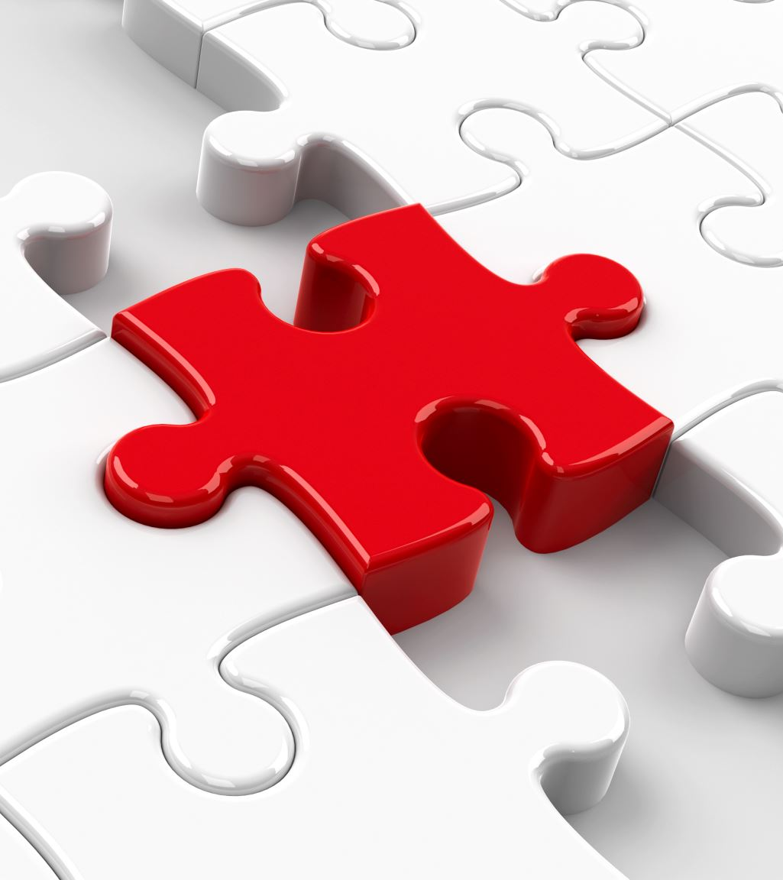
Community
Deaf and hard of hearing community
Providing tools for underrepresented and underserved community
Reviving development of a stagnant technology

Slide 4

Requirements
Utilize frequencies filteration to emphasize and de-emphasize particular sources of noise.
Emphasize dynamic sources of noise and de-emphasize static sources of noise.
Deploy elective filtering functions based on data returned to user upon digitization, processing, and automatic filtering

Slide 5
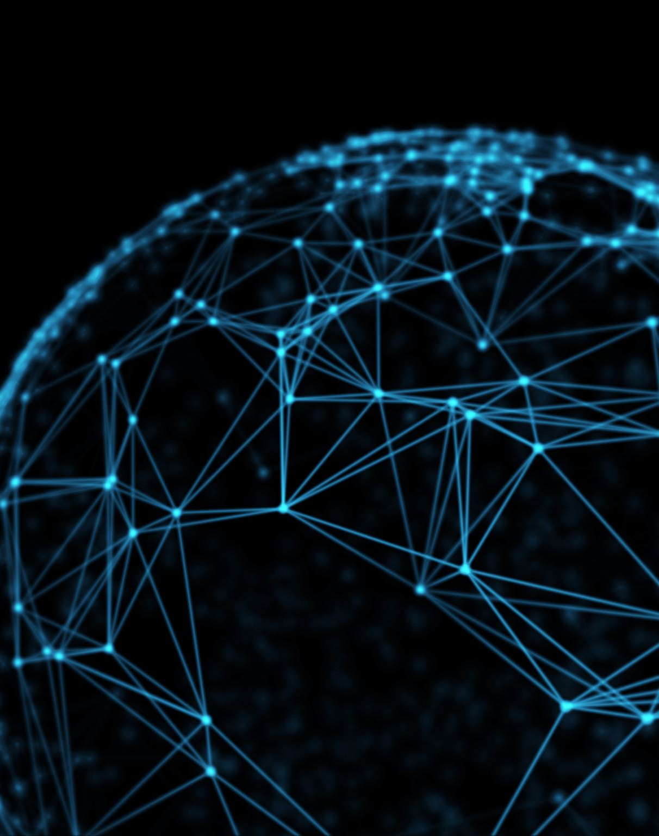
Technical elements
Python: UI and sound processing
Librosa
Mathplotlib
Custom tkinter

Slide 6
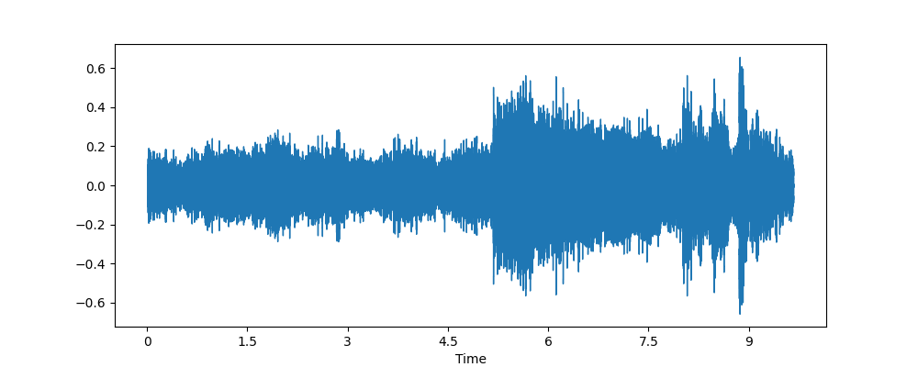

A demonstration

Slide 7
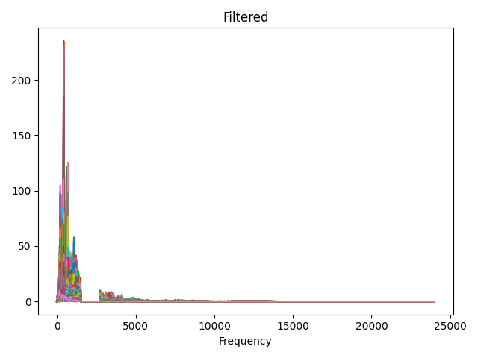
Buzzer

Slide 8
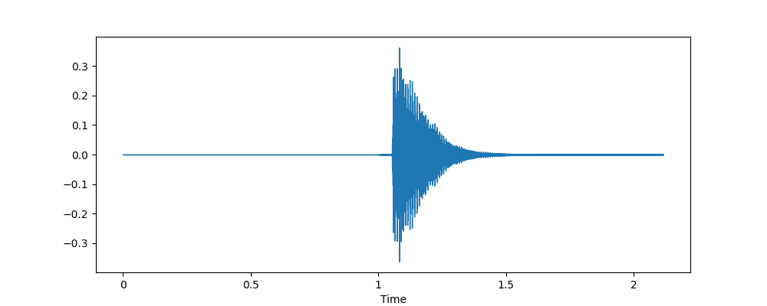
A major

Slide 9
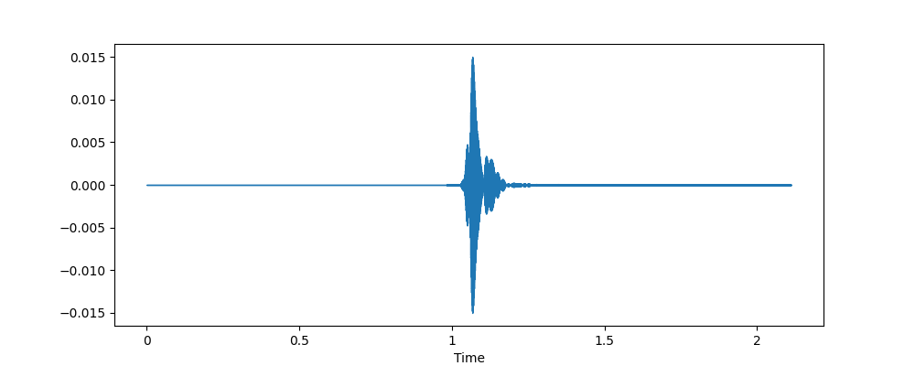
A major…but without the A

Slide 10
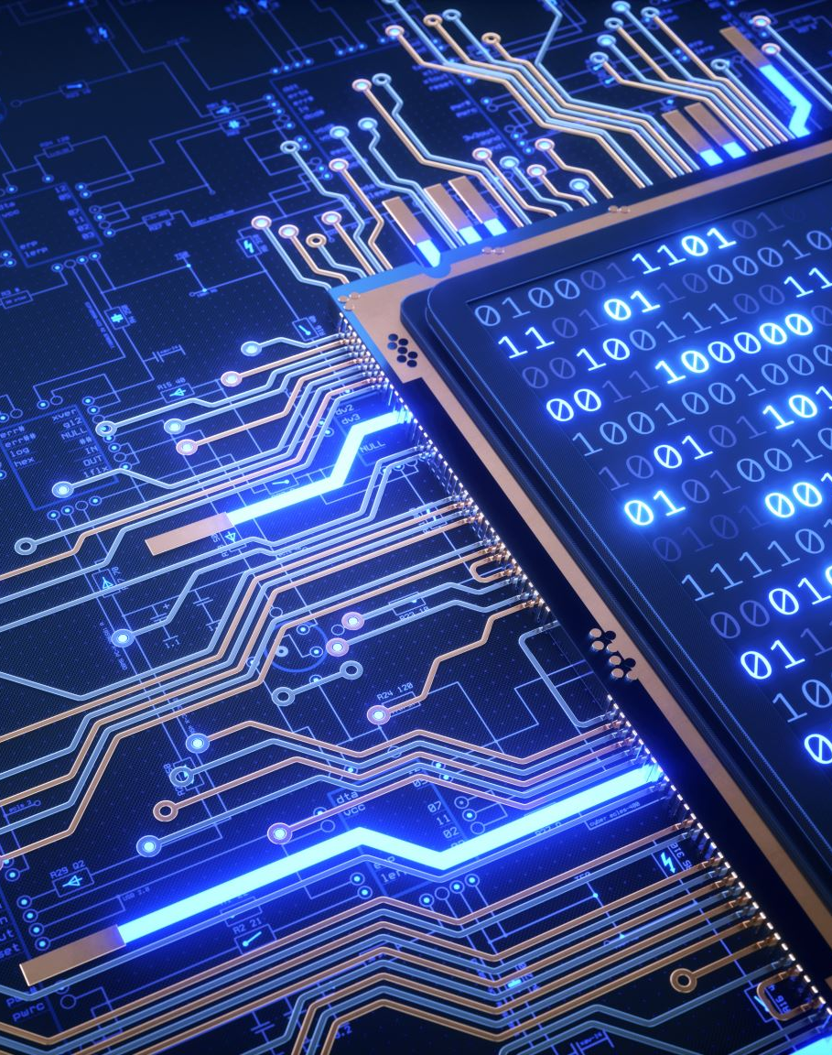
Next steps
Implementation inside of a hearing device
Airpods, Arduino, hearing aid, etc.
Processing time reduction
Continuous sound processing
Machine learning and predictive filtering

Slide 11
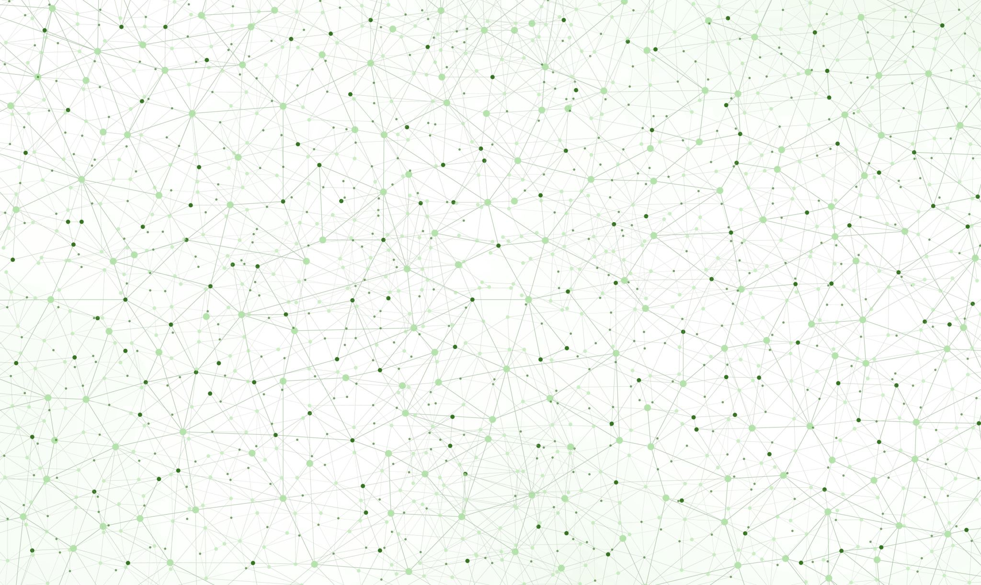
Questions?

