Slide 1
Compiler
Hui Hao CISC 603 Late Spring 2021

Slide 2
Compiler Composition
Lexer
Parser
Grammar
Emitter
Main
Demo

Slide 3
Lexer
Iterating through the input file (nextchar, peek)
Check Correct Syntax
Tokenize (check for num, letter, Keywords)
Other housekeeping helper functions (skip space, abort…)

Slide 4
Parser
Take in Tokens from Lexer
Check Grammar
Gen Parse Tree

Slide 5
Grammar defines
Keywords: Logic, input
Operators: +-x/
Statements

Slide 6
Emitter
Take Parse Tree from Parser
Compile to C code

Slide 7
Main
Take input file use Lexer
Use Parser with Grammar
Emit C code

Slide 8
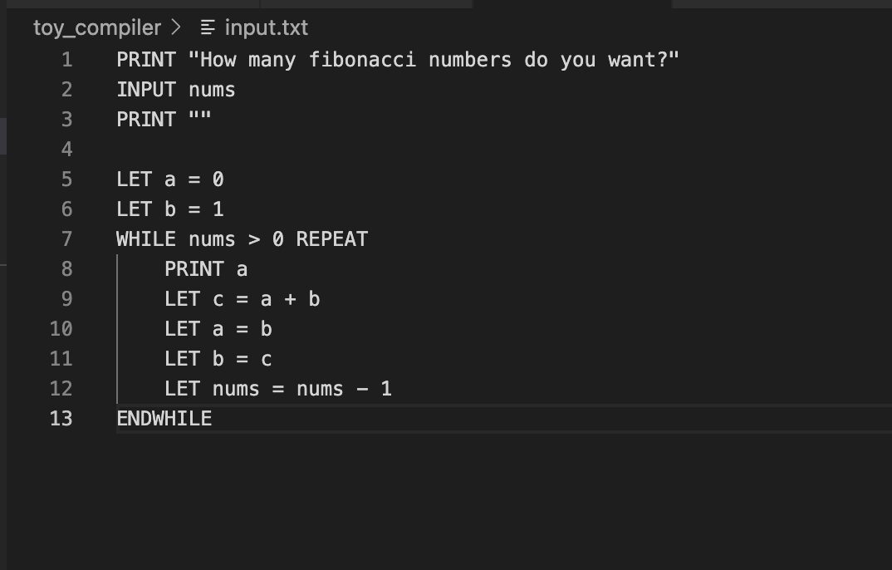
Driver Code prints out the first n elements in Fibonacci sequence.

Slide 9
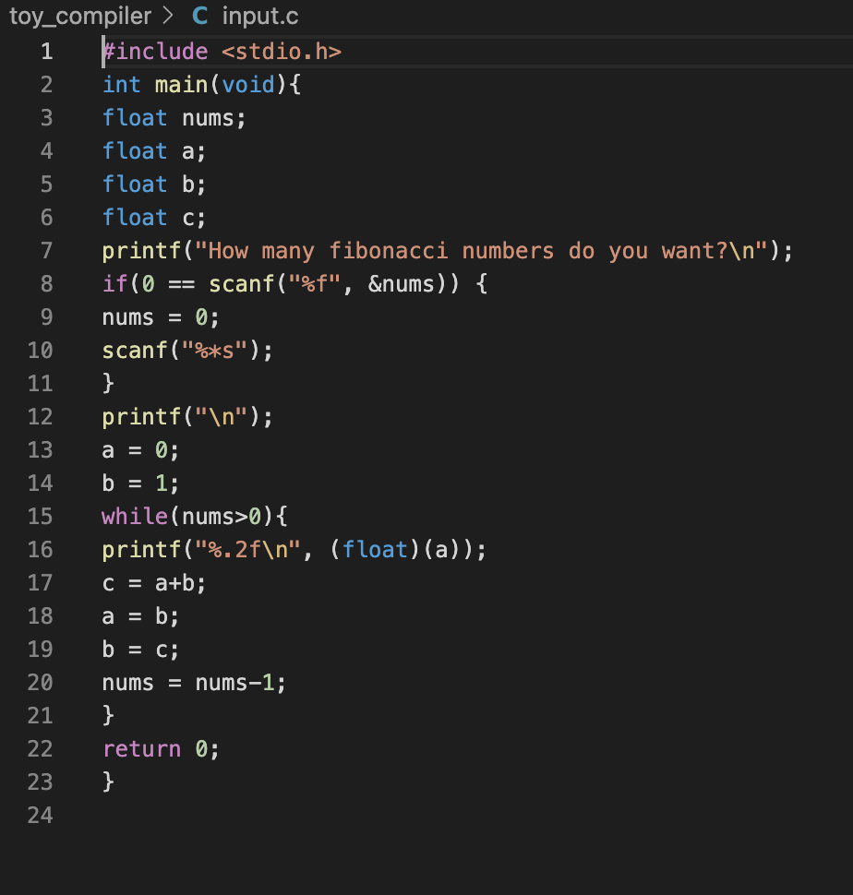
Output C Code

