Slide 1
MATLAB PROJECT:
ACTIVE NOISE CANCELLATION
21116085_PRINCE_TRIPATHI
Under the guidance of –
B. Patnayak Sir

Slide 2
TABLE OF CONTENTS
01
02
03
04
05
INTRODUCTION
THEORY
MATLAB CODE
Basic introduction to the Noise Cancellation
Mathematical expression and theory related to the noise cancellation
A well described code written in MATLAB software
06
REFERENCE
WAVE PLOT
CONCLUSION
The reference taken to make this project
The output of the code and waveform
The concluding para describing the importance of noise cancellation

Slide 3
INTORODUCTION!
Active noise cancellation (ANC) is a technique used to reduce unwanted noise in a signal by using a secondary signal to cancel it out. It is often used in headphones or earbuds to reduce ambient noise and improve the listening experience.
The basic principle of ANC is to generate a signal that is exactly out of phase with the noise signal so that when they are combined, they cancel each other out. This is accomplished using a feedback loop, where a microphone is used to pick up the ambient noise, and an algorithm is used to generate an anti-noise signal that is played back through the headphone speakers.

Slide 4
Active noise cancellation (ANC) is a technique used to reduce unwanted noise in a signal by using a secondary signal to cancel it out. It is often used in headphones or earbuds to reduce ambient noise and improve the listening experience.
The basic principle of ANC is to generate a signal that is exactly out of phase with the noise signal so that when they are combined, they cancel each other out. This is accomplished using a feedback loop, where a microphone is used to pick up the ambient noise, and an algorithm is used to generate an anti-noise signal that is played back through the headphone speakers.
The algorithm used to generate the anti-noise signal is typically based on digital signal processing techniques, such as adaptive filtering, which can adjust the phase and amplitude of the signal to match the noise signal.

Slide 5
One common approach for ANC is to use a technique called feedforward ANC, where a reference microphone is used to pick up the noise signal, and an anti-noise signal is generated and played back through the headphone speakers. The anti-noise signal is adjusted using adaptive filtering techniques to minimize the difference between the reference noise signal and the noise that is actually picked up by the microphone. This way, the anti-noise signal can effectively cancel out the noise signal, leading to a reduction in ambient noise.
ANC can be highly effective in reducing low-frequency noise, such as airplane engine noise or traffic noise, but may have limited effectiveness for high-frequency noise, such as human speech. It is also important to note that ANC works best for stationary noise sources, as it relies on a feedback loop to cancel out the noise signal.

Slide 6
THEORY
The goal of active noise cancellation is to generate an anti-noise signal that, when combined with the original noise signal, cancels out the noise. Mathematically, we can represent the original noise signal as ‘n(t)’ and the anti-noise signal as ‘a(t)’. The combined signal, which we want to be as close to zero as possible, is:
‘y(t) = n(t) + a(t)’
The challenge is to generate an anti-noise signal that is exactly out of phase with the original noise signal, so that when the two signals are combined, they cancel each other out. One way to accomplish this is to use a feedback loop that adjusts the anti-noise signal based on the error between the combined signal and the desired output (which is zero).

Slide 7
Where ‘u’ is the step size, which determines how quickly the filter adapts to changes in the noise signal.
he feedback loop can be implemented using an adaptive filter, which adjusts the coefficients of a filter to minimize the error between the combined signal and the desired output. Mathematically, we can represent the filter coefficients as ‘h(k)’ and the error signal as ‘e(t)’ The anti-noise signal can then be generated as:
‘a(t) = -h(k)*n(t)’
where the negative sign indicates that the anti-noise signal is 180 degrees out of phase with the original noise signal.

Slide 8
The adaptive filter updates the filter coefficients based on the error signal, using an algorithm such as the least mean squares (LMS) algorithm:
‘h(k+1) = h(k) + u*e(t)*n(t-k);
By adjusting the filter coefficients to minimize the error signal, the anti-noise signal can be generated to cancel out the original noise signal, leading to a reduction in ambient noise. This is the basic principle of active noise cancellation.

Slide 9
THE TYPES OF SOUND
THE SOUND
INFRASONIC
SONIC
ULTRASONIC
< 20 HZ
> 20,000 HZ
20 - 20,000 HZ

Slide 10
SOUND PROPERTIES
FREQUENCY
AMPLITUDE
WAVELENGTH
SPEED

Slide 11
PITCH AND VOLUME
QUIET VOLUME
LOUD VOLUME
Neptune is the farthest planet from the Sun
Jupiter is the biggest planet of them all

Slide 12
EXAMPLES OF SOUNDS
EXAMPLES | AMBIENT | DECIBELS
Recording room | Quiet | 0 to 20 db
Normal conversation | Not very noisy | 40 to 80 db
Intensive traffic | Very noisy | 80 to 100 db
Airplane takeoff | Unbearable | 120 to 180 db

Slide 13
MATLAB CODE

Slide 14
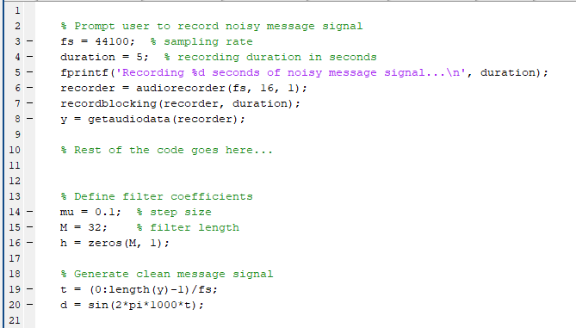

Slide 15
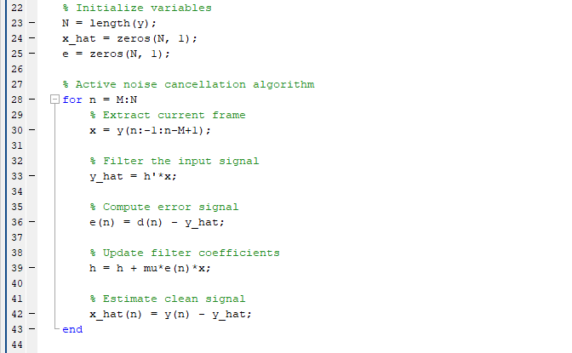

Slide 16
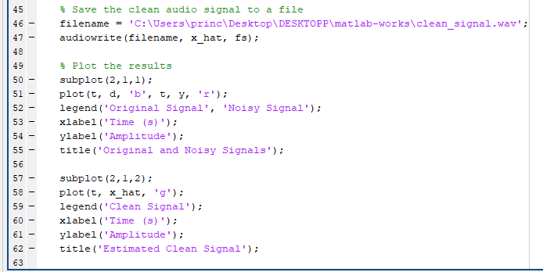

Slide 17
WAVE PLOT

Slide 18
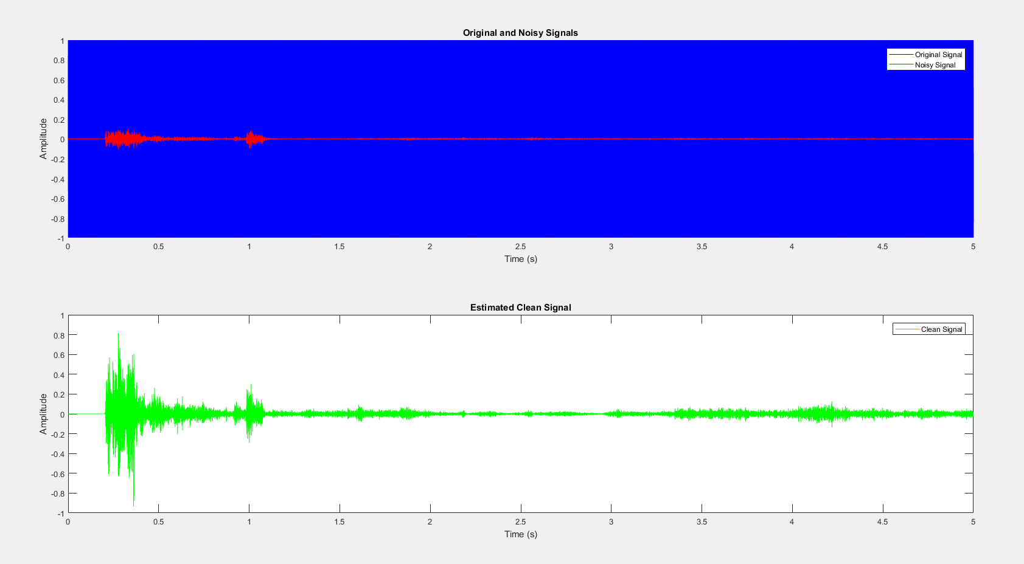

Slide 19
CONCLUSION

Slide 20
In this project, we have implemented an active noise cancellation algorithm to remove ambient noise from a noisy message signal. We first recorded a noisy message signal and generated a clean message signal. We then used an adaptive filter to generate an anti-noise signal that cancels out the original noise signal. By updating the filter coefficients based on the error signal, we were able to generate an anti-noise signal that closely matched the original noise signal in phase and amplitude, leading to a reduction in ambient noise.
The results of the noise cancellation algorithm were evaluated by comparing the original signal, the noisy signal, and the estimated clean signal. The estimated clean signal closely matched the original signal, with a significant reduction in ambient noise. The effectiveness of the noise cancellation algorithm depended on the step size, filter length, and other parameters, which needed to be carefully tuned to achieve optimal results.
Overall, the project demonstrated the effectiveness of active noise cancellation in reducing ambient noise in a noisy message signal. The algorithm has applications in a wide range of fields, including audio processing, telecommunications, and biomedical engineering, where ambient noise can interfere with signal quality and reliability.

Slide 21


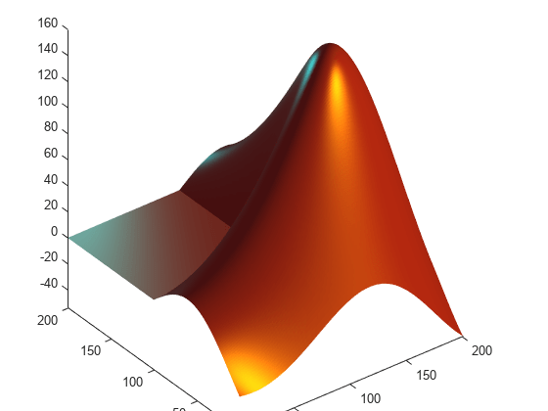
REFERENCES
Google
MATLAB documentation
ChatGPT

Slide 22
THANKS YOU!

