Slide 1
Skin lesion classification
Project review: models, methods and findings
Academic research prototype
Notes:
Project scope: README.md. This is a research prototype, not a clinical diagnostic system.

Slide 2

The problem and project goal
Skin images contain visual patterns that can help classify seven lesion types.
Training data is imbalanced, and patient images raise privacy concerns.
Our goal: compare image models and explore privacy-preserving training.
Notes:
Sources: README.md; TRAINING.md. The federated and centralized feature experiments are separate.
Illustration is AI-generated and conceptual; visual details are not project measurements.

Slide 3

Research that shaped the work
PanDerm: a dermatology foundation encoder can transfer to lesion classification with a trained head.
Multi-scale CNN research motivated looking at images in multiple views.
Published scores use different datasets, splits and metrics, so direct rankings can mislead.
Notes:
Sources: Yan et al., https://www.nature.com/articles/s41591-025-03747-y; Mahbod et al., https://pubmed.ncbi.nlm.nih.gov/32268255/; data/reference/research_papers.json. PanDerm published weighted F1 is not macro F1.
Illustration is AI-generated and conceptual; visual details are not project measurements.

Slide 4
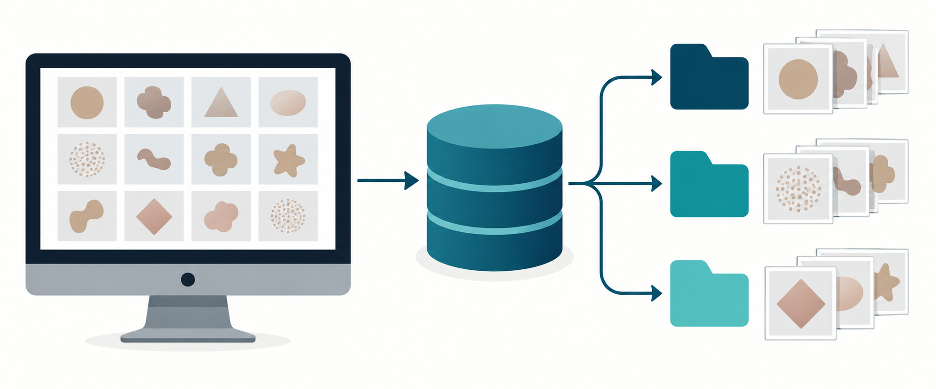
Dataset and evaluation
HAM10000: 10,015 dermoscopic images across seven diagnoses.
Our internal split: 7,014 training, 1,509 validation and 1,492 test images.
Images of the same lesion stay together within these internal splits.
Separate ISIC sets: 193 validation and 1,512 test images.
Notes:
Sources: TRAINING.md; outputs/feature_models/efficientnet_b0/REPORT.md. Official sets do not supply lesion IDs, so cross-set lesion separation cannot be established.
Illustration is AI-generated and conceptual; visual details are not project measurements.

Slide 5
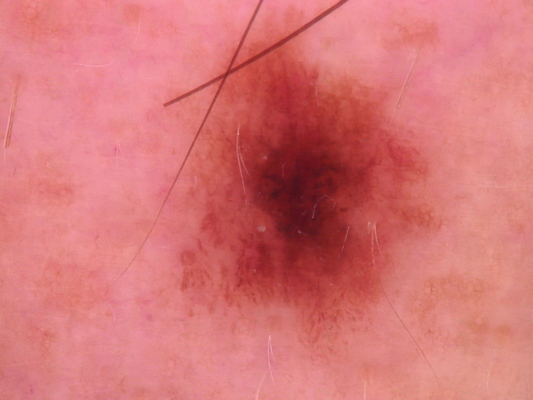
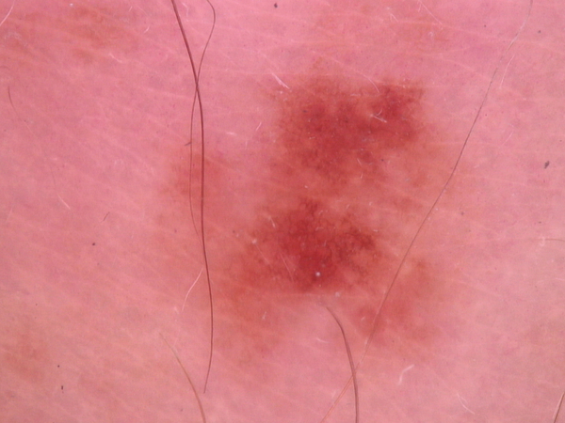
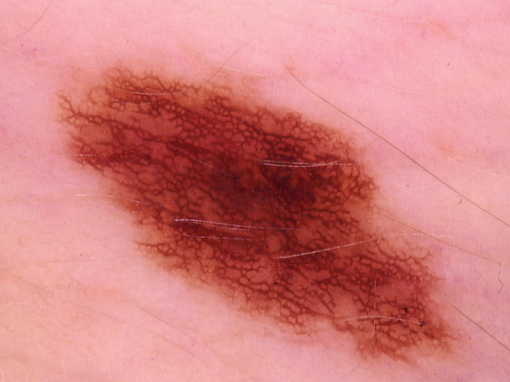
What the models see
Dermoscopic images vary in color, shape and texture.
The model learns visual features from images, then predicts one of seven classes.
Notes:
Examples from data/raw/images/ISIC_0024306.jpg, ISIC_0024307.jpg and ISIC_0024308.jpg. Images come from HAM10000; examples are illustrative and are not shown as a diagnosis. Dataset citation: https://doi.org/10.1038/sdata.2018.161.

Slide 6
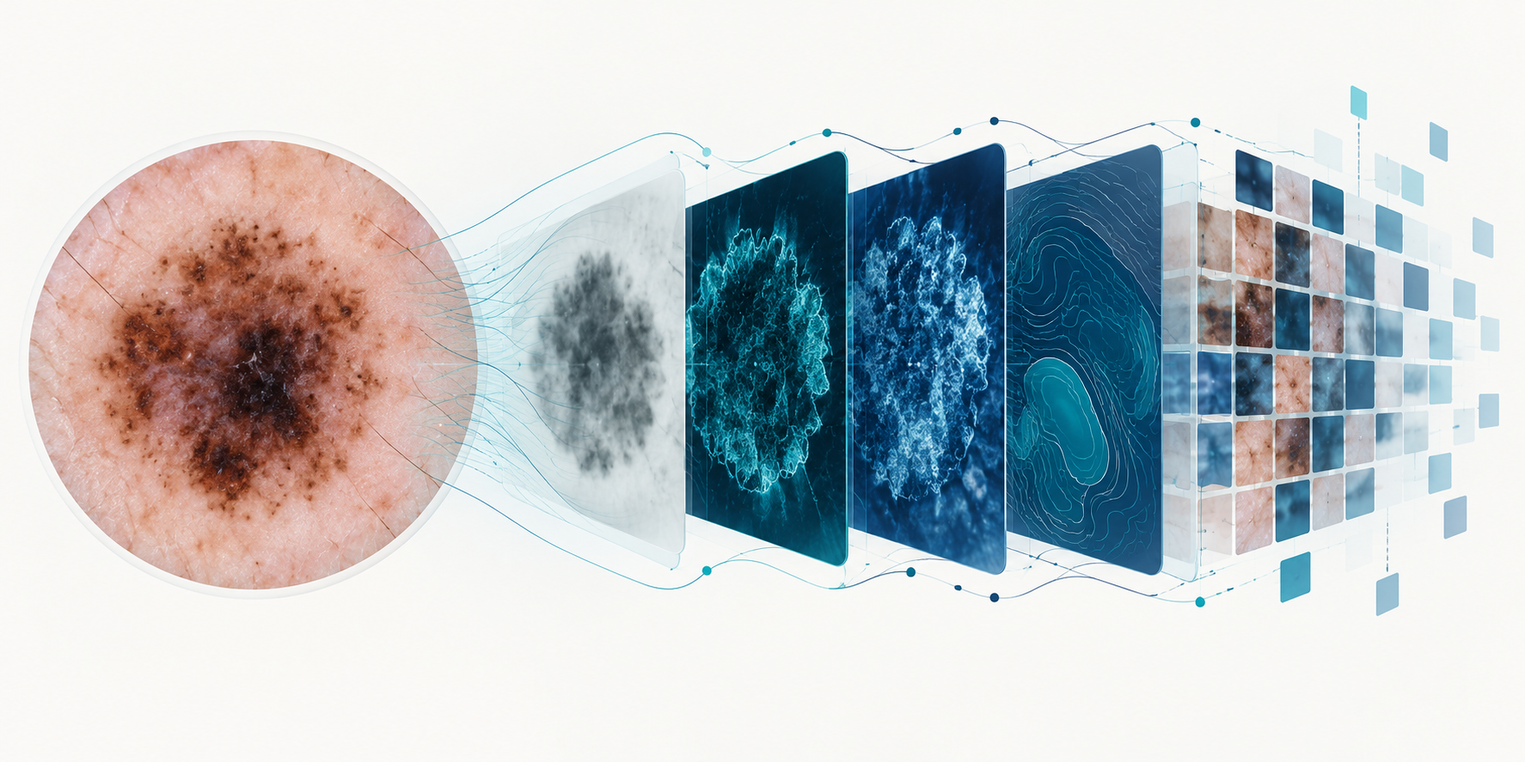
How images become model features
The encoder converts visual patterns into numerical features for a classifier.
Conceptual illustration
Notes:
AI-generated conceptual illustration, not a clinical image or a literal rendering of model activations. The actual encoders and classifiers are documented in TRAINING.md and src/models/panderm.py.

Slide 7

Our model workflow
1 Prepare images and split by lesion
2 Extract features with a pretrained image encoder
3 Train and select a classifier using training and validation data
4 Evaluate saved models on held-out sets and inspect class-level results
Notes:
Sources: TRAINING.md; outputs/feature_models/panderm_large_comparison/REPORT.md. Large uses the authors’ released split, rather than the original internal split.
Illustration is AI-generated and conceptual; visual details are not project measurements.

Slide 8
Architecture: frozen feature pipeline
Input image
224 × 224
Pretrained
encoder
Feature vector
(embedding)
Classifier
head
7 class
scores
Frozen encoder: learn the image representation once.
Train the head on labeled features; select settings with validation macro F1.
EfficientNet: 1,280 features | PanDerm Base: 768 | PanDerm Large: 1,024
Notes:
Sources: TRAINING.md; src/models/panderm.py; outputs/feature_models/panderm_large_comparison/REPORT.md. Feature dimensions describe the single-view encoder output. Improved EfficientNet concatenates canonical and averaged full-image views, producing 2,560 features. The bare encoder has no seven-class head.

Slide 9
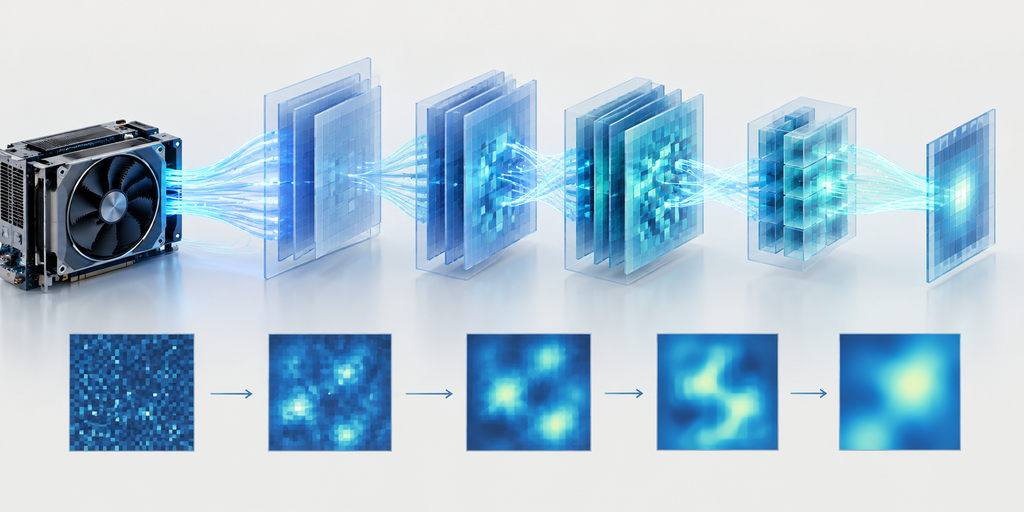
Relative training sequence
Early Centralized and federated CNN prototype; EfficientNet feature baselines
Next Class balancing, multiple views and lesion-specific classifiers
Then Frozen PanDerm Base with linear, neural and XGBoost heads
Later PanDerm Large author probe, tuned heads and capacity searches
Recent Fine-tuned EfficientNet and diagnostic adaptation experiments
Notes:
Sources: git history; TRAINING.md; outputs/feature_models reports; outputs/cnn_baseline/efficientnet_b0_finetuned/protocol.json. This is an approximate sequence of experiment families, not a claim about exact duration. Recorded durations are incomplete and do not support a complete wall-clock timeline.
Illustration is AI-generated and conceptual; visual details are not project measurements.

Slide 10
EfficientNet-B0 experiments
A pretrained ImageNet encoder converts each image into reusable features.
Compared logistic regression, a neural network and XGBoost.
Tested class weighting, SMOTE and multi-view image features.
Also trained a separate fine-tuned EfficientNet CNN; its recorded run lasted 15 epochs.
Notes:
Sources: TRAINING.md; outputs/feature_models/efficientnet_b0_improved/REPORT.md; outputs/cnn_baseline/efficientnet_b0_finetuned/history.json and protocol.json. Recorded epoch durations sum to approximately 21.8 minutes, excluding setup. Fine-tuning and frozen features are separate experiments.

Slide 11
EfficientNet-B0 architecture and training
Image
CNN feature
blocks
Pooling
1,280 features
7-class head
Frozen-feature runs
Trained logistic regression, MLP or XGBoost on cached features.
Fine-tuning run
Updated the EfficientNet backbone and a linear head; best checkpoint was epoch 11.
Notes:
Sources: TRAINING.md; outputs/cnn_baseline/efficientnet_b0_finetuned/protocol.json and REPORT.md. The CNN uses ImageNet V1 weights; the fine-tuning run uses cross-entropy, class weights, augmentation, AdamW, and a 7-class linear head. Stopped after 15 epochs; best epoch selected on validation macro F1.

Slide 12
Inside EfficientNet-B0
Input image
224 × 224
Stem
convolution
Repeated
MBConv blocks
Pooling
1,280 features
7-class
head
Convolutions detect visual patterns, from edges to more complex features.
MBConv blocks use efficient convolutions and channel attention.
Our experiments either froze the backbone or fine-tuned its weights.
Simplified architecture; block counts and training details omitted for clarity.
Notes:
Sources: torchvision EfficientNet-B0 implementation used in src/models/model.py and scripts/train_cnn_baseline.py; TRAINING.md. MBConv includes depthwise convolution and squeeze-and-excitation. The feature pipeline retained the original ImageNet backbone and its standard preprocessing. The fine-tuned CNN uses a linear seven-class head. Diagram is simplified and not to scale.

Slide 13
What the EfficientNet experiments showed
Original neural head: 61.6% internal test macro F1.
Improved multi-view linear head: 61.5% macro F1 on the official test.
SMOTE helped some heads but reduced XGBoost macro F1 in the original comparison.
Seven specialist classifiers did not beat the improved linear model overall.
Notes:
Sources: outputs/feature_models/efficientnet_b0/REPORT.md; outputs/feature_models/efficientnet_b0_improved/REPORT.md; outputs/feature_models/efficientnet_b0_specialists/REPORT.md. Different test sets are labeled explicitly.

Slide 14
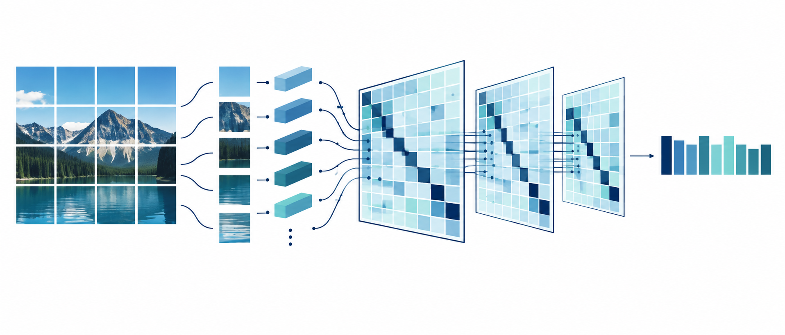
PanDerm: why we tested it
PanDerm is pretrained for dermatology, while EfficientNet starts with general ImageNet features.
We froze the encoder and trained small classifiers on its image embeddings.
Base produces 768 features per image; Large produces 1,024.
A bare encoder cannot predict seven diagnoses without a trained readout.
Notes:
Sources: outputs/feature_models/panderm_base_comparison/REPORT.md; outputs/feature_models/panderm_large_comparison/REPORT.md; https://www.nature.com/articles/s41591-025-03747-y.
Illustration is AI-generated and conceptual; visual details are not project measurements.

Slide 15
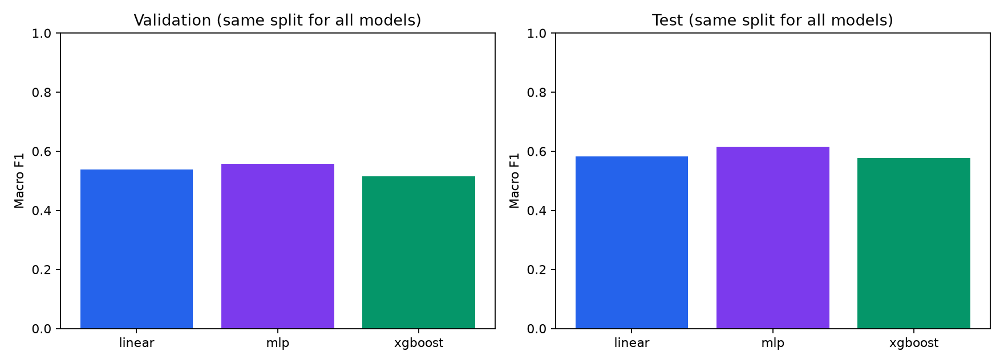
Original EfficientNet comparison
The MLP led the original comparison on internal test macro F1.
All three heads used the same frozen features and lesion-separated split.
Notes:
Source: outputs/feature_models/efficientnet_b0/comparison.png and REPORT.md. Internal test macro F1: linear .5832, MLP .6156, XGBoost .5764. The chart is from the original baseline and does not include later models.

Slide 16
Fine-tuned EfficientNet result
71.8%
macro F1 on the official test
81.6% accuracy on the same 1,512 images
The model used the original lesion-separated training split.
These test images had been examined in earlier experiments.
Notes:
Source: outputs/cnn_baseline/efficientnet_b0_finetuned/REPORT.md. The model uses 7,014 training images; selected checkpoint epoch 11. Official test macro F1 .7178, accuracy .8161. Official test lesion identifiers are unavailable. This comparison is exploratory.

Slide 17
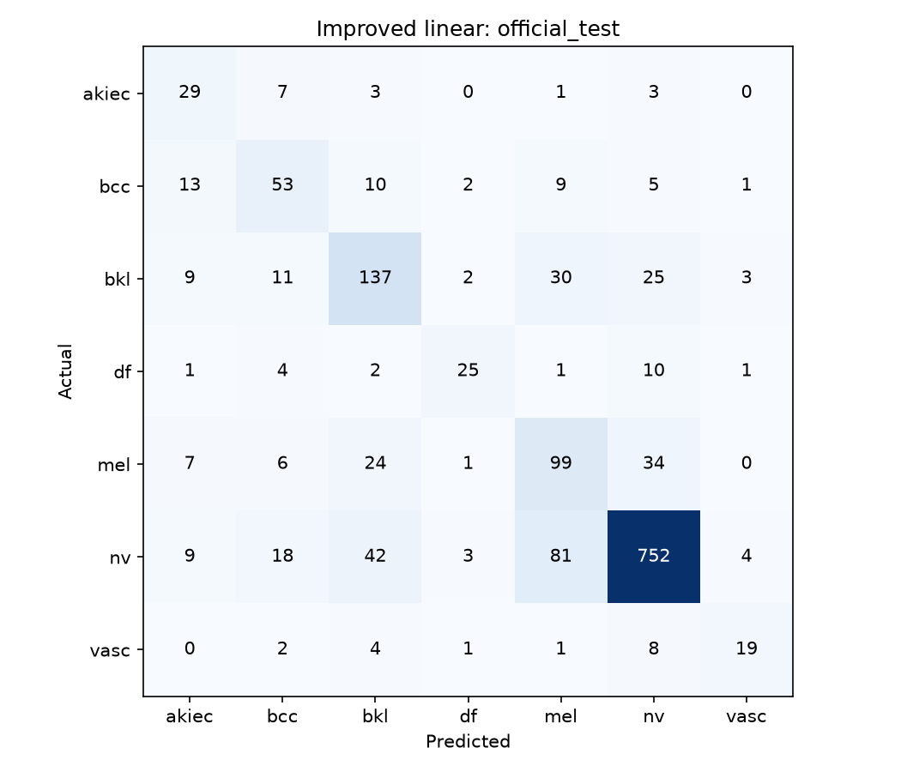
Reading a confusion matrix
Rows show the actual class.
Columns show the predicted class.
Diagonal cells are correct predictions; off-diagonal cells show mistakes.
Example: the improved linear model on the official ISIC test.
Notes:
Source: outputs/feature_models/efficientnet_b0_improved/linear/official_test_confusion_matrix.png and REPORT.md. Counts are raw, so common classes have larger cells. Classes: akiec, bcc, bkl, df, mel, nv and vasc. The set was used repeatedly in research and is not fresh independent confirmation.

Slide 18
PanDerm architecture and classifier heads
Image patches
16 × 16
Vision Transformer
PanDerm Base / Large
Embedding
768 / 1,024
Trained head
7 classes
The transformer combines information across image patches.
We kept the encoder frozen and compared linear, neural and XGBoost heads.
Large also used the authors’ linear-probe recipe as a reference.
Notes:
Sources: src/models/panderm.py; outputs/feature_models/panderm_base_comparison/REPORT.md; outputs/feature_models/panderm_large_comparison/REPORT.md; https://www.nature.com/articles/s41591-025-03747-y. Both use patch16 224-pixel vision transformers. The Large and Base runs use different training splits, so results do not isolate the encoder.

Slide 19

PanDerm Base and Large results
Base + neural head: 70.3% macro F1 on the 1,512-image official test.
Large + linear head: 73.8% macro F1 on the same official test.
Large + author-style probe: 71.6% macro F1 on that official test.
Training splits and head selection differ, so this is not an encoder-only comparison.
Notes:
Sources: outputs/feature_models/panderm_base_comparison/REPORT.md; outputs/feature_models/panderm_large_comparison/REPORT.md; outputs/diagnostics/panderm_paper_reference/REPORT.md. Base trained on 7,014 images; Large used 8,207 authors’ released training images. Tests had previously been examined.
Illustration is AI-generated and conceptual; visual details are not project measurements.

Slide 20
PanDerm Large: model comparison
Author-style probe: 80.98% macro F1 on the released HAM test.
Smaller neural head (192–64): 81.73% macro F1 on the same test.
Linear head led the shown Large models on official-test macro F1: 73.80%.
Wider or more complex heads did not consistently improve every test set.
Notes:
Sources: outputs/feature_models/panderm_large_refined/REPORT.md; outputs/feature_models/panderm_large_capacity/REPORT.md. Released HAM test contains 1,232 images. Reused test results are exploratory; they are not fresh independent confirmation.

Slide 21

Privacy-preserving workflow
The federated prototype simulates separate clients that train locally.
A server combines model updates into a shared model using FedAvg or FedProx.
Optional differential privacy adds noise during local training.
The feature-model results shown here are centralized and do not claim DP.
Notes:
Sources: README.md; config.yaml; src/client/client.py; src/server/strategy.py. Differential privacy accounting covers training-image updates, not a patient-level guarantee. Simulation is not evidence of real multi-hospital deployment.
Illustration is AI-generated and conceptual; visual details are not project measurements.

Slide 22
Federated learning workflow
Client 1
local data
Client 2
local data
Server aggregates
model updates
Shared global
model
Client 3
local data
Clients train locally, then send model updates for aggregation.
Optional noise during local training provides differential privacy accounting.
Notes:
Sources: README.md; src/client/client.py; src/server/strategy.py. This is a simulation; the feature-model results shown are centralized. FedProx optionally limits local drift. Differential privacy accounting concerns training-image updates, not patient-level privacy. The arrows summarize a repeated communication cycle; global model returns to clients each round.

Slide 23
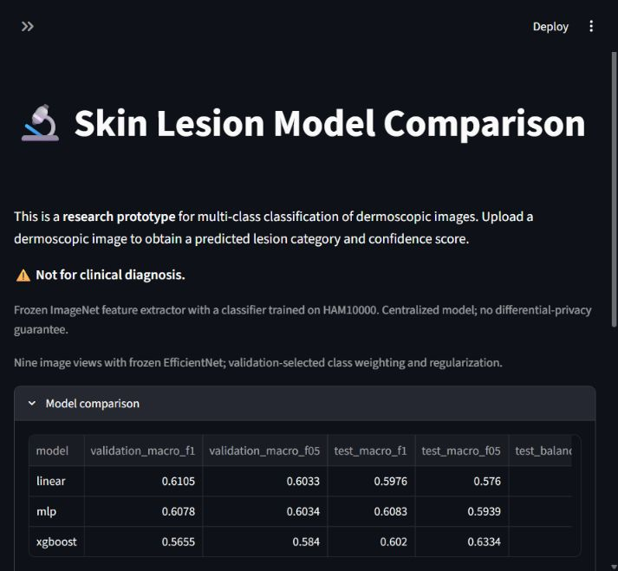
Research prototype interface
The local interface lets us inspect model comparisons and upload an image.
It supports the research workflow and displays the non-clinical warning.
This screenshot shows an earlier EfficientNet interface.
Notes:
Source: artifacts/improved-app.jpg; README.md; scripts/app.py. Screenshot is an earlier state of the research prototype. Model outputs should not be used for diagnosis; some feature-model scores are not calibrated probabilities.

Slide 24
What we learned
Macro F1 matters because it gives rare lesion classes equal weight.
PanDerm features improved the reported official-test results in our experiments.
Specialists and larger heads can overfit or improve one split while losing on another.
The authors’ published weighted F1 and our macro F1 measure different things.
Notes:
Sources: outputs/feature_models/efficientnet_b0_improved/REPORT.md; outputs/feature_models/panderm_large_comparison/REPORT.md; outputs/diagnostics/specialist_audit/REPORT.md; outputs/diagnostics/panderm_paper_audit/REFERENCE_CORRECTION.md.

Slide 25

Limitations and next steps
Repeated examination of test sets makes the comparisons exploratory.
Later adaptation used former test images for training; those scores are fitting results.
Evaluate a locked model on a fresh, independent dataset with lesion identifiers.
Test privacy and utility together before claiming a private clinical model.
Notes:
Sources: outputs/diagnostics/panderm_test_adaptation_once/REPORT.md; outputs/diagnostics/six_model_adaptation/REPORT.md; README.md; TRAINING.md. Pretraining overlap with downstream datasets has not been independently excluded.
Illustration is AI-generated and conceptual; visual details are not project measurements.

Slide 26
Project review: key conclusion
We built an end-to-end research workflow for seven-class lesion classification.
The project compared EfficientNet and PanDerm with several classifier families.
PanDerm Large with a linear head reached 73.8% macro F1 on the official test.
A fresh independent evaluation is needed before any clinical conclusion.
Notes:
Sources: README.md; outputs/feature_models/panderm_large_comparison/REPORT.md. The reported official-test score is exploratory after repeated test inspection.

