Slide 1


Taskiva
(Student Assignment System)
Prepared by : Gracy Sanjaykumar Patel
ID : 19DCS088
-Guided by : Sachin Patel

Slide 2
INDEX
Introduction and Problem Statement
02. Requirements and Flowchart
Basic Introduction and more about Taskiva and the basic need of the application.
Needs for the application and language used
03. Implementation
Snapshots
04. Future Enhancement
05. Bibliography and Conclusion
The Completed implementation up till now
Later what more to add
Strategy and references

Slide 3

INTRODUCTION
Taskiva is a student assignment system to make the students as well as Instructors task easier to manage their work. It basically has different application for students as well as Instructors. Here, Instructors assign task to the students and students can view their task.

Slide 4
PROBLEM STATEMENT
My main aim is to create a basic application to manage students tasks, so that they can keep tracks of their assignments and can also add tasks if they want.
Basically here there will be 2 different users where Instructor will assign task and students can view those tasks.

Slide 5
NEED FOR TASKIVA
It often happens that students forget their task and their work remains incomplete and to solve this problem we have Taskiva which is a student application but more like a to-do.

Slide 6
PROJECT PLAN OR TIMELINE
1. Jan – Feb
3. March–April
Flow Chart, UI-Design, and Basic of Python and Kivy
Creating Database using MySQL and connection
2. Feb – March
After Completion
Understanding Kivy Python and Front-End Using kivy.
Look for the further improvement.

Slide 7
CONSOLIDATE LIST OF REQUIREMENT
Software Requirements
Hardware requirement
Python 3.8.5 and above
Kivy and KivyMD
Any Text Editor or any python editor
MYSQL (for database)
(Python 3.8.5 and above as long as Kivy is supported)
Laptop
Phone

Slide 8
CONSOLIDATE LIST OF REQUIREMENT
Functional and Non-functional requirement
Languages Used
MySql database should be there.
Regular check of work needed.
Description of Task and Task should to added properly.
Python
Kivy and KivyMD

Slide 9
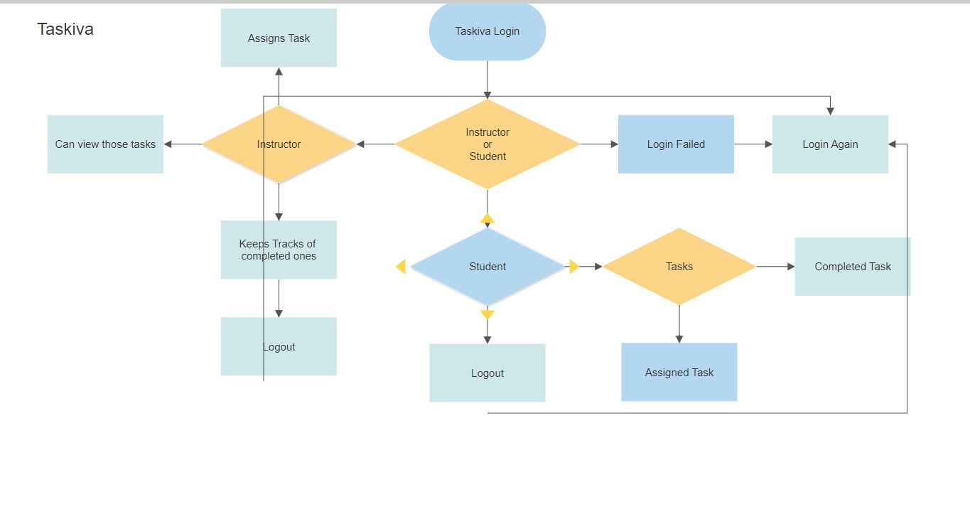
FLOW CHART

Slide 10
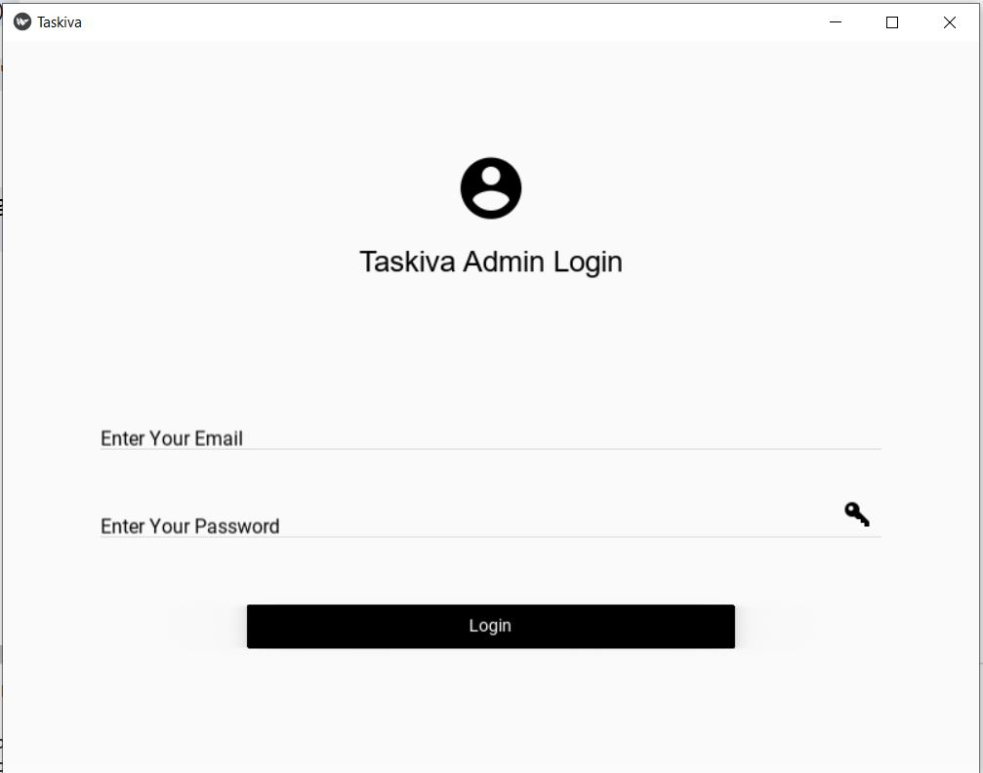
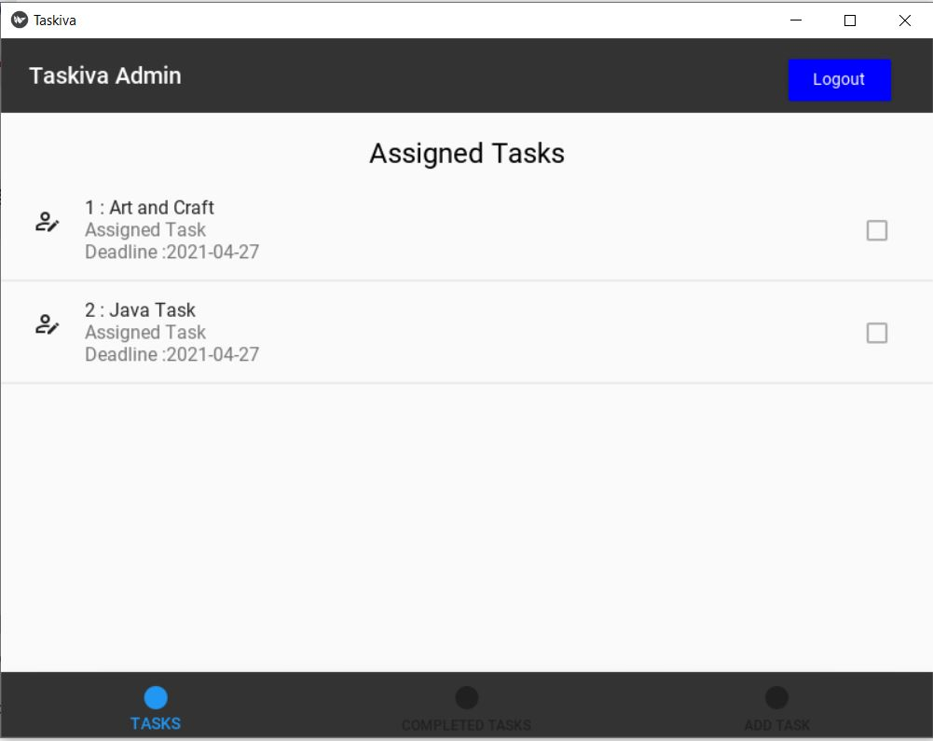
SCREENSHOTS

Slide 11
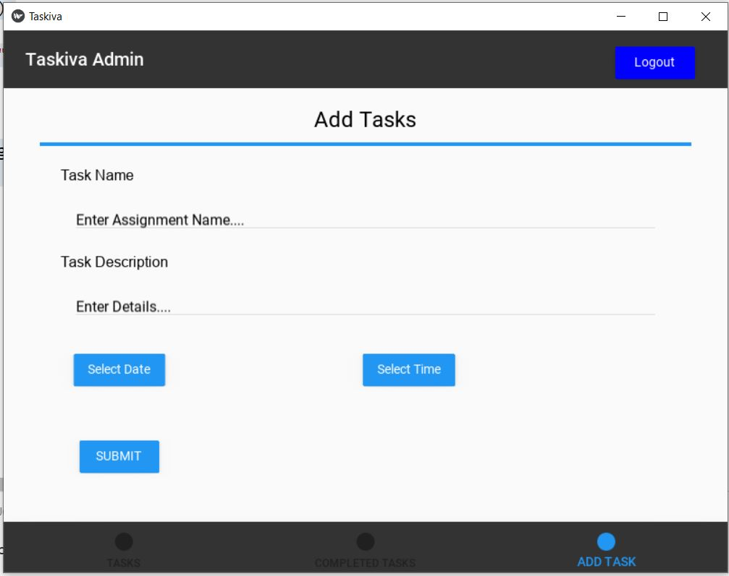
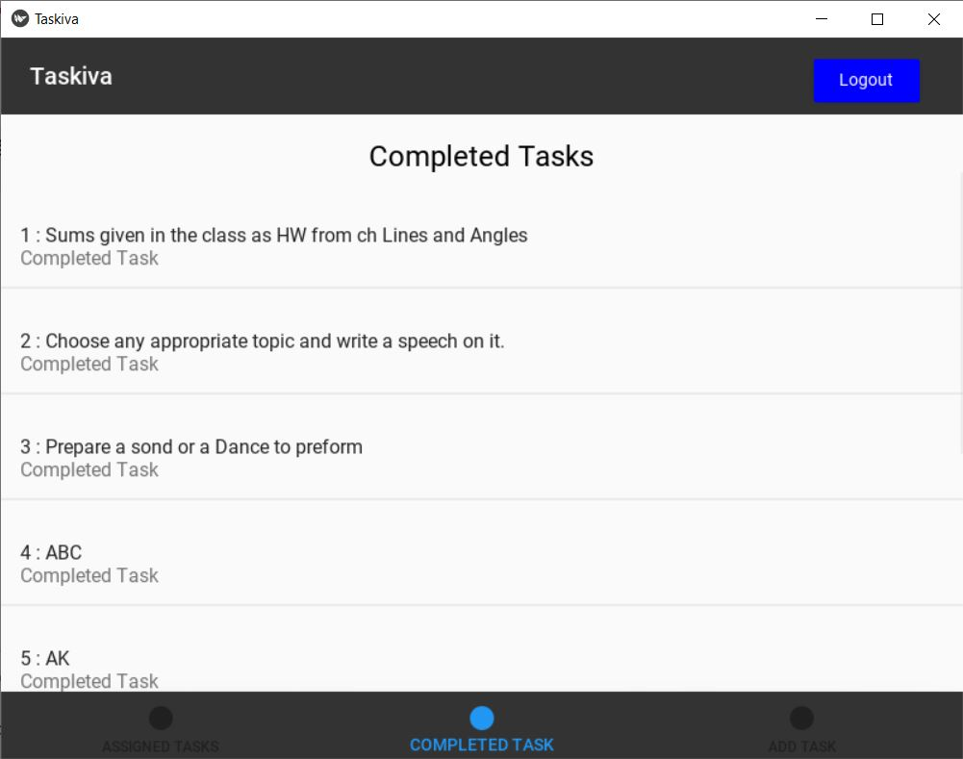

Slide 12
FUTURE ENHANCEMENT
It will currently manage the tasks and display it to the application (more like a to-do).
Set notification for the deadlines
Quiz or exam facility

Slide 13
Taskiva is made to help the students to manage the task and Instructor assign Task.

Slide 14
BIBLIOGRAPHY
References used:
Kivy : Kivy: Cross-platform Python Framework for NUI Development
Kivy : Welcome to KivyMD’s documentation! — KivyMD 0.104.2.dev0 documentation
Geeksforgeeks : Kivy Tutorial – GeeksforGeeks
Idea:
Idea from School

Slide 15

THANK YOU
Thanks for giving me opportunity to improve more.
I am further looking forward for working more with Python..
Gracy Patel
19DCS088

