Slide 1
Group 2 Presentation
Summer Camp Operations Management System
Database Design & Implementation
Robert Marshall
Ram Ganesan
Anuj Joshi
Pierre Augustamar
December 15, 2017
University of Washington : INFX 563

Slide 2
Topics
Database Purpose
Business Problems Addressed
Who is our audience
Application Usage
Design Logic or workflow
Design Diagram
User Roles
System Outlook
System Performance
System Logging/Monitoring
Demonstration/walk-through
Additional Enhancements
Project Dynamics
Lessons Learned
University of Washington : INFX 563

Slide 3
Database Purpose
System to maintain students’ records, courses, and activities for which they are registered for the Summer.
System to provide information regarding the teachers that are assigned to specific classes and the locations that these courses will be taken place.
Administrators and staff should be able to retrieve information for a particular course or a specific student.
Only faculty and administrators are allowed to make changes to the data.
Students and parents will be given access to view data that are specific to student courses and activities.
University of Washington : INFX 563

Slide 4
Business Problems Addressed
Display weekly scheduled activities
Display staff and student’s location
Display student’s contact information
Notify administrators when verification forms are out of date
Notify administrators when verification forms are unassigned or malformed
Notify administrators when payments were not received
University of Washington : INFX 563

Slide 5
Who is our audience?
Targets two main groups:
Children between the ages of 10-18
Working parents who have schooled aged kids
Websites and online communities advertising for summer camps
YMCA and other social community services needing to report on summer camp activities
Low-income families needing a place for their kids during summer
Local schools working with parents to find an alternative places for students during summer
Local churches working with parishioners to find a place for kids to spend time during Summer
Social services needing a summer camp for kids who are in transition from moving to different families
University of Washington : INFX 563

Slide 6
Application Usage
Websites to manage a summer camp can use our database as the backend store
Mobile apps can use our database as a backend store that will allow
parents to get summer camp notifications
kids to keep track of camp activities
Advertising companies can use the features and business purposes to advertise for a specific summer camp
Announcements and newsletters can be distributed to the list of users that are in the system
University of Washington : INFX 563

Slide 7
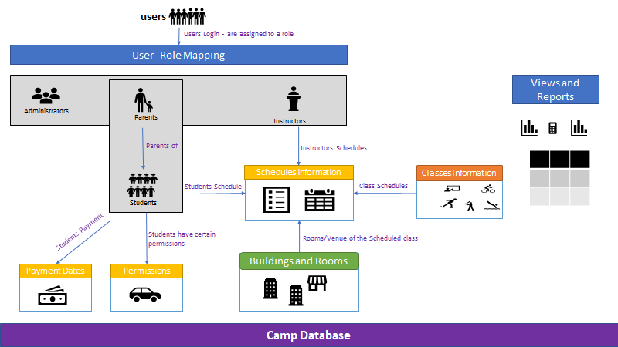
Workflow
University of Washington : INFX 563

Slide 8
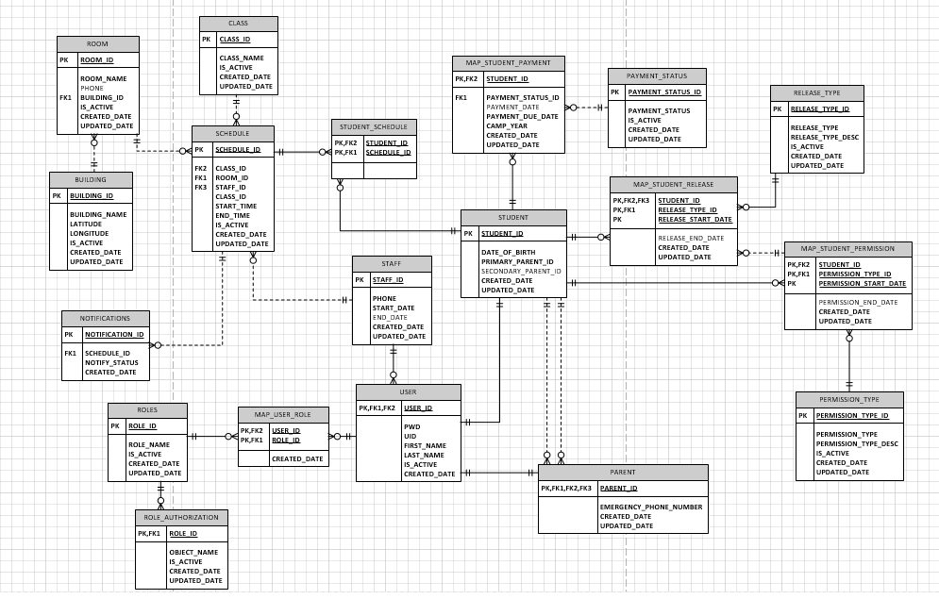
Design Logic – Database Diagram
University of Washington : INFX 563

Slide 9
User Roles
One of the requirements of this project was to define user/roles
For this project we used the following roles:
Role 1 - administrator
Role 2 - instructor
Role 3 - work crews
Role 4 - parent
Role 5 - student
Roles 1 - 3 are part of the staff
Anyone except students can have multiple roles
Someone with multiple roles will adopt the highest role.
Users roles can be found through a built-in stored procedure
Only active users will be eligible to use the system
University of Washington : INFX 563

Slide 10
User roles - continue
Someone with role 1 can perform any activities in the system
Someone with role 2 can perform his/her role including all the operations for roles 3 to 5
Roles are tied with authorization.
Views that are eligible to be accessed by parents are listed in a mapping table.
Anyone with role 3 or work crews do not have access to any of the views or stored procedures in the system.
University of Washington : INFX 563

Slide 11
System Outlook
System contains the following objects:
19 user defined tables
9 views
3 functions
3 triggers
7 store procedures
39 Primary keys and Foreign keys
Schema name
All artifacts are created under the camp schema
University of Washington : INFX 563

Slide 12
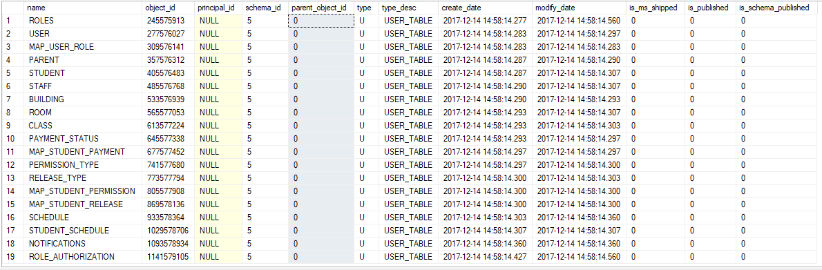
System Outlook - continue
The screenshot below display detailed information about the tables created for the camp database
University of Washington : INFX 563

Slide 13
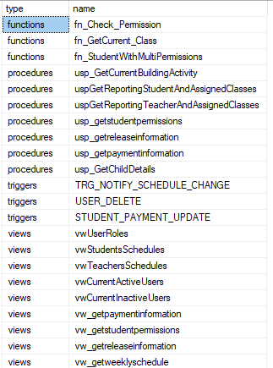
The screenshot below display detailed information about views, stored procedures, and functions created for the camp database
University of Washington : INFX 563

Slide 14
System Performance
System is designed to support on average 120 students, 10 teachers, 5 administrators, and 20 work crews on a giving summer camp year
System can handle multiple requests a second
Very little write on the system during camp activities, thus, minimal possibilities of deadlock or blocking
Heavy reads are expected when camps are in session
Select statements for each of the reports contain the needed columns
Primary key constraints and Foreign key constraint to match relationships between the tables
Queries are written based on the column’s data structure. For instance, columns that are stored as date time are not converted when executing queries
Queries are driven based on the existing clustered indexes
Utilized the query analyzer to optimize our report queries
In case of a database growth, the performance will remain stable because of the well-established indexes
Ensured that no distinct, no order by clauses were used unless the functionality warrants it
University of Washington : INFX 563

Slide 15
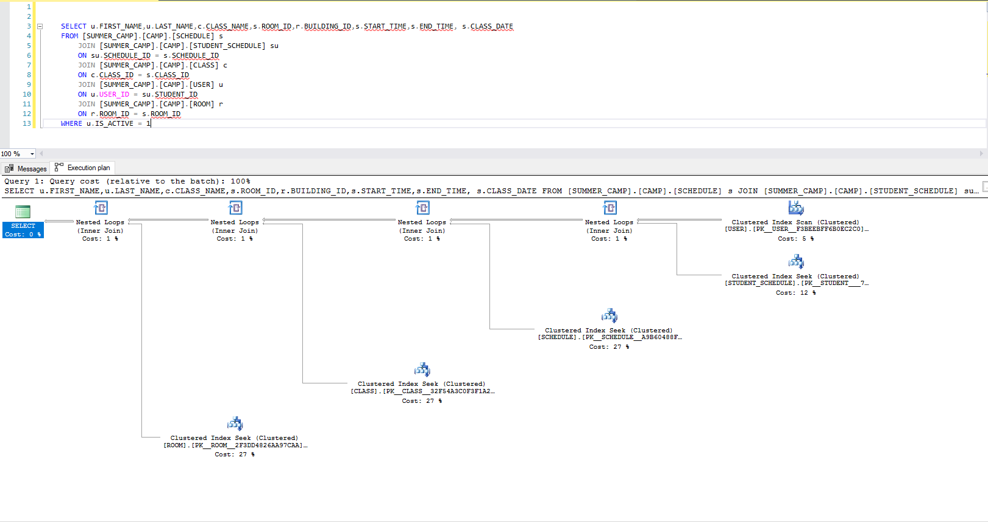
System Performance - Continue
University of Washington : INFX 563

Slide 16
System Performance - Continue - Explanation of the query
Most queries only have roughly 100 records to process
SQL Server performs "seeks" against the indexes, and it returns the data in about 30ms or less.
No visible warnings are shown in the execution plan, thus no apparent issues with the joins for a complex query.
University of Washington : INFX 563

Slide 17
System Logging/Monitoring
Tracking activities are done through analyzing last modified date
Created date and updated date columns are added to the main tables
Administrators can use the updated date to monitor changes in the system
Updated date or last modified date are designed not to allow nulls so that changes can be tracked
Updated date and created date can be leveraged by any downstream system for a delta load
University of Washington : INFX 563

Slide 18
Demonstration/walk-through
University of Washington : INFX 563

Slide 19
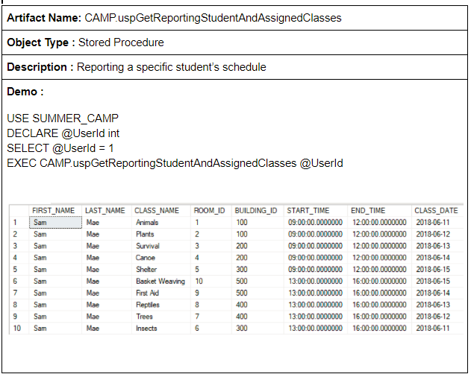
Use cases – Report showing a student’s schedule
University of Washington : INFX 563

Slide 20
Use cases – Report showing a student’s schedule - Continue
Most parents will execute this report to find out what classes/activities that their children will be having for each day during the camp session
Administrators and instructors may also implement this report when trying to check on a specific student
It is expected that this report will be executed at a lesser rate by the camp’s staff
University of Washington : INFX 563

Slide 21
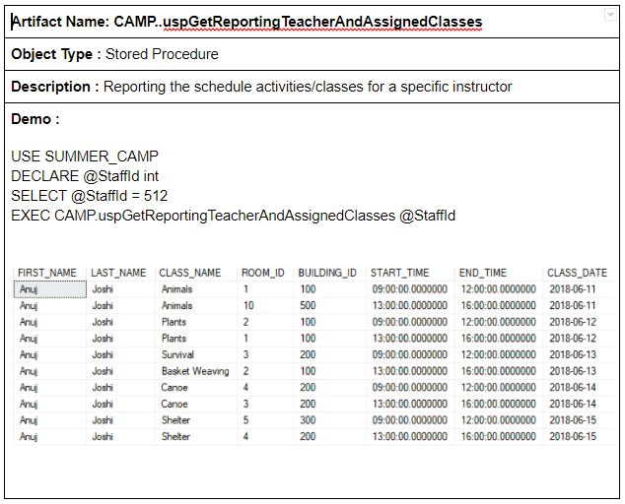
Use cases – Report showing an instructor’s schedule
University of Washington : INFX 563

Slide 22
Use cases – Report showing an instructor’s schedule
Report allows an instructor to check his/her schedule during the time this person has been teaching as part of a staff member at the camp
Administrators can also execute this report to view the location and activities of a specific instructor
University of Washington : INFX 563

Slide 23
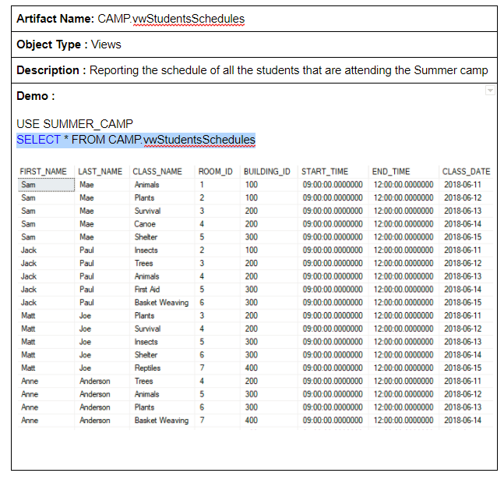
Use cases – Report showing a full list of every student's schedule
University of Washington : INFX 563

Slide 24
Use cases – Report showing a full list of every student's schedule - Continue
Report will only be executed by administrators and instructors
Parents and other persons in the system will not have the authorization to run this report
A critical scenario for this kind of report would be to ensure students are listed in the right camp activities or classes
At the start of each camp, every member who is administrators or instructors will be eligible to execute this report so that they are aware of the students that are expected to report to a specific camp
Report will only show students that are stated to be active meaning that their permissions forms, releases forms, and payment have been verified
University of Washington : INFX 563

Slide 25
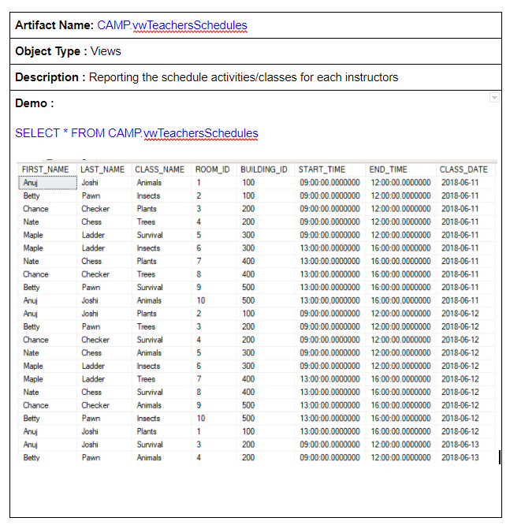
Use cases – Report showing a full list of every instructor's schedule
University of Washington : INFX 563

Slide 26
Use cases – Report showing a full list of every instructor's schedule - Continue
Report is available to anyone who is part of the staff
Administrators will be the primary users to generate this report.
Report will generate a historical list of classes or activities taught during a specific camp
Administrators can use this report to adjust or update the schedule as needed for the upcoming summer camp
Administrators can use this report to make changes due to current staff skills and or because of an unscheduled time off
University of Washington : INFX 563

Slide 27
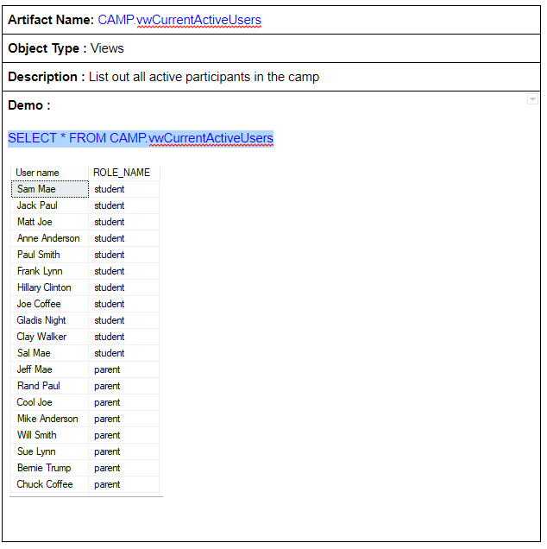
Use cases – Report showing all the active users
University of Washington : INFX 563

Slide 28
Use cases – Report showing all the active users - continue
Report allows administrators to view active participants in the summer camp.
Camp administrators can send notification and newsletters based on this report
Security crew members will have a list of the number of participants are expected to be allowed in the camp
Applications built on top of this database can use this list to check on the availability of a user to view specific reports
University of Washington : INFX 563

Slide 29
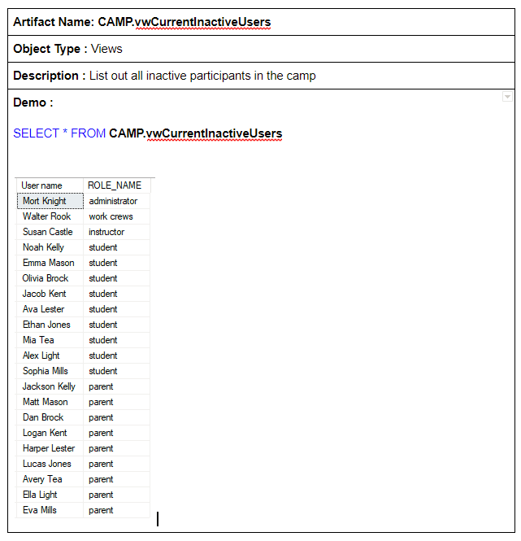
Use cases – Report showing all the inactive users
University of Washington : INFX 563

Slide 30
Use cases – Report showing all the inactive users - Continue
Report allows administrators to view inactive participants in the summer camp.
Security crew members will have a list of participants that are not allowed to be in camp buildings or classrooms
Applications built on top of this database can use this list to check on the availability of a user to view specific reports
University of Washington : INFX 563

Slide 31
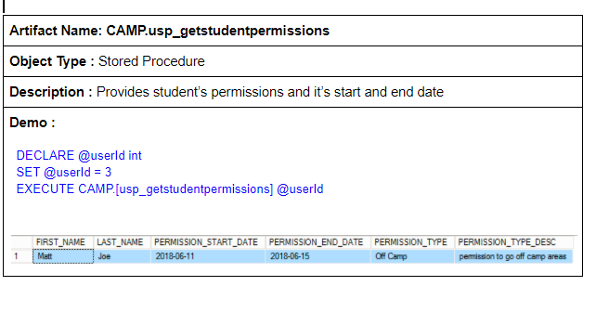
Use cases – Report to check a student's permission
University of Washington : INFX 563

Slide 32
Use cases – Report to check a student's permission - Continue
Verify a student’s permissions, for example, if a student has permission to go off camp areas, then it will report it
Administrators, students, and parents can execute this stored procedures
Provide a duration for the exemption
University of Washington : INFX 563

Slide 33
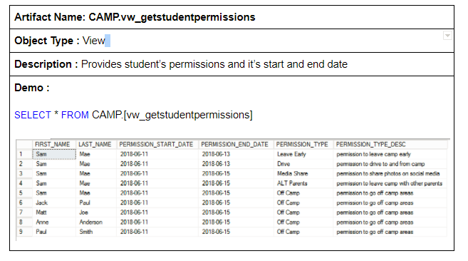
Use cases – Report to display all student's permissions
University of Washington : INFX 563

Slide 34
Use cases – Report to display all students’ release information - Continue
Report to provide release information of all the students
Provide details about release type and its description with release start and end date.
Administrators and instructors have access to this report
University of Washington : INFX 563

Slide 35
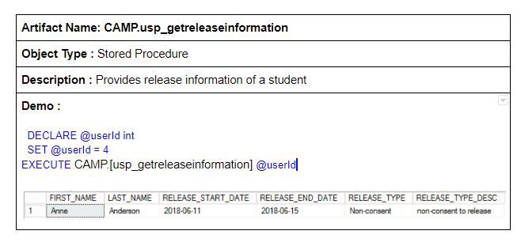
Use cases – Report to display a student’s release information
University of Washington : INFX 563

Slide 36
Use cases – Report to display a student’s release information - Continue
Allow student to view their release info
Allow parents to confirm that their children have the correct release information
Allow administrators and instructors to get release information for a student quickly
University of Washington : INFX 563

Slide 37
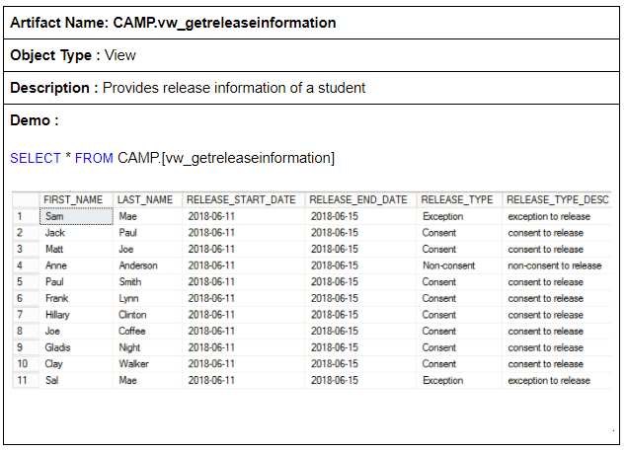
Use cases – Report to display all student's release information
University of Washington : INFX 563

Slide 38
Use cases – Report to display all student's release information - Continue
Allow administrators and instructors to get release information for a student quickly
Provide security personnel a list of all the students release detailed information
University of Washington : INFX 563

Slide 39
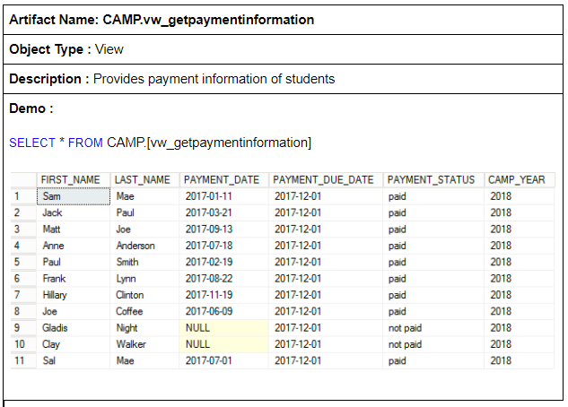
Use cases – Report to display all student's payment information
University of Washington : INFX 563

Slide 40
Use cases – Report to display all student's payment information - Continue
Provide administrators a list of the payment information of students
Provide details about payment due date, payment status, and payment date.
Instructors, parents, and students are not allowed to view this report
University of Washington : INFX 563

Slide 41
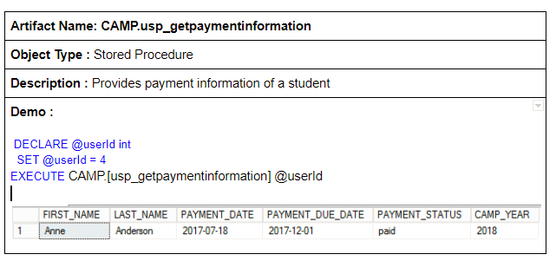
Use cases – Report to display a student's payment information
University of Washington : INFX 563

Slide 42
Use cases – Report to display a student's payment information - Continue
Parents can generate this stored proc to get payment information
Students and instructors are not allowed to run this stored procedure
Administrators can use this stored procedure to check on a student’s payment status quickly
University of Washington : INFX 563

Slide 43
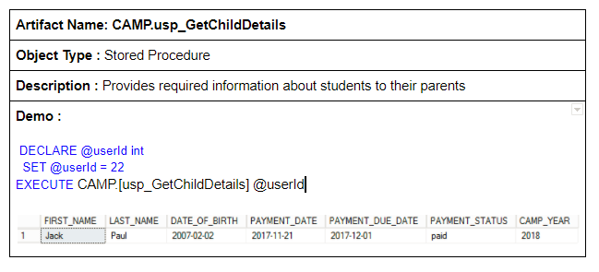
Use cases – Report to display a student’s detailed information
University of Washington : INFX 563

Slide 44
Use cases – Report to display a student’s detailed information - Continue
Parent’s will execute this report to confirm that their children data is correct
Administrators will perform this report to get information to celebrate student’s birthdays, or to organize students based on age
University of Washington : INFX 563

Slide 45
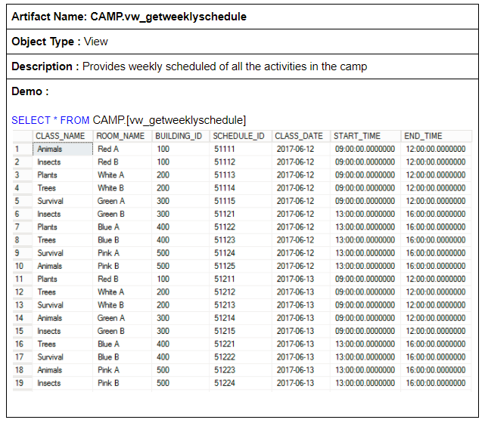
Use cases – Report to display camp’s weekly activities
University of Washington : INFX 563

Slide 46
Use cases – Report to display camp’s weekly activities
Report provides a list of all the activities that are happening during camp
Report contains the locations where the events are taken place
Report provides the time that the events will be taken place
Administrators, students, parents, and instructors will have access to this report
University of Washington : INFX 563

Slide 47
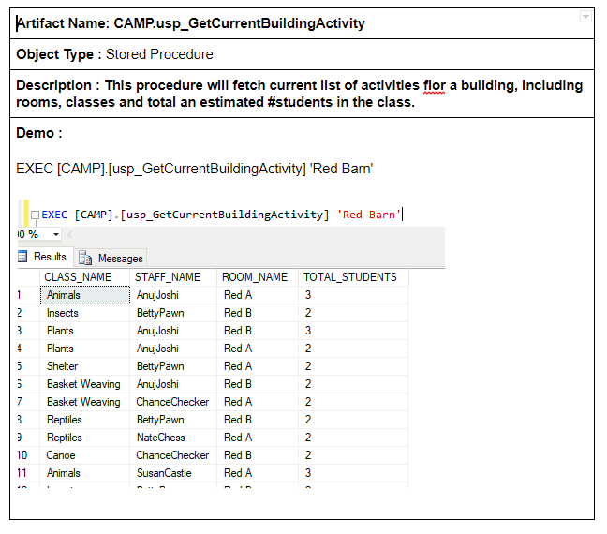
Use cases – Report to display where a specific event is taken place
University of Washington : INFX 563

Slide 48
Use cases – Report to display where a specific event is taken place - Continue
Administrators, and instructors will execute this report when trying to find where an event is taken place quickly
Security personnel will use this report in case of emergency
Parents and students will also have access to this report to find out where their classes are taken place
University of Washington : INFX 563

Slide 49
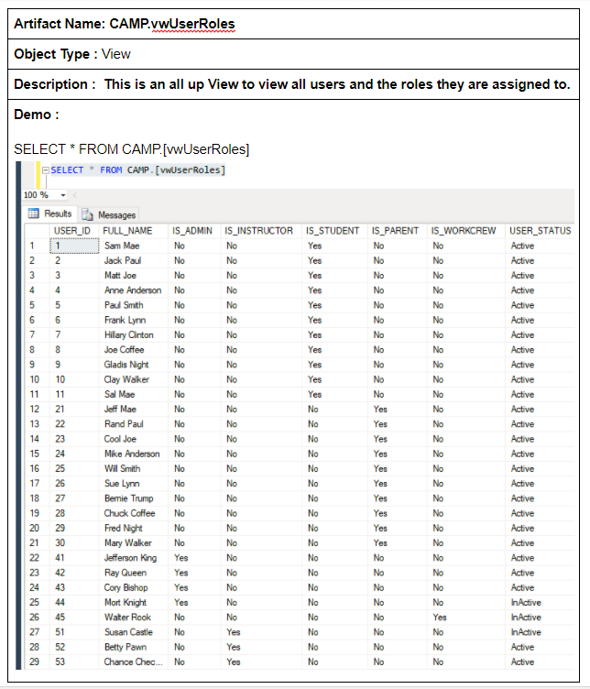
Use cases – Report to display what roles are assigned to each users
University of Washington : INFX 563

Slide 50
Use cases – Report to display what roles are assigned to each user - Continue
Report is only available to administrators
Report provides critical information on roles and authorizations available to each user who is active in the system
Report can be shared with security personnel in case of potential hacking
University of Washington : INFX 563

Slide 51
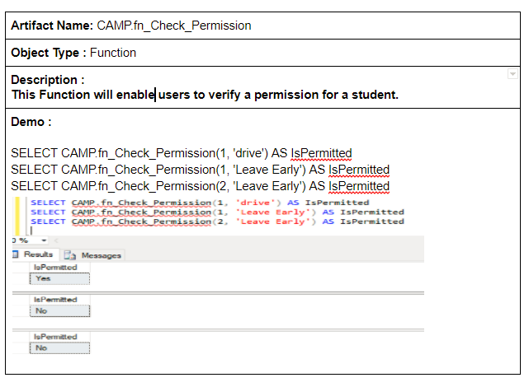
Administrator cases – Report to show what permissions are permitted for a student
University of Washington : INFX 563

Slide 52
Administrator cases – Report to show what permissions are permitted for a student
Report allows instructors and administrators to check on a student’s permission
A student’s permissions can be removed based on whether this report is accurate
University of Washington : INFX 563

Slide 53
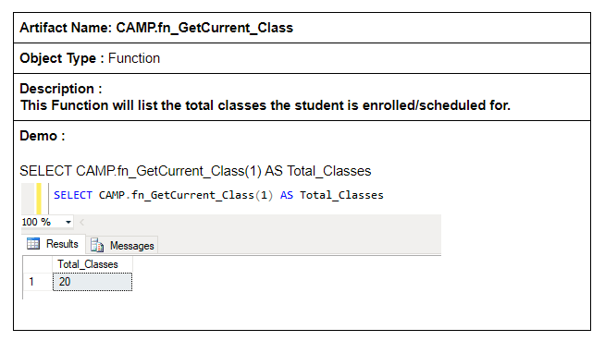
Administrator cases – Report to show number of classes a student is/has enrolled
University of Washington : INFX 563

Slide 54
Administrator cases – Report showing the number of classes a student is enrolled
Administrators use this report to find out the number of classes a student has taken throughout his/her time attending the camp
Report shows effectiveness of the camp based on total classes attended in a lifetime
University of Washington : INFX 563

Slide 55
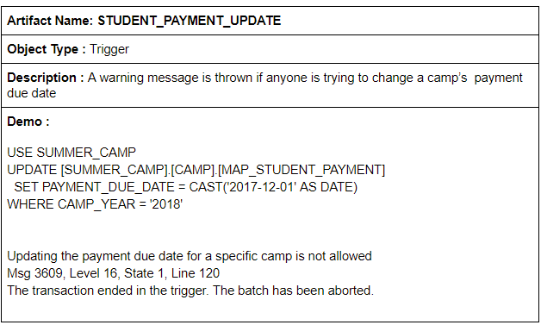
Administrator cases – Trigger when updating payment due date
University of Washington : INFX 563

Slide 56
Administrator cases – Trigger when updating payment due date - Continue
Trigger protects the system from camp’s payment due date.
Administrators will set the original payment due date, and this date is final
Protect parents from any unexpected events of payment due date being changed
University of Washington : INFX 563

Slide 57
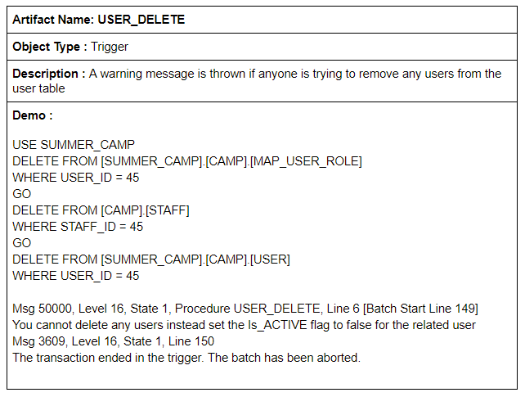
Administrator cases – Trigger when deleting a user
University of Washington : INFX 563

Slide 58
Administrator cases – Trigger when deleting a user
User table is meant to retain users information for life.
This trigger is intended to ensure that no users will ever be deleted.
If a user is no longer an active participant in the camp, then the best option is to set the is_active flag to false.
Security layer if anyone were to hack the system and to try to manipulate the data
University of Washington : INFX 563

Slide 59
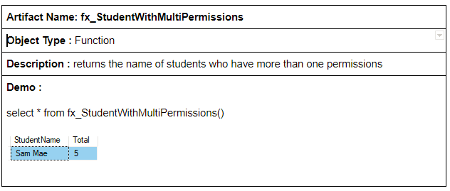
Administrator cases – Function to check what students have more than one permissions
University of Washington : INFX 563

Slide 60
Administrator cases – Function to check what students have more than one permissions - Continue
Enable staff to know which students have more than one permissions
List to show the students that will require extra monitoring because of the number of permissions
Only administrators will be allowed to run this function
University of Washington : INFX 563

Slide 61
Additional Enhancements
Future enhancements
Optionally list summer camp activities that can happen outdoor
Allow parents to make changes associated with their contact info
Add an entry for meal planning for those who require special diet
Allow students to update their meal preferences
Provide parents a way to remove their child from a camp program through the application
Provide pick up and drop off transportation schedule for those who cannot drive to the campground
Provide an option to have partial payments from divorced or separated parents
University of Washington : INFX 563

Slide 62
Project Dynamics
Robert Marshal
Created database objects and added test data
Ram Ganesan
Reviewed and redesigned original database objects, and created stored procedures, functions, and triggers
Anuj Joshi
Created stored procedures, and views
Pierre Augustamar
Handled all the documentation, and created stored procedures, functions, and triggers
University of Washington : INFX 563

Slide 63
Project Dynamics - Continue
We used an agile software development with rapid development.
With constant changes to the design after a team member raises a concern, then an agile methodology was best suited for this sort of group project
We continuously review the requirements to make sure that we are compliant with what was being asked
We had team meetings every other day at the beginning of the project; then we had sync up sessions every day during the last week that the project was due.
We had an open discussion style where everyone can voice his opinions
We had a democratic system where everyone’s inputs are taken into consideration before making any actions
All design changes required approval from everyone
University of Washington : INFX 563

Slide 64
Lessons Learned
Review the original design during the first group meeting so that we can avoid multiple iterations later on
Have concrete deliverables early in the project
Utilize teammate's strength early in the project
University of Washington : INFX 563

Slide 65
QUESTIONS
University of Washington : INFX 563

