Slide 1


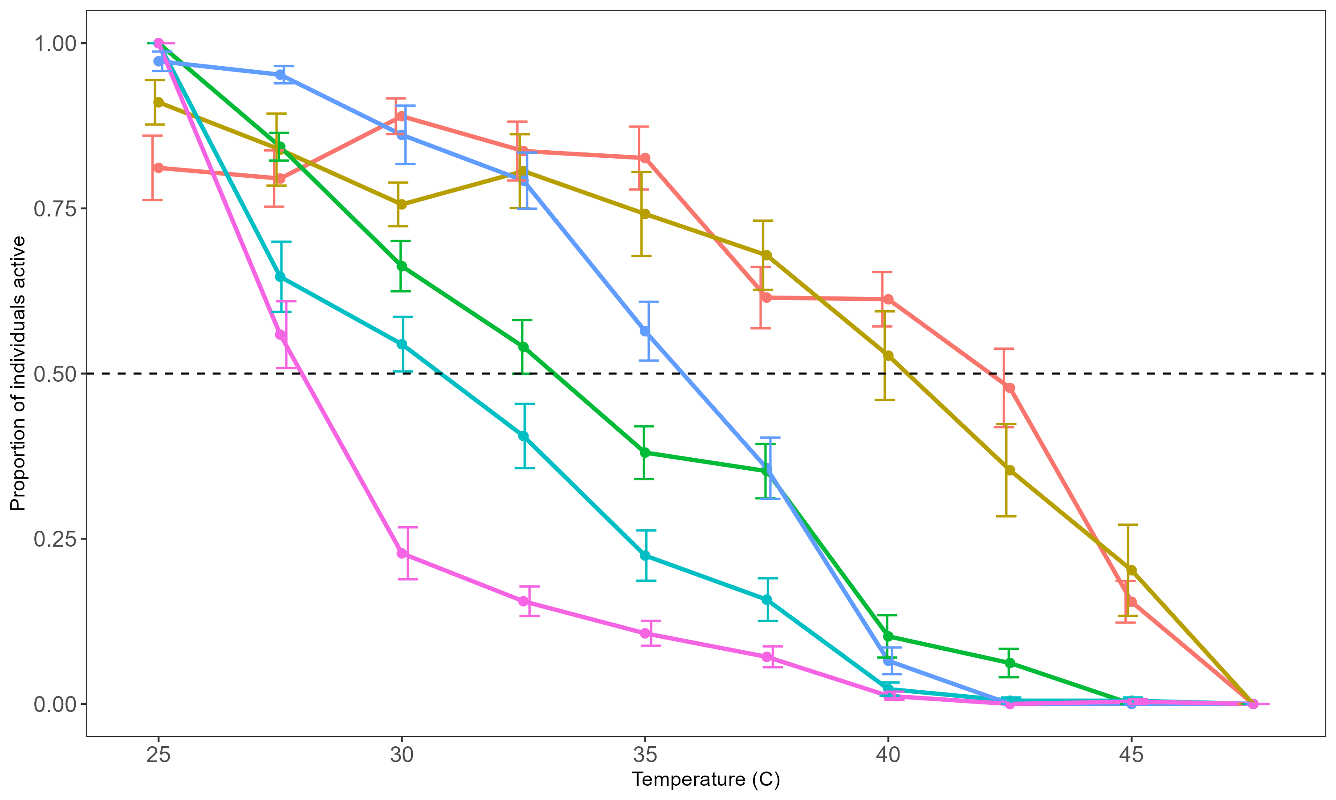
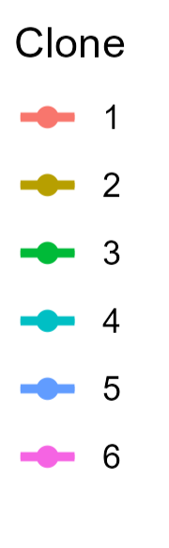
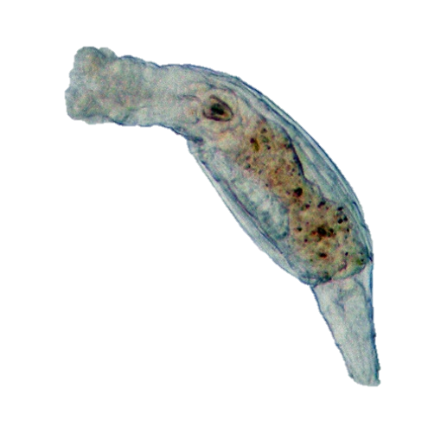
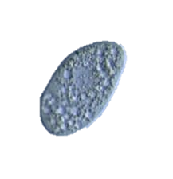
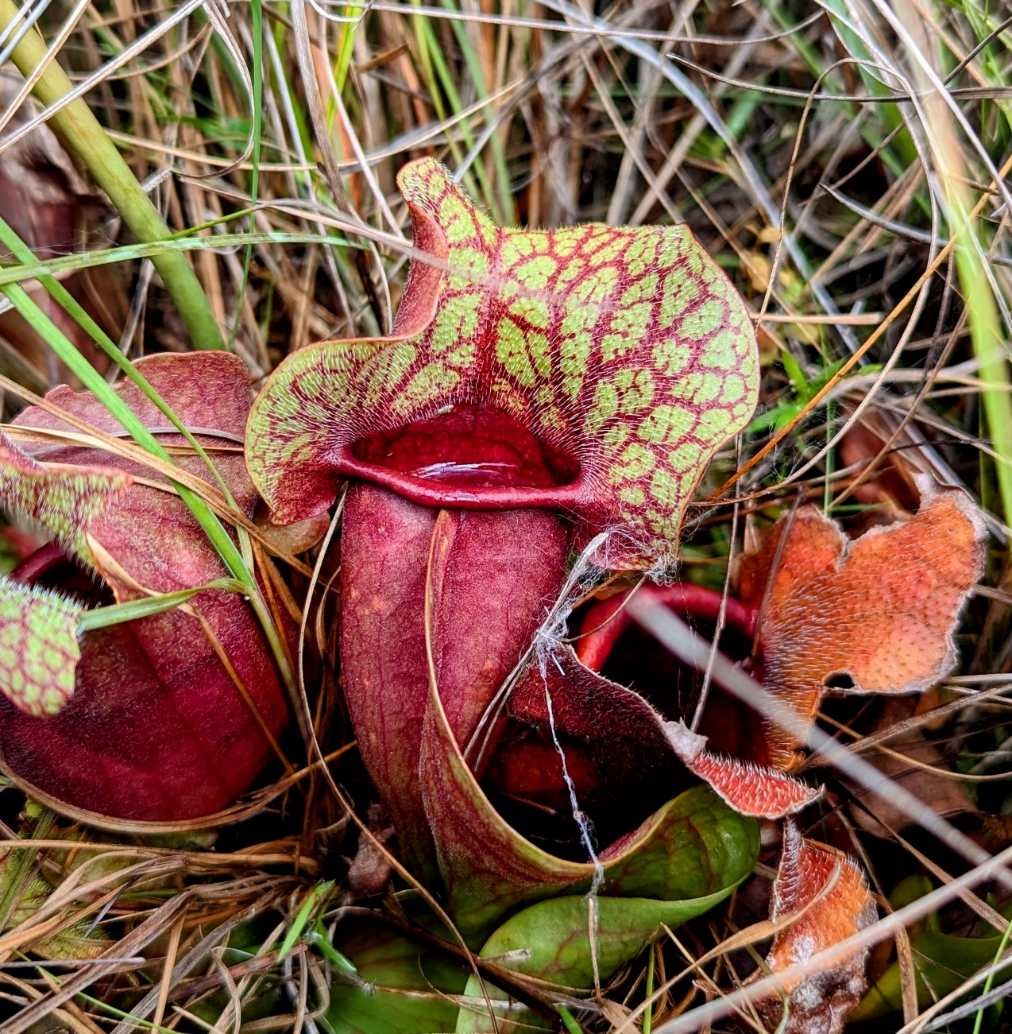
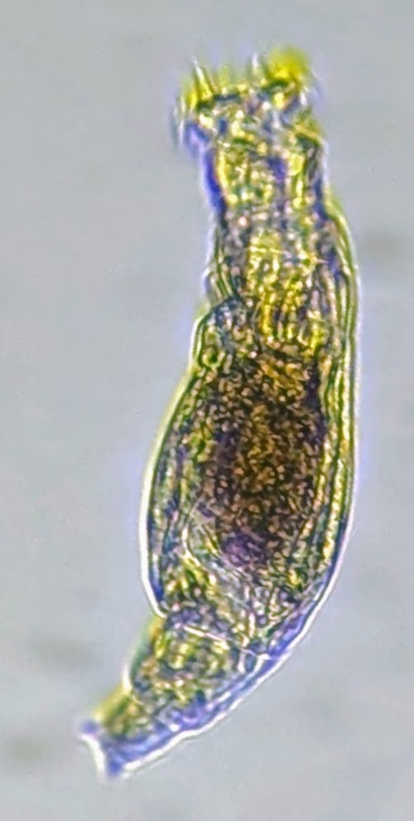
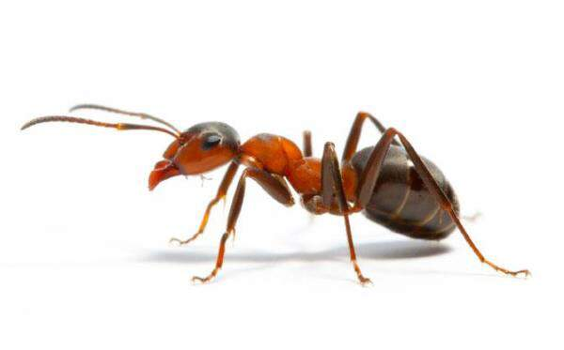
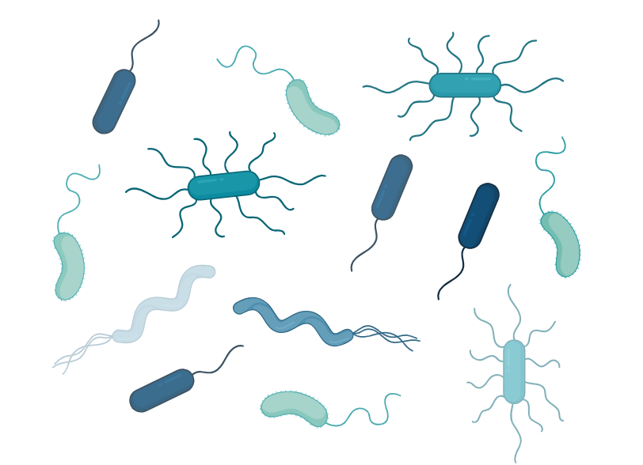

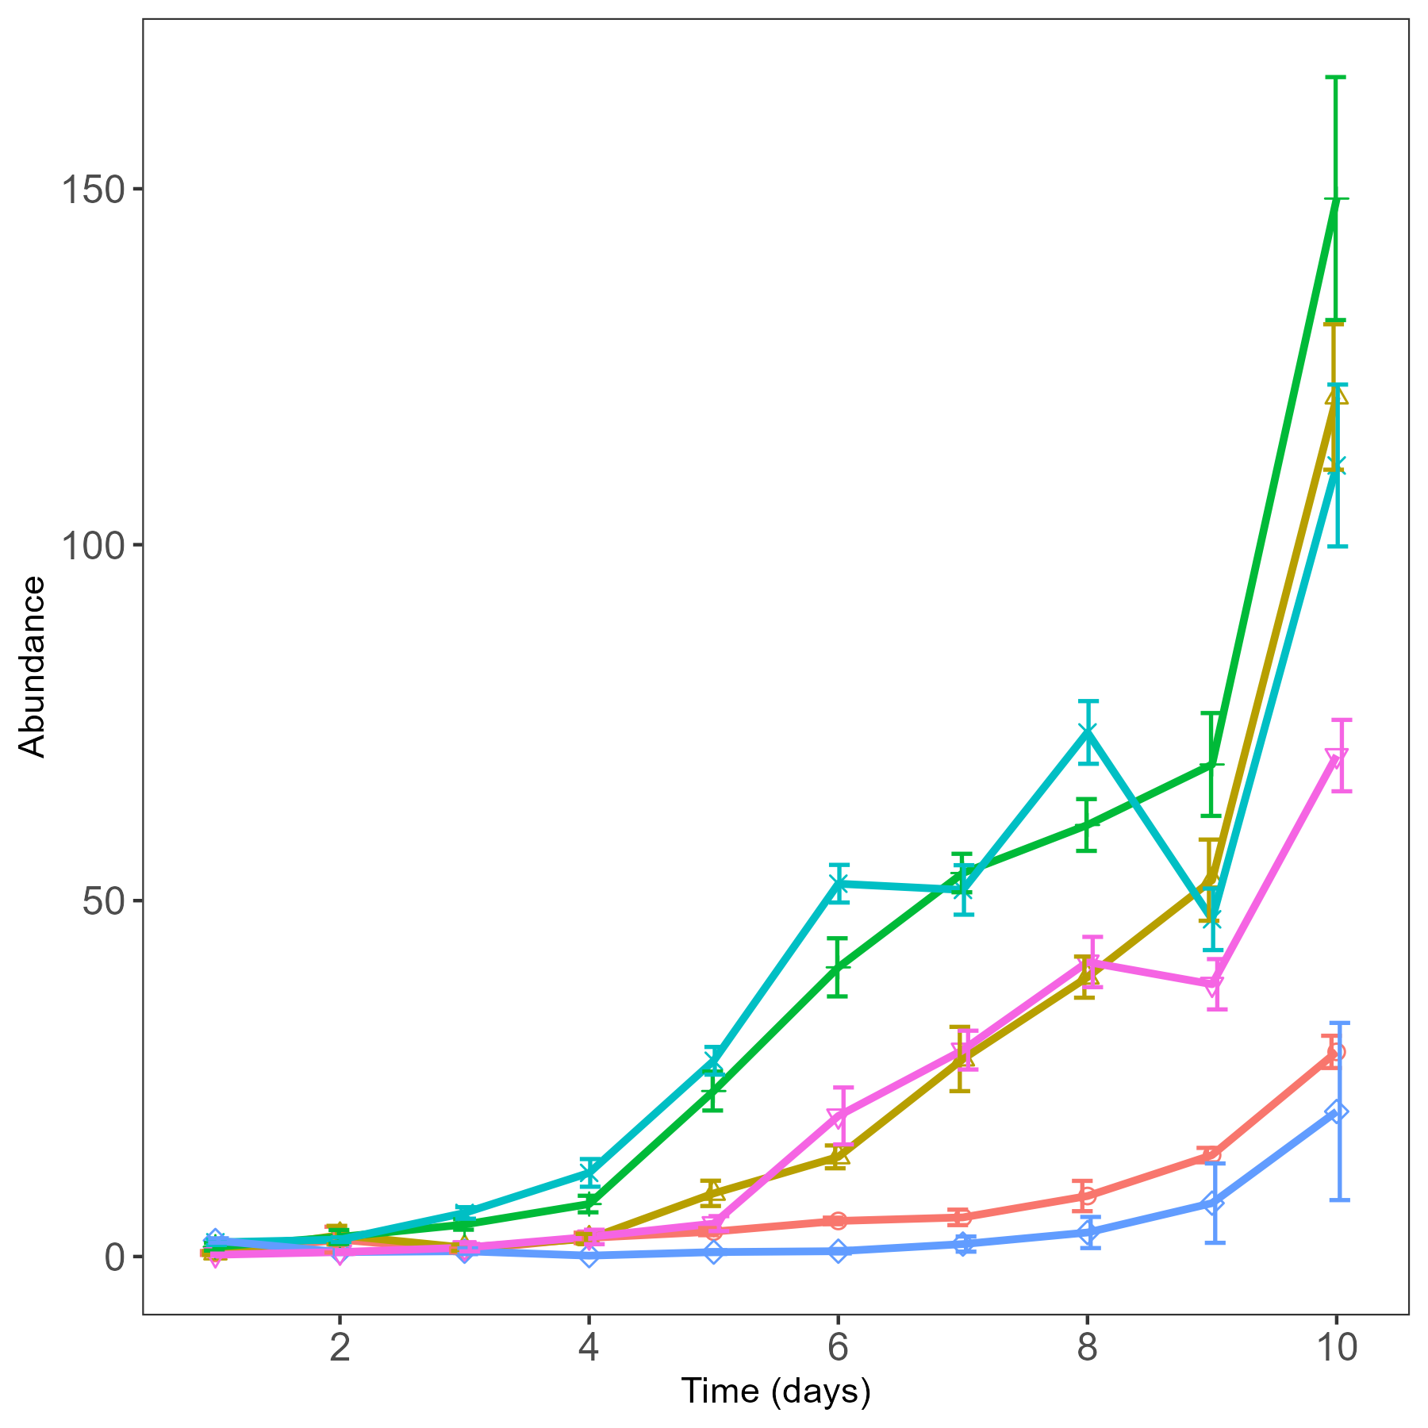
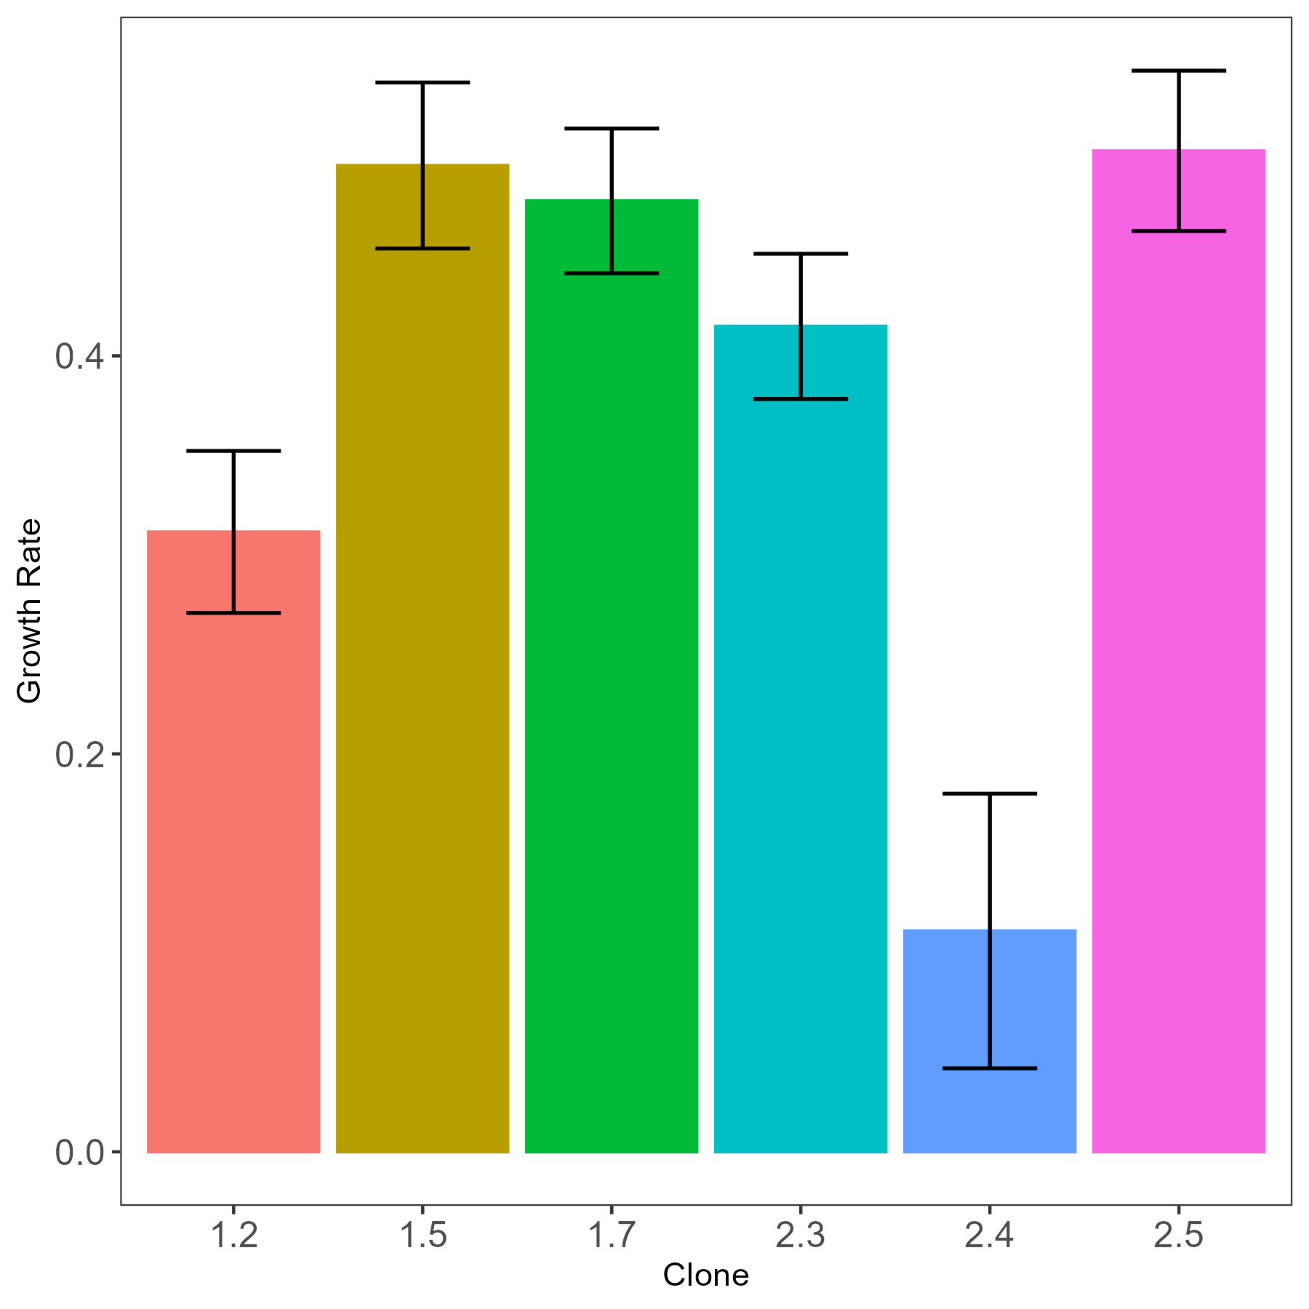

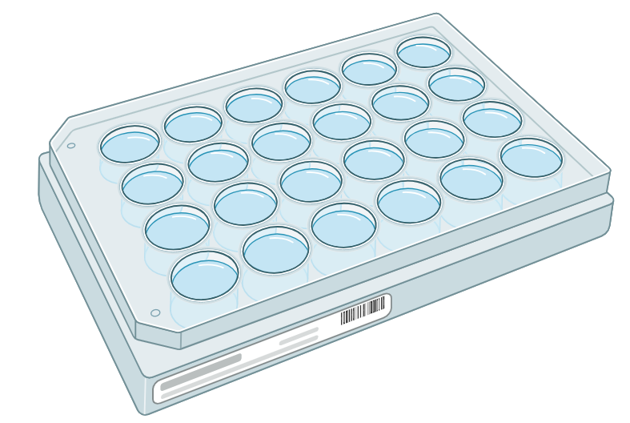

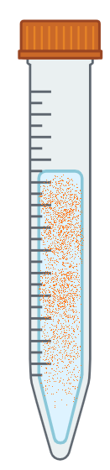
Does response to stressful temperature differ among clones of pitcher plant rotifers?
Alex A. Mendelson*, Casey P. terHorst
Department of Biology | California State University, Northridge
Background
Results
Next Steps
When faced with rapid global change, many populations are likely to rely on rapid evolution to avoid extinction.
Response to temperature differs among clones
Evolution over short time periods can have an important impact on ecology.
The potential for a population to rapidly adapt to new stressful conditions relies on diverse responses to stress.
Changes in traits that are important for interspecies interactions might lead to fundamental changes in those interactions.
Does response to stressful temperature differ among clones of pitcher plant rotifers?
Competition
Habrotrocha rosa:
Common name: “Pitcher plant rotifer”
Obligately parthenogenetic (asexual)
Filter-feeding bacterivore
Proportion of rotifers active
Habrotrocha rosa
Tetrahymena
Bacterivory
Basal Resource
Temperature (°C)
Bacteria
Figure 1: Proportion of active rotifers (mean +/-SE, n=12) across a gradient of 10 temperatures; 6 clonal lines (color/shape).
Indirect effects of climate change on ecology, mediated by evolution, may play an important roll on the trajectory of natural communities.
Growth rate among clones differs at a stressful temperature
Sarracenia purpurea, Purple Pitcher Plant (L) and Habrotrocha rosa, Pitcher Plant Rotifer (R)
a
b
Climate Change
Evolution
Species A
Competition
Species B
Methods
Thermal Performance:
Six clones of H. rosa
n = 12 per clone
Temp increased by 2.5°C every 1 h (25–47.5°C)
Scored for activity hourly
Abundance
Growth Rate
Indirect Effect
Acknowledgments
Growth Rate:
Six clones of H. rosa
n = 8 per clone
Grown at 24–35°C, 12h/12h day/night cycle
Abundance measured daily by removing and counting a 0.15 ml sample
Thank you to Dr. Tom Miller of Florida State University for providing Habrotrocha rosa samples, Mark Harris for loaning a microscope, and Vincent Cannizzaro, Breana Morales, and Lexi Atler for assisting in data collection.
This project was supported by the Thesis Support Grant from the CSUN Office of Graduate Studies.
Time (days)
1 2 3 4 5 6
Clone
Figure 2: (a) Daily abundance of rotifers (mean +/-SE, n=8); 6 clonal lines (color/shape). (b) Growth rates (+/-95% CI) for each clone estimated by slope of log-transformed abundance.

