Slide 1

Scope of Gradido
Core features and limits
of Gradido as Software

Slide 2
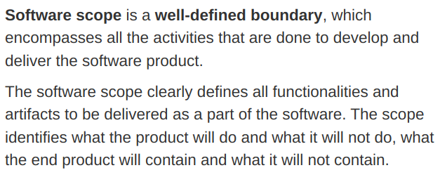
Definition Scope

Slide 3
Scope of Gradido
Money Transfer
Money Creation
Creation of Groups and their Relationships
User management
Chat system
Goods, Services, Abilities and Talent management & coordination
Marketplace
Dating App
Search Engine
Newsletter management

Slide 4
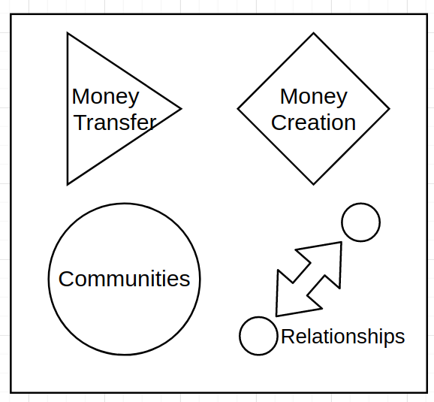
Core Features of Gradido
Money Transfere
Money Creation
Creation of Groups and their Relationships

Slide 5
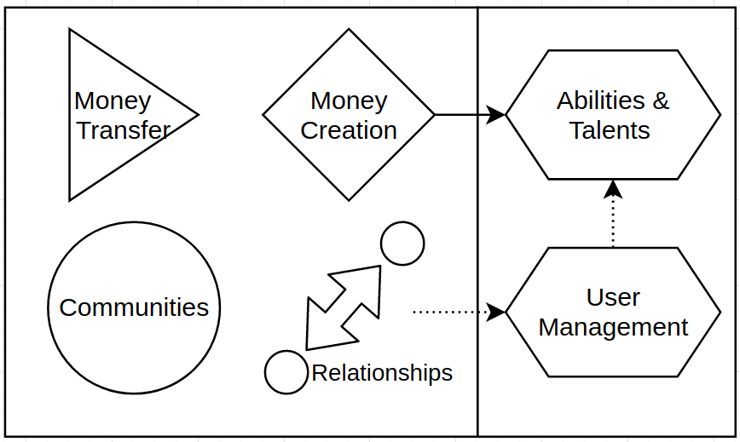
Advanced Features of Gradido
(Inter-Group-)User management
Abilities and Talent management & coordination

Slide 6
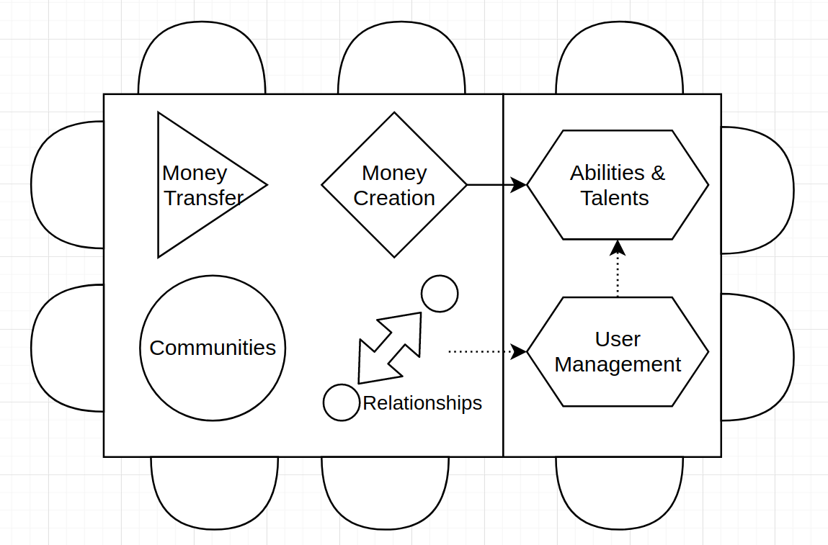
Gradido as Platform
Additional Functionality are external Tools
Definition of APIs

Slide 7
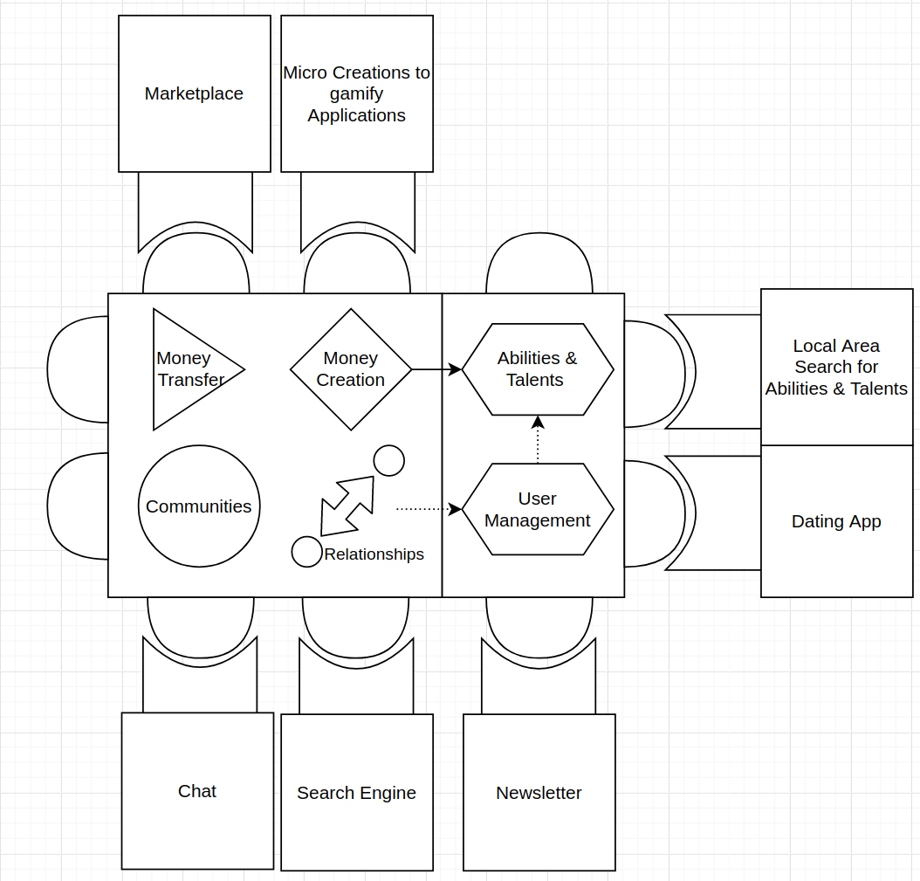
Gradido as Platform

