Slide 1
INSTITUTIONAL NOTE
T-Protocol is a coordination layer for AI systems that must keep their bearings over time.
• not a new foundation model • not another chatbot or agent swarm • a bounded recursive layer around existing models • designed for continuity, ambiguity handling, and recovery
Slide 1 of 6 · T-Protocol: What it is
Notes:
Open with the object category. This is infrastructure, not a replacement model. [Sources] - Internal/user-provided T-Protocol materials and user-guided framing in this conversation.

Slide 2
WHY NOW
Current AI is strong locally, but often weak across drift, contradiction, and changing context.
• today: good output, weak continuity • today: polished answers, fragile recovery • today: ambiguity cleaned up too early
• today: no actual sense of time and timing • T-Protocol separates mapping, continuation sensing, and contextual judgment
Slide 2 of 6 · T-Protocol: Why it matters
Notes:
This is the institutional problem statement. [Sources] - Internal/user-provided T-Protocol materials and user-guided framing in this conversation.

Slide 3
HOW IT EMERGED
The protocol came out of repeated bounded testing, not from a branding exercise.
• role separation stayed intact • shared state preserved continuity across cycles • mismatch did not force collapse • revision, de-confirmation, restart, and recoupling became explicit engineering objects
Slide 3 of 6 · T-Protocol: Why this is credible
Notes:
Stress that the protocol was distilled from repeated testing into a cleaner object. [Sources] - Internal/user-provided T-Protocol materials and user-guided framing in this conversation.

Slide 4
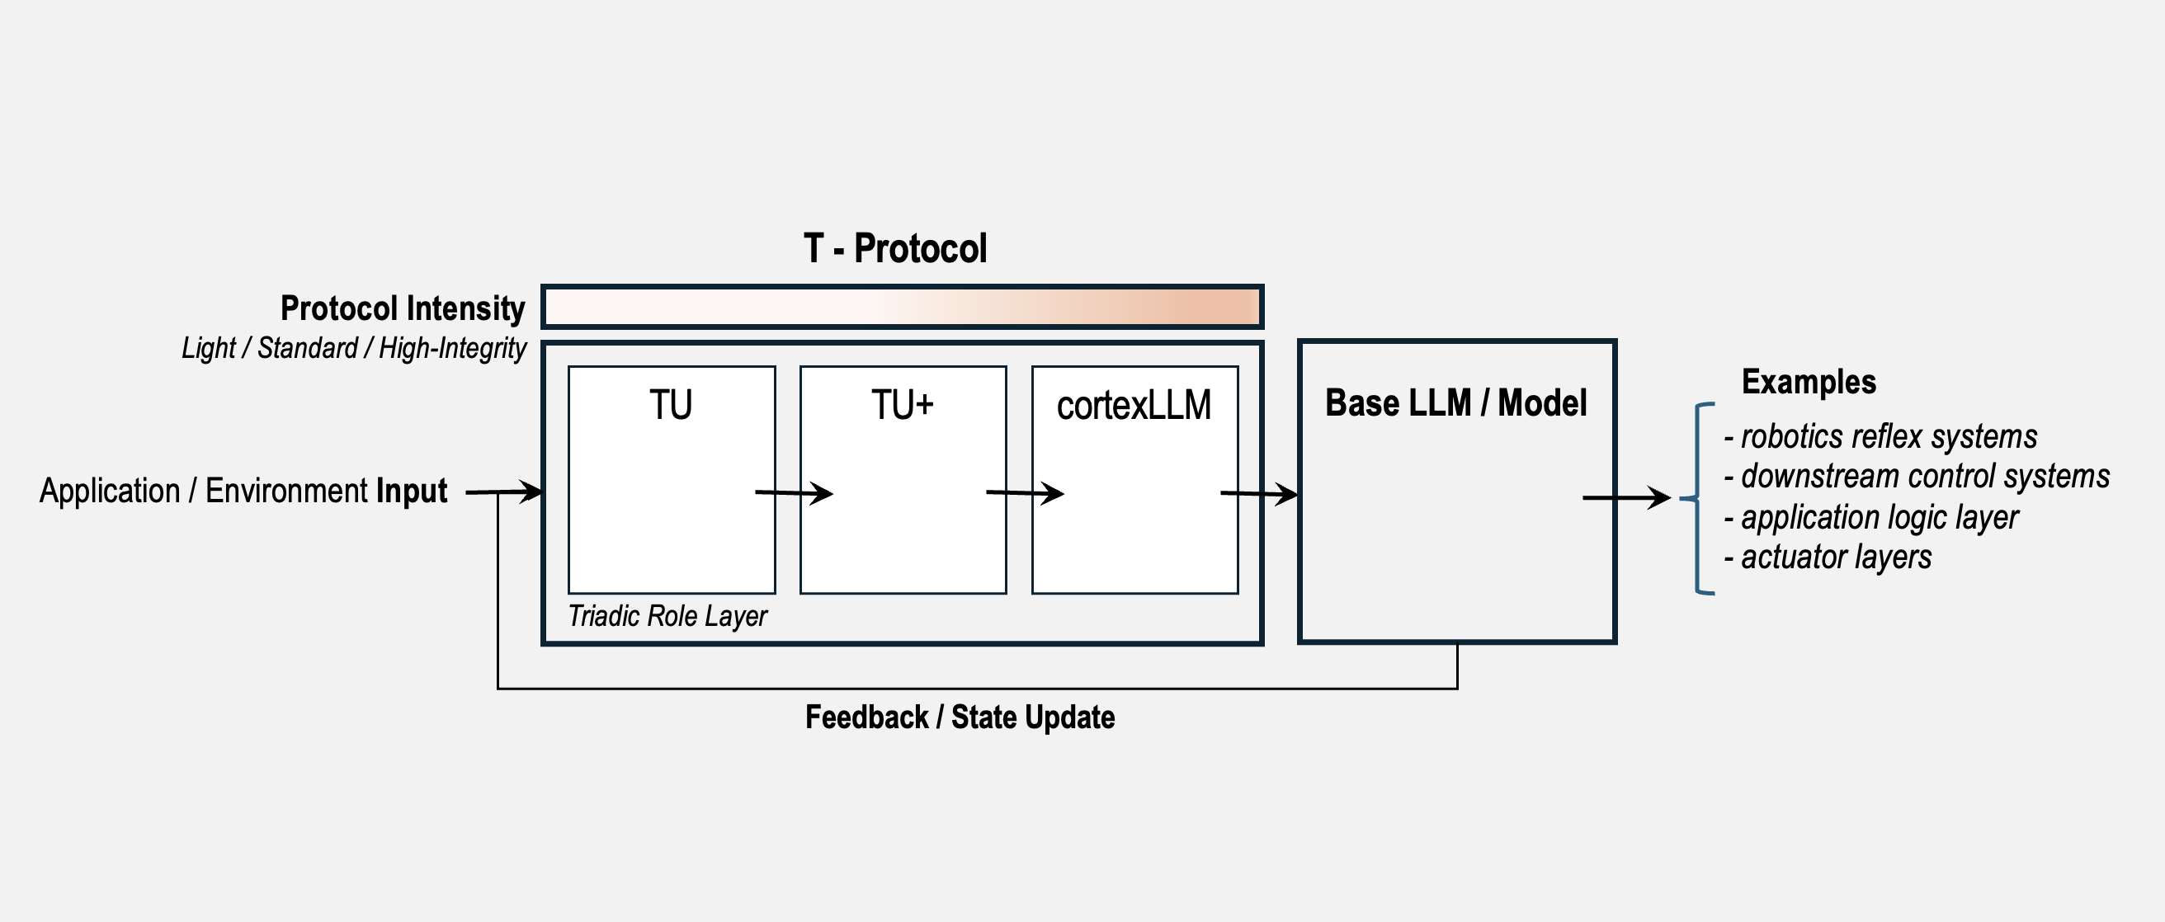
ARCHITECTURE
How T-Protocol sits in the stack.
Slide 4 of 6 · T-Protocol: Stack position
Notes:
Stress that the protocol was distilled from repeated testing into a cleaner object. [Sources] - Internal/user-provided T-Protocol materials and user-guided framing in this conversation.

Slide 5
STRATEGIC RELEVANCE
The likely value is not at the level of weights, but at the level of coordination infrastructure.
• fits enterprise copilots, orchestration, supervisory autonomy, and anomaly-aware systems • can be wrapped around existing model stacks • offers a route toward more world-facing AI behavior without changing the base model category
Slide 5 of 6 · T-Protocol: Why an institution should care
Notes:
This is the imec slide. Emphasize embed-ready protocol logic and relevance to trusted infrastructure. [Sources] - Internal/user-provided T-Protocol materials and user-guided framing in this conversation.

Slide 6
NEXT STEP
A protected review should determine fit before any broader disclosure.
• review the protocol package under confidentiality • test technical coherence and institutional fit • separate what is reviewable from what remains protected • decide whether deeper joint validation is warranted
Slide 6 of 6 · T-Protocol: What to do next
Notes:
Close on a modest ask: protected review, not immediate adoption. [Sources] - Internal/user-provided T-Protocol materials and user-guided framing in this conversation.

