Slide 1




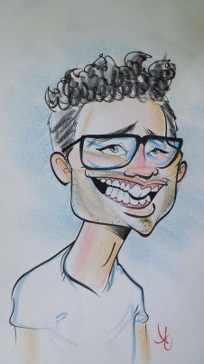
@
http://impactmovement.org/
https://www.facebook.com/groups/135299829873546/
Oct 2015
Hello Fam!
Do you believe Christ calls us to be reactive, active, or proactive? Are you comfortable with doing the Christian routine or are you looking to grow? Consider this verse below as well as the context in which the verse is used by Jesus Christ. What is the Spirit saying to us about this truth? Feel free to let me know, too. I’m not just saying this to say it. I want to know what the Spirit is saying to you.
Up to this month, a lot has been happening. We no longer consider our chapter another Bible study on campus. There are plenty already at Howard (like dozens). We are now a Biblical Leadership Development ministry focused on addressing life challenges with the Gospel. Our campus ministry evolves from Daniel 1:17-19.
Impact Professional “Gordon”
²⁴ Then He said to them, “Take heed what you hear. With the same measure you use, it will be measured to you; and to you who hear, more will be given. ²⁵ For whoever has, to him more will be given; but whoever does not have, even what he has will be taken away from him.” - Mark 4:24-25 (NKJV)
The 411 – LOTS of love and support!!!
Typically, I highlight some of our students, but in this newsletter I must highlight our professionals who have been showing crazy love and huge support for our ministry at Howard University with faith that our impact, Lord willing, will go beyond the boundaries of our campus. [Photos on next page] And, yo’, I know we don’t expect praise because all glory goes to God, but I’d be foolish not to mention this fortune.
Chris Coley has been diligent with being present while contributing to our studies since September 2nd.
Beverly Davis is in discipleship with a couple students and has been attending some of our studies as well as our first family night.
Ashley Holston is developing our social media communication. Follow us! @impactbison
Faith Booker and family are preparing to host our next Impact Family Night/Day.
Asa Briggs is preparing to enter discipleship with one of our students and has graciously offered to sponsor a financial education training for our students.
Brittany Clay is in discipleship with one of our students and almost won Settlers of Catan (board game) at our first family night.
Jewell Booker is taking the lead on our weekly family prayers on Thursdays at 9pm. Please pray with us when you can by joining our conference call 605-475-4333, code 440365#.
LaToya Archibald is leading another campus ministry and graciously allowing me to collaborate with her.
Two “investors” have blessed us which helps with covering resources that our ministry provides to our younger brothers and sisters (i.e. students) including scholarships to the Impact Fall Retreat and purchasing books like Kingdom Man/Woman.
Hope of the School Year: 100 Community + Social Investors How much do we know about “investing”? Apparently, I don’t know enough. From my understanding (and feel free to correct me) if we have 100 investors at $100 per month, then we can support our students with $100,000 and generously improve our national movement with $20,000 annually. This investment provides life skills…because a degree is simply not enough. - http://communityinvestor.com/index.php/home-page-menu-1/mission - http://www.bigsocietycapital.com/what-social-investment-0 - http://www.socialinvestors.com/

Slide 2
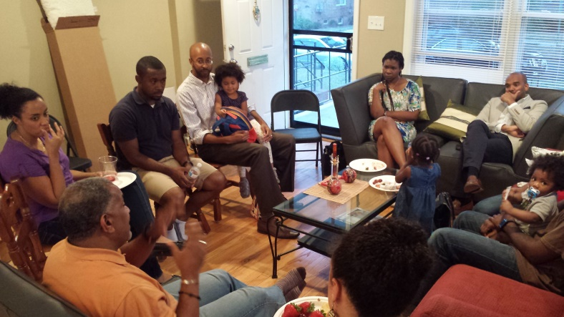
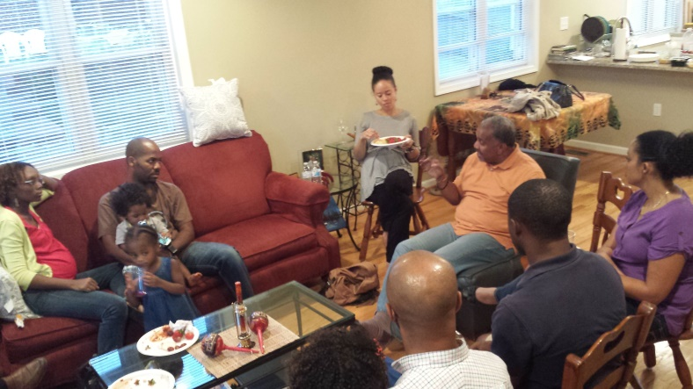
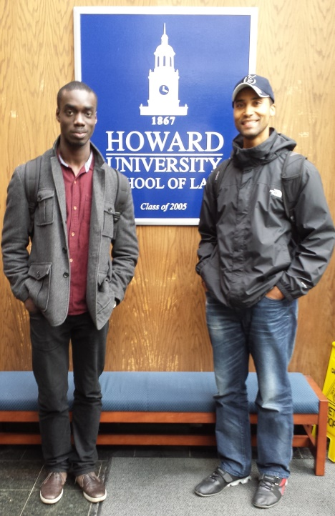
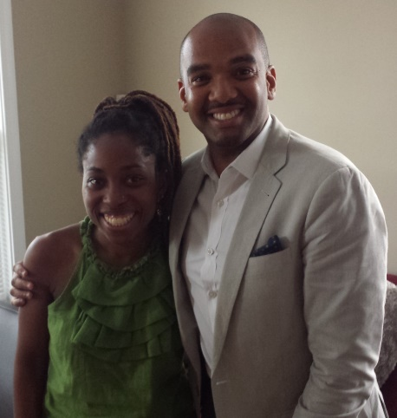
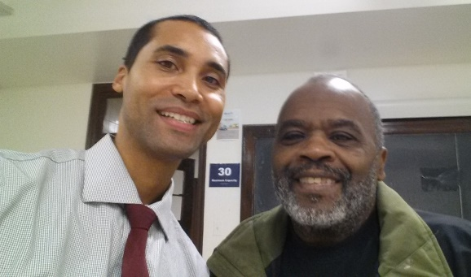
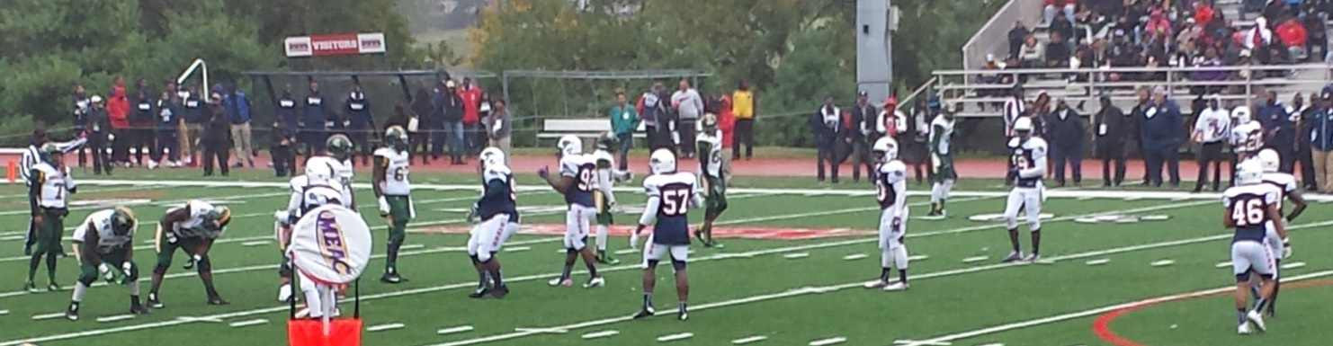
@
http://impactmovement.org/
https://www.facebook.com/groups/135299829873546/
Oct 2015
Top photos: President Jimmy McGee discussing the history, present, and future of the Impact Movement.
Center photo: Ty, a first year Law student, and me. Ty gives advice to any of our undergraduates interested in Law School. Thankful for his heart and leadership.
Left photo: Rev. Eugene Burrell, a legend in campus ministry at Howard, graciously taking me under his wings and teaching me how to minister well at Howard University.
Right photo: A long lost sister and brother of mine, Brittany and Asa, have been a wonderful blessing in helping all of us with rebuidling the Impact campus ministry at Howard University. Like many professionals, they too are super busy but make the time to invest in our younger brothers and sisters (i.e. our students).
Bottom photo: We are fans of our brother Jacob, player wearing #46, who is a safety for Howard’s football team and reminds us to be safeties for the Gospel. #unashamedGospel
And what’s more impressive is that all of us are making time (i.e. a priority) to be a blessing. This comforts my soul with the reminder of 1 Corinthians 12. Super thanks, vielen dank, muchas gracias, shukran…

