Slide 1

Fash
Brent, Matthew, Ibrahim en Elias

Slide 2

Wat is Fash?
Online platform
Outfits delen
Geld verdienen

Slide 3
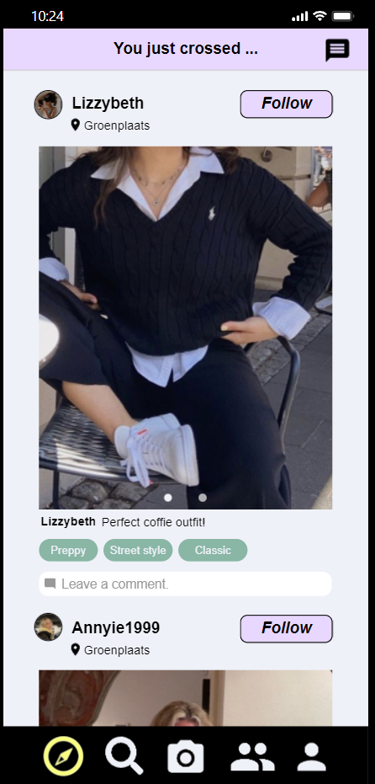
In de buurt?

Slide 4
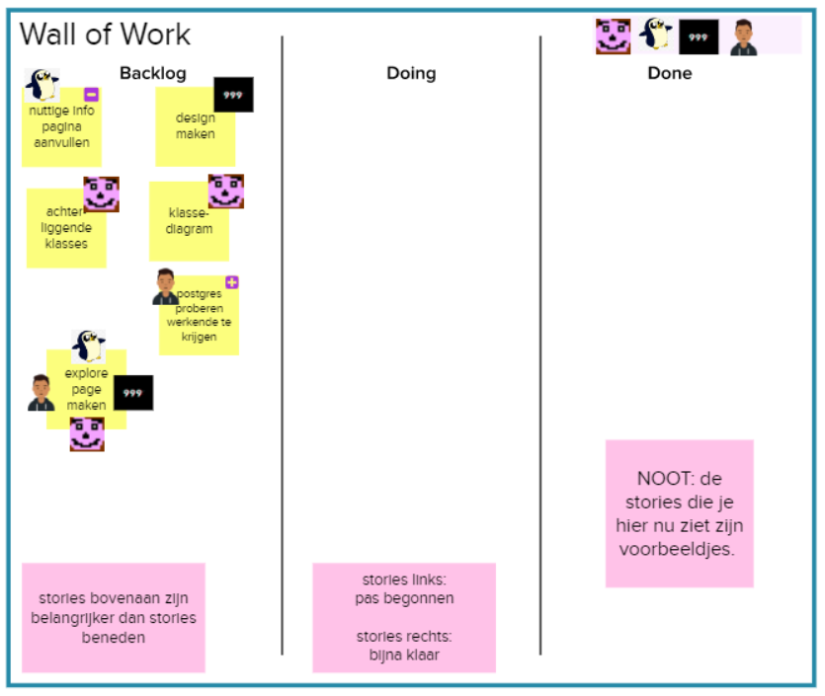
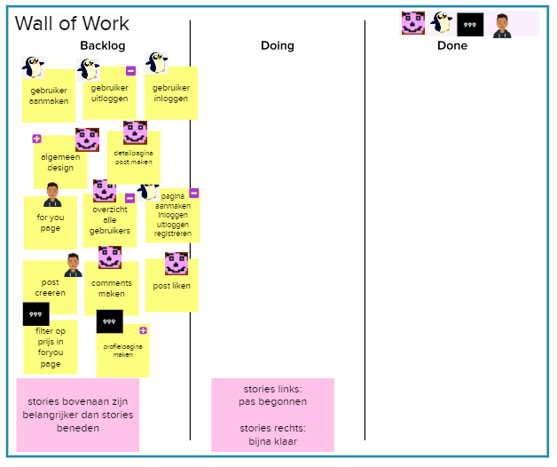
Onze aanpak
Scrum master: Elias
Product owner: Brent Budts

Slide 5
De app

