Slide 1


Fash
Brent, Matthew, Ibrahim en Elias

Slide 2

Wat is Fash?
Online platform
Outfits delen
Geld verdienen

Slide 3
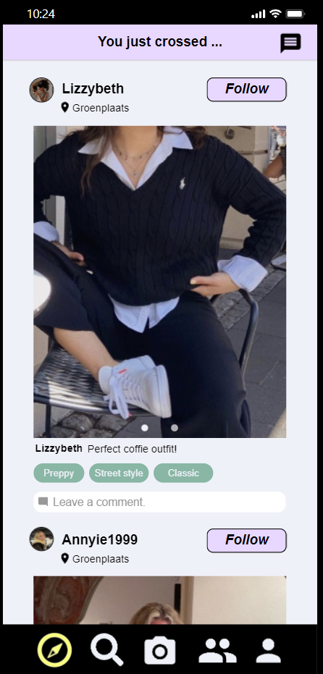
In de buurt?

Slide 4
De app

