Slide 1
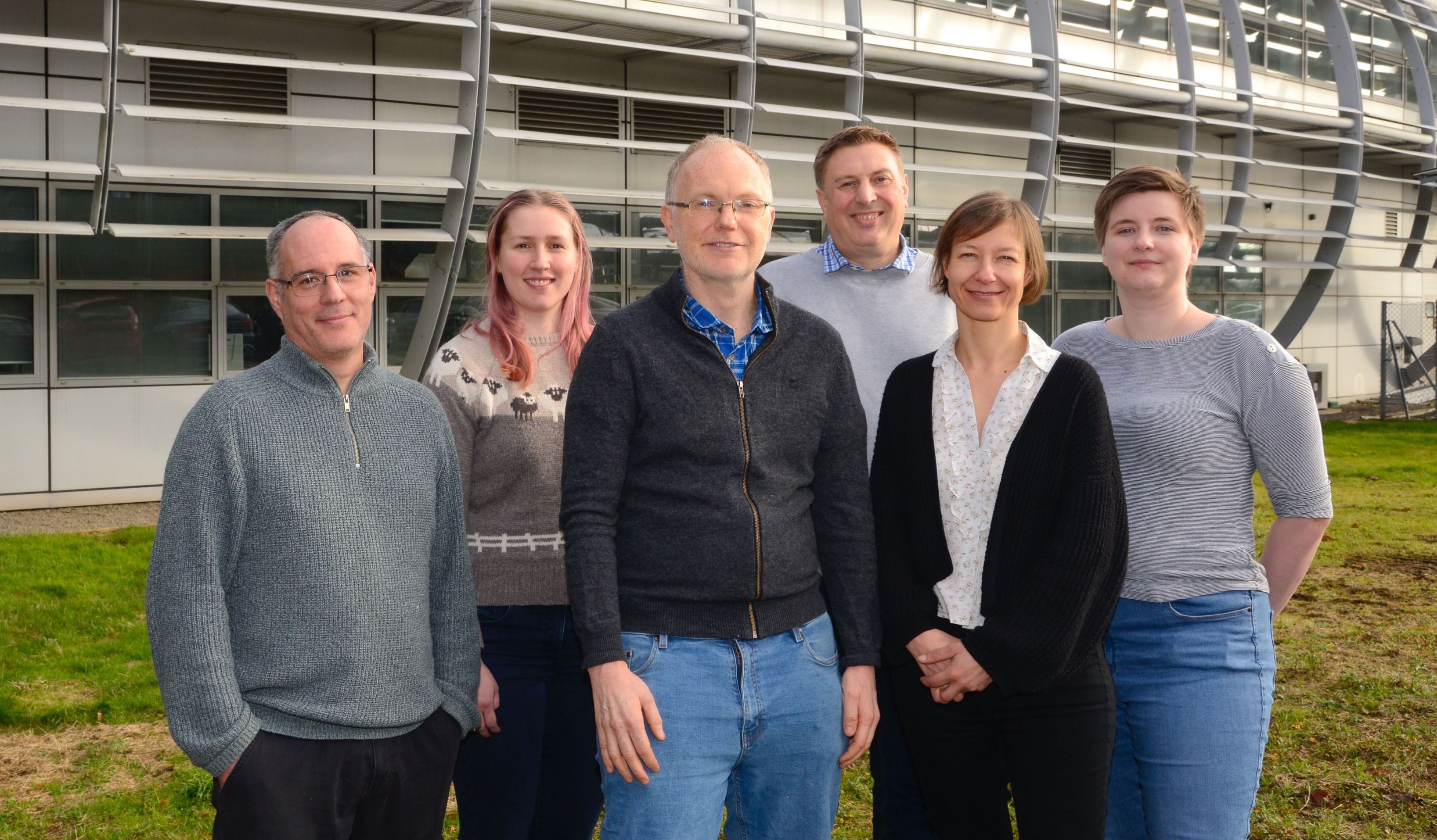
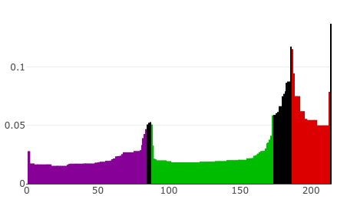
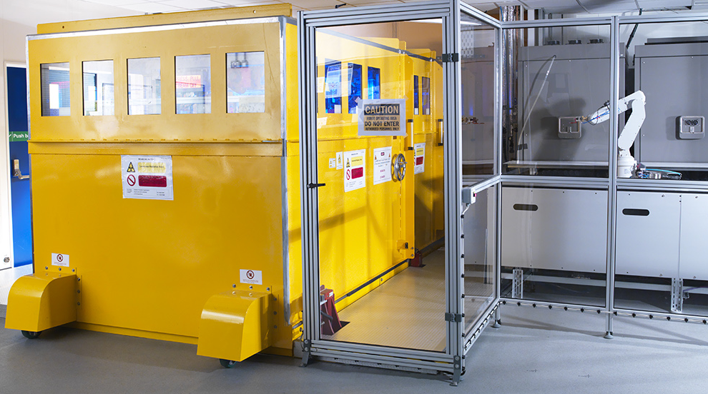



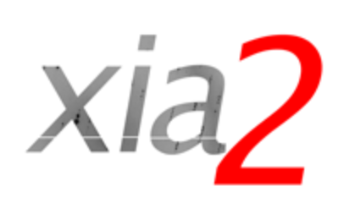

Multi-dataset DIALS / xia2.multiplex
Dr Amy Thompson
PDRA – VMXi Beamline – Diamond Light Source

Slide 2
Processing Multi-Crystal Data with xia2.Multiplex
Integrated data
Integrated data
Auto-processing Pipeline
Integrated data
Unit cell clustering
dials.cluster_unit_cell
Diffraction Images
Laue group analysis
dials.cosym
DIALS Pipelines
Unit cell refinement
dials.two_theta_refine
Identify Key Clusters
dials.correlation_matrix
Scaling
dials.scale
Integrated dataset
Isomorphism Analysis
dials.cosym
Resolution Analysis
dials.estimate_resolution
xia2.multiplex
Clustering Analysis
dials.correlation_matrix
Space group analysis
dials.symmetry
ΔCC½ filtering
dials.scale
Resolution Analysis
dials.estimate_resolution
Merged multi-crystal .mtz
Integrated data
Integrated data
scaled.mtz
filtered.mtz

Slide 3
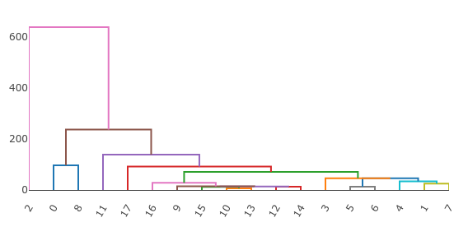
Clustering Methods to Achieve Isomorphous Data
Achieving isomorphous data from multi-crystal collections is critical, although differences can still exist within structurally isomorphous crystals (ligand binding, alternative confirmations, etc).
First requires a known and consistent symmetry (methods from Brehm and Diederichs)
Unit Cell Clustering
Intensity-based Clustering
Good to detect structural non-isomorphism
Clusters on unit cell dimensions
Good to detect differences in structurally isomorphous datasets
Clusters on pair-wise correlation coefficients
Dendrogram Representation
Height (proportional to difference)
Dataset Number
Brehm, W., Diederichs (2014). Acta. Cryst., D70, 101-109.

Slide 4
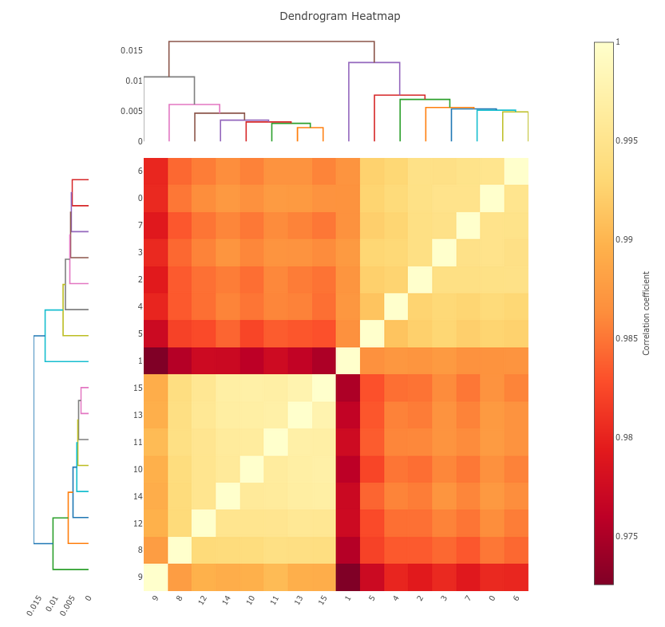
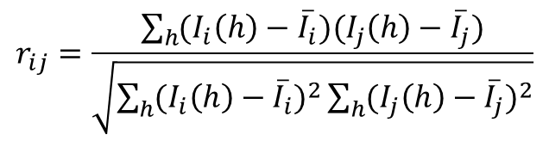
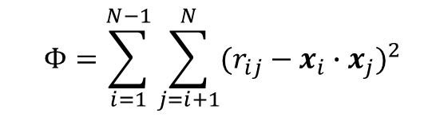
Hierarchical Clustering in xia2.multiplex
After consistent symmetry determination, there are three types of clustering available:
Unit Cell Clustering
Correlation Clustering (intensity-based)
Cosine Angle Clustering (intensity-based)
Correlation Clustering
Cosine Angle Clustering
Comparison of pairwise correlation coefficients
Does not distinguish types of error resulting in differences in intensities
Extension of correlation clustering
Separates systematic and random error
Same methods as indexing ambiguity resolution (dials.cosym)
$$r_{ij}=\frac{\sum_{h}{(I_{i}\left(h\right)−{\overline{I}}_{i})(I_{j}\left(h\right)−{\overline{I}}_{j})}}{\sqrt{\sum_{h}{(I_{i}\left(h\right)−{\overline{I}}_{i})^{2}\sum_{h}{(I_{j}\left(h\right)−{\overline{I}}_{j})^{2}}}}}$$
$$Φ=\sum_{i=1}^{N−1}{\sum_{j=i+1}^{N}{(r_{ij}−x_{i}∙x_{j})^{2}}}$$
Diederichs, K. (2017). Acta. Cryst., D73, 286-293.
Gildea, R. J. (2022). Acta. Cryst., D78, 752-769.
Gildea, R. J., Winter, G. (2018). Acta. Cryst., D74, 405-410.

Slide 5
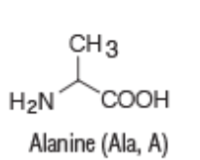
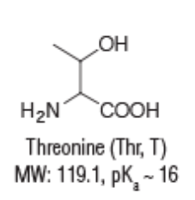
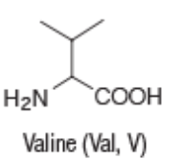
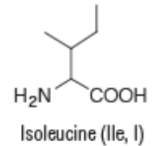

Introducing a Test Case… Cows, Pigs and People
Human insulin, porcine insulin and bovine insulin differ subtly in their amino acid sequences and readily grow high-quality, cubic, isomorphous crystals
 | Cows | Pigs | People
Chain A Residue 8
Chain A Residue 10
Chain B Residue 30 (terminus)
Thompson, A. J. et al. (2025) Acta Cryst. D81, 278-290.

Slide 6
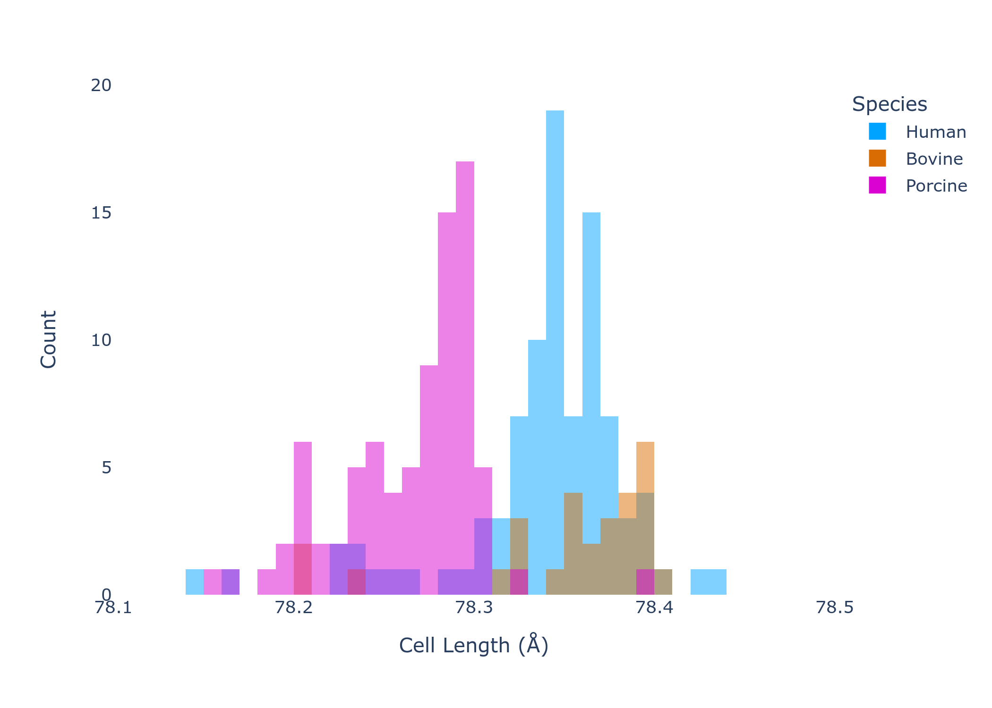
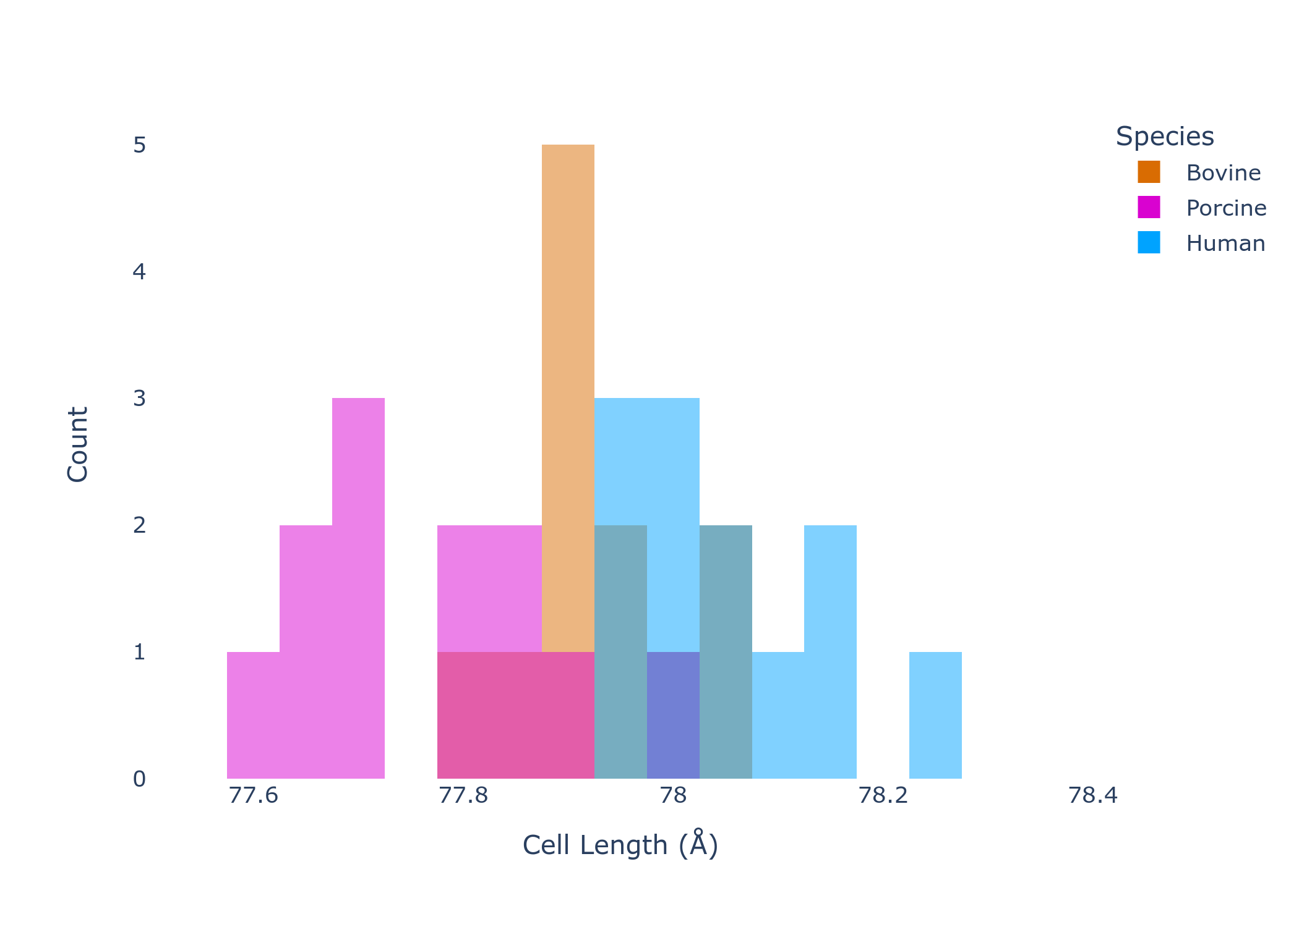
Introducing a Test Case… Cows, Pigs and People
Isomorphous nature of these samples evident at both cryogenic and room temperature
While subtle differences in unit cell are evident, natural spread across many crystals provides overlap, making them impossible to distinguish with unit cell-based clustering
100 K
293 K
Thompson, A. J. et al. (2025) Acta Cryst. D81, 278-290.

Slide 7
Can We Separate Cows, Pigs and People Using Clustering?
GITHUB LINK HERE

