Slide 1



Demystifying Azure AD, JWTs & OIDC
Graeme Foster
Apps & Innovation Technical Specialist
@ Microsoft

Slide 2
Aims for this session
Show tools and techniques to diagnose common problems with OIDC, AAD and MSAL
Show the moving parts involved in the PKCE flow
Break down JWT’s and relate their components to real world authentication and authorisation
Dig into Scopes, Groups and Roles

Slide 3


Christmas in July is coming…

Slide 4
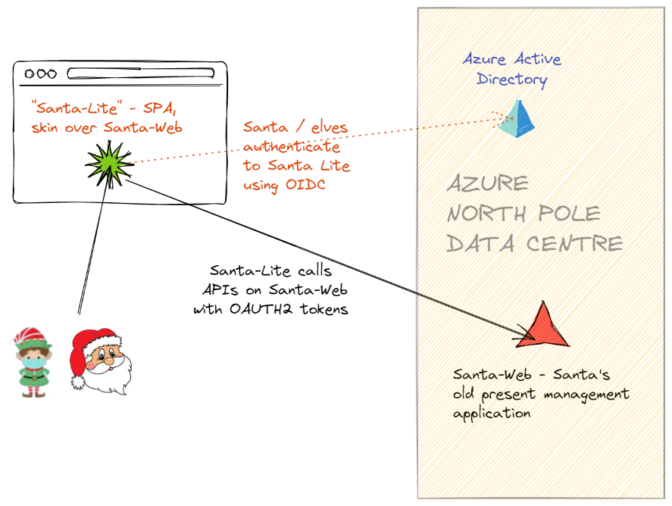
SantaWeb “Christmas Done right”

Slide 5
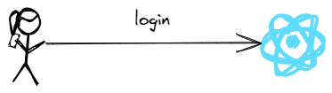
Sign In Flows
https://santalite.localtest.me

Slide 6
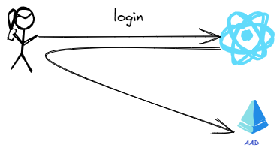
Sign In Flows
302
https://login.microsoftonline.com/.../authorize?
‘which application this is’ ‘what the application wants to do’
‘where to redirect to after the sign-in flow’ ‘security information’

Slide 7
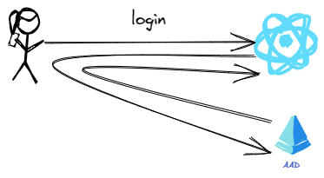
Sign In Flows (Implicit)
200 / 302
https://santalite.localtest.me/#id_token=ey........

Slide 8
Sign In Flows (PKCE)
200 / 302
https://santalite.localtest.me/#code=sdkjfhkjsdf

Slide 9
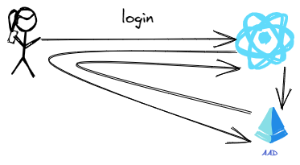
Sign In Flows (PKCE)
POST https://login.microsoftonline.com/.../token
Request includes
plaintext and
Code to get secret

Slide 10
JWTs (Json Web Tokens)
Base 64 encoded self-contained security tokens
Consist of three parts
Information about the signing key
A signature
The payload – assertions about the subject of the token.
Clients fetch the Authorisation server’s public keys ahead of time
If the audience isn’t ‘you’ then the token is for someone else
Microsoft Graph tokens are a good example as they don’t validate using normal methods

Slide 11
OIDC / PKCE
Use MSAL over ADAL unless you have no option
OIDC redirect URI must match between Client and IdP
Open redirects caused a security issue
PKCE is recommended for traditional web servers as-well as mobile / SPA clients
The Implicit flow revealed tokens in front-channel flows (# tags, query-strings)
PKCE binds the token request to the token retrieval using a 1-time passcode

Slide 12
Redirect mismatch
Redirect must be the same in 2 places, Client Application and AAD (IdP)
Self explanatory error when it’s wrong.
Fiddler / Browser Network trace will show redirect passed to AAD
AAD Configuration page shows expected redirects

Slide 13
Audience mismatch
Must be the same in 3 places, SPA, AAD and API
Microsoft.Identity.Web assumes an Audience based on version of token, unless given one
Diagnosed through fiddler trace / or diagnostics of Web App
Confirmed by looking at tokens in JWT.ms

Slide 14
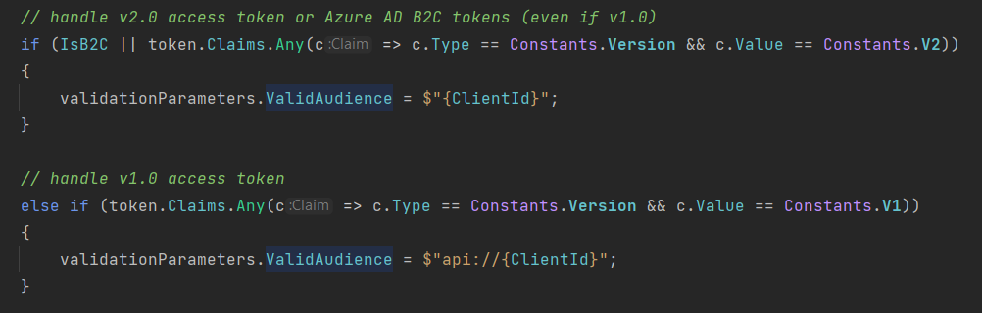
Microsoft.Web.Identity
https://github.com/AzureAD/microsoft-identity-web/blob/bb1b65fb4e3cc40080e2a61ed6554bef31767983/src/Microsoft.Identity.Web/Resource/RegisterValidAudience.cs#L70

Slide 15
Scopes
Scopes are fully qualified with the Application’s Uri
A token can only contain scopes from 1 API - the aud claim
In AAD a client can ask the end user to consent to any Scope defined on your API
Scopes are permissions for your client applications. Not your users

Slide 16
Groups and Roles
Groups are tenant wide. Azure AD limits the number returned in a token
Roles are bound to Applications.
They only appear in tokens whose Audience is that Application
Roles don’t work with users in nested groups.
Roles are not a replacement for fine grained business authorisation

Slide 17
Enterprise Applications / Service Principals / Managed Applications
An AAD “Application” describes your application
A Service Principal is a manifestation of an application in a tenant
User / group assignment and conditional access are defined against the Service Principal
In a directory a single service principal represents an application
A multi-tenant application can have service principals in many tenants (e.g. SaaS)

Slide 18
Resources
https://docs.microsoft.com/en-us/azure/active-directory/develop/v2-oauth2-auth-code-flow
https://nicolgit.github.io/AzureAD-Endopoint-V1-vs-V2-comparison/
https://brockallen.com/2019/01/03/the-state-of-the-implicit-flow-in-oauth2/
https://docs.microsoft.com/en-us/azure/active-directory/develop/msal-migration
https://docs.microsoft.com/en-us/azure/active-directory/develop/howto-add-app-roles-in-azure-ad-apps

