Slide 1
Persisting objects & their relationships
  With the TechInsite Object Persistence Framework

Slide 2
Tutorial Topics
  The need for an OPF
  What an OPF application can look like
  What is the tiOPF
  Design specification of an OPF
  Steps to building your first tiOPF application
  tiOPF internal architecture

Slide 3
The need for an OPF
Say you must write a client management database to store client names, address and phone numbers. The SQL Create statement statement might start out like this…

Slide 4
Create the client table
Create table client (
OID varchar( 36 )
,name_title varchar( 10 )
,given_name varchar( 160 )
,family_name varchar( 160 )
,adrs_lines varchar( 200 )
,locality varchar( 120 )
,state varchar( 3 )
,post_code varchar( 4 )
,phone_number varchar( 10 )
) ;

Slide 5
Extend the client schema
But then you may want to extend the client schema:
  Add alternative phone numbers:
  Home; work;
  fax; mobile.
  Add E-Addresses
  Email; Web; SMS,
  Add alternative regular addresses:
  Home; Work; Postal; Delivery.
  A customer may be a person, or a company 

Slide 6
More versatile client classes
TEAdrs
AdrsType
AdrsText
TAdrs
AdrsType
AdrsText
Locality
TLocality
LocalityName
State
PostCode
TClientAbs
Client_ID
TClientCompany
CompanyName
ACN
ABN
TClientPerson
NameTitle
GivenName
FamilyName
DateOfBirth
Sex

Slide 7
So the client schema may have these tables
Client
Client_Company
Client_Person
Adrs
EAdrs
Locality
Adrs_Type
EAdrs_Type
(And perhaps some mapping tables if companies and people can share the same addresses, or people can work for multiple companies.)

Slide 8
Tutorial Topics
  The need for an OPF
  What an OPF application can look like
  (tiDBProxyServer.exe) (Demo_AdrsBook_SideBar.exe)
  What is the tiOPF
  Design specification of an OPF
  Steps to building your first tiOPF application
  tiOPF internal architecture

Slide 9
Tutorial Topics
  The need for an OPF
  What an OPF application can look like
  What is the tiOPF
  Design specification of an OPF
  Steps to building your first tiOPF application
  tiOPF internal architecture

Slide 10
What is the tiOPF?
  A free, open source Object Persistence Framework
  (Released under MPL)
  Family of classes to build a business object model
  Auto OO-DB map framework to simplify persistence of data
  Classes to let you write custom SQL for optimised database access, or when persisting objects to a legacy database

Slide 11
What is the tiOPF?
  Persistence layers for IBX, IBO, BDE-Paradox, ADO-Access, ADO-SQLServer, DOA, XML, CSV, TAB, DBExpress, NexusDB, HTTP-XML Remote, or write your own (and it’s really not that hard)
  TPersistent aware GUI controls – for building UIs, or write your own
  Daily builds (with FinalBuilder) under D5, D6 & D7
  902 DUnit tests run for each Delphi version each night.

Slide 12
What is the tiOPF?
  About 500 download copies of source per month
  Mailing list of 220
  Source code repository (TeamCoherence) – 10 have write access
  Total of about 35 have contributed to the source
  Users mostly in Australia, UK, Germany, Russia & Brazil

Slide 13
Applications build with the tiOPF
  NEMMCO – Data warehouse (30 concurrent users, Oracle DB of about 50Gb) (PH)
  Victorian Dep of Human Services – Distributed over 600 sites with data synchronisation between head office and remote sites using tiOPF’s XML layer (IK)
  Knowledge management system – Norway. 2Gb db. 4 person years. 30 Installed customers.
  Lots more that I don’t know about. See website…

Slide 14
Tutorial Topics
  The need for an OPF
  What an OPF application can look like
  What is the tiOPF
  Design specification of an OPF (OPFSpecifications.ppt)
  Steps to building your first tiOPF application
  tiOPF internal architecture

Slide 15
Tutorial Topics
  The need for an OPF
  What an OPF application can look like
  What is the tiOPF
  Design specification of an OPF
  Steps to building your first tiOPF application
  tiOPF internal architecture

Slide 16
Steps to building your first tiOPF application
  Download & Install the source
  www.techinsite.com.au/tiOPF/ReleaseBuild
  Read the getting started chapter
  www.techinsite.com.au/tiOPF/Doc
  Setup search paths
  Compile packages
  Run unit tests & demo aps

Slide 17
Object persistence demos
  Create an empty database
  Connect to the database
  Create tables
  Insert test data (without the object model)
  Simple collection
  (Auto OO-DB map & hard coded SQL)
  Edit data in a GUI

Slide 18
Object persistence demos
  Collection with a filter
  One to Many
  (Auto OO-DB mapping & hard coded SQL)
  Inheritance
  (Auto OO-DB map & hard coded SQL)
  Ordinal types
  Lookup lists
  One to One

Slide 19
Tutorial Topics
  The need for an OPF
  What an OPF application can look like
  What is the tiOPF
  Design specification of an OPF
  Steps to building your first tiOPF application
  tiOPF internal architecture

Slide 20
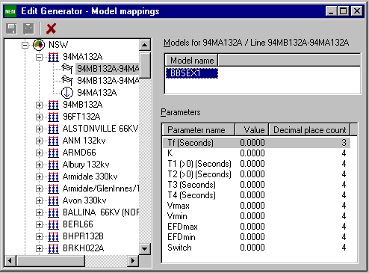
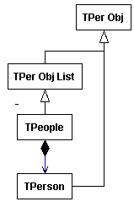
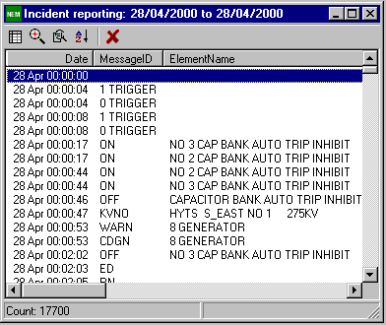
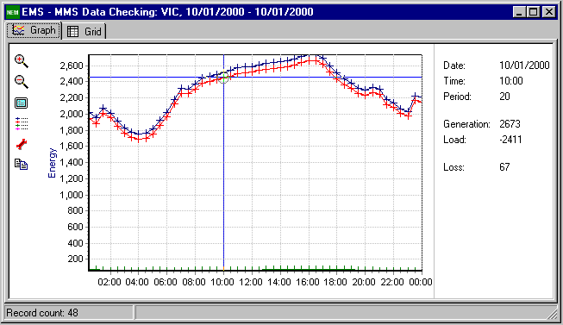
Internal architecture of the tiOPF
Application
Presentation
BOM
PerMgr
Mapps BOM to persistence plugin
PerPlugin
Saves data
to choosen database
Persistent
Store
(Database)

Slide 21
Three tiOPF layers
To achieve this architecture, we require:
  An abstract business object model – GoFs Composite Pattern
  A way of traversing this model – GoFs Visitor Pattern
  A framework for applying persistence to the BOM via the Visitors – GoFs Template Method Pattern. A swappable data access components – GoFs Adaptor & Factory patterns
  Some GUI controls to make building the presentation layer easier

Slide 22
Source code on the web
The source from this presentation, and the latest version of the documentation
can be found at:
www.techinsite.com.au
Peter Hinrichsen
TechInsite Pty Ltd

