Slide 1
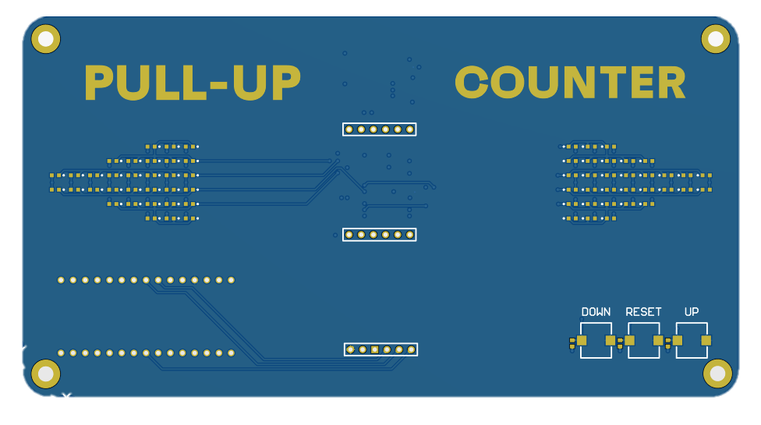
MD3 7-segment display
D1-D32 Success LEDs
D33-D64 Success LEDs
MD2 Proximity sensor
SW1-SW3 Tactile switches R2-R4 Resistors

Slide 2
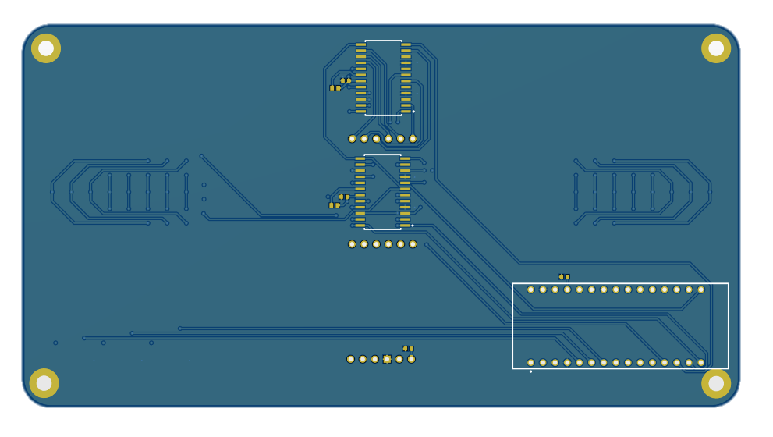
C2
U1
R1
C1
U2
R5
C4
MD1 Arduino Nano
C3

