Slide 1
Radikalstellen

Slide 2
Carbon Centered
rot: relevante Initialradikale
grün: relevante Radikale nach Radikalwanderung

Slide 3
Oxygen Centered
rot: relevante Initialradikale
grün: relevante Radikale nach Radikalwanderung

Slide 5
G-band EPR spectra
X-band EPR spectrum at 298 K
Other radicals?

Slide 6
Ballmill

Slide 7
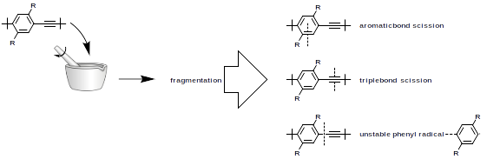

Ballmill – Unlikely Radicals via Mechanical Stress

Slide 8
Low Molecular Weight
Method | M_{p} | M_{n} | M_{w}
Control | 50887 | 22005 | 61405
Mortar | 47509 | 21018 | 57927
Ballmill | 48388 | 21559 | 59286

Slide 10
High Molecular Weight
Method | M_{p} | M_{n} | M_{w}
Control | 106787 | 51367 | 112789
Mortar | 104488 | 48344 | 111766
Ballmill | 79178 | 39666 | 101535

Slide 12
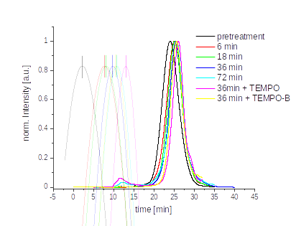
PPE Kugelmühle TEMPO Benzoat
Treatment | Mp | Mw | Mn
Pre-treatment | 106 324 | 163 074 | 47 116
6 min | 61 315 | 106 148 | 18 425
18 min | 58 335 | 83 568 | 19 539
36 min | 49 058 | 75 711 | 20 520
72 min | 44 549 | 76 882 | 19 521
36 min + TEMPO | 35 023 | 45 327 | 23 954
36 min + TEMPO-B | 45 585 | 59 245 | 31 999

Slide 13
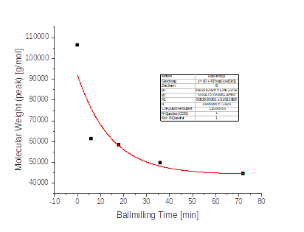

B2
Mp(0) ~ 44 223

Slide 14
Treatment | G-Faktor
Control | 2.003977
6 min | 2.003249
18 min | 2.003086
36 min | 2.003234
72 min | 2.003316

