Slide 1
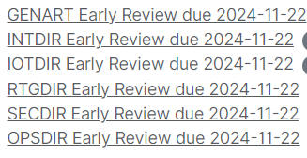
Status of draft-ietf-nmop-terminology
The text is getting more and more stable
The authors indicated that they think the text is close to the WGLC
There are still some very few points on which we expect converging SOON
Text tweaking: Resource/Service
NEW text: Network Observability
More discussion: Agree on the level of incident/anomaly details to include
Adrian made a comprehensive consistency check of the various NMOP documents with proposed actions when deviations were observed
Authors of some of these I-Ds implemented the proposed fixes
Early directorate reviews were requested:

Slide 2
Next Step for draft-ietf-nmop-terminology
Need to find a balance between
A minimal set of core terms use widely across all NMOP documents
A maximal set of terms that might be used in any one NMOP document
A proposal for discussion
Release new versions to address the pending comments and various directorate reviews
Let the document open for two/three months
If no major comment is raised, run a WGLC by end of Jan 2025
NMOP documents can define context-specific terms, if needed
Questions to the WG
Q#1: Do you agree to proceed with the WGLC as suggested in the proposal above?
Q#2: Do you prefer to hold the document and wait for the anomaly/incident I-Ds to be finalized as well, but with the risk to see its publication delayed if the other two I-Ds can’t make the target deadline?

