Slide 1
BMP (BGP Monitoring Protocol) Seamless Session
Optional BMP session lifecycle extension to prevent data duplication of previously exported messages when TCP session is re-established.
thomas.graf@swisscom.com
8. March 2021

Slide 2
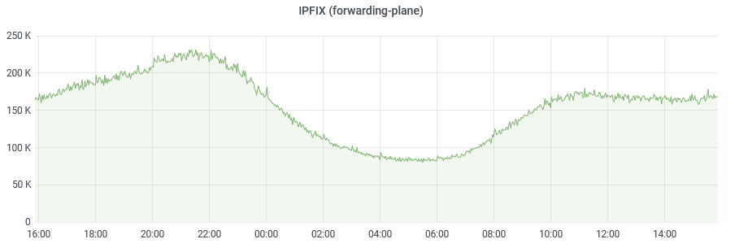
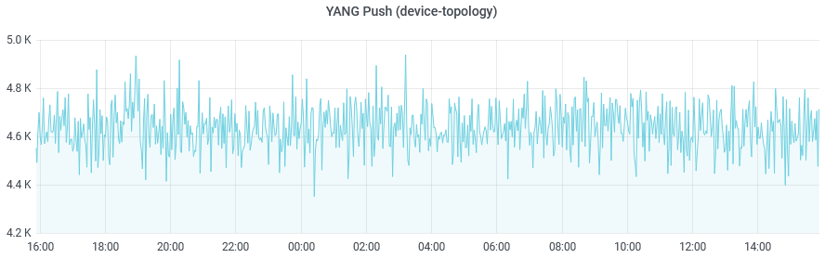
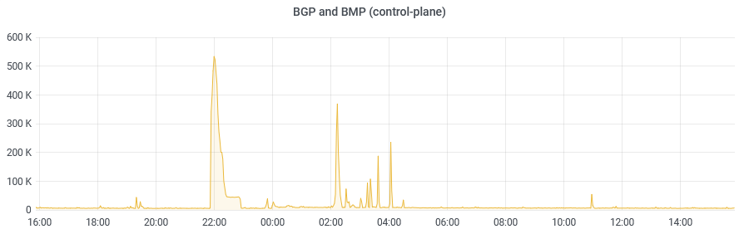
BMP Seamless Session Network Operator Status
By end of 2020, Swisscom collected from 2500 devices up to 1'000'000 Network Telemetry (BMP, IPFIX, YANG Push) messages per second.
By end of 2021, Swisscom forecasts up to 40'000 devices with 10'000'000 messages per second. 38'000 of them with BMP enabled.
BMP Adj-RIB IN is bursty and accounts with 300 devices and 67'000 peers for 600'000 messages per second peak and 8'000 in average.

Slide 3
BMP Seamless Session Why data duplication happens
Data duplication challenges the scalability of BMP with
the increase of BMP route-monitoring messages due to BGP path increase or BMP RIB coverage
the increase of TLV's for peering, RIB and route-policy contexts
Most of the BMP session re-establishment are related to
Brief loss of connectivity between BMP client and server
Maintenance of BMP server

Slide 4
BMP Seamless Session Where it comes from
Section 3.3 of RFC 7854 describes that BMP sessions is established and closed with TCP session.
Section 5.0 of RFC 7854 describes that initial RIB dump is performed with route-monitoring messages every time, regardless if a BMP session is established or re-establish.

Slide 5
BMP Seamless Session How to solve it
TCP Fast Open, RFC 7413, enables a fast re-establishment of a TCP session. Distinguishes between an initial and a re-established TCP session.
BMP session lifecycle is extended with a timeout which delays the closing of the BMP session until TCP is re-established.
BMP client buffers messages between TCP re-establishment.
BMP session is declared terminated when buffer is full, or timeout is reached.

Slide 6
BMP Seamless Session Don't re-invent the wheel
Preserves the key principles of BMP to be an unidirectional collection protocol.
Optional extensions to BMP session lifecycle based on established TCP Fast Open TCP session setup enhancement.
Requires BMP buffer which is described in section 6.0 of RFC 7854 and being used in most BMP implementations.

Slide 7
BMP Seamless Session Draft Status
-00 version.
Awaiting feedback from the GROW mailing list.
Does the draft have merit?
BMP session identifier in an additional TLV in the BMP init message vs. TCP Fast Open.
Inputs for improvement. Comments?
thomas.graf@swisscom.com
8. March 2021

