Slide 1
Getting and parsing JSON
In this exercise we are going to build a simple app that gets a JSON file from the internet, parses it and then displays it.

Slide 2
Parsing JSON
Create a single page app and name it JSON Example
Also since we are going to be getting data from the web we need to add the permission like we did for the web browser app. In your info.plist

Slide 3

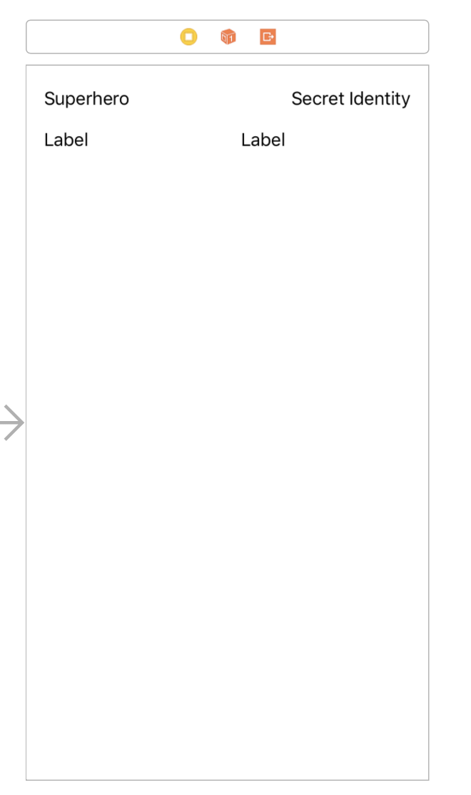
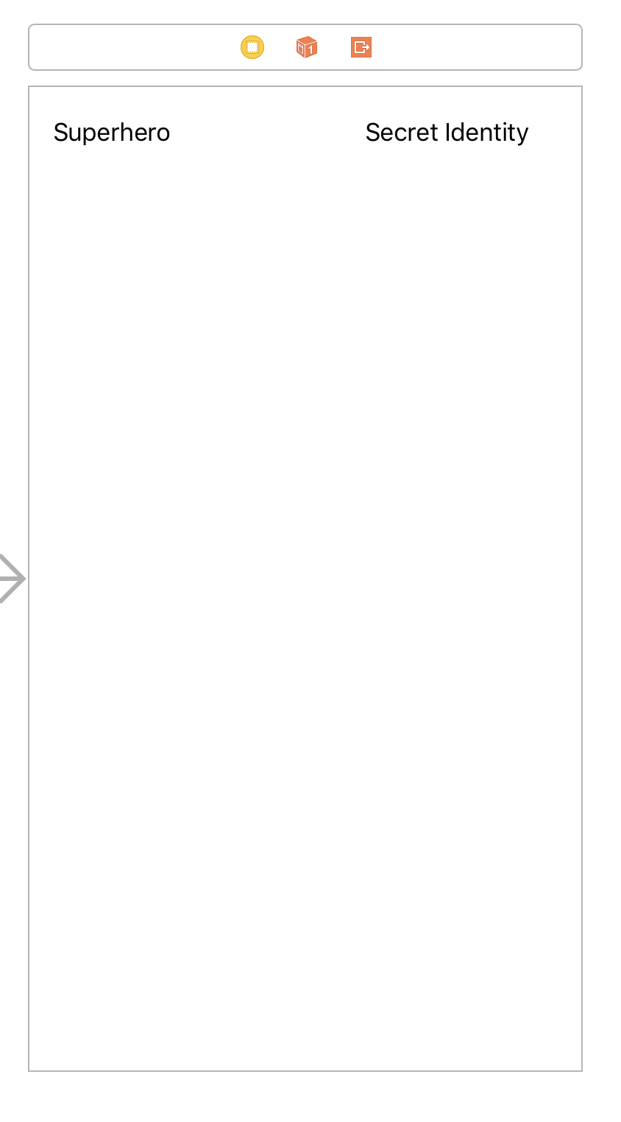
Making the UI
For this app we are going to use 4 labels. Two are going to hold the data we will be getting and two will be headings. Make the UI so it looks like so. One of the label’s text should read “Superhero” and another that reads “Secret Identity” and then add the other two labels below these. Don’t forget to add constraints to make it so the labels look good no matter the screen size or orientation. This is what mine looks like, but feel free to make it how you like. Also clear out the text for the other two labels so they are blank.

Slide 4
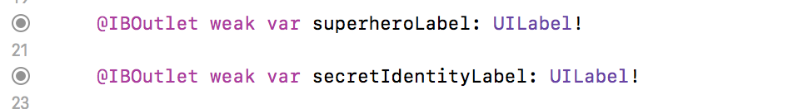
Create the references to two of the labels
Next, we are going to add the reference in the ViewController.swift file for the two labels we will be working with (we don’t need to create references for the heading labels since we do not need to do anything to them through the code)

Slide 5
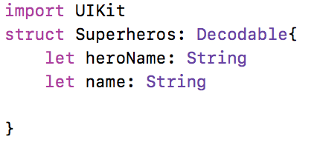
Creating a Struct
We will create a structure to hold the data. Right under the import UIKit add the following code:
This creates a data structure for us to put the decoded JSON data into. We need to specify that it is a decodable structure by using “Decodable”. The next step is to create a variable to store the URL. Within your viewController class add the following variable: let jsonDataURL = "http://patrickhill.nyc/justiceleague.json"
We also need to create an array called superheroArray like so. var superheroArray = [Superheros]()
We are stating that this array is going to store our Superheros structure.

Slide 6
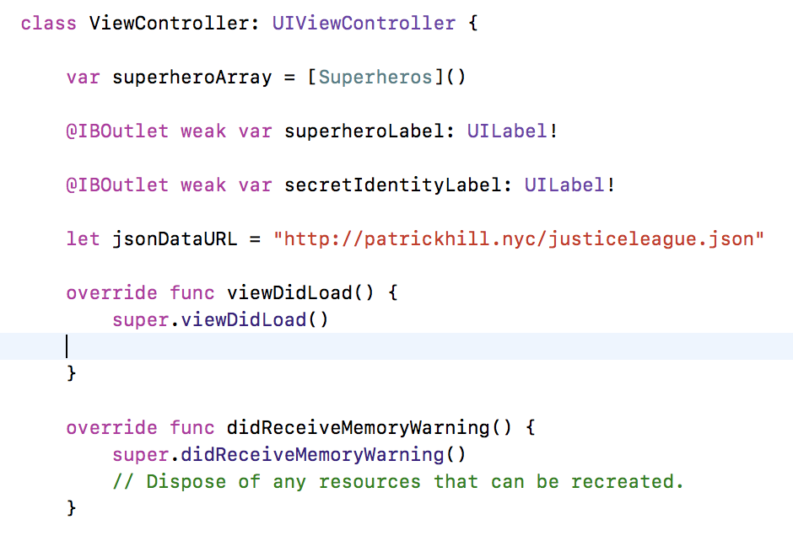
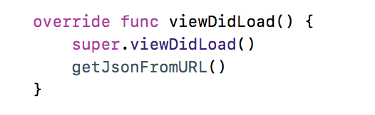
Now the beginning of your code should look like this:
In the viewDIdLoad function we are going to call a function getJsonFromURL()

Slide 7
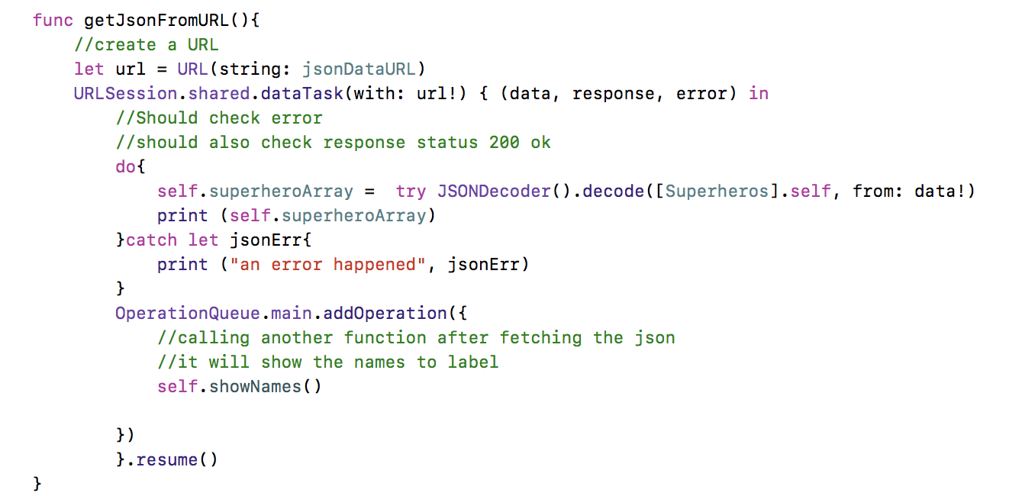
getjsonfromurl
This method is going to download the JSON data, decode it and then adds it to an array. We will use a URLSession as well as JSONDecoder. This is what the code should look like.
We create a url variable and set it to the jsonDataURL we set up earlier,
Then we create a URLSession and then get the data
Then we populate the superheroArray with the decoded JSON data. When we use JSONDecoder().decode we pass in the structure [Superheros].self. The brackets mean it will be an array of superheroes
Finally we use OperationQueue to call a function that should be called after the data is done processing. In this case self.showNames()

Slide 8
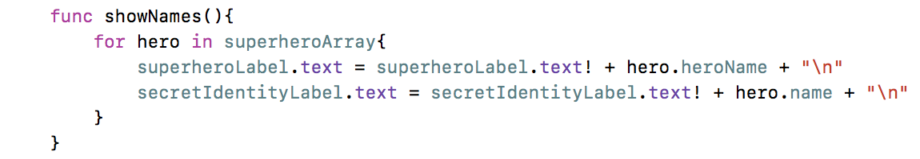
Displaying the JSON
Now we will create the showNames function. This function will just loop through the superheroArray and concatenate the labels text we will set one label to be the superhero name and the other to be the secret identity name

Slide 9

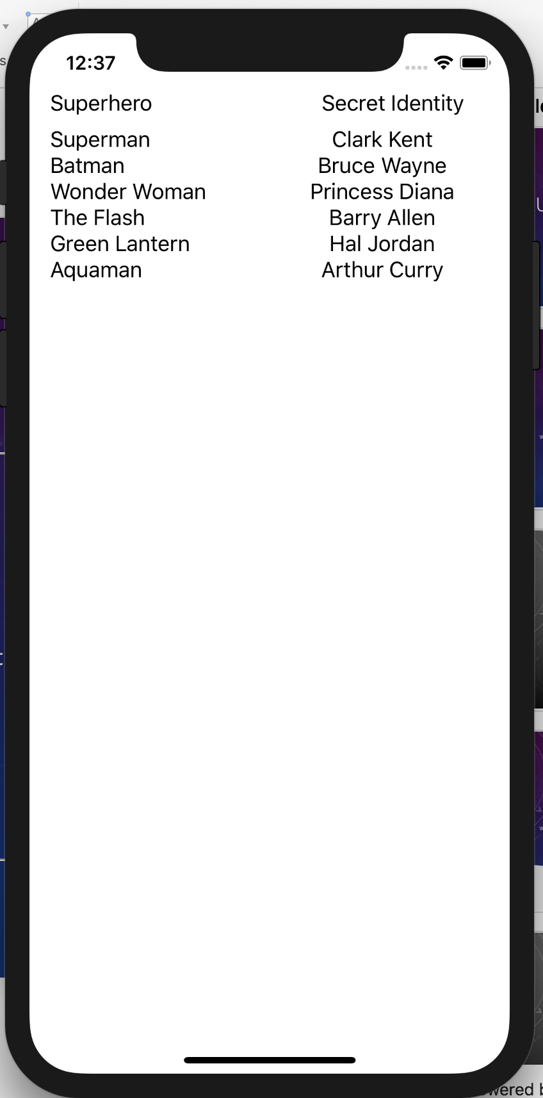
Running the app
When we run the app we can see a list of our superheroes and their secret identities

Slide 10
CHALLENGE
Now that we have seen how to get JSON from a server, decode it, add it to an array and display it we will use this knowledge to create a little trivia game. Using the same json file, and method to decode it. Write an app that has a two labels, a textfield, and a button. One label should ask “What is [superhero’s heroName from array] secret identity?” and the user will type the secret identity into the textfield. When they tap the button the 2nd label will display if they got it correct “You got it correct!” if they did not get it correct then that 2nd label should display “Sorry, [superhero’s name from array] secret identity is: [superhero’s name from array]

