Slide 1
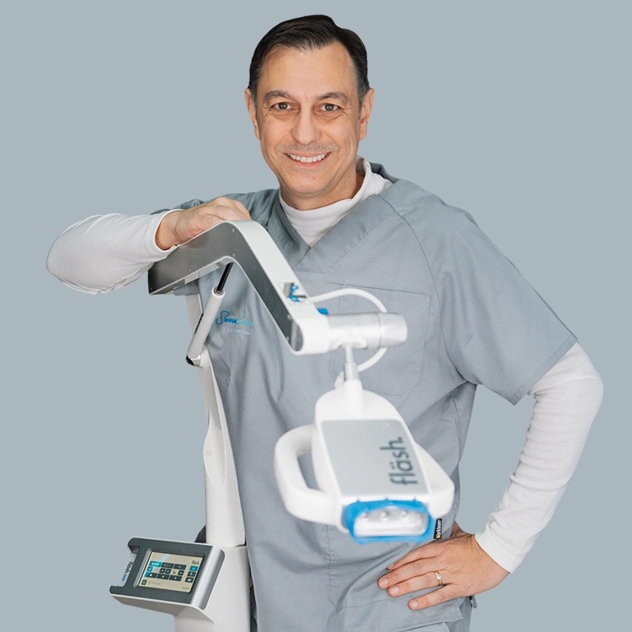
In-Office Whitening Workflow
02
Online Training · Episode 02
Step-by-Step Protocol + Common Mistakes
Dr. Germán Gómez
DDS · MD · PhD (University of Tübingen) · Esthetic Dentistry & Implantology, Spain
500+ lectures · 43 countries
Notes:
PROFESSIONAL TOOTH WHITENING · MADE IN GERMANY
ONLINE TRAINING SERIES — EPISODE 2
In-Office Whitening Workflow (SOP)
Step-by-Step Protocol + Common Mistakes
Dr. Germán Gómez
DDS · MD · PhD (University of Tübingen, Germany)
Esthetic Dentistry & Implantology · Spain | 500+ lectures · 43 countries

Slide 2
02
Hook
“My friend had her whitening done here — hers looks incredible. Will mine?”
1
2
3
The hard truth
The fläsh answer
4
Same gel, same lamp — two clinics, visibly different results. The chemistry never changes between offices. The workflow does.
If the outcome depends on who happens to be working that day, you have a whitening lottery. A strict, standardized protocol ends the lottery.
5
IN-OFFICE WHITENING WORKFLOW · 2
Notes:
HOOK
“My friend had her whitening done here — hers looks incredible. Will mine?”
THE HARD TRUTH
Same gel, same lamp — two clinics, visibly different results. The chemistry never changes between offices. The workflow does.
THE fläsh ANSWER
If the outcome depends on who happens to be working that day, you have a whitening lottery. A strict, standardized protocol ends the lottery.

Slide 3
A Protocol, Not a Performance
02
Principle · The big idea
1
01 A closed system.
  The 32% gel, Highpower LED lamp and fläshcard guidance work as one unit.
02 One standard.
  Same steps, same order, every patient — whoever is working today.
03 Happy patients, every time.
  An engineering claim, not a slogan — once the human steps are standardized.
04 Effortless for the clinical team.
  The lamp carries the physics, the card the clock — your team the patient.
2
3
4
5
IN-OFFICE WHITENING WORKFLOW · 3
Notes:
PRINCIPLE · THE BIG IDEA
A Protocol, Not a Performance
Predictable outcomes are engineered — a closed system executed identically, every time.
A closed system. The 32% gel, the Highpower LED lamp and the fläshcard guidance are built to function as one unit.
One standard. Same steps, same order, every patient — the outcome stops depending on who is working today.
Happy patients, every time. An engineering claim, not a slogan — delivered when the human steps are as standardized as the system.
Effortless for the clinical team. The lamp carries the physics, the card carries the clock — your team carries the patient.

Slide 4
02
Principle · The big idea
30
1
2
3
years of German-made whitening expertise
4
5
Gel, lamp and fläshcard engineered as one closed system · WHITEsmile
IN-OFFICE WHITENING WORKFLOW · 4
Notes:
30
years of German-made whitening expertise — gel, lamp and fläshcard engineered as one closed system · WHITEsmile

Slide 5
The Five-Phase SOP
02
Principle · The method
1
1
Document
2
Protect
3
Apply
2
Clean first, baseline shade in value order, standardized photos.
Vitamin E or vaseline, correct retractor, goggles, cured barrier.
A minimum 1 mm of green 32% gel on every facial surface.
3
4
4
Activate & monitor
5
Seal & instruct
Lamp locked on the retractor, fläshcard cycles, comfort checkpoints.
After Whitening Mousse, final documentation, the aftercare rules.
5
IN-OFFICE WHITENING WORKFLOW · 5
Notes:
PRINCIPLE · THE METHOD
The Five-Phase SOP
Every burn, every uneven result, every call-back lives inside one of these five phases.
Document. Clean first, baseline shade in value order, standardized photos.
Protect. Vitamin E or vaseline, correct retractor, goggles, cured barrier.
Apply. A minimum 1 mm of green 32% gel on every facial surface.
Activate & monitor. Lamp locked on the retractor, fläshcard cycles, comfort checkpoints.
Seal & instruct. After Whitening Mousse, final documentation, the aftercare rules.
5 phases in the chairside SOP — same steps, same order, for every single fläsh patient
PRACTICAL STEPS · The Five Phases, Chairside: Document · Protect · Apply · Activate & Monitor · Seal & Instruct

Slide 6
Document
1
02
1
Phase 1 of 5
2
3
4
Whitening never begins on an uncleaned tooth.
5
Notes:
PHASE 1 · DOCUMENT
Whitening never begins on an uncleaned tooth.

Slide 7
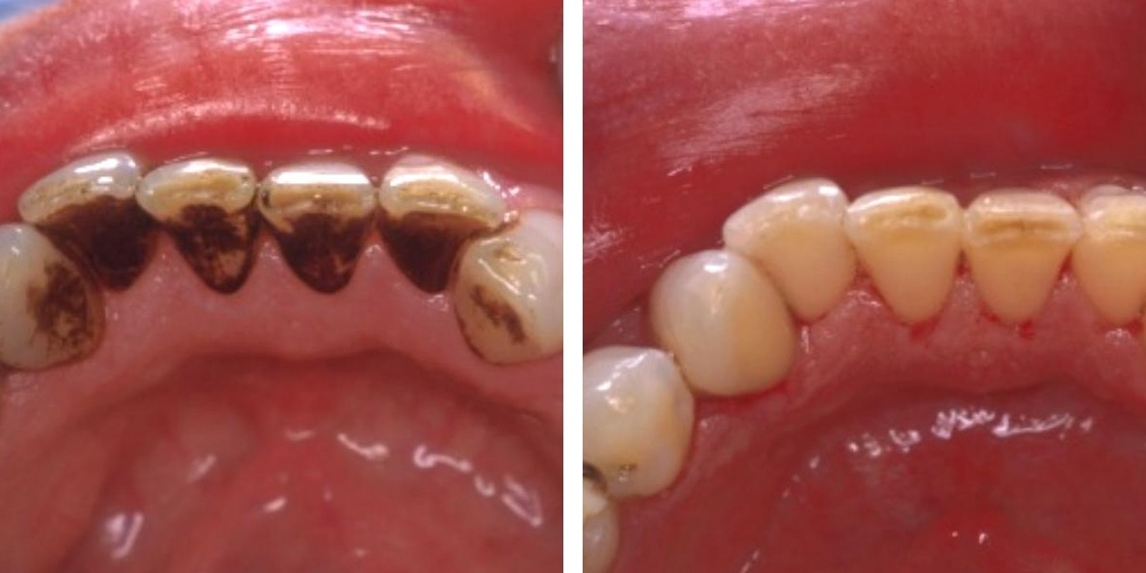
Clean Before You Whiten
02
Phase 1 · Document
1
01 Prophylaxis first.
  Always — plaque, calculus and stain removed before any chemistry.
02 Cleaning can be enough.
  If polishing delivers the wanted shade, say so — nothing builds trust faster.
03 Clean enamel, even contact.
  Your first defense against the uneven result in our mini case.
2
3
4
5
Professional prophylaxis — before and after
IN-OFFICE WHITENING WORKFLOW · 7
Notes:
PHASE 1 · DOCUMENT
Clean Before You Whiten
Whitening never begins on an uncleaned tooth.
Prophylaxis first. Always — plaque, calculus and surface stain removed mechanically, before any chemistry.
Cleaning can be enough. If polishing delivers the shade the patient wanted, say so — nothing builds trust faster.
Whitening is not polishing. The gel works deeper in the tooth, by oxidation of chromogens.
Clean enamel, even contact. Your first defense against the uneven result in our mini case.
Image: Professional prophylaxis — before and after

Slide 8
The Value-Ordered Baseline
02
Phase 1 · Document
1
B1
A1
B2
D2
A2
C1
C2
D4
A3
D3
B3
A3.5
B4
C3
A4
C4
2
3
Value-ordered shade guide · lightest to darkest
01 Determine it together.
  Daylight, teeth still hydrated, the tab in the patient’s own hand.
02 Enter it into the lamp.
  After treatment it reports the shades gained — a number, not an opinion.
4
5
Evidence
Joiner A., J Dent 2004
IN-OFFICE WHITENING WORKFLOW · 8
Notes:
PHASE 1 · DOCUMENT
The Value-Ordered Baseline
The patient must see that whiter teeth than their own exist.
Determine it together. Daylight, teeth still hydrated, the tab in the patient’s own hand.
Enter it into the lamp. After treatment the fläsh lamp displays the shades gained — VITA classical and Bleached Guide.
A number, not an opinion. The system reports the improvement — you never have to defend it.
VALUE-ORDERED SHADE GUIDE · lightest → darkest: B1 A1 B2 D2 A2 C1 C2 D4 A3 D3 B3 A3.5 B4 C3 A4 C4
Enter the baseline shade into the fläsh lamp — it counts the shades gained. Evidence: Joiner A. J Dent 2004.

Slide 9
Photograph Like a Scientist
02
Phase 1 · Document
1
01 The identical setup.
  Same camera, distance, angle and neutral light.
02 Motivation.
  Objective progress, session after session.
03 Ethical marketing.
  Consistent pairs, always with written consent.
04 Protection.
  If an outcome is disputed, your records speak.
Clinical focus
2
Consistency is credibility.
Identical setup, before and after.
3
4
5
IN-OFFICE WHITENING WORKFLOW · 9
Notes:
PHASE 1 · DOCUMENT
Photograph Like a Scientist
Thirty seconds of photography protects hours of clinical work.
The identical setup. Same camera, same distance and angle, same neutral light — shade tab at the incisal edge.
Motivation. The patient sees objective progress, session after session.
Ethical marketing. Consistent before-and-after pairs, always with written consent.
Protection. If an outcome is ever disputed, your records speak. (Deep dive: Episode 10.)
CLINICAL FOCUS: Consistency is credibility — identical setup, before and after.

Slide 10
Protect
2
02
1
Phase 2 of 5
2
3
4
Where every complication is born — and prevented.
5
Notes:
PHASE 2 · PROTECT
Where every complication is born — and prevented.

Slide 11
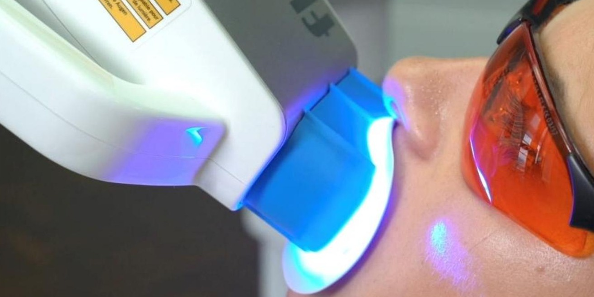
Soft Tissue First
02
Phase 2 · Protect
1
01 Vitamin E or vaseline on the lips.
  Then the fläsh lip retractor, docked onto the lamp head.
02 Filtered eye protection.
  For the patient and for every team member present.
03 Gingiva protector, light-cured.
  Dry gingiva; only slight overlap onto cervical enamel; cure until solid.
2
3
4
5
Lamp docked on the lip retractor · filtered goggles
Evidence
Li & Greenwall, Br Dent J 2013
IN-OFFICE WHITENING WORKFLOW · 11
Notes:
PHASE 2 · PROTECT
Soft Tissue First
Where every complication is born — and prevented.
Vitamin E or vaseline on the lips. Moisten the lips first; then the fläsh lip retractor, docked onto the lamp head — that geometry is the treatment.
Filtered eye protection. For the patient and for every team member present.
Gingiva protector, light-cured. Dry gingiva; slight — only slight — overlap onto cervical enamel; cure until solid.
Image: Lamp docked on the lip retractor · filtered goggles. Li & Greenwall, Br Dent J 2013.

Slide 12
The Seven Sins of Isolation
02
Phase 2 · Protect
1
1
No lip protection — vitamin E or vaseline
Clinical focus
2
2
Wrong retractor for the system
Burns are never caused by the gel.
3
3
No filtered eye protection
Rescue: vitamin E or vaseline onto the gingiva — no panic, protocol.
4
Barrier not properly placed or cured
4
5
Not enough whitening gel (below 1 mm)
5
6
Patient left unattended — no signal agreed
7
Dentin sensitivity not managed
IN-OFFICE WHITENING WORKFLOW · 12
Notes:
PHASE 2 · PROTECT
The Seven Sins of Isolation
Memorize them. Laminate them. Audit yourself against them.
1 No lip protection — vitamin E or vaseline
2 Wrong retractor for the system
3 No filtered eye protection
4 Barrier not properly placed or cured
5 Not enough whitening gel (below 1 mm)
6 Patient left unattended — no signal agreed
7 Dentin sensitivity not managed
CLINICAL FOCUS: Burns are never caused by the gel. Rescue: vitamin E or vaseline onto the gingiva — no panic, protocol.

Slide 13
Apply
3
02
1
Phase 3 of 5
2
3
4
The gel is engineered for precision.
5
Notes:
PHASE 3 · APPLY
The gel is engineered for precision — starve it and you starve the result.

Slide 14
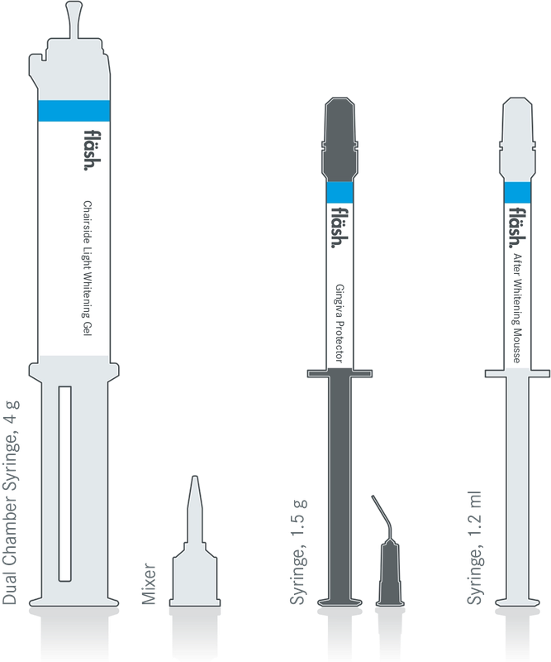
1 mm. Green. Neutral pH.
02
Phase 3 · Apply
1
01 Dual-chamber 32% HP.
  Mixed fresh, full potency until use.
02 Green = precision.
  Every surface visibly covered.
03 Oxidation, not erosion.
  Chromogens oxidised at neutral pH.
04 Minimum 1 mm, everywhere.
  A thin layer leaves a pale patch.
2
3
4
5
The fläsh syringe set: gel, barrier, mousse
IN-OFFICE WHITENING WORKFLOW · 14
Notes:
PHASE 3 · APPLY
1 mm. Green. Neutral pH.
The gel is engineered for precision — starve it and you starve the result.
Dual-chamber 32% HP. Mix fresh — full potency protected until the moment of mixing.
Green = precision. You see every surface covered — the gel turns clear as oxygen releases.
Oxidation, not erosion. Whitens by oxidation of chromogens at a neutral pH — never by corroding the enamel surface.
Minimum 1 mm, everywhere. A thin, starved layer produces a pale patch — Sin #5.
Image (as in the original slide): Chairside Light Whitening Gel (dual-chamber syringe, mixer) · Gingiva Protector · After Whitening Mousse

Slide 15
The Lamp: Position Is Power
02
Phase 3 · Apply
1
01 Lock the geometry.
  Patient at 45°, lamp head locked on the retractor — intensity level IIII.
02 The expensive centimetre.
  One centimetre of gap costs ≈50% of the power.
03 Complementary-colour activation.
  Blue 460 nm light, absorbed by the green gel — no UV, no infrared, below 39 °C.
Light power at the enamel
2
Lamp docked on the retractor
100%
3
1 cm of extra gap
56%
4
1 cm of extra gap ≈ 50% less light power (3² = 9 vs 4² = 16)
5
Evidence
Ontiveros & Paravina, J Dent 2009
IN-OFFICE WHITENING WORKFLOW · 15
Notes:
PHASE 3 · APPLY
The Lamp: Position Is Power
Light intensity falls with the square of distance — respect the physics.
Lock the geometry. Patient at 45°; lamp head easy-locked onto the fläsh retractor — confirm intensity level IIII.
The expensive centimetre. One centimetre of gap costs ≈50% of the power (3² = 9 → 4² = 16).
Complementary-colour activation. Blue 460 nm light is absorbed by the green gel — a photochemical effect, not heat.
Up to 30% lighter, safely. No UV, no infrared, below 39 °C — the light drives the chemistry, it never warms the tooth.
1 cm of extra gap ≈ 50% less light power. Ontiveros & Paravina, J Dent 2009.

Slide 16
Activate & Monitor
4
02
1
Phase 4 of 5
2
3
4
5
Insert the card — let the system lead your assistant.
Notes:
PHASE 4 · ACTIVATE & MONITOR
Insert the card — and let the system lead your assistant, step by step.

Slide 17
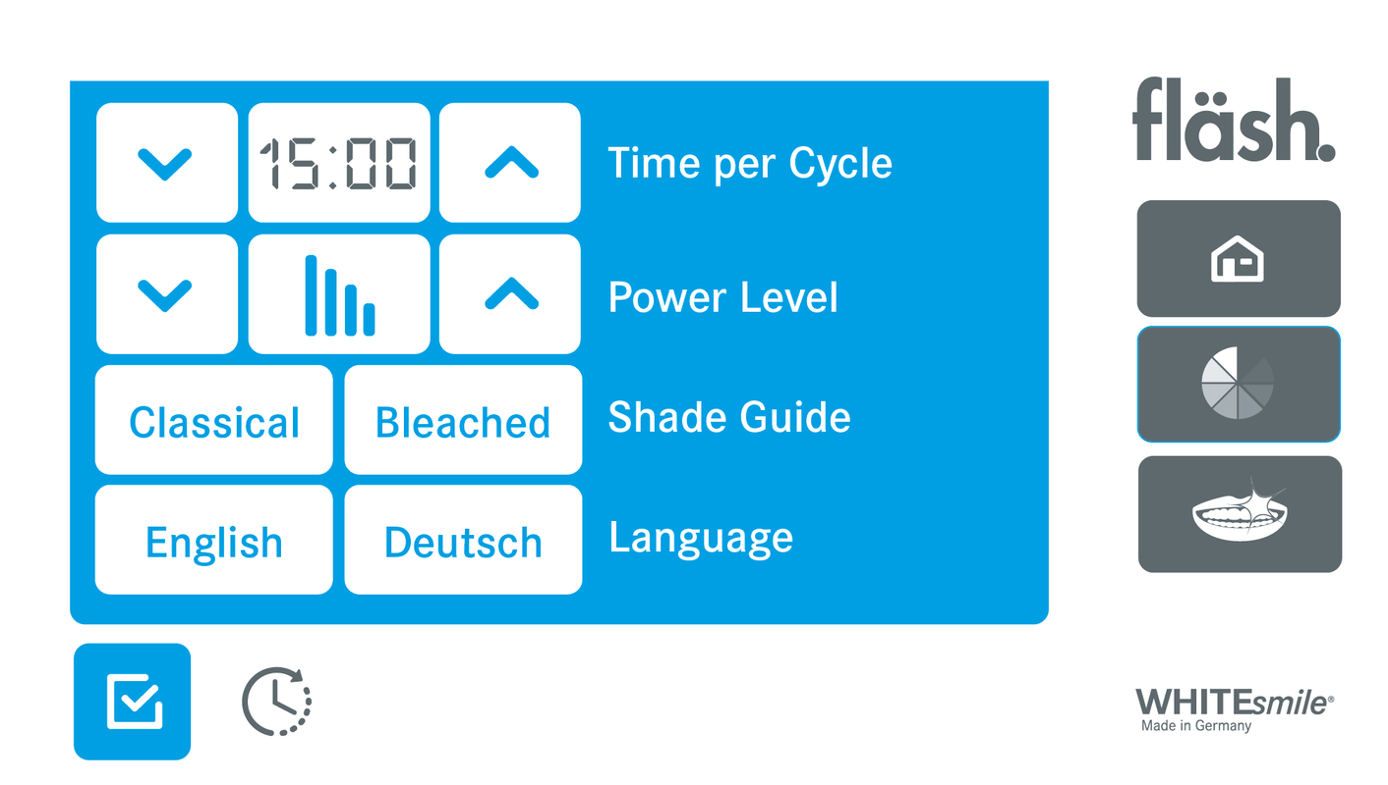
The fläshcard Discipline
02
Phase 4 · Activate & Monitor
1
01 3–4 cycles × 15 minutes.
  The cycle length is not a negotiable estimate — it is the protocol.
02 Fresh gel between cycles.
  Suction off the spent gel — never let the patient rinse.
03 Closed, but flexible.
  Every remaining minute is banked by the card — the hero of our mini case.
2
3
4
5
The touchscreen guides each cycle
IN-OFFICE WHITENING WORKFLOW · 17
Notes:
PHASE 4 · ACTIVATE & MONITOR
The fläshcard Discipline
Insert the card — and let the system lead your assistant, step by step.
3–4 cycles × 15 minutes. The cycle length is not a negotiable estimate — it is the protocol.
Fresh gel between cycles. Suction off the spent gel — never let the patient rinse.
The touchscreen leads. Step-by-step guidance for your assistant, cycle by cycle.
Closed, but flexible. Every remaining minute is banked by the card — those saved minutes become the hero of our mini case.
Image: The fläsh lamp touchscreen guides each cycle — timer, modes, power, guided treatment.

Slide 18
Comfort Checkpoints
02
Phase 4 · Activate & Monitor
1
01 Agreed hand signal.
  Established before the first cycle begins.
02 Verbal check.
  At every gel change — ask, don’t assume.
03 Pulse mode.
  Cycles 2–3, at the first sign of sensitivity.
04 Never unattended — Sin #6.
  Your assistant manages the human being.
Clinical focus
2
“Effortless for the clinical team”
3
The system carries the clock and the physics.
4
5
IN-OFFICE WHITENING WORKFLOW · 18
Notes:
PHASE 4 · ACTIVATE & MONITOR
Comfort Checkpoints
A premium experience is monitored — never endured.
Agreed hand signal. Established before the first cycle begins.
Verbal check. At every gel change — ask, don’t assume.
Pulse mode. Cycles 2–3, at the first sign of sensitivity — the dedicated setting exists for this.
Never unattended — Sin #6. The lamp manages the physics; your assistant manages the human being.
CLINICAL FOCUS: “Effortless for the clinical team” — the system carries the clock and the physics.

Slide 19
Seal & Instruct
5
02
1
Phase 5 of 5
2
3
4
5
The last ten minutes decide how the first sixty are remembered.
Notes:
PHASE 5 · SEAL & INSTRUCT
The last ten minutes decide how the first sixty are remembered.

Slide 20
Finish Without Undoing It
02
Phase 5 · Seal & Instruct
1
01 No rinsing between cycles.
  Rinsing destroys isolation — suction only.
02 Gel off, barrier last.
  Protect the tissue until the chemistry is gone.
03 After Whitening Mousse.
  Soothes and remineralizes the treated surface.
04 Final shade & after photos.
  Value-ordered guide, shades gained, identical setup.
Clinical focus
2
This is the moment
the mirror does your marketing.
3
4
5
IN-OFFICE WHITENING WORKFLOW · 20
Notes:
PHASE 5 · SEAL & INSTRUCT
Finish Without Undoing It
The last ten minutes decide how the first sixty are remembered.
No rinsing between cycles. Rinsing destroys isolation — suction only.
Gel off, barrier last. Remove all gel completely — protect the tissue until the chemistry is gone.
After Whitening Mousse. Soothes and remineralizes the treated surface.
Final shade & after photos. Value-ordered guide in hand, lamp shows shades gained, identical setup.
CLINICAL FOCUS: This is the moment the mirror does your marketing.

Slide 21
The Aftercare Window
02
Phase 5 · Seal & Instruct
1
Minutes
~2 h
18–24 h
2
Basal pellicle layer forms
Near-full thickness
Maturation in vivo
3
01 Mind the first hours.
  No magic number — make chromogen-light choices while the pellicle re-establishes.
02 Pre-empt the rebound.
  Slight settling over the next days is normal — say it in the chair.
4
5
Evidence
Hannig M., Clin Oral Investig 1999
IN-OFFICE WHITENING WORKFLOW · 21
Notes:
PHASE 5 · SEAL & INSTRUCT
The Aftercare Window
What you say in the next sixty seconds decides this week’s phone calls.
The pellicle rebuilds fast. A basal layer forms within minutes; near-full thickness by ~2 hours; maturation over ~18–24 hours in vivo.
Mind the first hours. Not a magic number — the rigid “48-hour” rule is weakly evidenced; make chromogen-light choices while the pellicle re-establishes.
Pre-empt the rebound. Today’s shade is partly dehydration-enhanced; slight settling over days is normal — say it in the chair.
The departure gift. fläsh Whitening Toothpaste with every patient — premium aftercare, your clinic on their shelf.
EVIDENCE: Hannig M. Ultrastructural investigation of pellicle morphogenesis over a 24-h period. Clin Oral Investig. 1999;3(2):88–95.

Slide 22
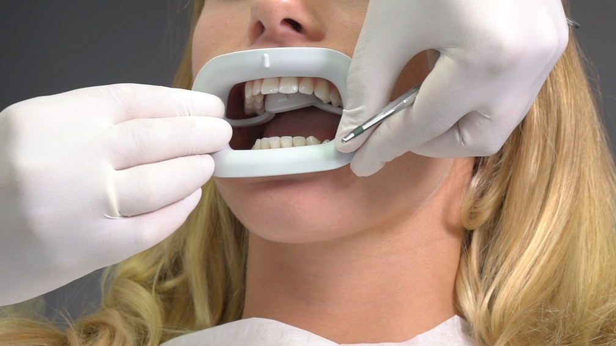
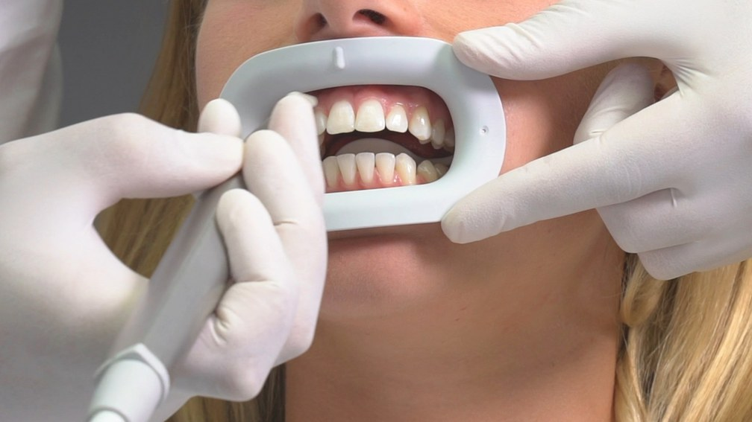
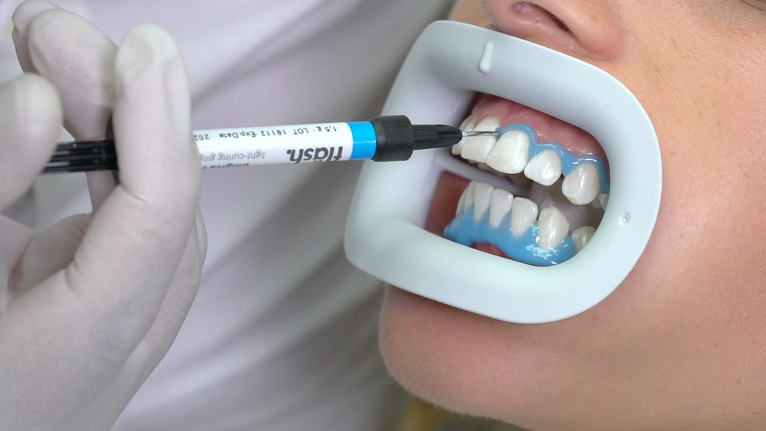
Prepare & Protect
02
The in-office procedure · Step by step
1
1
2
3
2
3
4
Insert the lip retractor
Air-dry teeth and gingiva
Apply the Gingiva Protector
5
Clean, isolate and seal the soft tissue before any gel.
IN-OFFICE WHITENING WORKFLOW · 22
Notes:
THE IN-OFFICE PROCEDURE · STEP BY STEP
Prepare & Protect
Clean, isolate and seal the soft tissue before any gel.
Image: Every complication is prevented here — the barrier is the treatment.
Photos: insert lip retractor · air-dry (new, not in the original) · apply Gingiva Protector.

Slide 23
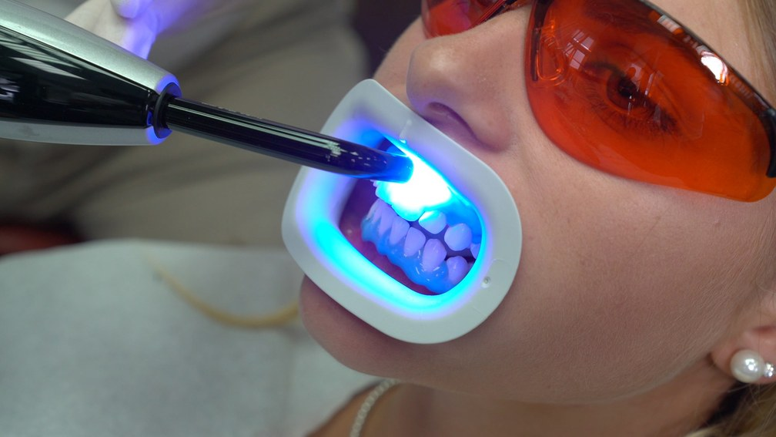
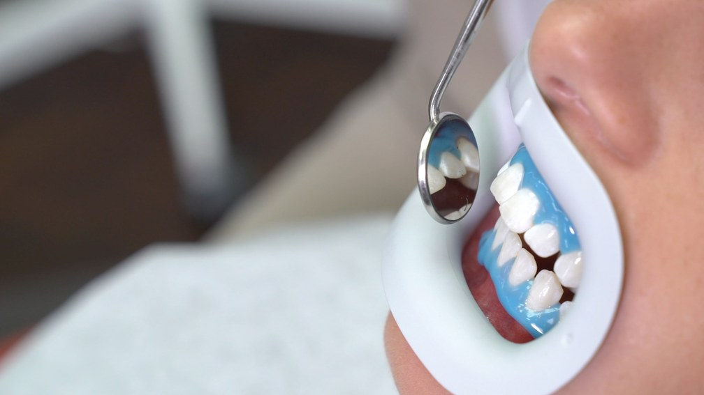
Prepare & Protect
02
The in-office procedure · Step by step
1
4
5
2
3
4
Light-cure the Gingiva Protector
Check the seal
5
Every complication is prevented here — the barrier is the treatment.
IN-OFFICE WHITENING WORKFLOW · 23
Notes:
THE IN-OFFICE PROCEDURE · STEP BY STEP
Prepare & Protect
Clean, isolate and seal the soft tissue before any gel.
Image: Every complication is prevented here — the barrier is the treatment.
Photos: light-cure Gingiva Protector · check the seal with the mirror (new, not in the original).

Slide 24
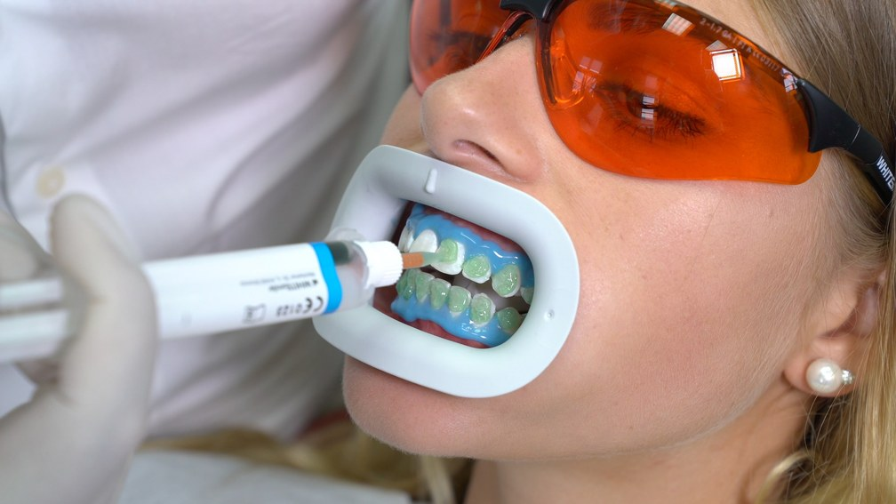
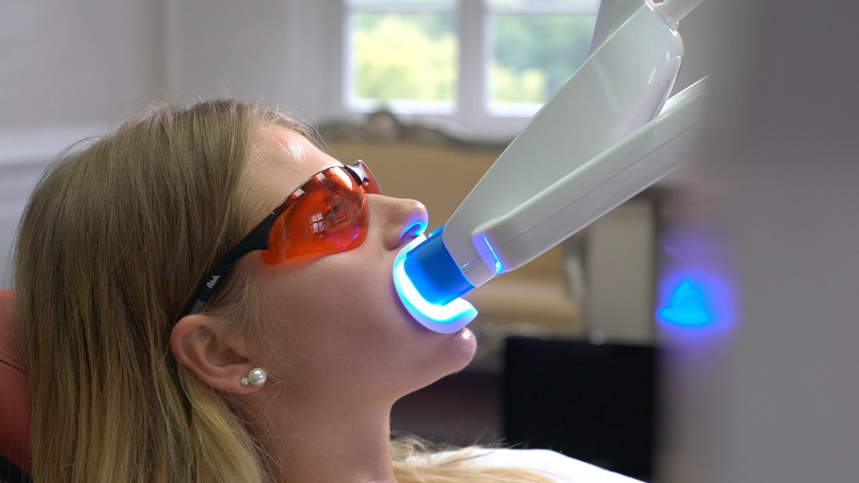
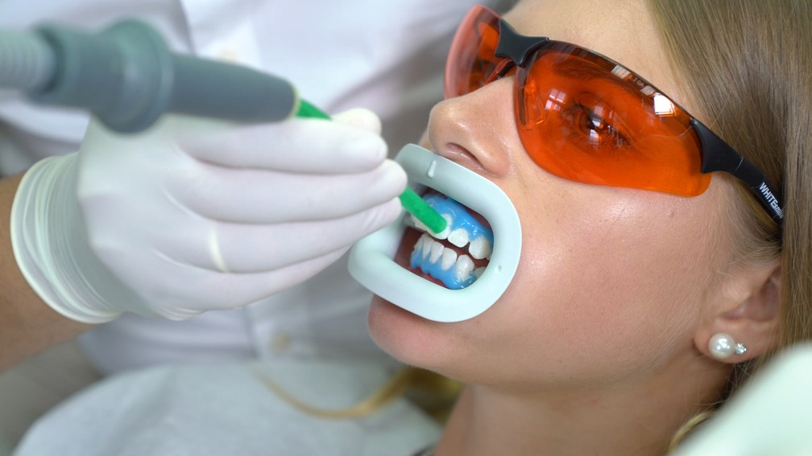
Apply & Activate
02
The in-office procedure · Step by step
1
6
7
8
2
3
4
Apply the gel, 1 mm thick
Adjust the lamp, start 15 min
Suction off the gel — no rinsing
5
Repeat 3× (max 4×) — fresh gel each cycle, suction only, never rinse.
IN-OFFICE WHITENING WORKFLOW · 24
Notes:
THE IN-OFFICE PROCEDURE · STEP BY STEP
Apply & Activate
A 1 mm layer of green gel, then the Highpower LED — in timed cycles.
Image: Repeat 3× (max 4×) — fresh gel each cycle, suction only, never rinse.
Photo labels in the original: Apply Gel (1 mm thick) · Adjust Whitening Lamp and turn on (15 minutes) · Suck off Gel without rinsing.

Slide 25
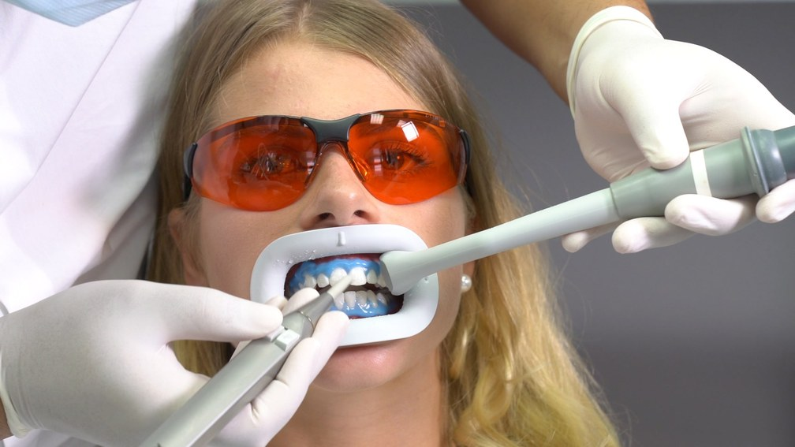
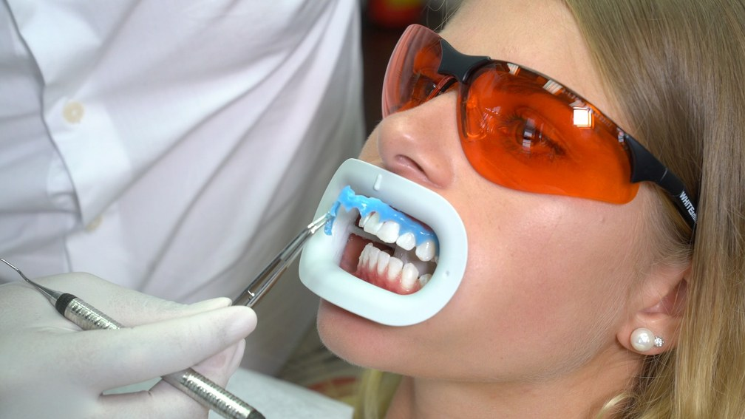
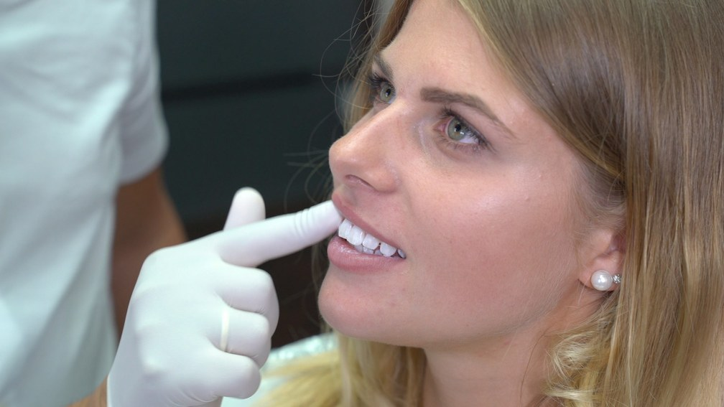
Seal & Finish
02
The in-office procedure · Step by step
1
9
10
11
2
3
4
Rinse off residual gel with water
Remove the Gingiva Protector
Apply After Whitening Mousse
5
After Whitening Mousse soothes and remineralises — then final shade & photos.
IN-OFFICE WHITENING WORKFLOW · 25
Notes:
THE IN-OFFICE PROCEDURE · STEP BY STEP
Seal & Finish
Remove, remineralise and document the new shade.
Image: After Whitening Mousse soothes and remineralises — then final shade & photos.
Photo labels in the original: Rinse off residual gel with water · Remove Gingiva Protector · Apply After Whitening Mousse.

Slide 26
“The Uneven Case”
02
Mini case · Diagnose
1
A 38-year-old at the end of cycle 3 — centrals magnificent, cervical thirds still yellow, canines two steps behind, chalky patches on the laterals. She is holding the mirror.
2
3
Finding
Cause
Cervical thirds still yellow
Barrier over-extended onto cervical enamel
4
Patchy brightness
Gel layer below 1 mm in zones — Sin #5
5
Everything underperforming
Lamp gap or tilt — 1 cm ≈ −50% power
Canines two steps behind
Thicker dentin — biology, not error
Chalky white patches
Transient dehydration — not damage
IN-OFFICE WHITENING WORKFLOW · 26
Notes:
MINI CASE
“The Uneven Case”
A 38-year-old at the end of cycle 3 — centrals magnificent, cervical thirds still yellow, canines two steps behind, chalky patches on the laterals. She is holding the mirror.
MINI CASE · DIAGNOSE
The Troubleshooting Checklist
Run the checklist — never guess in front of the patient.
Cervical thirds still yellow. Barrier over-extended onto cervical enamel — the gel never touched it.
Patchy brightness. Gel layer below 1 mm in zones — Sin #5.
Everything underperforming. Lamp gap or tilt — remember: 1 cm ≈ −50% power.
Biology, not error. Canines (thicker dentin) are always slowest; chalky patches are transient dehydration over hypocalcifications.
Chalky white patches. transient dehydration revealing hypocalcifications (not damage)
CLINICAL FOCUS: Five findings. Five causes. Zero mystery.

Slide 27
The Fix & The Conversation
02
Mini case · Resolve
1
1
Re-isolate, correctly
2
Fresh 1 mm gel
2
Rebuild the barrier and confirm the retractor is docked on the lamp head.
Full-thickness layer on the canines and cervical thirds — the lagging zones.
3
4
3
Spend banked minutes
4
Say the words
The cycle time the fläshcard saved becomes a targeted touch-up.
“The canines are always last. The white areas are temporary.” Book the one-week photo.
5
IN-OFFICE WHITENING WORKFLOW · 27
Notes:
MINI CASE · RESOLVE
The Fix & The Conversation
1 Re-isolate, correctly. Rebuild the barrier properly and confirm the retractor is docked on the lamp head.
2 Fresh 1 mm gel. Full-thickness layer on the canines and cervical thirds — the lagging zones.
3 Spend banked minutes. The cycle time the fläshcard saved becomes a targeted touch-up — the closed-but-flexible system pays you back.
4 Say the words. “The canines are always last — normal biology. The white areas are temporary dehydration.” Book the one-week photo before she leaves.

Slide 28
02
Knowledge check
Cervical thirds still yellow after cycle 3 — what is the most likely cause?
1
2
A
Gel layer below 1 mm
3
4
B
Barrier over-extended onto cervical enamel
5
Lamp gap or tilt
C
IN-OFFICE WHITENING WORKFLOW · 28
Notes:
Knowledge check from the mini case (source slide 21, Troubleshooting Checklist). Let the viewers decide before the answer slide.

Slide 29
02
Knowledge check · Answer
Cervical thirds still yellow after cycle 3 — what is the most likely cause?
1
2
A
Gel layer below 1 mm
3
4
B
Barrier over-extended onto cervical enamel
5
Lamp gap or tilt
C
The barrier covered the cervical enamel — the gel never touched it. Re-isolate correctly, then apply fresh 1 mm gel.
IN-OFFICE WHITENING WORKFLOW · 29
Notes:
The barrier covered the cervical enamel — the gel never touched it. Re-isolate correctly, then apply fresh 1 mm gel.

Slide 30
The SOP Blueprint
02
Summary + next action
1
Document
Activate & monitor
2
Clean first, baseline shade in value order, photograph like a scientist.
Lamp locked on the retractor · fläshcard discipline · comfort checkpoints.
3
Protect
Seal & instruct
Vitamin E or vaseline, correct retractor, goggles, cured barrier — avoid the Seven Sins.
Mousse, the aftercare window, the departure gift — identically, every time.
4
5
Apply
A minimum 1 mm of green gel, working by oxidation at neutral pH.
IN-OFFICE WHITENING WORKFLOW · 30
Notes:
SUMMARY + NEXT ACTION
The SOP Blueprint
Document. Clean first, baseline shade in value order, photograph like a scientist.
Protect. Vitamin E or vaseline, the correct retractor, goggles, a cured barrier — avoid the Seven Sins.
Apply. A minimum 1 mm of green gel, working by oxidation at neutral pH.
Activate & monitor. Lamp locked on the retractor · fläshcard discipline · comfort checkpoints.
Seal & instruct. Mousse, the aftercare window, the departure gift — identically, every time.

Slide 31
Make It Your Team’s Reflex
02
Next action · This week, not this quarter
1
1
Run one full dry run
No patient in the chair — your assistant drives the fläshcard start to finish.
Up next
2
Episode 03 · Sensitivity Prevention & Management
3
2
Appoint an SOP owner
One team member owns this protocol — and audits the clinic against it.
Preventing it, managing it — and turning a complaint into loyalty.
4
3
Laminate the phases
5
Visible chairside, next to the Seven Sins of Improper Isolation.
IN-OFFICE WHITENING WORKFLOW · 31
Notes:
NEXT ACTION · THIS WEEK, NOT THIS QUARTER
Make It Your Team’s Reflex
1 Run one full dry run. No patient in the chair — your assistant drives the fläshcard from start to finish.
2 Appoint an SOP owner. One team member owns this protocol — and audits the clinic against it.
3 Laminate the phases. Visible chairside, right next to the Seven Sins of Improper Isolation.
4 Up next — Episode 3. Sensitivity Prevention & Management: preventing it, managing it, and the call that turns a complaint into loyalty.

