Slide 1
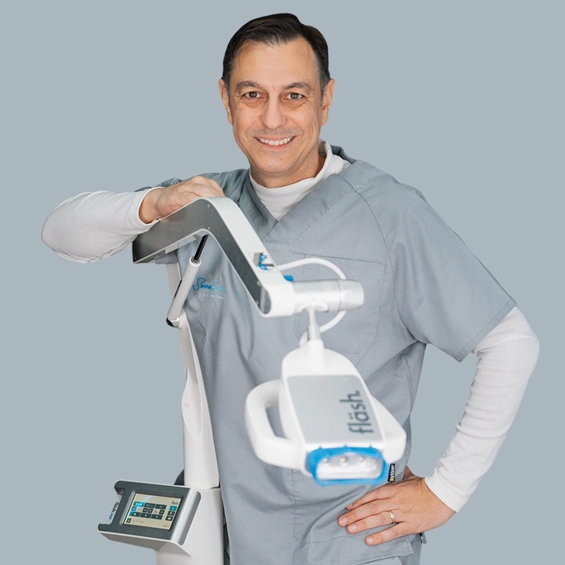
In-Office Whitening Workflow
02
Layout 01 · cover
Step-by-Step Protocol + Common Mistakes
Dr. Germán Gómez
DDS · MD · PhD (University of Tübingen) · Esthetic Dentistry & Implantology, Spain
500+ lectures · 43 countries
Notes:
01 Title (cover). Episode number, title, subtitle; presenter name, credentials (two lines) and portrait in the glowing circle. The video circle is not reserved here.

Slide 2
Apply
3
02
1
Layout 02 · chapter
2
3
4
The gel is engineered for precision.
5
Notes:
02 Chapter (chapter). Big chapter number, chapter name from the episode, one sentence. Long names wrap to two lines; the sentence moves down.

Slide 3
02
Layout 03 · hook
“My friend had her whitening done here — hers looks incredible. Will mine?”
1
2
3
The hard truth
The fläsh answer
4
Same gel, same lamp — two clinics, visibly different results. The chemistry never changes between offices. The workflow does.
If the outcome depends on who happens to be working that day, you have a whitening lottery. A strict, standardized protocol ends the lottery.
5
IN-OFFICE WHITENING WORKFLOW · 3
Notes:
03 Hook (hook). Opening quote or question, ‘The hard truth’ card and ‘The fläsh answer’ card. Labels can be changed per slide.

Slide 4
Make It Your Team’s Reflex
02
Layout 04 · closing
1
1
Run one full dry run
No patient in the chair — your assistant drives the fläshcard start to finish.
Up next
2
Episode 03 · Sensitivity Prevention & Management
3
2
Appoint an SOP owner
One team member owns this protocol — and audits the clinic against it.
Preventing it, managing it — and turning a complaint into loyalty.
4
3
Laminate the phases
5
Visible chairside, next to the Seven Sins of Improper Isolation.
IN-OFFICE WHITENING WORKFLOW · 4
Notes:
04 Closing (closing). One to three next steps with title and text, plus the ‘Up next’ card for the following episode.

Slide 5
1 mm. Green. Neutral pH.
02
Layout 05 · points
1
01 Dual-chamber 32% HP.
  Mix fresh — full potency protected until the moment of mixing.
02 Green = precision.
  You see every surface covered — the gel turns clear as oxygen releases.
03 Oxidation, not erosion.
  Oxidation of chromogens at a neutral pH — never corroding the enamel.
04 Minimum 1 mm, everywhere.
  A thin, starved layer produces a pale patch — Sin #5.
2
3
4
5
IN-OFFICE WHITENING WORKFLOW · 5
Notes:
05 Points (points). The standard slide: 2–4 points, each with a short lead and an explanation of about 14 words. Optional focus box on the right (points then narrow to 900 px).

Slide 6
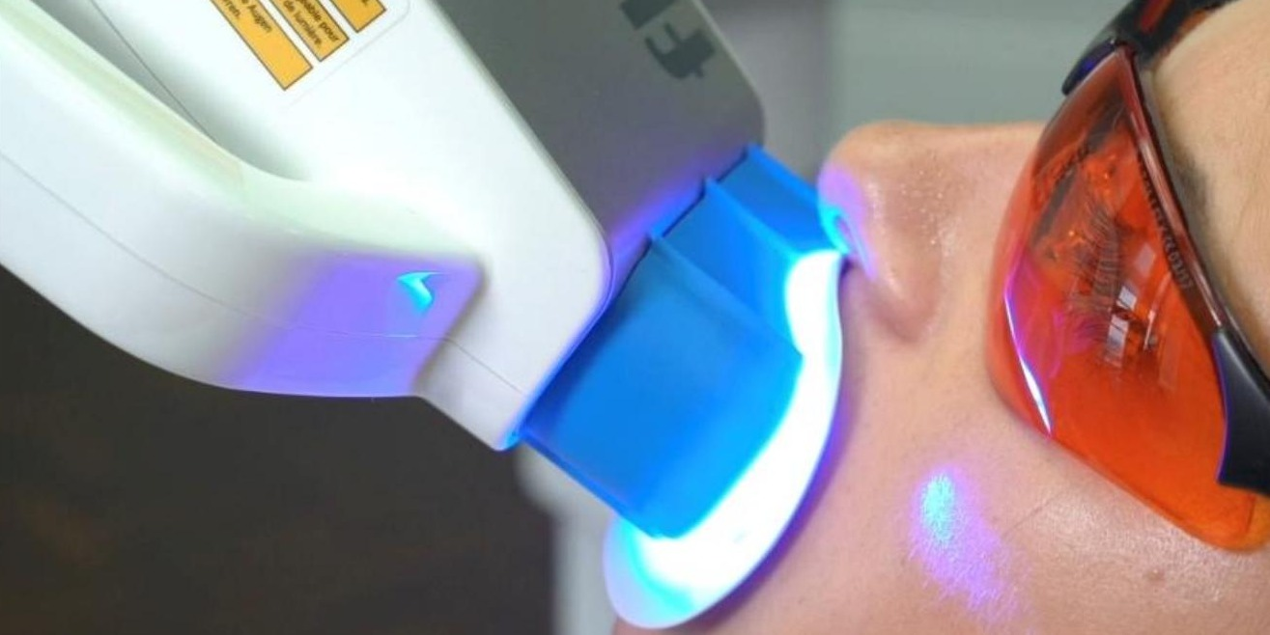
Soft Tissue First
02
Layout 06 · points_photo
1
01 Vitamin E or vaseline on the lips.
  Then the fläsh lip retractor, docked onto the lamp head.
02 Filtered eye protection.
  For the patient and for every team member present.
03 Gingiva protector, light-cured.
  Dry gingiva; only slight overlap onto cervical enamel; cure until solid.
2
3
4
5
Lamp docked on the lip retractor · filtered goggles
Evidence
Li & Greenwall, Br Dent J 2013
IN-OFFICE WHITENING WORKFLOW · 6
Notes:
06 Points + Photo (points_photo). 2–4 points plus photo (2:1) with caption. Without a photo file, a placeholder with the photo brief appears.

Slide 7
The Lamp: Position Is Power
02
Layout 07 · points_chart
1
01 Lock the geometry.
  Patient at 45°, lamp head locked on the retractor — intensity level IIII.
02 The expensive centimetre.
  One centimetre of gap costs ≈50% of the power.
03 Complementary-colour activation.
  Blue 460 nm light, absorbed by the green gel — no UV, no infrared, below 39 °C.
Light power at the enamel
2
Lamp docked on the retractor
100%
3
1 cm of extra gap
56%
4
1 cm of extra gap ≈ 50% less light power (3² = 9 vs 4² = 16)
5
Evidence
Ontiveros & Paravina, J Dent 2009
IN-OFFICE WHITENING WORKFLOW · 7
Notes:
07 Points + Chart (points_chart). 2–4 points plus a bar card (2–4 bars, values 0–100, one bar highlighted) with an optional note.

Slide 8
02
Layout 08 · statement
30
1
2
3
years of German-made whitening expertise
4
5
Gel, lamp and fläshcard engineered as one closed system · WHITEsmile
IN-OFFICE WHITENING WORKFLOW · 8
Notes:
08 Statement (statement). One big number or keyword, a statement line and a short explanation.

Slide 9
The Seven Sins of Isolation
02
Layout 09 · checklist
1
1
No lip protection — vitamin E or vaseline
Clinical focus
2
2
Wrong retractor for the system
Burns are never caused by the gel.
3
3
No filtered eye protection
Rescue: vitamin E or vaseline onto the gingiva — no panic, protocol.
4
Barrier not properly placed or cured
4
5
Not enough whitening gel (below 1 mm)
5
6
Patient left unattended — no signal agreed
7
Dentin sensitivity not managed
IN-OFFICE WHITENING WORKFLOW · 9
Notes:
09 Checklist (checklist). Up to 7 numbered items, optional focus box.

Slide 10
The Fix & The Conversation
02
Layout 10 · steps
1
1
Re-isolate, correctly
2
Fresh 1 mm gel
2
Rebuild the barrier and confirm the retractor is docked on the lamp head.
Full-thickness layer on the canines and cervical thirds — the lagging zones.
3
4
3
Spend banked minutes
4
Say the words
The cycle time the fläshcard saved becomes a targeted touch-up.
“The canines are always last. The white areas are temporary.” Book the one-week photo.
5
IN-OFFICE WHITENING WORKFLOW · 10
Notes:
10 Steps (steps). 3–5 numbered steps with title and text (grid 3, 2+2 or 3+2).

Slide 11
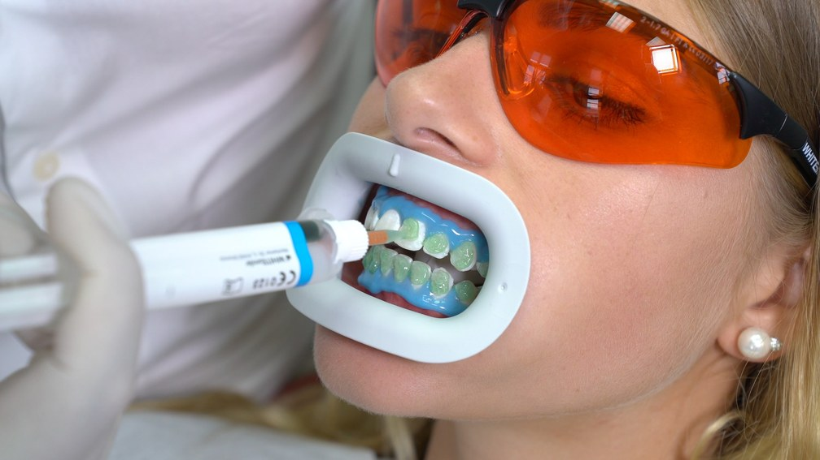
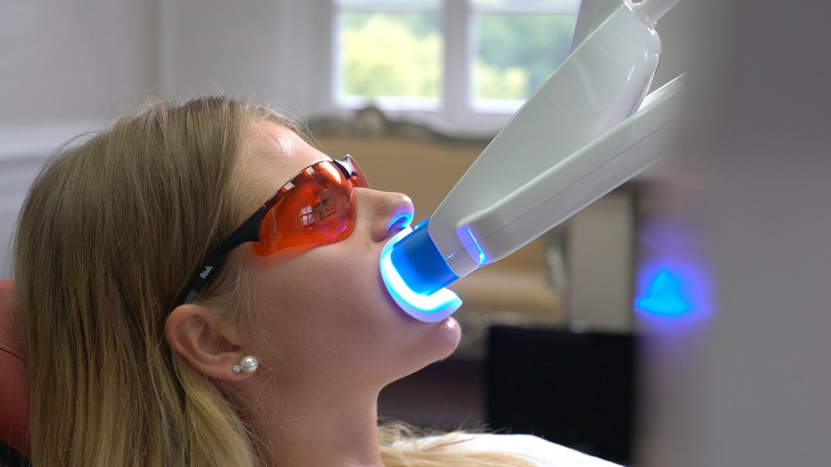
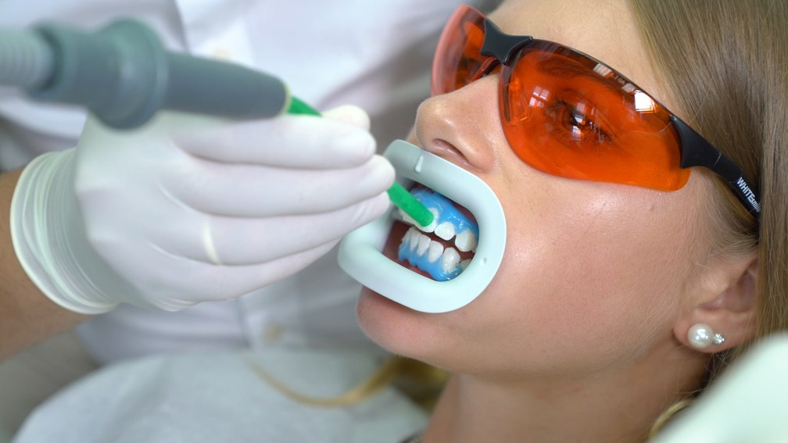
Apply & Activate
02
Layout 10 · steps with photos
1
6
7
8
2
3
4
Apply the gel, 1 mm thick
Adjust the lamp, start 15 min
Suction off the gel — no rinsing
5
Repeat 3× (max 4×) — fresh gel each cycle, suction only, never rinse.
IN-OFFICE WHITENING WORKFLOW · 11
Notes:
10 Steps with photos (steps + photo). 2–4 photos (16:9) in a row, step number on the photo, title below (max. two lines), optional caption. 'start' continues the numbering across slides.

Slide 12
Oxidation, Not Erosion
02
Layout 11 · compare
1
Myth
Fact
2
Whitening etches the enamel
Oxidation of chromogens at neutral pH
3
The lamp works by heating the tooth
Blue 460 nm light, below 39 °C — a photochemical effect
4
Burns come from the gel
Burns are never caused by the gel — isolation prevents them
5
IN-OFFICE WHITENING WORKFLOW · 12
Notes:
11 Compare (compare). Two columns, 1–4 items each, rows aligned. Style myth_fact (fact side highlighted) or do_dont (do side highlighted).

Slide 13
The Value-Ordered Baseline
02
Layout 12 · scale
1
B1
A1
B2
D2
A2
C1
C2
D4
A3
D3
B3
A3.5
B4
C3
A4
C4
2
3
Value-ordered shade guide · lightest to darkest
01 Determine it together.
  Daylight, teeth still hydrated, the tab in the patient’s own hand.
02 Enter it into the lamp.
  After treatment it reports the shades gained — a number, not an opinion.
4
5
Evidence
Joiner A., J Dent 2004
IN-OFFICE WHITENING WORKFLOW · 13
Notes:
12 Scale (scale). A scale of 2–16 chips (e.g. shade guide, optional highlight) or a timeline of 2–6 points, optional caption, 1–2 points below.

Slide 14
The SOP Blueprint
02
Layout 13 · summary
1
Document
Activate & monitor
2
Clean first, baseline shade in value order, photograph like a scientist.
Lamp locked on the retractor · fläshcard discipline · comfort checkpoints.
3
Protect
Seal & instruct
Vitamin E or vaseline, correct retractor, goggles, cured barrier — avoid the Seven Sins.
Mousse, the aftercare window, the departure gift — identically, every time.
4
5
Apply
A minimum 1 mm of green gel, working by oxidation at neutral pH.
IN-OFFICE WHITENING WORKFLOW · 14
Notes:
13 Summary (summary). Up to 5 items with check mark, title and text (two columns).

Slide 15

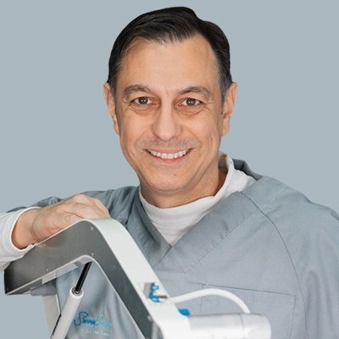
Apply & Activate
02
1
2
3
4
5
Layout 14 · photo
Repeat 3× (max 4×) — fresh gel each cycle, suction only, never rinse.
Notes:
14 Photo (photo). Full-bleed photo right of the rail, kicker, title and caption in a dark band. The video circle stays on top.

Slide 16
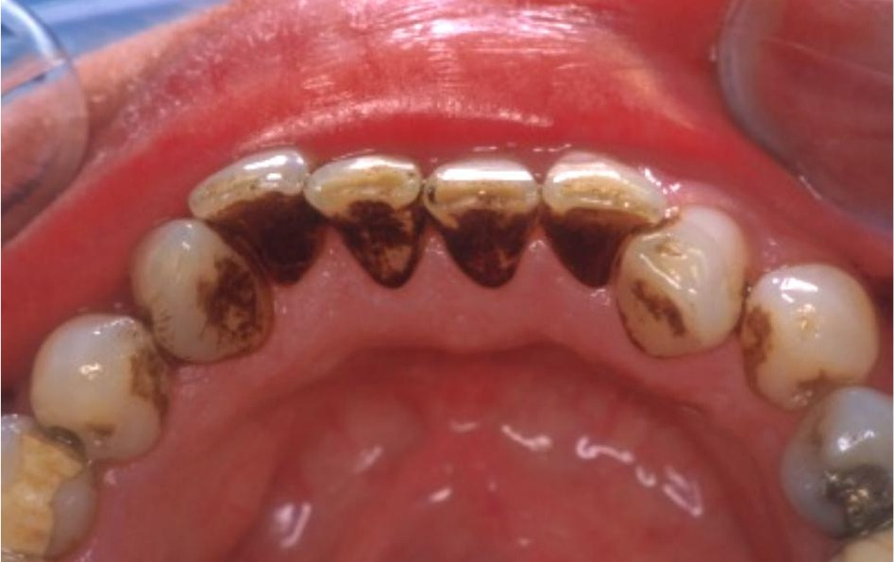
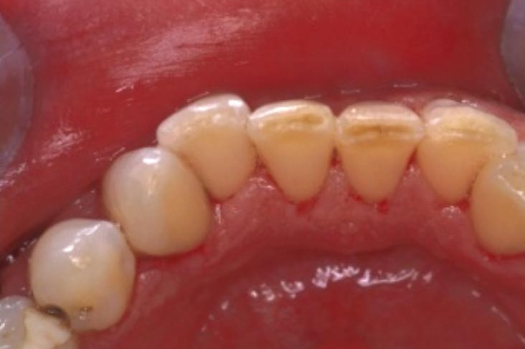
Clean Before You Whiten
02
Layout 15 · before_after
1
2
3
4
5
Before prophylaxis
After prophylaxis
IN-OFFICE WHITENING WORKFLOW · 16
Notes:
15 Before / After (before_after). Two photos (3:2) with labels, e.g. the shade value.

Slide 17
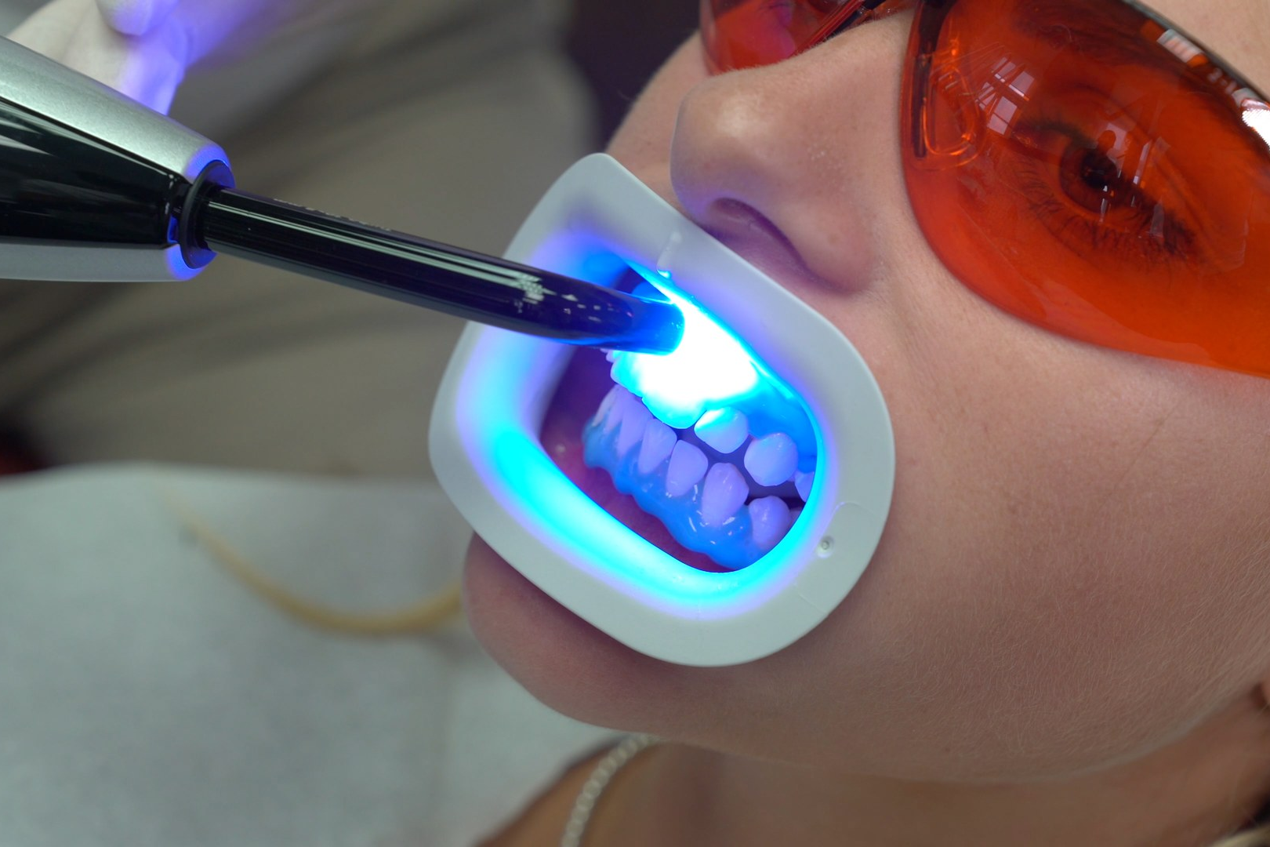
The Isolation Setup
02
Layout 16 · photo_annotated
1
Filtered goggles
1
2
1
2
Curing light
2
3
Lip retractor
3
4
4
Gingiva Protector, light-cured
3
4
5
IN-OFFICE WHITENING WORKFLOW · 17
Notes:
16 Photo Annotated (photo_annotated). Photo with up to 5 numbered markers (x/y from 0 to 1) and a legend on the right.

Slide 18
“The Uneven Case”
02
Layout 17 · case
1
A 38-year-old at the end of cycle 3 — centrals magnificent, cervical thirds still yellow, canines two steps behind, chalky patches on the laterals. She is holding the mirror.
2
3
Finding
Cause
Cervical thirds still yellow
Barrier over-extended onto cervical enamel
4
Patchy brightness
Gel layer below 1 mm in zones — Sin #5
5
Everything underperforming
Lamp gap or tilt — 1 cm ≈ −50% power
Canines two steps behind
Thicker dentin — biology, not error
Chalky white patches
Transient dehydration — not damage
IN-OFFICE WHITENING WORKFLOW · 18
Notes:
17 Case (case). Case story (up to three lines) and up to 5 findings, each with its cause in one line.

Slide 19
02
Layout 18 · quiz
Cervical thirds still yellow after cycle 3 — what is the most likely cause?
1
2
A
Gel layer below 1 mm
3
4
B
Barrier over-extended onto cervical enamel
5
Lamp gap or tilt
C
IN-OFFICE WHITENING WORKFLOW · 19
Notes:
18 Quiz (quiz). Question with three answers; the build adds the answer slide with the highlighted option and the explanation.

Slide 20
02
Layout 18 · quiz
Cervical thirds still yellow after cycle 3 — what is the most likely cause?
1
2
A
Gel layer below 1 mm
3
4
B
Barrier over-extended onto cervical enamel
5
Lamp gap or tilt
C
The barrier covered the cervical enamel — the gel never touched it. Re-isolate correctly, then apply fresh 1 mm gel.
IN-OFFICE WHITENING WORKFLOW · 20
Notes:
The barrier covered the cervical enamel — the gel never touched it. Re-isolate correctly, then apply fresh 1 mm gel.

